Slide 1


Mobiles Scrapping
Title: Web Scraping and Exploratory Data Analysis of Flipkart Mobiles Data

Slide 2
About us:
I am Akhil Yadav Postgraduate with a strong passion for Data Analytics and Visualization.
Skilled in exploring real-world datasets to uncover meaningful insights.
Experienced in web data extraction and cleaning using Python tools.
Continuously learning to enhance expertise in data analytics tools.
GITHUB - https://github.com/akhilyadav2502-stack
LINKEDIN -https://www.linkedin.com/in/akhilyadav25/

Slide 3
Preface:
INTRODUCTION
BUSINESS PROBLEM
OBJECTIVE
TOOLS USED
WEB SCRAPPING
DATA CLEANING STEPS
DATA VISUALIZATION
CONCLUSION

Slide 4
Introduction:
Offers smartphones from top brands like Apple, Samsung, Xiaomi, Vivo, and Realme
Provides detailed specifications, ratings, and customer reviews
Competitive pricing with discounts and exchange offers

Slide 5
Business Problem:
High-rated mobiles within budget
The smartphone market on Flipkart contains multiple brands with varying specifications and pricing.
Customers struggle to identify:
Which brand offers better value
Price vs performance relationship
Understand how features like battery, processor, and ratings impact price

Slide 6
Objectives:
To analyze and compare Mobile Features using Price , Brand, Processor , Storage ,Camera Quality , Ram and ratings insights from Flipkart..
To provide data-driven insights that help consumers to make proper decisions based on purchasing mobiles.
To explore patterns and trends across different segments in Mobile.

Slide 7






Tools Used:

Slide 8
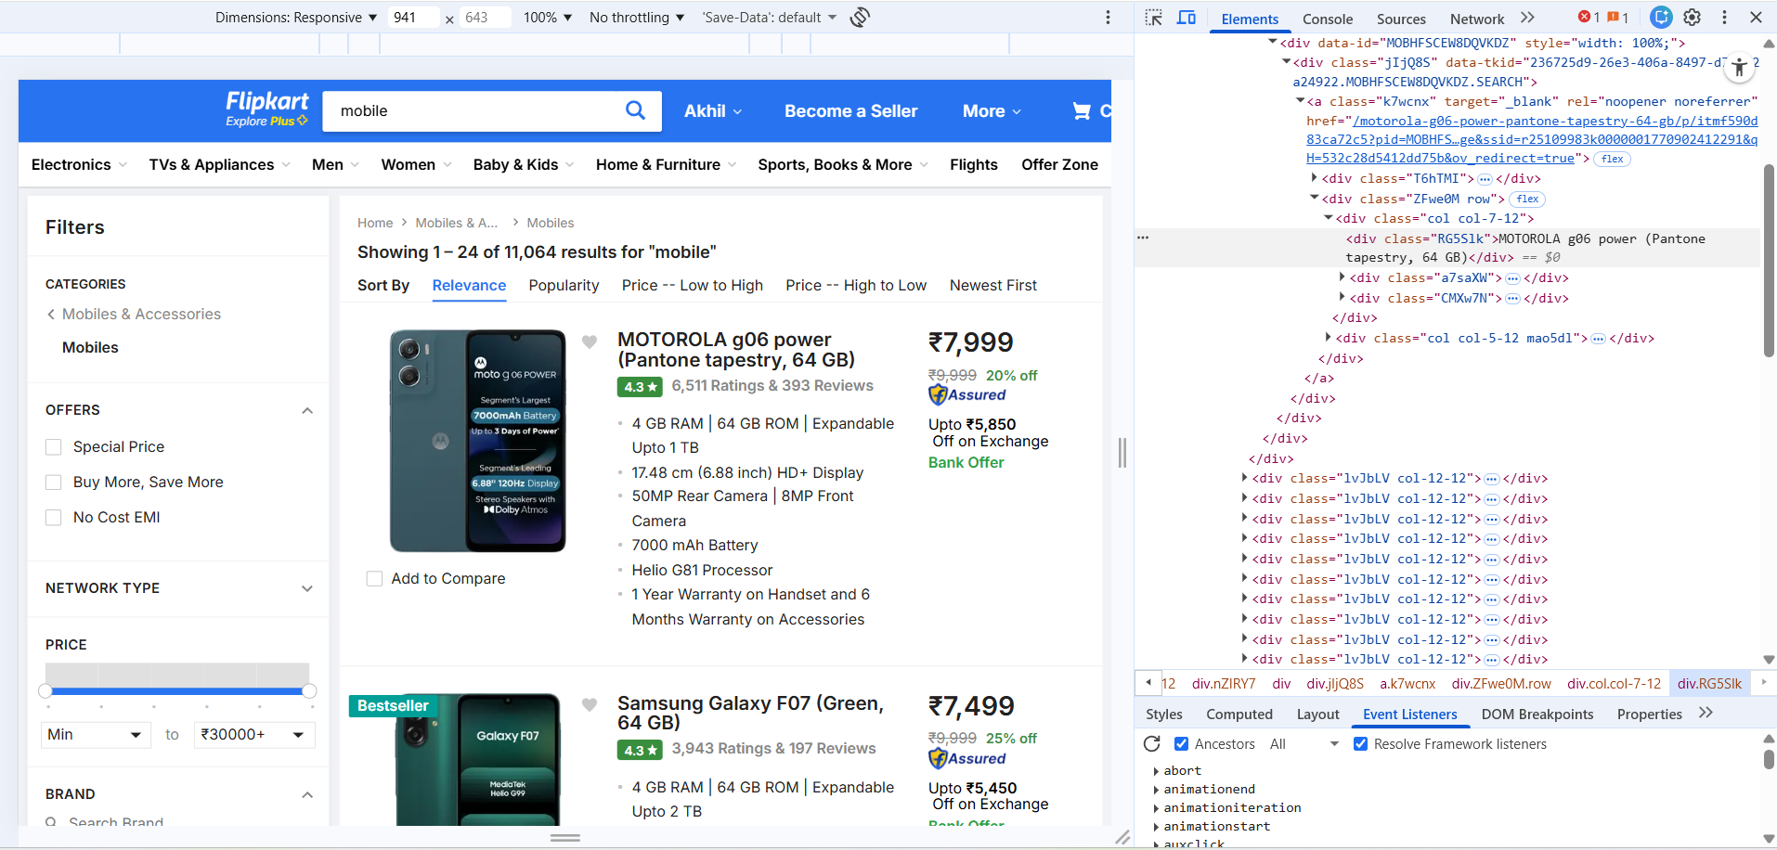
Web Scraping:
Flipkart Mobile was selected as the data source
Used browser developer tools (Inspect Element) to locate relevant HTML tags Data.
Used Beautiful Soup and Requests to extract data from Flipkart.
Sent HTTP requests to fetch web pages.
Performed Exploratory Data Analysis (EDA) to identify trends.

Slide 9
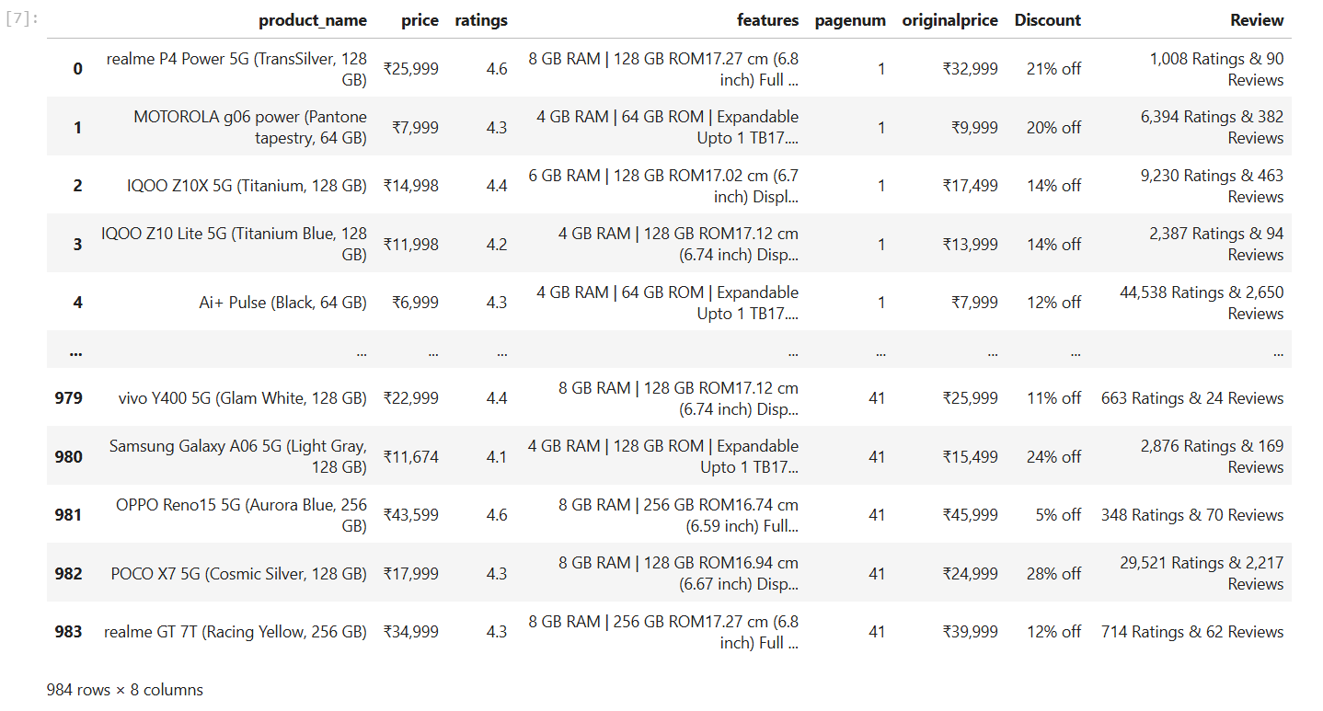
Uncleaned Dataset:

Slide 10
Data Cleaning Steps:
Checked and handled missing values using is null() to ensure data completeness.
Removed duplicate records using duplicated() to avoid biased analysis.
Converted text-based columns like Price, Battery, and Ratings into proper numeric format for accurate calculations.
Detected and treated outliers in the Price column using the IQR method to reduce extreme value impact.
Standardized column names and ensured correct data types for smooth EDA and visualization

Slide 11
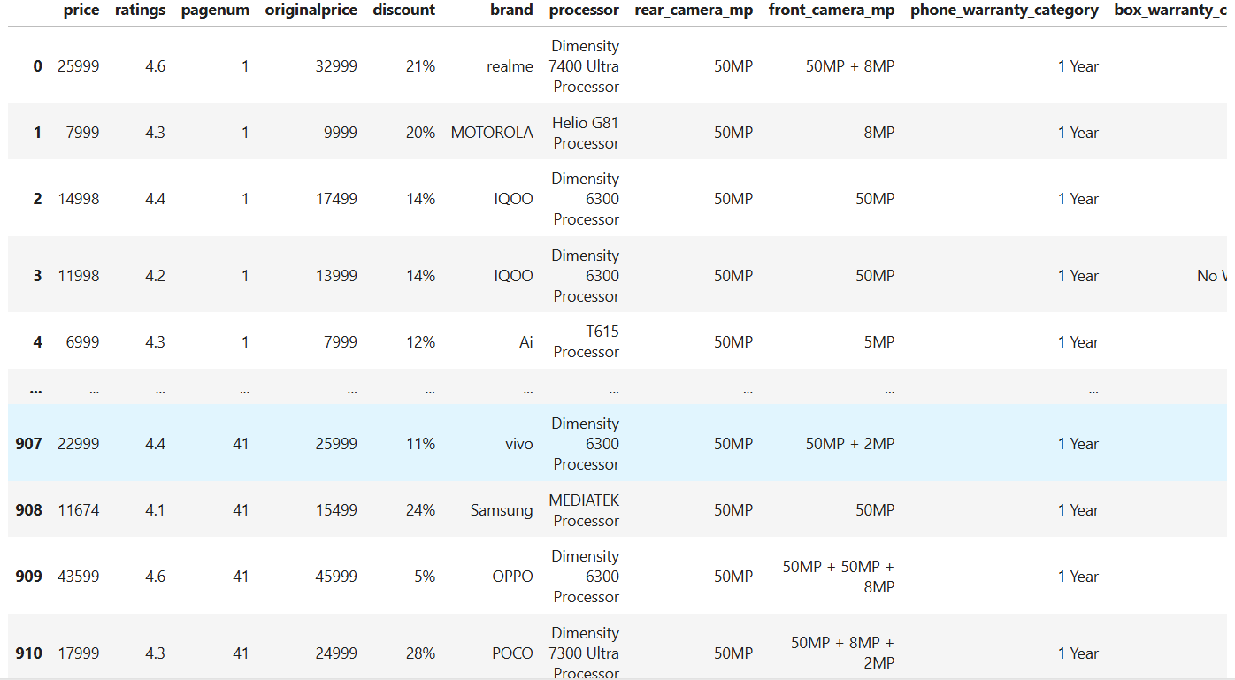
Cleaned Dataset

Slide 12
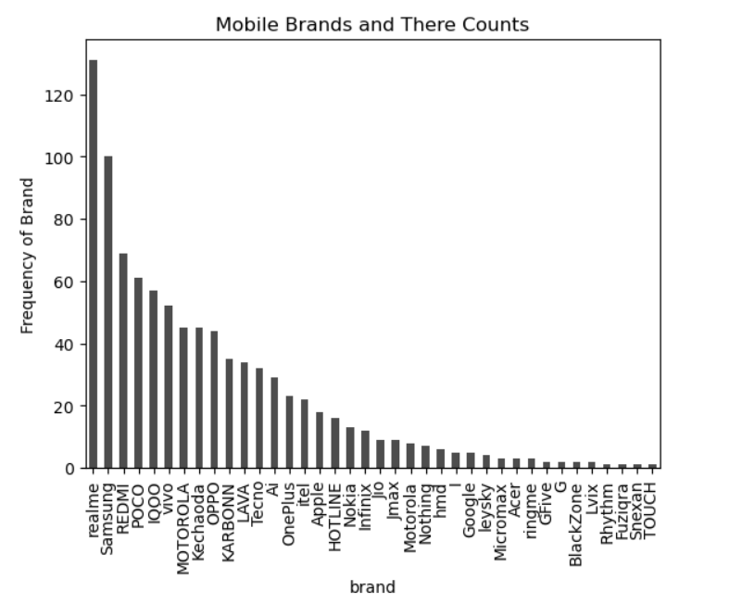
Data Visualization:
Realme leads in total listed models.
Followed by Samsung and Redmi, showing strong marketplace presence.
Mid-tier brands like IQOO, Vivo, and Motorola show moderate representation.
Long-tail distribution observed among smaller brands.
Marketplace is highly competitive but dominated by a few key brands.
Realme appears aggressively positioned in Flipkart listings.

Slide 13
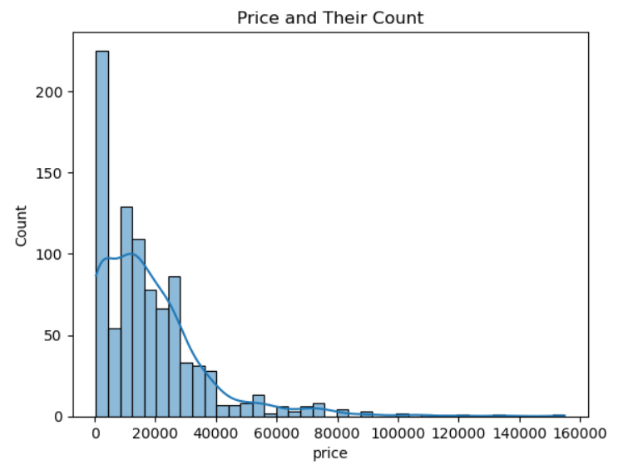
Data Visualization:
The price distribution is positively skewed (right-skewed).
Majority of mobile phones fall within the ₹5,000 – ₹30,000 range.
Very few products are priced above ₹60,000.
The dataset contains extreme values going up to ₹1.5 Lakhs+.
High concentration of products in the budget and mid-range segment.

Slide 14
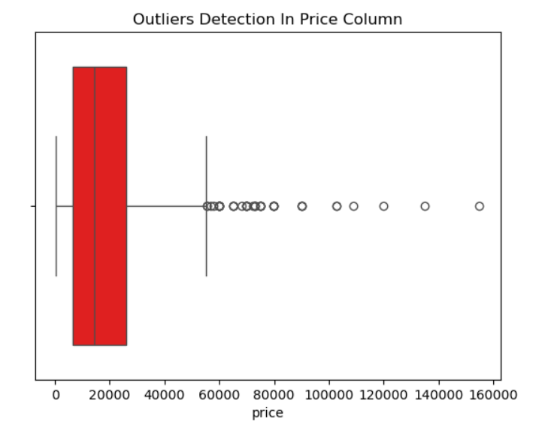
Data Visualization:
Median price lies around ₹15,000 – ₹20,000 range.
Interquartile range (IQR) is concentrated in lower price bands.
Multiple outliers detected above ₹60,000.
Extreme outliers extend beyond ₹1,00,000+.
Outliers represent premium flagship brands (Apple, high-end Vivo, Motorola models).
Removing outliers may improve predictive model performance if target is mass market.

Slide 15
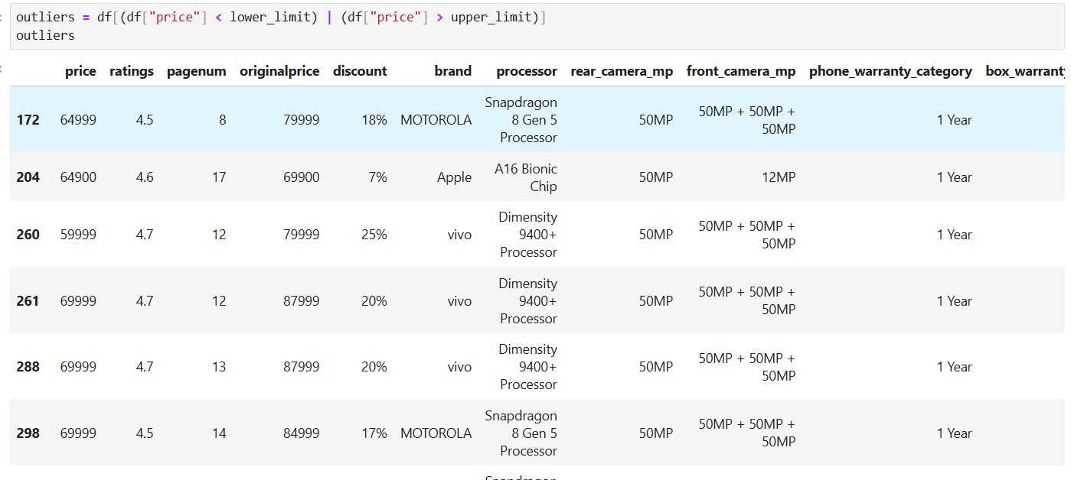
Data Visualization:
Outliers mostly priced between ₹59,000 – ₹69,999.
Brands contributing to outliers: Apple , Motorola , Vivo
High-end processors observed: Snapdragon 8 Gen 5,A16 Bionic Chip ,Dimensity 9400+
These phones maintain high ratings (4.5 – 4.7).
Discounts range between 7% – 25%.
Rear camera mostly 50MP configurations.
Warranty: 1 Year (standardized across premium models).
Premium phones maintain: High ratings ,Powerful processors ,Competitive discounts

Slide 16
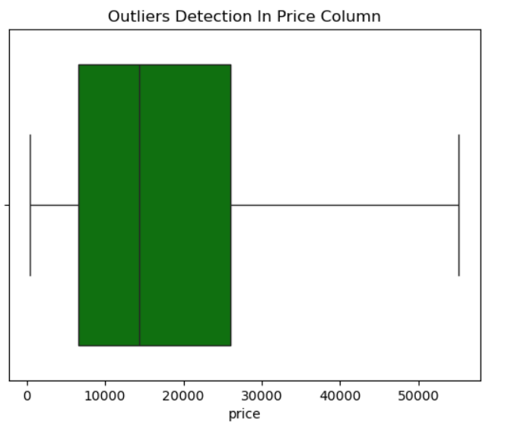
Data Visualization:
The median price is somewhere near the middle of the box, suggesting that most of the mobile prices are evenly distributed around the center value.
There is a consistent range in mobile prices, as shown by the whiskers. There’s no indication of extreme high or low prices (no outliers), which means the price distribution is relatively stable.
The green color of the box emphasizes that most of the mobile prices fall within a reasonable range, without any dramatic price spikes or drops.

Slide 17
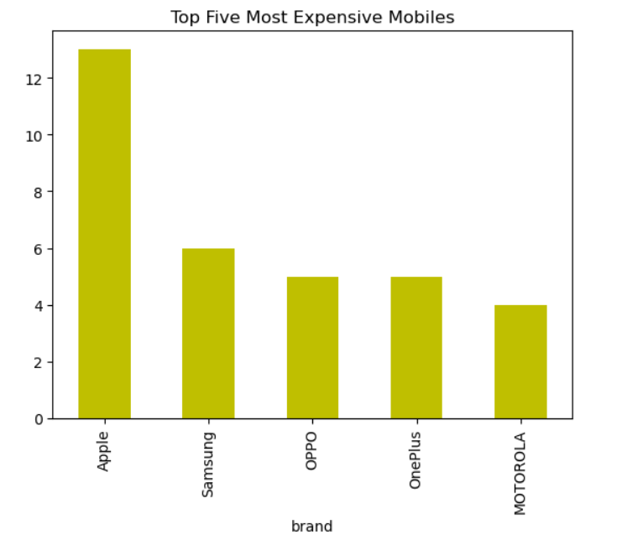
Data Visualization:
Apple dominates the premium mobile market with the highest number of expensive models, showing 12 models in total.
Samsung follows with 7 high-priced models, significantly fewer than Apple but still a strong contender in the premium market.
OPPO, OnePlus, and Motorola each have 4 to 5 expensive models, indicating a more limited presence in the high-end price range.
The chart clearly highlights the dominance of Apple in terms of the number of high-priced phones, far ahead of other brands.
The yellow bars visually emphasize the significant difference between Apple and the other brands in the high-end mobile segment.

Slide 18
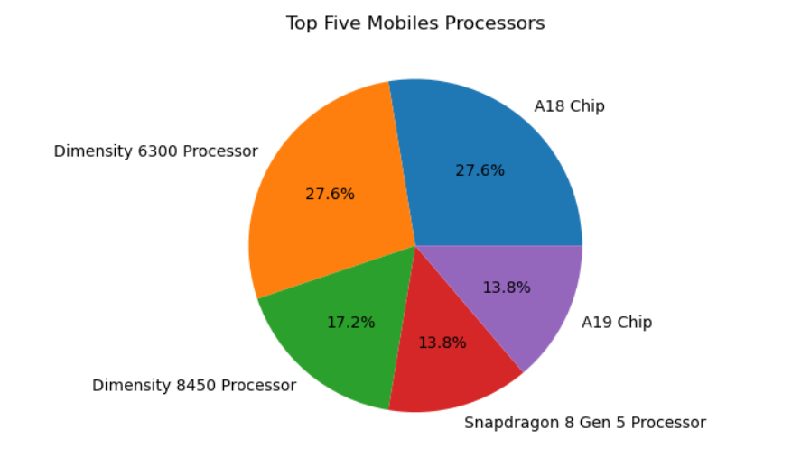
Data Visualization:
A18 Chip and Dimensity 6300 Processor are the most common processors, each accounting for 27.6% of the market share.
Dimensity 8450 Processor holds 17.2% of the share, indicating its significant, though smaller, presence.
A19 Chip and Snapdragon 8 Gen 5 Processor each contribute 13.8% of the share, showing a smaller but notable presence in the market.
The chart provides a clear visual representation of the market distribution among the top five mobile processors, with A18 and Dimensity 6300 leading the way.

Slide 19
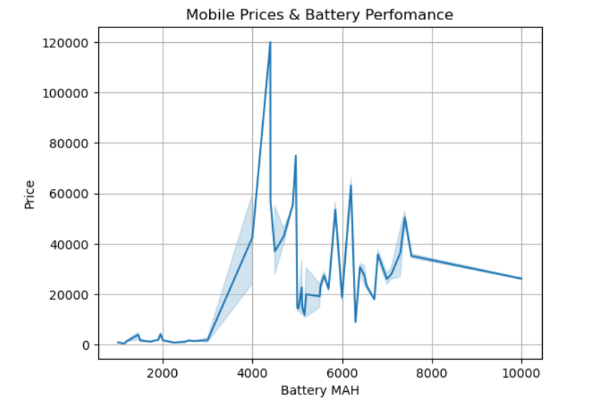
Data Visualization:
1. Price vs Battery Capacity: The chart shows the relationship between mobile price and battery capacity (mAh). As the battery capacity increases, prices tend to spike, especially for higher capacities around 4000mAh.
2. Sharp Price Increase: A significant price surge is observed around the 4000mAh battery range, indicating that mobiles with higher battery capacity tend to have significantly higher prices.
3. Fluctuating Trend: After the sharp price increase, the chart shows price fluctuations, especially as battery capacity continues to rise, suggesting that other factors also influence price at higher capacities.
4. Decreasing Trend at Higher Capacities: For mobile batteries above 6000mAh, the price tends to decrease or stabilize, indicating that larger batteries don’t always correlate with higher prices beyond a certain point.

Slide 20
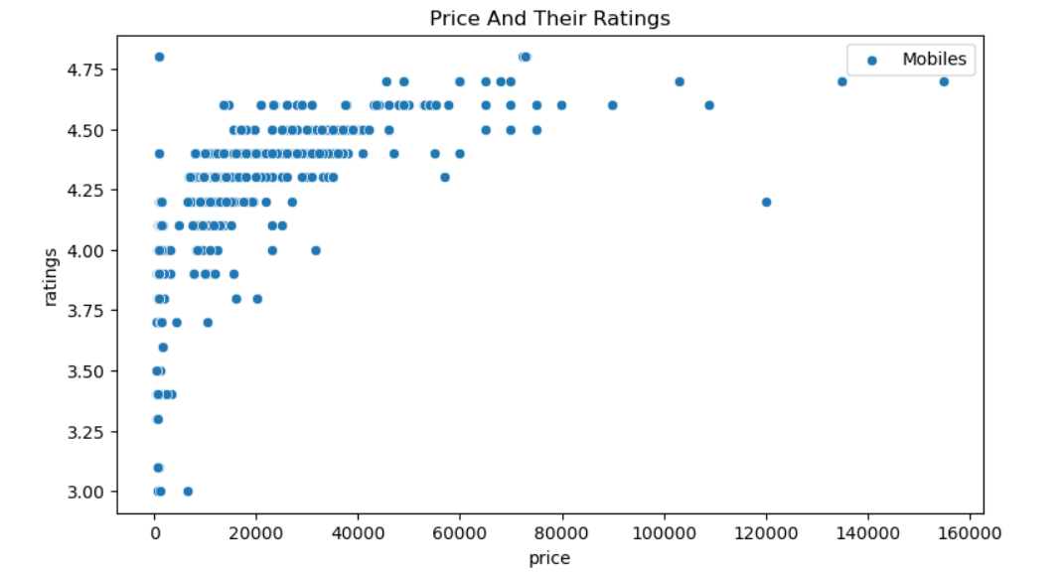
Data Visualization:
The chart shows a negative correlation between price and ratings. As the price increases, the ratings tend to decrease slightly, especially for the higher-priced phones.
High-Rating Concentration: Most phones with high ratings (4.0 and above) are concentrated in the lower price range, indicating that many affordable mobiles have good customer feedback.
Outliers: A few phones with extremely high prices (over ₹100,000) have relatively lower ratings, which could indicate that higher prices do not always guarantee better customer satisfaction.
Price Saturation: Beyond a certain price point (₹60,000), there are fewer phones with high ratings, suggesting diminishing returns in terms of customer satisfaction as the price rises

Slide 21
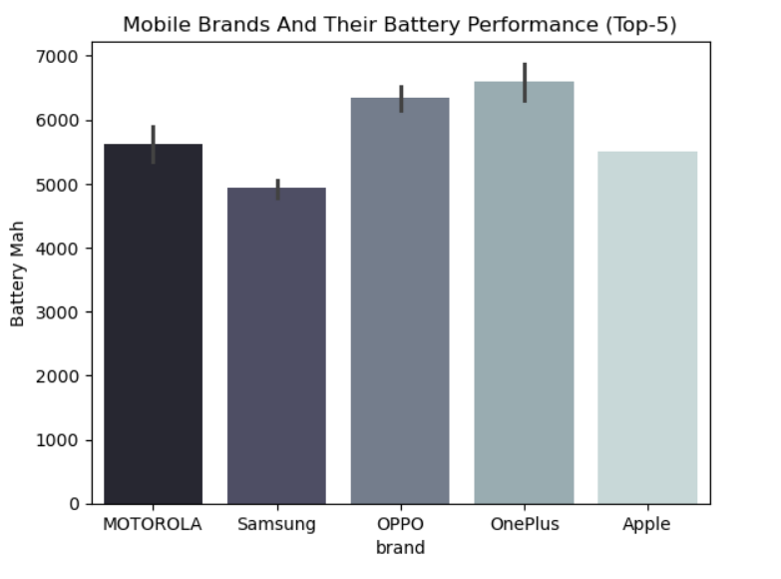
Data Visualization:
Motorola Leads: Motorola has the highest average battery capacity, with around 6000 Mah, indicating its strong focus on offering long-lasting battery performance.
Samsung and OPPO: Samsung and OPPO have similar battery capacities, each around 5000 Mah, providing good battery performance but slightly lower than Motorola.
OnePlus: OnePlus comes close to Motorola, with a battery capacity near 5500 Mah, showing strong performance, though slightly lower than Motorola’s.
Apple: Apple has the lowest average battery capacity among the top 5 brands, with around 4000 Mah, reflecting its typical design trade-offs for performance, but still offering competitive battery life.

Slide 22
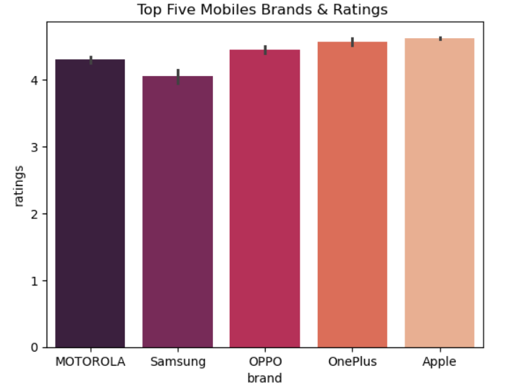
Data Visualization:
Motorola Leads in Ratings: Motorola has the highest average rating, just above 4.5, indicating strong customer satisfaction with its mobile phones.
Samsung and OPPO: Both Samsung and OPPO have similar ratings, slightly below 4.5, showing that these brands are also highly rated by customers but slightly behind Motorola.
OnePlus and Apple: OnePlus and Apple have very close ratings, both near 4.4, indicating strong performance and customer satisfaction, though slightly lower than Motorola and Samsung/OPPO.
Error Bars: The error bars indicate the variability in ratings across models within each brand, showing some differences in how individual devices perform in terms of user feedback

Slide 23
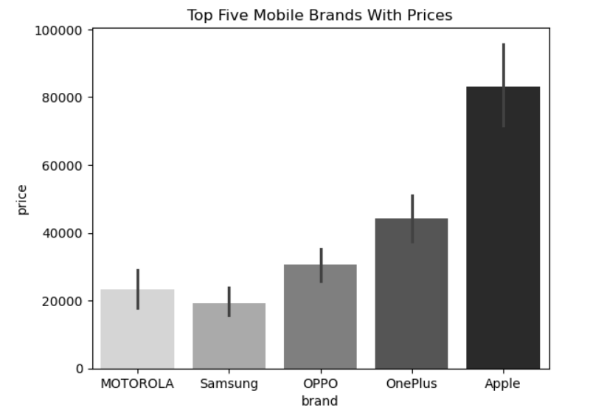
Data Visualization:
Apple's Premium Pricing: Apple has the highest average price, exceeding ₹80,000, indicating that Apple mobiles are positioned in the premium price segment.
Other Brands' Prices: Motorola, Samsung, OPPO, and OnePlus have significantly lower average prices, ranging from around ₹20,000 to ₹40,000, suggesting these brands cater to more mid-range and affordable price points.
Error Bars: The error bars represent the variability in prices within each brand, showing that there's some fluctuation in mobile prices for each brand, with Apple having a wider range.
Price Range Distribution: While all brands have their price ranges, Apple clearly stands out as the most expensive, while other brands, like Motorola and OPPO, are more affordable, offering a mix of budget and mid-range options.

Slide 24
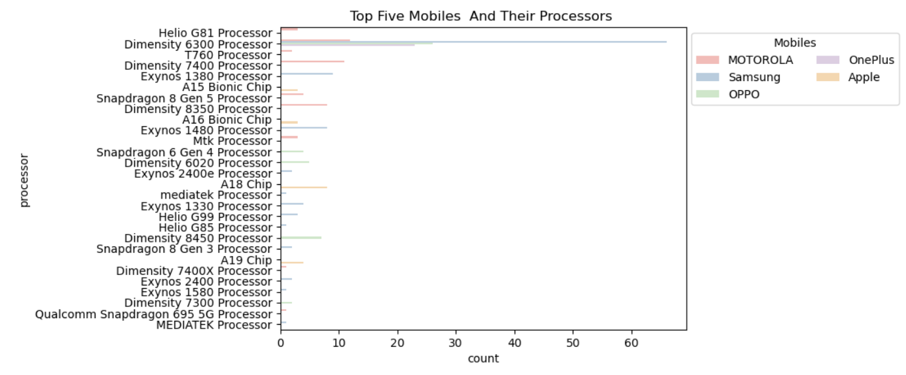
Data Visualization:
Processor Distribution: The chart shows the distribution of mobile processors used by the top five mobile brands: Motorola, Samsung, Apple, OnePlus, and OPPO.
Most Common Processors: The Helio G81, Dimensity 6300, and Dimensity 7400 processors appear frequently, suggesting that many mid-range and budget phones use these chipsets.
Apple's Dominance: Apple primarily uses its proprietary A15 Bionic Chip and A16 Bionic Chip, which appear prominently in the chart, indicating Apple’s focus on high-performance, in-house processors.
Processor Variety: Samsung, Motorola, and OPPO have a more diverse set of processors, with Snapdragon and Exynos chips being used across different models, showing a range of options for different price points and performance levels.

Slide 25
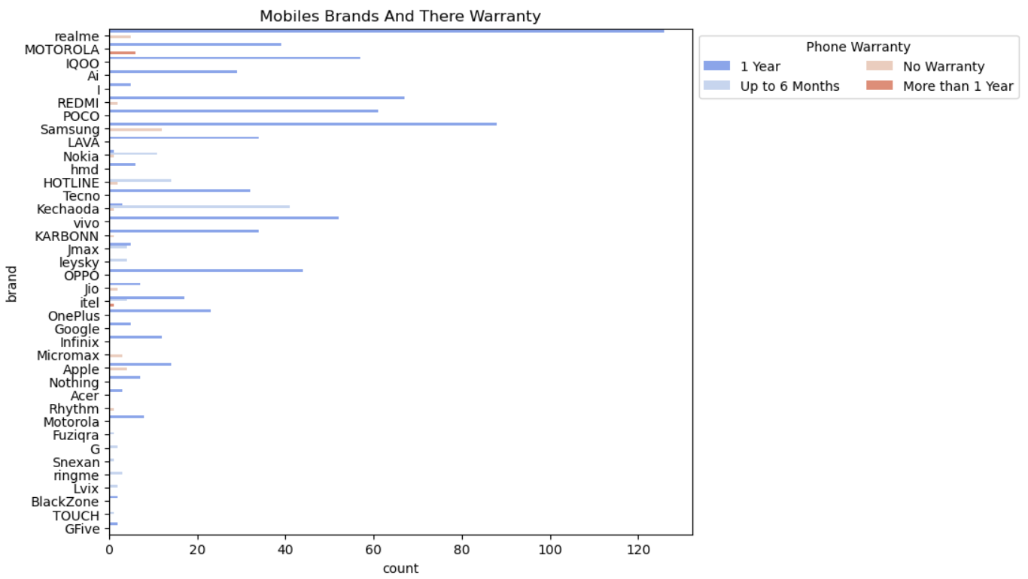
Data Visualization:
The chart shows the distribution of warranty types across different mobile brands. The warranty types include 1 Year, Up to 6 Months, and No Warranty
Brands with Most 1-Year Warranty: realme, Motorola, and iQOO have the highest number of mobile models offering a 1-year warranty, indicating these brands typically provide standard warranty periods.
Brands with Longer Warranties: MOTOROLA stands out with some models offering a warranty longer than 1 year, reflecting a commitment to customer confidence in their products.
Brands with No Warranty: Some brands, such as Jmax and Kechaoda, have models with no warranty, which may indicate either budget-friendly pricing or more limited customer support.

Slide 26
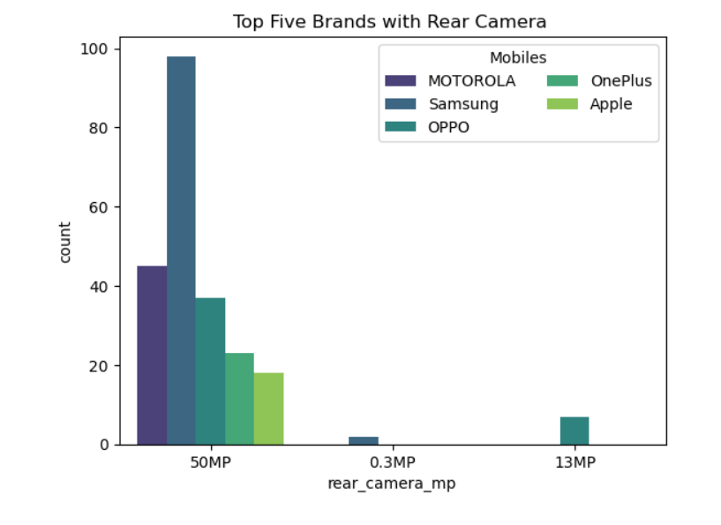
Data Visualization:
50MP Cameras Dominate: The chart shows that the majority of mobiles from Motorola, Samsung, OPPO, OnePlus, and Apple have 50MP rear cameras, with Motorola leading in this category.
Motorola's Dominance: Motorola stands out significantly, with the highest number of models featuring 50MP cameras, indicating its strong focus on high-resolution camera phones.
Other Camera Resolutions: There are fewer phones with 13MP and 0.3MP rear cameras across the brands, with only a few models featuring these lower resolutions, mainly from OPPO and OnePlus
Focus on High-Quality Cameras: Most of the top brands prioritize higher-resolution rear cameras, with 50MPbecoming the most common, showing a market trend toward better camera performance in mid-range and premium models.
This chart highlights the focus of top mobile brands on providing high-quality cameras, particularly with a 50MP resolution

Slide 27
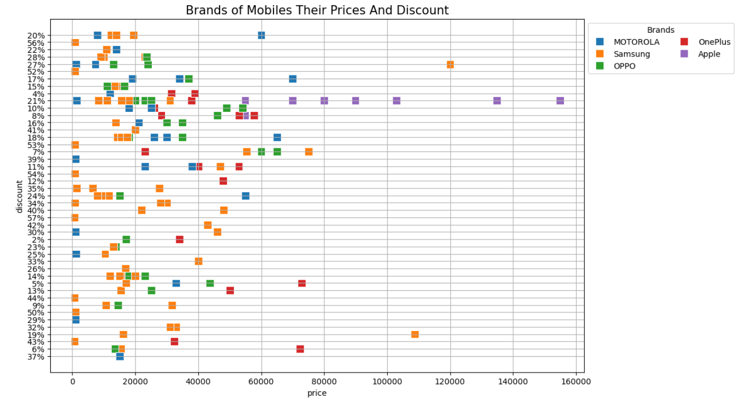
Data Visualization:
Price vs Discount Distribution: The chart shows the price range of mobiles against their discount percentages across four top brands: Motorola, Samsung, OPPO, and Apple
Motorola's Pricing and Discount: Motorola offers mobiles with lower prices (around ₹10,000 to ₹30,000) and relatively higher discounts (up to 50%), making it the most affordable brand with substantial discounts.
Samsung's Mid-Range: Samsung offers mobiles with a wide range of prices (₹20,000 to ₹80,000) and moderate discounts, with discounts typically between 10-30%.
Apple's High Prices with Lower Discounts: Apple has higher-priced models (often over ₹80,000), but it offers smaller discounts (around 5-10%), indicating a premium pricing strategy with limited discounting.

Slide 28
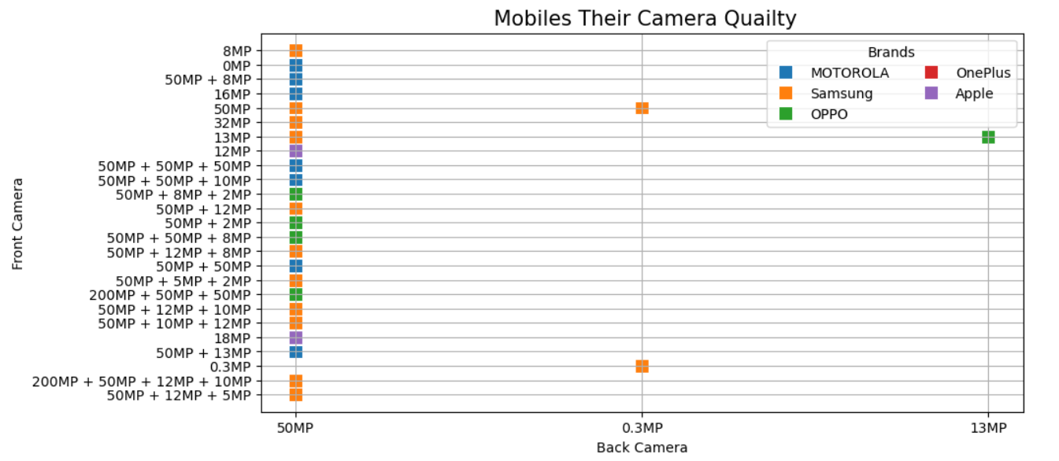
Data Visualization:
High Camera Resolutions: The chart shows a focus on 50MP cameras, especially for both front and back cameras, with many mobile models featuring combinations like 50MP + 50MP + 50MP or 50MP + 12MP + 8MP.
Samsung's Camera Range: Samsung offers a variety of camera configurations, including models with high-quality 50MP back cameras, often paired with 8MP to 16MP front cameras, making it prominent in mid-to-high-range camera setups.
Motorola's Camera Focus: Motorola is leading with 50MP back cameras, often coupled with decent front cameras like 8MP or 16MP, catering to both high-quality photos and balanced performance.
Apple and OPPO: Apple and OPPO use a combination of high-resolution back cameras, like 200MP or 50MP, with front cameras ranging from 12MP to 50MP, focusing on strong rear cameras while keeping front camera resolutions competitive.

Slide 29
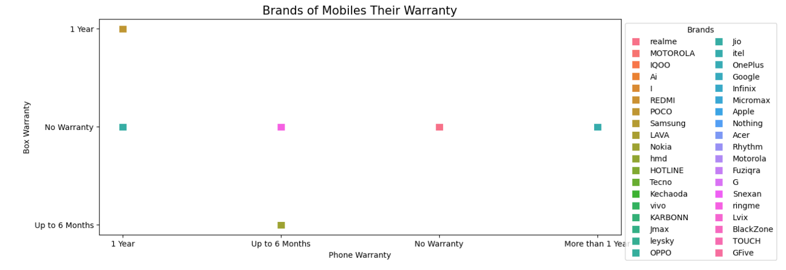
Data Visualization:
Warranty Distribution: The chart shows different mobile brands and their box warranty offerings, including 1 year, up to 6 months, and no warranty.
1-Year Warranty: Several brands, including realme, Motorola, iQOO, and OnePlus, provide 1-year warranty on their mobile devices, which is standard for most mobile phones.
No Warranty: A few brands, such as Jmax and BlackZone, offer no warranty on their mobile phones, indicating budget-oriented or region-specific sales strategies.
Short-Term Warranty: Brands like OPPO and Samsung feature phones with up to 6 months warranty, suggesting either limited-time offers or shorter-term product guarantees for specific markets or mode

Slide 30
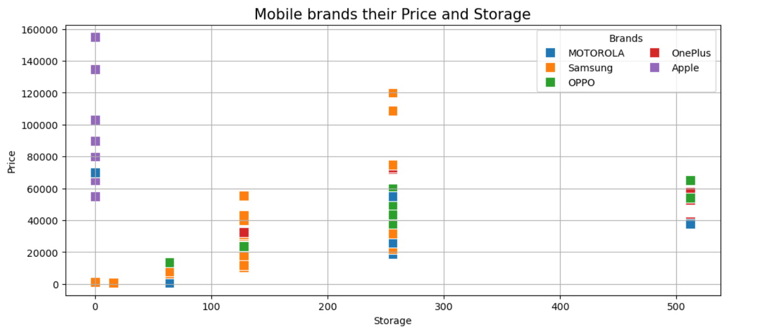
Data Visualization:
Price vs Storage Distribution: The chart shows the relationship between mobile prices and storage capacities for different brands: Motorola, Samsung, OPPO, and Apple.
Apple's High Price and Storage: Apple mobiles are priced higher (up to ₹150,000) and come with larger storage capacities (up to 500GB), which aligns with their premium positioning in the market.
Motorola and Samsung's Price Range: Motorola and Samsung offer affordable to mid-range mobiles with lower storage options, mostly in the range of 64GB to 128GB storage, priced around ₹10,000 to ₹40,000
OPPO's Mid-Range Offering: OPPO offers mobiles with moderate pricing (around ₹20,000 to ₹50,000), feat

Slide 31
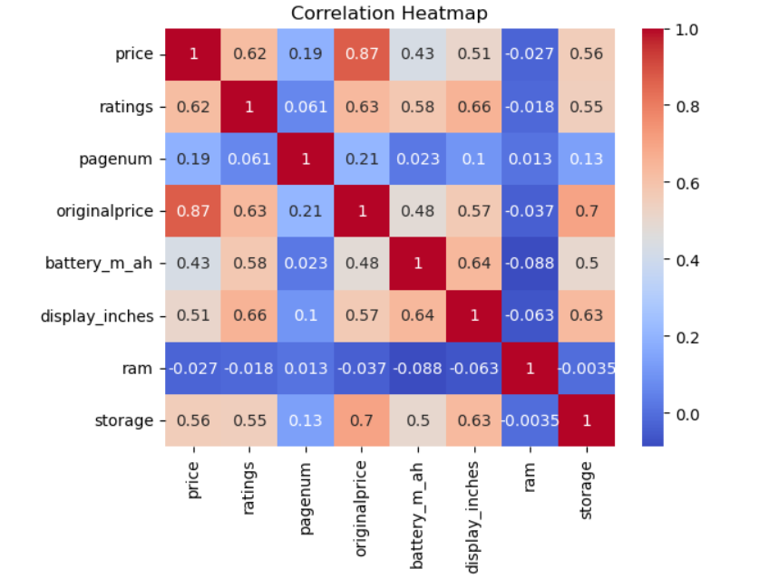
Data Visualization:
Strong Positive Correlation Between Price and Original Price: There is a very strong correlation (0.87) between price and original price, suggesting that the mobile's retail price is closely related to its original price
Price and Ratings Correlation: The price has a moderate positive correlation (0.62) with ratings, indicating that higher-priced mobiles tend to have better user ratings, but the relationship is not extremely strong.
Storage and Price Correlation: Storage has a moderate positive correlation (0.56) with price, implying that higher storage capacities are often found in more expensive models.
Battery and Display Size Correlation: Battery capacity (mAh) and display inches both show moderate positive correlations (0.64), suggesting that larger displays are often paired with larger battery capacities.
This heatmap visually represents how different variables, such as price, ratings, battery, and storage, correlate with each other, highlighting key relationships in mobile pricing and features

Slide 32
Conclusion:
Dataset of 900+ mobile models shows strong dominance of budget & mid-range segment (₹5,000–₹30,000).
Samsung and Realme lead in total listings, indicating strong marketplace presence.
Premium segment is limited but led by Apple, with high pricing and strong brand positioning.
Price distribution is positively skewed, with few high-end flagship outliers above ₹60,000.
50MP cameras and 5000–6000mAh batteries have become standard features in mid-range phones.
Moderate correlation observed between price, storage, and ratings, showing structured pricing strategy.
Clear segment-based market positioning visible across brands

Slide 33
Experiences & Challenges:
Extracted large datasets from dynamic web pages using Python (Beautiful Soup, Requests).
Faced challenges with inconsistent data formats and missing values during cleaning.
Automated scraping process to handle multiple pages and reduce time.
Structured raw HTML data into a clean Pandas Data Frame for analysis.
Addressed inconsistent data formats during preprocessing.
Handled missing values and cleaned noisy data to ensure accurate EDA

Slide 34


Slide 35

THANK YOU

