Slide 1
Class, functions and props in react
Bojan Angjeleski - Semos

Slide 2
Passing props to a Component
React components use props to communicate with each other. Every parent component can pass some information to its child components by giving them props. Props might remind you of HTML attributes, but you can pass any JavaScript value through them, including objects, arrays, and functions.

Slide 3
You will learn
How to pass to a component
How to read from a component
How to specify default values for props
How to pass some JSX to a component
How Props change overtime
Data flow
Conditional Rendering
Functional vs Class components

Slide 4
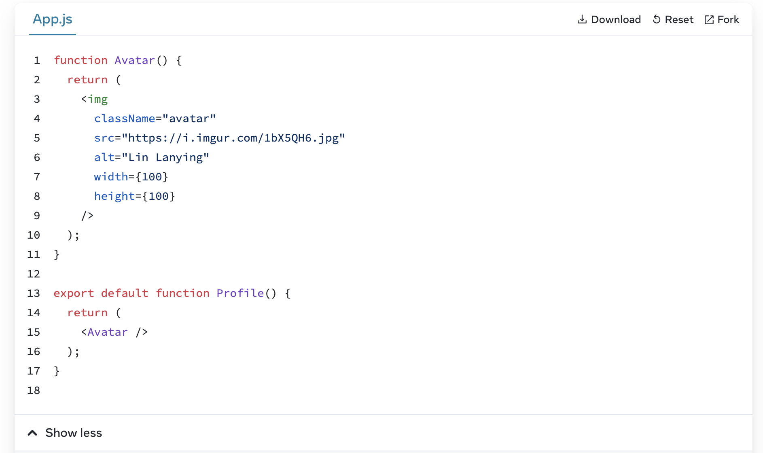
How to pass to a component

Slide 5
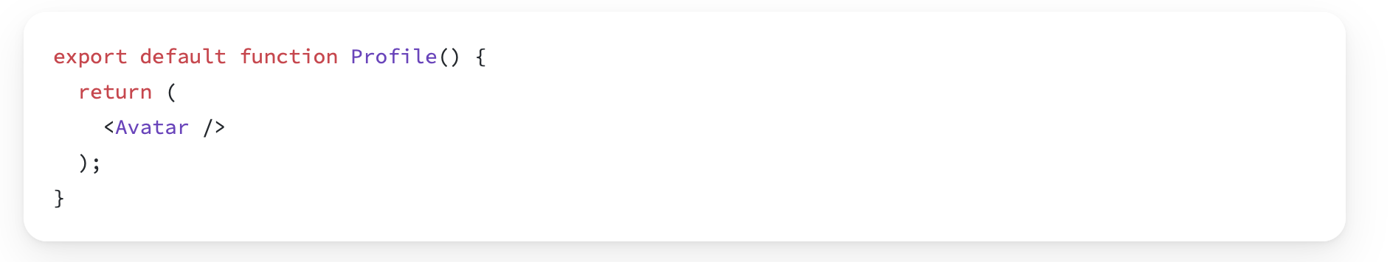
Passing props to a component
In this code, the Profile component isn’t passing any props to its child component, Avatar:

Slide 6
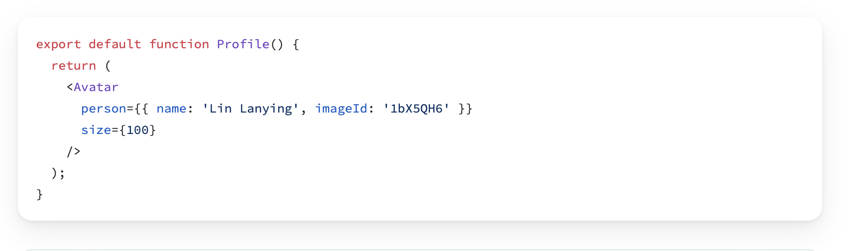
Step 1: Pass props to a child component
First, pass some props to Avatar. For example, let’s pass two props: person (an object), and size (a number):

Slide 7
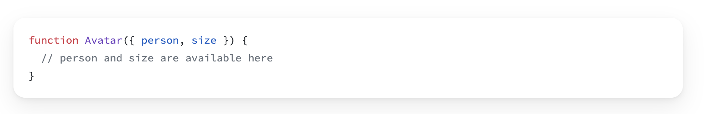
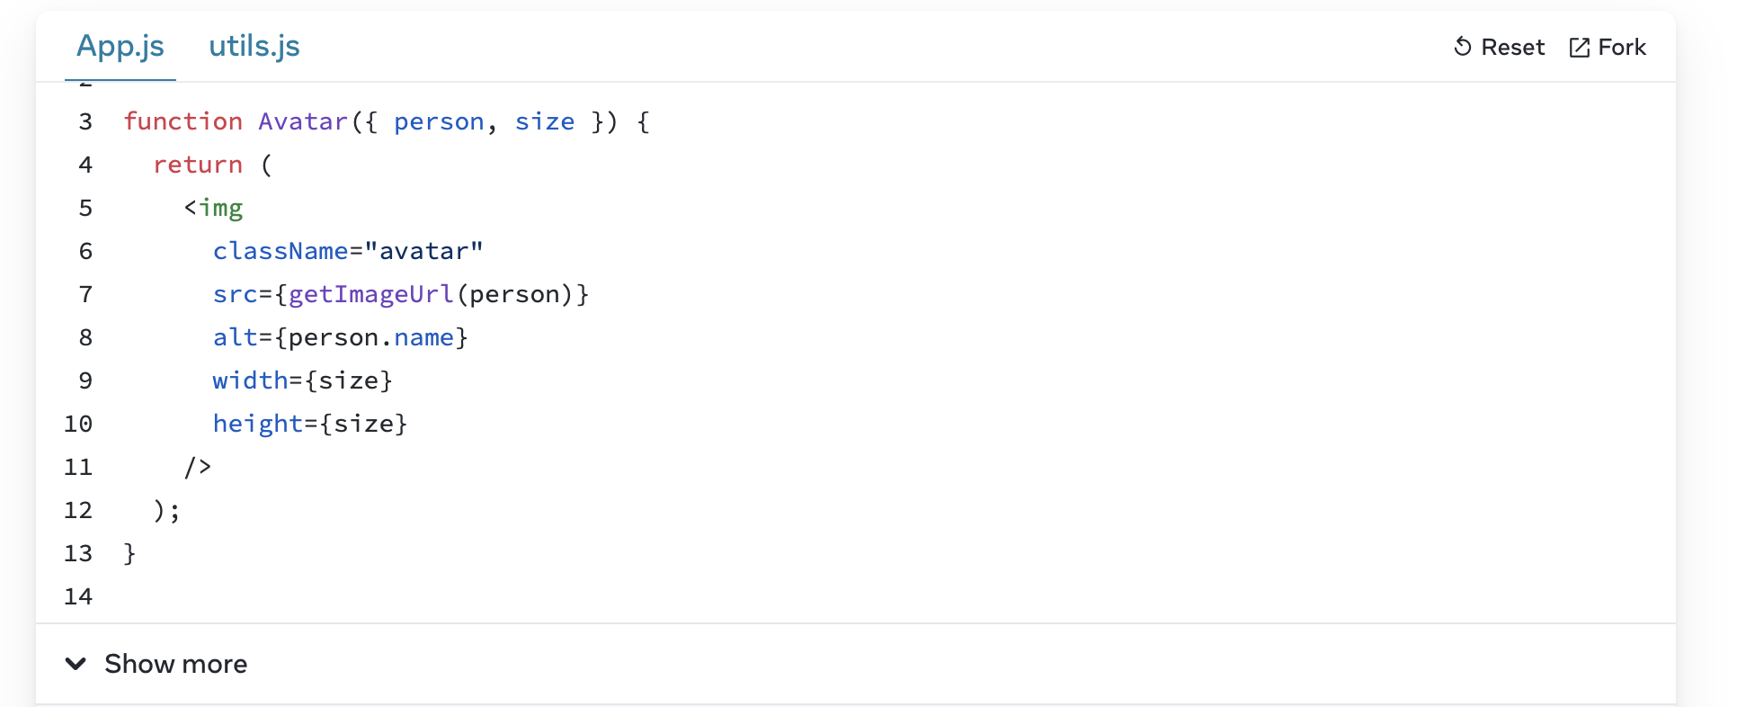
Step 2: Read props inside the child component
You can read these props by listing their names person, size separated by the commas inside ({ and }) directly after function Avatar. This lets you use them inside the Avatar code, like you would with a variable.
Add some logic to Avatar that uses the person and size props for rendering, and you’re done.

Slide 8
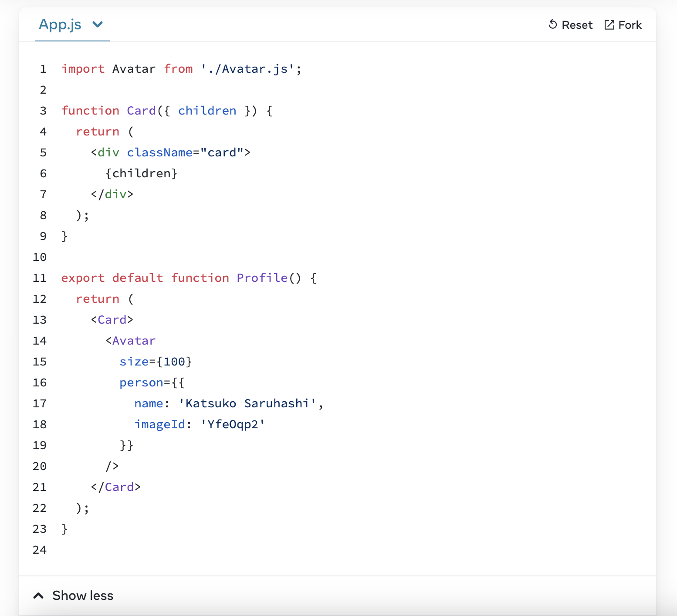
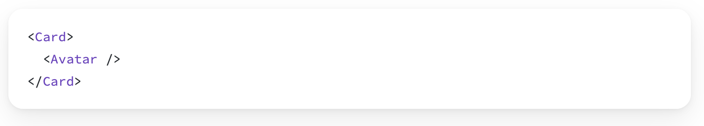
Passing JSX as children
Sometimes you’ll want to nest your own components the same way:
When you nest content inside a JSX tag, the parent component will receive that content in a prop called children. For example, the Card component below will receive a children prop set to <Avatar /> and render it in a wrapper div:

Slide 9
Data flow
Unidirectional data flow describes a one-way data flow where the data can move in only one pathway when being transferred between different parts of the program.
React, a Javascript library, uses unidirectional data flow. The data from the parent is known as props. You can only transfer data from parent to child and not vice versa.
This means that the child components cannot update or modify the data on their own, makeing sure that a clean data flow architecture is followed. This also means that you can control the data flow better.
Effect of state changes
In React, each state is owned by one component. Due to the unidirectional flow, the changes made on the state of the component will only affect the children and not the parents or siblings.

Slide 10
Conditional Rendering
Your components will often need to display different things depending on different conditions. In React, you can conditionally render JSX using JavaScript syntax like if statements, &&, and ? : operators.
You will learn
How to return different JSX depending on a condition
How to conditionally include or exclude a piece of JSX
Common conditional syntax shortcuts you’ll encounter in React codebases

Slide 11
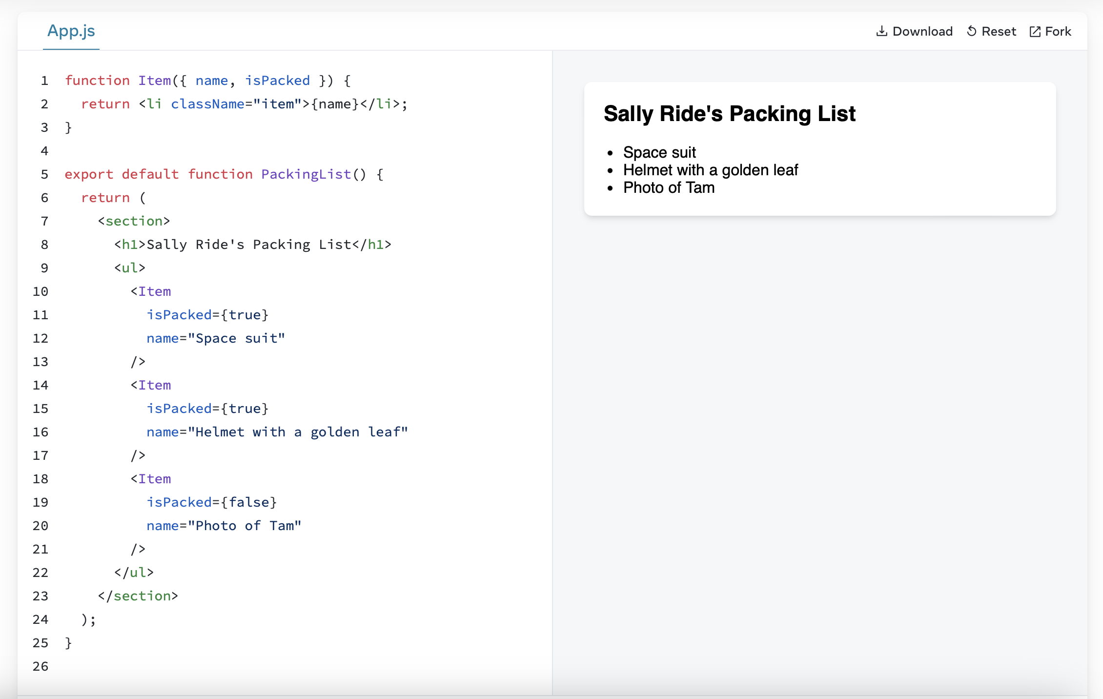
Conditional returning JSX
Let’s say you have a PackingList component rendering several Items, which can be marked as packed or not:

Slide 12
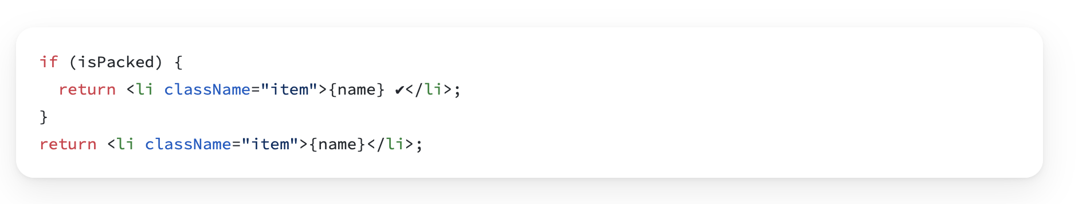

Conditional returning JSX
Notice that some of the Item components have their isPacked prop set to true instead of false. You want to add a checkmark (✔) to packed items if isPacked={true}.
You can write this as an if/else statement like so:
If the isPacked prop is true, this code returns a different JSX tree. With this change, some of the items get a checkmark at the end:

Slide 13
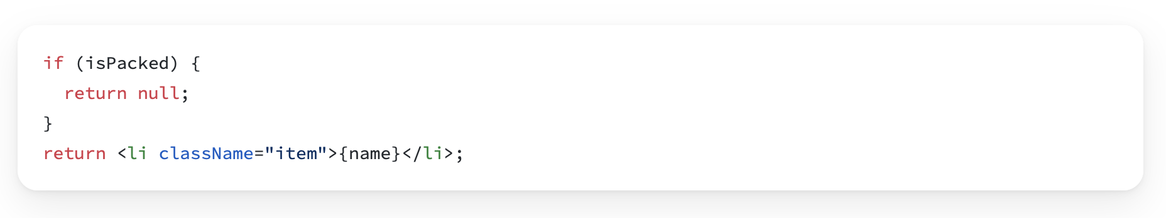
Conditional returning nothing with null
In some situations, you won’t want to render anything at all. For example, say you don’t want to show packed items at all. A component must return something. In this case, you can return null:
If isPacked is true, the component will return nothing, null. Otherwise, it will return JSX to render.
In practice, returning null from a component isn’t common because it might surprise a developer trying to render it. More often, you would conditionally include or exclude the component in the parent component’s JSX. Here’s how to do that!

Slide 14
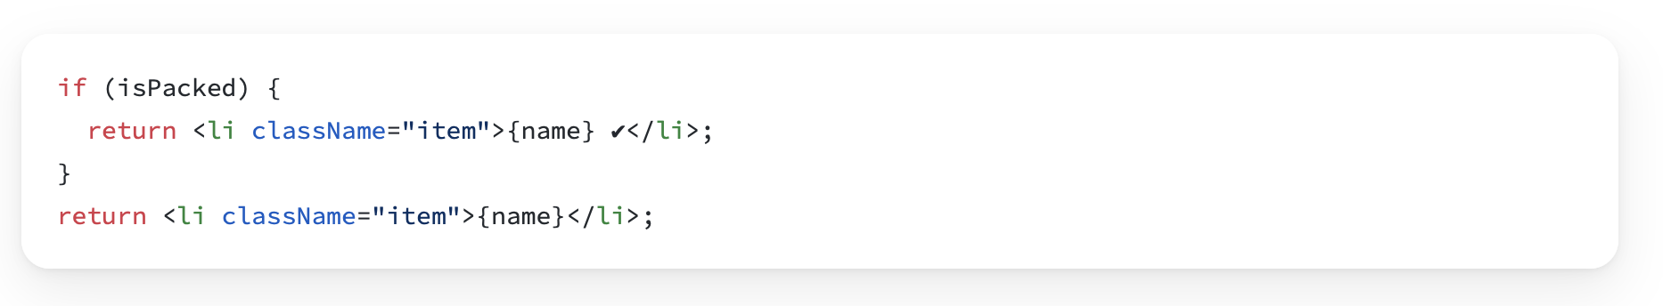
Conditionally including JSX
In the previous example, you controlled which (if any!) JSX tree would be returned by the component. You may already have noticed some duplication in the render output:
is very similar to
Both of the conditional branches return <li className="item">...</li>:

Slide 15
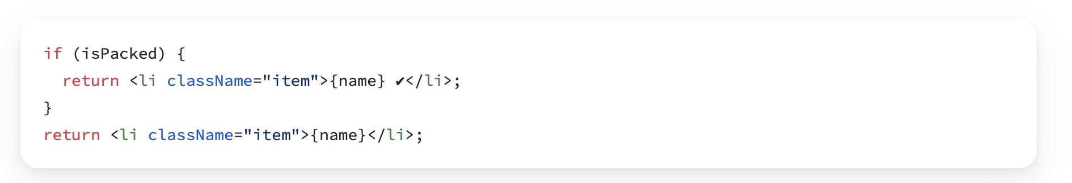
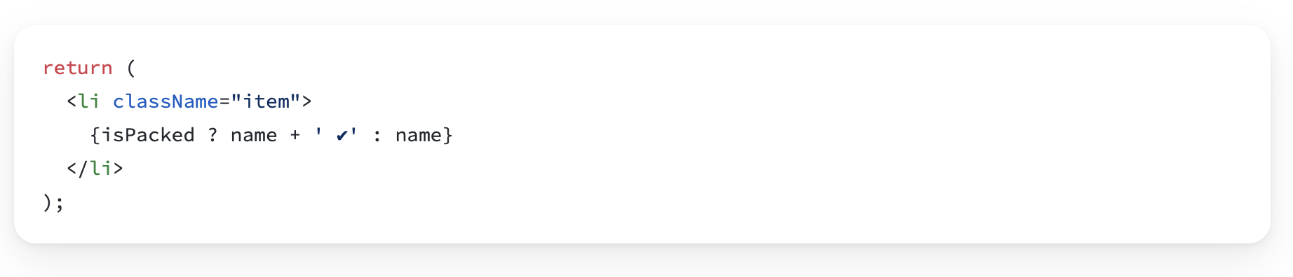
Conditional (ternary) operator (? :)
JavaScript has a compact syntax for writing a conditional expression — the conditional operator or “ternary operator”.
Instead of this:
You can write this:

Slide 16
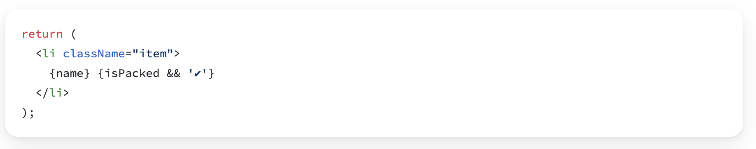
Logical AND operator (&&)
Another common shortcut you’ll encounter is the JavaScript logical AND (&&) operator. Inside React components, it often comes up when you want to render some JSX when the condition is true, or render nothing otherwise. With &&, you could conditionally render the checkmark only if isPacked is true:
You can read this as “if isPacked, then (&&) render the checkmark, otherwise, render nothing”.

Slide 17
Recap in Conditional Rendering
In React, you control branching logic with JavaScript.
You can return a JSX expression conditionally with an if statement.
You can conditionally save some JSX to a variable and then include it inside other JSX by using the curly braces.
In JSX, {cond ? <A /> : <B />} means “if cond, render <A />, otherwise <B />”.
In JSX, {cond && <A />} means “if cond, render <A />, otherwise nothing”.
The shortcuts are common, but you don’t have to use them if you prefer plain if.

Slide 18
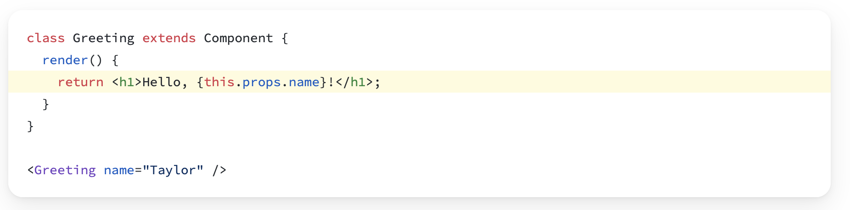
Class Components
Component is the base class for the React components defined as JavaScript classes. Class components are still supported by React, but we don’t recommend using them in new code.
The props passed to a class component are available as this.props.

Slide 19
Questions
How to pass props ?
Ternary operator example.
What is the difference using props in class component vs functional component ?
How to define a required array of objects using prop types ?
What function is present in the basic component setup in class components, but not in functional ones?

Slide 20
Home work
Create a React application that consists of two components: Item and PackageList. Within PackageList, render multiple Item components. For each Item, you should pass in two props: name (the name of the item) and isPacked (a boolean indicating whether the item is packed or not). The isPacked prop should determine if the item displays a checkmark (✔) or a cross (❌) next to its name.

