Slide 1
Intro with Build-in React Hooks
Bojan Angjeleski

Slide 2
Built-in React Hooks
Hooks let you use different React features from your components. You can either use the built-in Hooks or combine them to build your own. This page lists all built-in Hooks in React.

Slide 3
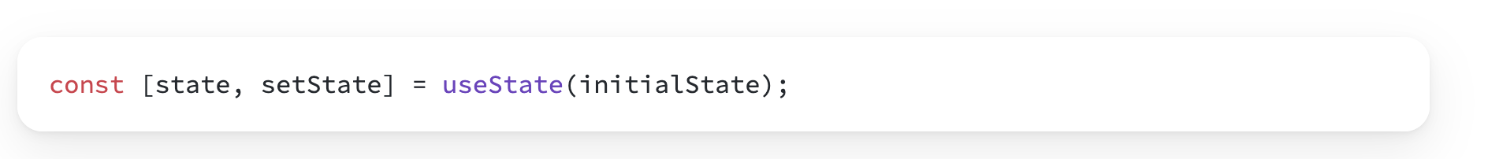
Use state
useState is a React Hook that lets you add a state variable to your component.

Slide 4
Use state
useState is a React Hook that lets you add a state variable to your component.

Slide 5
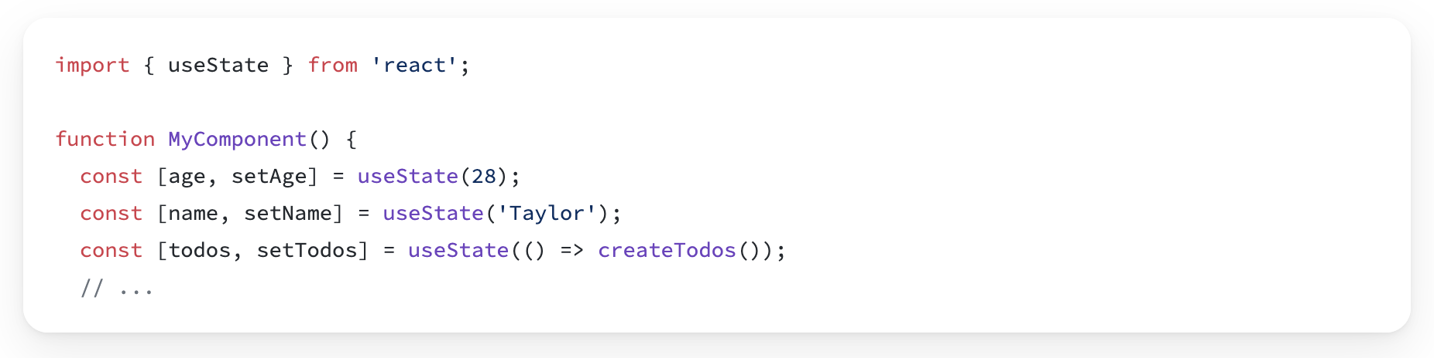
Reference
useState(inicialState)
Call useState at the top level of your component to declare a state variable.

Slide 6
Parameters
initialState: The value you want the state to be initially. It can be a value of any type, but there is a special behavior for functions. This argument is ignored after the initial render.
If you pass a function as initialState, it will be treated as an initializer function. It should be pure, should take no arguments, and should return a value of any type. React will call your initializer function when initializing the component, and store its return value as the initial state.

Slide 7
Returns
useState returns an array with exactly two values:
The current state. During the first render, it will match the initialState you have passed.
The set function that lets you update the state to a different value and trigger a re-render.

Slide 8
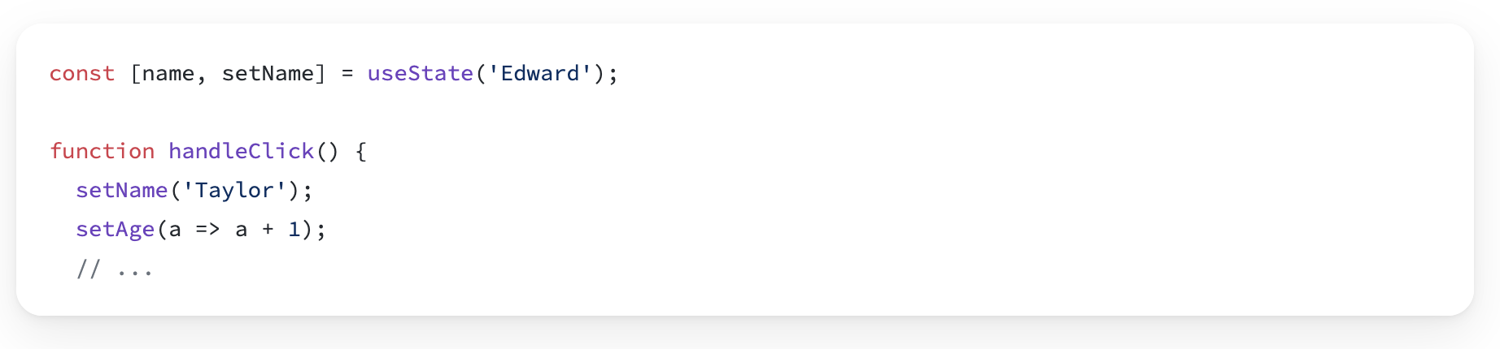
set functions, like setSomething(nextState)
The set function returned by useState lets you update the state to a different value and trigger a re-render. You can pass the next state directly, or a function that calculates it from the previous state:

Slide 9
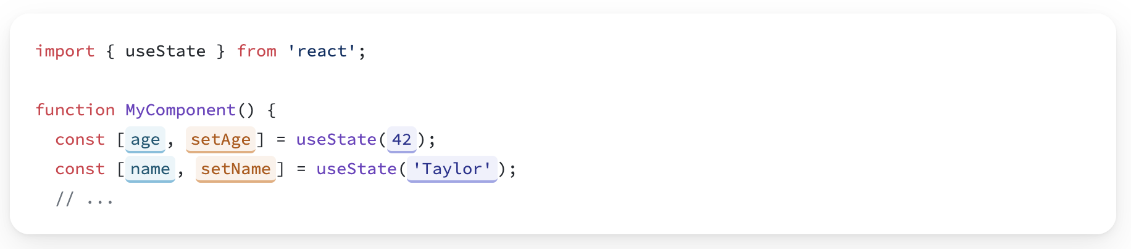
Adding state to a component
Call useState at the top level of your component to declare one or more state variables.

Slide 10
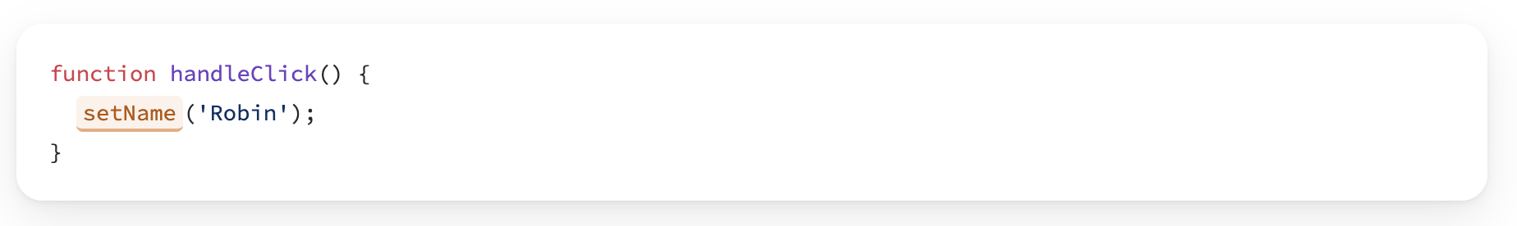
Adding state to a component
The convention is to name state variables like [something, setSomething] using array destructuring.
useState returns an array with exactly two items:
The current state of this state variable, initially set to the initial state you provided.
The set function that lets you change it to any other value in response to interaction.
To update what’s on the screen, call the set function with some next state:

Slide 11
UseEffect()
useEffect is a React Hook that lets you synchronize a component with an external system.

Slide 12
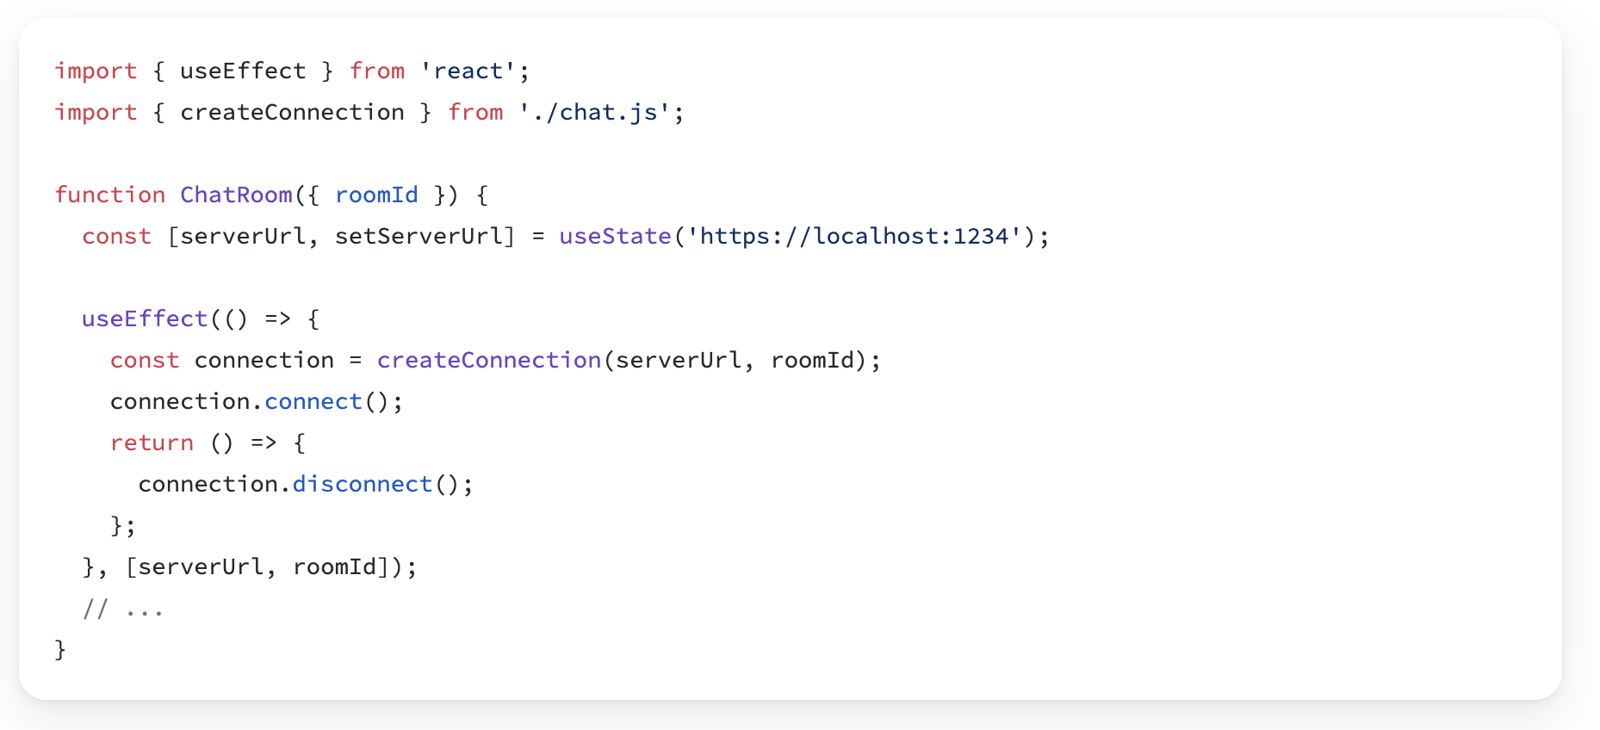
Reference
useEffect(setup, dependencies?)

Slide 13
Parameters
setup: The function with your Effect’s logic. Your setup function may also optionally return a cleanup function. When your component is added to the DOM, React will run your setup function. After every re-render with changed dependencies, React will first run the cleanup function (if you provided it) with the old values, and then run your setup function with the new values. After your component is removed from the DOM, React will run your cleanup function.
optional dependencies: The list of all reactive values referenced inside of the setup code. Reactive values include props, state, and all the variables and functions declared directly inside your component body. If your linter is configured for React, it will verify that every reactive value is correctly specified as a dependency. The list of dependencies must have a constant number of items and be written inline like [dep1, dep2, dep3]. React will compare each dependency with its previous value using the Object.is comparison. If you omit this argument, your Effect will re-run after every re-render of the component. See the difference between passing an array of dependencies, an empty array, and no dependencies at all.

Slide 14
Parameters
setup: The function with your Effect’s logic. Your setup function may also optionally return a cleanup function. When your component is added to the DOM, React will run your setup function. After every re-render with changed dependencies, React will first run the cleanup function (if you provided it) with the old values, and then run your setup function with the new values. After your component is removed from the DOM, React will run your cleanup function.
optional dependencies: The list of all reactive values referenced inside of the setup code. Reactive values include props, state, and all the variables and functions declared directly inside your component body. If your linter is configured for React, it will verify that every reactive value is correctly specified as a dependency. The list of dependencies must have a constant number of items and be written inline like [dep1, dep2, dep3]. React will compare each dependency with its previous value using the Object.is comparison. If you omit this argument, your Effect will re-run after every re-render of the component. See the difference between passing an array of dependencies, an empty array, and no dependencies at all.

