Slide 1
React Data Management & Operations
Understanding Forms, Validation, and CRUD Operations Bojan Angjeleski

Slide 2
Introduction
Data Collection: This is our starting point. Whenever users interact with our applications—be it signing up, leaving feedback, or placing orders—they're providing data. Effective data collection ensures that we're capturing this information accurately and efficiently.
Validation: But not all data is useful or even safe. Validation acts as a gatekeeper, ensuring that the data adheres to the standards and requirements we set. It keeps our systems robust and trustworthy.
Processing: Once we have the data and are sure of its validity, it's time to act on it. Whether we're calculating results, sorting information, or preparing it for storage, data processing transforms raw data into actionable insights.
CRUD Operations: And finally, CRUD operations—which stand for Create, Read, Update, and Delete—are the backbone of data interactions. They allow our applications to be dynamic and responsive to user needs, ensuring data can be added, retrieved, modified, or removed seamlessly.

Slide 3
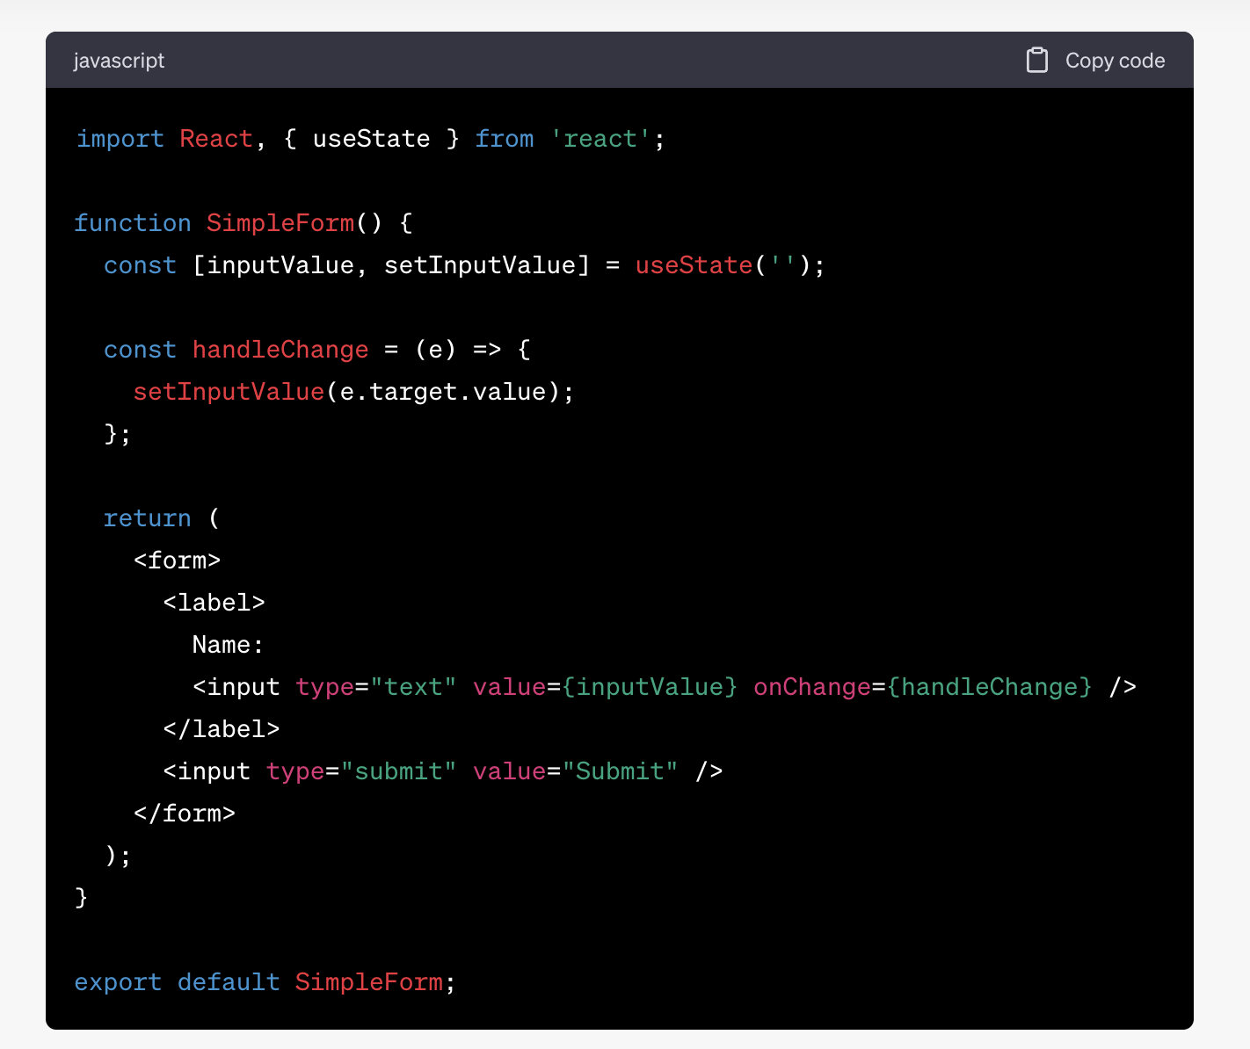
Use of forms and input fields for data entry
React Forms: Interactive elements allowing user input.
Common Elements: Input, Textarea, Select, Checkbox, Radio.
Controlled Components: Elements whose values are controlled by React state.
Code example

Slide 4
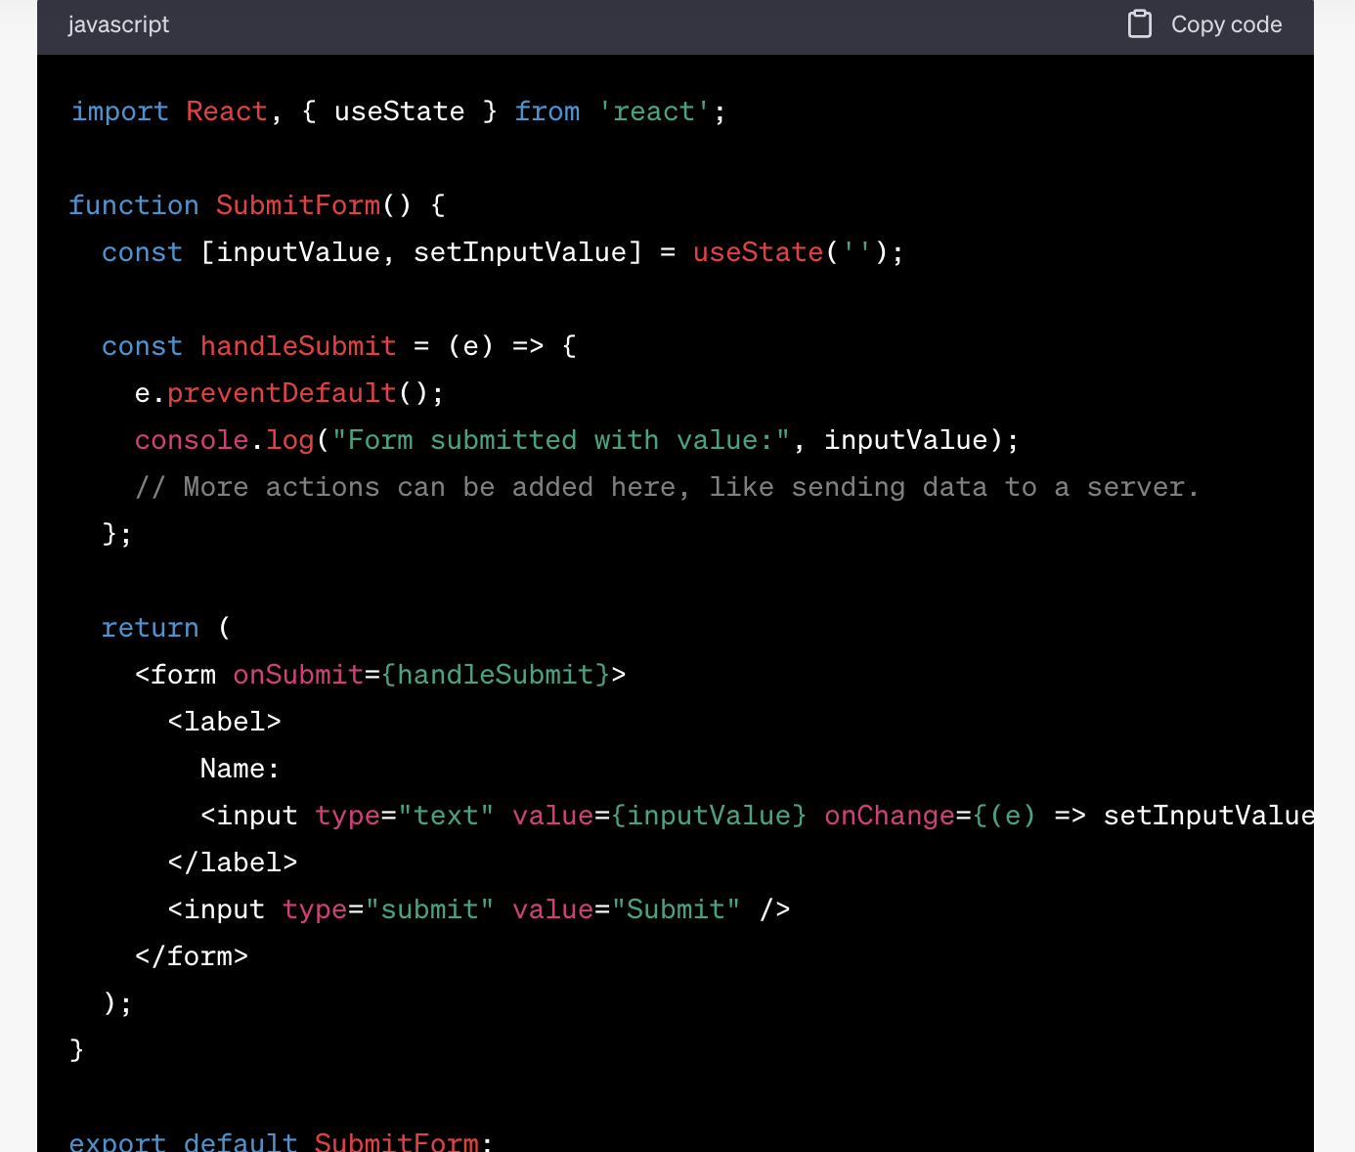
Handling Form Submission
onSubmit Event: Triggered when a form is submitted. Ideal for validating, processing, or sending data.

Slide 5
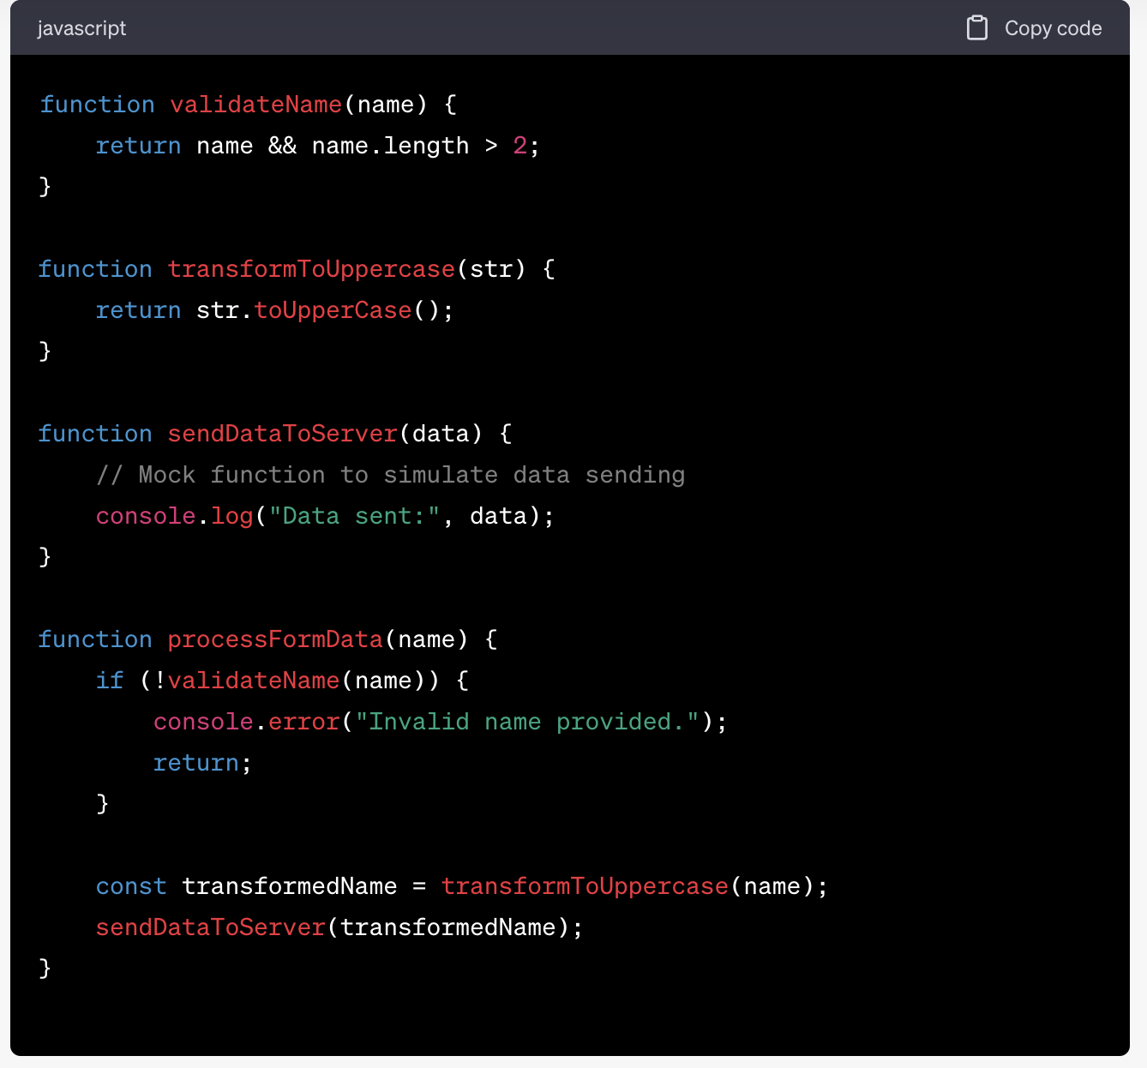
Data processing in separate functions
Modular Code: Breaking code into small, reusable parts.
Helper Functions: Functions designed for a specific task, aiding in readability and maintainability.

Slide 6
Data processing in separate functions
Modular Code: Breaking code into small, reusable parts.
Helper Functions: Functions designed for a specific task, aiding in readability and maintainability.

Slide 7
Introduction to CRUD
CRUD is an acronym that stands for the four primary operations we perform on data, especially within databases. These are:
Create - adding new data.
Read - retrieving and viewing data.
Update - modifying existing data.
Delete - removing data.

