Slide 1
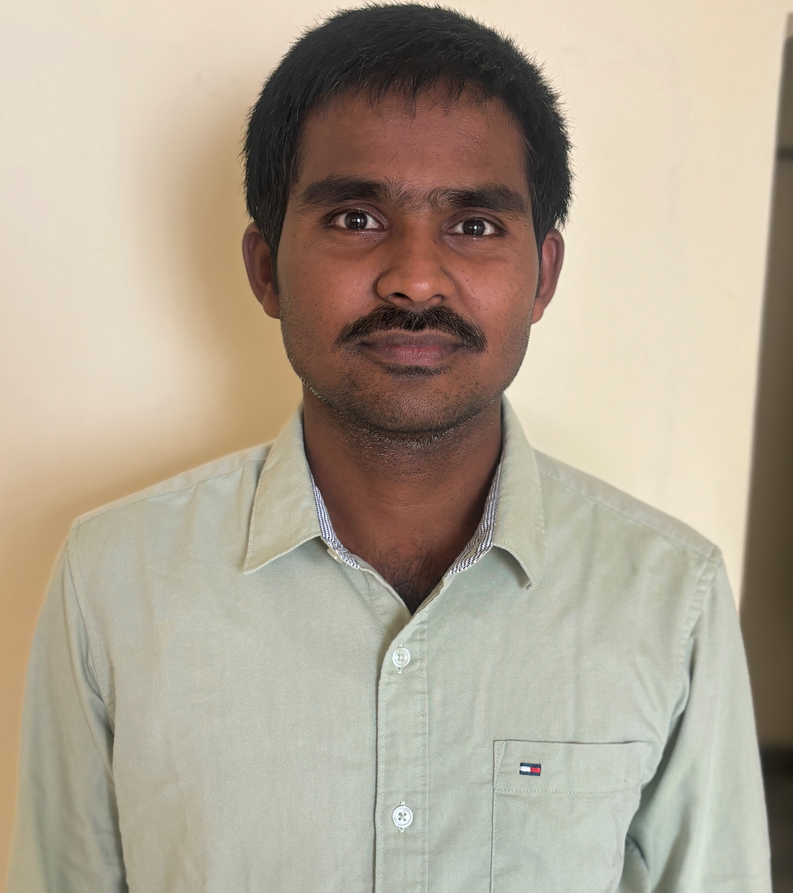
Bojanapalli Shashidhar Reddy
Your Pic here
Bojanapalli Shashidhar Reddy is a Consultant with Deloitte’s Azure DevOps Engineer. I am having 5 years of experience as a Cloud & DevOps Engineer with exclusive hands-on experience in Azure DevOps and Jenkins, Docker, Kubernetes and solving complex problems with creative solutions and also I have a good experience in creating Terraform automation scripts for CI/CD Pipeline building, deployments an Azure DevOps, cloud environments. Skilled in leveraging cloud and DevOps methodologies to deliver scalable, secure, and high-performing cloud solutions.
Select Experience:
Expertise in the creation of CI/CD (Build and Release) pipelines using Azure DevOps Experience
Experience using Terraform (IaC) to create resources in the Azure cloud.
Experienced in verifying the deployments in the Azure Kubernetes Services.
Visualizing the data through the Marvel dashboards in Kibana. Experience in Virtual Machines, Virtual Networks, Azure App Service, Azure Functions, Service Bus, Azure Kubernetes Service, Azure Container Registry, and APIM.
Creating automation accounts to stop the VM based on the CPU utilization to save cost.
Good experience in Jenkins to automate the code build and deploy process for Java-based applications.
Skilled in building a plan for project success and executing strategies that generate quantifiable
Working experience with continuous delivery/integration/deployment tools such as Ansible, and Jenkins.
Deployed Azure IaaS virtual machines(VMs)and Cloud services(PaaS role instances)into secure VNets and subnets.
Identify and resolve project issues and manage project risk.
Responsible for E2E completion of a Project including all five phases Diagnose, Implement, Embed &amp; Grow, Governance &amp; Closure of project.
Bojanapalli Shashidhar Reddy
Consultant
Location: Hyderabad
Contact: sbojanapalii@deloitte.com
Areas of Expertise
Azure DevOps
Docker
Kubernetes
Terraform
Jenkins & Maven
Ansible
Shell scripting
Git
Nexus artifactory

