Slide 1
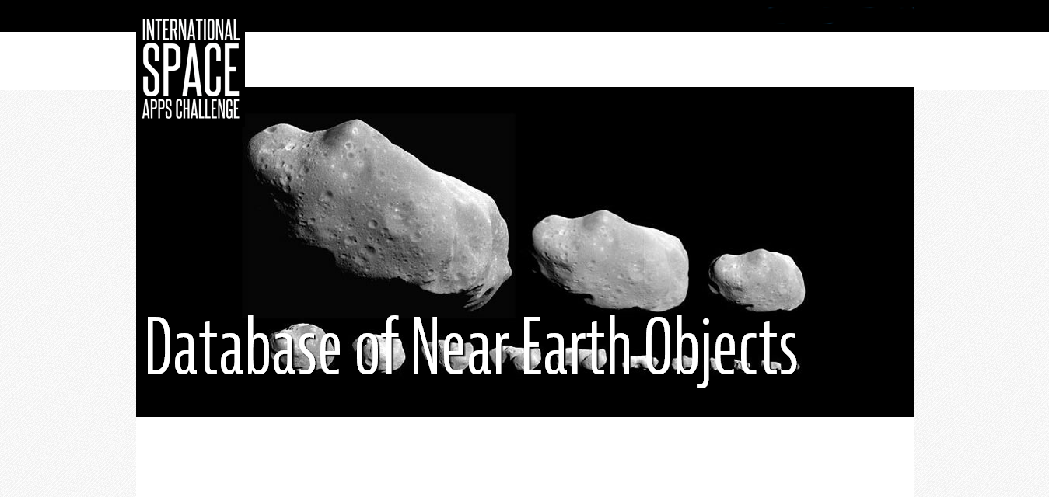
NEO for everyone
(Near Earth Objects Database)
Bojan Seirovski , Andries Hannaart , Dennis Silin

Slide 2
NEOs?
A near-earth object (NEO) is a Solar system object whose orbit brings it into proximity with Earth.
  Asteroids or comets
  Divided into several families, depending on orbit
  From several meters to several tens km in size

Slide 3
The need for tracking NEOs and working databases
Potentially dangerous, direct threat to Earth
Possible goals for space exploration
Many are still undiscovered
Amateur astronomers and citizen scientists can fruitfully participate
Working solution : The Minor Planet Center

Slide 4
Why this?
User friendly
Can use the existing data format
Allows social interaction

Slide 5
How it works?
Go online, Register for an account
Enter your findings
Wait for the findings to be ranked by others and rank others
Users get personalized pages

Slide 6
What else can be done?
Can be used as a front end for the existing NEO database – The Minor Planet Center
Can be upgraded to improve the user experience and therefore, personilzed lists, image galleries, to improve the quality of collaboration between astronomers

Slide 7
Questions?

