Slide 1
Lecture 17
GUI Programming

Slide 2
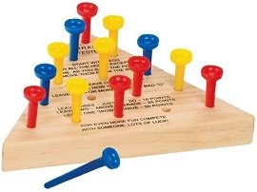
GUI programming
Today, we’re going to begin looking at how we can create GUIs (Graphical User Interfaces) in Python. So far, every application we’ve built has been either console-based or a web application. If we want to create a user-friendly standalone application, we really must create a nice interface for it.
As an example, we’ll create an interface for the triangle peg game.
First, let’s see what packages are available to help us do this.

Slide 3
GUI programming in python
There are a huge number of modules available to help you create an interface. Some of these include:
Tkinter: wrapper around Tcl/Tk. Python’s standard GUI.
PyQt: bindings for the Qt application framework.
wxPython: wrapper around wxWidgets C++ library.
pyGTK: wrapper around GTK+.
PyJamas/PyJamas Desktop
etc.

Slide 4
Choosing a toolkit
Toolkit | Important Points
Tkinter | - Limited theme support: “look” was relatively the same until recently. - Relatively limited widget options. - Bundled with Python since the beginning. - Most commonly used.
PyQt | - Limited licensing choices. - Very good docs - Very beautiful applications. - Huge! Both good and bad...
wxPython | - Very large user base. - Great widget selection. - Bad docs. - Not Python 3 compatible.
pyGTK | - Originally developed for GIMP. - Stable with a full selection of widgets. - Only offers theme-able native widgets on Windows + Linux. Mac lags behind somewhat. - Some quirks to work around (some C programming style).

Slide 5
PyQt
In this class, we will be exploring basic GUI development with PyQt since it is a widely-used toolkit. However, the other mentioned options are all very good and it may be necessary to branch out depending on the complexity and/or needs of the application.
First, we’ll discuss some of the mechanics of GUI development. Afterwards, we could spend tons of class time learning about PyQt’s ~1000 classes but we won’t. What we’ll do is build an application together and get familiar with the common parts of a PyQt application.
As a note, we’ll be using PyQt5 in this lecture. A PyQt4 tutorial is included in the old lecture but the details aren’t very different.

Slide 6
Getting Pyqt5
1. Go to https://www.riverbankcomputing.com/software/sip/download and grab the latest version of SIP.
2. Run the following commands to build and install SIP (version numbers may be different).
$ gunzip sip-4.18.tar.gz $ tar -xvf sip-4.18.tar $ cd sip-4.18/ $ python configure.py $ make $ sudo make install

Slide 7
GETTing PyQT5
1. Now go to https://www.riverbankcomputing.com/software/pyqt/download5 and grab the latest version of PyQt5.
2. Run the following commands to build and install PyQt5 (version numbers may be different).
3. Open up an interpreter and import PyQt5 to make sure everything’s working.
$ gunzip PyQt5_gpl-5.6.tar.gz
$ tar -xvf PyQt5_gpl-5.6.tar
$ sudo apt-get install qt5-default
$ cd PyQt5_gpl-5.6
$ python configure.py $ make ← go get some coffee, this one will take a while!
$ sudo make install

Slide 8
Gui programming in pyqt
PyQt is a multi-platform GUI toolkit. It has approximately ~1000 classes divided into a set of ~38 modules. Among these are QtCore and QtGui – the most commonly used PyQt modules.
QtCore contains the core classes, including the event loop and Qt’s signal and slot mechanism. It also includes platform independent abstractions for animations, state machines, threads, mapped files, shared memory, regular expressions, and user and application settings.
QtGui contains classes for windowing system integration, event handling, 2D graphics, basic imaging, fonts and text.
QtWidgets contains classes that provide a set of UI elements to create classic desktop-style user interfaces.
Besides these, there are other modules (like, QtNetwork and QtOpenGL) which focus on specific functionality.

Slide 9
Gui programming in pyqt
Programming a GUI is not that different than programming an object-oriented console application. What is different is that GUI programming involves the use of a Toolkit and GUI developers must follow the pattern of program design specified by the toolkit. As a developer, you should be familiar with the API and design rules of at least one toolkit – preferably one that is multiplatform with bindings in many languages!

Slide 10
GUI programming in pyqt
GUI programming necessarily means object-oriented programming with an event-driven framework. This should make sense: your job as a GUI developer is to create an application that responds to events. For instance, when a user clicks their mouse on a certain button, the program should do X. When the user presses enter in a text field, the program should do Y. You’re defining the behavior of the program as a response to external events.

Slide 11
Basic pyqt
Let’s dive right in by looking at an embarrassingly basic PyQt program.
from PyQt5 import QtWidgets if __name__ == "__main__": app = QtWidgets.QApplication(sys.argv) main_window = QtWidgets.QWidget() main_window.show() app.exec_()
The QApplication class manages the application’s control flow and main settings. It controls the main event loop through which all events are handled and scheduled. No matter how many windows there are, there is only one QApplication instance.

Slide 12
Basic pyqt
Let’s dive right in by looking at an embarrassingly basic PyQt program.
from PyQt5 import QtWidgets if __name__ == "__main__": app = QtWidgets.QApplication(sys.argv) main_window = QtWidgets.QWidget() main_window.show() app.exec_()
A widget is a control element which is visible and can be manipulated by the user. These include elements such as buttons, text fields, radio selections, etc.
If we create a basic widget QWidget instance without a parent widget, it automatically becomes a window.

Slide 13
Basic pyqt
Let’s dive right in by looking at an embarrassingly basic PyQt program.
from PyQt5 import QtWidgets if __name__ == "__main__": app = QtWidgets.QApplication(sys.argv) main_window = QtWidgets.QWidget() main_window.show() app.exec_()
QWidget implements a variety of methods for it and its derived classes. These include resize, move, setWindowTitle (for widgets with no parents), among many others.
Widgets and their children are created in memory and made visible with the show() method.

Slide 14
Basic pyqt
Let’s dive right in by looking at an embarrassingly basic PyQt program.
from PyQt5 import QtWidgets if __name__ == "__main__": app = QtWidgets.QApplication(sys.argv) main_window = QtWidgets.QWidget() main_window.show() app.exec_()
Calling exec_() on our QApplication instance will start our main event loop.

Slide 15
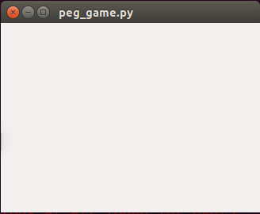
Basic pyqt
Let’s dive right in by looking at an embarrassingly basic PyQt program.
from PyQt5 import QtWidgets if __name__ == "__main__": app = QtWidgets.QApplication(sys.argv) main_window = QtWidgets.QWidget() main_window.show() app.exec_()

Slide 16
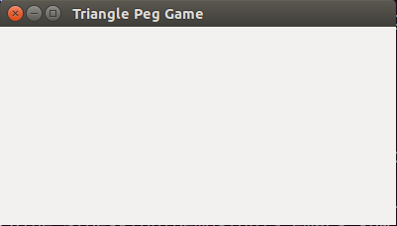
Basic PyQT
Rather than the procedural approach we took before, we should try to define our interface in an object-oriented manner.
from PyQt5 import QtWidgets class PegGameWindow(QtWidgets.QWidget): def __init__(self): QtWidgets.QWidget.__init__(self) self.setGeometry(200, 200, 400, 200) self.setWindowTitle('Triangle Peg Game') self.show() if __name__ == "__main__": app = QtWidgets.QApplication(sys.argv) main_window = PegGameWindow() app.exec_()

Slide 17
QWidget
So, we can see that a parentless QWidget instance gives us a window, but the QWidget class is actually the base class for all UI elements. Some of the classes that inherit and extend QWidget include:
QProgressBar
QPushButton
QCheckBox
QScrollBar
and many, many more!

Slide 18
QWidget
The QWidget class also defines some of the basic functionality common to all widgets.
QWidget.geometry() and Qwidget.setgeometry(x, y, w, h)
QWidget.resize(w, h)
QWidget.setParent(parent)
QWidget.setToolTip(str), QWidget.setStatusTip(str)
QWidget.setPalette(palette)
Check here for an exhaustive list. Not only is this not all of the methods defined – we’re not even including all the different ways you can call these methods!

Slide 19
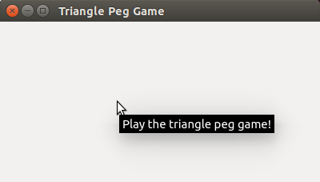
BASIC PYQT
class PegGameWindow(QtWidgets.QWidget): def __init__(self): QtWidgets.QWidget.__init__(self) self.setGeometry(200, 200, 400, 200) self.setWindowTitle('Triangle Peg Game') self.setToolTip("Play the triangle peg game!") self.show() if __name__ == "__main__": app = QtWidgets.QApplication(sys.argv) main_window = PegGameWindow() app.exec_()

Slide 20
BASIC PyQT
Let’s make some buttons!
Class StartNewGameBtn(QtWidgets.QPushButton): def __init__(self, parent): QtWidgets.QPushButton.__init__(self, parent) self.setText("Start New Game") self.move(20,160) class QuitBtn(QtWidgets.QPushButton): def __init__(self, parent): QtWidgets.QPushButton.__init__(self, parent) self.setText("Quit") self.move(150,160)

Slide 21
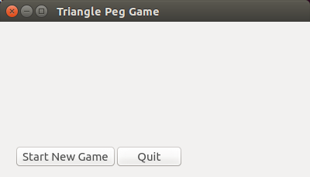
BASIC PYQT
class PegGameWindow(QtWidgets.QWidget): def __init__(self): QtWidgets.QWidget.__init__(self) self.setup() def setup(self): self.setGeometry(200, 200, 400, 200) self.setWindowTitle('Triangle Peg Game') self.setToolTip("Play the triangle peg game!") self.new_button = StartNewGameBtn(self) self.quit_button = QuitBtn(self) self.show()

Slide 22
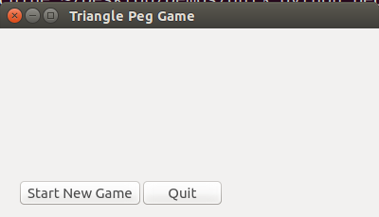
BASIC PYQT
Alternatively….
class PegGameWindow(QtWidgets.QWidget): def __init__(self): QtWidgets.QWidget.__init__(self) self.setup() def setup(self): self.setGeometry(200, 200, 400, 200) self.setWindowTitle('Triangle Peg Game') self.setToolTip("Play the triangle peg game!") self.new_button = QtWidgets.QPushButton("Start New Game", self) self.new_button.move(20, 160) self.quit_button = QtWidgets.QPushButton("Quit", self) self.quit_button.move(150, 160) self.show()

Slide 23
Signals and Slots
PyQt5 makes use of a signal/slot mechanism for specifying the actions that should be taken when an event happens.
A signal is emitted when a particular event occurs. Widgets already have many predefined signals, but you could also create custom signals on subclassed widgets.
Some common signals of QPushButton are:
QPushButton.clicked – signal activated when button is pressed and then released while mouse is on button.
QPushButton.pressed – signal activated when button is pressed.
QPushButton.released – signal activated when button is released.

Slide 24
Signals and slots
The example buttons we created earlier can be clicked, but nothing will happen. That’s because we need to assign a slot to the signal. A slot is a function that is called in response to a particular signal. Widgets have many pre-defined slots, but because a slot can be any Python callable, we can easily define our own slots to define our reaction to the signal.
Let’s try to make our Quit button exit the application. The slot we want to assign is: QWidgets.qApp.quit() Note that QWidgets.qApp is the QApplication instance running our program.

Slide 25
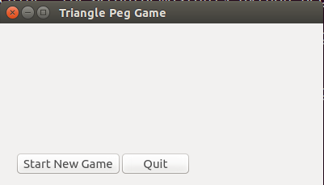
Signals and Slots
class QuitBtn(QtWidgets.QPushButton): def __init__(self, parent): QtWidgets.QPushButton.__init__(self, parent) self.setText("Quit") self.move(150,160) self.clicked.connect(QtWidgets.qApp.quit) self.setToolTip("Close the triangle peg game.")
Clicking quit now causes our window to close!

Slide 26
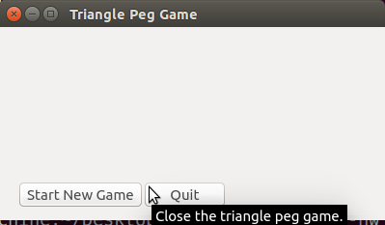
Signals and Slots
class QuitBtn(QtWidgets.QPushButton): def __init__(self, parent): QtWidgets.QPushButton.__init__(self, parent) self.setText("Quit") self.move(150,160) self.clicked.connect(QtWidgets.qApp.quit) self.setToolTip("Close the triangle peg game.")
Clicking quit now causes our window to close!

Slide 27
Basic pyqt
class PegGameWindow(QtWidgets.QWidget): def __init__(self): ... def setup(self): ... def closeEvent(self, event): reply = QuitMessage().exec_() if reply == QtWidgets.QMessageBox.Yes: event.accept() else: event.ignore()
We are also free to define the behavior of our application by overriding built-in methods.
For example, QtWidgets.QWidget has a method called closeEvent() which is called automatically with an instance of a window close request. By default, we just accept the request and close the window. Here, we’ll override the function to ask if they’re sure.
class QuitMessage(QtWidgets.QMessageBox): def __init__(self): QtWidgets.QMessageBox.__init__(self) self.setText("Do you really want to quit?") self.addButton(self.No) self.addButton(self.Yes)

Slide 28
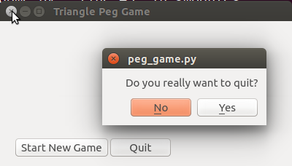
Basic pyqt
class PegGameWindow(QtWidgets.QWidget): def __init__(self): ... def setup(self): ... def closeEvent(self, event): reply = QuitMessage().exec_() if reply == QtWidgets.QMessageBox.Yes: event.accept() else: event.ignore()
class QuitMessage(QtWidgets.QMessageBox): def __init__(self): QtWidgets.QMessageBox.__init__(self) self.setText("Do you really want to quit?") self.addButton(self.No) self.addButton(self.Yes)

Slide 29
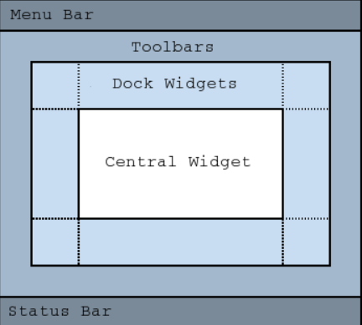
QT MAIN WINDOW
The QtWidgets.QMainWindow class provides a main application window. QMainWindow has its own layout as opposed to QWidget (but it inherits from QWidget).
QMainWindow automatically makes room for:
• QToolBar
• QDockWidget
• QMenuBar
• QStatusBar
• Any widget can occupy Central Widget.

Slide 30
Basic pyqt
class PegGameWindow(QtWidgets.QMainWindow): def __init__(self): ... def setup(self): ... self.central_widget = QtWidgets.QWidget(self) self.new_button = StartNewGameBtn(self.central_widget) self.quit_button = QuitBtn(self.central_widget) self.setCentralWidget(self.central_widget)
exit_action = QtWidgets.QAction('Exit', self) exit_action.triggered.connect(QtWidgets.qApp.quit) menu_bar = self.menuBar() file_menu = menu_bar.addMenu('File') file_menu.addAction(exit_action) self.show()
We’re going to add a menu bar with a File > Exit action.
First, we create a QAction instance for exiting the application, for which the text is “Exit”. When the action is taken, we quit the application.

Slide 31
Basic pyqt
class PegGameWindow(QtWidgets.QMainWindow): def __init__(self): ... def setup(self): ... self.central_widget = QtWidgets.QWidget(self) new_button = StartNewGameBtn(self.central_widget) quit_button = QuitBtn(self.central_widget) self.setCentralWidget(self.central_widget)
exit_action = QtWidgets.QAction('Exit', self) exit_action.triggered.connect(QtWidgets.qApp.quit) menu_bar = self.menuBar() file_menu = menu_bar.addMenu('File') file_menu.addAction(exit_action) self.show()
We reference the menu bar for our main window by calling menuBar(). This will also create and return an empty menu bar if there is none.
Then we add a new menu with the text “File”. Then we add the Exit action to the File menu.

Slide 32
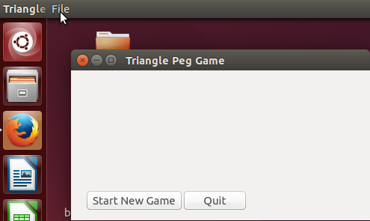
Basic Pyqt
Where’s our menu bar!?

Slide 33
Basic Pyqt
Where’s our menu bar!?
Very sneaky, Ubuntu…

Slide 34
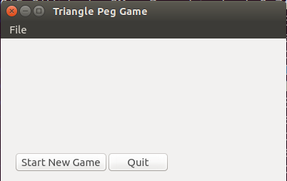
Basic PyQt
menu_bar = self.menuBar() menu_bar.setNativeMenuBar(False) file_menu = menu_bar.addMenu('File') file_menu.addAction(exit_action)

