Slide 1
Lecture 18
GUI Programming Part 2

Slide 2
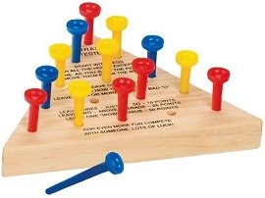
GUI programming
Our goal: the triangle peg game!

Slide 3
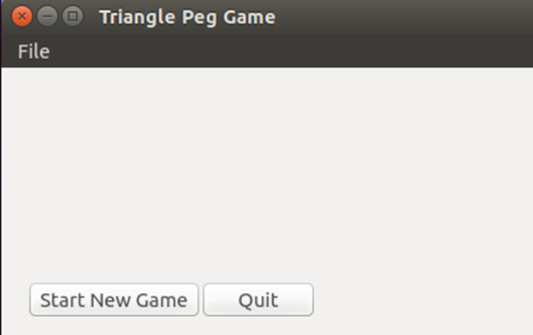
Basic pyqt
class PegGameWindow(QtWidgets.QMainWindow): def __init__(self): ... def setup(self): ... self.central_widget = QtWidgets.QWidget(self) new_button = StartNewGameBtn(self.central_widget) quit_button = QuitBtn(self.central_widget) self.setCentralWidget(self.central_widget)
exit_action = QtWidgets.QAction('Exit', self) exit_action.triggered.connect(QtWidgets.qApp.quit) menu_bar = self.menuBar() file_menu = menu_bar.addMenu('File') file_menu.addAction(exit_action) self.show()
Last lecture, we created a basic PyQt4 application which had a few buttons and a menu bar.

Slide 4
Layout management
Before we can add more components to our application, we need to talk about layout management in PyQt4. The two options for managing the position of widgets are
Absolute positioning
Layout classes Absolute positioning is as simple as calling the move() method on a widget with some arguments that specify a position (x,y). This can be impractical for a few reasons. First, applications might look differently on different platforms (or even using different fonts) as they won’t scale. Secondly, changes in layout will be much more tedious.

Slide 5
Layout management
Layout classes automatically position and resize widgets to accommodate space changes so that the look and feel is consistent.
Every QWidget subclass may have a layout specified which gives a widget control over:
Positioning of child widgets.
Sensible default sizes for widgets.
Sensible minimum sizes for widgets.
Resize handling.
Automatic updates when contents change (font size, text or other contents of child widgets, hiding or showing a child widget, removal of child widgets).

Slide 6
Layout management
There are a large number of layout classes but the most common include:
Box Layout (QBoxLayout): lays out widgets in a horizontal row (QHBoxLayout) or vertical column (QVBoxLayout) from left-to-right or top-to-bottom.
Grid Layout (QGridLayout): lays out widgets in a 2-D grid where widgets can occupy multiple cells.
Form Layout (QFormLayout): layout class for managing forms. Creates a two-column form with labels on the left and fields on the right.

Slide 7


Box layout
The QBoxLayout class lines up child widgets horizontally or vertically. QBoxLayout will take a given space and divide it up into boxes that contain widgets.
QHBoxLayout makes horizontal rows of boxes.
QVBoxLayout makes vertical columns of boxes.

Slide 8
Box layout
Once you create a box layout and attach it to a parent widget, the following methods are used to add child widgets and manage the space:
addWidget(widget, stretch=0) to add a widget to the QBoxLayout and set the widget's stretch factor.
addSpacing(size) to create an empty (non-stretchable) box with a particular size.
addStretch(stretch=0) to create an empty, stretchable box.
addLayout(layout, stretch=0) to add a box containing another QLayout to the row and set that layout's stretch factor.
Stretch factors indicate the relative amount of leftover space that should be allocated to a block.

Slide 9
Grid layout
The Grid Layout class is the most universal, but we will use both Grid and Box layouts. A grid is represented with multiple rows and columns. Widgets can be attached to the grid by indicating the (row, column) space it should fill.
Create a grid layout with QtWidgets.QGridLayout().
Attach widgets to the grid with addWidget(QWidget, row, column). You can also set the number of grid spaces that it should take up.

Slide 10
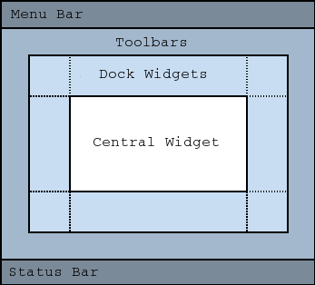
Basic pyqt
class PegGameWindow(QtWidgets.QMainWindow): def __init__(self): ... def setup(self): ... self.central_widget = QtWidgets.QWidget(self) self.new_button = StartNewGameBtn(self.central_widget) self.quit_button = QuitBtn(self.central_widget) self.setCentralWidget(self.central_widget)
exit_action = QtWidgets.QAction('Exit', self) exit_action.triggered.connect(QtWidgets.qApp.quit) menu_bar = self.menuBar() file_menu = menu_bar.addMenu('File') file_menu.addAction(exit_action) self.show()
Recall that QMainWindow includes a default layout for traditional GUI components like a menu bar, status bar, tool bar, etc. The focal point of the application is stored in the Central Widget of the layout.

Slide 11
Basic pyqt
class PegGameWindow(QtWidgets.QMainWindow): def __init__(self): QtWidgets.QMainWindow.__init__(self) self.setup() def setup(self): self.setWindowTitle('Triangle Peg Game') self.setToolTip("Play the triangle peg game!") self.peg_game = PegGame(self) self.setCentralWidget(self.peg_game) ... self.show()
Let’s really define what this central widget should look like. We’ll create a new class called PegGame.

Slide 12
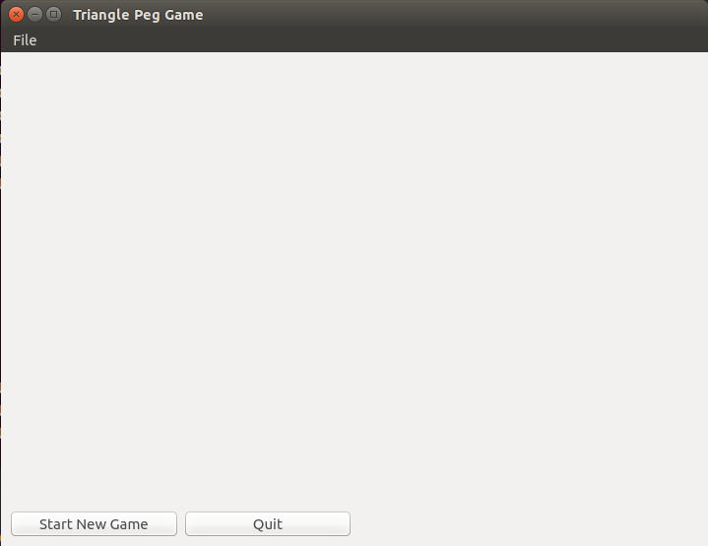
Grid layout
So what do we want PegGame to look like? Well it’s not too interesting. But let’s point out the important details.

Slide 13
Grid layout
So what do we want PegGame to look like? Well it’s not too interesting. But let’s point out the important details.
PegGame

Slide 14
Grid layout
PegGame will contain three important components (at least, to start): - PegBoard, which will house the board, pegs, etc. - Start New Game Button - Quit Button
PegGame
PegBoard

Slide 15
Grid layout
So how do we define PegGame? PegGameWindow has a built-in layout because it inherits from QMainWindow. PegGame, however, is a plain widget. So we can associate a Grid layout with it.
class PegGame(QtWidgets.QWidget): def __init__(self, parent): QtWidgets.QWidget.__init__(self, parent) self.setup() def setup(self): self.board = PegBoard(self) self.new_btn = StartNewGameBtn(self) self.quit_btn = QuitBtn(self) self.grid = QtWidgets.QGridLayout() self.setLayout(self.grid) self.grid.addWidget(self.board, 1, 1, 1, 4) self.grid.addWidget(self.new_btn, 2, 1, 1, 1) self.grid.addWidget(self.quit_btn, 2, 2, 1, 1)
Our three components

Slide 16
Grid layout
So how do we define PegGame?
class PegGame(QtWidgets.QWidget): def __init__(self, parent): QtWidgets.QWidget.__init__(self, parent) self.setup() def setup(self): self.board = PegBoard(self) self.new_btn = StartNewGameBtn(self) self.quit_btn = QuitBtn(self) self.grid = QtWidgets.QGridLayout() self.setLayout(self.grid) self.grid.addWidget(self.board, 1, 1, 1, 4) self.grid.addWidget(self.new_btn, 2, 1, 1, 1) self.grid.addWidget(self.quit_btn, 2, 2, 1, 1)
Creating and setting our grid layout

Slide 17
Grid layout
So how do we define PegGame?
class PegGame(QtWidgets.QWidget): def __init__(self, parent): QtWidgets.QWidget.__init__(self, parent) self.setup() def setup(self): self.board = PegBoard(self) self.new_btn = StartNewGameBtn(self) self.quit_btn = QuitBtn(self) self.grid = QtWidgets.QGridLayout() self.setLayout(self.grid) self.grid.addWidget(self.board, 1, 1, 1, 4) self.grid.addWidget(self.new_btn, 2, 1, 1, 1) self.grid.addWidget(self.quit_btn, 2, 2, 1, 1)
Adding our components to the grid layout.
row, column

Slide 18
Grid layout
So how do we define PegGame?
class PegGame(QtWidgets.QWidget): def __init__(self, parent): QtWidgets.QWidget.__init__(self, parent) self.setup() def setup(self): self.board = PegBoard(self) self.new_btn = StartNewGameBtn(self) self.quit_btn = QuitBtn(self) self.grid = QtWidgets.QGridLayout() self.setLayout(self.grid) self.grid.addWidget(self.board, 1, 1, 1, 4) self.grid.addWidget(self.new_btn, 2, 1, 1, 1) self.grid.addWidget(self.quit_btn, 2, 2, 1, 1)
Adding our components to the grid layout.
height, width

Slide 19
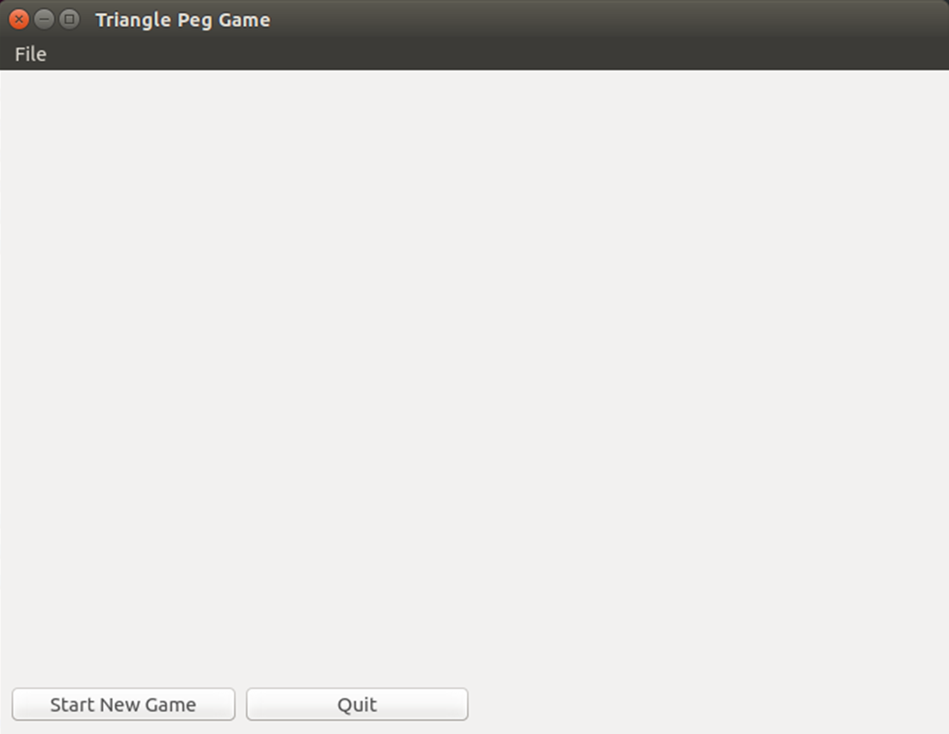
Grid layout
class PegGame(QtWidgets.QWidget): def __init__(self, parent): QtWidgets.QWidget.__init__(self, parent) self.setup() def setup(self): self.board = PegBoard(self) self.new_btn = StartNewGameBtn(self) self.quit_btn = QuitBtn(self) self.grid = QtWidgets.QGridLayout() self.setLayout(self.grid) self.grid.addWidget(self.board, 1, 1, 1, 4) self.grid.addWidget(self.new_btn, 2, 1, 1, 1) self.grid.addWidget(self.quit_btn, 2, 2, 1, 1)

Slide 20
PegBoard
So, what does the PegBoard look like so far?
class PegBoard(QtWidgets.QWidget): def __init__(self, parent): QtWidgets.QWidget.__init__(self, parent) self.setFixedSize(700, 460)
The parent we passed in was the PegGame instance that holds the PegBoard.
The setFixedSize(width, height) method gives us a convenient way to not only define a size for the PegBoard instance, but also set a lower bound on the size of the parent containers (PegGame and PegGameWindow).

Slide 21
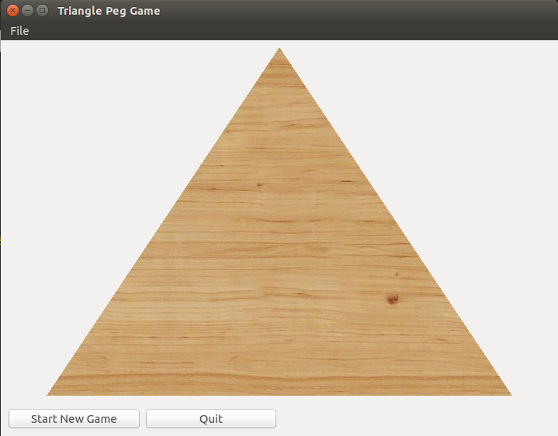
PegBoard
Here’s our first goal: let’s get a wooden triangle. To get this, we need to introduce the QPainter object.

Slide 22
QPainter
The QtGui.QPainter class performs low-level painting on any object that inherits the QtGui.QPaintDevice class (e.g. QWidget, QPixmap, QPicture).
The most basic usage involves creating a QPainter instance, calling the begin method with the QPaintDevice to which we will be painting, and then calling the end method.
qp = QtGui.QPainter() qp.begin(canvas) ... qp.end()

Slide 23
QPAinter
qp = QtGui.QPainter() qp.begin(canvas) ... qp.end()
So what can we do in those ellipses?
Manipulate settings
font(), brush(), pen() give you access to the tools used to draw. Return QFont, QBrush, and QPen objects.
Also setFont(font), setBrush(brush), setPen(pen).
Draw
drawEllipse(), drawPolygon(), drawImage(), drawLine(), drawPath(), drawPicture(), drawPie(), etc…
If you can dream it, you can draw it. ☺

Slide 24
QPainter
class PegBoard(QtWidgets.QWidget): def __init__(self, parent): QtWidgets.QWidget.__init__(self, parent) self.setFixedSize(700, 460) def paintEvent(self, event): points_list = [QtCore.QPoint(50,455), QtCore.QPoint(650,455), QtCore.QPoint(350,5)] triangle = QtGui.QPolygon(points_list) qp = QtGui.QPainter() qp.begin(self) qp.drawPolygon(triangle) qp.end()
First thing to notice is the method name we’re using: paintEvent. paintEvent is a method called automatically whenever the widget’s appearance is updated. This includes when we first show the widget, but also when we request an update.

Slide 25
QPainter
class PegBoard(QtWidgets.QWidget): def __init__(self, parent): QtWidgets.QWidget.__init__(self, parent) self.setFixedSize(700, 460) def paintEvent(self, event): points_list = [QtCore.QPoint(50,455), QtCore.QPoint(650,455), QtCore.QPoint(350,5)] triangle = QtGui.QPolygon(points_list) qp = QtGui.QPainter() qp.begin(self) qp.drawPolygon(triangle) qp.end()
We create a list of QPoint objects representing the vertices of our triangle.

Slide 26
QPainter
class PegBoard(QtWidgets.QWidget): def __init__(self, parent): QtWidgets.QWidget.__init__(self, parent) self.setFixedSize(700, 460) def paintEvent(self, event): points_list = [QtCore.QPoint(50,455), QtCore.QPoint(650,455), QtCore.QPoint(350,5)] triangle = QtGui.QPolygon(points_list) qp = QtGui.QPainter() qp.begin(self) qp.drawPolygon(triangle) qp.end()
Using these points, we initialize a QPolygon object representing our triangle.

Slide 27
QPainter
class PegBoard(QtWidgets.QWidget): def __init__(self, parent): QtWidgets.QWidget.__init__(self, parent) self.setFixedSize(700, 460) def paintEvent(self, event): points_list = [QtCore.QPoint(50,455), QtCore.QPoint(650,455), QtCore.QPoint(350,5)] triangle = QtGui.QPolygon(points_list) qp = QtGui.QPainter() qp.begin(self) qp.drawPolygon(triangle) qp.end()
Finally, we create our QPainter, make the PegBoard instance our QPaintDevice and draw the triangle!

Slide 28
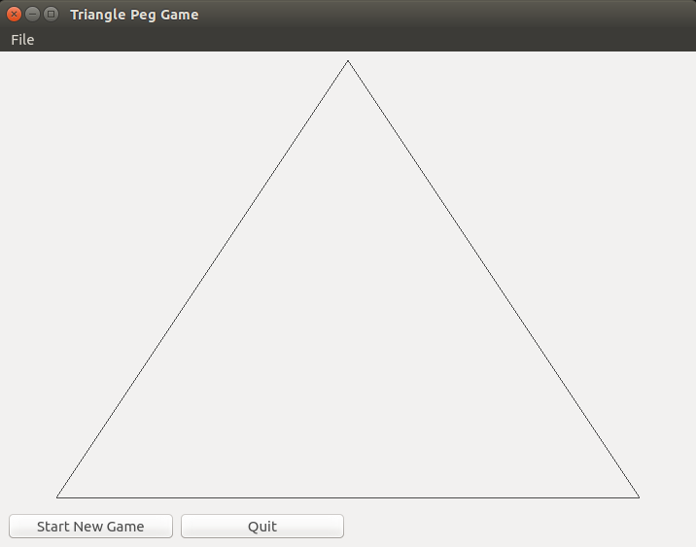
QPainter
class PegBoard(QtWidgets.QWidget): def __init__(self, parent): QtWidgets.QWidget.__init__(self, parent) self.setFixedSize(700, 460) def paintEvent(self, event): points_list = [QtCore.QPoint(50,455), QtCore.QPoint(650,455), QtCore.QPoint(350,5)] triangle = QtGui.QPolygon(points_list) qp = QtGui.QPainter() qp.begin(self) qp.drawPolygon(triangle) qp.end()

Slide 29
Qpainter
We want to make two changes: get rid of the black outline and apply a wood grain fill.
qp = QtGui.QPainter() qp.begin(self) pen = qp.pen() pen.setColor(QtCore.Qt.transparent) qp.setPen(pen) brush = QtGui.QBrush() brush.setTextureImage(QtGui.QImage('wood.jpg')) qp.setBrush(brush) qp.drawPolygon(triangle) qp.end()
Grab the curren QPen object, set the color to transparent, and reset Qpen object.
Create a new QBrush object, set the texture image to a local picture of some wood. Set the QBrush object.

Slide 30
QPAINTER
Ok, so what if we want a black background? Rather than drawing on the widget, that requires us to change the way the widget draws itself. Specifically, we’ll need to change the way the PegBoard widget displays.

Slide 31
QPalette
To do this, we need to introduce the idea of a QPalette. The QPalette class contains color groups for each widget state. It describes how the widget should render itself on the screen for each state.
A palette consists of three color groups: Active (keyboard focus), Disabled (not in focus), and Inactive (disabled). All widgets in Qt contain a palette and use their palette to draw themselves. QWidget’s palette() method returns the currently used QPalette object and setPalette(palette) allows you to reassign the QPalette object being used.

Slide 32
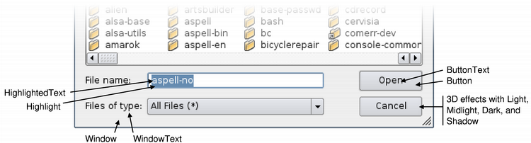
QPalette
For each state of a widget, there are many roles of which we need to describe the look and feel. Each role has an assigned color and brush.
Window
Background
WindowText
Foreground
Button
Etc.

Slide 33
QPalette
Colors and brushes can be set for particular roles in any of a palette's color groups with setColor() for color and setBrush()for color, style, and texture.
Calling, for example, backgroundRole() on a widget will return the current brush from the widget’s palette that is being used to draw the role. You can also get this, and any other brush, as palette.Background.

Slide 34
QPalette
Calling palette() on a QWidget object will return its currently associated QPalette. QPalette objects have a method setColor() which allows a ColorRole to be associated with a QColor. setAutoFillBackground toggles the filling in of the background, which is transparent by default.
class PegBoard(QtWidgets.QWidget): def __init__(self, parent): QtWidgets.QWidget.__init__(self, parent) self.setFixedSize(700, 460) p = self.palette() p.setColor(self.backgroundRole(), QtGui.QColor(0, 0, 0, 255)) self.setPalette(p) self.setAutoFillBackground(True)

Slide 35
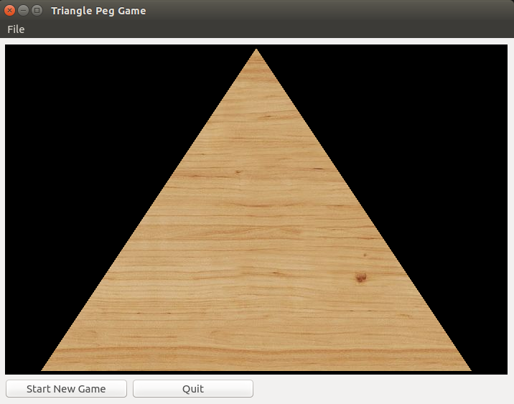
QPALETTE

Slide 36
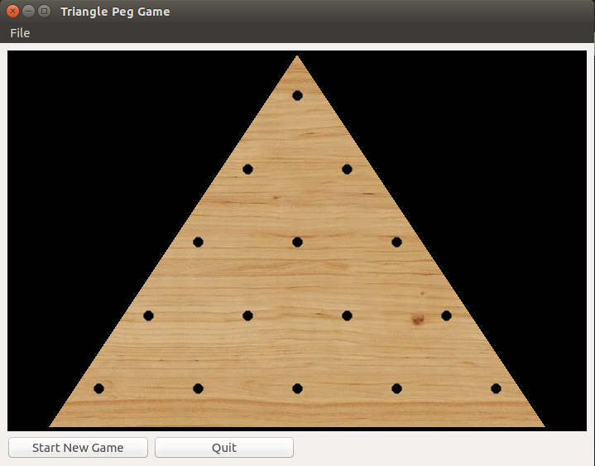
Adding to the Peg Board
Next is to add the peg holes to our peg board. We won’t merely draw some dark circles on the board – we will create PegHole objects that can contain Peg objects. But let’s just start with the PegHole definition.

Slide 37
Peg Holes
class PegHole(QtWidgets.QWidget): def __init__(self, parent): QtWidgets.QWidget.__init__(self, parent) self.grid = QtWidgets.QGridLayout() self.setLayout(self.grid) self.peg = None def paintEvent(self, event): qp = QtGui.QPainter() qp.begin(self) brush = QtGui.QBrush(QtCore.Qt.SolidPattern) qp.setBrush(brush) qp.drawEllipse(QtCore.QPointF(60, 45), 6, 6) qp.end() def minimumSizeHint(self): return QtCore.QSize(120, 90)
Radius = 6
90
120
Note that our background is actually transparent!

Slide 38
Peg Holes
Now, how do we place these things on our board? Start by creating a vertical box layout on the PegBoard.

Slide 39
Peg Holes
Now, add 5 horizontal box layouts to the vertical box layout.

Slide 40
Peg Holes
In each horizontal box layout, add: - a very stretchy spacer. - the PegHole objects. - another very stretchy spacer.

Slide 41
Peg Holes
class PegBoard(QtWidgets.QWidget): def __init__(self, parent): QtWidgets.QWidget.__init__(self, parent) self.setFixedSize(700, 460) p = self.palette() p.setColor(self.backgroundRole(), QtGui.QColor(0, 0, 0, 255)) self.setPalette(p) self.setAutoFillBackground(True) self.vbox = QtWidgets.QVBoxLayout() self.setLayout(self.vbox) self.vbox.setSpacing(0) self.place_holes()
Create a vertical box layout for the PegBoard instance. The setSpacing method allows us to manipulate the margins between widgets in the layout.

Slide 42
Peg Holes
def place_holes(self): for row in range(0,5): rowLayout = QtWidgets.QHBoxLayout() self.vbox.addLayout(rowLayout) rowLayout.addStretch(1) for col in range(0,row+1): hole = PegHole(self) rowLayout.addWidget(hole, 0) rowLayout.addStretch(1)

Slide 43
Pegs
class PegHole(QtWidgets.QWidget): def __init__(self, parent): QtWidgets.QWidget.__init__(self, parent) self.grid = QtWidgets.QGridLayout() self.setLayout(self.grid) self.peg = None
So, the next step is to create a Peg object. Keep in mind that PegHole objects are designed to house Peg objects and control their manipulation on the board.

Slide 44
Pegs
Radius = 10
90
class Peg(QtWidgets.QWidget): def __init__(self, parent): QtWidgets.QWidget.__init__(self, parent) self.resize(parent.size()) def paintEvent(self, event): qp = QtGui.QPainter() qp.begin(self) brush = QtGui.QBrush(QtCore.Qt.SolidPattern) brush.setColor(QtCore.Qt.red) qp.setBrush(brush) qp.drawEllipse(QtCore.QPointF(self.width()/2,self.height()/2),10,10) qp.end()
120
Size is changed to match PegHole size.

Slide 45
Pegs
Now, we add a method to our PegHole class which allows us to associate Peg instances with PegHole objects.
class PegHole(QtWidgets.QWidget): def __init__(self, parent): QtWidgets.QWidget.__init__(self, parent) self.grid = QtWidgets.QGridLayout() self.setLayout(self.grid) self.peg = None ... def addPeg(self): self.peg = Peg(self) self.grid.addWidget(self.peg)

Slide 46
PEGS
And finally, we extend our PegBoard.place_holes method to associate Pegs with PegHoles.
def place_holes(self): for row in range(0,5): rowLayout = QtWidgets.QHBoxLayout() self.vbox.addLayout(rowLayout) rowLayout.addStretch(1) for col in range(0, row+1): hole = PegHole(self) rowLayout.addWidget(hole, 0) if (row, col) != (2,1): hole.addPeg() rowLayout.addStretch(1)

Slide 47
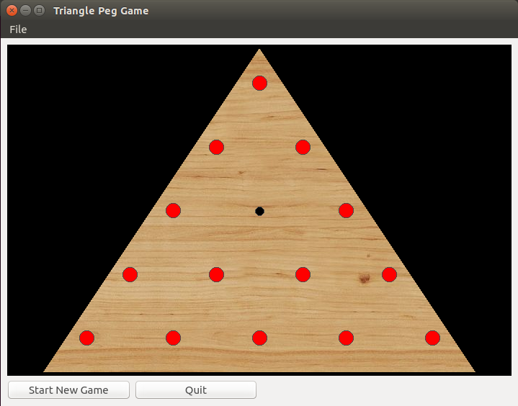
PeGS

Slide 48
Peg movement
Now, the hard part. How do we describe the mechanics of moving the pegs? How does a user interact with the game board? We aren’t going to concern ourselves with keeping score or enforcing legal movements yet. We just want to figure out how to move the pegs around.
The most natural mechanism is probably drag-and-drop. We should be able to “pick up” pegs, move them with the mouse, and “drop” them into an empty hole.

Slide 49
Drag and drop
Drag and drop, a commonly implemented GUI interaction mechanism, centers around the QDrag object.
The QDrag class supports MIME-based drag and drop transfer.
MIME (Multiple Internet Mail Extensions) is a system originally designed to package arbitrary attachments to email. But this system is also commonly used to package arbitrary data with a QDrag object so we can send it anywhere in the application.

Slide 50
Drag and drop
There are two parts to a drag and drop action to be considered: - The drag source. - The drop target.
Let’s start with our drag source, the PegHole object.

Slide 51
Drag source
A drag source is any object that creates a QDrag object when we interact with it. What does it mean to “interact”? Well, we could define it a couple of ways – here are some methods we could override to start a drag:
mousePressEvent(self, event)
Called when the mouse is pressed down.
mouseReleaseEvent(self, event)
Called when the mouse is released.
mouseMoveEvent(self, event)
Called when the mouse is pressed down and moved.

Slide 52
Drag Source
class PegHole(QtWidgets.QWidget): def __init__(self, parent): QtWidgets.QWidget.__init__(self, parent) self.grid = QtWidgets.QGridLayout() self.setLayout(self.grid) self.peg = None def mousePressEvent(self, event): if not self.peg: QtWidgets.QWidget.mousePressEvent(self, event) return drag = QtGui.QDrag(self) drag.setMimeData(QtCore.QMimeData()) dropAction = drag.exec_(QtCore.Qt.MoveAction)
Now, when we click on a PegHole object, we’ll start the process of dragging… but only if there is a Peg object associated!

Slide 53
Drag Source
class PegHole(QtWidgets.QWidget): def __init__(self, parent): QtWidgets.QWidget.__init__(self, parent) self.grid = QtWidgets.QGridLayout() self.setLayout(self.grid) self.peg = None def mousePressEvent(self, event): if not self.peg: QtWidgets.QWidget.mousePressEvent(self, event) return drag = QtGui.QDrag(self) drag.setMimeData(QtCore.QMimeData()) dropAction = drag.exec_(QtCore.Qt.MoveAction)
If there is no associated Peg object, simply call the basic mousePressEvent method and return.

Slide 54
Drag Source
class PegHole(QtWidgets.QWidget): def __init__(self, parent): QtWidgets.QWidget.__init__(self, parent) self.grid = QtWidgets.QGridLayout() self.setLayout(self.grid) self.peg = None def mousePressEvent(self, event): if not self.peg: QtWidgets.QWidget.mousePressEvent(self, event) return drag = QtGui.QDrag(self) drag.setMimeData(QtCore.QMimeData()) dropAction = drag.exec_(QtCore.Qt.MoveAction)
If there is a Peg object, then start a drag by instantiating a new QDrag object.

Slide 55
Drag Source
class PegHole(QtWidgets.QWidget): def __init__(self, parent): QtWidgets.QWidget.__init__(self, parent) self.grid = QtWidgets.QGridLayout() self.setLayout(self.grid) self.peg = None def mousePressEvent(self, event): if not self.peg: QtWidgets.QWidget.mousePressEvent(self, event) return drag = QtGui.QDrag(self) drag.setMimeData(QtCore.QMimeData()) dropAction = drag.exec_(QtCore.Qt.MoveAction)
Associate a QMimeData object. This is required, but your QMimeData object is not required to hold anything significant.

Slide 56
Drag Source
class PegHole(QtWidgets.QWidget): def __init__(self, parent): QtWidgets.QWidget.__init__(self, parent) self.grid = QtWidgets.QGridLayout() self.setLayout(self.grid) self.peg = None def mousePressEvent(self, event): if not self.peg: QtWidgets.QWidget.mousePressEvent(self, event) return drag = QtGui.QDrag(self) drag.setMimeData(QtCore.QMimeData()) dropAction = drag.exec_(QtCore.Qt.MoveAction)
Call the exec_() method on the QDrag object to start the drag and drop operation. This method returns a value indicating the drop action taken.

Slide 57
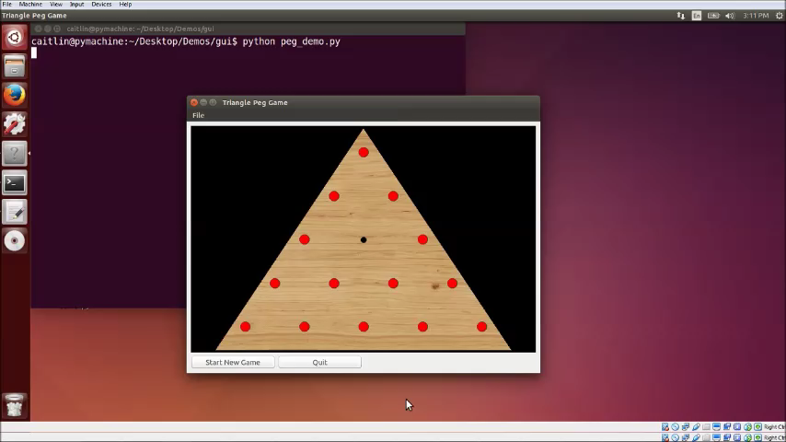
Drag Source
So, what happens now? Well, not much. We haven’t defined what it looks like to drag the Peg and we haven’t defined any drop targets. The only thing we can see for sure is that a drag event starts when the PegHole has an associated Peg, otherwise nothing happens.

Slide 58
Drop target
Now, let’s define a drop target. Since a PegHole is conceptually both the source of the Peg as well as the eventual destination of the Peg, we will also use a PegHole as our drop target. Drop targets have the following properties:
Sets self.setAcceptDrops(True).
Implements the dragEnterEvent(self, event) method.
Called when a drag enters the target’s area. Typically defined to either accept or reject the drag.
Implements the dropEvent(self, event) method.
Called when the user releases the mouse button, “dropping” on the target.

Slide 59
Drop Target
class PegHole(QtWidgets.QWidget): def __init__(self, parent): QtWidgets.QWidget.__init__(self, parent) self.setAcceptDrops(True) self.grid = QtWidgets.QGridLayout() self.setLayout(self.grid) self.peg = None def dragEnterEvent(self, event): event.acceptProposedAction() def dropEvent(self, event): if not self.peg: self.addPeg() event.accept() else: event.ignore()
Our PegHole now accepts drop requests
Allow the drag to enter the widget space and set the drop action to be whatever the QDrag object proposes (i.e. MoveAction).

Slide 60
Drop Target
class PegHole(QtWidgets.QWidget): def __init__(self, parent): QtWidgets.QWidget.__init__(self, parent) self.setAcceptDrops(True) self.grid = QtWidgets.QGridLayout() self.setLayout(self.grid) self.peg = None def dragEnterEvent(self, event): event.acceptProposedAction() def dropEvent(self, event): if not self.peg: self.addPeg() event.accept() else: event.ignore()
Accept the drop and add a new Peg object if there is not already a Peg object associated.

Slide 61
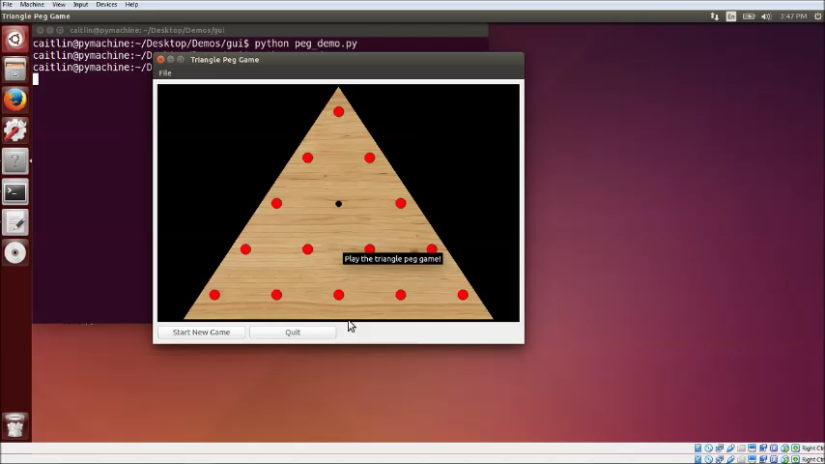
Drop Target
We can at least force a new Peg object to appear. But that does not delete the old Peg object nor describe what it means to drag from PegHole instance to PegHole instance.

Slide 62
Drag Source
def mousePressEvent(self, event): if not self.peg: QtWidgets.QWidget.mousePressEvent(self, event) return self.peg.hide() drag = QtGui.QDrag(self) drag.setMimeData(QtCore.QMimeData()) dropAction = drag.exec_(QtCore.Qt.MoveAction) if dropAction: del(self.peg) self.peg = None else: self.peg.show()
Back to the drag source….
Hide the peg temporarily
When “drop” happens, check whether drop was accepted or not. If so, delete Peg. Otherwise, show the Peg again.

Slide 63
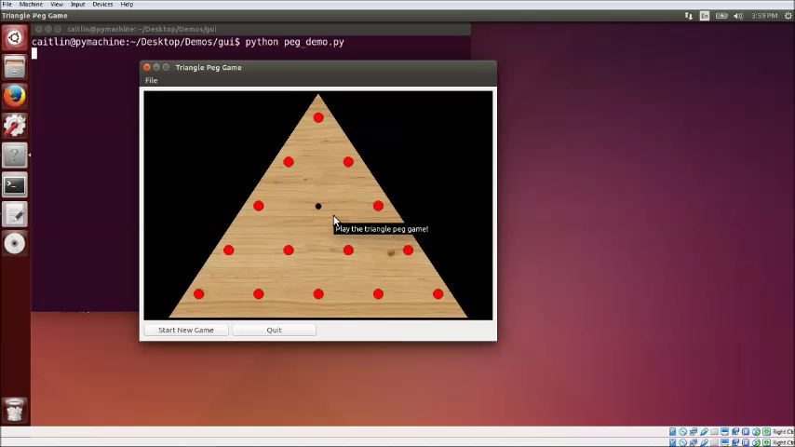
Drag and drop
Ok, once again!

Slide 64
Drag and Drop
def mousePressEvent(self, event): if not self.peg: QtWidgets.QWidget.mousePressEvent(self, event) return self.peg.hide() drag = QtGui.QDrag(self) drag.setMimeData(QtCore.QMimeData()) drag.setPixmap(self.peg_icon) drag.setHotSpot(self.peg_icon.rect().topLeft()) dropAction = drag.exec_(QtCore.Qt.MoveAction) if dropAction: del(self.peg) self.peg = None else: self.peg.show()
But wouldn’t it be so nice to see the Peg move?
We’ll create an icon of the Peg and associate it with the QDrag object.

Slide 65
Drag and drop
class PegHole(QtWidgets.QWidget): def __init__(self, parent): QtWidgets.QWidget.__init__(self, parent) self.setAcceptDrops(True) self.grid = QtWidgets.QGridLayout() self.setLayout(self.grid) self.peg = None self.create_icon() def create_icon(self): self.peg_icon = QtGui.QPixmap(22, 22) self.peg_icon.fill(QtCore.Qt.transparent) qp = QtGui.QPainter() qp.begin(self.peg_icon) brush = QtGui.QBrush(QtCore.Qt.SolidPattern) brush.setColor(QtCore.Qt.red) qp.setBrush(brush) qp.drawEllipse(0, 0, 20, 20) qp.end()
Now we have an icon that represents what a Peg looks like visually. This is the visual we’ll associate with the drag so that our user feels like they’re moving the object in space.

Slide 66
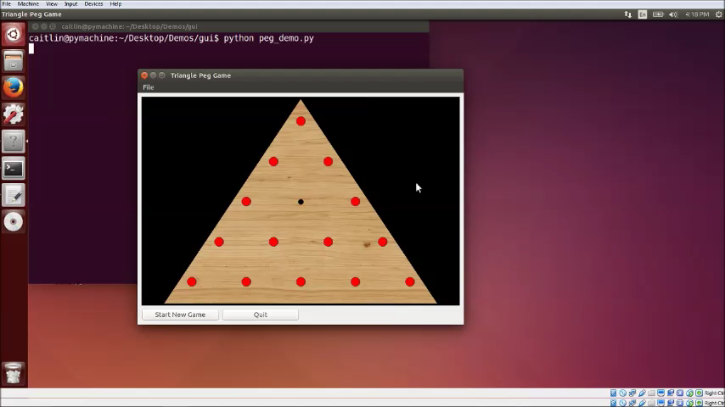
Drag and drop

Slide 67
Enforcing rules
So, we have the mechanics of movement. Now, all we need to do is enforce some rules. This comes down to two checks:
Make sure destination is valid.
Make sure “hopped” hole contains a Peg to be removed.
We’re going to use the MIME mechanism to send information about our drag source to our drop target – this will help us decide whether to accept or not.

Slide 68
Checking destination
class PegBoard(QtWidgets.QWidget): def __init__(self, parent): QtWidgets.QWidget.__init__(self, parent) self.holes = [] ... self.place_holes() self.peg_count = len(self.holes)- 1 def place_holes(self): for row in range(0,5): row_list = [] ... for col in range(0,row+1): hole = PegHole(self, row, col) ... rowLayout.addStretch(1) self.holes.append(row_list[:])
We first extend the PegHole class definition to accept its position as an argument. We pass in the row and column where it is placed on the board. Furthermore, the PegBoard now maintains a list of its child widgets and an associated counter

Slide 69
Checking destination
def mousePressEvent(self, event): if not self.peg: QtWidgets.QWidget.mousePressEvent(self, event) return self.peg_icon = self.create_icon() self.peg.hide() drag = QtGui.QDrag(self) data = QtCore.QMimeData() data.setText(pickle.dumps((self.row, self.col))) drag.setMimeData(data) drag.setPixmap(self.peg_icon) drag.setHotSpot(self.peg_icon.rect().topLeft()) dropAction = drag.exec_(QtCore.Qt.MoveAction) ...
The QMimeData object associated with the QDrag object will now house some information – a pickled string holding the source’s coordinates.

Slide 70
Checking destination
def dropEvent(self, event): if not self.peg: row, col = pickle.loads(event.mimeData().text()) if(self.check_valid(row, col)): self.addPeg() event.accept() else: event.ignore() else: event.ignore()
Only accept the drop request if the destination does not have a Peg and the source of the drag is valid.

Slide 71
Enforcing rules
def check_valid(self, row, col): hopped = None # Calculate coordinates of skipped peg # and store as hopped if not hopped: return False if(self.parent.holes[hopped[0]][hopped[1]].peg): self.parent.holes[hopped[0]][hopped[1]].deletePeg() self.parent.peg_count -= 1 return True else: return False

Slide 72
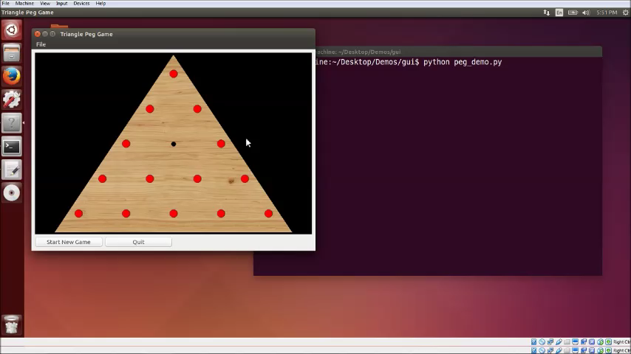
Enforcing rules

Slide 73
Further reading
Check out this link for a little tutorial on custom widgets.
Check out this link for a small tetris game demo.
Very thorough PyQt source here.

