Slide 1
Lecture 7
The Standard Library Part 1:
Built-ins, time, sys, and os

Slide 2
The Python language
Believe it or not, you now have all the Python syntax and structures you need already. At this point, we can turn our attention to writing applications in Python. There will still be some points to be made about the Python language as we continue the course, but they will be brought to your attention when they come up.
For now, let’s start by learning some of the libraries that every Python programmer must know.

Slide 3
The Python standard library
The Python Standard Library is a collection of modules that are distributed with every Python installation. It is a vast assortment of useful tools and interfaces, which covers a very wide range of domains. Besides the standard library, there is also the Python Package Index (PyPI), the official third-party repository for everything from simple modules to elaborate frameworks written by other Python programmers. As of right now, there are 60,660 81,341 98,609 packages in PyPI.
We will start by spending the next couple of lectures covering the most commonly used modules in the standard library. Then, we will spend the rest of the semester covering widely-used third party packages.

Slide 4
Standard Library: built-ins
We’ve already learned about a lot of data types – such as numbers and lists – which are part of the “core” of Python. That is, you don’t need to import anything to use them. However, it’s the standard library that actually defines these types, as well as many other built-in components.
We’ve already learned all about the built-in data types so we won’t re-cover that material but we’ll start by looking at what other “built-ins” are defined by the standard library.

Slide 5
Standard library: built-in constants
There are a few built-in constants defined by the standard library:
True: true value of a bool type.
False: false value of a bool type.
a = True b = False if a is True: print "a is true." else: print "a is false" if b is True: print "b is true." else: print "b is false."

Slide 6
Standard library: built-in constants
None: used to represent the absence of a value. Similar to the null keyword in many other languages.
conn = None try: database = MyDatabase(db_host, db_user, db_password, db_database) conn = database.connect() except DatabaseException: pass if conn is None: print('The database could not connect') else: print('The database could connect')

Slide 7
Standard library: built-in constants
NotImplemented: returned when a comparison operation is not defined between two types. This constant is meant to be used in conjunction with “rich comparison” methods, __lt__(), __eq__(), etc. Behind the scenes, when we execute the following statement:
Python is really executing this statement:
The NotImplemented constant allows us to indicate that a does not have __lt__() defined for b’s type, so perhaps we should try calling b’s __ge__() method with a as an argument.
>>> a < b
>>> a.__lt__(b)

Slide 8
Standard library: built-in constants
class A: def __init__(self, value): self.value = value def __eq__(self, other): if isinstance(other, B): print('Comparing an A with a B') return other.value == self.value print('Could not compare A with other') return NotImplemented class B: def __init__(self, value): self.value = value def __eq__(self, other): print('Could not compare B with other') return NotImplemented
>>> a = A(2) >>> b = B(2) >>> a == b # a.__eq__(b) Comparing an A with a B True >>> b == a # b.__eq__(a) Could not compare B with other Comparing an A with a B True

Slide 9
Standard library: built-in constants
Ellipsis: for custom use in extended slicing syntax (not used by any built-in function).
>>> class TwoDimList: def __init__(self, data): self.data = data def __getitem__(self, item):
if item is Ellipsis:
return [x[i] for i in range(len(x)) for x in self.data]
else:
return self.data[item]
>>> x = TwoDimList([[1,2,3],[4,5,6],[7,8,9]]) >>> x[0] # x.__getitem__(0) [1, 2, 3] >>> x[...] [1, 2, 3, 4, 5, 6, 7, 8, 9]

Slide 10
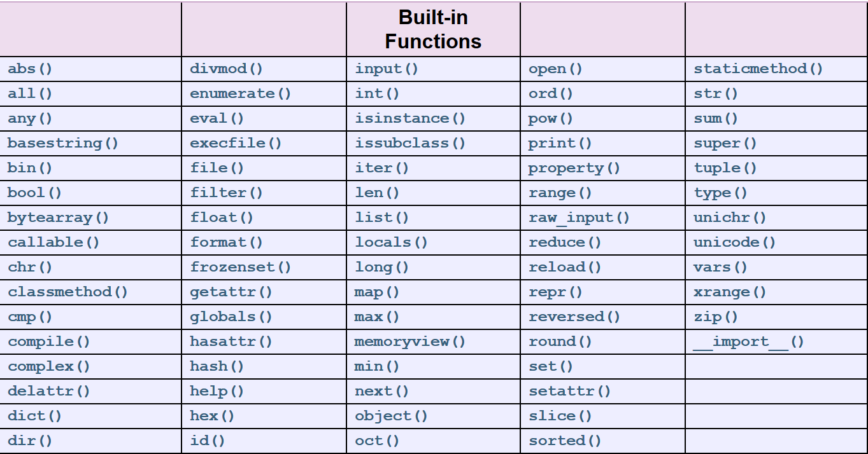
Standard library: built-in functions
There are a huge number of built-in functions which are always available. We’ve seen a good number of these already and most of them are “manual” calls for actions typically done another way.

Slide 11
Standard library: time
The time module is responsible for providing time-related functions and conversion methods. You can obtain access to time’s methods and attributes with the import time statement.
The most commonly used methods are:
time.time() – returns the time in seconds since the epoch (typically 1/1/1970).
time.sleep(s) – suspends execution for s seconds.
time.clock() – returns the current processor time in seconds.

Slide 12
Standard library: time
>>> import time >>> def timer(): ... s = time.time() ... time.sleep(5) ... e = time.time() ... print (e-s) >>> def cpu_timer(): ... s = time.clock() ... time.sleep(5) ... e = time.clock() ... print (e-s) >>> timer() 5.00614309311 >>> cpu_timer() 0.000121
Here, we create two small timing functions which measure time passed over a call to time.sleep(). The time.time() method simply measures elapsed wall clock time.
The time.clock() method, however, only measures time during which the CPU is actively working on behalf of the program. When we sleep, we are suspending the program for some time so the CPU is not active during the sleeping time.

Slide 13
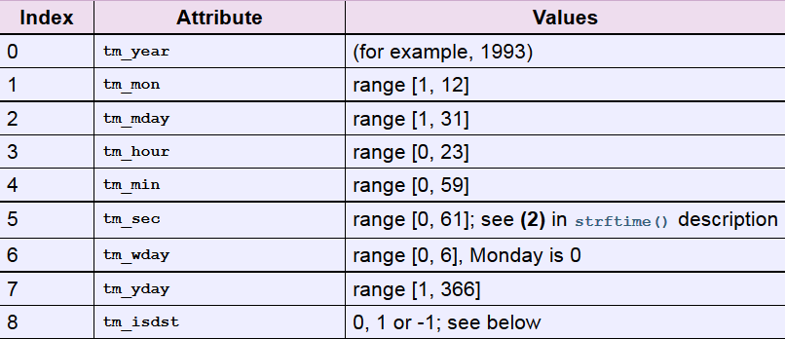
Standard library: time
There are some additional useful time methods but they all depend on the struct_time class so we’ll cover that first. The struct_time class is also defined in the time module. It is a class which simply has 9 attributes for describing a particular time.

Slide 14
Standard library: time
The struct_time class is unique in that it uses a named tuple interface. You can access the attributes of the class using either the attribute name (e.g. t.tm_year) or an index (e.g. t[0]).
The time.strftime(format[, t])method can be used to convert a struct_time object t into a readable format. A table of the possible format string arguments is found here.

Slide 15
Standard library: time
time.asctime([t]) – converts a struct_time object t into a specific formatted output string. If t is not provided, the current time is used.
time.gmtime([s]) – converts a time expressed in seconds s since the epoch to a struct_time object in UTC. If s is not provided, time.time()is used.
time.localtime([s]) – like time.gmtime([s]), but converts to a local time.
time.mktime(t) – inverse of time.localtime([s]). Converts a struct_time object t in local time to seconds since the epoch.

Slide 16
Standard library: time
>>> time.time() 1433264623.282071 >>> time.gmtime() time.struct_time(tm_year=2015, tm_mon=6, tm_mday=2, tm_hour=17, tm_min=3, tm_sec=58, tm_wday=1, tm_yday=153, tm_isdst=0) >>> time.localtime() time.struct_time(tm_year=2015, tm_mon=6, tm_mday=2, tm_hour=13, tm_min=4, tm_sec=8, tm_wday=1, tm_yday=153, tm_isdst=1) >>> time.asctime(time.localtime()) 'Tue Jun 2 13:05:00 2015' >>> time.strftime("%A, %B %d, %Y",time.localtime()) 'Tuesday, June 02, 2015'

Slide 17
Standard library: sys
The sys module provides access to some variables used or maintained by the interpreter as well as some methods for interacting with the interpreter. It allows you to receive information about the runtime environment as well as make modifications to it.
To use the sys module, just execute the import sys statement.

Slide 18
Standard library: sys
As we’ve already seen, one of the most common ways to use the sys module is to access arguments passed to the program. This is done with the sys.argv list.
The first element of the sys.argv list is always the module name, followed by the whitespace-separated arguments.
import sys for i in range(len(sys.argv)): print "sys.argv[" + str(i) + "] is " + sys.argv[i] $ python testargs.py here are some arguments sys.argv[0] is testargs.py sys.argv[1] is here sys.argv[2] is are sys.argv[3] is some sys.argv[4] is arguments

Slide 19
Standard library: sys
The sys.path variable specifies the locations where Python will look for imported modules. The sys.path variable is also a list and may be freely manipulated by the running program. The first element is always the “current” directory where the top-level module resides.
import sys print "path has", len(sys.path), "members" sys.path.insert(0, "./samples") import sample sys.path = [] import math
$ python systest.py
path has 8 members
Hello from the sample module!
Traceback (most recent call last):
File "systest.py", line 9, in ?
import math
ImportError: No module named math

Slide 20
Standard library: sys
Note that there are some modules that are always available to the interpreter because they are built-in. The sys module is one of them. Use sys.builtin_module_names to see which modules are built-in.
import sys print "path has", len(sys.path), "members" sys.path.insert(0, "./samples") import sample sys.path = [] import math
$ python systest.py
path has 8 members
Hello from the sample module!
Traceback (most recent call last):
File "systest.py", line 9, in ?
import math
ImportError: No module named math

Slide 21
Standard library: sys
The sys.modules dictionary contains all of the modules currently imported.
The sys.platform attribute gives information about the operating system.
>>> import sys >>> sys.modules.keys() ['copy_reg', 'sre_compile', '_sre', 'encodings', 'site', '__builtin__', 'sysconfig', '__main__', 'encodings.encodings', 'math', 'abc', 'posixpath', '_weakrefset', 'errno', 'encodings.codecs', 'sre_constants', 're', '_abcoll', 'types', '_codecs', 'encodings.__builtin__', '_warnings', 'encodings.latin_1', 'genericpath', 'stat', 'zipimport', '_sysconfigdata', 'warnings', 'UserDict', 'sys', 'codecs', 'readline', 'os.path', 'signal', 'traceback', 'linecache', 'posix', 'encodings.aliases', 'exceptions', 'sre_parse', 'os', '_weakref']
>>> sys.platform 'linux2'

Slide 22
Standard library: sys
The sys.version attribute provides information about the interpreter including version, build number, and compiler used. This string is also displayed when the interpreter is started.
$ python Python 2.7.5 (default, Oct 5 2013, 01:47:54) [GCC 3.4.3 20041212 (Red Hat 3.4.3-9.EL4)] on linux2

Slide 23
Standard library: sys
The sys.stdin, sys.stdout, and sys.stderr attributes hold the file objects corresponding to standard input, standard output, and standard error, respectively. Just like every other attribute in the sys module, these may also be changed at any time! If you want to restore the standard file objects to their original values, use the sys.__stdin__, sys.__stdout__, and sys.__stderr__ attributes.
f = open("somefile.txt", "w") sys.stdout = f print "This is going to be written to the file!" sys.stdout = sys.__stdout__

Slide 24
Standard library: sys
The sys.exit([status])function can be used to exit a program gracefully. It raises a SystemExit exception which, if not caught, will end the program.
The optional argument status can be used to indicate a termination status. The value 0 indicates a successful termination, while an error message will print to stderr and return 1.
The sys module also defines a sys.exitfunc attribute. The function object specified by this attribute is used to perform “cleanup actions” before the program terminates.

Slide 25
Standard library: OS
The os module provides a common interface for operating system dependent functionality. Most of the functions are actually implemented by platform-specific modules, but there is no need to explicitly call them as such.

Slide 26
Standard library: OS
We’ve already seen how the os module can be used to work with files. We know that there are built-in functions to open and close files but os extends file operations.
os.rename(current_name, new_name) renames the file current_name to new_name.
os.remove(filename) deletes an existing file named filename.

Slide 27
Standard library: OS
>>> os.listdir("demos") ['frac.py', 'dogs.py', 'csv_parser.py'] >>> os.listdir(".") ['lect5.py', 'demos', 'lect3.py'] >>> os.getcwd() '/home/faculty/carnahan/CIS4930' >>> os.chdir(os.getcwd() + "/demos") >>> os.getcwd() '/home/faculty/carnahan/CIS4930/demos' >>> os.rename("dogs.py", "cats.py") >>> os.listdir(".") ['frac.py', 'cats.py', 'csv_parser.py'] >>> os.remove("cats.py") >>> os.listdir(".") ['frac.py', 'csv_parser.py']
There are also a number of directory services provided by the os module.
os.listdir(dirname) lists all of the files in directory dirname.
os.getcwd() returns the current directory.
os.chdir(dirname) will change the current directory.

Slide 28
Standard library: OS
Use os.mkdir(dirname) and os.rmdir(dirname) to make and remove a single directory.
Use os.makedirs(path/of/dirs) and os.removedirs(path/of/dirs) to make and remove a hierarchy of directories.
Make sure directories are empty before removal!

Slide 29
Standard library: OS
>>> os.makedirs("dir1/dir2/dir3") >>> os.listdir(".") ['frac.py', 'dir1', 'csv_parser.py'] >>> f = open("dir1/dir2/dir3/test", "w") >>> f.write("hi!") >>> f.close() >>> for line in open("dir1/dir2/dir3/test", "r"): ... print line ... hi! >>> os.remove("dir1/dir2/dir3/test") >>> os.removedirs("dir1/dir2/dir3") >>> os.listdir(".") ['frac.py', 'csv_parser.py']

Slide 30
Standard library: OS
The os.walk(path) method will generate a tuple (dirpath, dirnames, filenames) for each directory found by traversing the directory tree rooted at path.
>>> os.makedirs("dir1/dir2/dir3") >>> os.listdir(".") ['frac.py', 'dir1', 'football.csv', 'csv_parser.py'] >>> os.mkdir("dir1/dir2/dir4") >>> f = open("dir1/dir2/d2file", "w") >>> f = open("dir1/dir2/dir3/d3file", "w") >>> f = open("dir1/dir2/dir4/d4file", "w") >>> path = os.getcwd() >>> for (path, dirs, files) in os.walk(path): ... print "Path: ", path ... print "Directories: ", dirs ... print "Files: ", files ... print "---"

Slide 31
Standard library: OS
Path: /home/faculty/carnahan/CIS4930/demos
Directories: ['dir1']
Files: ['frac.py','football.csv','csv_parser.py']
---
Path: /home/faculty/carnahan/CIS4930/demos/dir1
Directories: ['dir2']
Files: []
---
Path: /home/faculty/carnahan/CIS4930/demos/dir1/dir2
Directories: ['dir4', 'dir3']
Files: ['d2file']
---
Path: /home/faculty/carnahan/CIS4930/demos/dir1/dir2/dir4
Directories: []
Files: ['d4file']
---
Path: /home/faculty/carnahan/CIS4930/demos/dir1/dir2/dir3
Directories: []
Files: ['d3file']
---
The os.walk(path) method will generate a tuple (dirpath, dirnames, filenames) for each directory found by traversing the directory tree rooted at path.

Slide 32
Standard library: OS
The os module includes an os.stat(path) method which will return file attributes related to the path provided (equivalent to stat() system call). Result is a stat structure which includes
st_size: size of file in bytes.
st_atime: time of most recent access.
st_uid: user id of owner.
st_nlink: number of hard links.
>>> import os >>> stat_info = os.stat("football.csv") >>> stat_info posix.stat_result(st_mode=33216, st_ino=83788199L, st_dev=20L, st_nlink=1, st_uid=87871, st_gid=300, st_size=648L, st_atime=1422387494, st_mtime=1421257389, st_ctime=1421257413) >>> stat_info.st_mtime 1421257389.0

Slide 33
Os services
The os.system(cmd) function executes the argument cmd in a subshell. The return value is the exit status of the command.
>>> os.system("ls") csv_parser.py dir1 football.csv frac.py 0 >>> os.system("touch newfile.txt") 0 >>> os.system("ls") csv_parser.py dir1 football.csv frac.py newfile.txt 0

Slide 34
Standard library: OS
The os.exec(path, args) function will start a new process from path using the args as arguments, replacing the current one. Alternatives include os.execve(), os.execvp(), etc as usual. Arguments depend on version used.
$ python2.7 Python 2.7.5 (default, Oct 5 2013, 01:47:54) [GCC 3.4.3 20041212 (Red Hat 3.4.3-9.EL4)] on linux2 Type "help", "copyright", "credits" or "license" for more information. >>> import os >>> os.execvp("python2.7", ("python2.7", "csv_parser.py")) Aston_Villa has a minimum goal difference of 1 $

Slide 35
Standard library: OS
Combine the os.exec*() functions with os.fork() and os.wait() to spawn processes from the current process. The former makes a copy of the current process, the latter waits for a child process to finish. Use os.spawn() on Windows.
import os import sys pid = os.fork() if not pid: os.execvp("python2.7", ("python2.7", "csv_parser.py")) os.wait()

