Slide 1
КУРСОВАЯ РАБОТА по дисциплине
Системы управления базами данных
Тема
АИС подписного пункта
Ипполитова А.И. ПИН-122

Slide 2
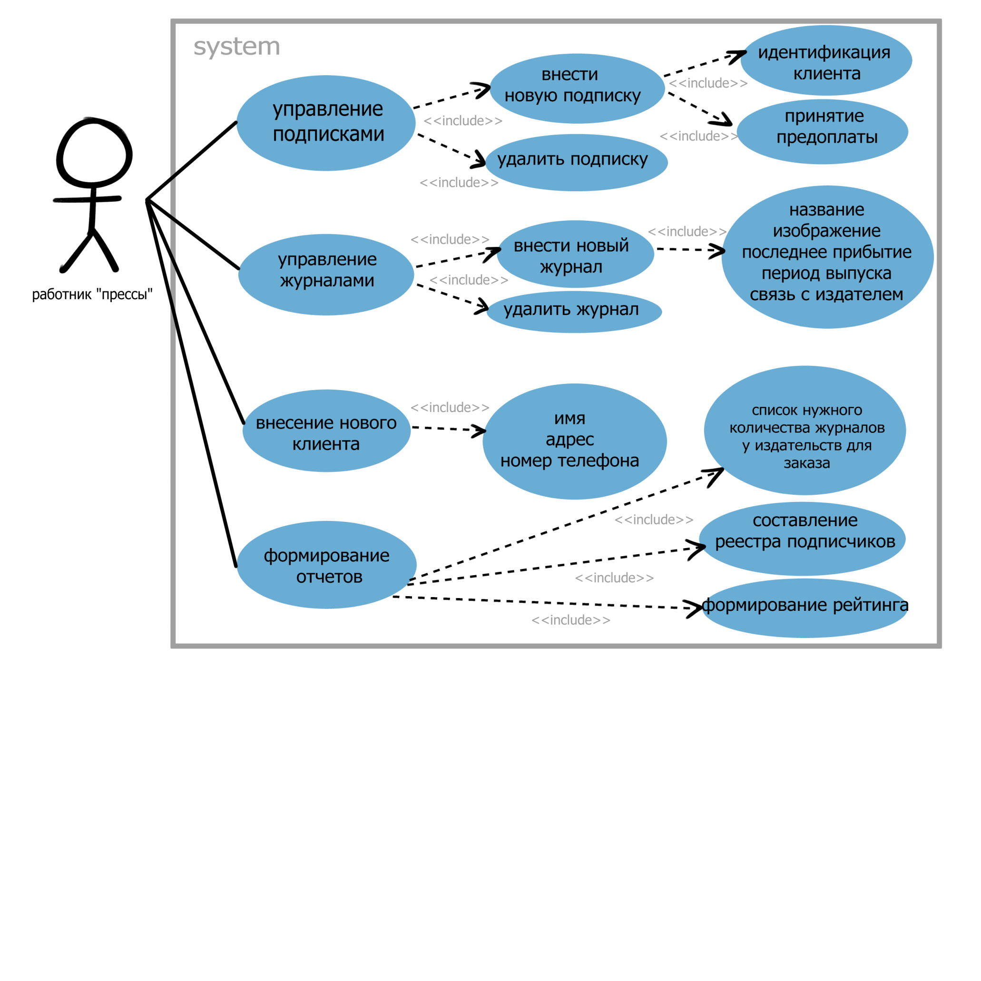
Концептуальная модель системы

Slide 3
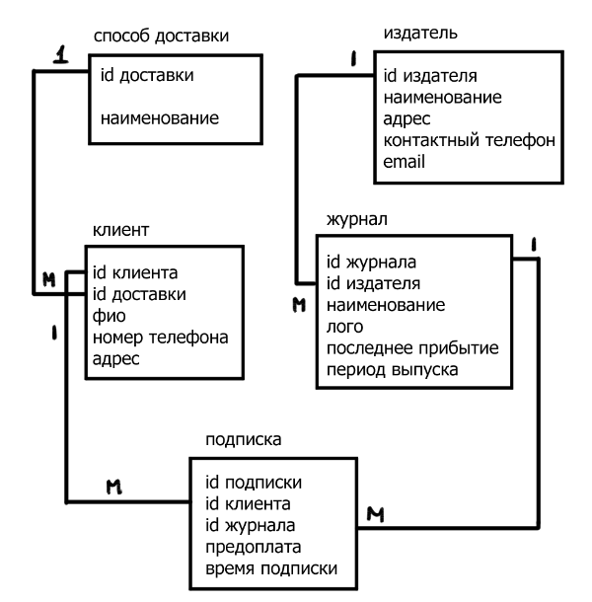

Slide 4
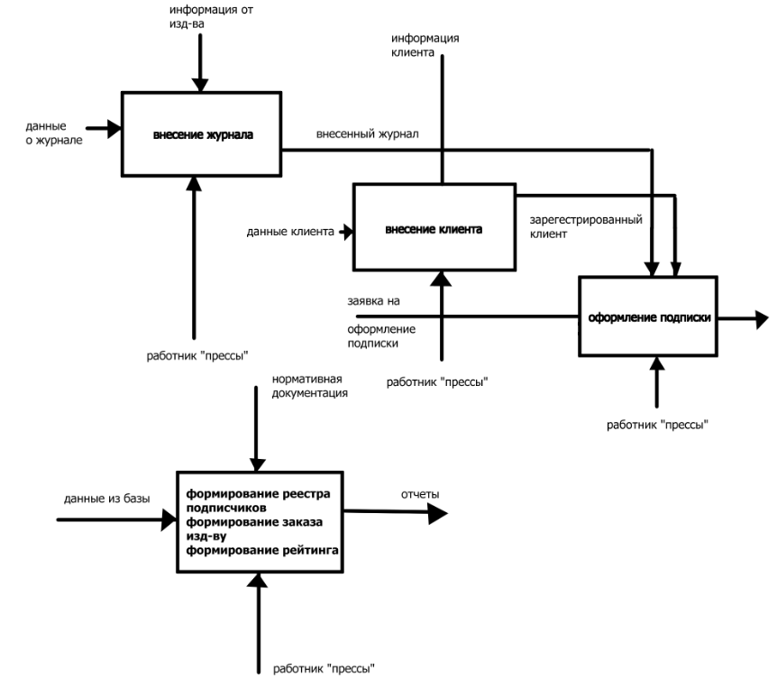

Slide 5
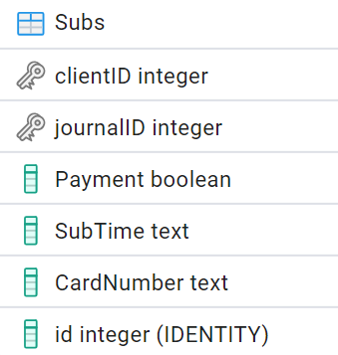
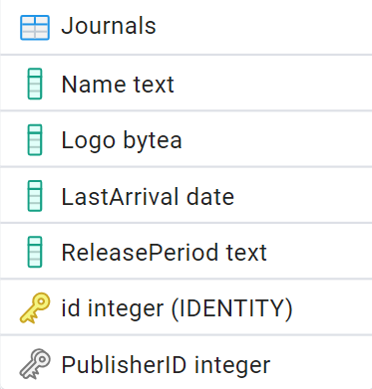
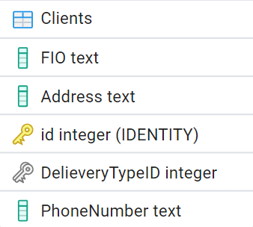
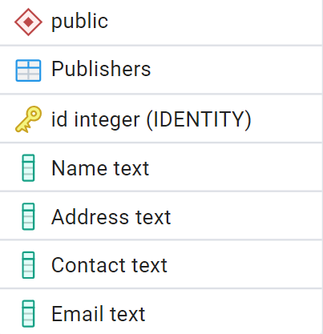
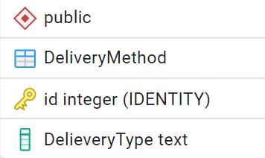

Slide 6
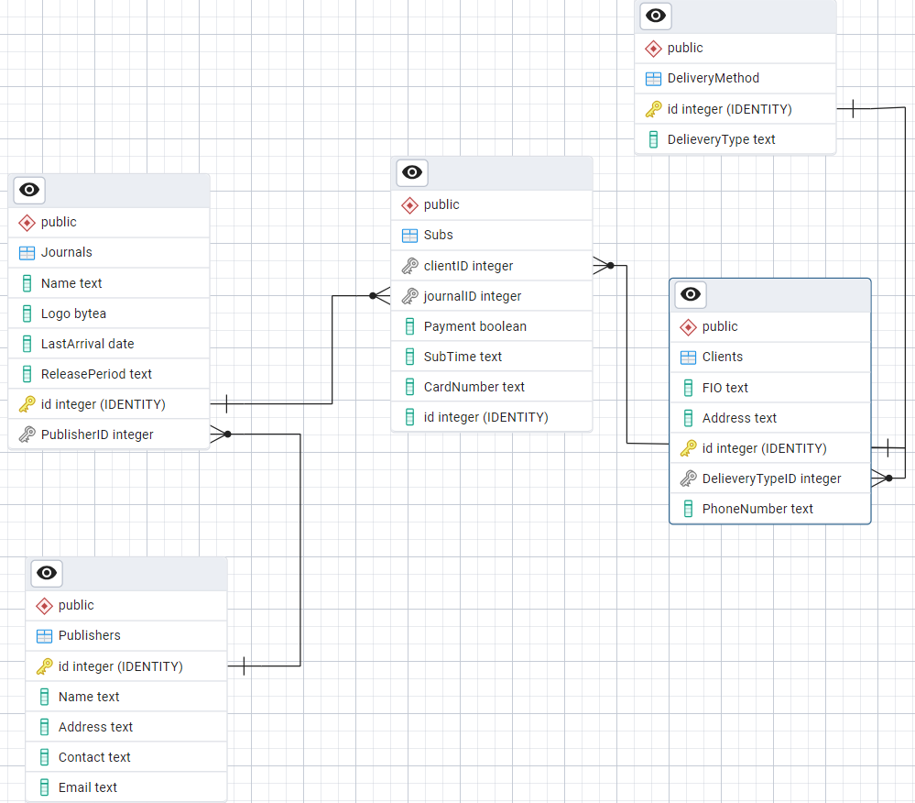

Slide 7
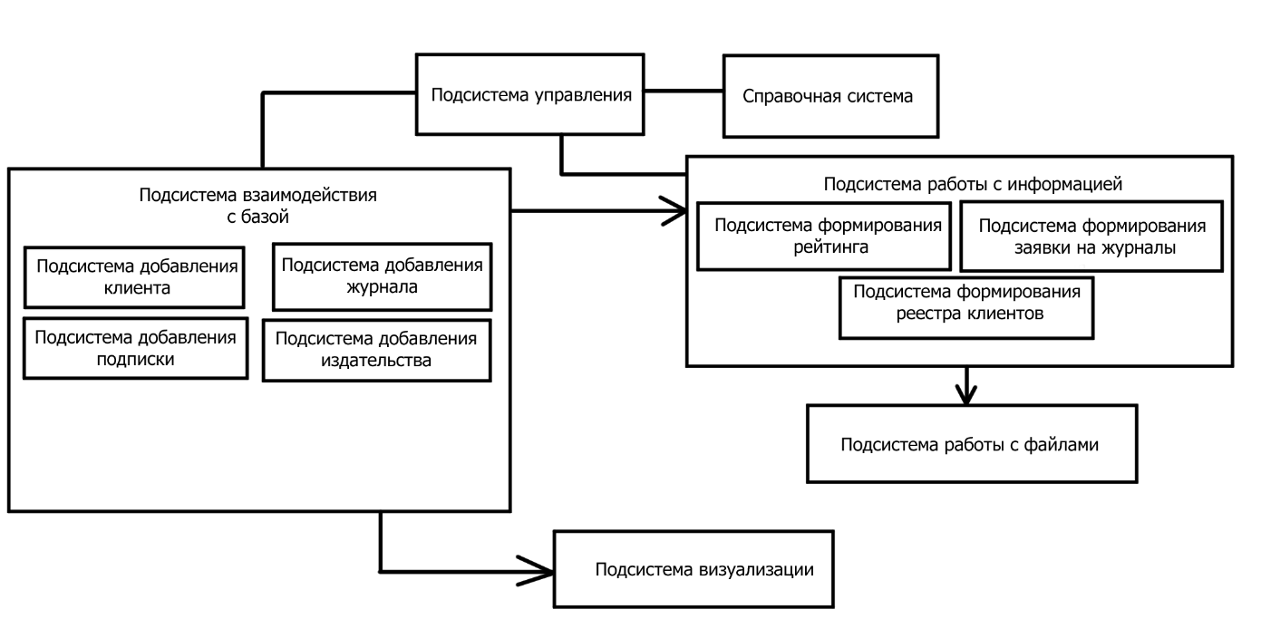

Slide 8
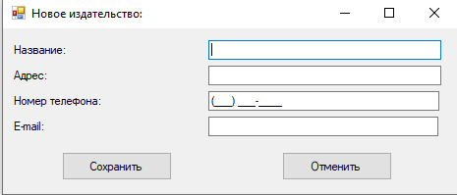
"INSERT INTO public.\"Publishers\" (\"Name\", \"Address\", \"Contact\", \"Email\") " +
"VALUES (@Name, @Address, @Contact, @Email)"

Slide 9
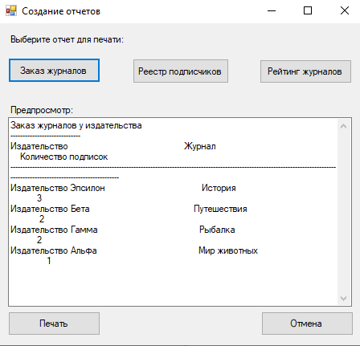
SELECT
p.""Name"" AS ""Издательство"",
j.""Name"" AS ""Журнал"", COUNT
(s.""journalID"") AS ""Количество подписок""
FROM
public.""Subs"" s
JOIN
public.""Journals"" j ON s.""journalID"" = j.id
JOIN
public.""Publishers"" p ON j.""PublisherID"" = p.id
GROUP BY
p.""Name"", j.""Name""
ORDER BY
COUNT(s.""journalID"") DESC;

Slide 10
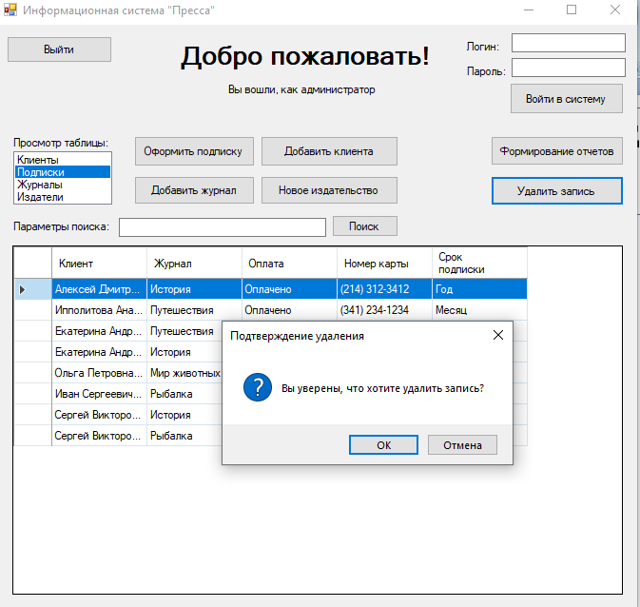
"DELETE FROM public.{currentTable} WHERE id = @id"

Slide 11
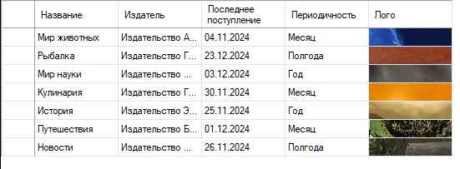
if (tableName == "\"Journals\"") { return
@"SELECT j.id,
j.""Name"" AS ""Название"",
p.""Name"" AS ""Издатель"",
j.""LastArrival"" AS ""Последнее поступление"",
j.""ReleasePeriod"" AS ""Периодичность"",
j.""Logo"" AS ""Лого""
FROM public.""Journals"" j
JOIN public.""Publishers"" p
ON j.""PublisherID"" = p.id;";
}

