Slide 1



基於私密分享之保有隱私授權 深度神經網路分類於雙雲架構 Privacy-preserving Outsourced Deep Neural Network Dual-cloud Training using Secret Sharing
學生: 陳柏嘉
指導教授: 張經略 博士
陳昱圻 博士
Notes:
基於私密分享之保有隱私授權深度神經網路分類於雙雲架構

Slide 2
Outline
Introduction
Related works
Preliminaries
Proposed method
Discussions
Conclusions
Notes:
首先，我們介紹研究背景，然後講解一些相關的保有隱私訓練的做法。
然後，在介紹本篇論文提出的架構之前，會先說明一下預備知識。
最後，進行正確性與安全性的分析，展示實驗結果，並總結。

Slide 3
Outline
Introduction
Related works
Preliminaries
Proposed method
Discussions
Conclusions

Slide 4
Research Background
AI app base on DNN:
face recognition, natural language processing, object detection, object classification ... etc.
The more data in training are well-prepared, the more powerful model can be generated.
Massive data are collected from many different organizations.
Model trainer can’t “directly” collect user information, and use it in model training.
Notes:
因為硬體的進步，基於DNN的AI應用在各領域已被廣泛應用。如：臉部辨識、自然語言處理、…等等
2. 基於DNN的AI模型有一個特性，就是資料及的數量與品質。越大量、越精細，訓練出來的模型強度就越高。
3. 大量的資料會從不同的機構 (或是個體) 收集而來， (Hint：資料提供者為複數單位)
如：Facebook, Twitter, Youtube … 等等社交媒體，為了提升用戶體驗，會收集用戶的個人資料與活動紀錄，以便更準確地向用戶推薦內容。
如：若要建立疾病診斷系統，會從各大醫院蒐集病歷資料。
4. 因此在資料的收集就產生了隱私的問題。

Slide 5
Outline
Introduction
Related works
Preliminaries
Proposed method
Discussions
Conclusions
Notes:
這邊介紹兩個保有隱私手段

Slide 6
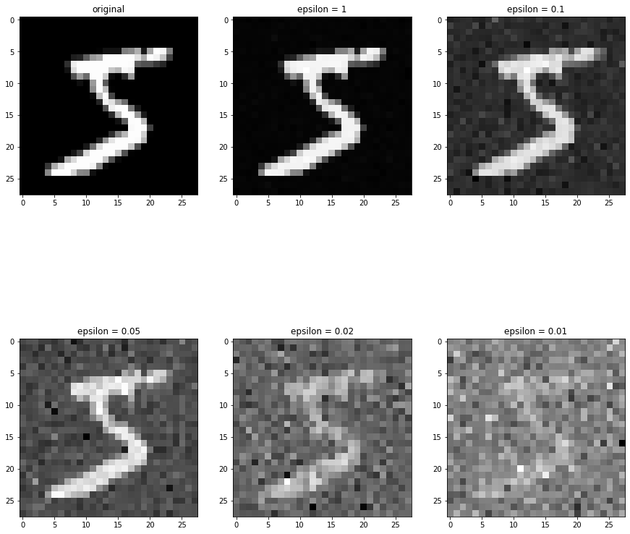
Differential Privacy
Data security depends on privacy budget.
Noise ↑, Data security ↑, Utility ↓, Model Accuracy ↓
Notes:
差分隱私是一個蠻熱門的保有隱私手段，最大的好處是不會因為一些加密手段造成計算上的困難。
但缺點也顯而易見，其安全性取決於其隱私預算，越高的安全性則犧牲越多的可用性，會一定程度影響模型的準確率。
(可能一些重要的feature也被DP混淆了。)

Slide 7
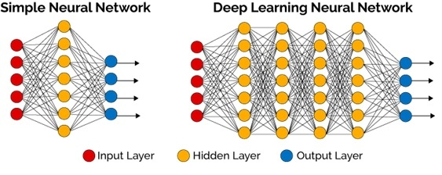
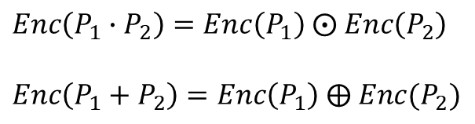
Homomorphic Encryption
High computing cost, high storage cost.
It is an impractical solution in multi-layer DNN learning.
$Enc\left(P_{1}∙P_{2}\right)=Enc\left(P_{1}\right) ⨀ Enc\left(P_{2}\right)$
$Enc\left(P_{1}+P_{2}\right)=Enc\left(P_{1}\right) ⨁ Enc(P_{2})$
Notes:
同態加密則是主打密文的可計算性。能夠實現密文的相加或是相乘。
但相應的需要大量的計算與儲存空間來處理「密文維度膨脹」的問題。
要使用在DNN訓練中，更需要非常大量的硬體成本。
這篇論文主要目的是要提出一種輕量化的授權訓練手段。

Slide 8
Outline
Introduction
Related works
Preliminaries
Proposed method
Discussions
Conclusions
Notes:
這邊先提一下本篇論文需要的預備知識。

Slide 9










Pseudorandom Generator
Deterministic function
Maps a random seed to a longer pseudorandom sequence.
Cannot be told apart from a uniform distribution by any polynomial-time observer.
Protocol to share $PRG$ seed
$${𝒞𝒮𝒫}_{2}$$
$${𝒞𝒮𝒫}_{1}$$
Generate a random seed $s$
$$PRG\left(s\right)→r$$
$${𝒫𝒦ℰ.Enc}_{pk}(s)→c$$
$${𝒫𝒦ℰ.Dec}_{sk}(c)→s$$
$$c$$
$$PRG\left(s\right)→r$$
Notes:
相同輸入得到相同輸出 (這就是我們想要的)
將種子映射到較長的偽隨機數列 (在傳遞種子時可以節省通訊成本) (且亂數愈長安全性愈高)
與真隨機數列存在不可分辨性 (即無法分辨此數是真隨機還是偽隨機)
Pseudorandom Generator簡稱PRG
在生成共用的Key時會用到，Key為CSP1與CSP2溝通時使用
透過 Protocol 來 share PRG seed，使兩方擁有相同的要密鑰。

Slide 10
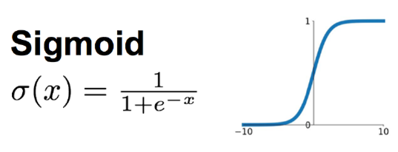








Neural Network Learning
Neural network consists of multiple hidden layers and an output layer.
Receives output from the previous layer, and multiplies its weight.
It needs to go through an activation function before outputting to the next layer.
$$X$$
$${\text{W}}^{(h)}$$
$${\text{W}}^{(o)}$$
input layer
hidden layer
output layer
Input $x_{1}$
Output $y_{1}$
Input $x_{2}$
$$\text{Output} y_{2}$$
Input $x_{3}$
Notes:
神經網路學習
如圖所示，每兩層之間都是全連接的，因此下一層節點裡的內容會是一層所有點的線性組合。
隱藏層要到輸出層前會先將結點內的值代入Sigmoid函數中，再到輸出層。
(為了解決非線性問題，因此需要激活函數，添加非線性元素。)

Slide 11
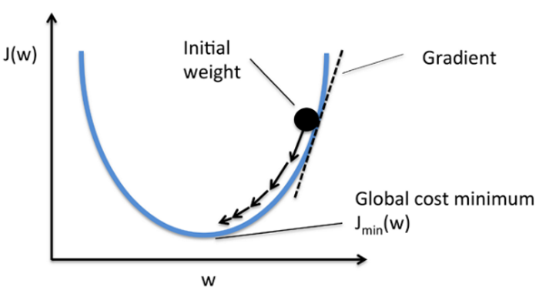
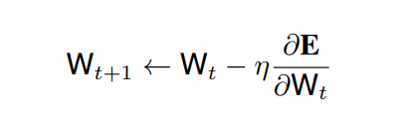





Stochastic Gradient Descent
Modify the weights to obtain the global optimal solution.
$${\text{W}}^{(h)}$$
Model
$${\text{W}}^{(o)}$$
GD
hidden
output
$$E$$
$$y$$
$$x$$
Notes:
BGD – 每次更新須帶入所有資料點。優：必定可以得到GOS。缺：速度很慢。
SGD – 每次更新只帶入1個資料點。優：速度快。缺：單次更新效率差。
MBGD – 每次更新帶入1個Batch的資料。速度中等，更新效率也不錯。
隨機梯度下降
這邊講解一下模型是如何持續更新的。
輸出層輸出結果後會與真實的label計算誤差E(loss function)，並對E進行微分。
乘上學習率後更新到現有模型上。

Slide 12
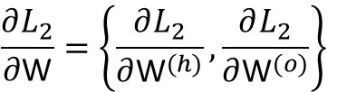






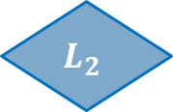



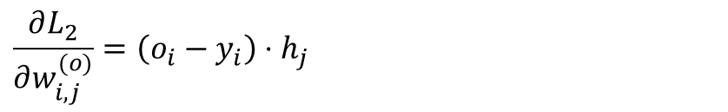

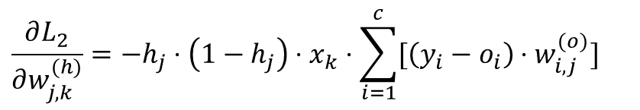

Stochastic Gradient Descent
$$b×a$$
$$c×b$$
$${\text{W}}^{(h)}$$
Model
$${\text{W}}^{(o)}$$
GD
$$b$$
$$c$$
$$a$$
$$\text{h}$$
$$\text{o}$$
$$L_{2}$$
$$c$$
$$x$$
hidden
output
$$y$$
$$\frac{∂L_{2}}{∂\text{W}}=\left\{\frac{∂L_{2}}{∂{\text{W}}^{(h)}},\frac{∂L_{2}}{∂{\text{W}}^{(o)}}\right\}$$
$$\frac{∂L_{2}}{∂w_{j,k}^{(h)}}=−h_{j}⋅\left(1−h_{j}\right)⋅x_{k}⋅\sum_{i=1}^{c}{[\left(y_{i}−o_{i}\right)⋅w_{i,j}^{(o)}]}$$
$$\frac{∂L_{2}}{∂w_{i,j}^{(o)}}=\left(o_{i}−y_{i}\right)⋅h_{j}$$
Notes:
本論文所使用的loss function是L2 norm loss(平方損失)。
這邊先展示一下隱藏層與輸出層的梯度是如何計算出來的。
之後證明會用到。

Slide 13
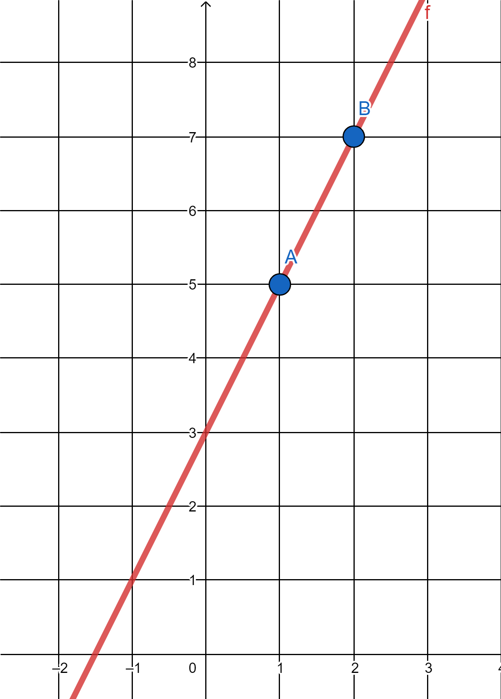













Secret Sharing
$$y=2x+3$$
Share($s$) →${\left|s\right|}_{1},{\left|s\right|}_{2}$.
Recover(${\left|s\right|}_{1},{\left|s\right|}_{2}$) → $s$.
$$(2, 7)$$
$${\left[Res\right]}_{1}$$
$$(1, 5)$$
$${\left[Req\right]}_{1}$$
$${𝒞𝒮𝒫}_{1}$$
$$(0,3)$$
Trainer
$${\left[Req\right]}_{2}$$
$${\left[Res\right]}_{2}$$
$${𝒞𝒮𝒫}_{2}$$
Notes:
主要利用SS，將Trainer的Model與Dataowner的Data切分成2份Share，分別給兩個不同的雲端計算，達成保有隱私訓練的目的。

Slide 14
Outline
Introduction
Related works
Preliminaries
Proposed method
Discussions
Conclusions
Notes:
在來進到本論文提出的架構

Slide 15
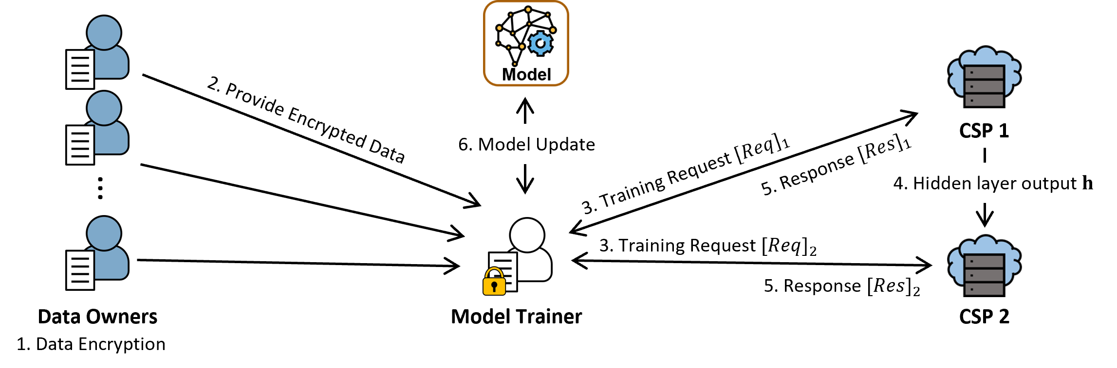


PP-DNN Architecture
$$𝒫𝒦ℰ.Gen→(pk,sk)$$
Notes:
首先CSP1會生成PKE的公私鑰對，Dataowners將各自的data加密。
Trainer生成訓練請求給CSP1與CSP2，CSP1與CSP2回應。

Slide 16
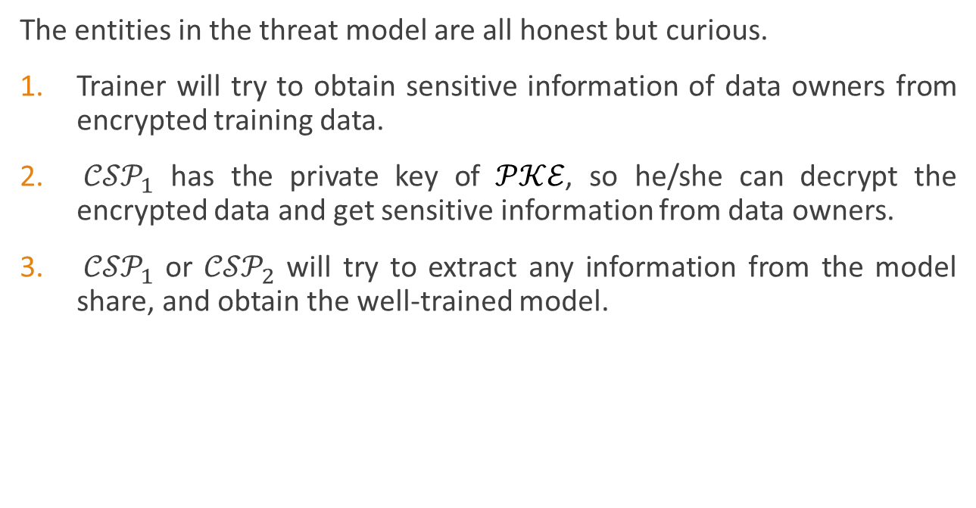
Threat Model
The entities in the threat model are all honest but curious.
Trainer will try to obtain sensitive information of data owners from encrypted training data.
${𝒞𝒮𝒫}_{1}$ has the private key of $𝒫𝒦ℰ$, so he/she can decrypt the encrypted data and get sensitive information from data owners.
${𝒞𝒮𝒫}_{1}$ or ${𝒞𝒮𝒫}_{2}$ will try to extract any information from the model share, and obtain the well-trained model.
Premise: Trainer, ${𝒞𝒮𝒫}_{1}$ and ${𝒞𝒮𝒫}_{2}$ cannot collude with each other.
Notes:
這邊提出3個威脅模型
在本論文架構中，所有實體都是誠實但好奇的。因此：
Trainer可能會試圖取得Dataowners的敏感資訊。
CSP1擁有PKE私鑰，因此可能透過PKE.Dec取得Dataowners的敏感資訊。
CSP1與CSP2可能會從訓練請求中得到Trainer的模型資訊。
前提：CSP1與CSP2不可共謀。

Slide 17







Model
Initialize the model weight ${\text{W}}_{0}=\left\{{\text{W}}_{0}^{\left(h\right)},{\text{W}}_{0}^{\left(o\right)}\right\}$, where ${\text{W}}_{0}^{\left(h\right)}∈ℤ^{b×a}$ and ${\text{W}}_{0}^{\left(o\right)}∈ℤ^{c×b}$.
Update the model with the following equation:
${\text{W}}_{t+1}←{\text{W}}_{t}−η\left\{{\text{G}}^{(h)},{\text{G}}^{(o)}\right\}$
input layer
hidden layer
output layer
Sigmoid
$$⋮$$
$$⋮$$
$$⋮$$
#neurons:
$$a$$
$$b$$
$$c$$
Notes:
此架構中的模型如圖所示。
初始化為隨機生成，並透過梯度下降更新模型。

Slide 18
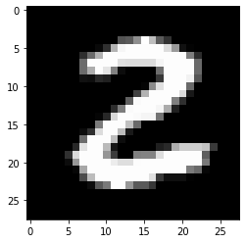
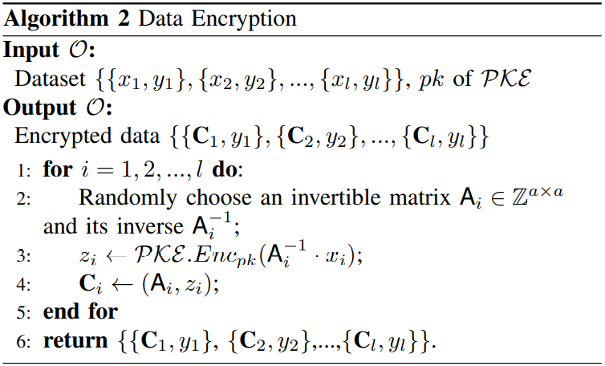
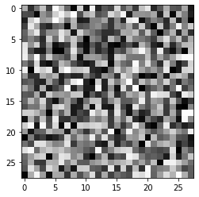
Data Encryption
Notes:
首先，Dataowners會透過此演算法將data加密。
(OTP + PKE Enc)

Slide 19

PP-Outsourced Training
for $t=0,1,…,r−1$ do:
Training Request;
Gradient Computation;
Model Update;
return model ${\text{W}}_{r}=\left\{{\text{W}}_{r}^{\left(h\right)},{\text{W}}_{r}^{\left(o\right)}\right\}$.
Notes:
然後進入授權訓練環節。
主要分成三大部分~~~
並執行r輪訓練。

Slide 20






PP-Outsourced Training Training Request
$$𝒯$$
Randomly sample a $s$-size batch $S_{t}=\left\{\left\{C_{1},𝓎_{1}\right\},…,\left\{C_{s},𝓎_{s}\right\}\right\}$.
Convert $𝓎_{i}$ into one-hot format ${\text{y}}_{i}$, which is $c$-size column vector.
Compute $ω_{i}←{𝒫𝒦ℰ.Enc}_{pk}\left({\text{W}}_{t}^{\left(h\right)}∙{\text{A}}_{i}\right)$.
Share$\left({\text{y}}_{i}\right)→{[{\text{y}}_{i}]}_{1},{[{\text{y}}_{i}]}_{2}$.
$$\left[\begin{matrix}0 \\ \begin{matrix}0 \\ \begin{matrix}1 \\ \begin{matrix}⋮ \\ 0\end{matrix}\end{matrix}\end{matrix}\end{matrix}\right]$$
$${𝒞𝒮𝒫}_{1}$$
$${𝒞𝒮𝒫}_{2}$$
$${[{Req}_{1}]}_{1}=\left\{\left\{ω_{1},𝓏_{1},{[{\text{y}}_{1}]}_{1}\right\},…,\left\{ω_{s},𝓏_{s},{[{\text{y}}_{s}]}_{1}\right\}\right\}$$
$${[{Req}_{1}]}_{2}=\left\{\left\{{[{\text{y}}_{1}]}_{2}\right\},…,\left\{{[{\text{y}}_{s}]}_{2}\right\}\right\}$$
Notes:
在Training Request階段
Trainer會隨機採樣一個batch，並將label轉為one hot編碼，並用SS加密。
並從C中取得隨機矩陣A，將隱藏層權重加密 (注意：有s個~)
將上述組合成[Req1]1與[Req1]2。

Slide 21




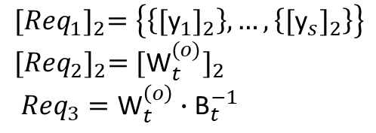
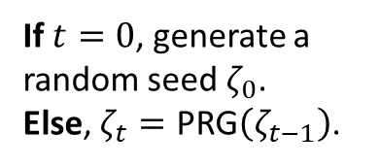
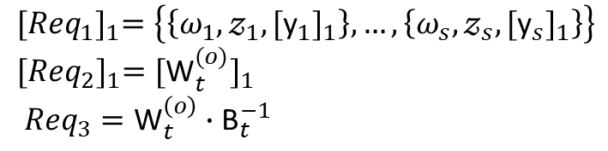
PP-Outsourced Training Training Request
$$𝒯$$
Share$\left({\text{W}}_{t}^{\left(o\right)}\right)→{[{\text{W}}_{t}^{(o)}]}_{1},{[{\text{W}}_{t}^{(o)}]}_{2}→{[{Req}_{2}]}_{1},{[{Req}_{2}]}_{2}$.
Randomly choose an invertible matrix ${\text{B}}_{t},{\text{B}}_{t}^{−1}∈ℤ^{b×b}$.
Compute ${Req}_{3}←{\text{W}}_{t}^{\left(o\right)}∙{\text{B}}_{t}^{−1}$.
If $t=0$, generate a random seed $ζ_{0}$.
Else, $ζ_{t}=\text{PRG}\left(ζ_{t−1}\right)$.
Send $ζ_{t}$ by $𝒫𝒦ℰ$
$${𝒞𝒮𝒫}_{1}$$
$${𝒞𝒮𝒫}_{2}$$
$${[{Req}_{1}]}_{1}=\left\{\left\{ω_{1},𝓏_{1},{[{\text{y}}_{1}]}_{1}\right\},…,\left\{ω_{s},𝓏_{s},{[{\text{y}}_{s}]}_{1}\right\}\right\}$$
$${[{Req}_{2}]}_{1}={[{\text{W}}_{t}^{(o)}]}_{1}$$
${Req}_{3}={\text{W}}_{t}^{\left(o\right)}∙{\text{B}}_{t}^{−1}$
$${[{Req}_{1}]}_{2}=\left\{\left\{{[{\text{y}}_{1}]}_{2}\right\},…,\left\{{[{\text{y}}_{s}]}_{2}\right\}\right\}$$
$${[{Req}_{2}]}_{2}={[{\text{W}}_{t}^{(o)}]}_{2}$$
${Req}_{3}={\text{W}}_{t}^{\left(o\right)}∙{\text{B}}_{t}^{−1}$
$$γ←\text{PRG}(ζ_{t})$$
$$γ←\text{PRG}(ζ_{t})$$
Notes:
將輸出層權重用SS加密，成為[Req2]1與[Req2]2。
將輸出層權重執行OTP加密，成為Req3。
Training Request就結束了。
在CSP1與CSP2執行Gradient Computation之前，會先執行Share PRG seed取得溝通密鑰。

Slide 22


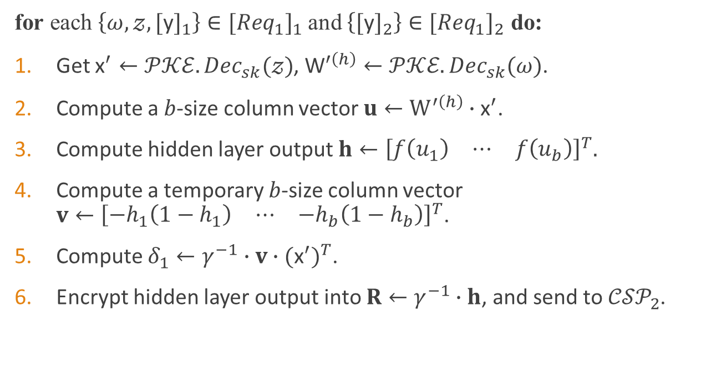


PP-Outsourced Training Gradient Computation
$${𝒞𝒮𝒫}_{1}$$
for each $\left\{ω,𝓏, {[\text{y}]}_{1}\right\}∈{[{Req}_{1}]}_{1}$ and $\left\{{[\text{y}]}_{2}\right\}∈{[{Req}_{1}]}_{2}$ do:
Get ${\text{x}}^{′}←{𝒫𝒦ℰ.Dec}_{sk}(𝓏)$, ${\text{W}}^{′\left(h\right)}←{𝒫𝒦ℰ.Dec}_{sk}(ω)$.
Compute a $b$-size column vector $u←W^{′\left(h\right)}∙{\text{x}}^{′}$.
Compute hidden layer output $h←{\left[\begin{matrix}f\left(u_{1}\right) & ⋯ & f\left(u_{b}\right)\end{matrix}\right]}^{T}.$
Compute a temporary $b$-size column vector $v←{\left[\begin{matrix}−h_{1}\left(1−h_{1}\right) & ⋯ & −h_{b}\left(1−h_{b}\right)\end{matrix}\right]}^{T}$.
Compute $δ_{1}←γ^{−1}∙v∙{({\text{x}}^{′})}^{T}$.
Encrypt hidden layer output into $R←γ^{−1}∙h$, and send to ${𝒞𝒮𝒫}_{2}$.
Decrypt and get $\text{h}←γ⋅\text{R}$
$${𝒞𝒮𝒫}_{2}$$
Notes:
為了比較好辨識，省略了1~s的編號。
對於[Req1]1與[Req1]2兩個set中每個元素都做相同的運算。
首先執行PKE解密，計算得到隱藏層節點內的值u。
代入Sigmoid函式得到隱藏層的輸出h。
並計算一個暫時的column vector v，計算出delta1。
然後透過溝通密鑰將h傳送給CSP2。

Slide 23

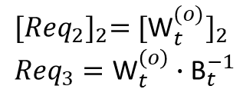
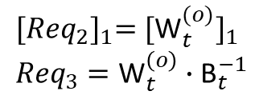




PP-Outsourced Training Gradient Computation
$${𝒞𝒮𝒫}_{1}$$
$${𝒞𝒮𝒫}_{2}$$
Compute the shares of model output ${[\text{o}]}_{1/2}←{[{Req}_{2}]}_{1/2}∙h$.
Compute ${[δ_{2}]}_{1/2}←γ∙{\left({[\text{y}]}_{1/2}−{[\text{o}]}_{1/2}\right)}^{T}∙{Req}_{3}$.
Compute ${[δ_{3}]}_{1/2}←\left({[\text{o}]}_{1/2}−{[\text{y}]}_{1/2}\right)∙h^{T}$.
${[{Req}_{2}]}_{1}={[{\text{W}}_{t}^{(o)}]}_{1}$
${Req}_{3}={\text{W}}_{t}^{\left(o\right)}∙{\text{B}}_{t}^{−1}$
${[{Req}_{2}]}_{2}={[{\text{W}}_{t}^{(o)}]}_{2}$
${Req}_{3}={\text{W}}_{t}^{\left(o\right)}∙{\text{B}}_{t}^{−1}$
$$γ←\text{PRG}(ζ_{t})$$
$$γ←\text{PRG}(ζ_{t})$$
$${[Res]}_{1}=\left\{\left\{{δ_{1}}_{1},{[{δ_{1}}_{2}]}_{1},{[{δ_{1}}_{3}]}_{1}\right\},…,\left\{{δ_{s}}_{1},{[{δ_{s}}_{2}]}_{1},{[{δ_{s}}_{3}]}_{1}\right\}\right\}$$
$${[Res]}_{2}=\left\{\left\{{[{δ_{1}}_{2}]}_{2},{[{δ_{1}}_{3}]}_{2}\right\},…,\left\{{[{δ_{s}}_{2}]}_{2},{[{δ_{s}}_{3}]}_{2}\right\}\right\}$$
$$𝒯$$
Notes:
之後CSP1與CSP2執行相同的SS運算。
將[Req2]與h相乘，就能得到模型輸出o的share。
並使用o計算出delta2與delta3的share，在之後的Model Update會使用到。
最後組成各自的Res，傳送回Trainer。

Slide 24
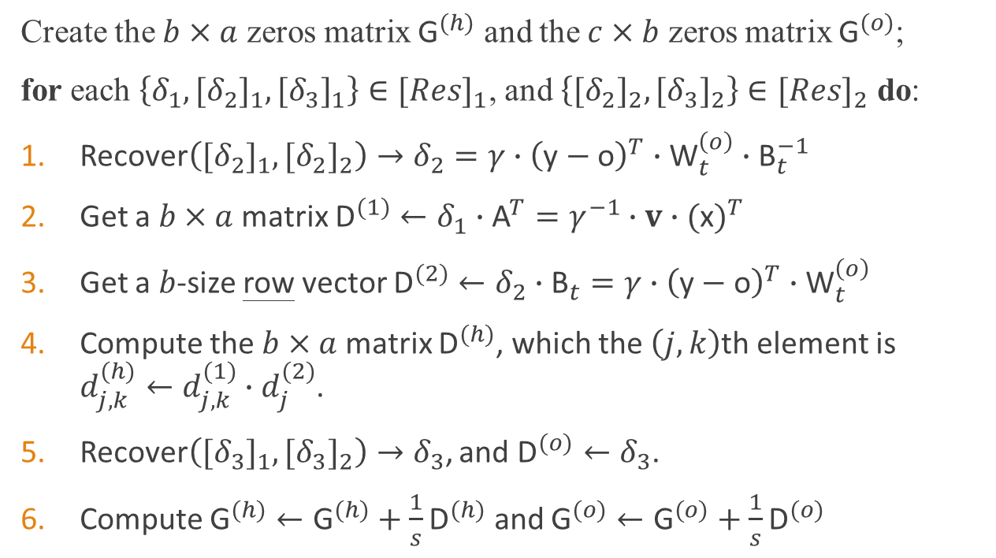

PP-Outsourced Training Model Update
$$𝒯$$
Create the $b×a$ zeros matrix ${\text{G}}^{(h)}$ and the $c×b$ zeros matrix ${\text{G}}^{(o)}$;
for each $\left\{δ_{1},{[δ_{2}]}_{1},{[δ_{3}]}_{1}\right\}∈{[Res]}_{1}$, and $\left\{{[δ_{2}]}_{2},{[δ_{3}]}_{2}\right\}∈{[Res]}_{2}$ do:
Recover$\left({[δ_{2}]}_{1},{[δ_{2}]}_{2}\right)→δ_{2}=γ∙{\left(\text{y}−\text{o}\right)}^{T}∙{\text{W}}_{t}^{\left(o\right)}∙{\text{B}}_{t}^{−1}$
Get a $b×a$ matrix ${\text{D}}^{(1)}←δ_{1}∙{\text{A}}^{T}=γ^{−1}∙v∙{(\text{x})}^{T}$
Get a $b$-size row vector ${\text{D}}^{(2)}←δ_{2}∙{\text{B}}_{t}=γ∙{\left(\text{y}−\text{o}\right)}^{T}∙{\text{W}}_{t}^{\left(o\right)}$
Compute the $b×a$ matrix ${\text{D}}^{(h)}$, which the $\left(j,k\right)$th element is $d_{j,k}^{(h)}←d_{j,k}^{(1)}∙d_{j}^{(2)}$.
Recover$\left({[δ_{3}]}_{1},{[δ_{3}]}_{2}\right)→δ_{3}$, and ${\text{D}}^{(o)}←δ_{3}$.
Compute ${\text{G}}^{(h)}←{\text{G}}^{(h)}+\frac{1}{s}{\text{D}}^{(h)}$ and ${\text{G}}^{(o)}←{\text{G}}^{(o)}+\frac{1}{s}{\text{D}}^{(o)}$
Notes:
再來Model Update階段。一樣省略了1~s的編號。
Trainer用Recover還原了delta2，並unmask delta1、delta2。
得到D1、D2，並使用D1、D2計算出Dh。
Trainer用Recover還原了delta3，得到Do。
最後將batch內所有Dh、Do平均，得到梯度Gh、Go。

Slide 25

PP-Outsourced Training Model Update
Finally update the model weight
$${\text{W}}_{t+1}←{\text{W}}_{t}−η\{{\text{G}}^{\left(h\right)},{\text{G}}^{(o)}\}$$
Notes:
更新model。

Slide 26






PP-Outsourced Training Correctness
$$b×a$$
$$c×b$$
$${\text{W}}^{(h)}$$
Model
$${\text{W}}^{(o)}$$
GD
$$b$$
$$c$$
$$a$$
$$\text{h}$$
$$\text{o}$$
$$L_{2}$$
$$c$$
$$x$$
hidden
output
$$y$$
$$\frac{∂L_{2}}{∂\text{W}}=\left\{\frac{∂L_{2}}{∂{\text{W}}^{(h)}},\frac{∂L_{2}}{∂{\text{W}}^{(o)}}\right\}$$
$$d_{j,k}^{(1)}=γ^{−1}∙v_{j}∙x_{k}$$
$$\frac{∂L_{2}}{∂w_{j,k}^{(h)}}=−h_{j}⋅\left(1−h_{j}\right)⋅x_{k}⋅\sum_{i=1}^{c}{[\left(y_{i}−o_{i}\right)⋅w_{i,j}^{(o)}]}$$
$${\text{D}}^{(1)}=γ^{−1}∙v∙{(\text{x})}^{T}$$
$$d_{j}^{(2)}=γ∙\sum_{i=1}^{c}{[\left(y_{i}−o_{i}\right)⋅w_{i,j}^{(o)}]}$$
$${\text{D}}^{(2)}=γ∙{\left(\text{y}−\text{o}\right)}^{T}∙{\text{W}}_{t}^{\left(o\right)}$$
$${\text{D}}^{(o)}=\left(\text{o}−\text{y}\right)∙h^{T}$$
$$\frac{∂L_{2}}{∂w_{i,j}^{(o)}}=\left(o_{i}−y_{i}\right)⋅h_{j}$$
$$d_{i,j}^{(o)}=\left(o_{i}−y_{i}\right)⋅h_{j}$$
Notes:
驗證正確性
左邊是先前展示的梯度的計算方式。
右邊則是在本論文的架構下計算出來的參數D1、D2、Do。
從D1、D2、Do內的元素很明顯可以看到，與左邊的算是是符合的。

Slide 27
Outline
Introduction
Related works
Preliminaries
Proposed method
Discussions
Conclusions
Notes:
討論安全性

Slide 28





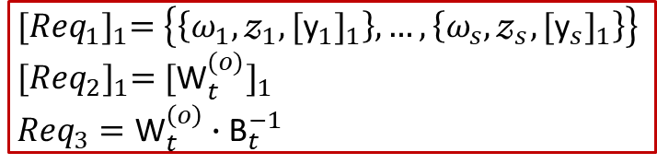


Security Analysis
Trainer is adversary to Data Owners $(𝒜_{1})$
${𝒞𝒮𝒫}_{1}$ is adversary to Data Owners $(𝒜_{2})$
${𝒞𝒮𝒫}_{1}$ or ${𝒞𝒮𝒫}_{2}$ is adversary to Trainer $(𝒜_{3})$
Data Owners
$$Data$$
$$\left\{\left\{C_{1},𝓎_{1}\right\},…,\left\{C_{m},𝓎_{m}\right\}\right\}$$
${[{Req}_{1}]}_{1}=\left\{\left\{ω_{1},𝓏_{1},{[{\text{y}}_{1}]}_{1}\right\},…,\left\{ω_{s},𝓏_{s},{[{\text{y}}_{s}]}_{1}\right\}\right\}$
${[{Req}_{2}]}_{1}={[{\text{W}}_{t}^{(o)}]}_{1}$
${Req}_{3}={\text{W}}_{t}^{\left(o\right)}∙{\text{B}}_{t}^{−1}$
Trainer
$${\left[Res\right]}_{1}$$
$${\left[Req\right]}_{1}$$
CSP1
CSP2
Notes:
驗證先前提到三個威脅模型，以A1、A2、A3表示。

Slide 29
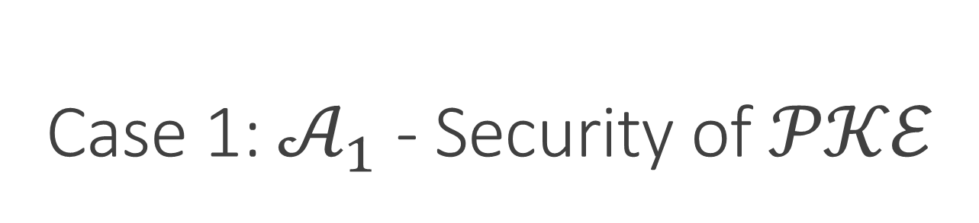


Case 1: $𝒜_{1}$ - Security of 𝒫𝒦ℰ
$𝒜_{1}$’s view: the large scale of data $\left\{\left\{C_{1},𝓎_{1}\right\},…,\left\{C_{m},𝓎_{m}\right\}\right\}$
$C_{i}=\left({\text{A}}_{i},𝓏_{i}\right)$ , $𝓏_{i}={𝒫𝒦ℰ.Enc}_{pk}({\text{A}}_{i}^{−1}⋅x_{i})$
Definition 1 (CCA-security of 𝒫𝒦ℰ).
We say that a public key encryption scheme is secure against chosen-ciphertext attacks (CCA-security) if for all probabilistic polynomial time adversaries 𝒜 there is a negligible probability to distinguish $Enc(pk,m_{0})$ and $Enc(pk,m_{1})$. It is formal as:
$$Enc(pk,m_{0})≈Enc(pk,m_{1})$$
Notes:
這邊可以將A1的安全性reduce到PKE的CCA安全性定義。
定義證明m0與m1在PKE加密下對多項式時間的敵人具有不可分辨性。

Slide 30
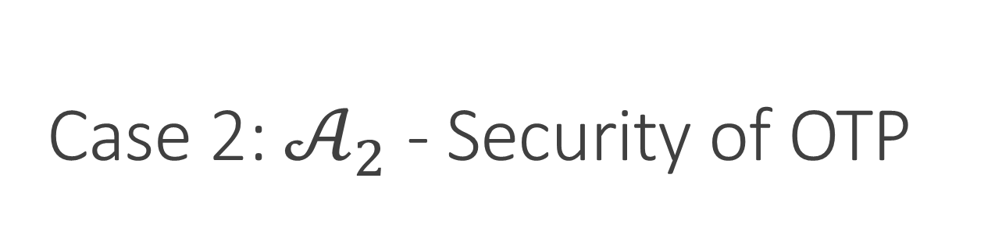

Case 2: $𝒜_{2}$ - Security of OTP
$𝒜_{2}$’s view: ${[{Req}_{1}]}_{1}=\left\{\left\{ω_{1},𝓏_{1},{[{\text{y}}_{1}]}_{1}\right\},…,\left\{ω_{s},𝓏_{s},{[{\text{y}}_{s}]}_{1}\right\}\right\}$, ${Req}_{3}={\text{W}}_{t}^{\left(o\right)}∙{\text{B}}_{t}^{−1}$
${𝒫𝒦ℰ.Dec}_{sk}\left(ω_{i}\right)={\text{W}}_{t}^{(h)}⋅{\text{A}}_{i}$ , ${𝒫𝒦ℰ.Dec}_{sk}\left(𝓏_{i}\right)={\text{A}}_{i}^{−1}⋅x_{i}$
Definition 2 (information-theoretically secure of one-time pad).
We say that the one-time pad technique is information-theoretically secure, and satisfies perfect secrecy if satisfied the following conditions are met:
The key should be at least as long as the plaintext.
The key should be truly randomly and distributed uniformly.
The key cannot be reused in the whole process.
The key should be completely private.
Notes:
這邊可以將A2的安全性reduce到OTP的資訊理論安全性定義。
定義證明在滿足以下4點的情況下對於任何敵人是絕對安全的。

Slide 31
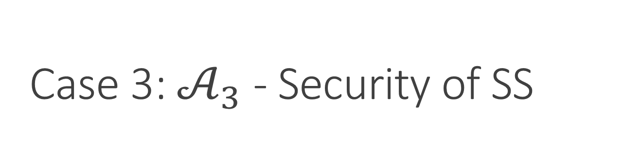

Case 3: $𝒜_{3}$ - Security of SS
$𝒜_{3}$’s view: ${[{Req}_{1}]}_{1}=\left\{\left\{ω_{1},𝓏_{1},{[{\text{y}}_{1}]}_{1}\right\},…,\left\{ω_{s},𝓏_{s},{[{\text{y}}_{s}]}_{1}\right\}\right\}$
${[{Req}_{2}]}_{1}={[{\text{W}}_{t}^{(o)}]}_{1}$
Definition 3 (information-theoretically secure of secret sharing).
Secret sharing scheme has the property of information-theoretically secure, guaranteeing that even an adversary 𝒜 with infinite time and computing ability cannot reconstruct the secret without enough share.
Notes:
這邊可以將A3的安全性reduce到Secret Sharing的資訊理論安全性定義。
定義證明對於任何敵人，在沒有收集到足夠share的狀態下是絕對安全的。

Slide 32
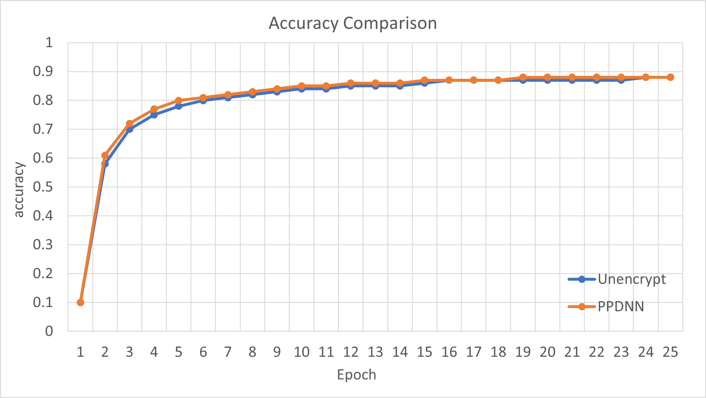
Performance - Accuracy
The accuracy is almost the same as the normal DNN learning.
Notes:
模型準確度的部分，本論文在實作時主要與沒有加密的版本進行比對。
結果表明，模型的準確度並沒有任何損失。

Slide 33
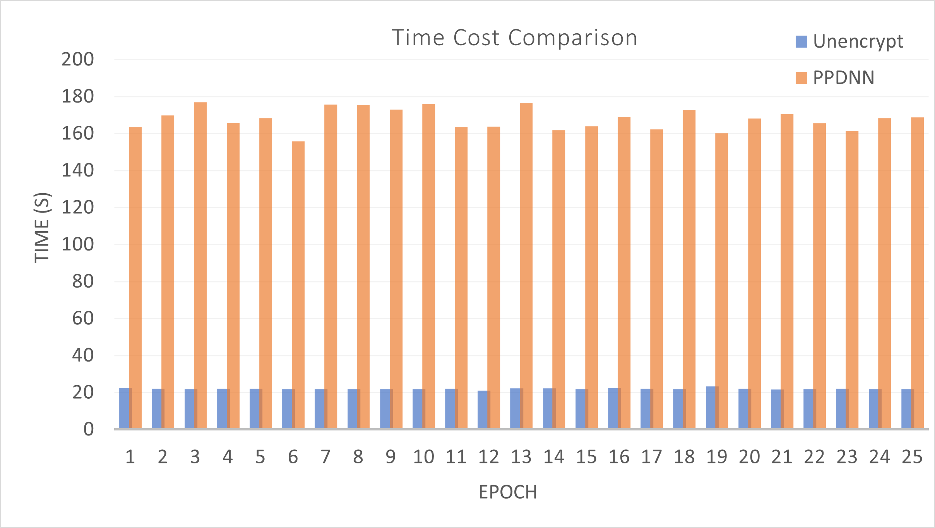
Performance - Time
The training time of each epoch is about 8 times that of the normal DNN learning with the three-layer DNN model.
Notes:
在時間花費的部分，在12000筆test data，batch size 60的測試中，
時間大約為原本的8倍。

Slide 34
Property Compare
 | OMT | FL | PoD | PoM | PoG | Performance (ms)
Ours | ✓ | ✗ | PKE+OTP | SS | SS | 158.8 (PC)
PPDL [1] (20) | ✗ | ✓ | N/A | HE | HE | 405.5 (Server)
PPDL [1] (1) | ✗ | ✓ |  | ✗ | ✓ | 1419.8 (Server)
 | SoD | SoM | TSP
Ours | CCA+ITS | ITS | HBC
PPDL [1] | ✗ | CPA | HBC
[1] L. Trieu Phong, Y. Aono, T. Hayashi, L. Wang, S. Moriai et al., “Privacy preserving deep learning via additively homomorphic encryption,” IEEE Transactions on Information Forensics and Security, vol. 13, no. 5, pp. 1333–1345, 2017.
Notes:
與使用同態加密的DNN訓練的paper相比，batch size設定為50的狀況下的時間比較。
但因為硬體不同，對方為server等級的硬體，理論上相同硬體差距應該更大。
OMT：Outsource model training，FL：Federated Training，PoD：data加密手段…
ITS：資訊理論安全，HBC：誠實但好奇

Slide 35
Outline
Introduction
Related works
Preliminaries
Proposed method
Discussions
Conclusions

Slide 36
Guarantees
No private information can be obtained from the training data by any honest but curious entity.
The model trainer can outsource the training task to the cloud service provider and ensure the security of the model.
The experiments show that the accuracy of the model does not decrease, and the execution time is within an acceptable range.
Notes:
結論
此架構中的任何實體皆無法從訓練資料中得到任何隱私資訊。
Trainer可以安全地將訓練工作授權給雲端服務器。因此Trainer也可以是輕量化的設備。
實驗表明準確度不會有任何損失，且執行時間在可接受的範圍內。

