Slide 1



Mastering hydrological models with Python:
Taking SWMM and Modflow as examples
Boji CHEN
bojichen@connect.hku.hk

Slide 2



Installed softwares
A free, open-source distribution of Python and R that simplifies package management and deployment.
Manages libraries and dependencies, and provides a virtual environment for various projects.
An open-source web application that allows you to create and share documents that contain live code, equations, visualizations, and narrative text.
Facilitates data cleaning, transformation, numerical simulation, statistical modeling, data visualization, and much more.
A lightweight, powerful source code editor that runs on your desktop
Enhances coding with features like IntelliSense (code completion), debugging, and direct integration with Git for version control.

Slide 3
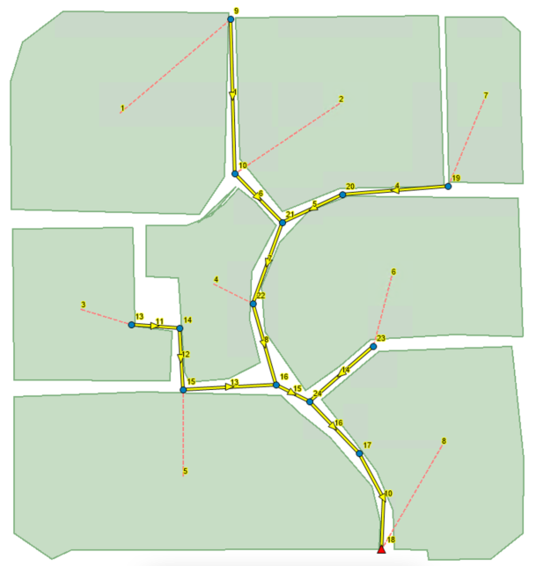

Storm Water Management Model (SWMM)
Dynamic rainfall-runoff simulation model
Single event or long-term (continuous) simulation
Runoff quantity and quality.
Source: https://www.pyswmm.org/examples

Slide 4
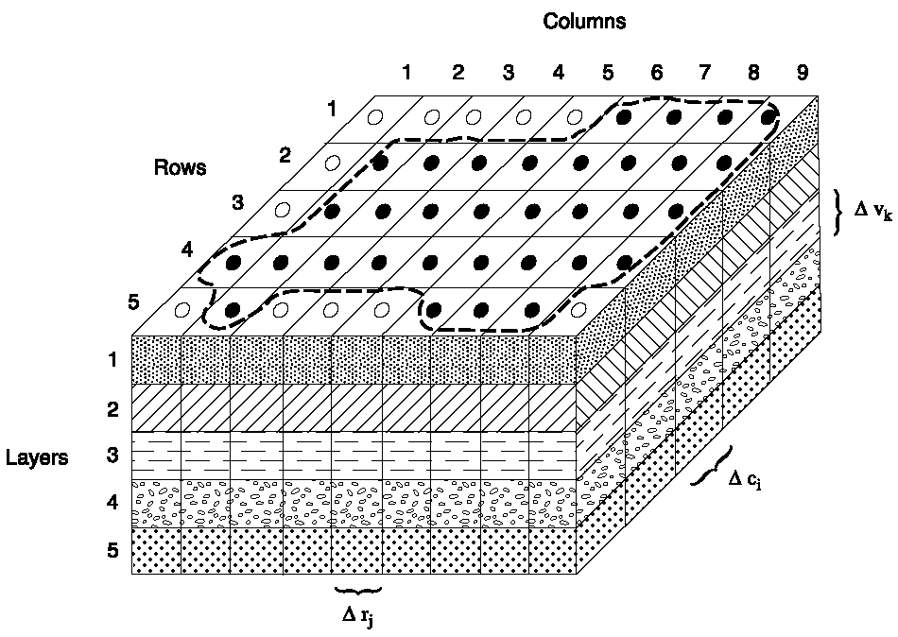
Modflow
Groundwater flow model
Source: https://en.wikipedia.org/wiki/MODFLOW#/media/File:MODFLOW_3D_grid.png

Slide 5
Why Python?
Automation: Python can automate repetitive simulation tasks in SWMM, improving efficiency and scalability.
Integration: It enables integration with data processing and visualization libraries, enhancing SWMM’s analytical capabilities.
Customization: Python allows for custom extensions to SWMM, tailoring its functions to specific project needs.

Slide 6



Python interface (packages)
Input files
executables
Output files
Modification and Creation
Data Integration
Automated Execution
Parameter Control
Data Extraction
Visualization and Reporting

Slide 7
Python interface (packages)
SWMM → Pyswmm
https://www.pyswmm.org/
Modflow → Flopy
https://flopy.readthedocs.io/en/stable/

Slide 8
Pyswmm
Packages
Pyswmm
Module
__init__.py
subcatchments.py
nodes.py
links.py
Constant
Function
Class

