Slide 1
Social Blogging Platform
Bozhidara Partenova, 1MI0600569

Slide 2
What is it?
This project is a full-stack social platform featuring secure JWT-based authentication, user profile management, post creation, customizable filters, follow/unfollow functionality, groups, chats with friends and instant live notifications.

Slide 3
Tech stack
Frontend
Vite
React
TypeScript
Backend
Node.js
Express
TypeScript
JWT Auth
Yup
Database
MongoDB

Slide 4
Architecture
Repository
Service
Controller
Routes
Routes Layer: Maps URL endpoints and HTTP methods to the correct controller function. It also handles request-level middleware like authentication checks.
Controller Layer: Extracts input data, validates payload formats, calls the appropriate service method, and formats the final HTTP response.
Service Layer: Implements all business rules, calculations, and orchestrations.
Repository Layer: Performs database read, write, update, and delete (CRUD) queries using Mongoose.

Slide 5
Core features Overview

Slide 6
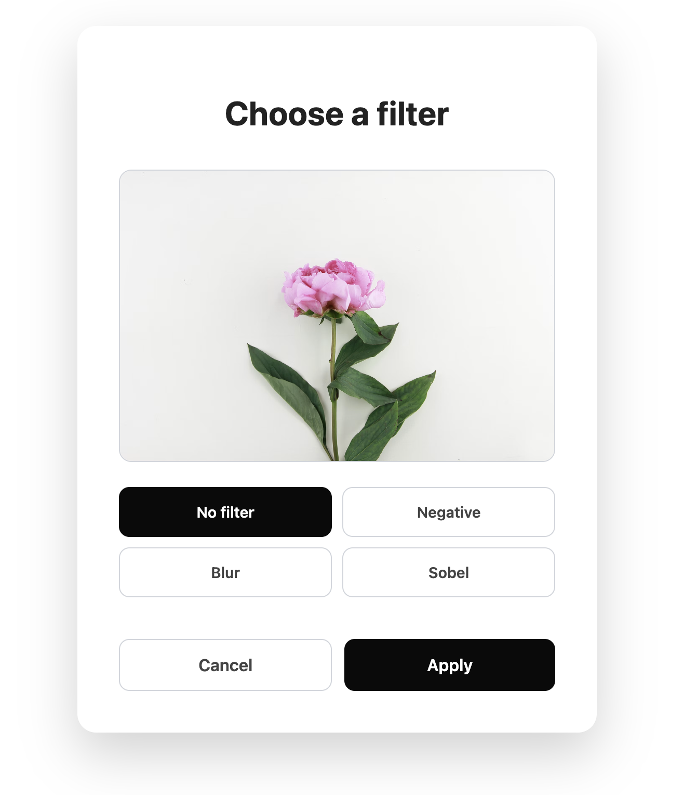
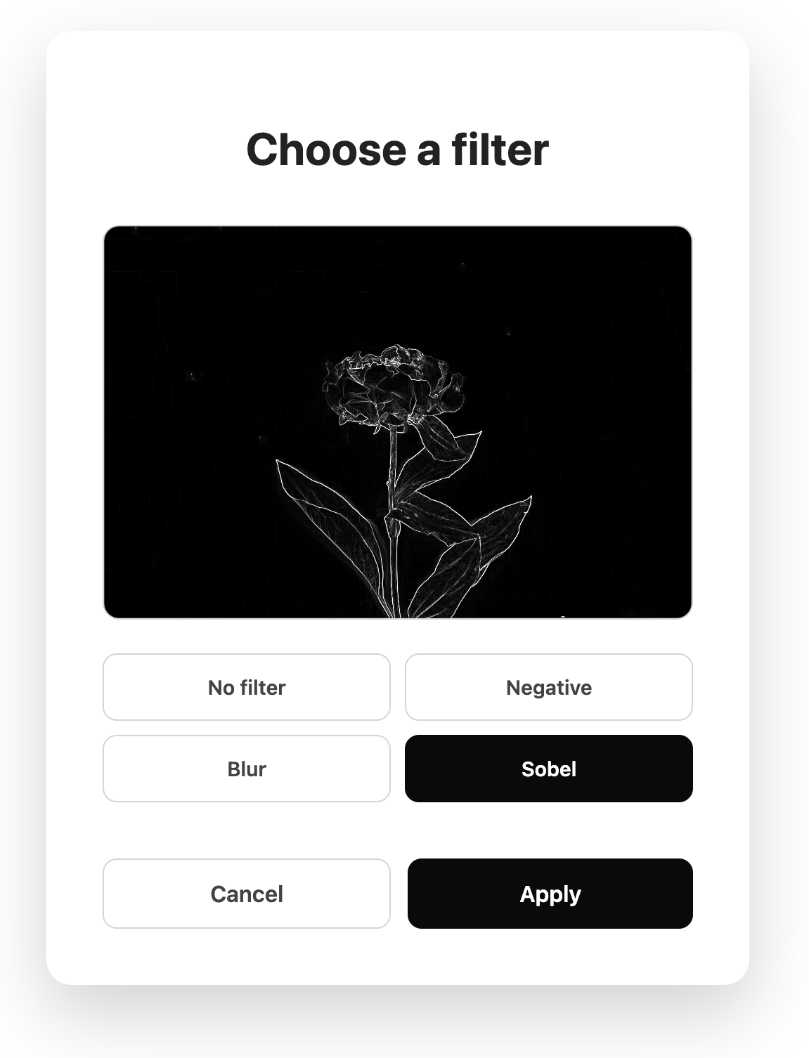
Posts & Filters

Slide 7
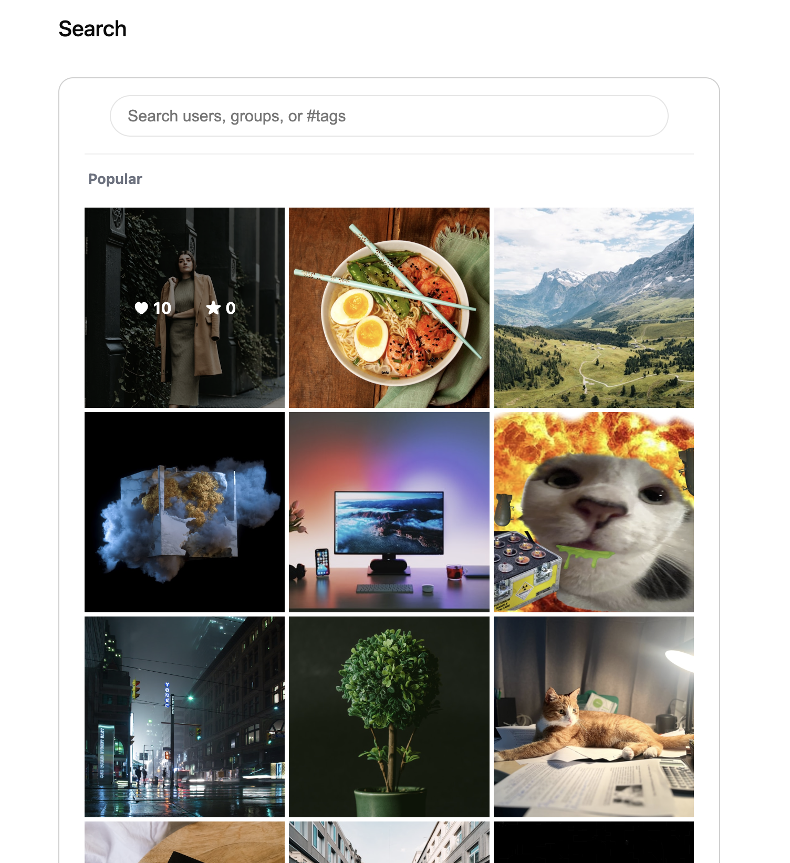
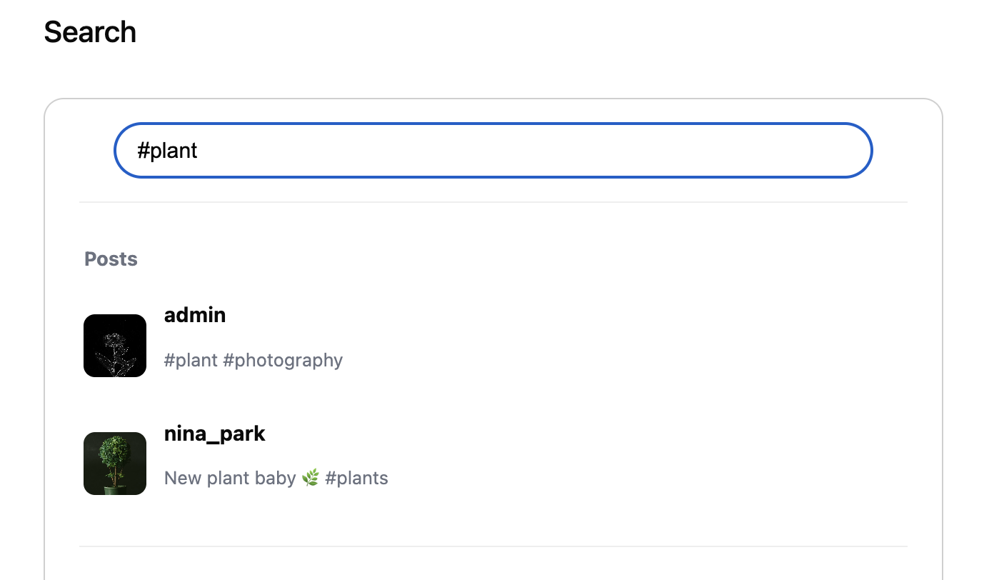
Search & Explore new content

Slide 8
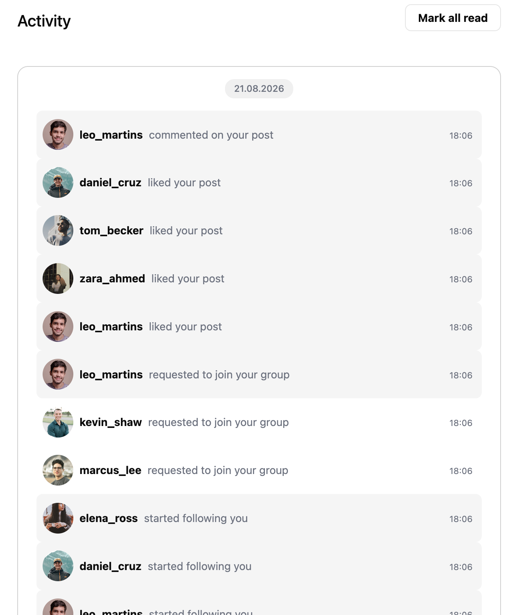
Notifications

Slide 9
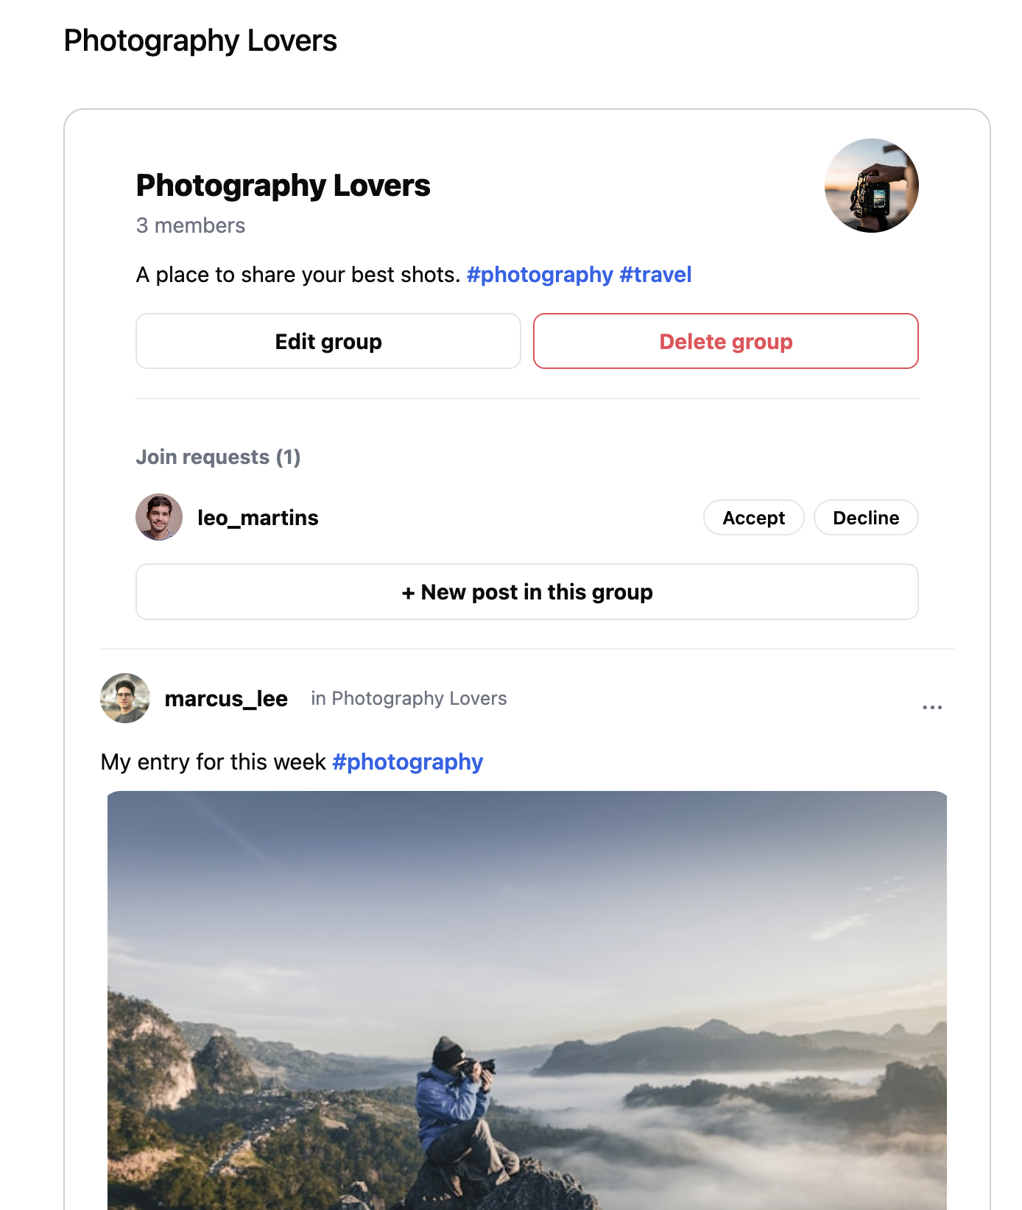
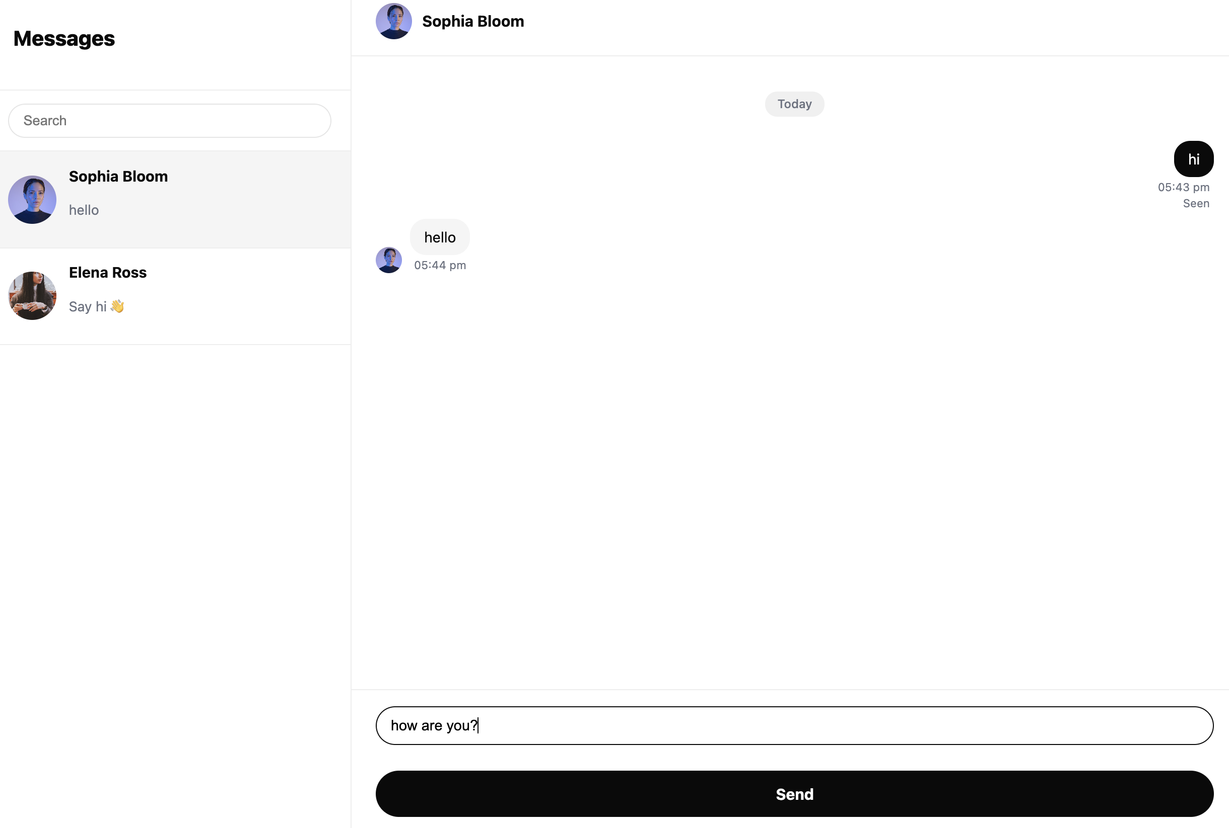
Participate in Groups & Chat with your Friends

Slide 10
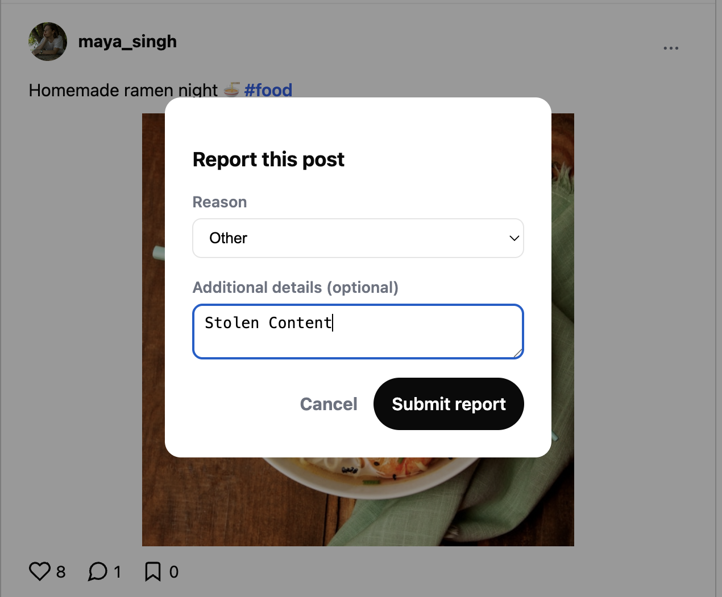
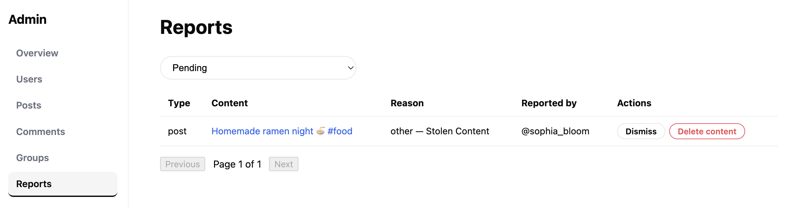
Report content

Slide 11
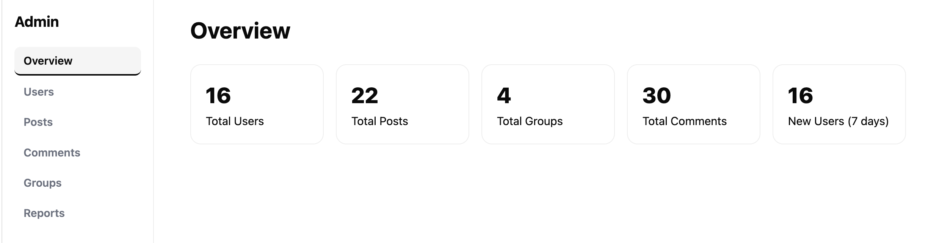
Admin Dashboard

Slide 12
Thank you

