Slide 1
Particle Systems 粒子系统
李博杰
PB10000603

Slide 2
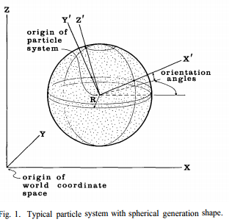
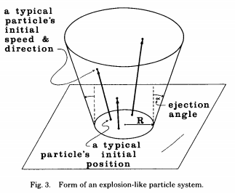
Particle systems—a technique for modeling a class of fuzzy objects (SIGGRAPH 1983)

Slide 3
粒子的参数
初始位置
初始速度的大小和方向
初始大小
初始颜色
初始透明度
形状
生存期

Slide 4
粒子的产生
如何决定产生新粒子的速度？
第一种方法：使新粒子产生速度有一定随机性
Nparts = MeanParts + Rand() * VarParts
第二种方法：考虑到屏幕大小的影响
Nparts = (MeanParts + Rand() * VarParts) * ScreenArea

Slide 5
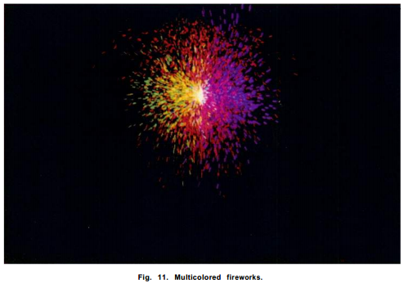
April 1983

Slide 6
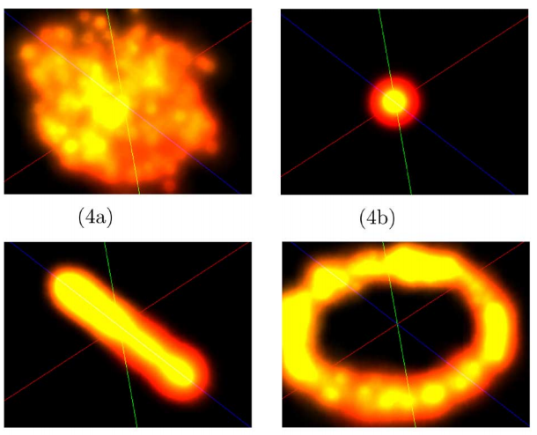
粒子形状

Slide 7
粒子形状
Spherical generation produces area effects such as smoke and explosions.
Point generation facilitates effects that are attached to specific points on objects, such as vehicle thrust and muzzle flash.
Line generation commonly produces effects attached to characters or melee weapons, such as glowing swords.
Circular generation enables effects that surround objects, such as energy fields

Slide 8
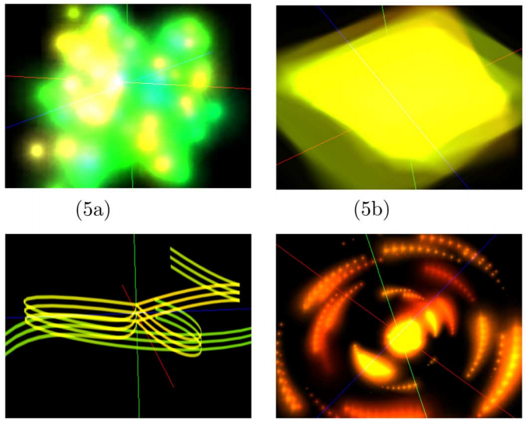
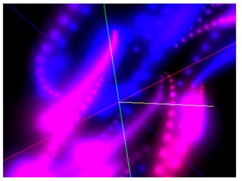
粒子系统分类

Slide 9
粒子系统分类
The generic particle system models effects such as fire, smoke, and explosions.
The plane system warps and stretches individual particles for flashes, lens flares, and other effects.
The beam system simulates beam, laser, or electricity effects.
The rotator system models effects based on orbital rotation common in explosions, energy, and magic.
The trail system is similar to the generic system; however, each particle drops a trail of smaller particles.

Slide 10
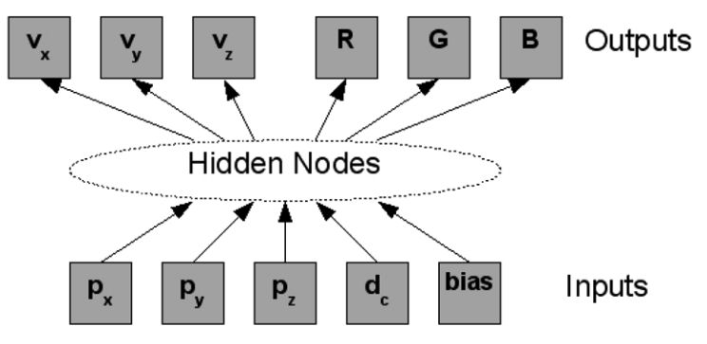
人工神经网络

Slide 11
几种粒子系统的控制参数
Generic: input: current position (x,y,z), distance from center (d_{c}) output: velocity (x,y,z), color (R,G,B)
Plane system: input: position of each corner (x,z), distance from center (d_{c})
Beam system: input: position of each Bezier control point (x,y,z), distance from center (d_{c})
Rotator system: output: rotation around x,y,z axis, color (R,G,B)
Trail system: 定期让部分粒子静止下来并逐渐消失

Slide 12
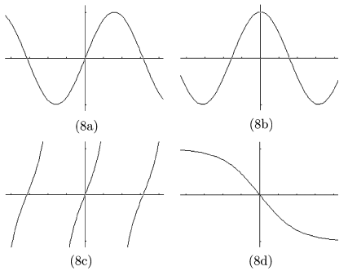
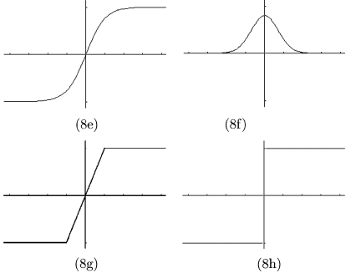
人工神经网络中的节点
从下面的8种函数中随机选择一个

Slide 13
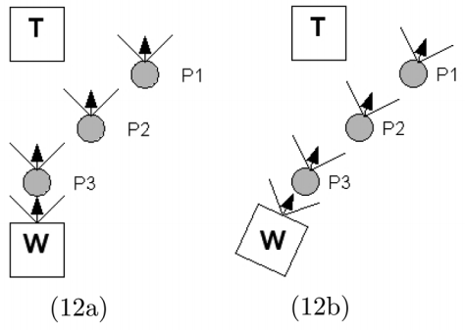
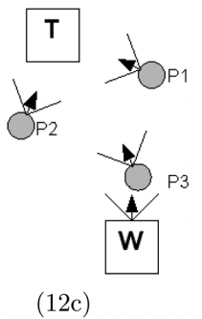
随机中的限制
以武器为例，随机运动的粒子（子弹）不能返回来打到自己

Slide 14
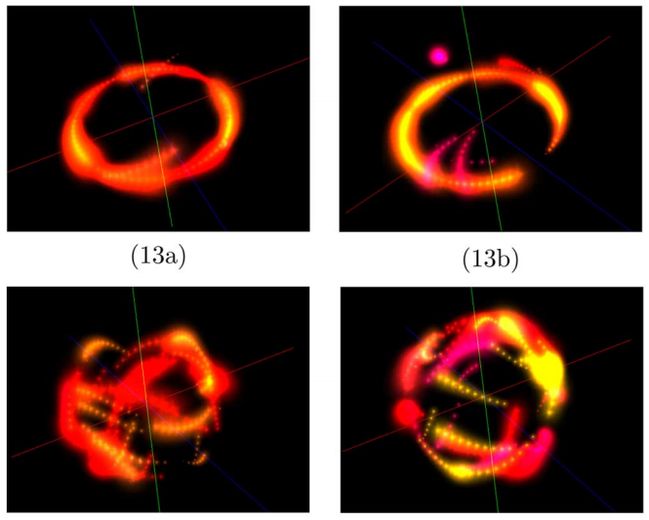
粒子系统进化的魅力

Slide 15
参考文献
William T. Reeves. 1983. Particle systems—a technique for modeling a class of fuzzy objects. SIGGRAPH Comput. Graph. 17, 3 (July 1983), 359-375. DOI=10.1145/964967.801167
Hastings, E.J.; Guha, R.K.; Stanley, K.O., "Interactive Evolution of Particle Systems for Computer Graphics and Animation," Evolutionary Computation, IEEE Transactions on , vol.13, no.2, pp.418,432, April 2009
查到的其他文献大多是引用这两篇的，这两篇是思想的集大成之作，因此没有列出其他文献。

Slide 16
谢谢！

