Slide 1
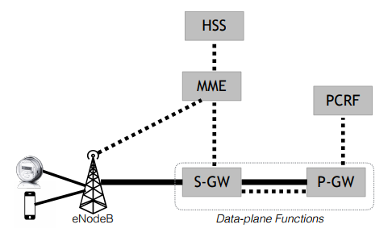
Control signal (add/remove bearers)
controller
Dump connection states for fault tolerance
Software
Cmd
State
PCIe
Hardware
Catapult FPGA
Encapsulated user traffic
Decapsulated user traffic
EPC Architecture

