Slide 1
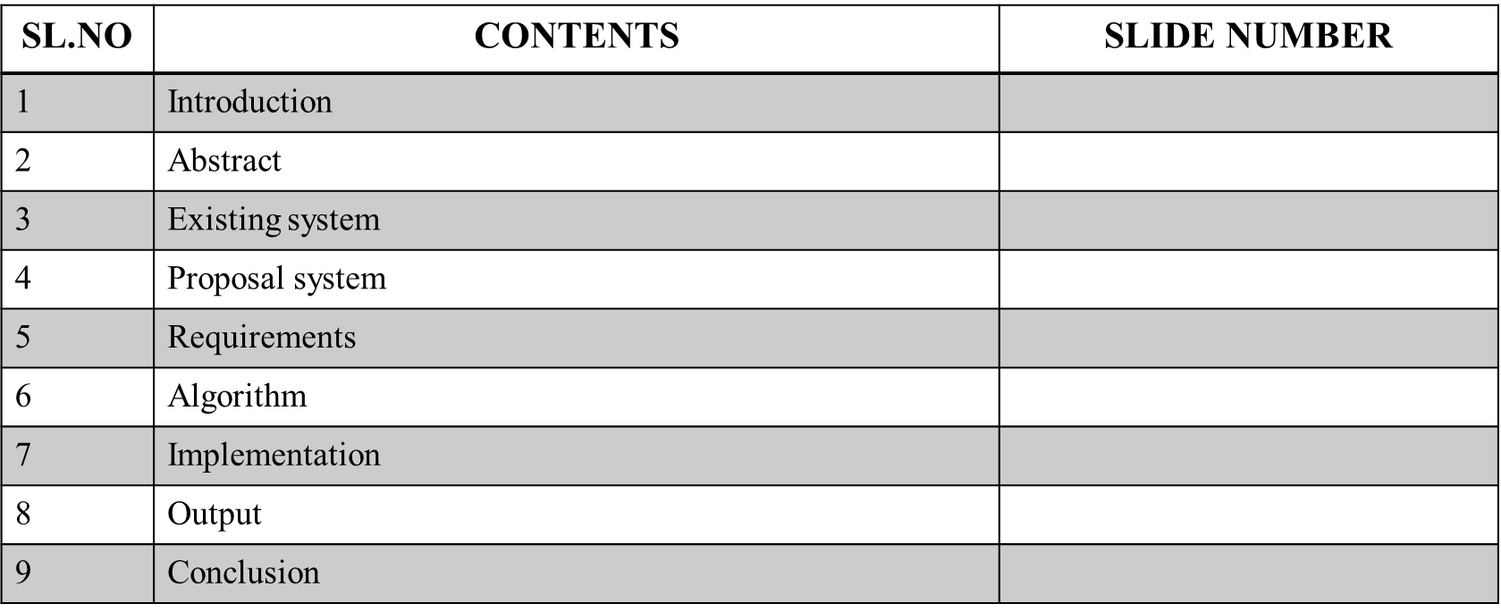

Slide 2
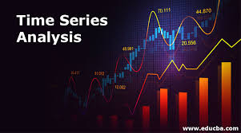
We know that planning for the future is very necessary for every Business firm, and every govt. institute, every individual, and every country. Every family is also planning for his income expenditure. As like every business is planning for possibilities of its financial resources & sales and maximization of its profit.
DEFINITION :
A time series is a set of observations taken at specified times, usually at equal intervals.”
A time series may be defined as a collection of reading belonging to different periods of some economic or composite variables".

Slide 3
ABSTRACT :
Time series analysis describes, explains, predicts, and controls changes through the time of selected variables. Time-series analysis is a statistical method of analyzing data from repeated observations on a single unit or individual at regular intervals over a large number of observations. Time-series analysis can be viewed as the exemplar of longitudinal designs. The most widely employed approach is based on the class of models known as autoregressive integrated moving average linear regression,(ARIMA) models. regression models can address several major classes of research questions, including an analysis of basic processes, intervention analysis, and an analysis of the pattern of treatment effects over time. Technical aspects of ARIMA models are described,

Slide 4
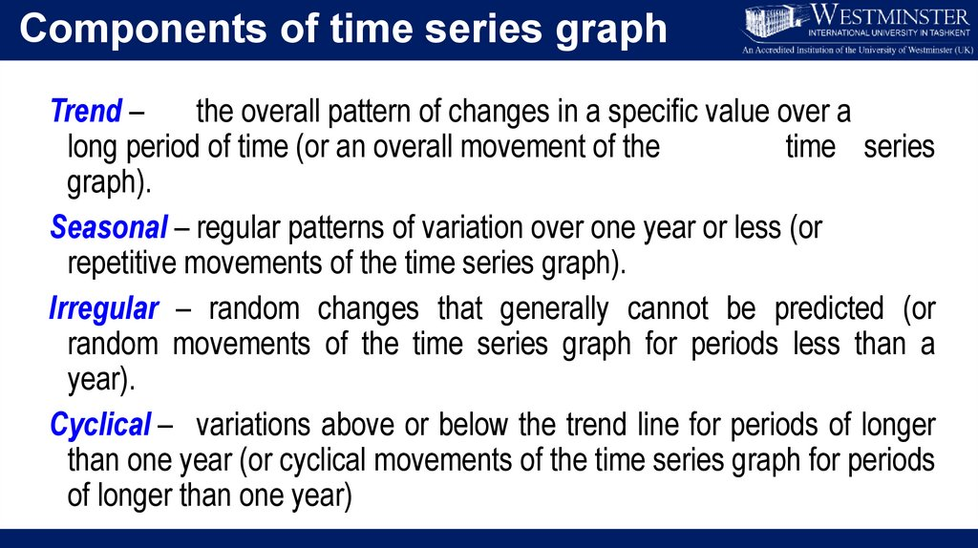
COMPONENTS OF TIME SERIES ANALYSIS

Slide 5
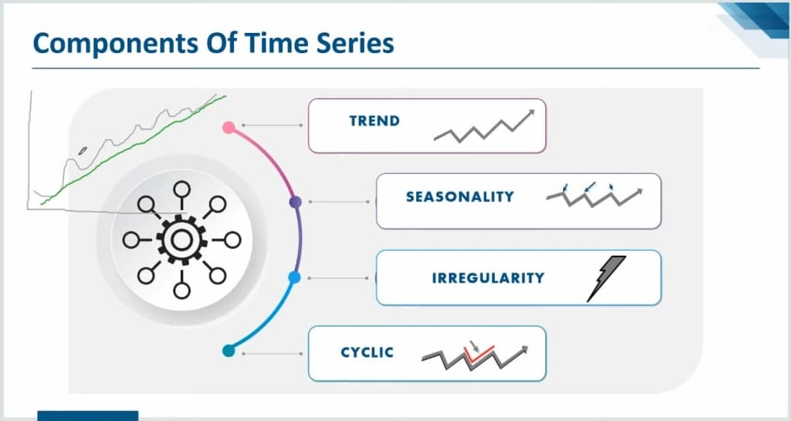

Slide 6
Existing system
In time series problems, we expect observations close to each other in time to be more similar than observations far away, after accounting for seasonality. For example, the weather today is usually more similar to the weather tomorrow than the weather a month from now. Time series analysis also suffers from several weaknesses, including problems with generalization from a single study, difficulty in obtaining appropriate measures, and problems with accurately identifying the correct model to represent the data.

Slide 7
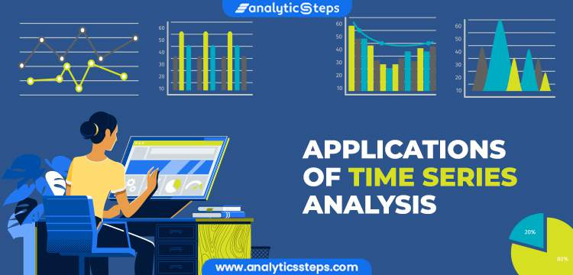
disadvantages
Cannot find optimal model itself
search-based optimization required
Loss of information, especially individual series dynamics.
Distribution of forecasting to lower levels can be difficult
No prediction intervals
difficulty in obtaining appropriate measures
problems with accurately identifying the correct model to represent the data.
Require more memory
More computational time

Slide 8
Proposed system
Time series analysis helps organizations understand the underlying causes of trends or systemic patterns over time. Using data visualizations, business users can see seasonal trends and dig deeper into why these trends occur. With modern analytics platforms, these visualizations can go far beyond line graphs . Advantage is that treatment does not have to be withdrawn and disadvantages include that it can be more time consuming, more resources than other designs. Weaker than a withdrawal design because experimental control is not clearly present.

Slide 9
advantages
Understanding the phenomenon under consideration
Gaining knowledge about Past behavior.
Evaluate the Current behavior of the time series.
Preparing and projecting the future of the time series.
Multivariate analysis possible
Linear regression

Slide 10
requirements
Hard-ware requirements:-
Intel core i3
4 GB RAM
Minimam storage

Slide 11
Soft-ware requirements
Windows 10 / Linux
anaconda (Jupiter notebook)
Ms excel
Python version 3.11.1
Any web browser

Slide 12
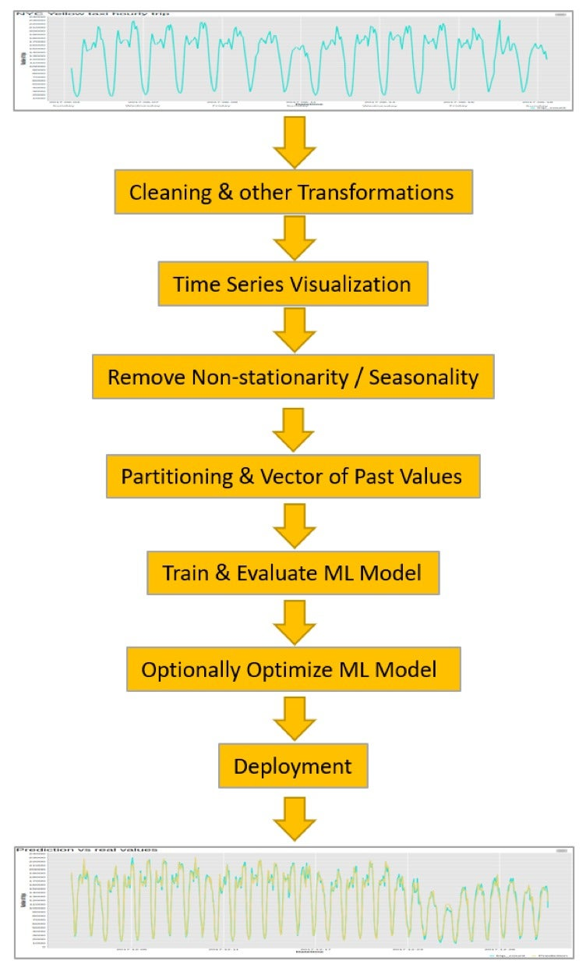
System architecture :

Slide 13
ALGORITHAM :
Here we use linear regression algorithm. The main concept of this algorithm to find predictive analysis.
Linear regression is a type of supervised machine learning It deals with the two variables one is dependent variable and independent variable.
Predciting future data using past observations.
Spliting the data into futures (test , train )
Fiting the train data set in linear regression.
Using predicited data and old data ploting the graph

Slide 14
Modules description :
Step 1 : uploading the data from the Kaggle
download the .csv file and run in the jupyter or any other
source
Step 2: here we are using linear regression algorithm.
based on this algorithm we are splitting the data into training
and testing data set.
and apply the algorithm on that splitted data sets.
Step 3: here we are using linear regression in this project . Linear regression is a simple Supervised Learning algorithm that is
used to predict the value of a dependent variable(y) for a given value of the independent variable(x) by effectively modelling a
linear relationship between the input(x) and output(y) variables using the given dataset.
Step 4 : after predicting the values , ploting them with old observed data
Step 5 : analysing the graph of time series .

Slide 15
IMPLEMENTATION:
import pandas as pd
import numpy as np
import os
os.getcwd()
'C:\\Users\\REVALLA LOKESH'
df=pd.read_csv("tesla.csv")
df.head()
import pandas as pd
import numpy as np
from sklearn.tree import DecisionTreeRegressor
from sklearn.linear_model import LinearRegression
from sklearn.model_selection import train_test_split
import matplotlib.pyplot as plt
plt.style.use('bmh')

Slide 16
plt.figure(figsize=(16,8))
plt.title('netflix')
plt.xlabel('days')
plt.ylabel('Close price usd ($)')
plt.plot(df['Close'])
plt.show()
df = df[['Close']]
df.head(4)x_future = df.drop(['Prediction'], 1)[:-future_days]
x_future = x_future.tail(future_days)
x_future = np.array(x_future)
x_future
future_days=25
df['Prediction']=df[['Close']].shift(-future_days)
df.tail(4)

Slide 17
x = np.array(df.drop(['Prediction'], 1))[:-future_days]
print(x)
y = np.array(df['Prediction'])[:-future_days]
print(y)
x_train,x_test,y_train,y_test=train_test_split(x,y,test_size=0.25)
lr=LinearRegression().fit(x_train,y_train)
x_future = df.drop(['Prediction'], 1)[:-future_days]
x_future = x_future.tail(future_days)
x_future = np.array(x_future)
x_future
lr_prediction = lr.predict(x_future)
print(lr_prediction)

Slide 18
valid = df[x.shape[0]:]
valid['Predictions'] = predictions
plt.figure(figsize=(16,8))
plt.title('Model')
plt.xlabel('days')
plt.ylabel('close price usd($)')
plt.plot(df['Close'])
plt.plot(valid[['Close','Predictions']])
plt.legend(['Orig','Val','Pred'])
plt.show()

Slide 19
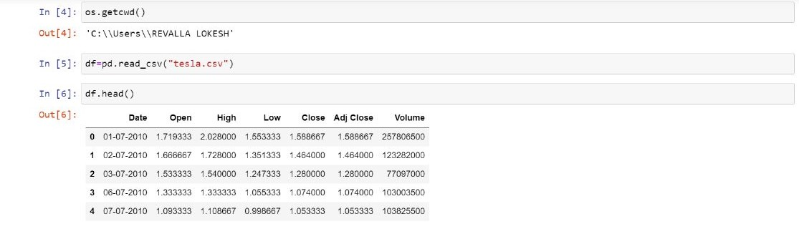
OUTPUTS:

Slide 20
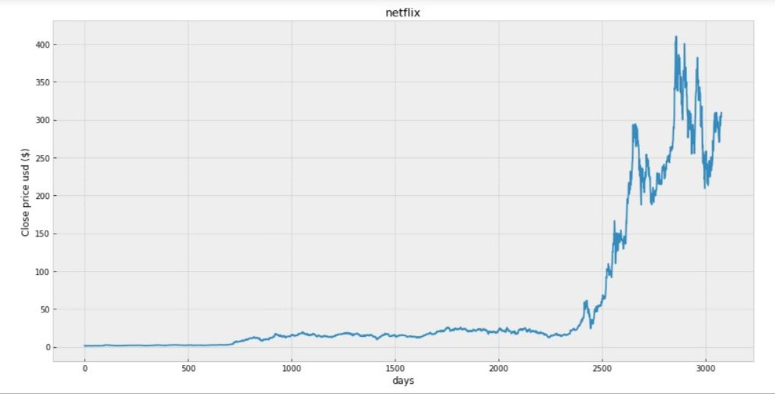
Data before prediction :

Slide 21
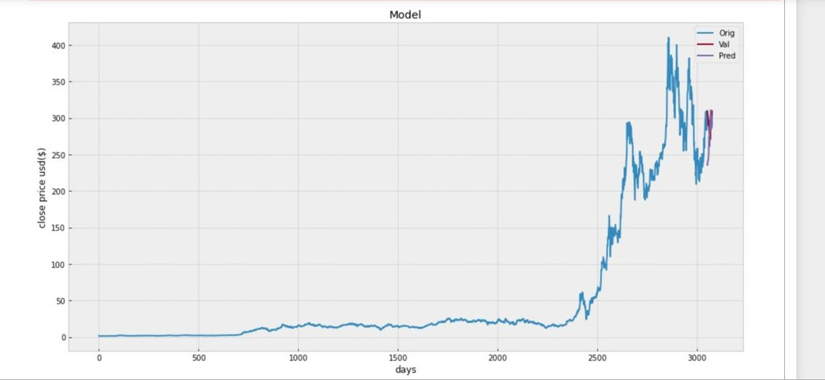
Data after prediction :

Slide 22
Conclusion :
Time series analysis is one of the most important aspect of data analytics for any large organization as it helps in understanding seasonality, trends, cyclicality and randomness in the sales and distribution and other attributes.
The task facing the modern time-series econometrician is to develop reasonably simple models capable of forecasting, interpreting, and testing hypotheses concerning economic data. . The challenge has grown over time the original use of time-series analysis was primarily as an aid to forecasting. As such, a methodology was developed to decompose a series into a trend, a seasonal, a cyclical, and an irregular component. Uncovering the dynamic path of a series improves forecast accuracy.. Using the time-series methods, it is possible to decompose this series into the trend, seasonal, and irregular components.

Slide 23
Applications :
Economic Forecasting
Gold price
Sales Forecasting
Budgetary Analysis
Stock Market Analysis
Process and Quality Control
Inventory Studies
Workload Projections
Utility Studies

