Slide 1



G H RAISONI INSTITUTE OF ENGINEERING AND TECHNOLOGY, NAGPUR
(Approved by AICTE, New Delhi and Recognized by DTE, Maharashtra)
An Autonomous Institute Affiliated to Rashtrasant Tukadoji Maharaj Nagpur University, Nagpur
Accredited by NAAC with A+ Grade
Department of Computer Science & Engineering
Introductory Seminar
On
AN EMULATOR FOR THE ATARI 2600 VIDEO-GAME-CONSOLE
by
Aayush Raj Singh
Anshul Nagrare
Shreeyash Pandey
Session 2021-22

Slide 2
Contents
Introduction
Literature Survey
‘Why we chose to write an emulator’
Objectives
Software and Hardware Requirements
Expected Result

Slide 3
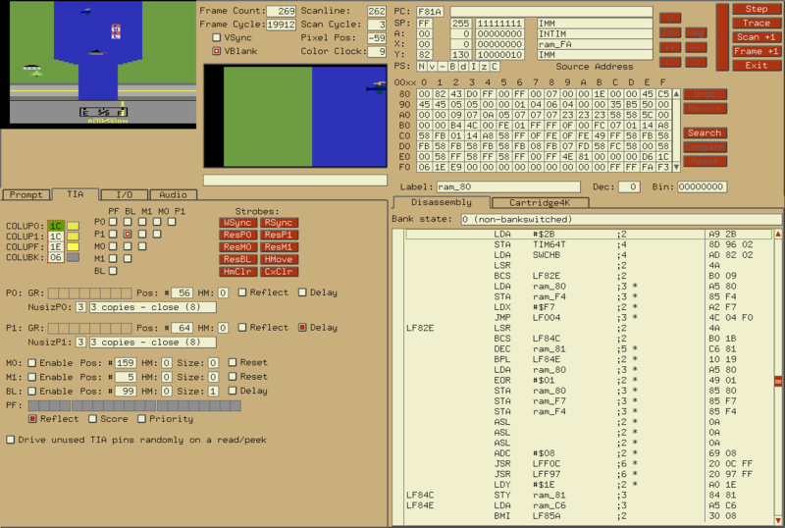
Emulator
An emulator is hardware or software that enables one computer system
(called the host) to behave like another computer system called the guest

Slide 4
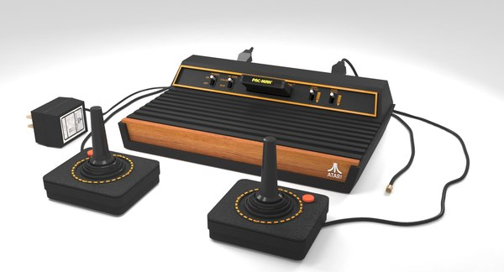
Atari 2600
* Atari Inc. was one of the first companies to enter the home-video-game-console
market.
* Atari 2600 was the best-selling console in the late 70s.
* Two Controllers
* MOS 6507 CPU
* MOS 6532 RIOT RAM Module
* Custom TIA chip for Graphics.

Slide 5
Literature Survey
1. Atari 2600 Specification Sheet - Nocash
2. 6502 Assembly Language Programming - Christopher Lampton
3 Atari 2600 Programming Guide (Stella) - Steve Wright
4. Making Games for Atari 2600 - Steven Hugg
5. Atari Age <https://atariage.com>

Slide 6
WHY WE CHOSE TO WRITE AN EMULATOR
Curiosity and a desire to understand computers and computer architecture at a deeper level.
An affinity towards “low-level” programs.
An emulator is at the right level of the computer hierarchy.
Lower than this and we are dealing with hardwares; any higher and the program becomes a mere abstraction

Slide 7
Objective
Not Complete.
But compliant.
Getting as close as possible to a complaint Atari 2600 emulator, capable of running a game written for the original system.

Slide 8
Software and Hardware Requirements
No Hardware
C Programming Language and SDL Media Library.
Software Tools:
Compilers: gcc, clang, msvc.
Debuggers: gdb.
Profilers: gprof
Build System: make
Libraries: SDL
Testing: [No knowledge yet]
Emulators: Stella

