Slide 1
工作汇报
张博钧
2025/10/11

Slide 2
目录
Data prepare
Multi Branch Transolver
Error locate

Slide 3
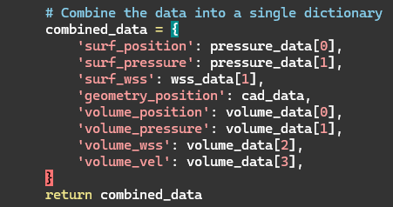
Data prepare
CADdata_loader.py
Volume_data_loader.py
WSSdata_loader.py
Pressure_data_loader.py
CombinedDataset.py

Slide 4
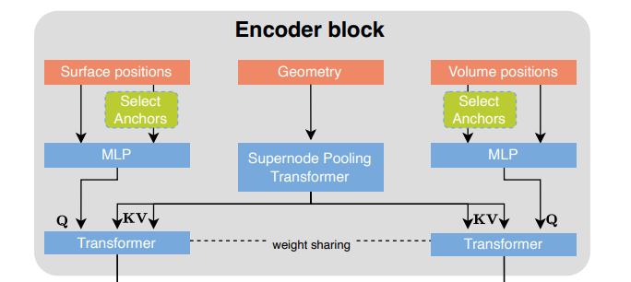
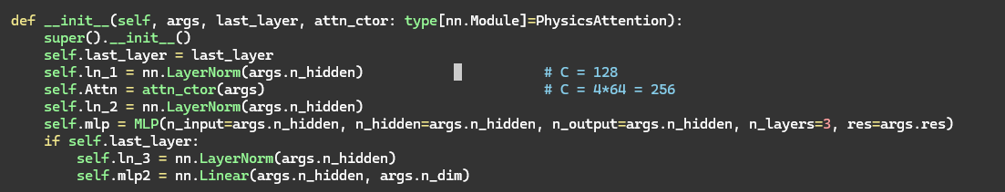
MB-Transolver
Geometry
position_embed = MLP(n_dim=3, n_hidde=128, n_layers=8, res=True)
transolver_block.py
physics_attention.py

Slide 5
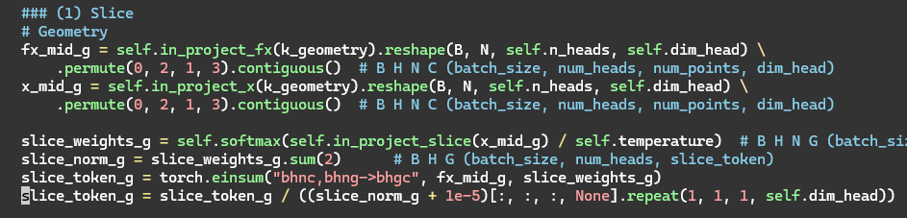
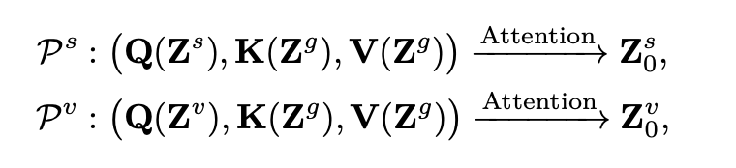
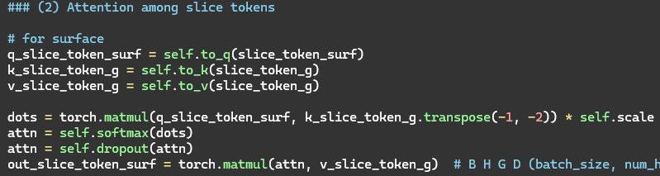
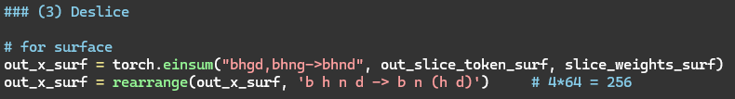
MB-Transolver
perceiver_block.py
perceiver_attention.py

Slide 6
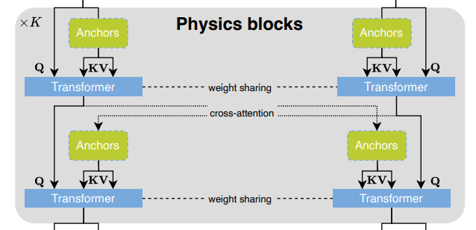
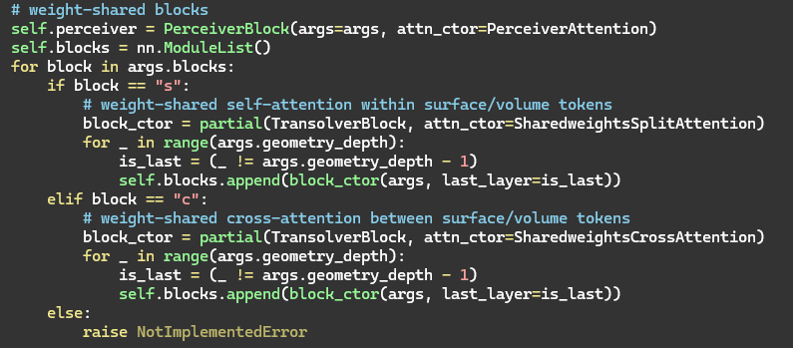
MB-Transolver
transolver_block.py
sharedweights_split_attention.py sharedweights_cross_attention.py

Slide 7
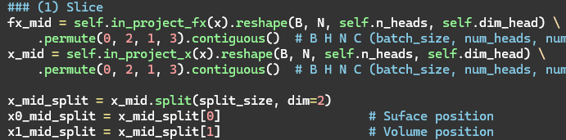

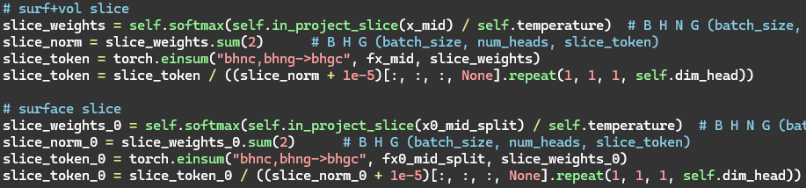
MB-Transolver
sharedweights_split_attention.py

Slide 8
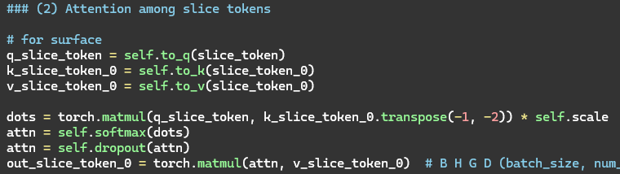
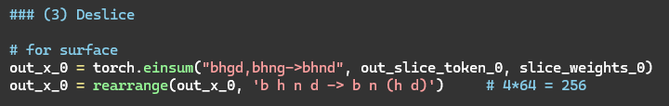
MB-Transolver
sharedweights_split_attention.py

Slide 9
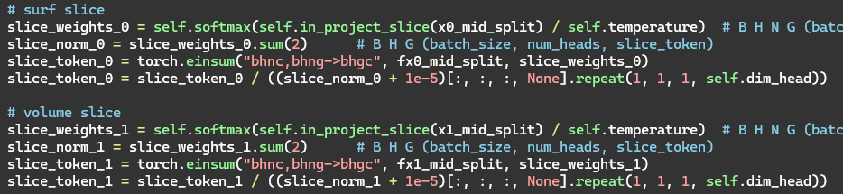
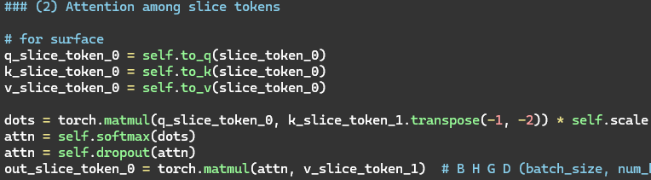

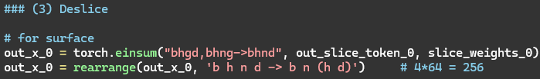
MB-Transolver
sharedweights_cross_attention.py

Slide 10
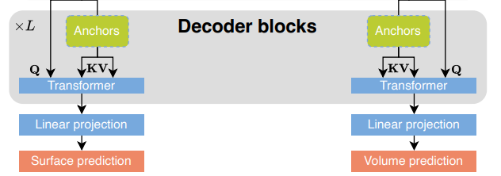
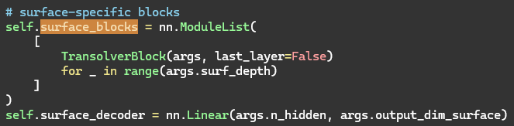
MB-Transolver
tansolver_block.py

Slide 11
Error Locate
体积场数据和面场数据区别太大
check
MLP 隐藏层过多
check
pos_embed 编码的方式不同
Rope frequencies 未使用
Slice对于split_attention和corss_attention的影响

Slide 12
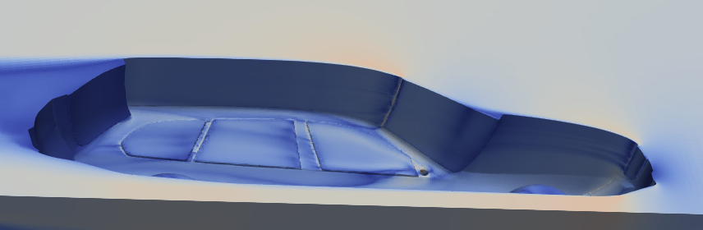
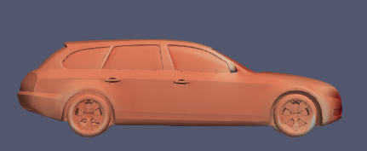

Error Locate
volume
Surface

