Slide 1
工作汇报
张博钧
2025/8/2

Slide 2
目录
Transolver Darcy flow 结果复现
DrivAriNet Pressure field 结果复现

Slide 3
1. Transolver Darcy flow 结果复现
Darcy Flow | L2_error
Wu2024 |  | 0.0057
Mine |  | 0.0047(train_loss) 0.0082(evaluation_loss)

Slide 4
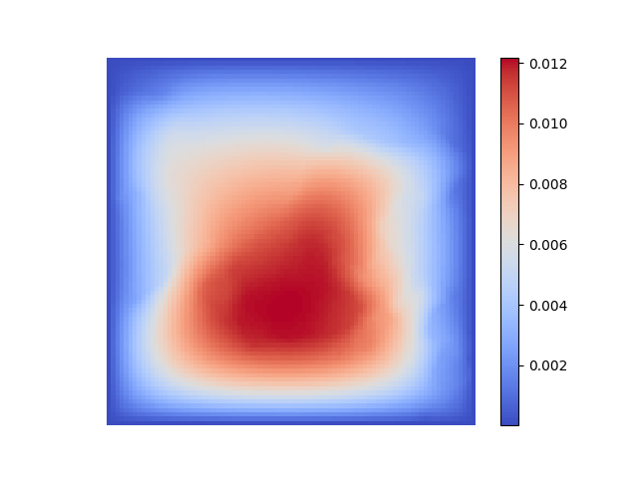
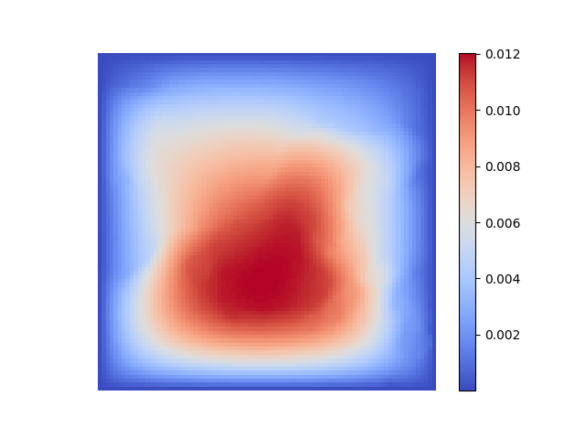
1. Transolver Darcy flow 结果复现
Prediction
Ground Truth

Slide 5
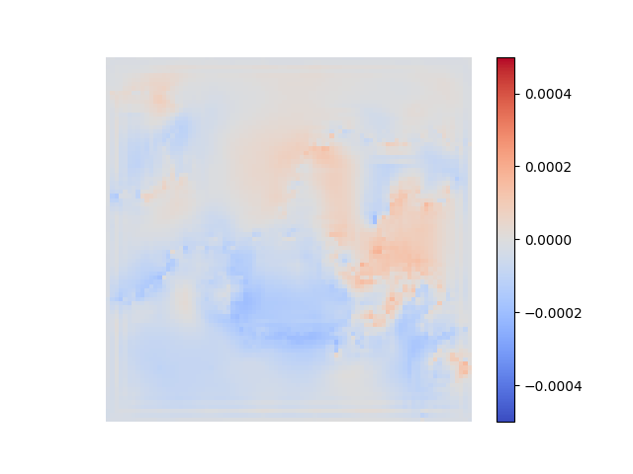
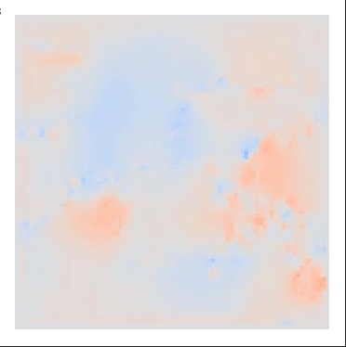

1. Transolver Darcy flow 结果复现
Mine
Wu2024

Slide 6
2. DrivAriNet Pressure field 结果复现
Pressure field | Test_R2
DrivAriNet |  | /
Mine |  | 0.91

Slide 7
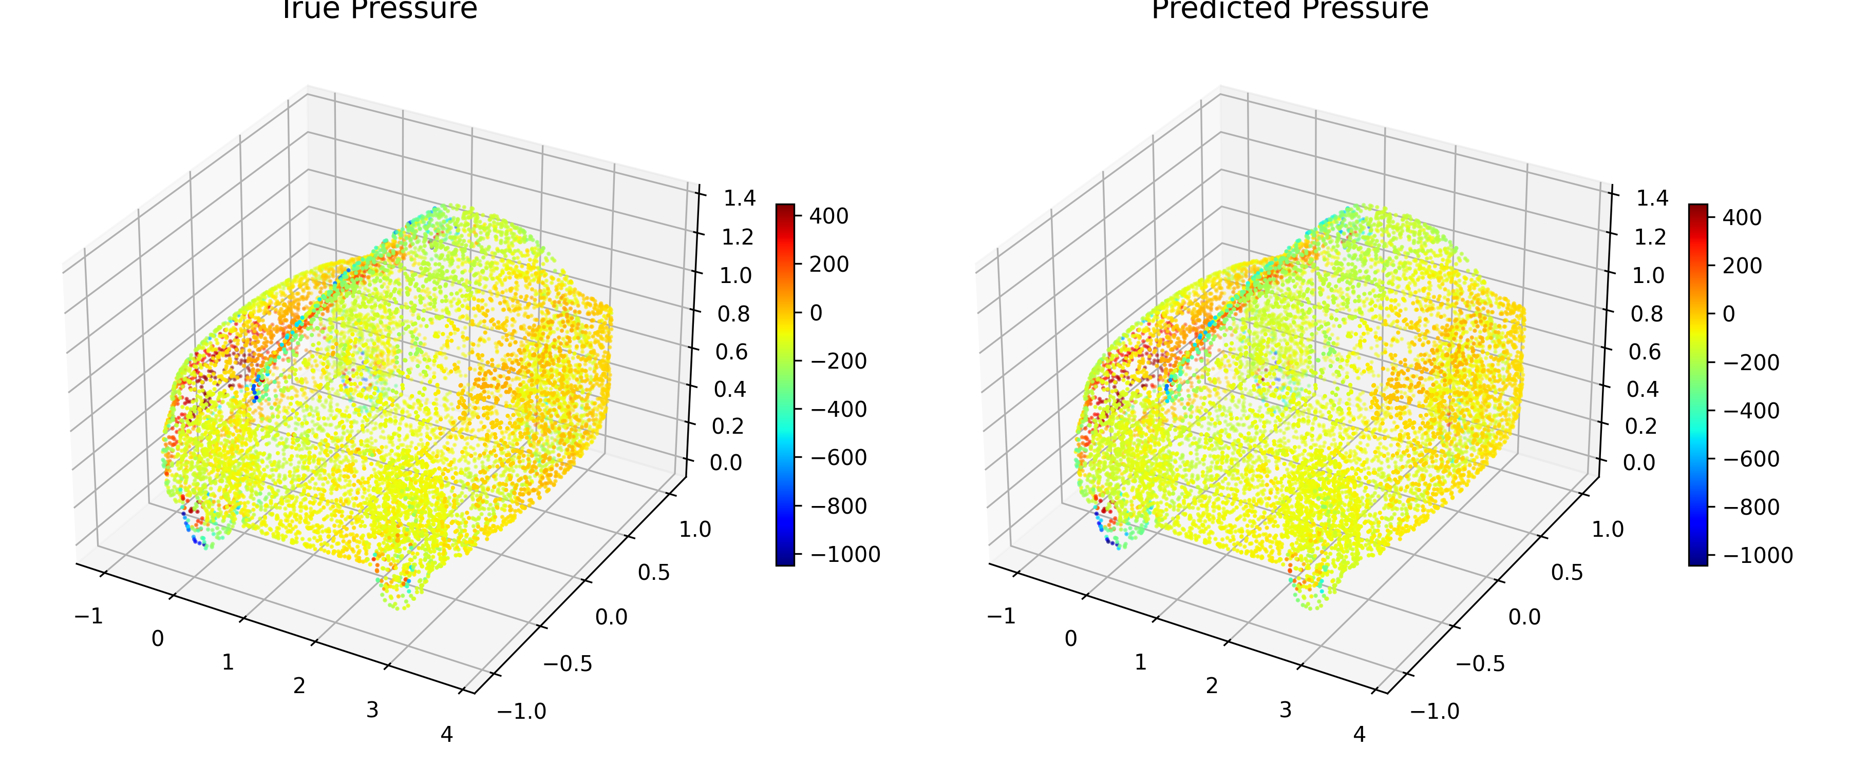
2. DrivAriNet Pressure field 结果复现
Prediected Pressure
True Pressure

