Slide 1
工作汇报
张博钧
2025/8/2

Slide 2
目录
Transolver Darcy flow 结果复现
DrivAriNet Pressure field 结果复现
Transolver + 3D PointNet file
Future work

Slide 3
1. Transolver Darcy flow 结果复现
Darcy Flow | L2_error
Wu2024 |  | 0.0057
Mine |  | 0.0047(train_loss) 0.0082(validation_loss)

Slide 4
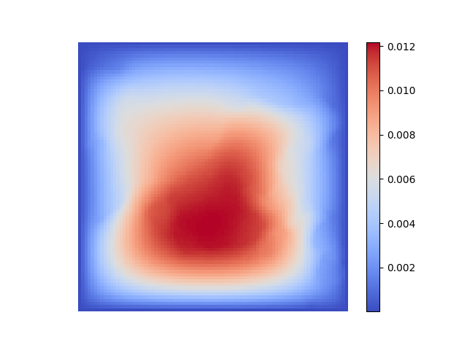
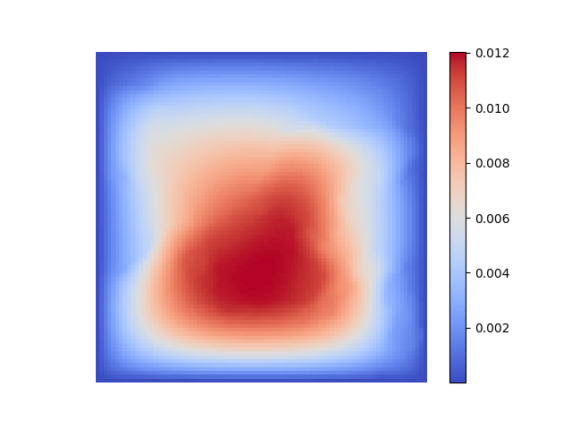
1. Transolver Darcy flow 结果复现
Prediction
Ground Truth

Slide 5
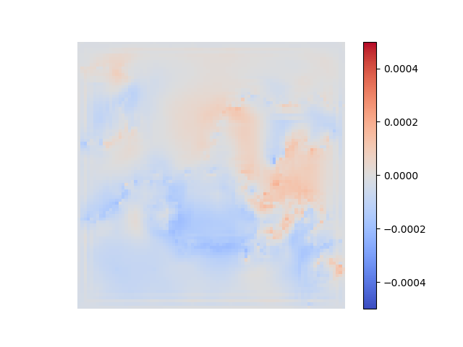
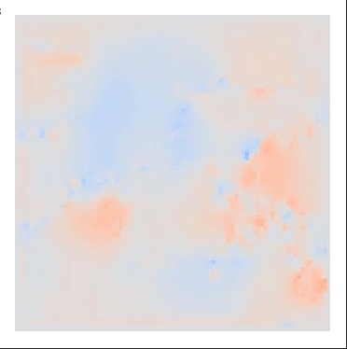

1. Transolver Darcy flow 结果复现
Transolver error
Mine
Wu2024

Slide 6
2. DrivAriNet Pressure field 结果复现
Pressure field | Test_R2 |  | Train_loss
DrivAriNet |  | / |  | /
Mine |  | 0.90 |  | 0.1

Slide 7
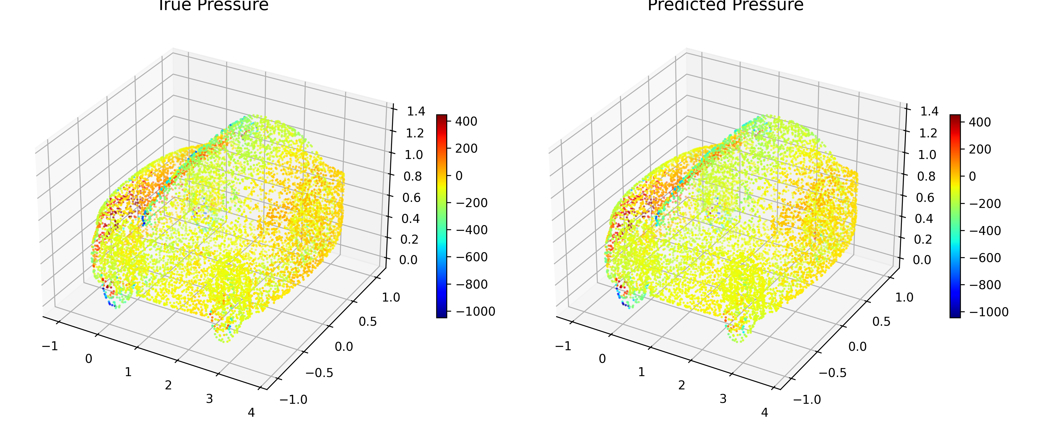
2. DrivAriNet Pressure field 结果复现
Prediected Pressure
True Pressure

Slide 8
3. Transolver + 3D PointNet
Pressure field | Test_R2 |  | Train_loss
DrivAriNet |  | 0.90 |  | 0.1
Transolver |  | 0.95 |  | 0.05

Slide 9
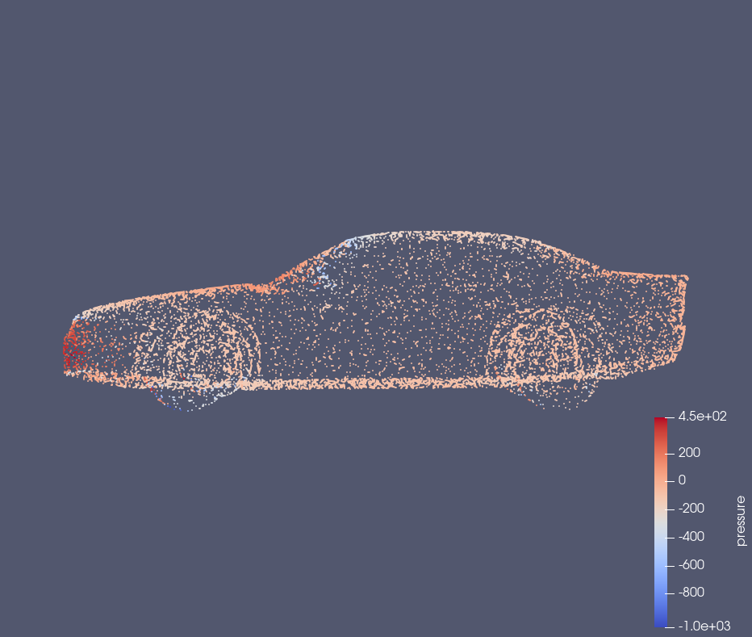
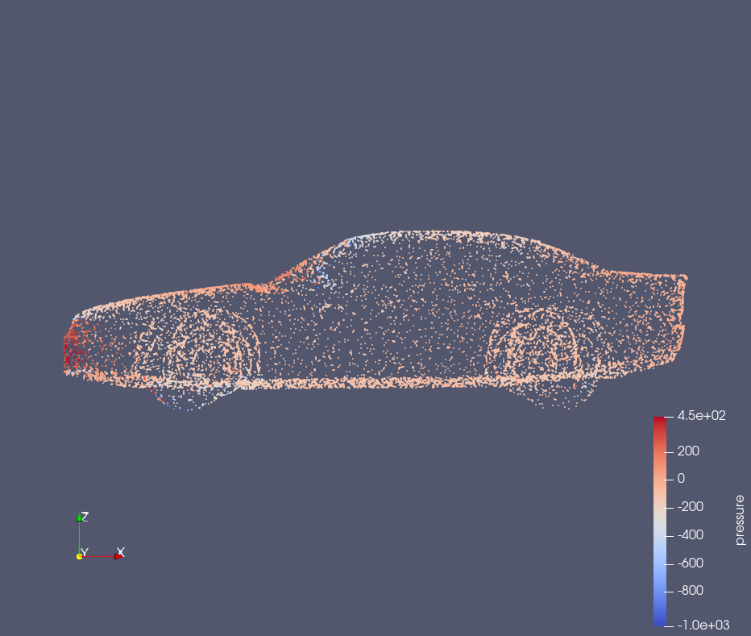
3. Transolver + 3D PointNet
Prediected Pressure
Ground Truth
Notes:
目前用的是10k个点，

