Slide 1

Geological Modeling by Cokriging Interpolation in GemPy and Its Hardware Acceleration
Advising Prof. : 黃穎聰 教授
Student : 陳帛駿

Slide 2
Project Flow Chart
Algorithm
Profiling
Hardware
Integration
Compare

Slide 3
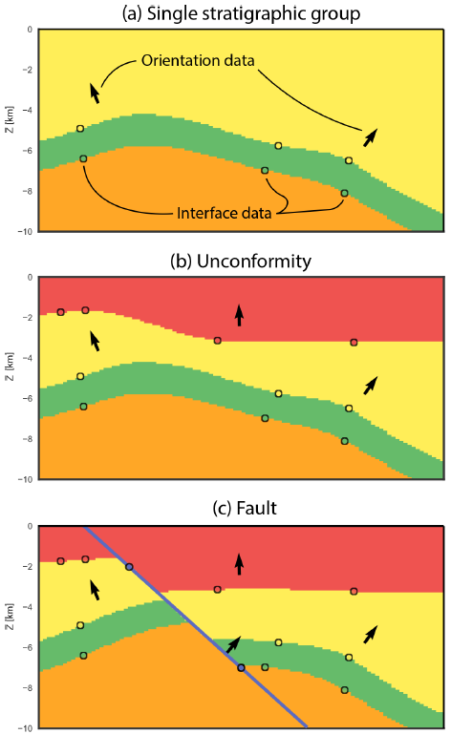
GemPy Geological Modeling
The construction of 3-D geological models from geological
input data. Include surface contact points and orientation
measurements, stratigraphic sequences and fault networks.

Slide 4
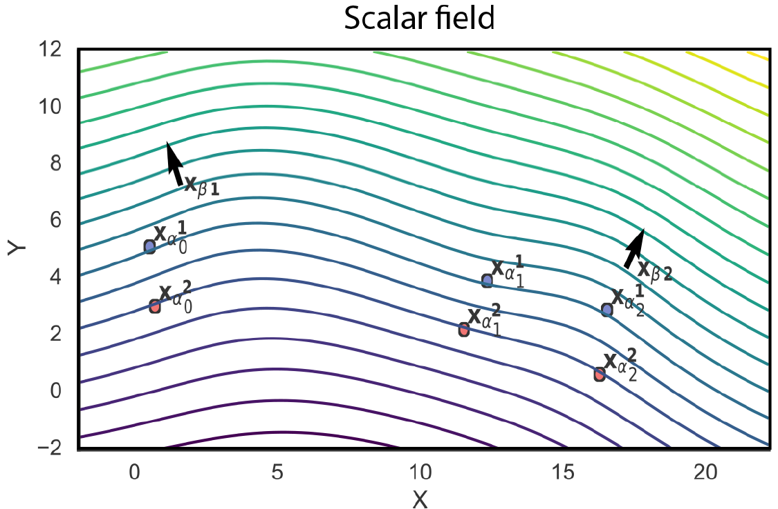

GemPy Geological Modeling
The general idea is to construct an interpolation function Z(x) where x is any point in the continuous three-dimensional space $(x, y, z)∈{ℝ }^{3}$, which describes the domain $𝒟$as a scalar field.
The interpolation function is obtained as a weighted interpolation based on universal cokriging.

Slide 5
Kriging Interpolation
Used to estimate data at unknown points based on known data at observed points.
Applicable to almost any problem where we need to know a value at every location in space, and we are confident that closer locations are more similar.
It can be used for mineral analysis, water saturation, population distribution, precipitation analysis, and more.
Simple Kriging – known mean.
Ordinary Kriging – unknown mean but constant.
Universal Kriging – mean varies smoothly via specified trend.
Co-Kriging – multiple observed data.

Slide 6
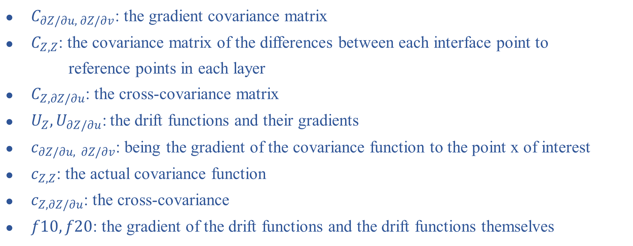
Universal Cokriging In GemPy
$C_{∂Z/∂u, ∂Z/∂v}$: the gradient covariance matrix
$C_{Z, Z}$: the covariance matrix of the differences between each interface point to
reference points in each layer
$C_{Z, ∂Z/∂u}$: the cross-covariance matrix
$U_{Z}, U_{∂Z/∂u}\text{:}$the drift functions and their gradients
$c_{∂Z/∂u, ∂Z/∂v}$: being the gradient of the covariance function to the point x of interest
$c_{Z, Z}$: the actual covariance function
$c_{Z, ∂Z/∂u}$: the cross-covariance
$f10, f20$: the gradient of the drift functions and the drift functions themselves

Slide 7

Dual form
$c_{∂Z/∂u, Z }$, $c_{Z, Z}$, $f20$ of RHS change with calculated point.
For each calculated point we must solve the whole system.
For this reason it is recommended to solve the system in its dual form.
Then RHS is independent of the calculated point. Only need to solve system once.

Slide 8
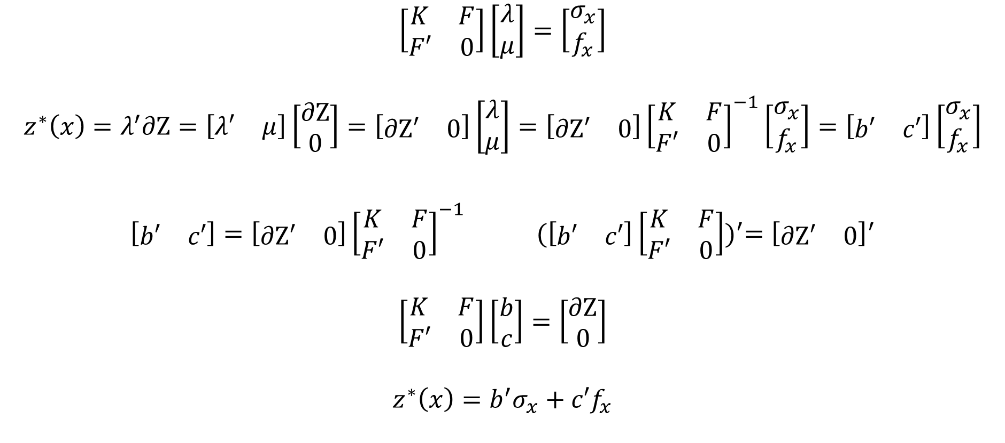
Dual form
$$\left[\begin{matrix}K & F \\ F′ & 0\end{matrix}\right]\left[\begin{matrix}λ \\ μ\end{matrix}\right]=\left[\begin{matrix}σ_{x} \\ f_{x}\end{matrix}\right]$$
$$z^{∗}\left(x\right)=λ^{′}\text{∂}\text{Z}=\left[\begin{matrix}λ′ & μ\end{matrix}\right]\left[\begin{matrix}\text{∂}\text{Z} \\ 0\end{matrix}\right]=\left[\begin{matrix}\text{∂}\text{Z}′ & 0\end{matrix}\right]\left[\begin{matrix}λ \\ μ\end{matrix}\right]=\left[\begin{matrix}\text{∂}\text{Z}′ & 0\end{matrix}\right]{\left[\begin{matrix}K & F \\ F′ & 0\end{matrix}\right]}^{−1}\left[\begin{matrix}σ_{x} \\ f_{x}\end{matrix}\right]=\left[\begin{matrix}b′ & c′\end{matrix}\right]\left[\begin{matrix}σ_{x} \\ f_{x}\end{matrix}\right]$$
$\left[\begin{matrix}b′ & c′\end{matrix}\right]=\left[\begin{matrix}\text{∂}\text{Z}′ & 0\end{matrix}\right]{\left[\begin{matrix}K & F \\ F′ & 0\end{matrix}\right]}^{−1}$ ${(\left[\begin{matrix}b′ & c′\end{matrix}\right]\left[\begin{matrix}K & F \\ F′ & 0\end{matrix}\right])}^{′}={\left[\begin{matrix}\text{∂}\text{Z}′ & 0\end{matrix}\right]}^{′}$
$$\left[\begin{matrix}K & F \\ F′ & 0\end{matrix}\right]\left[\begin{matrix}b \\ c\end{matrix}\right]=\left[\begin{matrix}\text{∂}\text{Z} \\ 0\end{matrix}\right]$$
$$z^{∗}\left(x\right)=b^{′}σ_{x}+c′f_{x}$$
dual form

Slide 9
Calculate Flow
Interface coordinate
Orientation coordinate
Orientation data
SRT transform
SRT transform
C_Z
U_{Z}
C_GZ
U _{∂Z/ ∂u}
C_G
extent
K
b
resolution
grid
w
SRT transform
Scalar field
labels

Slide 10







Parameter
$$oi means ith orientation point$$
$$i_{k}^{j} means kth interface point in jth layer$$
$a=1.7$(range)
c_o$=10$ (sill)
nugget_grad$=1e−2$
nugget_scalar$=2e−5$
$$\text{ε}=1e−5$$
i_res$=4$
gi_res$=2$

Slide 11

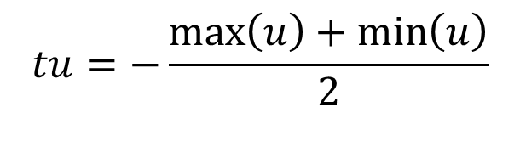
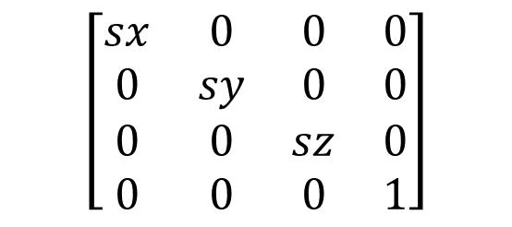

SRT Transform
Implement scale rotate and translate in one matrix.
Make the distance magnitude of axis consistent.
All interface and orientation coordinates are scaled to [-0.25, 0.25].
$$sx=sy=sz=\frac{1}{2∗max\left(\max\left(x\right)−\min\left(x\right),\max\left(y\right)−\min\left(y\right),\max\left(z\right)−\min\left(z\right)\right)}$$
$$tu=−\frac{\max\left(u\right)+\min\left(u\right)}{2}$$
S
R
T
$$\left[\begin{matrix}sx & 0 & 0 & 0 \\ 0 & sy & 0 & 0 \\ 0 & 0 & sz & 0 \\ 0 & 0 & 0 & 1\end{matrix}\right]$$
$$\left[\begin{matrix}r_{11} & r_{12} & r_{13} & 0 \\ r_{21} & r_{22} & r_{23} & 0 \\ r_{31} & r_{32} & r_{33} & 0 \\ 0 & 0 & 0 & 1\end{matrix}\right]$$
$$\left[\begin{matrix}1 & 0 & 0 & tx \\ 0 & 1 & 0 & ty \\ 0 & 0 & 1 & tz \\ 0 & 0 & 0 & 1\end{matrix}\right]$$

Slide 12
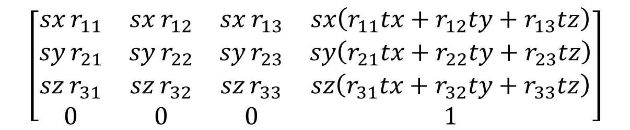

SRT Transform
The fourth column is only there to ensure that the SRT matrix is square. We don't need to keep it, so it can be removed.
S*R*T
$$\left[\begin{matrix}sx r_{11} & sx r_{12} & sx r_{13} & sx​\left(r_{11}tx+r_{12}ty+r_{13}tz\right) \\ sy r_{21} & sy r_{22} & sy r_{23} & sy​\left(r_{21}tx+r_{22}ty+r_{23}tz\right) \\ sz r_{31} & sz r_{32} & sz r_{33} & sz​\left(r_{31}tx+r_{32}ty+r_{33}tz\right) \\ 0 & 0 & 0 & 1\end{matrix}\right]$$
$$input=S∗R∗T∗[input, 1]′$$

Slide 13
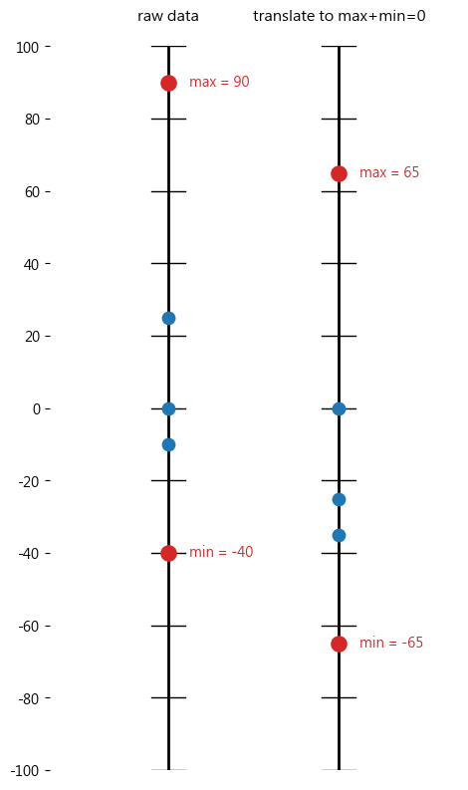
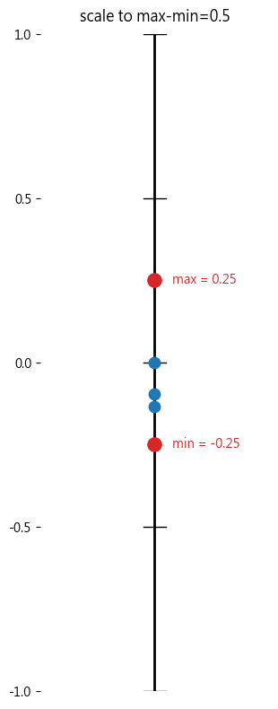
SRT Transform

Slide 14
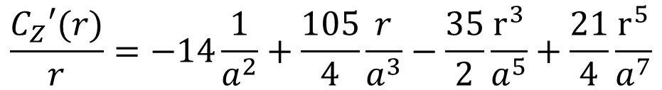
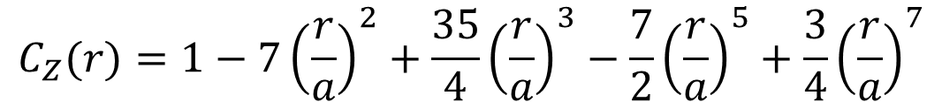
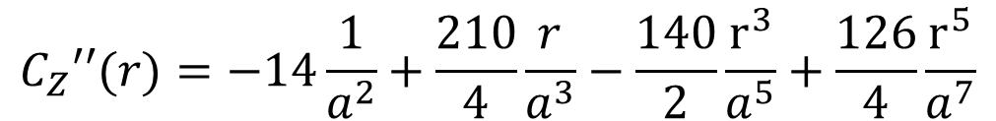
Covariance model
Use cubic covariance because of mathematical robustness and its coherent geological description of the space.
Parameter r is 3D Euclidean distance .
Cubic covariance
$$C_{Z}(r)=1−7{\left(\frac{r}{a}\right)}^{2}+\frac{35}{4}{\left(\frac{r}{a}\right)}^{3}−\frac{7}{2}{\left(\frac{r}{a}\right)}^{5}+\frac{3}{4}{\left(\frac{r}{a}\right)}^{7}$$
$$\frac{C_{Z}′(r)}{r}=−14\frac{1}{a^{2}}+\frac{105}{4}\frac{r}{a^{3}}−\frac{35}{2}\frac{r^{3}}{a^{5}}+\frac{21}{4}\frac{r^{5}}{a^{7}}$$
$$C_{Z}′′(r)=−14\frac{1}{a^{2}}+\frac{210}{4}\frac{r}{a^{3}}−\frac{140}{2}\frac{r^{3}}{a^{5}}+\frac{126}{4}\frac{r^{5}}{a^{7}}$$

Slide 15
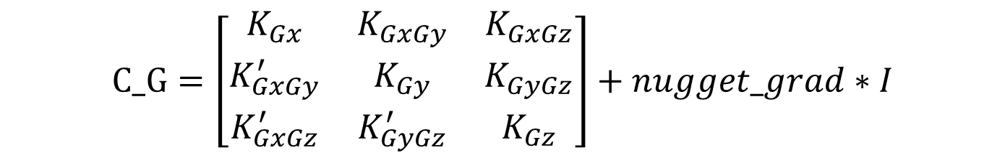
Gradient covariance
Calculate the covariance matrix between gradient points.
Need some sub matrix to construct.
Add nugget_grad to diagonal.
$$C_G=\left[\begin{matrix}\begin{matrix}K_{Gx} & K_{GxGy} & K_{GxGz} \\ K_{GxGy}^{′} & K_{Gy} & K_{GyGz} \\ K_{GxGz}^{′} & K_{GyGz}^{′} & K_{Gz}\end{matrix}\end{matrix}\right]+nugget_grad∗I$$

Slide 16
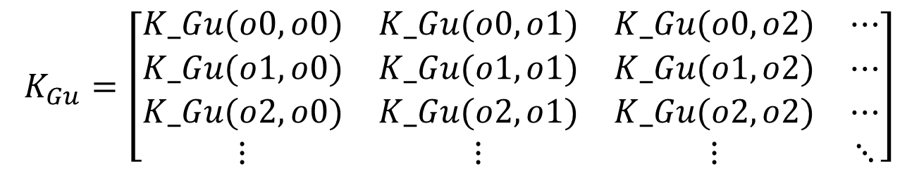
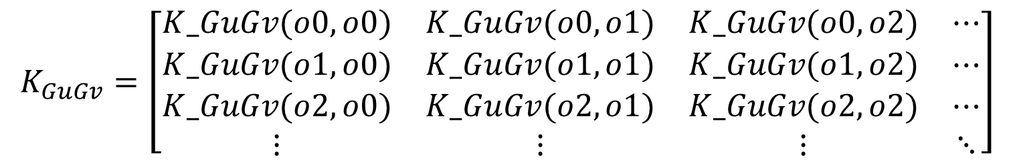
Gradient covariance
$K_{Gu}$ is the sub covariance matrix of same direction.
$K_{GuGv}$ is the sub covariance matrix of different direction.
$$K_{Gu}=\left[\begin{matrix}K_Gu(o0,o0) & K_Gu(o0,o1) & K_Gu(o0,o2) & ⋯ \\ K_Gu(o1,o0) & K_Gu(o1,o1) & K_Gu(o1,o2) & ⋯ \\ K_Gu(o2,o0) & K_Gu(o2,o1) & K_Gu(o2,o2) & ⋯ \\ ⋮ & ⋮ & ⋮ & ⋱\end{matrix}\right]$$
$$K_{GuGv}=\left[\begin{matrix}\begin{matrix}K_GuGv(o0,o0) & K_GuGv(o0,o1) & K_GuGv(o0,o2) & ⋯ \\ K_GuGv(o1,o0) & K_GuGv(o1,o1) & K_GuGv(o1,o2) & ⋯ \\ K_GuGv(o2,o0) & K_GuGv(o2,o1) & K_GuGv(o2,o2) & ⋯ \\ ⋮ & ⋮ & ⋮ & ⋱\end{matrix}\end{matrix}\right]$$

Slide 17
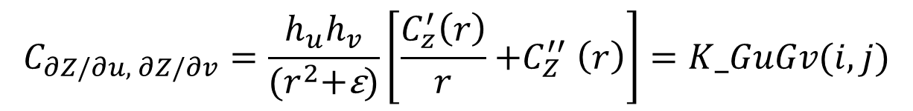
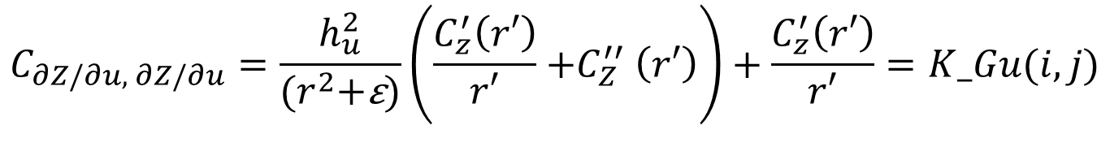
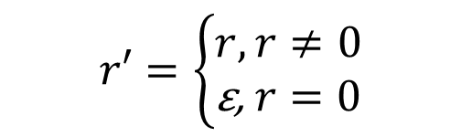
Gradient covariance
Add a small constant ε to the denominator to avoid division by zero.
If r = 0 let r’ = ε.
$$r′=\left\{\begin{aligned}r, r≠0 \\ \text{ε}\text{,} r=0\end{aligned}\right.$$
$$C_{∂Z/∂u, ∂Z/∂u}=\frac{h_{u}^{2}}{{(r}^{2}+\text{ε})}\left(\frac{C_{z}^{′}\left(r′\right)}{r′}{+C}_{Z}^{′′}\left(r′\right)\right)+\frac{C_{z}^{′}\left(r′\right)}{r′}=K_Gu(i, j)$$
$$C_{∂Z/∂u, ∂Z/∂v}=\frac{h_{u}h_{v}}{{(r}^{2}+\text{ε})}\left[\frac{C_{z}^{′}\left(r\right)}{r}{+C}_{Z}^{′′}\left(r\right)\right]=K_GuGv(i, j)$$

Slide 18
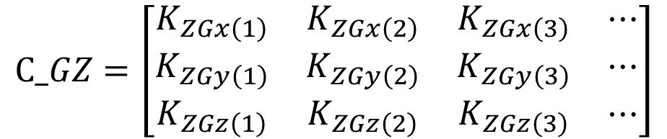
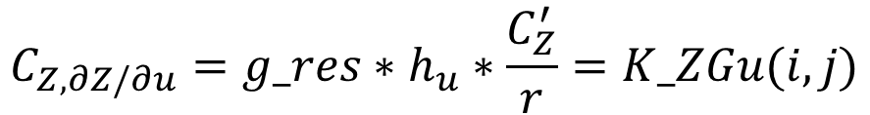
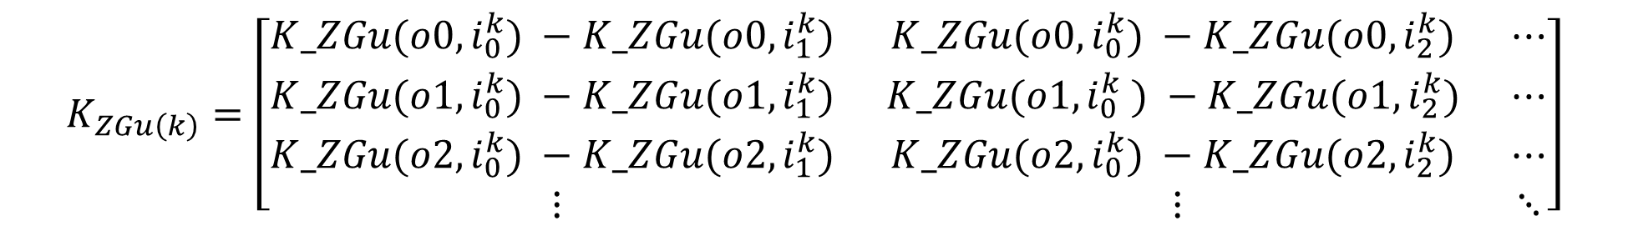
Cross covariance
Calculate the cross covariance matrix between gradient points and interface points.
To calculate cross covariance, we need both gradient points and interface points.
$$C_{Z, ∂Z/∂u}={g_res∗h}_{u}∗\frac{C_{Z}^{′}}{r}=K_ZGu(i,j)$$
$$K_{ZGu\left(k\right)}=\left[\begin{matrix}K_ZGu(o0,i_{0}^{k}) −K_ZGu(o0,i_{1}^{k}) & K_ZGu(o0,i_{0}^{k}) −K_ZGu(o0,i_{2}^{k}) & ⋯ \\ K_ZGu(o1,i_{0}^{k}) −K_ZGu(o1,i_{1}^{k}) & K_ZGu(o1,i_{0}^{k} ) −K_ZGu(o1,i_{2}^{k}) & ⋯ \\ K_ZGu(o2,i_{0}^{k}) −K_ZGu(o2,i_{1}^{k}) & K_ZGu(o2,i_{0}^{k}) −K_ZGu(o2,i_{2}^{k}) & ⋯ \\ ⋮ & ⋮ & ⋱\end{matrix}\right]$$
$$C_GZ=\left[\begin{matrix}K_{ZGx\left(1\right)} & K_{ZGx\left(2\right)} & K_{ZGx\left(3\right)} & ⋯ \\ K_{ZGy\left(1\right)} & K_{ZGy\left(2\right)} & K_{ZGy\left(3\right)} & ⋯ \\ K_{ZGz\left(1\right)} & K_{ZGz\left(2\right)} & K_{ZGz\left(3\right)} & ⋯\end{matrix}\right]$$

Slide 19
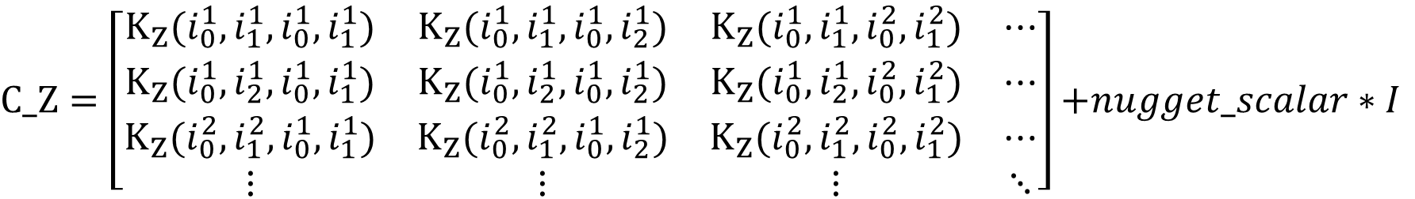
Interface covariance
Calculate the covariance matrix between interface points.
Add nugget_scalar to diagonal.
$$K_Z(v)=i_res∗CZ(r)$$
$$K_{Z}(a,b,c,d)=\left[K_Z\left(a−c\right)−K_Z\left(a−d\right)−K_Z\left(b−c\right)+K_Z\left(b−d\right)\right]$$
$C_Z=\left[\begin{matrix}{K_{Z}(i}_{0}^{1},i_{1}^{1},i_{0}^{1},i_{1}^{1}) & {K_{Z}(i}_{0}^{1},i_{1}^{1},i_{0}^{1},i_{2}^{1}) & {K_{Z}(i}_{0}^{1},i_{1}^{1},i_{0}^{2},i_{1}^{2}) & ⋯ \\ {K_{Z}(i}_{0}^{1},i_{2}^{1},i_{0}^{1},i_{1}^{1}) & {K_{Z}(i}_{0}^{1},i_{2}^{1},i_{0}^{1},i_{2}^{1}) & {K_{Z}(i}_{0}^{1},i_{2}^{1},i_{0}^{2},i_{1}^{2}) & ⋯ \\ {K_{Z}(i}_{0}^{2},i_{1}^{2},i_{0}^{1},i_{1}^{1}) & {K_{Z}(i}_{0}^{2},i_{1}^{2},i_{0}^{1},i_{2}^{1}) & {K_{Z}(i}_{0}^{2},i_{1}^{2},i_{0}^{2},i_{1}^{2}) & ⋯ \\ ⋮ & ⋮ & ⋮ & ⋱\end{matrix}\right]$ $+nugget_scalar∗I$

Slide 20

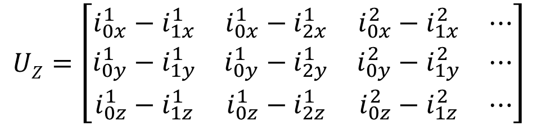

Universal matrix
$U_{Z}, U_{∂Z/∂u}\text{:}$the drift functions and their gradients
Describe certain drift towards the direction of the orientations.
$$UZ=\left[\begin{matrix}i_{0x}^{1}−i_{1x}^{1} & i_{0x}^{1}−i_{2x}^{1} & i_{0x}^{2}−i_{1x}^{2} & ⋯ \\ i_{0y}^{1}−i_{1y}^{1} & i_{0y}^{1}−i_{2y}^{1} & i_{0y}^{2}−i_{1y}^{2} & ⋯ \\ i_{0z}^{1}−i_{1z}^{1} & i_{0z}^{1}−i_{2z}^{1} & i_{0z}^{2}−i_{1z}^{2} & ⋯\end{matrix}\right]$$
$$o0 o1 o2 ⋯ o0 o1 o2 ⋯ o0 o1 o2 ⋯$$
$$U_{∂Z/∂u}=\left[\begin{matrix}1 & 1 & 1 & ⋯ & 0 & 0 & 0 & ⋯ & 0 & 0 & 0 & ⋯ \\ 0 & 0 & 0 & ⋯ & 1 & 1 & 1 & ⋯ & 0 & 0 & 0 & ⋯ \\ 0 & 0 & 0 & ⋯ & 0 & 0 & 0 & ⋯ & 1 & 1 & 1 & ⋯\end{matrix}\right]$$

Slide 21
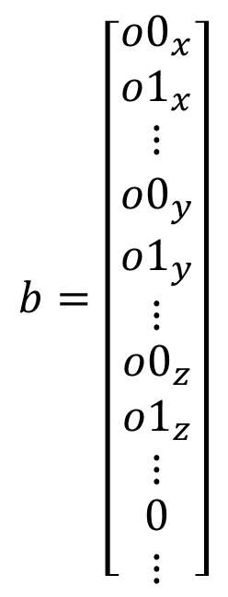
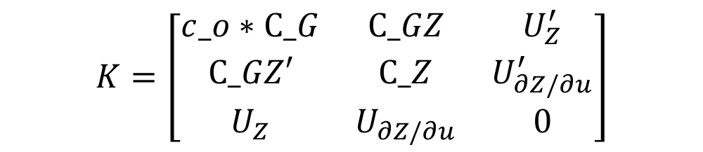
Weights
Combine all sub matrix get kriging matrix K.
Combine all orientation points and 0 get b vector.
Size determine by how many inputs.
Solve weights by K matrix and b vector.
$$b=\left[\begin{matrix}{o0}_{x} \\ {o1}_{x} \\ \begin{matrix}\begin{matrix}⋮ \\ {o0}_{y}\end{matrix} \\ {o1}_{y} \\ \begin{matrix}\begin{matrix}⋮ \\ \begin{matrix}{o0}_{z} \\ {o1}_{z}\end{matrix}\end{matrix} \\ \begin{matrix}⋮ \\ \begin{matrix}0 \\ ⋮\end{matrix}\end{matrix}\end{matrix}\end{matrix}\end{matrix}\right]$$
$$K=\left[\begin{matrix}c_o∗C_G & C_GZ & U_{Z}^{′} \\ C_GZ′ & C_Z & U_{∂Z/∂u}^{′} \\ U_{Z} & U_{∂Z/∂u} & 0\end{matrix}\right]$$
$$3∗orientation_points+interface_points−layers+3$$
$$w=K^{−1}b$$

Slide 22
Evaluate Scalar field
$$Z=w′∗\left[\begin{matrix}\begin{matrix}\begin{matrix}\begin{matrix}\begin{matrix}\begin{matrix}\begin{matrix}\begin{matrix}K_ZGx(o0−grid)∗c_o \\ K_ZGx(o1−grid)∗c_o \\ ⋮\end{matrix} \\ \begin{matrix}K_ZGy(o0−grid)∗c_o \\ K_ZGy(o1−grid)∗c_o \\ ⋮\end{matrix} \\ \begin{matrix}K_ZGz(o0−grid)∗c_o \\ K_ZGz(o1−grid)∗c_o \\ ⋮\end{matrix}\end{matrix}\end{matrix} \\ [K_Z\left(grid−i_{0}^{1}\right)−K_Z\left(grid−i_{1}^{1}\right)]∗c_o \\ [K_Z\left(grid−i_{0}^{1}\right)−K_Z\left(grid−i_{2}^{1}\right)]∗c_o\end{matrix} \\ [K_Z\left(grid−i_{0}^{2}\right)−K_Z\left(grid−i_{1}^{2}\right)]∗c_o \\ ⋮\end{matrix} \\ {grid}_{x}∗gi_res \\ {grid}_{y}∗gi_res\end{matrix} \\ {grid}_{z}∗gi_res\end{matrix}\end{matrix}\right]$$
Scalar field Z is the inner product
of weights and evaluate vector.
We need to do this inner product
many times depend on resolution.

Slide 23
Calculate Flow
Interface coordinate
Orientation coordinate
Orientation data
SRT transform
SRT transform
C_Z
U_{Z}
C_GZ
U _{∂Z/ ∂u}
C_G
extent
K
b
resolution
grid
w
SRT transform
Scalar field
labels

Slide 24
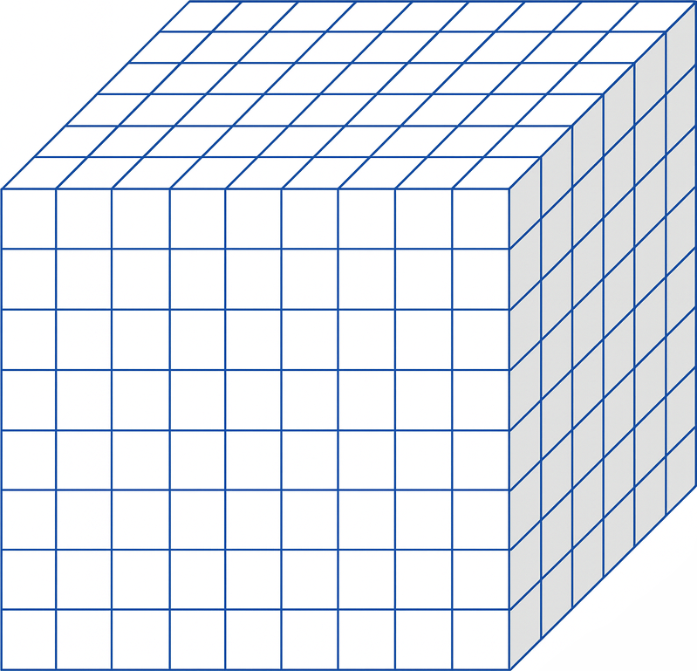



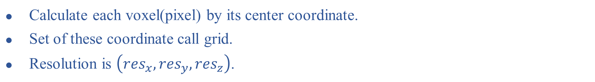
Grid
Calculate each voxel(pixel) by its center coordinate.
Set of these coordinate call grid.
Resolution is $\left({res}_{x},{res}_{y},{res}_{z}\right)$.
$${res}_{z}$$
$${res}_{y}$$
$${res}_{x}$$

Slide 25
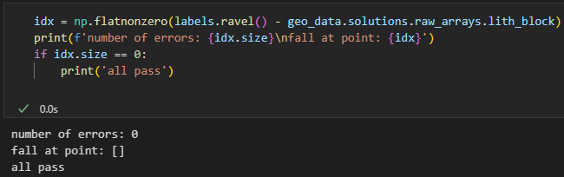
Output
Output values are meaningless. We only care about their relative value.
Replace values in difference section with 1, 2, 3, … from big to small.
The resulting labels show no discrepancy when compared with GemPy’s implementation.

Slide 26
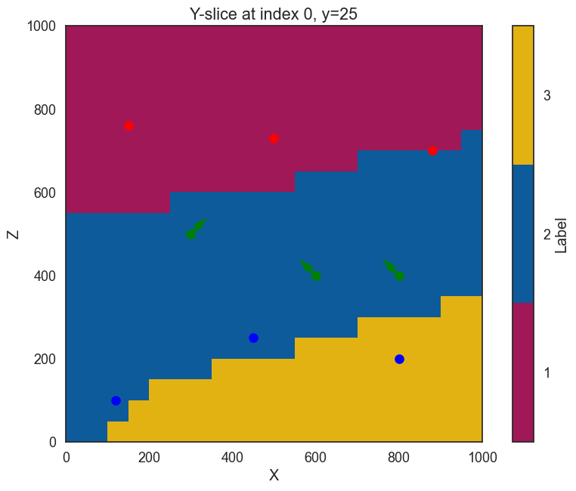
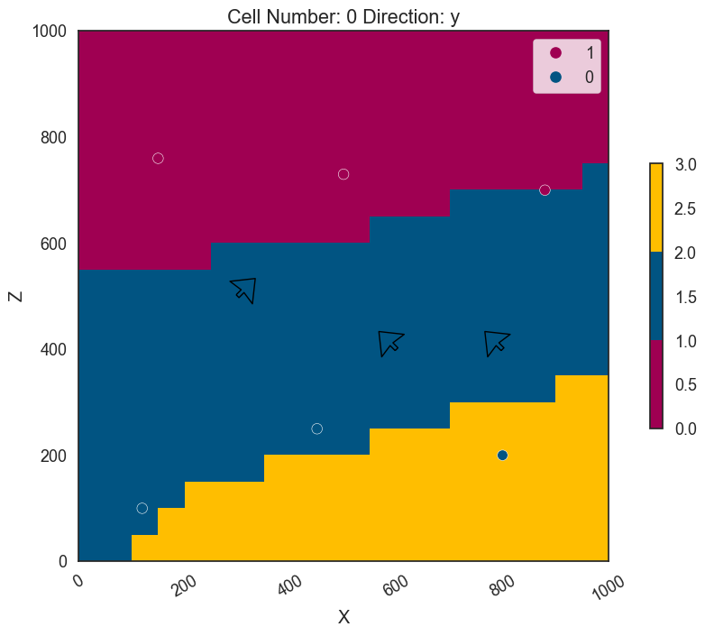
2D Rendering
Rendering colors for each voxel(pixel) by label.
The plot is 2D and points is in 3D space so points will not exactly on interface.

Slide 27
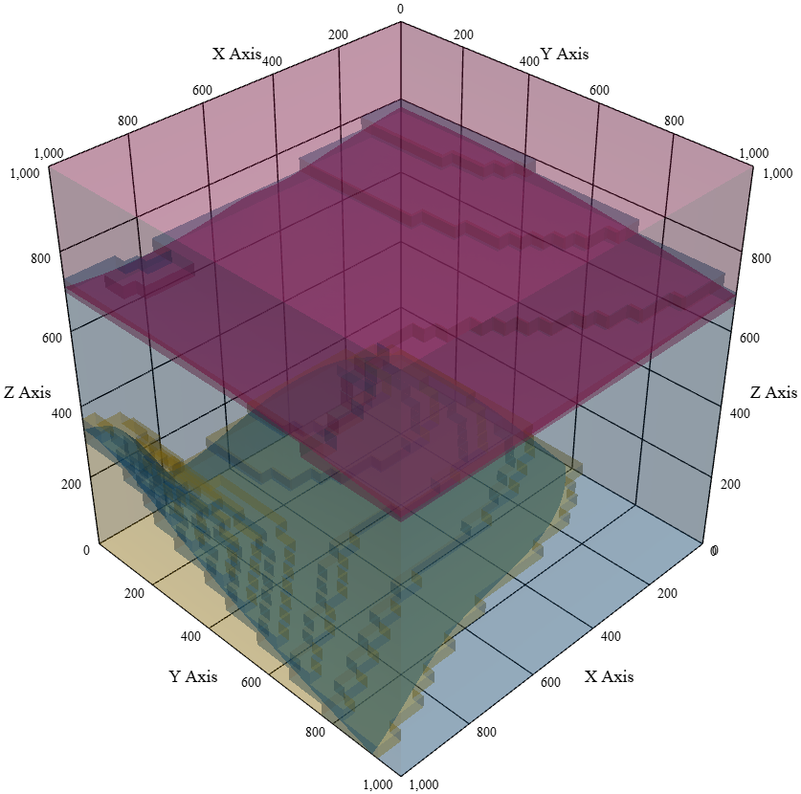
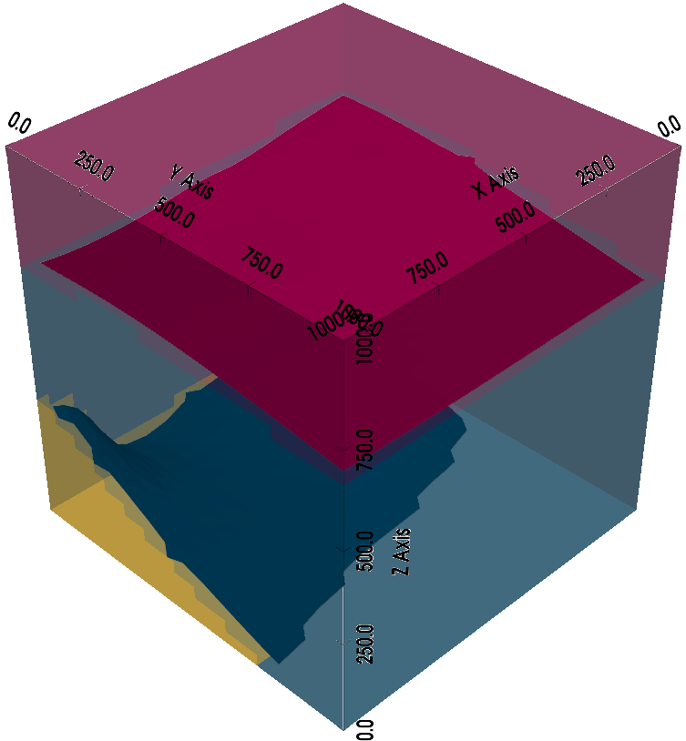
3D Rendering

Slide 28
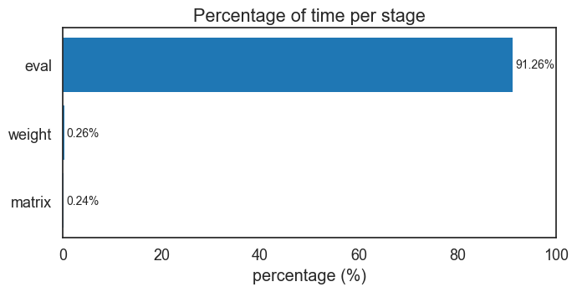
Profiling
Evaluating the scalar field takes the most time.
Establish kriging matrix and solve weight take very small time.

Slide 29

Horner’s Method
Use MATLAB to simulate 10,000,000 times.
Horner’s method speedup 97.14 times.

Slide 30
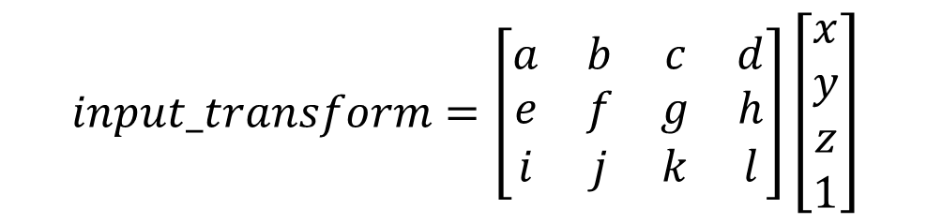
Systolic Array
a,b,…,i and x,y,z,1 are 16-bit signed integers.
Group them in fours and pack them into a 64-bit signed integer.
First 3 clock send matrix value, then each clock send a vector.
$$input_transform=\left[\begin{matrix}a & b & c & d \\ e & f & g & h \\ i & j & k & l\end{matrix}\right]\left[\begin{matrix}x \\ y \\ z \\ 1\end{matrix}\right]$$
$$matrix_val_input1=(d≪48)\left|\left(c≪32\right)\right|(b≪16)|a=\{d,c,b,a\}$$
$$matrix_val_input2=(h≪48)\left|\left(g≪32\right)\right|(f≪16)|e=\{h,g,f,e\}$$
$$matrix_val_input3=(l≪48)\left|\left(k≪32\right)\right|(j≪16)|i=\{l,k,j,i\}$$
$$vector_input=(1≪48)\left|\left(z≪32\right)\right|(y≪16)|x=\{1,z,y,x\}$$

Slide 31
Systolic Array
Signal Name | Width | I/O | Simple Description
clk | 1 | I | Asynchronous rising edge clock
arstn | 1 | I | Asynchronous active low falling edge reset
load | 1 | I | When load is high, update matrix_val
matrix_val | 16 | I | Matrix value (multiplicand)
left_in | 16 | I | Augend
top_in | 16 | I | Multiplier
down_out | 16 | O | Same as top_in
partial_out | 16 | O | left_in + matrix_val * top_in

Slide 32
Systolic Array
A 3x4 systolic array with registers in input and output.
Add registers in input and output so I can input and get output of the same point simultaneously.

Slide 33
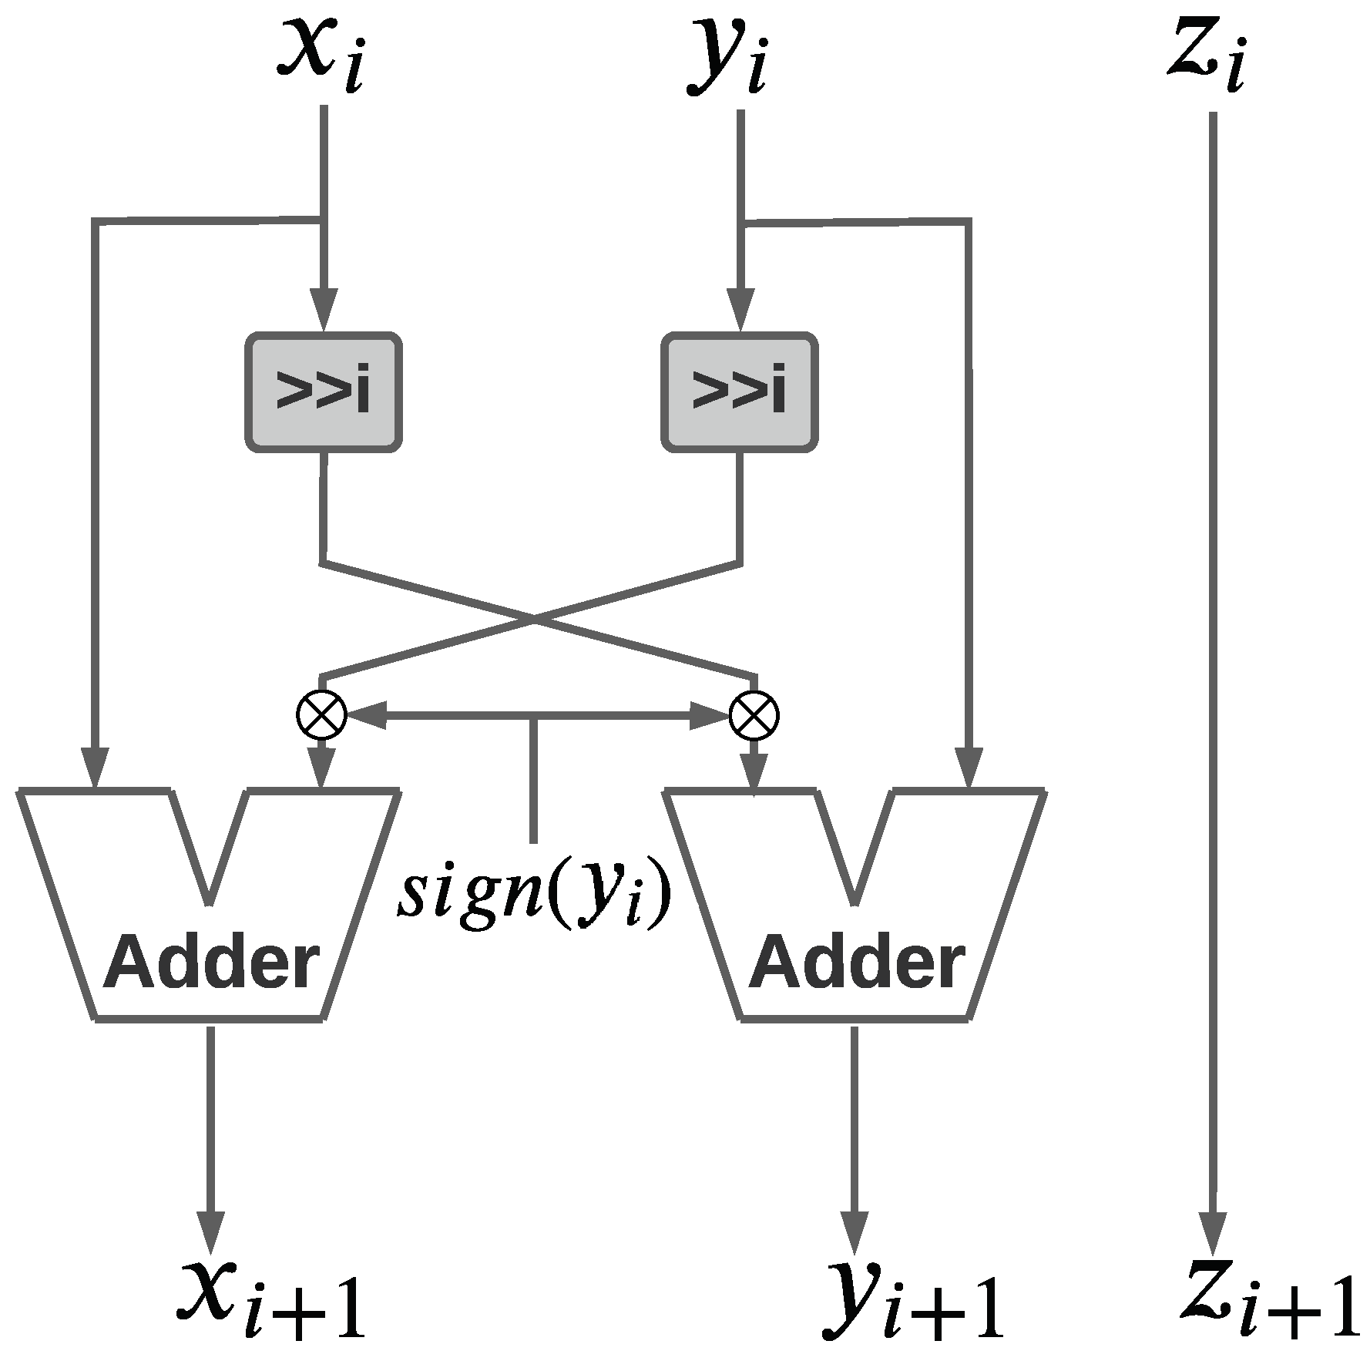
CORDIC
Simplify calculation into simple operations such as shifting and adding.
Multiple iterations are required for accuracy.

Slide 34
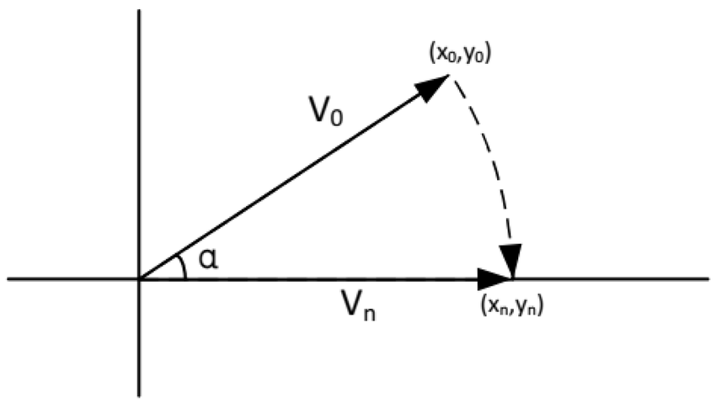
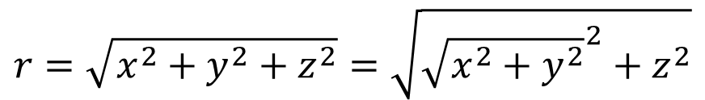
CORDIC
2D Euclidean distance can be calculated by CORDIC vector mode.
Do CORDIC vector mode two times can get 3D Euclidean distance.
$$r=\sqrt{x^{2}+y^{2}+z^{2}}=\sqrt{{\sqrt{x^{2}+y^{2}}}^{2}+z^{2}}$$

Slide 35
CORDIC
Series connect two 16-stage pipeline CORDIC IP.

Slide 36
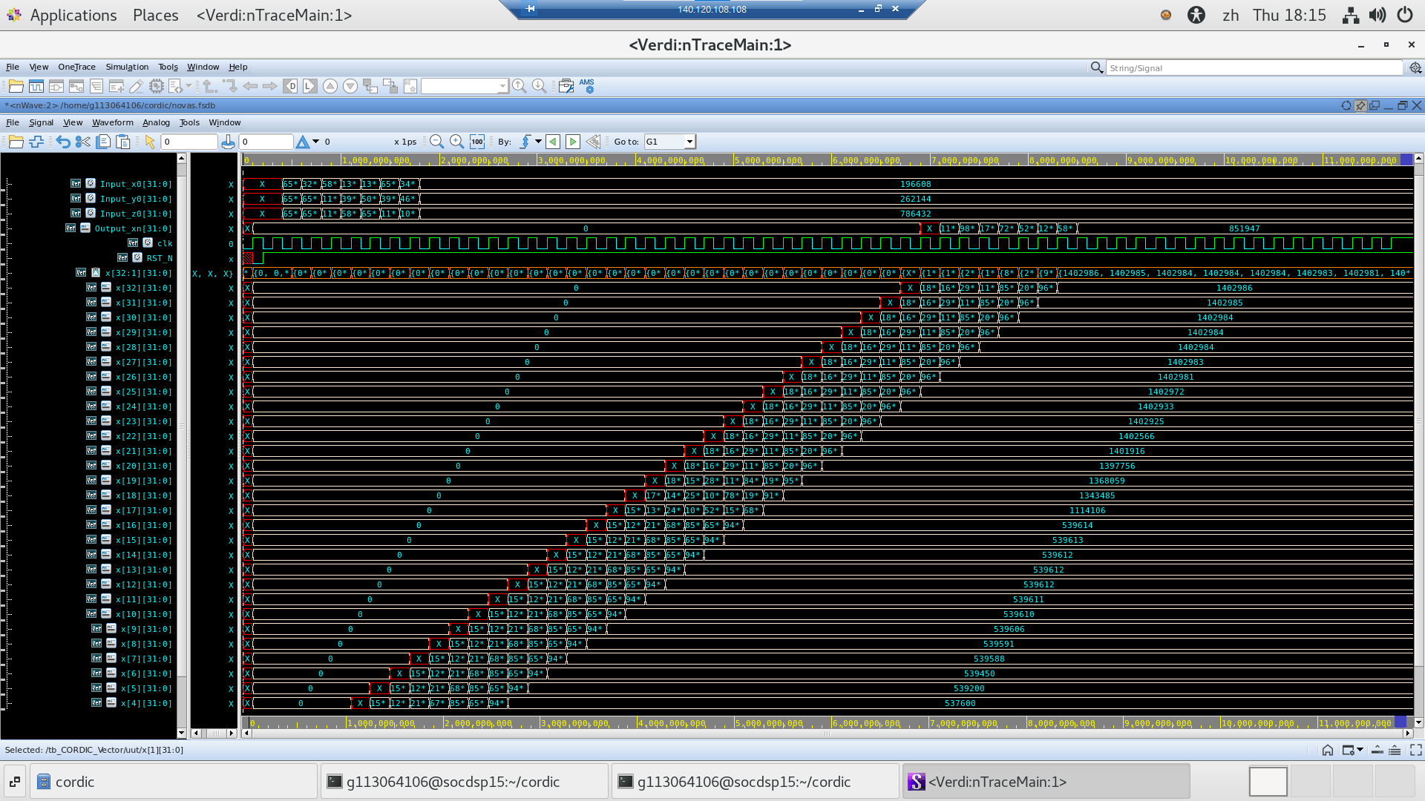
CORDIC
Output result in every clock.

Slide 37


Horner’s Method
Writing a polynomial as nesting form to reduce computational complexity.
$$x^{5}+x^{4}+x^{3}+x^{2}+x^{1}+1$$
10 multiplications 5 additions
$$x∗\left(x∗\left(x∗\left(x∗\left(x+1\right)+1\right)+1\right)+1\right)+1$$
4 multiplications 5 additions

Slide 38
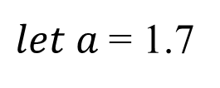
Horner’s Method
$let a$= 1.7
$$C_{Z}(r)=1−2.42215t^{2}+1.78099t^{3}−0.2465t^{5}+0.01828t^{7}$$
17 multiplications 4 additions
$$C_{Z}\left(r\right)=t^{2}\left(t\left(t^{2}\left({0.01828t}^{2}−0.2465\right)+1.78099\right)−2.42215\right)+1$$
7 multiplications 4 additions
If reuse t²,final become
5 multiplications 4 additions

Slide 39
Horner’s Method
Cz(r)
C7 = 0.01828 * 65536 ≈ 1198
C5 = -0.2465 * 65536 ≈ -16155
C3 = 1.78099 * 65536 ≈ 116719
C2 = -2.42215* 65536 ≈ -158738
C0 = 1 * 65536 = 65536

Slide 40
Horner’s Method
Cz’(r)/r
C5 = 0.12794 * 65536 ≈ 8385
C3 = -1.23252 * 65536 ≈ -80744
C1 = 5.34297 * 65536 ≈ 350157
C0 = -4.84429 * 65536 = -317475

Slide 41
Block Diagram
All K_Z modules run in parallel.
The number of K_Z modules depends on the number of interface and orientation points.

Slide 42
Block Diagram
K_Z modules and K_Zgu modules run in parallel.
All K_ZGu modules run in parallel.
The number of K_ZGu modules depends on the number of interface and orientation points.

Slide 43
Block Diagram
Multiply K_ZGu、K_Z、x’、y’ and z’ by weights and add together to get field value.
Compare field value of different points to layers to get label.

Slide 44
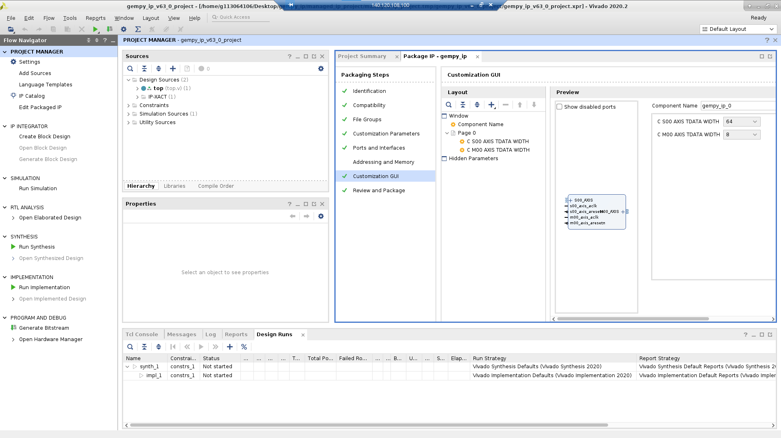
Create IP
Package verilog code into IP.

Slide 45
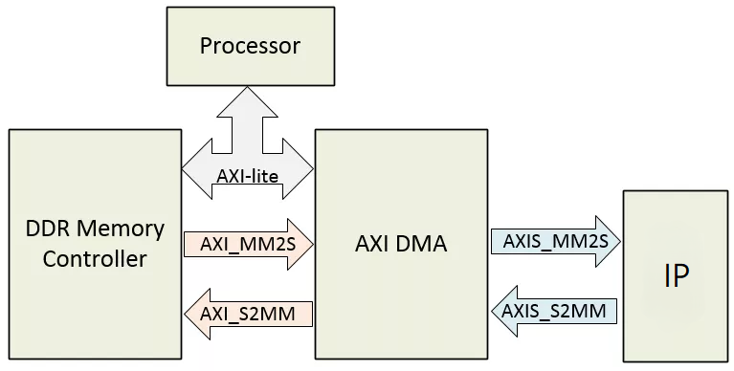
Data Flow
DMA and my IP connect with AXI stream mode.

Slide 46
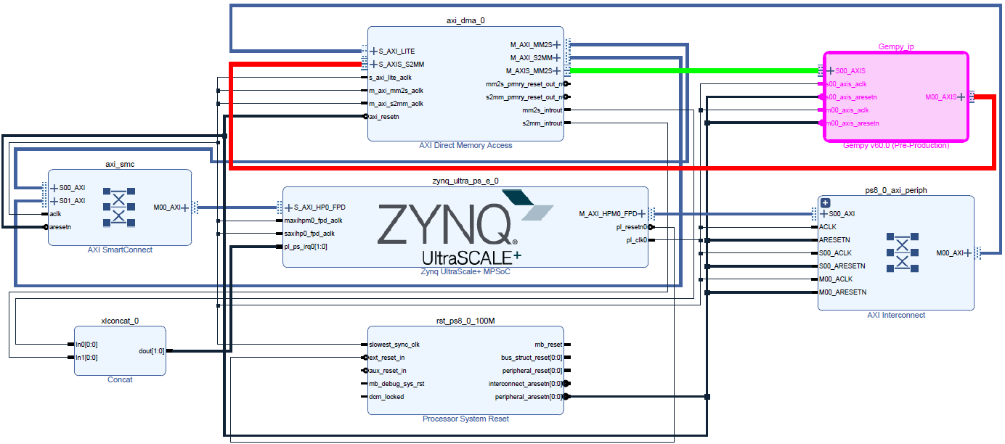
Block Design

Slide 47
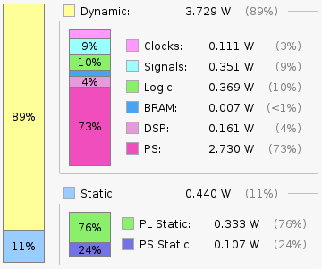
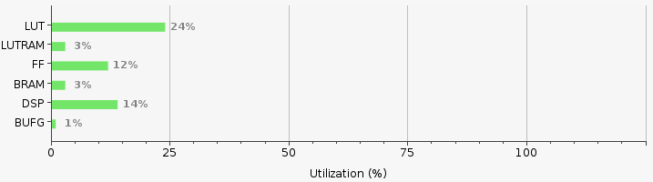
Utilization
Sythesys with 150 MHz.
Power consumption is extremely low compared to CPUs and GPUs, which is a major advantage.

Slide 48
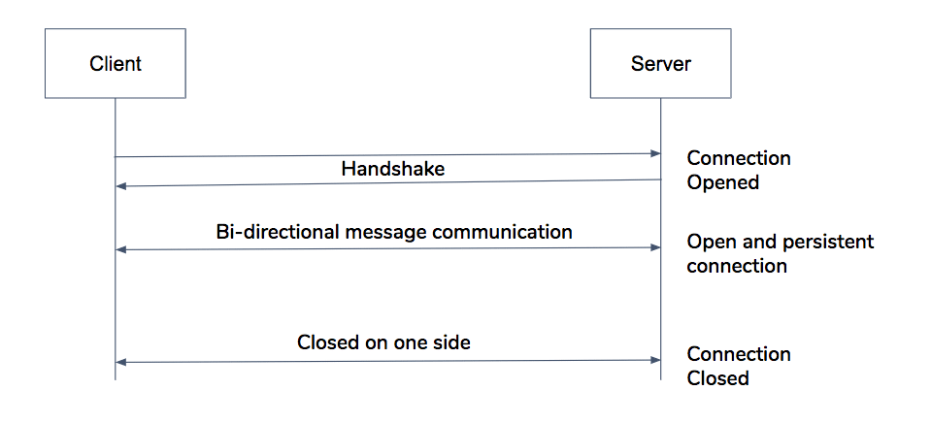
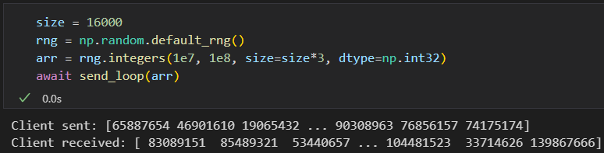

WebSocket
The client initiates the connection by sending an HTTP upgrade handshake to the server.
Once the connection is established, it remains persistent.
Local computer
FPGA board(PYNQ-ZU)
Local computer result

Slide 49
GemPy default setting
Before comparing the results, it is essential to note GemPy’s default settings.
Because of some library restriction, we can’t use GPU to accelerate GemPy under Windows environment.
The basic backend for computation is NumPy; here, we use it as a benchmark for comparison. It can only use CPU.
Another available backend is PyTorch, which can use either CPU or GPU.

Slide 50
Hardware Parameter
Platform | Device | Process | Hardware Configuration | Clock Frequency
FPGA | PYNQ-ZU | 16 nm FinFET | 256,200 system logic cells 234,240 Flip-Flops 117,120 LUTs 5.1 Mb total block RAM 18.0 Mb ultra RAM 1,248 DSP slices | PS: 1200 MHz PL: 296.66 MHz
CPU | Intel Core i7-12700 | Intel 7 (10 nm-class) | 12 cores, 20 threads | 2.10 GHz (base) 4.90 GHz (max turbo)

Slide 51
Compare
Interface_point format: [X,Y,Z,formation]
Orientation_point format: [X,Y,Z,Gx,Gy,Gz,formation]
 | Pattern1 | Pattern2 | Pattern3
interface_point1 | 120,600,100,0 | 200,700,150,0 | 150,500,250,0
interface_point2 | 800,200,200,0 | 700,300,100,0 | 710,220,100,0
interface_point3 | 450,180,250,0 | 440,190,150,0 | 360,790,150,0
interface_point4 | 150,460,760,1 | 140,400,790,1 | 250,440,710,1
interface_point5 | 880,120,700,1 | 880,120,420,1 | 890,220,620,1
interface_point6 | 500,700,730,1 | 560,700,640,1 | 530,800,540,1
orientation_point1 | 300,800,500,1,0,1,0 | 400,900,300,1,1,1,0 | 400,750,200,1,0,0,0
orientation_point2 | 600,0,400,-1,0,1,0 | 700,100,500,-1,0,0,0 | 750,50,400,-1,0,0,0
orientation_point3 | 800,500,400,-1,0,1,0 | 900,400,600,1,0,0,0 | 750,400,500,1,1,1,0

Slide 52
Compare
Ignore weights compute time since it takes very short time (< 0.5%).
Faster then CPU under all patterns, but has a little fixed-point precision error.
FPGA Speedup
 | 10 | 20 | 30 | 40
Pattern1 | 172.53 | 107.36 | 63.37 | 45.97
Pattern2 | 173.19 | 112.05 | 63.83 | 45.17
Pattern3 | 146.65 | 90.33 | 57.05 | 40.58
Pattern
Resolution
FPGA Error Rate (%)
 | 10 | 20 | 30 | 40
Pattern1 | 0.70 | 0.53 | 0.34 | 0.37
Pattern2 | 0.00 | 0.30 | 0.31 | 0.28
Pattern3 | 1.00 | 0.58 | 0.83 | 0.78
Pattern
Resolution

Slide 53

Compare

Slide 54
Compare
The image on the left shows the result after replacing the label of GemPy’s result.
The difference is imperceptible to the naked eye.

Slide 55
Conclusion
Analyze GemPy’s function and source code.
Successfully separated the main modeling component.
Profiling which part takes the most time.
Proposed several methods for hardware acceleration.
Implement systolic array and CORDIC to hardware.
By combining all the module, we can compute the interpolation faster than a CPU using the NumPy backend, which is the default configuration on Windows.
Using WebSocket to enable communication between PC and FPGA.
Reduce errors to a level undetectable by the human eye.

Slide 56
Reference
“GemPy 1.0: open-source stochastic geological modeling and inversion” by de la Varga et al. (2019).
Lajaunie, C., Courrioux, G., & Manuel, L. (1997). `Foliation fields and 3D cartography in geology: principles of a method based on potential interpolation. Mathematical Geology, 29(4), 571-584.
Allard, D. (2013). J.-P. Chilès, P. Delfiner: Geostatistics: Modeling Spatial Uncertainty. Mathematical Geosciences, 45(3), 377–380.

Slide 57
THANKS

