Slide 1
Group Activity
32 bit virtual address; 28 bit physical memory address; 4 KB page size; 8 processes currently executing;
How many entries in the PT?
How many page frames in memory?
How many page tables in memory?

Slide 2
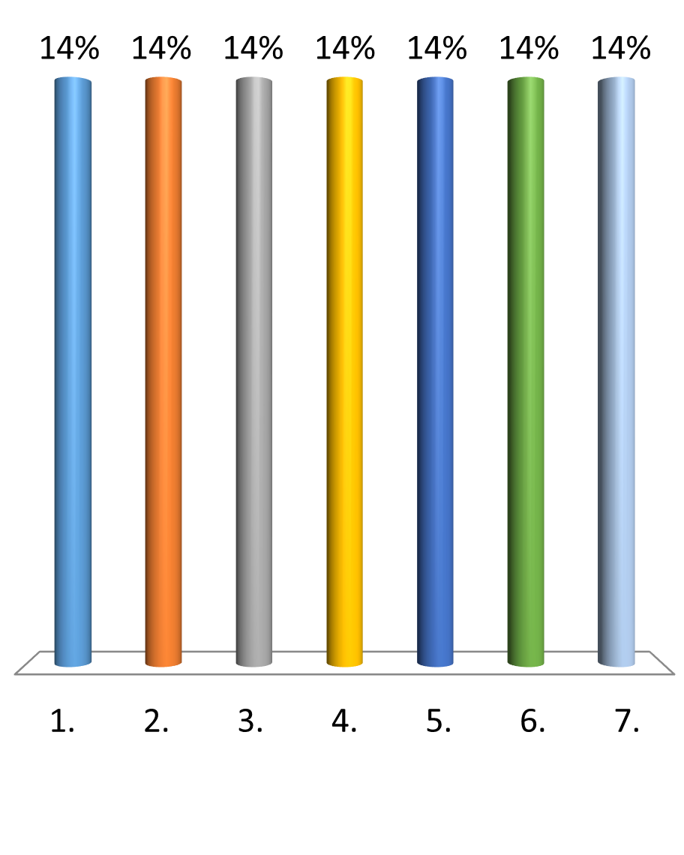
32 bit virtual address; 28 bit physical memory address; 4 KB page size; 8 processes currently executing; how many entries in the page table?
4
2²⁰
8
28
12
2¹⁶
32

Slide 3
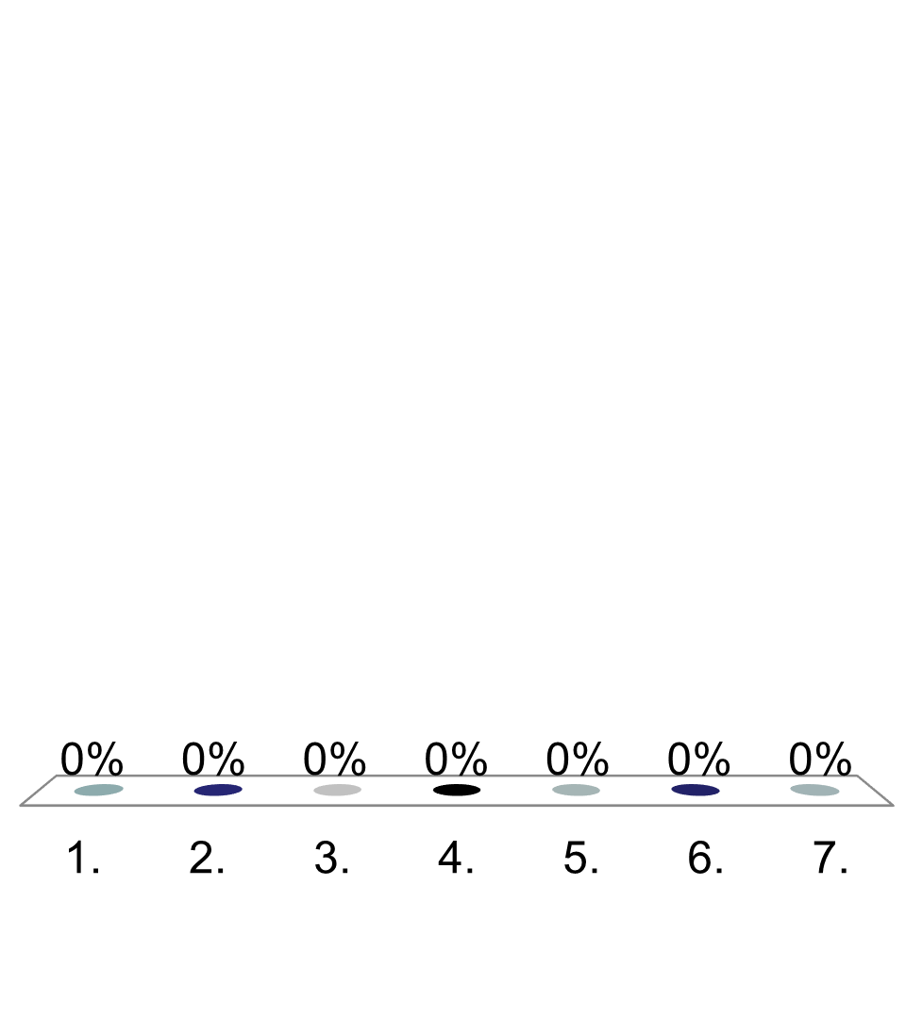
32 bit virtual address; 28 bit physical memory address; 4 KB page size; 8 processes currently executing; how many frames in physical memory?
4
2²⁰
8
28
12
2¹⁶
32

Slide 4
32 bit virtual address; 28 bit physical memory address; 4 KB page size; 8 processes currently executing; how many page tables in memory?
4
2²⁰
8
28
12
2¹⁶
32

Slide 5
32 bit virtual address; 28 bit physical memory address; 4 KB page size; 8 processes currently executing;

Slide 6
32 bit virtual address; 28 bit physical memory address; 4 KB page size; 8 processes currently executing;

Slide 7
32 bit virtual address; 28 bit physical memory address; 4 KB page size; 8 processes currently executing;

Slide 8
32 bit virtual address; 28 bit physical memory address; 4 KB page size; 8 processes currently executing;

