Slide 1
CS 6476 Project 3
Bojun Yang
byang301@gatech.edu
byang301
903254309

Slide 2
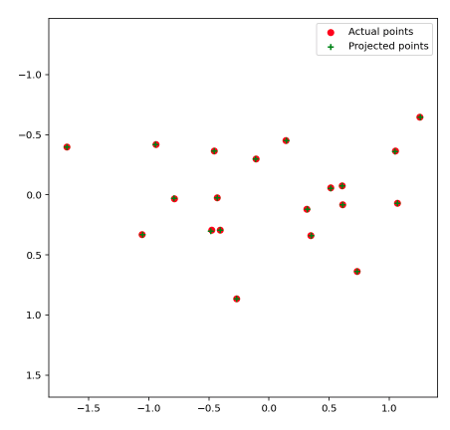
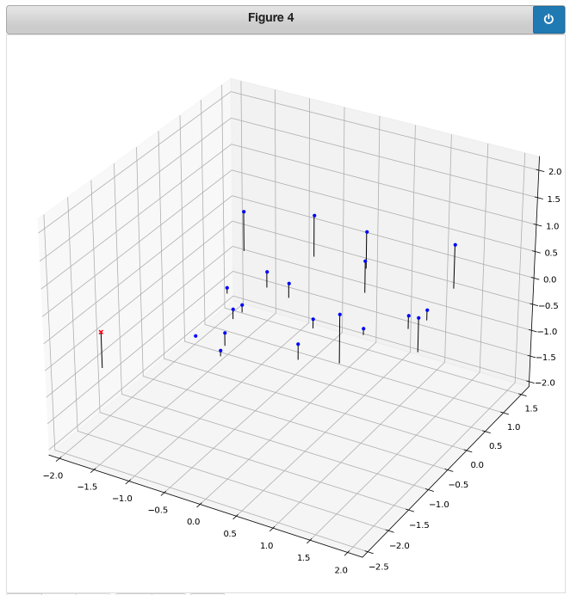
Part 1: Projection matrix
[insert visualization of projected 3D points and actual 2D points for the CCB image we provided here]
[insert visualization of camera center for the CCB image here]

Slide 3
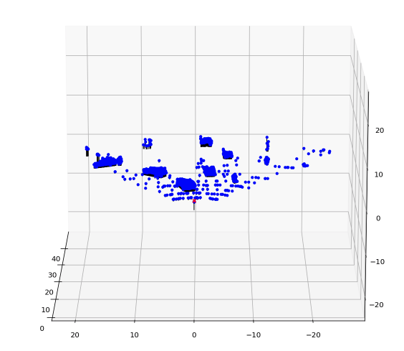
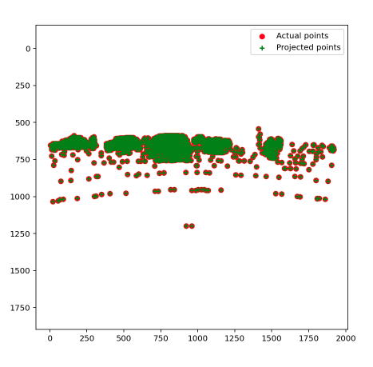
Part 1: Projection matrix
[insert visualization of projected 3D points and actual 2D points for the Argoverse image we provided here]
[insert visualization of camera center for the Argoverse image here]

Slide 4
Part 1: Projection matrix
The camera matrix relates the known 2d image coordinates and the known 3d locations.
The camera matrix can be decomposed into the x and y values of the 2d image coordinates, the x,y,z values for the know 3d locations, and the linear product of the 2d and 3d image coordinates.
The camera projection matrix is determined by the 2d and 3d image coordinates. The matrix is composed of 2D translations, 2D scaling, 2D shear, 3D translation, and 3D rotation. We can either use svd regression or least squares to calculate for the matrix. We can use least squares by setting the last camera parameter to 1. We can do this because there is actually only 8 degrees of freedom within the camera matrix.

Slide 5
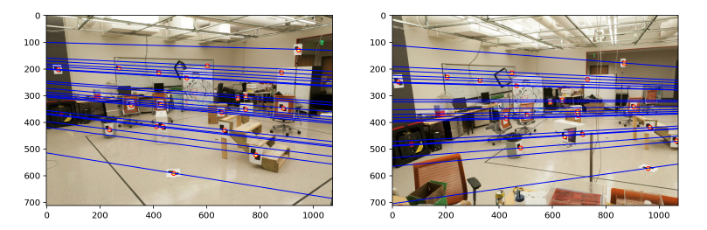
Part 2: Fundamental matrix
[insert visualization of epipolar lines on the CCB image pair]

Slide 6
Part 2: Fundamental matrix
Epipolar lines are the intersection between the image plane and the epipolar plane. The epipolar plan is the plane defined be camera1 location, camera 2 location, and target location. The fundamental matrix relates epipolar lines from camera1 to camera2. In more simple terms, say we have a pair of epipolar lines. Pixels on camera1’s epipolar line can only be found on the corresponding epipolar line on camera2.
This makes the epipolar lines converge onto one point on the images. This because the location of camera2 is in camera1’s view, say at pixel image coordinates (a1, a2) and real coordinates (r1, r2, r3). Camera2’s center point will be (b1,b2) which is (r1, r2, r3) in real coordinates. That means every feature that pixels away from (r1,r2,r3) expand from that center location. This causes the epipolar lines to extrude from that centerpoint.

Slide 7
Part 2: Fundamental matrix
This means there was a horizontal movement between the two images. One point (x,y) in image1 will be (x+k,y) in image2. Connecting these two points will give horizontal lines across the image.
Once we find the F that solves the fundamental matrix equation, we can multiply that F by any factor and still be able to solve the fundamental matrix equation. This is due the the fact that there are 7 degrees of freedom with 9 elements. Thus, there are infinite possible F’s but by finding one F, we can find all other F’s.
The fundamental matrix maps a point in the epipolar plane to an epipolar line, reducing the dimensions by 1. Another explanation is that it is based off of the essential matrix which is also rank2.

Slide 8
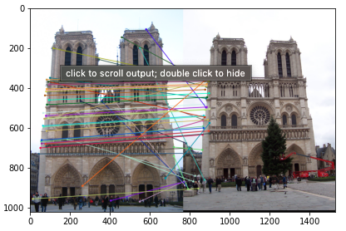
Part 3: RANSAC
[insert visualization of correspondences on Notre Dame after RANSAC]

Slide 9
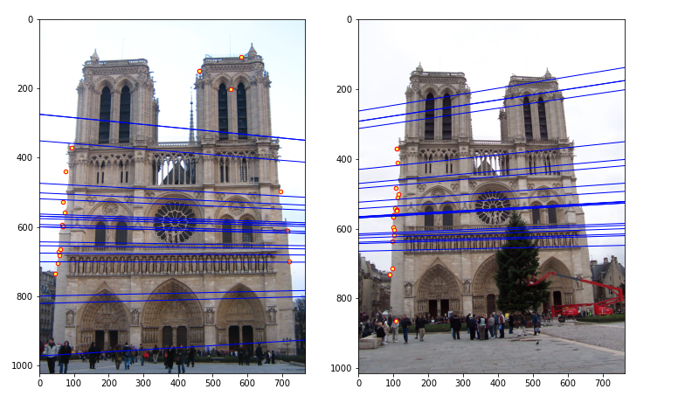
Part 3: RANSAC
[insert visualization of epipolar lines on the Notre Dame image pair]

Slide 10
Part 3: RANSAC
99.9% certainty and 90% point correspondence: 12 iterations with a sample size of 8.
18 point correspondence: 42 iterations. 3.5 times more iterations for twice the amount of points.
99.9% certainty, 70% point correspondence: 116 with a sample size of 8.
The lower the point correspondence, the more iterations.

Slide 11
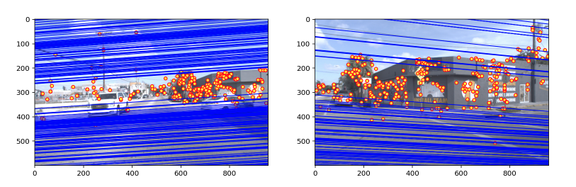
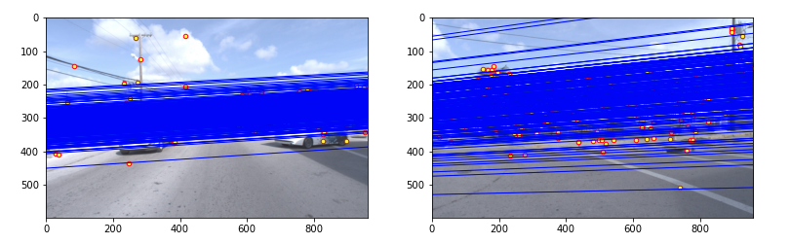
Part 4: Performance comparison
[insert visualization of epipolar lines on the Argoverse image pair using the linear method]
[insert visualization of epipolar lines on the Argoverse image pair using RANSAC]

Slide 12
Part 4: Performance comparison
The ransac method was significantly slower. Linear method took 0.00127s while the ransac method took 3.289s.
The differences appear because the linear method performs the estimation of F once. With ransac, the estimation is performed many times. With my parameters, over a thousand iterations were performed.
Ransac should be more robust since real application can have very high percentage of incorrect matches. Thus, ransac will perform the best in real applications while being slower.

Slide 13
Part 5: Visual odometry
We can use our code from part 2 and 3 to track a specific feature (say a lamppost) throughout the frames. We can use the changes of in pixels to calculate transformations which can determine the motion. However, this method is good only if throughout all frames there is something to latch on to. If not, we would have to latch on to one thing, then latch onto another once the first disappears. Instead of doing this, we can use epipolar lines and epipoles and the changes in slope and distance between them to estimate the motion of the camera. The transformation matrices that describe the changes between epipolar lines and epipoles will also give us a good estimate of motion.
We would also need depth measurements (say from a lidar) to accurately recover the ego-motion. Or else we would only have relative measurements.

Slide 14
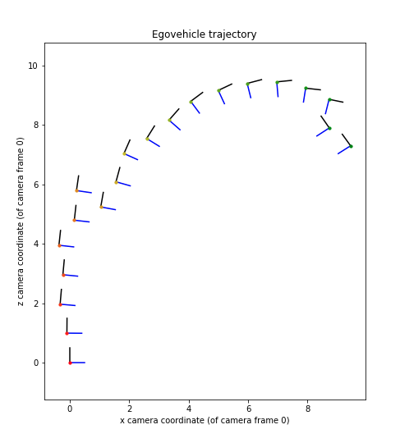
Part 5: Visual odometry
[Attach a plot of the camera’s trajectory

