Slide 1
CS 6476 Project 5
Bojun Yang
byang301@gatech.edu
byang301
903254309

Slide 2
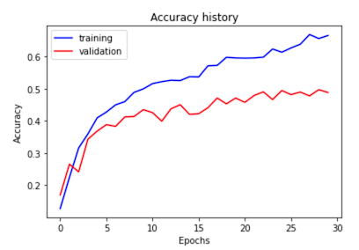
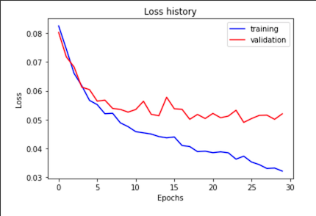
Part 1: SimpleNet
[Insert loss plot for SimpleNet here]
Final training accuracy: 0.6650
Final validation accuracy: 0.4880
[Insert accuracy plot for SimpleNet here]

Slide 3
Part 2: SimpleNetFinal
Add each of the following (keeping the changes as you move to the next row):
 | Training accuracy | Validation accuracy
SimpleNet | 0.6650 | 0.4880
Jittering | 0.5585 | 0.4773
Zero-centering & variance-normalization | 0.7005 | 0.5560
Dropout regularization | 0.6972 | 0.6082
Making network "deep" | 0.7819 | 0.5907
Batch normalization | 0.8322 | 0.6313

Slide 4
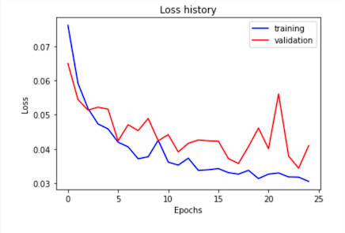
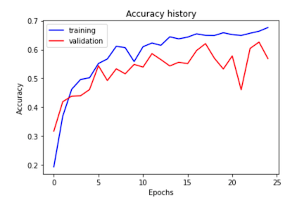
Part 2: SimpleNetFinal
[Insert loss plot for SimpleNetFinal here]
Final training accuracy: 0.6764
Final validation accuracy: 0.5687
[Insert accuracy plot for SimpleNetFinal here]

Slide 5
Part 2: SimpleNetFinal
[Name 10 different possible transformations for data augmentation.]
Horizontal flip, vertical flip, scaling, cropping, padding, rotation, translation, increase/decrease brightness, increase/decrease contrast, increase/decrease saturation
[What is the desired variance after each layer? Why would that be helpful?]
In general, we want low variance after each layer. The variance of a model is the difference between validation error and training error, so we want that to be small. A big variance means we are overfitting. In theory, if we have low variance, we can increase the size of the model to increase the accuracy on the training set, and if variance remains small, that means our accuracy on the validation set will also increase.

Slide 6
Part 2: SimpleNetFinal
[What distribution is dropout usually sampled from?]
Drop out is usually sampled from the output of a convolutional layer.
[How many parameters does your base SimpleNet model have? How many parameters does your SimpleNetFinal model have?]
SimpleNet has 6 parameters in the conv layers and 2 in the fully connected layers. SimpleNetFinal has 11 in the conv layers and 2 in the fully connected layers.
[What is the effect of batch norm after a conv layer with a bias?]
If the distribution in the conv layer with a bias changes rapidly, it will also affect the efficiency of the layer after the conv layer. BatchNorm mitigates this by normalizing the hidden unit activation values.

Slide 7
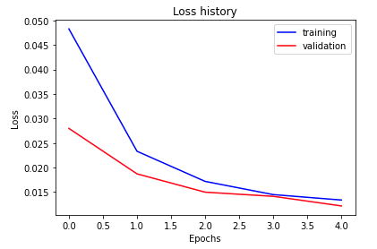
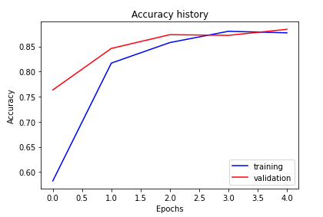
Part 3: ResNet
[Insert loss plot here]
Final training accuracy: 0.877
Final validation accuracy: 0.884
[Insert accuracy plot here]

Slide 8
Part 3: ResNet
[Insert visualization of confusion matrix obtained from your final ResNet model.]

Slide 9
Part 3: ResNet
[Insert visualizations of 3 misclassified images from the most misclassified class according to your confusion matrix. Explain why this may have occurred.]

Slide 10
Part 3: ResNet
[What does fine-tuning a network mean?]
Fine tuning a network means to take a pre-trained model that has been trained for another task and tweak it to make it perform a second similar task. ResNet was trained to recognize 1000 classes so we took it and fine tuned it to recognize our 15 classes.
[Why do we want to "freeze" the conv layers and some of the linear layers from a pre-trained ResNet? Why can we do this?]
We want to freeze the layers for the pre-trained ResNet since updating the weights for these layers will take a lot of computation. We can do this by turning off gradient descent for those layers and only updating weights for the last fully connected layer.

Slide 11
Extra credit (optional)
[Discuss what extra credit you did and provide analyses.]

