Slide 1
Collaborators: Machine learning theory book, pytoch docs, research papers given

Slide 2
Assignment 2 Writeup
Name: Bojun Yang
GT Email: byang301@gatech.edu
GT ID: byang301

Slide 3
Part-1 ConvNet

Slide 4
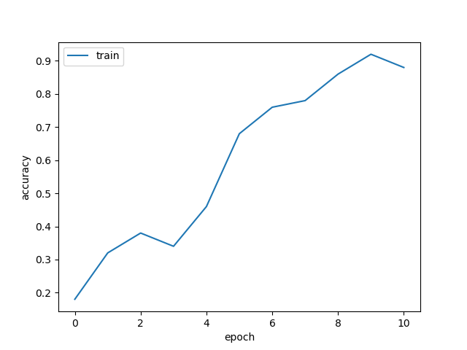
Put your learning curve here:

Slide 5
My EvalAI Model

Slide 6
Model description: My model was inspired by architectures for cifar10 I found in papers. All of my layers are followed by a GELU activation. It is a sequential neural net that begins with 4 sets of 2 conv layers (6 total conv) with increasing hidden layers from 128 to 512. I found that the depth of the model was more effective in increasing accuracy than width so I increased the depth instead of the width of the conv blocks. I apply max pooling, bach norm, and dropout(0.1) to each set. Then I simply have 3 fully connected layers that classify the flattened output from the conv layers. The kernel size for my conv layers was 3, stride = 1, and padding = 1.
Hyperparameter choice: I kept the hyperparameters the same as the vanilla cnn except I increased learning from 0.0001 to 0.01. I did this because I saw my accuracy was generally increasing, but never reached equilibrium. I decreased the size of the kernel from 7 to 3 because the images were already 32x32 and so a smaller kernel would be able to better filter out details from an already small image. After figuring out more optimal hyperparameters, I increased the number of epochs to get more training in and gradually increased the number of hidden nodes of each layer.
EvalAI acc: My final accuracy on EvalAi was 0.91, under the username byang301.

Slide 7
Data Wrangling

Slide 8
What’s your result of training with regular CE loss on imbalanced CIFAR-10?
Fill in your per-class accuracy in the table
 | Class 0 | Class 1 | Class 2 | Class 3 | Class 4 | Class 5 | Class 6 | Class 7 | Class 8 | Class 9
CE Loss | .833 | .8060 | .2900 | .1770 | .0110 | .0020 | 0 | 0 | 0 | 0

Slide 9
What’s your result of training with CB-Focal loss on imbalanced CIFAR-10?
Tune the hyper-parameter beta and fill in your per-class accuracy in the table
 | Class 0 | Class 1 | Class 2 | Class 3 | Class 4 | Class 5 | Class 6 | Class 7 | Class 8 | Class 9
beta=0.9999 | .5720 | .1500 | .1700 | .3430 | 0 | 0 | 0 | 0 | 0 | 0
beta=0.1 | 1 | 0 | 0 | 0 | 0 | 0 | 0 | 0 | 0 | 0

Slide 10
Put your results of CE loss and CB-Focal Loss(best) together:
 | Class 0 | Class 1 | Class 2 | Class 3 | Class 4 | Class 5 | Class 6 | Class 7 | Class 8 | Class 9
CE Loss | .833 | .8060 | .2900 | .1770 | .0110 | .0020 | 0 | 0 | 0 | 0
CB-Focal | .5720 | .1500 | .1700 | .3430 | 0 | 0 | 0 | 0 | 0 | 0

Slide 11
I observed that CB focal loss was able to achieve higher accuracies on classes with less labels in the data.

