Slide 1
Mobile Auditory Interfaces

Slide 2
Wearable and Mobile
Goal is to have instant access
2 second rule
Augmented cognition
Remembrance Agent
People/Engagement recognition
Contextual awareness
Wayfinding
Wearable computing concepts are becoming part of standard mobile interfaces
Project Glass http://www.youtube.com/watch?v=9c6W4CCU9M4

Slide 3
Challenges of Wearables
Bulky, unwieldy
Power consumption
Cost
Fragile
Conspicuous
Distracting
Coordination of multiple devices
User interface issues are very different from desktop (and mobile)
Appropriate applications are very different from desktop (and mobile)
Handling multiple channels of information (information overload!)
Notes:
Power consumption and bulk are often opposing problems

Slide 4
Audio for wearables
Audio can address many of the challenges
Less bulky
Possibly lower power
Cheap
Not as fragile as displays
Non-conspicuous
Possibly less distracting
Peripheral awareness
Speech input?

Slide 5
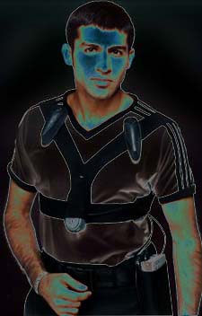
Nomadic Radio
Sawhney (99), an audio-only wearable computer
http://www.youtube.com/watch?v=l99vjTHWhk8
Addresses “messaging”
In office we are constantly receiving notifications
Email
Cell phone
Meeting reminders
PDA
Telephone
Pager
Watch alarms

Slide 6
Problems with notifications
Lack of differentiation
Binary messages..you have email, someone wants to talk to you
Requires user to focus full attention to figure out what is going on
Minimal awareness of user and environment
Can’t behave differently based on what the user is doing, so user interrupted, embarrassed

Slide 7
Problems with notifications
No learning
Behavior is not adapted based on user behavior. Cell-phones keep on ringing
Notifications not coordinated
All devices want our complete attention
Result is people don’t adopt technology or they turn their devices off
Interruptions impact productivity (10 min per hour spent on interruptions)
Need filtering methods to move interruptions to asynchronous media, messages can be dealt with when convenient

Slide 8
Nomadic Radio
Personal messaging and communication using context
Uses a “notification strategy” based on
Message priority
Usage level
Environmental context
Infer user’s attention from activities such as device interaction and conversations in the room
Adapt notifications over time based on user behavior

Slide 9
Nomadic Radio
Audio-only interface to email, voice mail, news broadcasts, personal calendar
Information downloaded to device during the day. Accessed via voice input (also tactile input, for privacy)
Output is speech, auditory cues, and spatial audio

Slide 10
Nomadic Radio
User scenario (Jane)
Auditory cue, speech about meeting reminder
Jane scans emails about meeting
Audio cue speeds up and slows down, message from friend
Jane ignores and goes to meeting
System scales back audio because she is not interacting and conversation level high
Timely message arrives related to email she sent earlier, so plays sound of water that speeds up to show that summary will be played soon
Jane busy so she presses button to stop playback, sound slows and no summary played. She turns down notification level for next hour. System in sleep mode
Very important message from daughter, so plays cue anyway, then VoiceCue of daughter
Jane indicates she wants to hear it, here’s voicemail saying daughter needs to be picked up from school

Slide 11
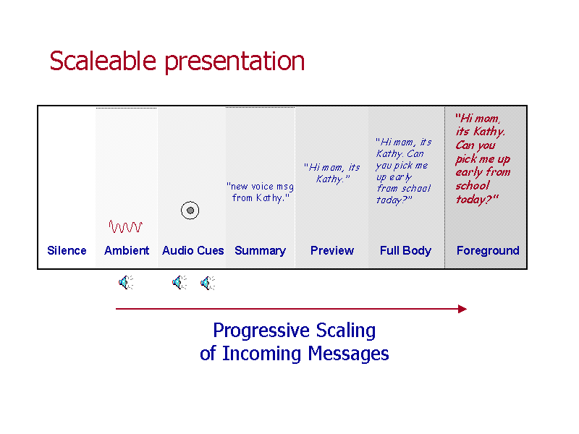
Nomadic Radio

Slide 12
Nomadic Radio
Scaleable Audio Presentation, 7 levels of notification
Silence
no cues or speech feedback, message only played if high priority, saves power also
Ambient cues for peripheral awareness
Continuous cues to show state of system. Water flowing sound shows it is awake, changes pitch when downloading. So, short email sounds like splash, long news broadcast is faster flowing water.
Result is person has peripheral awareness of message size, can stop its playback if they want to, less cognitive overhead than additional cues to show size

Slide 13
Seven Levels of Notification
Auditory Cues for Notification and Identification
Feedback
task completed/confirmation (speech understood, button pressed,message deleted)
Mode transition (silent to ambient feedback)
Exceptional conditions, connection lost, error
Priority cues
Cues indicate what type of message (telephone rings for email, station identifier news) and content of email message (group, personal, timely, important)
VoiceCues
1-2 second segment of voicemail message linked to email address. When email arrives, the voice clip is played to let you know who the email is from. Less distracting then synthesize speech

Slide 14
Seven Levels of Notification
Message Summary
Spoken description of incoming message, name of sender, subject of message. Also used for the voice mail, news etc. plays first 2.5 seconds of message
Message Preview
First 100 character of message read. For voice mail and news. 1/5 of message played with increasing speed up to 1.3X normal speed

Slide 15
Seven Levels of Notification
Full Message
The entire content is played in background of the audio space
Full Message in the Foreground
Audio source is moved closer to listener, then after 4/5 of message begins to fade away, moving to original location. Faded so next message can begin playing

Slide 16
Spatial Audio
“Radio” because active broadcasts coming in all the time
Maybe be listening to news when meeting reminder occurs and email message arrives
Spatial audio allows the user to segment and browse the various streams of info
“Cocktail Party” effect
But cognitive load increases with number of streams, more than 3 causes loss of comprehension
Spatialization effect is improved if user can “pull” sounds to the forefront

Slide 17
Spatial Audio
Audio braiding, multiple audio sources can be monitored and browsed if played simultaneously while spatialized
Exact locations not important
In Nomadic Radio, spatial position of sound indicates time arrived and importance
Sounds placed on “24 hour clock” around users head
Distance from head indicates importance

Slide 18
Spatial Audio
The spatial listening is used for three modes of message playback
Broadcasting, when message arrives it is played from location and fades away if user doesn’t choose to pay attention
Browsing, user goes forward and back in category, when message chosen it is brought to the foreground
Scanning, messages brought to foreground briefly in order, automatically

Slide 19
User Evaluation
Was able to do parallel tasks while hearing notifications
Had casual discussion while hearing notifications
Audio turned off during important meetings
Nearby people nearby distracted by spoken feedback when loud, but used as a cue that they should wait
Auto volume was requested, based on environmental noise
Liked the gradual notification more than distinct tones.
Priority cues not very useful, While VoiceCues were
Maybe priority should be woven into ambient audio
Auditory scheme somewhat complex
Ambient most useful
Found superior to pager

Slide 20
Augmented Reality and Audio
Augmented Reality applications typically focus on graphics.
Audio-only AR has advantages
Demands less attention from user
Lightweight
Low cost
Easy to deploy
Lets user use his/her imagination

Slide 21
Motivation and Goals
To create a lightweight audio-only wearable device
To create a audio AR system that allows a user to move through an environment, receiving appropriate sounds based on location and previous actions.

Slide 22
Infrastructure
Positioning system
RF transmitters sending out unique IDs
Wearable computing device
Diamond Rio, RF receiver, PIC microcontroller

Slide 23
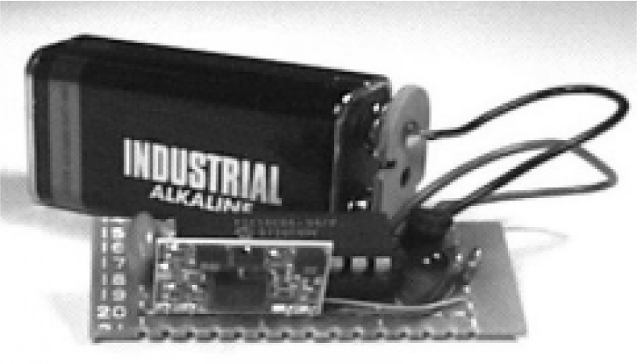
Positioning System
RF transmitter and 9V battery

Slide 24
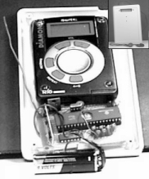
Wearable Device
Inside of device
Diamond Rio
RF receiver
PIC microcontroller
9V battery

Slide 25
User Experience
User puts on device and possibly hears some introductory audio
Then the user moves through an environment hearing sounds based on their location
However, the sounds played at a location are determined by a state machine that takes into account the user’s previous locations

Slide 26
Prototype Game
Setting is medieval fantasy world
Game play similar to traditional role playing game
Player is on a quest to rescue a friend
As player moves in real world play space, he/she will encounter friends and foes, and will obtain items needed to complete the quest

Slide 27
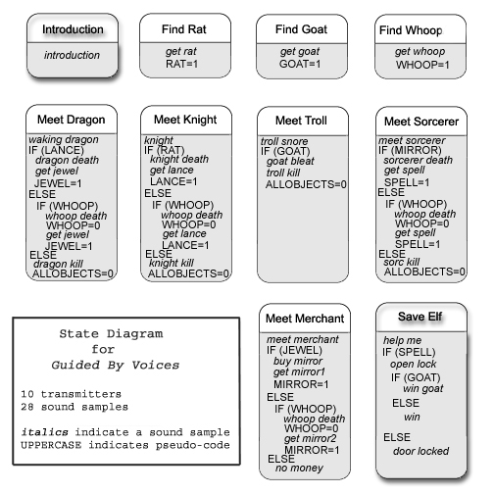

Slide 28
Sound Design
Where am I?
What is going on?
How does it feel?
What happens next?
Challenges
No graphics to aid understanding
Nonlinear narrative
Noisy environment
User confusion
Experience needs to be entertaining and fun

Slide 29
Sound Design
Caricature of sound, matching mental model of sound for user
What does a dragon fireball sound like?
What does it sound like when a troll eats you?
Noisy environment
Sounds exaggerated and clear so as to be heard

Slide 30
Sound Design
Sound event layers
Ambient Sounds
Give impression of setting the player has just entered
Sound Effects
Include speech from characters in game. All reflect acoustics of setting
Narration
Distinct voice that provides more information when necessary. Voice is “dry” and louder to differentiate from characters in the game.

Slide 31
Problems
Hard to control zone from RF transmitters, works well in large spaces
People steal props!
Have alarm at exits?
Users confused
Temporal nature of sound
Replay button?

Slide 32
The Beware Home
Used GBV as part of Beware Home demonstration Halloween 2000
Demonstrating Aware Home research with Halloween twist
GBV used to guide visitors through the house
Explained back-story as well as guided users through space

Slide 33
Beware Home: Lessons Learned
Had environmental audio and personal audio
Noise problems
Very easy to make narration too long
When people started listening they didn’t pay attention to visuals and vice versa
People easily confused
Serious zone problems

Slide 34
Future Work
Add timing control
Can leave zone
Other types of interaction by user
Picking up objects
Action changes ID of transmitter
Transmitters on other users
Assassins game
State maintained on transmitters as well as on users
Can react differently to different users
Knows who has passed through already

Slide 35
Hear & There
Rozier (2000), audio based augmented reality used to enhance outdoor locations
More heavyweight then GBV, but more powerful as well
Users can embed sounds (oral history and reflections) at a location to be enjoyed by others
Social interactivity, where users create the content
Previous work has been done in this area using visuals

Slide 36
Questions
How do we define an audio imprint?
How do we embed the imprint in space?
How are we made aware that it exists?
How can we link sounds to compose a coherent path for users to navigate freely?
Required development of easy to use authoring system for user and navigational system for exploring space

Slide 37
Audio Imprint
Multi-layer customizable collection of sounds that can be placed in space
Single primary sound with others braided into the periphery
User can choose what layers of sound to use and how they will be braided
Speech about restaurant braided with favorite song

Slide 38
Navigation
Must have “navigation toolkit”
Headphones
Digital compass
Laptop
Palm pilot
GPS receiver
Battery
Microphone
Or in 2010 just use a mobile phone :)
Used to determine user location and head position so appropriate sounds can be played
Palm shows locations of imprints and directions to them, not necessary, future sound beacons

Slide 39
Navigation
People can be guided by Palm, or in the future by audio cues, or they can wander
GPS used so no transmitters have to be placed in environment
Means that busy areas, historic landmarks etc can be easily augmented
Will only work outdoors
Not always consistent

Slide 40
Authoring
Must allow user to create sounds, place them, and modify and arrange them quickly and intuitively
Uses GUI and mobile authoring device
Mobile system used to create sounds in the field
Mic and start/stop buttons on Palm, sound then placed where you were standing
GUI used for later refinement
draft mode, see imprints on map, can create, place, and adjust properties
Demo mode, hear simulation of experience as if you were outdoors
Linking
Imprints can be linked, like web links
Must be directed to location where next link resides

Slide 41
Problems/Future Work
Visuals? Or audio-only to aid navigation
Audio streams instead of spot, use sound spatialization
System too bulky (GPS requires to large antennas and receiving unit)
How many sounds can you have at a location?
Filtering?
Moderator?
Anonymity?
Would people use this?

Slide 42
Audio Aura
Mynatt (98), provides information about a workplace via audio, delivery based on user actions
In workplace limited explicit dialog with computer, rich dialog with coworkers
Audio Aura provides implicit dialogs with our computers while were are away from our desks

Slide 43
Audio Aura
Audio used to create peripheral cues
Proves serendipitous information that is useful but is not required
The delivery of the information is tied to the user’s physical actions like stopping at someone’s office door

Slide 44
Audio Aura
Serendipitous information
It is nice to have but not required like getting a voice mail message or meeting reminder
Information that is necessary has to invade periphery so you can be sure the user got it
This system can not assume that you are aware of all information since peripheral
But this information is important, can be responsible for sparking a new idea or solving a problem in a new way

Slide 45
Audio Aura
Probing of the environment is not required (like Hear&There), your normal activities like walking around the office will trigger information delivery
Devised three sample scenarios to guide design process, then prototyped in VRML before deploying on actual hardware
Scenarios built out of need for different types of serendipitous information and the responsiveness, privacy, complexity, and abstractness of info that would be required.

Slide 46
Scenarios
Scenario 1
People check email between meetings to see if anything important has happened. Also want to get coffee, but may feel that they must check email
When you enter breakroom you hear cue conveying how many emails you have and who they are from

Slide 47
Scenarios
Scenario 2
People like to just stop by a coworker’s office either to socialize or to convey info that is done quicker or more appropriately in person
But what if the person is gone, visitor will try to ascertain if they just stepped out, they are gone to a long meeting, they are gone for the day etc.
Cue lets you know if they have been in at all that day, how long they have been gone
Qualitative information, not quantitative

Slide 48
Scenarios
Scenario 3
People collaborating on projects are often not co-located.
Means that they don’t share the sense of community and group activity that people in the same space have.
Cue is “group pulse” showing if people are in office, if they are using shared artifacts, if some of them are meeting

Slide 49
Sound Design
Tried out different sound “ecologies” to explore different approaches to the three scenarios
Four sound environments made up of these ecologies
Had to avoid alarm paradigm since peripheral
No sharp attacks, high volume, or freq in human speech range
Information embedded in constant track so not to startle, group pulse
Ecologies, all the sounds fit into this theme
Example, beach sounds
Amount email = seagulls, email from particular people = birds and seals, group activity = waves, office occupancy = buoy bells
Think of frequency bandwidth and human perception as limited resource
Configurations with voice only, music only, effects only, and all three combined

Slide 50
Four Prototype Designs
Voice World, used for testing, and for exploring Audio Aura as navigational aid
Voice labels on doorways
SFX world, auditory icons
Beach ecology
Music world, earcons
Qualitative info carried in shifts in melody rhythm and length
Went for simple mappings, more mail = more notes
Rich world, Music, speech, SFX
Most powerful, but requires careful sound design

Slide 51
Sound Design
Examples of configurations
Email quantity
SFX, gull cry, more cries, few gulls crying, gulls squabbling
Music, bell melody rising pitch, longer melody falling at end, lower/longer melody, longest melody falling at end
Voice, “You have no email”, “You have n email messages”
Rich, same as SFX
Group activity
SFX, distant surf, waves, more active waves
Music, vibe, vibe with sample, three vibes
Voice, none….breathing was too obnoxious
Rich, surf and vibe

Slide 52
Audio Aura Infrastructure
Active Badges, used to track peoples’ locations in the building
IR signal emitted by badge, detected by sensors in the environment
Location server collates all this location information
Audio Aura Server , Java “nerve center”
Communicates with location server
Provides data via queries to the Audio Aura services
Audio Aura Services, subscribe to data from server

Slide 53
Audio Aura Infrastructure
Audio Aura Services, subscribe to data from server
Thin clients, a returned query from the server will trigger an auditory cue, the gathering of other data, or invoking of another program
Sound sent via RF transmitter to wireless headphones

Slide 54
Conclusion
Could be used for other things like tours, reminders etc.
Very hard to evaluate with users
Nine subjects, intro, tasks, questionnaire
Reactions were positive
Liked peripheral audio
Meaning of sounds difficult to remember
Privacy concerns

Slide 55
References
http://digitalmedia.oreilly.com/pub/a/oreilly/digitalmedia/2007/03/22/how-to-make-user-interfaces-musical.html?page=1
Kent Lyons, Maribeth Gandy, Thad Starner,”Guided by Voices: And Audio Augmented Reality System”, ICAD 2000
Beth Mynatt, Maribeth Back, Roy Want, Michael Baer, Jason Ellis, “Designing Audio Aura”, CHI 1998, April 18-23
Joseph Rozier, Karrie Karahalios, Judith Donath, “Hear & There: An Augmented Reality System of Linked Audio”, ICAD 2000

Slide 56
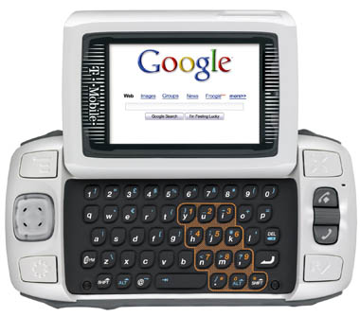
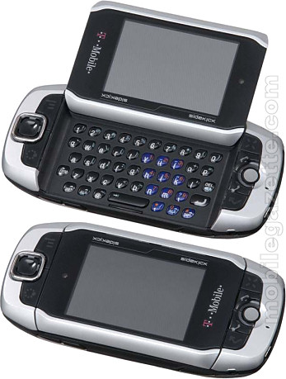
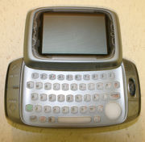
Industry Case Study
Audio UIs for three generations of T-Mobile Sidekick (Peter Drescher, Sound Designer)
http://digitalmedia.oreilly.com/pub/a/oreilly/digitalmedia/2007/03/22/how-to-make-user-interfaces-musical.html?page=1

Slide 57

Everything I know I learned from Star Trek
Rapid typing, confirmed responses, error alerts, warning voiceovers etc.
But long sequences for emotional messages, “shields are overloading, we’re all gonna die!”
Can inspire actual audio UI design
Interactive feedback without being annoying
Customers will turn off
You should hear it, not listen to it

Slide 58
Audio UI is Interactive Music
Non-linear
Just like game sound design
You don’t know what the user is going to do and when
Score may never be the same twice
Used much longer than a movie score, so repetition must be avoided
Sound elements work together in unpredictable ways
But sequence is not random
Device = superhero, Audio UI = superhero theme song

Slide 59
Device Limitations
Sprint PC Phone
Original plan, “full-blown, heavily synthesized, digital audio branding sound”
Couldn’t be heard without blowing the speaker
Piezo ringer (1 voice polyphony and square waves)
Output sample rate, speaker size, audio engine capabilities
Learn to love your limitations

Slide 60
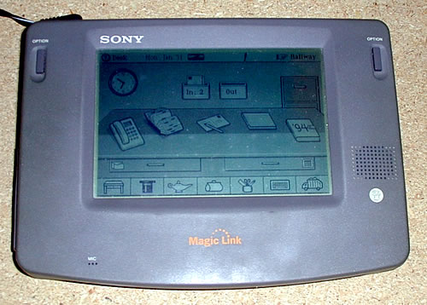
First Audio UI
General Magic PDA 1994
Midi files associated with icons
Sound samples and midi < 128K, uncompressed
8 bit, low sample rate
15 system sounds
12 musical instruments
12 music “stamps”

Slide 61

General Magic UI
“touch” sound
Most common so very important
Tapping pencil eraser on materials
Effects libraries also used
“door” ,”type” , “switch”
Musical effects
Email “postcards”, reverse ringtones
Cartoony?
Sounds too literal?
Put something in folder
Dismiss dialog

Slide 62
Original Sidekick
2002
“All in” with audio UI
Every button made different sound
Flipping the lid, opening a menu, system alerts, ringtones
Voice-over alerts for “retro sci-fi” feel
200KB of audio, 11.025kHZ, speaker the size of a dime
Slow CPU and small RAM, wavs and midi

Slide 63
Original Sidekick
Flip open, flip closed
Prototype
Final, , “dangerous switchblade” sound on small speaker
Avoid cartoon sounds for keyboard
Sine wave + hand drawn click
Common sounds all related
Menu ,jump , back , wheel ,scroll up ,scroll down
Source for buttons

Slide 64
SideKick II
Speaker the size of a quarter
Loud volume
16kHz, 500KB capacity
Content of sound is less important than consistency
But not “jarringly wrong” (explosion for button press) or too “on the money” (AOL mail)
Must work together without clashing
Emotion from sound
First pass, low battery is “as horrifying as possible”
People frightened
Final approach, “sad clown”

Slide 65
Sidekick 3
MPEG compression so MP3s are used
44.1kHz
1MB storage
Speaker the size of a penny (and only one)
Audio UI “crystalline”
“drops of water in a cave”, “shimmering crystal ball”
More reverb!

Slide 66
Sidekick 3
Source material
Glass bowls, pipe clanks, wine goblets, drinking glasses etc.
You never knew what it would sound like on tiny mono speaker
MPEG compression blurs transients
Encoded sounds with very sharp attacks
“a glass harmonica”

