Slide 1
Digital Audio
Maribeth Gandy
Notes:
Principles of Dig Audio, Pohlmann
http://www.tc.umn.edu/~erick205/Papers/paper.html
http://www.earlevel.com/Digital%20Audio/index.html

Slide 2
Analog to Digital Conversion
Analog = Continuous
Digital = Discrete
Analog becomes Digital via sampling
Is information lost? No
A continuous signal can be reproduced from discrete samples
An analogy is a movie where our brain fills in missing information. With digital signals the missing information comes from interpolation
http://www.earlevel.com/main/category/digital-audio/

Slide 3
Sampling Frequency
How fast should we take samples?
Sampling theorem
A continuous band-limited signal can be replaced by a discrete sequence of samples without any loss of information.
the sampling frequency must be greater than or equal to twice the highest frequency in the original analog signal
Nyquist frequency, FS < 2F
Aliasing
Wagon wheel effect http://www.youtube.com/watch?v=YpMtanpsVeE http://www.youtube.com/watch?v=gzSYnGEqof8
Notes:
http://www2.egr.uh.edu/~glover/applets/Sampling/Sampling.html

Slide 4
Sampling Frequency
When aliasing occurs the result is folding
FA = | F – ((K + 1)FS)/2| where K*FS/2<=F<=(K+2)FS/2, K is odd integer that satisfies the inequality
the audible frequency is half the sampling frequency minus the amount the frequency exceeded half the sampling frequency
44 KHz , 27KHZ is sampled, resulting audio is 17 KHz
http://www.cems.uvm.edu/~mirchand/classes/EE171/Mitra/media/demos/demos.htm
Notes:
K is for where F is much larger than Fs, F of 70, Fs of 44, K = 3 to satisfy inequality
http://www.cems.uvm.edu/~mirchand/classes/EE171/Mitra/media/demos/demos.htm#D1

Slide 5
Sampling Frequency
Higher sampling freq will not improve reconstruction of freq within the FS/2 range.
Higher sampling freq requires faster circuitry, more storage space, CD->DVD Audio->Super Audio CD
Supposedly, human hearing range stops around 20KHz

Slide 6
Sampling Frequency
Steps in Analog to Digital(ADC) and Digital to Analog Conversion(DAC)
To avoid aliasing, filter signal before sampling
“Brickwall” Low Pass Filter, Filter not perfect so “guard band” is used
Sample input waveform
Result in frequency domain contains images of the original spectrum centered at multiples of the sampling frequency
Another Low Pass Filter with the same characteristics as the first. “ reconstruction filter”
http://www2.egr.uh.edu/~glover/applets/Sampling/Sampling.html
http://www.jhu.edu/~signals/sampling/index.html
Aliasing must be prevented, because once it has happened it can’t be undone
Notes:
http://www.nt.e-technik.uni-erlangen.de/~rabe/SYSTOOL/SYSTOOL2.02/HTTP/sampl.htm
Diagrams from Pohlmann book

Slide 7
Quantization
A sample will represent the amplitude of the signal at that point in time
The analog value of the amplitude will be converted to a discrete value
Quantization
Sampling = Time, Quantization = Value, together they characterize an acoustic event
Therefore the bit resolution is very important
Finite word length means measuring error introduced
Sampling is lossless, but quantization is not
16 bit = 65,536 different levels, 2^n is number of levels
Error will not exceed ½ of the interval
Notes:
The measuring error can not be avoided
Speech can barely be intelligible with 1 bit
So adding a bit doubles the number of levels
24 bit accuracy of distance between NY and LA…accurate to 9 inches

Slide 8
Quantization
Signal-to-error ratio
S/E(dB) = 6.02n + 1.76, where n is number is the number of bits
16 bits = 98 dB, 15 bits = 92 dB
An additional bit will increase the ratio by 6 dB
Distortion introduced to signal
As the signal level decreases the percentage of distortion increases
16 bit, but half amplitude signal, value never exceeds 32,768. Therefore , it is quantized with 15 bit resolution
Heard as white noise in high amplitude broadband signals
For low amplitude or narrow bandwidth signals distortion is more evident
Aliasing can occur, because the distortion creates freq components above the Nyquist frequency
How the quantization values are assigned is also important
MP3 coding not linear
Notes:
As statistical correlation increases the noise becomes less benign…in high band, the successive values are random…this is not true for low amp or narrow bandwidth.
Although linear is normally used..this changed with perceptual coding like MP3

Slide 9

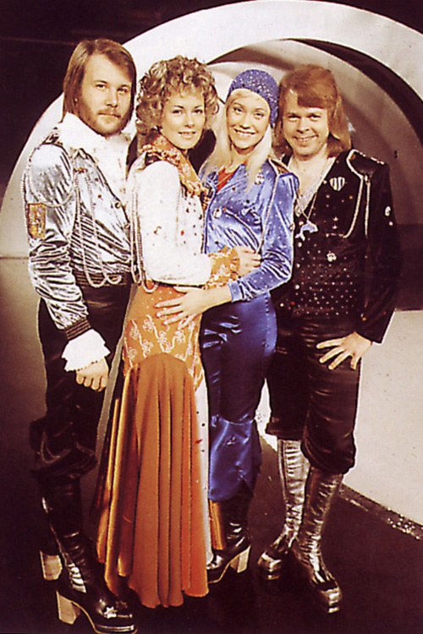
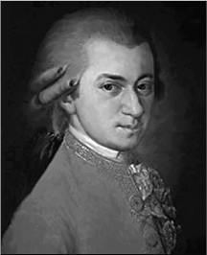


Sampling and Quantization
Mozart versus ABBA
44, 16
44, 16
44, 8
44, 8
22, 16
22, 16
22, 8
22, 8
11, 16
11, 16
11, 8
8, 16
8, 16
8, 8
8, 8
2, 16
2, 8
2, 8
Notes:
44-16
44-8
22-16
22-8
11-16
11-8
8-16
8-8
2-16
2-8

Slide 10
Dithering
Could add more bits to reduce error, but low level signal will always have distortion
Dithering is a more efficient technique
Dithering is adding low level white noise to the signal
Finger example
Lets us hear components below the level of our least-significant bit
WWII bombers vibrating the mechanical computer
De-correlates noise from input signal
Tradeoff of hiss for distortion
Various dither functions used
Rectangle, triangular, Gaussian
Less bits = more dithering required
Notes:
Remember random error is white noise which is okay
finger examples
Example is waveform with eamplitude of 1 quantization interval, square wave results
Example of WWII bombers with mechanical computer that worked better when flying because of vibrations…first example of dithering..they put vibrating motors into machines

Slide 11
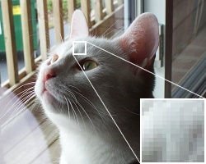
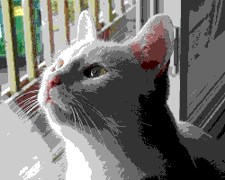
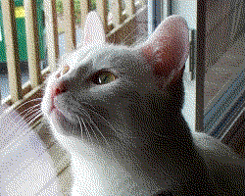
Dithering
http://www.earlevel.com/main/2010/11/07/the-sound-of-dither/
Notes:
Remember random error is white noise which is okay
finger examples
Example is waveform with eamplitude of 1 quantization interval, square wave results
Example of WWII bombers with mechanical computer that worked better when flying because of vibrations…first example of dithering..they put vibrating motors into machines

Slide 12
Phase Distortion
Phase distortion can occur from sources such as analog equalization and DAC filters
Error is constant and effects a group of frequencies
Humans can’t hear relative phase shift of static waveform
Human’s can hear phase shift in dynamic waveforms, transients
Voice with phaser effect
Notes:
Of course you can hear phase shifting done on purpose, done for effects
Depends on music, the frequencies, amount of phase error
http://en.wikipedia.org/wiki/Phaser_(effect)

Slide 13
Oversampling
Oversampling is exceeding the Nyquist frequency
Can relax demands such as “brickwall” filter
Signal to Noise ratio is boosted
Quantization noise is reduced in audible band
Same as increasing bit depth
When used during analog to digital conversion, data is sampled at high frequency and then decimated.
Notes:
Draw graph of oversampling

Slide 14
Oversampling
When used in DAC
Not sampling at higher rate
Samples are introduced between samples and set to zero. Then their values are created via interpolation.
Moves the location of the “folding” point FS/2 so you can use a LPF with a gradual slope
Quantization noise is now spread over wider band and power density is reduced
Noise Shaper is applied (combined with dithering)
Alters the frequency spectrum of the error signals so as to move most of the quantization error out of the audible frequency range
Shapes the quantization noise instead of leaving it as white noise
Notes:
One problem with this is that, ideally, we want to block everything above the Nyquist rate (22.05 KHz), but let everything below it pass unaffected. Filters aren't perfect, though. They have a finite slope as they begin attenuating frequencies, so we have to compromise. If we can't keep 22 KHz while blocking everything above it, we'd certainly like to shoot for 20 KHz. That means the low-pass filter's cutoff must go from about 0 dB attenuation at 20 KHz to something like 90 dB at 22 KHz—a very steep slope.
While we can do this in an analog filter, it's not easy. Filter components must be very precise. Even so, a filter this steep has a great deal of phase shift as it nears the cut-off point. Besides the expense of the filter, many people agree that the phase distortion of the upper audio frequencies is not a good thing.
Now, what if we had sampled at a higher rate to begin with? That would let us get away with a cheaper and more gentle output filter. Why? Since the reflections are wrapped at the sampling frequency and its multiples, moving the sampling frequency that far up moves the reflected image far from the audio portion we want to preserve. We don't need to record higher frequencies—the low-pass filter will get rid of them anyway—but simply having more samples of our audio signal would be a big help.
This is where interpolation comes in. We calculate what it would look like if we had sampled with more points to begin with. If we could have, for instance, eight times as many sample points running at eight times the rate ("8X oversampling"), we could use a very gentle filter, because instead of 2 KHz of room to get the job done, we'd have 158 KHz.
In practice, we do exactly this, following it with a phase linear digital "FIR" (finite-impulse response) filter, and a gentle and simple (and cheap) analog low-pass filter.

Slide 15
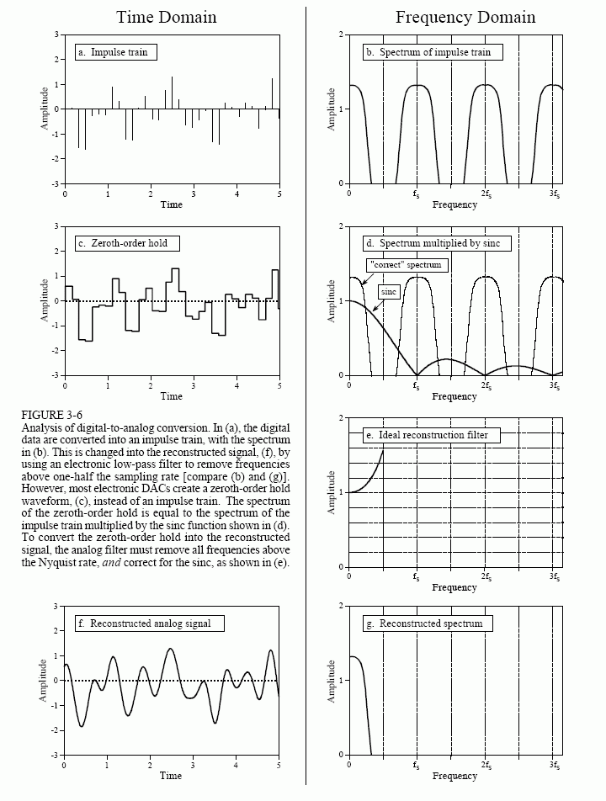
Digital to Analog Conversion
Ideal DAC impulses passed through reconstruction filter
Notes:
Example of cycling the light in a room to get intermediate values
1 bit at 11 MHz
Puts quantization noise out of the audible band.

Slide 16
Digital to Analog Conversion
1bit ADC/DAC with oversampling is superior
Sampling with smaller word size, but at much higher frequency
Low cost (1 bit DAC common in consumer electronics)
Distortions and non-linearities reduced
Quantization noise now out of the audible band
Phase distortion reduced
http://repository.upenn.edu/cgi/viewcontent.cgi?article=1144&context=ese_papers
DACs important because they are at the beginning of the chain
Total Harmonic Distortion THD
Dynamic Range
High end systems may have external DAC
Notes:
Example of cycling the light in a room to get intermediate values
1 bit at 11 MHz
Puts quantization noise out of the audible band.

Slide 17
Jitter
Jitter is a time instability during sampling or playback
Anti-jitter circuits, buffering, and jitter correction in software
Timebase correction (analog recordings on mechanical media)
products sold to reduce jitter and other errors

Slide 18
Why digital is better
Why do we choose digital over analog?
Ideally analog should be better, no information is lost.

Slide 19
Why digital is better
Digital circuits are complex, but precision not needed for digital (1 or 0)
Performance can be improved simply by increasing word size or sample rate. Cheaper
Less maintenance. Analog circuits change over time
Digital information is more durable. Easier to correct errors (in media, from transmission etc.)
Can create new sounds purely from numbers, and can control them precisely.
Every analog copy introduces more noise

Slide 20
Why digital is better
With analog media, oftentimes the mechanism has to touch the media
With analog system the total noise is the summation of all distortion and noise from each component in signal path.
Analog equipment often have uneven frequency response, lower dynamic range.

Slide 21
Error Correction
With analog audio there is no way to do error correction
With digital error detection and correction is both possible and necessary.
Data can be encoded or redundant
Upon detection the error can be corrected, or concealed
Necessary due to defects in media and harsh environments
CD and DVD systems approach the computer industry standard of an error rate of 1 uncorrectable error in 1 trillion bits

Slide 22
Sources of Errors
Error correction mainly focused on stored and transmitted data
Media can become damaged or can contain defects
Transmission can become corrupted do to many types of interference
Noise, attenuation, limited bandwidth, reflection, ringing
Types of errors
Random-bit errors
Occur singly, easy to correct
Burst error
Large error that may effect many bits
One property of a correction system is therefore, burst length, or how many erroneous bits in a row can be corrected.
That is why a scratch in a CD perpendicular to the track is easier to correct than one along a track

Slide 23
Error Correction
There will always be errors, therefore redundancy is necessary
But redundancy must be minimized to reduce data size
The steps in an error-correction system
Error detection, check the data for validity
Error correction replaces error with new valid data
If error can’t be fixed, conceal with approximately correct data
If all else fails mute the signal for severely erroneous data

Slide 24
Error Detection
Just having multiple copies of data is not enough. Which copy do you believe?
Single- bit parity
Extra bit indicates whether there was an even or odd number of 1s in number
Detects odd numbers of errors, okay for random-bit errors
Cyclic Redundancy Check Code (CRCC)
Parity word formed
Could be from sum of bits in data
In reality uses more complex division of data and remainder is appended to data. Upon reception the data is divided to check for errors
Some errors can then be corrected with this technique as well
Notes:
1011011010 = 6 0110

Slide 25
Error Correction
Simplest solution is to detect error then go to redundant track for correction.
Redundant samples should be separated so as to reduce chance of it be corrupt too.
Channel Coding
CD uses 20 bits to encode the 2^16 different values so as to avoid difficult to read sequences like 0000000100000000.
Errors can also be detected with this method, and data can be changed to the closest allowed value.
Interleaving used on CDs
Data stored non-sequentially around a circuit

Slide 26
Error Correction
Many more sophisticated techniques are also used
Block Codes
Parity words from blocks of data
Hamming Codes
Can pinpoint location of error
Convolution Codes

Slide 27
Error Concealment
Errors may not be detected
These can not be concealed
Errors may be detected but not corrected
These can be concealed
Interpolation
Use surrounding data to generate new data
Muting
Silence is better than a click
Sample is just set to zero
May fade out and back in to conceal mute
Error concealment will cause errors in duplication

Slide 28
References
Principles of Digital Audio: fourth edition, Ken Pohlmann,2000

