Slide 1
Sonification
Notes:
http://ra.csee.wvu.edu/SEPSCoR/sonification/sonification.htm
http://www.cs.uml.edu/~grinstei/tut/node37.html#SECTION00050000000000000000

Slide 2
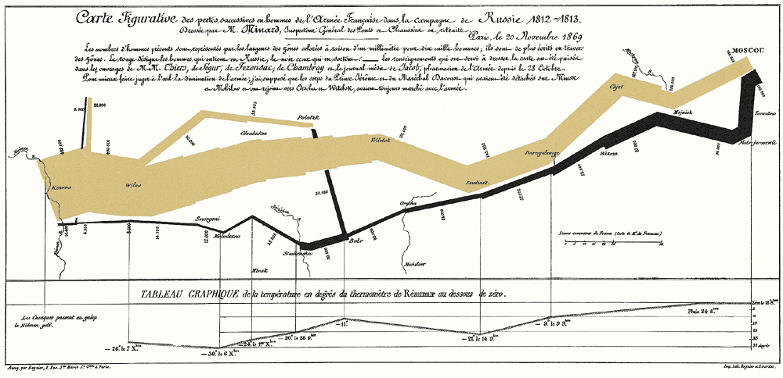
Visualization
First there was visualization
Presenting a graphical representation of data in order to interpret and understand the data
Minard, 1861, Napoleon’s march on Moscow

Slide 3
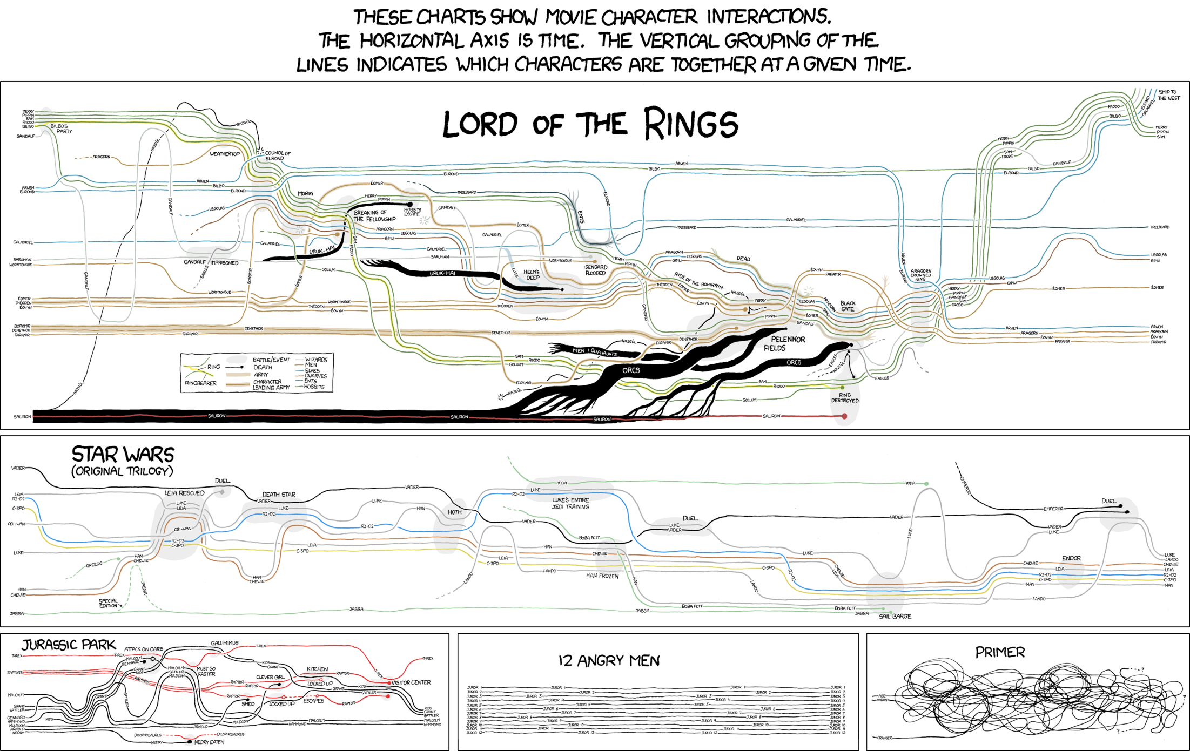

Slide 4
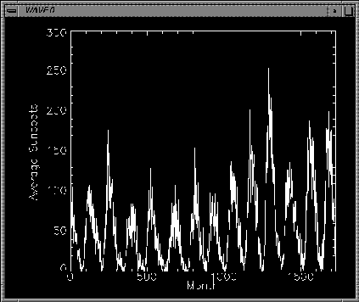
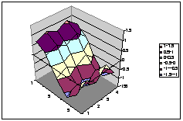
Visualization

Slide 5
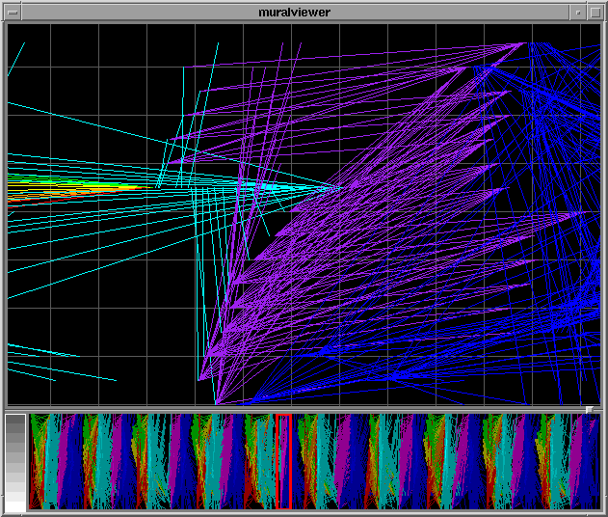
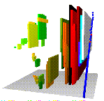
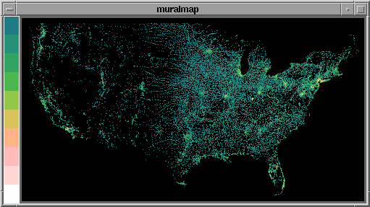
Visualization

Slide 6

What is Sonification?
The transformation of numerical data into sound for purposes of observing that data (NSCS ADS 1999).
Data representation through audio (ICAD 1999).
Earliest example
Geiger Counter, 1900’s
“clicks” based on radiation levels
Alerts user to danger
Medical
Heart monitor
Pulse-oximeter, monitor blood oxygen level

Slide 7

Why Sonify or Visualize?
We need to comprehend an abundance of data
Finally the computing and media technologies are available to produce visualizations and sonifications
Mathematical analysis is not enough
Human Genome
Gigantic data sets
Can use human perceptual capabilities to comprehend data
Recognize patterns
Discern relationships
Extract important structural features
EEG (90x, seizures)
Realtime EEG analysis (eye blinks)

Slide 8
Why Sonify?
High dimensions without information overload
Large number of variables that are changing can be monitored simultaneously
Voyager 2
Strange behavior when traversing Saturn’s rings, visual analysis revealed nothing but noise
Data of plasma waves interacting with AC electric fields was synthesized into sound
“machine gun” sound heard during the critical times indicated impacts with micrometeroids
http://solarsystem.nasa.gov/galileo/sounds.cfm
http://cse.ssl.berkeley.edu/stereo_solarwind
Notes:
“machine gun” sound heard during the critical times
Indicated impacts with micrometeroids

Slide 9
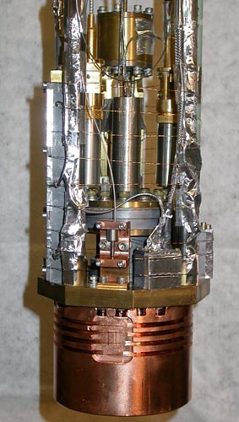

Why Sonify?
The Quantum Whistle
Researchers looking for oscillations predicted by quantum theory
Visual analysis of oscilloscope traces show nothing
Listening to headphones attached to experiment reveals the whistle that indicates oscillations
Notes:
“machine gun” sound heard during the critical times
Indicated impacts with micrometeroids

Slide 10
Why Sonify?
Natural Sciences (Astrophysics,Seismology etc.)
24 hours of data in a few minutes, can differentiate between earthquakes and bomb blasts
Visually impaired users
Spectrometry data for chemists and students
Wayfinding
Reading
Make learning more engaging?
Statistics, geometry etc.
Rhythm, music already used as mnemonic device

Slide 11
Sonification Problems
Parameters include pitch, intensity, attack, decay, timbre, tempo etc.
Which ones are orthogonal?
Human perception problems
Changes in pitch perceived differently
Range of hearing
Not everyone has perfect pitch, may require training
How do we interact with a sonification?

Slide 12
Sonification Levels
Audification?
Data itself forms samples of audio that are then played
Shifting may be necessary to make resulting sound audible
No other sound generating elements
Seismographic data, radio telescopes, brain activity etc.
Seismographic data conforms to elastic wave equation so audification works well
http://soundcloud.com/micahfrank
Notes:
https://soundcloud.com/micahfrank/sets/japan-earthquake-sonifications

Slide 13
Sonification Levels
Sonification
The sound generation is not directly linked to the data
Mapping data values to loudness
Number of low level variables is limited therefore the number of dimensions is limited
Answer is to use intermediary structures like modulation, envelope generators, pulse streams
High level models to encode data

Slide 14
Simple Sonification
Sound controlled by data values
Time and Pitch
X = Time
Y = Pitch
Y=X
Y = sin (X)

Slide 15
Sonification
“Virtual Engine”
The sound of an engine is very meaningful to a mechanic
Pitch might indicate RPM, tapping sounds might indicate knocking
The mechanic gets a lot of data from the sound because he has experience and the sounds relate to the laws of physics
Such a model can use our everyday listening skills to understand sonifications, and model doesn’t have to directly correlate with data
Inputs cause sounds to change in “natural” ways
A pitch increase means something is running faster,
A louder sound means something was hit harder
Increase comprehensibility

Slide 16
Levels of Sonification
Audiation
Cognitive process giving meaning to sonifications
Predicting based on previous experiences with audio
“hearing in their head” sound learned on previous occasions
But these categories are not discreet and it can be hard to classify a sonification with just one
http://www.mat.ucsb.edu/~b.sturm/music/50Particles.htm
Notes:
Audiation is derived from musicianship – the ability to hear and comprehend music which is not or no longer is present. For example, the ability to hear or perform music from reading sheet music notation.

Slide 17
Parameter Nesting
High dimensions mean you can have several sound streams in parallel or you can have a single stream with lots of parameters with different levels.
Nesting means you use a parameter like intensity in different ways simultaneously, resulting in many more dimensions

Slide 18
Loudness Nesting
Pulse Speed
Sound broken into pulses where intensity goes to zero periodically
Duration
The length of one of the pulses
Envelope
Sound is also subjected to attack and decay
Cluster Speed
Amplitude modulation the main sound <1Hz
Master Volume
Overall loudness of the sound

Slide 19
Pitch Nesting
More limited value because of peoples’ differing abilities to perceive pitch
Master pitch
Pitch range that the sound is in
Pitch
The instantaneous value within the master pitch range
Instantaneous pitch
Rapid short changes in pitch, vibrato
Waveshape

Slide 20
Brightness Nesting
Brightness is the high frequency content of the sound
Harmonics
Timbre
Can control this by adding or subtracting frequencies, filtering
Nesting might include things like reverb, flange, resonance etc.

Slide 21
Realistic and Abstract Sounds
Can use auditory icons or earcons for sonification
With auditory icons you can convey about six dimensions
Duration
Envelope
Master loudness
Master pitch
Master brightness
Speed
And multiple sounds can be used simultaneously

Slide 22
Problem of Orthogonality
Certain parameters can interfere with the perception of others
Reverberation causes attack and decay to become unclear as well as brightness
Clustering causes loss of concentration on other parameters like loudness
Parameter Overlap
Clustering that is too slow confuses pulsing and vice versa
Certain parameters draw our attention more than others
Master pitch is more noticeable than cluster speed
Will be linked to perception of importance (forcefulness)

Slide 23
Making a Balanced Display
Counteract differences in forcefulness
Scaling down range of a variable
Map pitch to a smaller range which will result in lower resolution of that value. Will also mean it doesn’t change as often, grabbing user attention
Mapping values in data to more than one variable
Variety of mappings for the data set
User can choose how to listen to data, can highlight the parameters that he/she is currently interested in
Sequencing can be used to allow the user to scan through different mappings, comparing
Interpolation may be required to make this sound nice
Unfortunately, a truly balanced display is virtually impossible

Slide 24
Sound Beacons
Sound can also be used in a visualization or sonification to help to orient the user
A “snapshot” sound that represents some data, an overview or summary
Could be some average values of the data around that point
Could be a fabricated reference value that represents data in its set
Can be used for compare different sets or areas
Static or dynamic
Static is not changing value, represents one data point
Dynamic is changing, might be the first few seconds of a long simulation or the first few values in a spreadsheet

Slide 25
Beacon Examples
Monitor a process by comparing a beacon of your data to a reference beacon that represents an ideal state.
Guy working with a molding machine, listens to sonification of functioning. Can listen to “normal state beacon” to remind himself what it should sound like
Data Analysis
Analyst browses stock market info over many years. She marks sites of interest and they are saved as beacons. Then she can compare beacons to see what they have in common or not. Can try to understand what stocks make money and which don’t etc.
Can use dynamic beacons to get more trend info

Slide 26
Correlating Data and Display
When using a sonification system the user has to remember the mappings, distracts from ability to get useful info from sonification
Display must be structured to reflect structures in data
Look for natural hierarchies in data
Example, ecology data grouped by air variables (temp, pressure, wind speed), water variables ( rain fall, pH), flora (biomass, diversity)
Maintain these families and types in the display
Distinct audio stream for each, air, water, flora with distinct timbre
Map common parameters like temperature to same value like pitch

Slide 27
Handling Multiple Streams
Problem with multiple streams is that the user must shift focus from one to the other
User may not be able to discern a very large number of streams if they are of high dimension
User must segment the auditory stream
But, can also be perceived as a “sea of sound” which users can get an overall understanding of the whole system.
ARKola

Slide 28
Associations
Abstract sounds have no intrinsic connection to the data.
There is no particular sound that we would associate with stock market data
So which sound parameter do we use then in a sonification?
How will the user remember the mapping?
Which direction should the parameter change in response to the data?

Slide 29
Metaphorical Associations
A method of choosing sounds and parameters that relies on the user understanding a metaphor
Using a sound that allows the user to link a physical world value metaphorically with the change in parameter
Pitch going up = physical speed value increasing (in real world machines make higher pitched sounds the faster they go)
Often you will want to encode the idea of “more” and “less” in many types of data
Can capitalize on sound metaphor for “more”
Increase a value like loudness (large objects make louder sounds)

Slide 30
Affective Association
A method of choosing sounds and parameters based on connection between the user’s feelings about a change in data and the feelings aroused by the sound
And undesirable change can be described by a sound that sounds “undesirable” to the user
Falling stock price for a broker represented with sound like a sound with unpleasant upper partials
A rise in stock price could cause the sound to become more “pleasing”
Possible affective associations
Increase in “ugliness”, decrease in “richness” = increase in undesirable variable in data
Increase in “predictability” of sound = increase in desirable variable

Slide 31
Affective Associations
Requires that you can classify sounds by these types of feelings
Will only work where there is an affect of the data
Increase in toxins in the environment does
Increase in scattering particles in a physics experiment may not
Would not be useful and in fact could be detrimental
It is easier to accomplish this type of association in the user with audio than with graphics

Slide 32
Associations
Can be conflicts between both types of mappings
What if rising pitch equals increased value metaphor coexists with rising pitch equals less desirable
A desirable variable like stock market price…if the pitch rises which association is being used?
There is a large subjective component to designing auditory displays, but must be combined with objective data about the data set being sonified
“most people in France find the increase in network traffic annoying”

Slide 33
Sonification Applications
“Sonifying the Body Electric” , Fitch, Kramer(94)
Subjects are anesthesiologists, must keep “patient” alive
8 continuous signals to monitor
Heart rate, body temp, blood pressure etc.
Many types of “complications”, single and multivariable
Sound mappings
Base sounds, thudding heart sound, AM noise at breathing rate
Piggy-back variables modify the base
Temp, bandpass freq on breathing
Blood pressure, pitch of heart sound
CO2, timbre heart sound
Use of audio more accurate and faster than visuals

Slide 34
Sonification Applications
Babble Online, Hansen(2001)
Sonified browsing on Lucent web site, and internet chat sites
Browsing sonification
Is the site busy or quiet?
How many people are looking deep in site, versus “passing through”
What content sections are people looking at?
What patterns of browsing are there?

Slide 35
Sonification Applications
Browsing sonification
Pitch mapped to five sub-domains in site
Number visitors mapped to loudness and tonal balance
When deep content requested higher-pitched pulsing tone, speed mapped to number of people accessing the area
More high register sounds, more detailed the content.

Slide 36
Sonification Applications
Chat Sonification
What are people chatting about?
System determines top ten topics that are being discussed in the chat rooms
Pan left and right
Sonification consists of topics being spoken
Sample sentences spoken
Entropy shown with piano score

Slide 37
References
Gregory Kramer, “Some Organizing Principles for Representing Data with Sound”, Auditory Display, SFI Studies in the Sciences of Complexity, Proc. Vol. XVIII, Addison-Wesley 1994
Tecumseh Fitch, Gregory Kramer,”Sonifying the Body Electric: Superiority of an Auditory over a Visual Display in a Complex, Multivariate System”, Auditory Display, SFI Studies in the Sciences of Complexity, Proc. Vol. XVIII, Addison-Wesley 1994
M.H. Hansen, B. Rubin,”Babble Online: Applying Statistics and Design to Sonify the Internet”, ICAD 2001, July 29 – August 1 2001

Slide 38
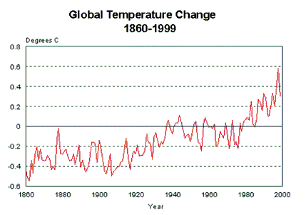
Sonification Design
How do I turn this…
Into a sonification?

Slide 39
Sonification Lab
Prof. Bruce Walker
http://sonify.psych.gatech.edu/research/
Sonification Sandbox
Auditory Graphs
Audio Abacus
User Training
Accessible Aquarium

