Slide 1
Sound Synthesis
Notes:
http://music.dartmouth.edu/~book/MATCpages/chap.4/4.1.intro_synth.html
http://www.sonicspot.com/guide/synthesistypes.html
http://www.arturia.com/en/synth.html
The computer music tutorial, curtis roads, 1996

Slide 2
Sound Synthesis
Digital audio is just stored samples that make up a sound
Samples can be created by digitizing real analog sounds
Real instruments can be simulated
New instruments that never existed in nature can be created
Sound effects can be created and modified dynamically
Synthesis began with the advent of the programmable stored digital computer in the 1940s

Slide 3
History of Synthesis
First synthesis experiments with sound being created by computer, 1957 at Bell Labs
IBM 704 with 32K of core memory
Calculations so complicated they had to be performed at IBM World Headquarters in NY
Results would be converted to sound back at Bell Labs

Slide 4
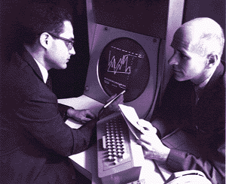

History of Synthesis
Music I -V program, Max V. Mathews
Father of computer music
Researcher at Bell Labs 1962-1985
Triangle wave, with control over pitch, waveform, and duration
“Bicycle Built for Two”, movie 2001
IBM 704 + vocoder
http://www.youtube.com/watch?v=qoqEC2mLYyE
Notes:
Up to Music V in 1970s
Bicycle Built for Two…2001
http://chris.kom.com/daisy.au
http://www.vortex.com/rmf/daisy.ram

Slide 5
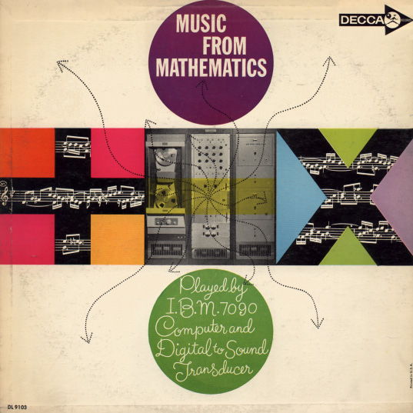
History of Synthesis
Newman Guttman
“In a Silver Scale” First piece composed on Music I
“Pitch Variations”
Amplitude modulation
Notes:
In a Silver Scale, Newman Guttman
Pitch Variations, Guttman

Slide 6

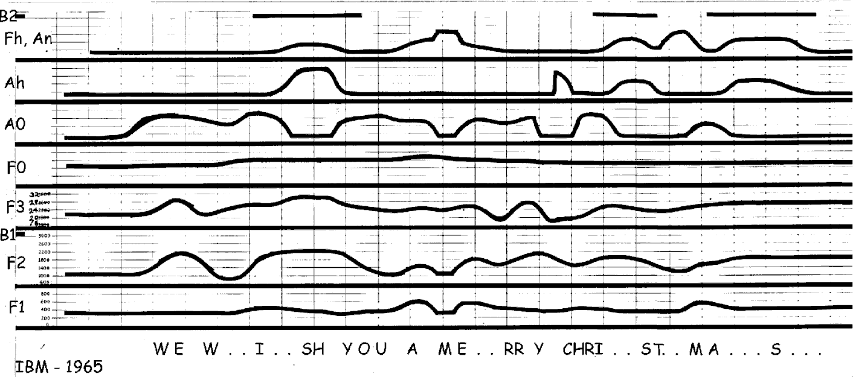
History of Synthesis
IBM TASS-II , Analog Speech Synthesizer II (1965)
Patterns manually constructed on transparent film
Film read in at 5 inches/sec
Notes:
Formant synthesizer control pattern for song "Merry Christmas", by N. Rex Dixon. First part of pattern is shown; full pattern measured 6 x 54 inches (15 x 137 cm). Vertical marks every 0.5 inches (1.3 cm) corresponded to 100 milliseconds at the nominal reading speed of 5 inches/sec (12.7 cm/sec). The three-part harmony was synthesized as separate voices, then combined with sound on sound recording.
The patterns were manually constructed on pre-printed transparent film with 1/16-inch (0.16 cm) black masking tape (developed for photoetching circuit boards), that could easily be changed with scalpel and tweezers. The control patterns were taped to a transparent belt to be carried past a flying-spot scanner. A nominal scanning rate of 100 scans/second provided control-function values for the synthesizer every 10 milliseconds.
The control functions were the first three formant frequencies (F1, F2, F3), voice fundamental (F0), voice amplitude (A0), noise or "hiss" amplitude (Ah), and a shared channel for nasal amplitude (An) or fricative frequency (Fh), switched by a binary control (B2).
http://www.mindspring.com/~ssshp/ssshp_cd/ss_home.htm
http://www.mindspring.com/~ssshp/ssshp_cd/ss_ibm5.htm

Slide 7
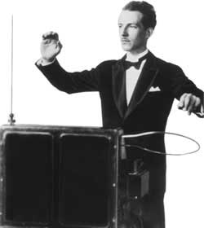
History of synthesis
Leon Theremin
Invented Theremin/Thereminvox
First instrument you play without touching
Control frequency and pitch via metal antennae
Often used for sci-fi sounds
http://www.youtube.com/watch?v=cd4jvtAr8JM&feature=fvwe2
http://www.youtube.com/watch?v=mW0B1sipLBI
Notes:
http://www.theremin.nl/

Slide 8
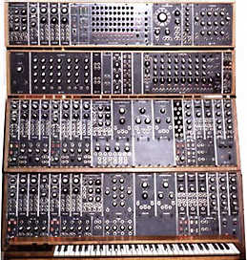
History of synthesis
Robert Moog
Theremin Kits 1961
Moog synthesizers
Modular
Generate, modify, control signals
Minimoog Model D
Portable and affordable
http://www.youtube.com/watch?v=0z0cbMkOvY0
http://www.youtube.com/watch?v=WY2AeD0Tn4Y
http://www.youtube.com/watch?v=KkUTChyWOB4 (synthesis 1970’s style)
Evolution of synthesizers
http://documentation.apple.com/en/logicexpress/instruments/index.html#chapter=A%26section=5%26tasks=true

Slide 9
Sound Synthesis Techniques
Dozens of synthesis techniques have been developed
Some are not widely used and others go in and out of fashion
Radio wave demodulation
Pulse tone synthesis
Frequency modulation
Amplitude modulation
Additive and subtractive synthesis
Wavetable synthesis
Granular synthesis
Physical modeling
In modern equipment and software multiple techniques are often used together

Slide 10
Sound Synthesis Examples
Kraftwerk
http://www.kraftwerk.com/
ATT Labs voice synthesis
http://www.research.att.com/~ttsweb/tts/demo.php
Stomper
Hindustani Music Synthesis

Slide 11
Sound Synthesis
Simple synthesis techniques
A function is defined to create sample values. The function depends on the synthesis technique
Input is usually time values and output is amplitude values (samples)

Slide 12
Sound Synthesis
Could simply create 44,100 random samples and then play them for 1 second, but the result would be noise
Since all sounds can be created from a sum of sin waves, a simple synthesis formula is to generate samples from a sin function
Y = Sin(X)

Slide 13
Sound Synthesis Basics
Unit Generators
Modules that form synthesis instruments or patches
Signal Generators
Signal Modifiers
Oscillators are signal generators
Amplitude, frequency, waveform

Slide 14
Sound Synthesis Basics
When a computer plays a sound. There is a buffer of samples being sent one by one to the DAC.
Could be calculating values of a function like Sin(x) for each index
A better solution is : Table Lookup
For a periodic sound simply calculate one cycle of the waveform and loop through it again and again
This is a digital oscillator
Current location in table is “phase index”

Slide 15
Sound Synthesis Basics
Table Lookup
What will the frequency of this waveform be?
Depends on sampling frequency and number of elements in the table.
For example. Sampling frequency is 1000 Hz, and there are 1000 values in the table. The computer will play an entire cycle in 1 sec…therefore the resulting sound is 1 Hz.
Output freq = (sampling freq)/(# elements in table)
How do we change output frequency
Can change sampling freq…but this will make processing and mixing more difficult
Instead, change the rate the computer scans through the table by skipping samples
If you skip every other sample, the resulting output frequency will be 2X the original.
Notes:
100,000Hz sampling…still 1000 entries..output is 100 Hz.

Slide 16
Sound Synthesis Basics
Therefore, “increment” is the amount added to the “phase location” to find next sample. Increment determines output frequency
A simple oscillator
Phase index = (previous_phase_index + increment) mod L, where L is length of table
Output sample = amplitude * table[phase_index]

Slide 17
Sound Synthesis Basics
How do we calculate the increment we need?
Increment = (L * (output freq)) / (sampling freq)
L = 1000, FS = 40k, output = 2k?…Increment = 50
But what about when the increment is not an integer?
Can truncate or round the value
The result is table-lookup noise. Waveform is now distorted
Best results come from interpolation
Can use linear
More sophisticated interpolation techniques yield even better results
Notes:
L = 1000, sampling freq = 40,000, want 2000 Hz…increment = 50
Example y=.75, x = 27, y = .25, x=28…what is value at 27.5? Find slope diffy / diffx…solve for b = 14.25,plug in 27.5 as x and solve for y = .5

Slide 18
Sound Synthesis Basics
A constant fixed frequency signal is not very interesting
Need envelopes to change sound over time
Amplitude Envelope
ADSR
Attack, Decay, Sustain, Release
Envelope generator
Duration of sound
Peak amplitude
Waveform
http://www.freesound.org/tagsViewSingle.php?id=1667
Frequency Envelope
Vibrato, glissando/portamento
http://www.freesound.org/samplesViewSingle.php?id=35372
http://www.freesound.org/samplesViewSingle.php?id=82975

Slide 19

Additive Synthesis
Domain of techniques based on the idea of summing simple waves (such as sin) to create sounds
Old idea, this is how pipe organs work
Several harmonically related pipes are chosen to play at once. Making different sounds from the same instrument.
Theoretically, any sound could be produced this way
Not possible in reality due to fact that complex sounds have a time varying spectrum that may be very difficult to analyze or reproduce

Slide 20

Additive Synthesis
Simple fixed waveform technique
A fundamental and some harmonics or partials are summed together.
For more interesting sounds
Vary parameters over time such as the amplitude, frequency envelope, harmonics and partials
Give each partial or harmonic its own set of envelopes
Example, a trumpet will have 12 sin waves in the initial attack, after 300ms only 3-4 are needed
Lemon Drops, Kenneth Gaburo, 1960, Harmonic Tone Generator
Even speech can be approximated with this technique
Sinwave speech
http://www.lifesci.sussex.ac.uk/home/Chris_Darwin/SWS/

Slide 21
Additive Synthesis
Additive Analysis/ Resynthesis
A natural sound is analyzed to determine frequency components and envelopes etc. Then the sound is resynthesized
Fast Fourier Transforms (FFTs) are performed over small windows in the sound to capture this information
The data can be modified before resynthesis in order to make it more interesting

Slide 22
Additive Synthesis
Drawbacks
Large number of oscillators may be required
Large amount of control data required for each voice, or possibly for all its partials
Center frequency
Peak amplitude
Amplitude envelope
Start time for amplitude envelope
Duration of amplitude envelope
Frequency envelope
Start time of frequency envelope
Duration of frequency envelope
Where will all this control data come from?
Earth’s magnetic field
Notes:
Manual,
or mapped from some domain like sky line Charles Dodge “Earth’s Magnetic Field or mathematical models
http://eamusic.dartmouth.edu/~book/MATCpages/chap.1/1.snds/earth.mp3
Composition program
Program that applies high level musical concepts
Analyzing natural sounds

Slide 23
Subtractive Synthesis
You start with a high frequency signal (like whitenoise) and remove frequencies from it to form your sound
Frequencies are removed via filters that boost or attenuate regions of a frequency spectrum
High pass, Low pass filters
Cutoff frequency (-3dB)
Stopband, passband
bandwidth
Bandpass, bandreject filters
Center frequency (resonant frequency)
Equalizer
Comb filters

Slide 24
Subtractive Synthesis
What is this good for?
Can make sounds that would be extremely difficult to achieve with additive
Wind instruments
The unpitched attack portion of a sound
Stomper example
As with additive, the most interesting sound result from varying the parameters with time
Subtractive Analysis/Resynthesis used mainly in speech synthesis

Slide 25
Subtractive Synthesis
Linear Prediction Coding (LPC)
Analyzes voice recording, resynthesizes approximation
Approximates how speech produced (buzzer at end of tube)
Used when there wasn’t the capability to store or transmit full speech data
Early speech synthesizers in products such as TI’s Magic Wand Reader (1983)
Used in cellphones
Research at GT in using this for “whisper” speech
Real whisper
Real voice
Synthesized from whisper
w/ pitch shift
Notes:
Real voice, whisper, synthesized from whisper, synth with pitch shift

Slide 26
Amplitude Modulation
Modulation means some parameters of a “carrier” signal are modified according to some parameters of a “modulator” signal
With Amplitude Modulation the carrier signal is multiplied by a unipolar modulator
Unipolar, meaning all values are greater than 0,
Therefore, an amplitude envelope is a simple example
But >20Hz will yield the most interesting results
Notes:
440 Hz with envelope

Slide 27
Amplitude Modulation
When modulating with a sin wave, sideband are formed by AM at the sum and difference frequencies around the carrier frequency, carrier frequency still present
Example, 1000 HZ tone modulated by 400 Hz signal results in a sound with components at 600, 1000, and 1400
Sidebands have half of original amplitude
Ring Modulation, version of AM where bipolar modulator is used (so values are between –1, +1)
Carrier frequency not present in result
Formula remains the same, multiply the two signal together to get the modulated signal
Notes:
In AM the carrier frequency is preserved and the sidebands generated are at half the amplitude of the carrier amplitude.

Slide 28
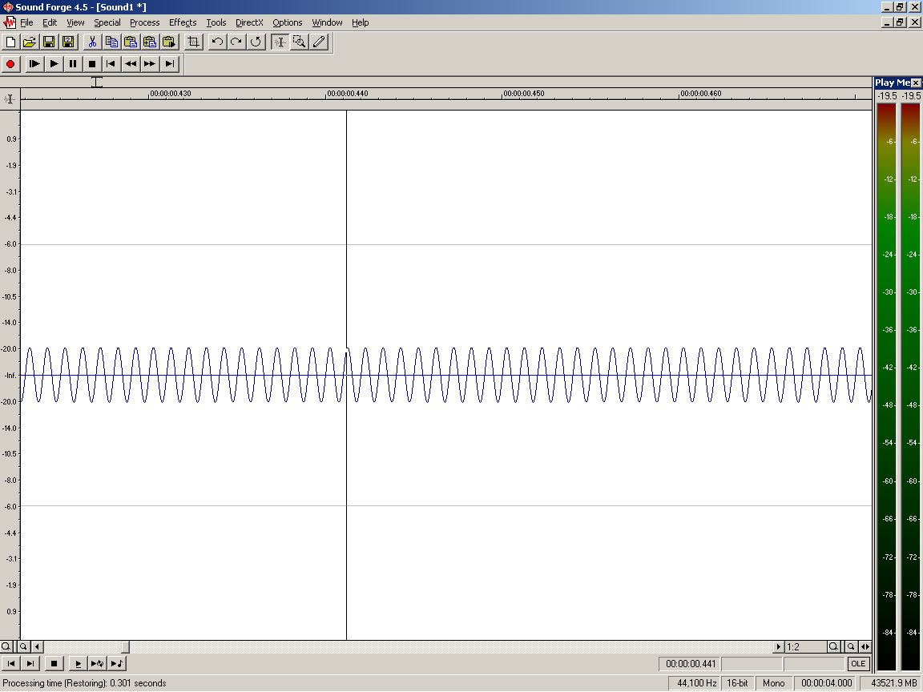
Ring Modulation
Example, 1000 HZ tone

Slide 29
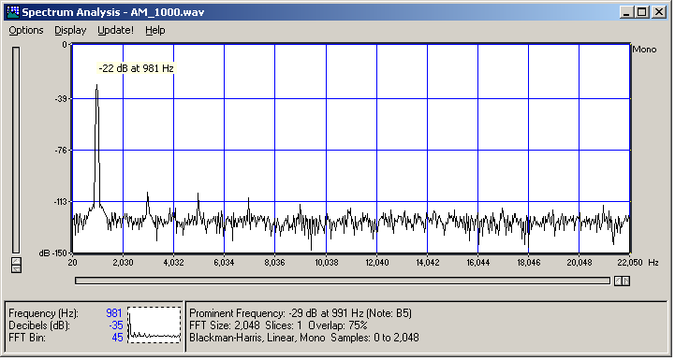
Ring Modulation
Spectrum of 1000 Hz tone

Slide 30
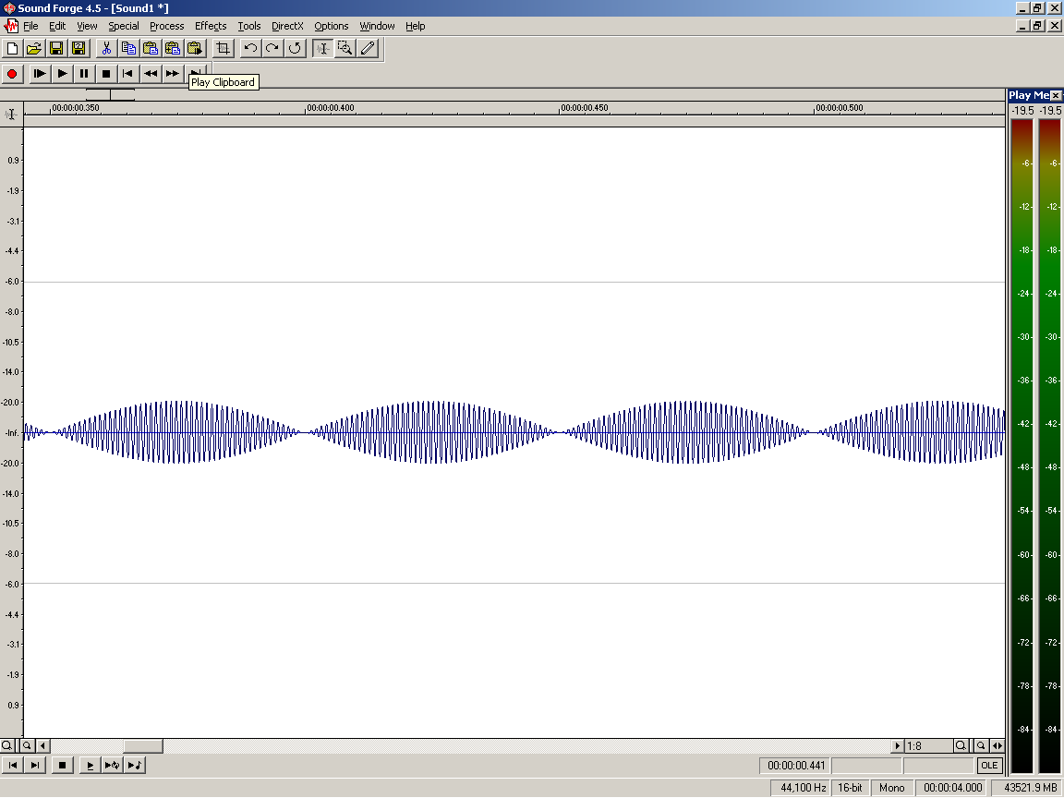
Ring Modulation
1000Hz modulated by 20 Hz

Slide 31
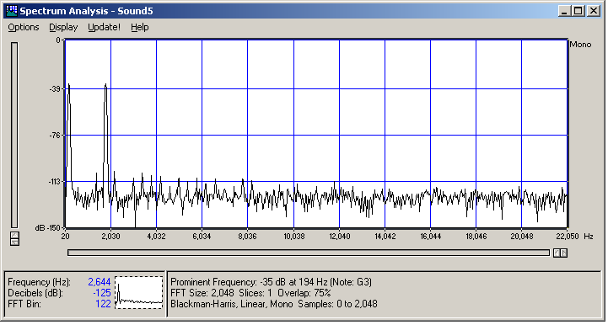
Ring Modulation
1000 Hz modulated by 800 Hz

Slide 32
Amplitude Modulation
What about sidebands that are negative?
Example, carrier = 300Hz, modulator = 500
Sidebands at 800Hz, and –200Hz
Negative results in change of phase
Waveform flipped around x axis
Modulation with other types of waves, such as square waves will result in more frequencies appearing in final signal
Notes:
Negative means a change in phase. Waveform is flipped around x axis

Slide 33
Frequency Modulation
1970s, John Chowning, a composer and researcher at Stanford University discovers and begins working with FM synthesis for music
Chowning realized that natural sounds have very dynamic spectra, especially during attack and decay.
Requires little computational power, therefore it was popular in early sound cards and synthesizers
In additive synthesis if you wanted 50 harmonics you needed 50 oscillators, with FM you only need two

Slide 34
Frequency Modulation
Simply, the frequency of the carrier is modulated by another oscillator.
The greater the intensity of the modulating frequency, the greater the change in carrier frequency
Low frequency modulation (<30 Hz) = siren like sounds
Modulation with frequencies in audible range create sounds with interesting timbre
cos(carrier_angle[t] + B*sin(mod_angle[t]))
Notes:
Example
C = 1000, M = 300
Sideband at
C +M= 1300 , C-M = 700
C +2M= 1600, C-2M = 400
C +3M= 1900, C-3M = 100
Etc.
Fc = 800
Fm = 200
Fc:fm = 4:1
Fc=800
Fm=210
Fc:fm = 80:21

Slide 35
Frequency Modulation
Many more sidebands created, carrier freq remains
Dependent on the ratio of the carrier frequency to the modulation frequency. C:M ratio
Sidebands = FCarrier +- K *FMod
K is non-negative integer
Integer ratio Fc:Fm = harmonic spectra
1:1,1:4,1:9 etc.
Complex ratios, inharmonic
2:5,4:9 etc.
Notes:
Example
C = 1000, M = 300
Sideband at
C +M= 1300 , C-M = 700
C +2M= 1600, C-2M = 400
C +3M= 1900, C-3M = 100
Etc.
Fc = 800
Fm = 200
Fc:fm = 4:1
Fc=800
Fm=210
Fc:fm = 80:21

Slide 36
Frequency Modulation
C = 1000, M = 300
Sideband at
C +M= 1300 , C-M = 700
C +2M= 1600, C-2M = 400
C +3M= 1900, C-3M = 100
Etc.
Fc = 800
Fm = 200
Fc:fm = 4:1
Fc=800
Fm=210
Fc:fm = 80:21
Notes:
Example
C = 1000, M = 300
Sideband at
C +M= 1300 , C-M = 700
C +2M= 1600, C-2M = 400
C +3M= 1900, C-3M = 100
Etc.
Fc = 800
Fm = 200
Fc:fm = 4:1
Fc=800
Fm=210
Fc:fm = 80:21

Slide 37
Frequency Modulation
Modulation Index based on Amplitude of Fm
I = D / Fm (D= deviation from Fc)
Higher D spreads power over more of the spectrum
Determines strength of sidebands (Bessel function)
Higher Modulation Index increases contributions of sidebands
http://music.columbia.edu/cmc/MusicAndComputers/
Notes:
Larger D, the more the power is spread over the spectrum
Amplitude of sidebands fluctuate, rising and falling in quasi-sine wave pattern (Bessel functions)

Slide 38
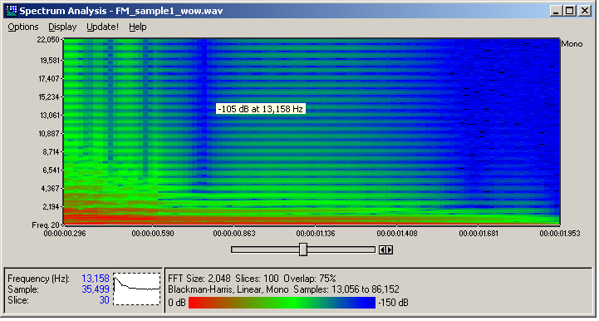
Frequency Modulation
Demo sounds
Arras
Notes:
Wow sample is one with spectrum

Slide 39
Wavetable Synthesis
Audio samples (perhaps recorded from nature) are stored in a wavetable in memory and played at different pitches.
The common synthesis method for consumer sound cards, also appears in keyboards/samplers
Requires storage for the samples
Data compression used on samples
If all pitches of sample can’t be stored intermediate pitches must be created
Attack, Sustain, Decay sections
Sustain must be loopable
One problem can be that the sounds are very repetitive, mechanical
Note to note transitions are unrealistic
Demo
Drums
Midi file
Notes:
Demo drums, and John Appleton, tape based sample piece, back in black

Slide 40
Granular Synthesis
Like additive synthesis except that you are adding together thousands of small grains of sound (<100 ms). These grains can be sinusoids, or sampled sounds.
Control time placement of grains as well as the amplitude envelope, frequencies
Very complex and strange sounds are possible
“sound clouds”
Granular Synthesis
http://www.youtube.com/watch?v=ajdRGF5NHIs
“Not just more idle chatter”, Paul Lansky
Notes:
Paul lansky not-just-more-idle-chatter

Slide 41
Physical Modeling
Next step in synthesis technology, the sound is generated from mathematical models of the mechanical and acoustical attributes of the instruments.
Basically, a simulation of the instrument is created and input such as breathe, or plucking etc. are given to it, the sound is then computed
Can simulate real instruments or explore crazy designs

Slide 42
Physical Modeling
Requires we have mathematical models that describe and instrument. Can be very complex
Models are very simplified because they are constrained to the types of input that would occur during a performance
Current models are very simplified, so result is not totally realistic
Very computationally intensive
But result could be very realistic, because it could include variation and side effects
Someone has to play this virtual instrument. If it is controlled just by software, you also need a virtual performer
Physical modeling (bass)
http://www.youtube.com/watch?v=0szLUItjvXY&feature=related
“Star Spangled Banner”, Charlie Sullivan
SPASM, Perry Cook
Notes:
Charlie Sullivan Star, Perry Cook SPASM

