Slide 1
The Physics of Sound
Maribeth Gandy
Notes:
Sources
http://www.nsa.gov/wwii/papers/start_of_digital_revolution.htm
http://www.digitalcentury.com/encyclo/update/audiohd.html
http://www.rci.rutgers.edu/%7Edmorton/sound_recording_overview.htm
http://www.digitalcentury.com/encyclo/update/audiohd.html
http://www.studio-sound.com/archive/nov99/celeb_computing.html
http://www.8trackheaven.com/early.html
http://teenmusic.about.com/library/weekly/aa012401a.htm
http://www.howstuffworks.com/cassette.htm
http://www.sharp.ca/consumer_minidisc.htm

Slide 2
What is sound?
Sound is a wave
A disturbance moving through a medium
A wave propagating through an elastic medium
Density and stiffness of medium effects propagation
Almost 100% elastic collision, attenuation
Velocity increases with density and with temperature

Slide 3
What is sound?
Transducers turn one type of energy into another
Notes:
Microphone is a type of transducer (physical diaphragm converting pressure to electrical energy)
Tuning fork (seen above) is also a transducer
The human ear is also a transducer! (more on this later)

Slide 4
What is sound?
Longitudinal wave
Particles moving in direction parallel to energy transport
Notes:
Note each little particle is only moving a small amount, which then impacts the next particle, and so forth.

Slide 5
What is sound?
Sound radiation
Emitter must move fast enough to form high pressure zone
Emitter needs vibration…not just forward movement
Emitters work best when inertia of medium is enough to keep it from moving appreciably, and the inertia of the emitter isn’t so large that the emitter is hard to move.
Notes:
Key things for an emitter:
Fast enough so that pressure is formed
(e.g. hand moving slowly in the air causes the particles to move around the hand, if the hand moves quickly then zones of high and low pressure are created which emit sound)
Needs to be a vibration
Something moving forward does not create the oscillating wave needed for sound
When designing speakers, there is much research into what you make the speaker cone out of. Typically this is cheap (cardboard). On one hand, you need enough inertia versus inertia of medium it is in so that when the osciallation is performed it creates pressure changes rather than particles moving around
Also the inertia of the emitter is not so much that it moves the emitter (something that can be oscillated back and forth quite easily)

Slide 6
What is sound?
Changing levels of pressure in the medium
Compressions and rarefactions
Notes:
Consider a guitar string or speaker cone
Loudness is how compressed or rarefied the sound is. How quickly do the oscillations happen? This is the frequency. The amount that it moves is the loudness. A softer sound may have the same rate of movement, but the air is less compressed/rarefied leading to less displacement in the eardrum (leading to lower perceived volume)

Slide 7
Frequency
Wavelength, physical measurement of the distance a sound travels in a cycle.
http://www.mcsquared.com/wavelength.htm
Period is the length of one cycle of the sound
The inverse of period is frequency. A, 440Hz
Notes:
Oscillations per second is frequency
Emitter moving back and forth goes from high pressure to low pressure… one iteration of this process is a cycle, or period.
Emitter creates the sound and the wave goes out, which could be physically measured in terms of how far it travels in one cycle.
In sound, wavelengths are a scale we can comprehend. If a low frequency, like bass, we are talking about very large wavelengths.
Terminology that is important:
Frequency – interesting sounds have many of these
Period is the inverse of the frequency, the length of time it takes for one cycle to complete.
If it takes 2 seconds for a wave to complete a full cycle, then the frequency of this is the inverse… hence ½ = 0.5 Hz tone
Numbers used in the class are the range fo human hearing – 20Hz – 20,000Hz (20KHz). 440Hz is a standard frequency for A in music.

Slide 8
Intensity
Amplitude, height of the wave. Degree of compression of sound wave
Peak to trough / 2
Point Source
Sound pressure variations at a point
Attenuation
Inverse square law
Doubling radius from point source halves the amp
Can overcome with reverberation (e.g. auditoriums)
Notes:
http://hyperphysics.phy-astr.gsu.edu/hbase/acoustic/invsqs.html#c2
Volume is how humans perceive intensity. They are not the same (will be covered later).
--
Same sound with many ranges of intensity depends on the amount of compression that the particles go through.
Consider this as the height of the wave… the amplitude is measuring from the peak to the trough of the graph divided by 2.
Attenuation is the falloff of the sound, lowering the intensity over time due to the loss of energy from each collision. This is governed by the inverse square law from Physics (see next slide).

Slide 9
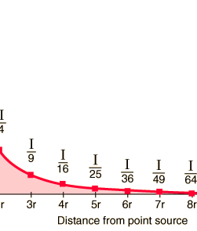
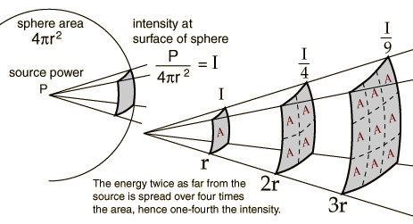
Intensity
Notes:
http://hyperphysics.phy-astr.gsu.edu/hbase/acoustic/invsqs.html#c2
Auditoriums must overcome this by using reverberation
--
The power coming out from the wave fans out over a greater surface area as it goes out into the world. This is a logarithmic scale.
Note that this also assumes no obstacles in the way of the wave. In the auditorium, the waves strike the walls and reflect back into the center of the room. Some frequencies are absorbed by the wall, some are reflected, etc. There are other rooms that are intentionally “dead”, like in studios, that absorb frequencies rather than reflect them.

Slide 10
Frequency
Transducers (including ears) can’t linearly receive or produce that range.
Frequency response is not flat, and frequency range is limited
Amplitude response to frequency
Bandwidth = highest freq – lowest freq
Pitch is psychological attribute of frequency
Notes:
Pitch is how humans perceive frequency. They are not the same (will be covered later).
If transducers were all the same, then why are there expensive microphones?
--
Transducers are better at vibrating at certain frequencies rather than others. A tuning fork is an extreme example… it only reproduces a single frequency, making it a terrible transducer.
Expensive speakers have a graph showing the frequency response of the speaker. It may be weighted towards low frequencies to reflect bass heavy sounds while not being as good at high frequencies.
Ears work similarly… hearing is not a linear response to frequencies. (this gets ahead to perception)
Bandwidth (difference between highest and lowest frequency transducer can respond to). A speaker in a mobile phone with a poor frequency response may only do 1-5kHz versus home theatre speaker that can go from 20-20kHz (needs to be physically larger, pointing to issues that cannot be physically overcome in improving small speaker design easily.
Note again that pitch is not the same as frequency. Pitch is what humans attribute to frequency. Humans cannot perceive frequency linearly. Different humans can perceive frequency changes at different rates, and this changes over the range of frequencies.

Slide 11
Phase
The fraction of a complete cycle elapsed as measured from a specified reference point and often expressed as an angle.
Notes:
Phase of a periodic signal (repeating over and over again) is at what point within a complete cycle you are currently through, typically refered to in degrees. Consider 0 -> 360 degrees or 0 -> 2pi. Phase is expressed as an angle.
You can have two tones of the same frequency that are out of phase from one another. One could start at 0, while another starts at 180 degrees, which leads the sounds to cancel out through summing.

Slide 12
Interference
When waves meet
Multiple sound sources
Fortunately, it’s linear…the sources can be summed (S1 + S2 + S3…)
Constructive and destructive
Noise cancelling
Notes:
Waves do not exist alone, they meet each other, and they affect each other. What happens when multiple waves come together?
It is a simple calculation. If an emitter in one place emits one frequency (440) while another emits in another place (220) you simply sum them together. However, the sounds may be at a different phase when they meet.
e.g. Two emitters emitting the same tone e.g. 400 Hz. If perfectly in phase, then they add together, leading to a higher intensity with the same frequency.
Another simple example… Two sounds at 180 degrees out of phase. If you add these together, they zero out, leading to silence. Nothing. This is how noise cancelling headphones work… they have microphones that take in the outside sound and playback that sound as a mirror image. It seems counter-intuitive that two loud sounds would result in nothing, and in practice this rarely works perfectly. They are never completely in perfect sync.
[example of acapella here, perhaps]

Slide 13
Interference
Standing waves
Pattern resulting from multiple waves
Nodes and antinode
Notes:
The modes of vibration associated with resonance in extended objects like strings and air columns have characteristic patterns called standing waves. These standing wave modes arise from the combination of reflection and interference such that the reflected waves interfere constructively with the incident waves. An important part of the condition for this constructive interference for stretched strings is the fact that the waves change phase upon reflection from a fixed end. Under these conditions, the medium appears to vibrate in segments or regions and the fact that these vibrations are made up of traveling waves is not apparent - hence the term "standing wave".
--
The summing of these waves are the source of interesting sounds we hear in our world. When sounds reflect from surfaces, you have the same frequencies coming back on themselves. Waves being reflected can interfere with themselves! The shapes of acoustic musical instruments are done so to shape the sound before it emerges from the holes in the instrument body. This is what makes different instruments sound different from one another.

Slide 14
Interference
Beating
Two sounds with slight difference in frequency
In and out of phase
Beating frequency equal to the frequency difference
Notes:
When alignment happens and then falls out of alignment, it creates this effect called beating (see picture on next slide). This sound is most commonly heard when a reference tone is played in conjunction with tuning a string (guitar tuning)

Slide 15

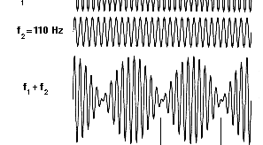
Beating

Slide 16
Reflection and Absorption
When waves hits rigid surface, does not stop, but is reflected.
Some of the pressure will be absorbed by the surface giving. Energy is taken from wave and turned into heat, via friction. This is why there are no infinite echoes
Size and Frequency do matter!
Size as in the scale of the material. Paper only absorbs highest frequencies, heavy curtain will absorb low and mids as well.
Notes:
When pressure waves encounter obstacles, dependent on the size, surface of the material, that determines which frequencies pass completely through, are absorbed by the material, or are reflected back.
No matter what the surface, some of the surface energy is absorbed (slight amount turned into heat). This is why you don’t have an echo that goes on forever. Size matters in both aspects… the wavelength of the sound, the size of the obstacle and their relative size to one another. Different materials respond in different ways to different sounds, etc. Ph.D theses are written to study this.
Symphony halls are designed not just to reflect the sound, but reflect the sound in a way that is perceived as pleasant or complimentary to the music being played by each individual instrument. Poorly designed spaces will absorb the sounds you actually want reflected (e.g. egg crate material in studios absorb almost all sound directed towards it).

Slide 17
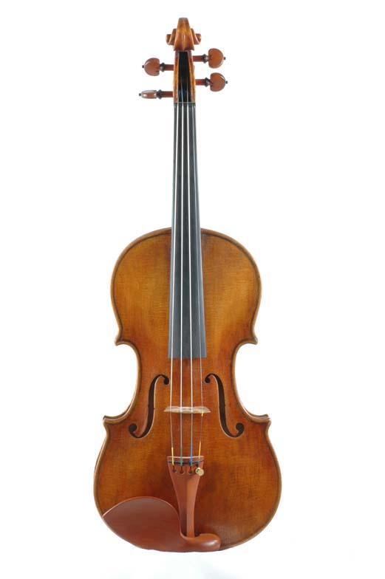
Resonance
Reflection + Interference
Resonant frequencies will reinforce sounds of that frequency
I.e. distance between obstacles is a multiple of the wavelength.
Reverse, or damping can also occur
Modes of Vibration
Instruments
Speakers
Room “coloring”
Complexity increases in multiple dimensions (I.e. irregular or curved surfaces)
Resonant Frequency of objects
The frequency at which an object vibrates when set in motion
Notes:
These calculations are very complex… game engines typically do not perfectly simulate the acoustics of a 3D space as they are very complex and computationally expensive (hard to do in real time). Pragmatically, as in lighting in graphics, you take shortcuts to approximate.
Resonance is the frequency an object will naturally vibrate at. Tuning forks have a very specific resonant frequency, every object has a specific resonant frequency (shattering the wine glass example from Mythbusters).
With large speakers you could play different frequencies to find the resonant frequency of a room.
Bridges that collapse when people walk across them due to large lockstep walking causing the object to begin to vibrate to the point of collapse. Instruments are designed to reproduce specific frequencies, buildings are designed with materials that do not resonate at common frequences (that would cause it to collapse).
Stradivarius violins are prized due to their resonance. The geometry, the materials in the wood, the varnish, etc.

Slide 18
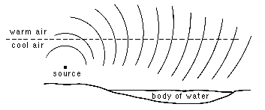
Refraction
When medium the wave is traveling through is not homogeneous.
Analogous to wave optics
If wavefront hits boundary at an angle, the angle of motion is changed
For audio the effect is usually caused by a gradient temperature change
Notes:
Refraction comes from optics… place a straw in a water glass and you see the straw appear to be broken as the light is passing through two different media.
With sound, it is similar but not as dramatic. A sound wave going through one media in conjunction with another… this causes an angle change in the direction of a wave. You experience this typically over a body of water (e.g. lake)… it is not two mediums you are hitting, but you are hitting air with significant different densities. When the boundary is struck it changes the angle. Around lakes you can hear people very very far away due to this refraction effect.

Slide 19
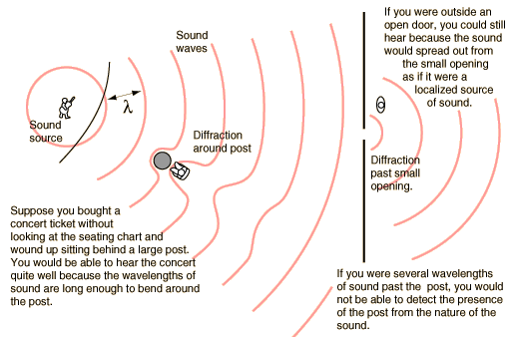
Diffraction
The bending of waves around objects and edges
For small object, insubstantial. Large objects reflect locally. So often overlooked
Where diffraction is significant is called the “Near Field Effect”
Notes:
About how waves bend around objects… diffraction only comes into play when you have the object and the sound wavelength be of the right ratio. A very small object does not affect the wave much (pen in front of one’s mouth). A giant screen in the path of someone’s mouth would affect it. Pop shields on microphones are designed to diffract before the waves hit the microphone (causing plosives).

Slide 20
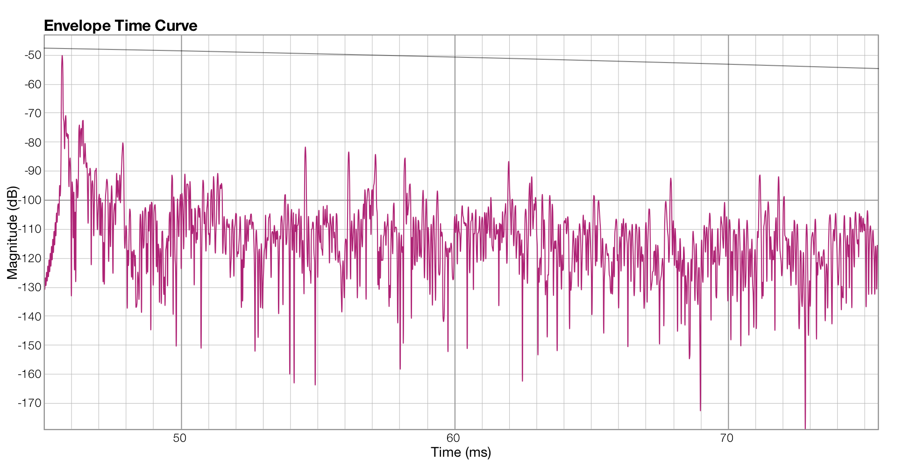
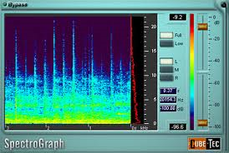
Domains
Time Domain
The representation you are used to seeing
Intensity (or Sound Pressure Levels (SPL) with respect to time)
Frequency Domain
Represent frequency and intensity components in a sound
Spectral analysis will yield these graphs
Notes:
Aphex Twin video
VERY big concept in this class are the different representations of a sound. Everything talked about until now has been in the TIME DOMAIN. You speak in terms of how the sound pressure level changing over time. X axis is time, Y axis is amplitude / sound pressure level (SPL).
A one Hz wave means that every second a complete cycle of the sound has completed.
In the frequency domain, time is represented by the X axis, The Y axis represents the frequencies present and the color represents the intensity of that particular frequency at that particular point in time. IN 2D, the X axis is represented by frequencies present and Y is represented by the intensity. The frequency domain representation is ALL the frequencies present in the signal.
If you asked for all frequencies in the signal, it would not have any time element in it. In a spectral view, that represents how the frequencies change over time. This takes analysis over smaller windows of the signal (or slice) and represents many small segments of time in the signal. (pixel represents a certain range of frequencies, color of pixel represents the intensity).

Slide 21
Periodicity
Periodic: A fundamental and its harmonics
A fundamental is the lowest frequency in complex sound, harmonics are integer multiple frequencies of that fundamental
Fundamental determines “pitch”
Notes:
In nature, pure sine waves are rare…most are one of these three
Triangle wave…only odd harmonics with intensity of 1/(n)2, square wave…odd harmonics, with 1/n amplitude
Harmonics..integer multiples of the fundamental
--
Simple signals are periodic. They repeat the same cycle over and over again. Even sounds with multiple frequencies can repeat. Musical tones are periodic tones, but they have a relationship to one another in terms of frequency.
Example of periodic tone from keyboard… looking at this in the frequency domain, you will see one frequency that is (more intense) than the rest (the one we perceive) with other frequencies in addition to this that are at integer multiples of the fundamental frequency. These ratios are pleasing to our ears. The pitch we perceive is the fundamental frequency.
A440 on a piano or guitar would be very distinct from one another with the same fundamental pitch, but they would be made up of very different harmonics.

Slide 22

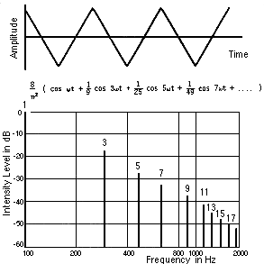

Periodicity
100 Hz
Triangle wave
Only odd harmonics, intensity 1/(n)2
Notes:
http://www.sfu.ca/sonic-studio/handbook/Triangle_Wave.html
Created using a formula that determines the harmonics that should be added in to the fundamental. Compare the sine tone to the triangle, which has multiple sine waves summed together at different frequencies and amplitudes. This is relatively simple to compute, and could be performed by circuits in the 60s. More interesting than simple sine waves alone.
It is key to not only be at different frequencies, but different intensities.

Slide 23
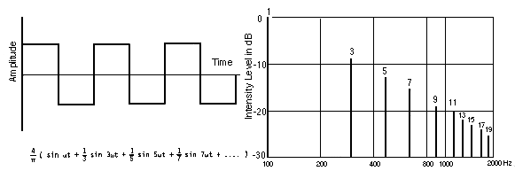
Periodicity
Square wave
Only odd harmonics, intensity 1/n
Notes:
http://www.sfu.ca/sonic-studio/handbook/Square_Wave.html
Odd harmonics like triangle, but the intensity is the only modified aspect (1/n versus 1/n^2 for triangle)

Slide 24
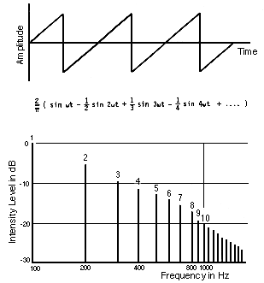
Periodicity
Sawtooth wave
All harmonics, intensity 1/n
Notes:
http://www.sfu.ca/sonic-studio/handbook/Sawtooth_Wave.html
Add together all harmonics (even and the odd).
These formulae assume you will generate infinite sine waves. There is a practical limit to this… in reality the waveform may not be as crisp and perfect.

Slide 25
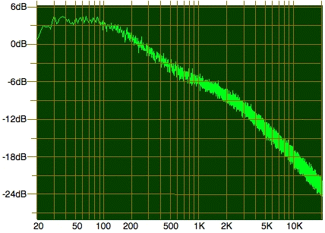
Periodicity
Quasi-Periodic: partials added together, not necessarily in harmonic relationship with each other. Most interesting and most instruments produce these types of sounds.
Aperiodic: continuous spectrum
White Noise – random over whole spectrum
Pink Noise – power skewed 1/freq. More bass, matches with how humans hear
Brown Noise – 1/freq^2, very bassy
Notes:
http://yusynth.net/Modular/Commun/NOISE/pink-noise.gif
Partials are quasi-periodic signals. In real life, there are many partials present in guitars and other physical instruments. This is why synthesis of these instruments is not as good in MIDI. Most interesting sounds have partials in them.
White noise is easy to generate digitally… just fill an array with random intensities. However, this will not have a flat frequency response to the human ear. Pink noise is skewed to have less intensity at higher frequencies (which humans can hear better), which gives it a more balanced sound to humans. Brown noise is even more skewed to bass.

Slide 26
Fourier Analysis
Fourier’s Theorem: Any complex periodic waveform can be expressed as the sum of a series of simple sine waves, each with its own frequency and amplitude.
http://www.earlevel.com/Digital%20Audio/harmonigraf.html
Notes:
As an introduction to a topic covered later in signal processing… any signal (no matter how complex it is) can be broken up into sine waves. This allows for speech recognition and other audio effects… break the sound apart, modify and put it back together again.
Each sine wave has its own frequency, amplitude and phase. Two sine waves can be at the same frequency, but the phase they are in changes how they modify one another.

