Slide 1
Mobile Phone Security: Protect your device and data in the digital age
BoJun Zhang
Date: 2023 May 3

Slide 2
Content
1
Introduction
2
Methodology
3
Identify security issues
4
Mobile Phone Safety Guide
5
Summary and Future Suggestions

Slide 3
Introduction
1.Explore the current network status
2.Identify user mobile phone assets
What assets does the user have
Impact of different attacks on different assets
3.Explore unsafe user behavior
What is unsafe behavior
What are the causes
4.Exploring mobile threats
A common mobile attack
The attack mode
5.Give suggestions to users
How to regulate security behavior
How do we avoid mobile attacks

Slide 4
Methodology
Search relevant mobile phone attack cases and statistics through the website. For example, mobile phone security related technology, mobile phone common threats, mobile devices the best protection
Consult relevant literature on mobile phone safety behavior to analyze what causes mobile phone users' unsafe behavior
Explore the security levels of different mobile phone systems through experiments
Create charts and visualizations help readers more intuitively understand mobile threats and better follow mobile security

Slide 5
Project structure
Identify mobile assets
Identify Unsafe user behavior
Identify mobile attacks
Users better understand mobile assets
Pay attention to mobile security
Users can take steps to prevent mobile attacks
Know how to respond quickly and effectively
Be aware of unsafe behavior on our phone
Regulate normal behavior

Slide 6
Identify Mobile Asset
Personal data
Photos and videos
Banking and Payment applications
name, address, date of birth, and social security number
Project progress, state secrets, strategic information, intelligence collection, decision-making
Bank deposits, transfers
social media app
Historical information
Contacts
Personal information, account password
Text messages, personal notes, passwords, memos,
Personal information such as names, phone numbers, email addresses and social media profiles

Slide 7
Identify Unsafe User Behavior
Password
weak password
same password
share password
Connect public wifi
Log into web account and fill out the form
Transmission of private data
WiFi login page jumps to phishing website
Jailbreaking
Click unknown link
from web page
from stranger
from unidentified emails, text messages
Download third-party store apps
There are no updated patches or versions
Compromise system integrity

Slide 8
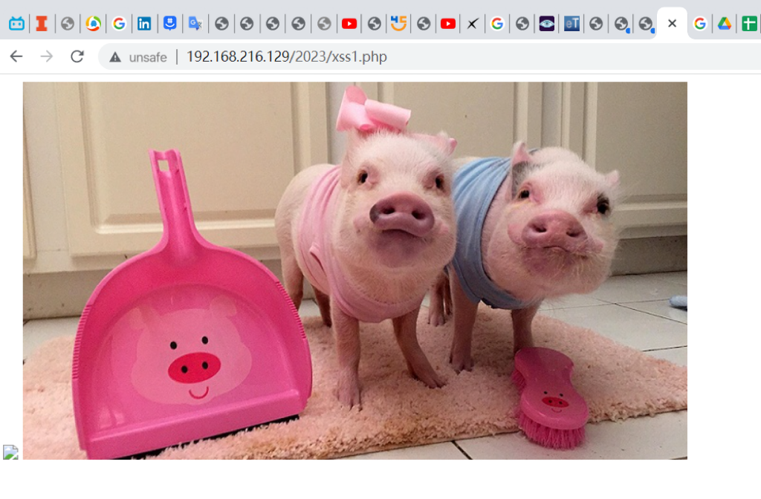
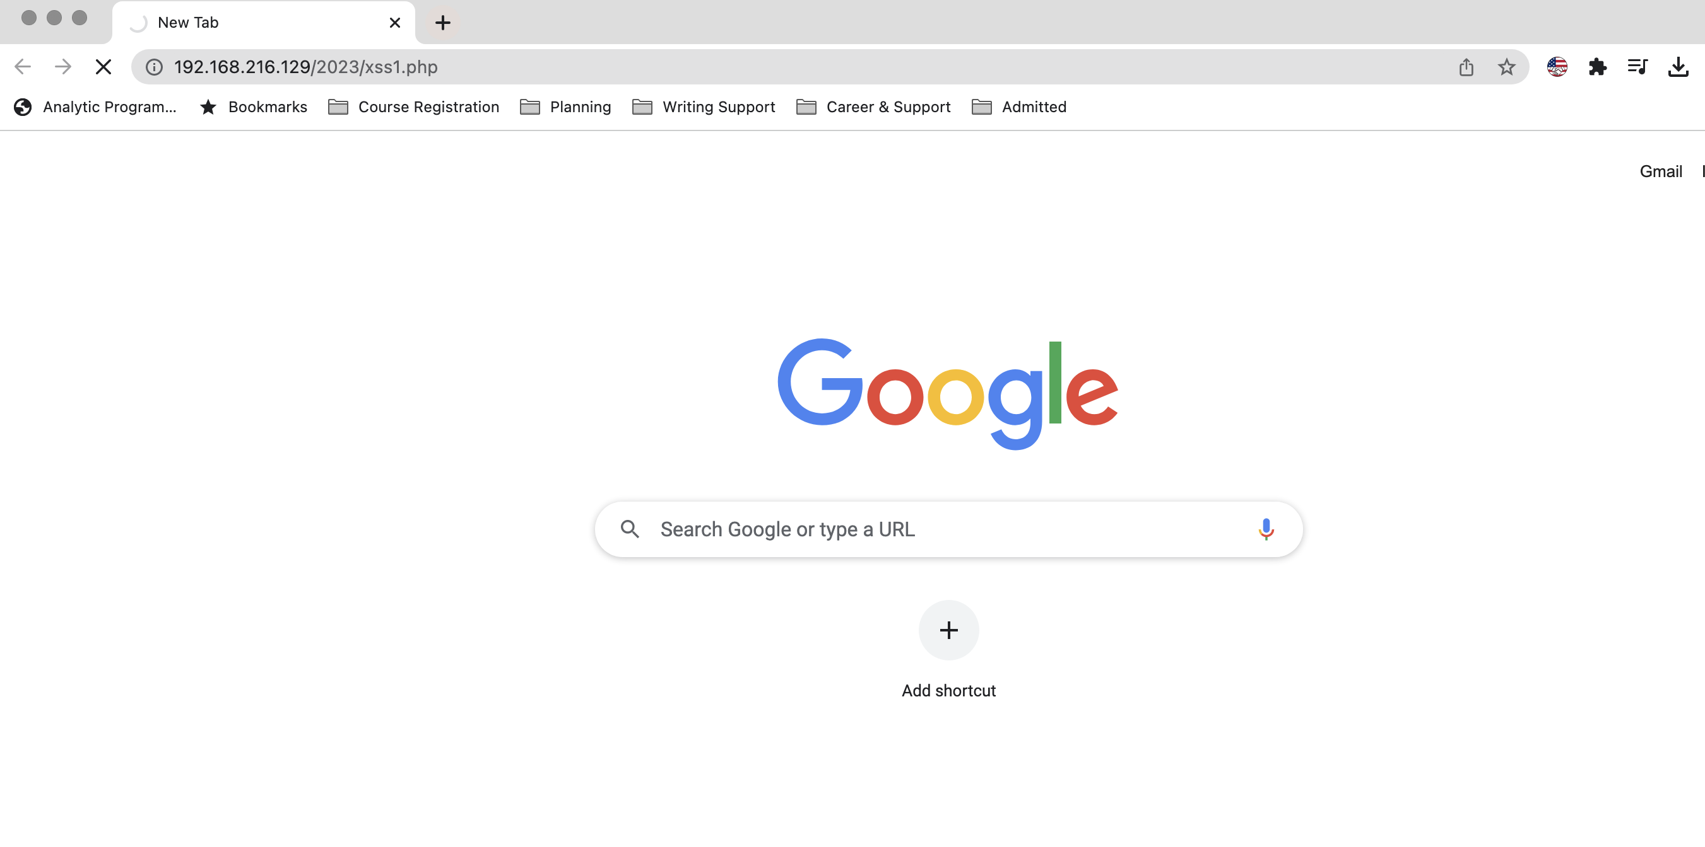
Jailbreaking
Built-in safety features
Apple and Android have a reputation for reliability and functionality, especially when it comes to security.
iOS is a closed system
Apple does not release its source code to application developers
That makes it harder for hackers to find vulnerabilities on ios-powered devices
More stringent controls
Network certificate
App store
Sandboxing
secure Boot
Data Encryption
Application permission

Slide 9
Identify Common mobile attack
phishing
blowing up one’s phone
malware
Mobile ransomware
Voice call transfer
spyware
Bank horse
Man-in-the-middle attack
Password attack

Slide 10

Man in the middle attack
Normal data transmission route
Packet interception
Data theft
Modify data
User
Internet
Attacker

Slide 11
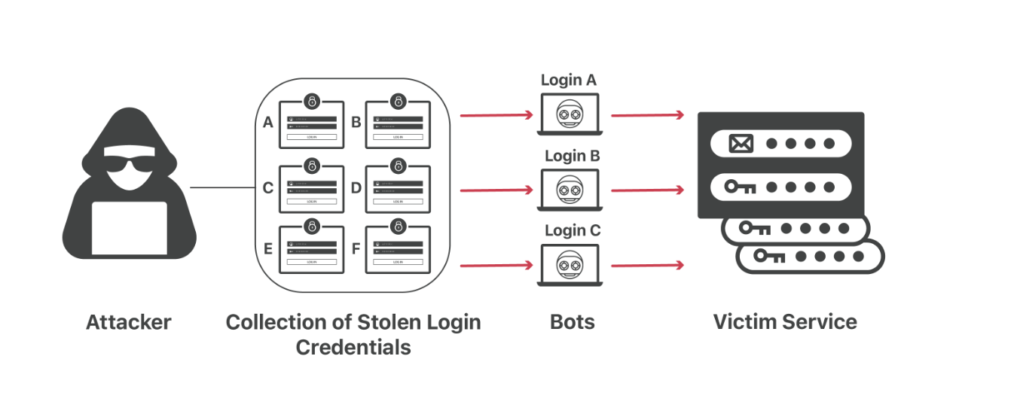
Password attack
Password cracking
Dictionary attack
Brute force attack
Rainbow attack
credential stuffing
Direct loss
Try another service with the same login credentials
Data breach
Identity theft
Economic loss
Phishing website
Indirect loss
Get passwords directly through forms or social engineering
Regular phishing
Spear phishing
Smishing and vishing
Whaling
Continue to send phishing emails or spam

Slide 12
User security guide
Use strong passwords and two-factor authentication
Avoid jailbreaking or Root your device
Be wary of others using your phone
Don't click on unknown links
Back up data regularly
Avoid using public Wi-Fi

Slide 13
Summary
Current status of mobile security
In December 2022, the number of global mobile cyber attacks was approximately 2.2 million
Almost every organization experienced at least one mobile malware attack in 2020
Forty-six percent of organizations had at least one employee download a malicious mobile app in 2020 that threatened their organization's network and data.
In 2020, Check Point saw a 15% increase in banking Trojan activity, putting users' mobile banking credentials at risk of theft
Explore user mobile phone assets
Explicit assets
Inexplicit assets
Extended assets
Exploring Mobile Phone Security Vulnerabilities(User Unsafe Behavior)
Optimism bias
Risky behavior
Curiosity
Decision making in bad situations (tired, sick, drunk)
Explore threats Common Security Mobile
Main attack route
Phishing email
Malicious website
Malicious advertising
The infected application
Target
Access to personal information
Obtain the account password
Bank theft, money theft
Execute malware for more attacks

Slide 14
Thank you

Slide 15
Cybersecurity Infographics
MERCURY
MARS
Mercury is the smallest planet
Mars is actually a cold place
JUPITER
SATURN
Jupiter is the biggest planet
Yes, Saturn is the ringed one

Slide 16
Cybersecurity Infographics
MERCURY | Mercury is the closest planet to the Sun
NEPTUNE | Neptune is the farthest planet from the Sun
MARS | Despite being red, Mars is actually a cold place
VENUS | Venus has a beautiful name, but it’s very hot

Slide 17
Cybersecurity Infographics
MERCURY
MARS
Mercury is the smallest planet
Mars is actually a cold place
JUPITER
SATURN
Jupiter is the biggest planet
Yes, Saturn is the ringed one

Slide 18
Cybersecurity Infographics
MERCURY
Mercury is the smallest and innermost planet
It’s the farthest
planet from the Sun
NEPTUNE
MARS
Despite being red, Mars is a very cold place
Venus is the second planet from the Sun
VENUS

Slide 19
Cybersecurity Infographics
01
02
03
04
MERCURY
MARS
JUPITER
VENUS
It's the closest planet to the Sun
Despite being red, Mars is a cold place
It's a gas giant and the biggest planet
Venus is the second planet to the Sun

Slide 20
Cybersecurity Infographics
MERCURY
MARS
JUPITER
VENUS
SATURN
It's the closest planet to the Sun
Despite being red, Mars is a cold place
It's a gas giant and the biggest planet
Venus is the second planet to the Sun
Yes, Saturn is the ringed one

Slide 21
Cybersecurity Infographics
MERCURY
MARS
Mercury is the smallest planet
Mars is actually a cold place
VENUS
NEPTUNE
Venus has a beautiful name
It’s the farthest planet

Slide 22
Cybersecurity Infographics
MERCURY
VENUS
MARS
It’s a very small planet
Venus has a beautiful name
Mars is a cold place
JUPITER
NEPTUNE
SATURN
Jupiter is the biggest planet
It’s the farthest planet
Yes, Saturn is the ringed one

Slide 23
Cybersecurity Infographics
MERCURY
MARS
Mercury is the smallest planet
Mars is actually a cold place
VENUS
NEPTUNE
Venus has a beautiful name
It’s the farthest planet
JUPITER
SATURN
Jupiter is the biggest planet
Yes, Saturn is the ringed one

Slide 24
Cybersecurity Infographics
Venus is the second planet from the Sun
Venus is the second planet from the Sun
Neptune is the farthest known planet
Jupiter is the fifth planet from the Sun
Mercury is the smallest planet

Slide 25
Cybersecurity Infographics
MERCURY
MARS
JUPITER
VENUS
It's the closest planet to the Sun
Despite being red, Mars is a cold place
It's a gas giant and the biggest planet
Venus is the second planet to the Sun

Slide 26
Cybersecurity Infographics
MERCURY
MARS
JUPITER
VENUS
It's the closest planet to the Sun
Despite being red, Mars is a cold place
It's a gas giant and the biggest planet
Venus is the second planet to the Sun

Slide 27
Cybersecurity Infographics
MERCURY
MARS
Mercury is the smallest planet
Mars is actually a cold place
VENUS
NEPTUNE
Venus has a beautiful name
It’s the farthest planet
JUPITER
SATURN
Jupiter is the biggest planet
Yes, Saturn is the ringed one

Slide 28
Cybersecurity Infographics
Unknown links within the app
SMS & Text Message
Voice Calls
Social Media Messaging

Slide 29
Cybersecurity Infographics
MERCURY
MARS
Mercury is the smallest planet
Mars is actually a cold place
VENUS
NEPTUNE
Venus has a beautiful name
It’s the farthest planet
JUPITER
SATURN
Jupiter is the biggest planet
Yes, Saturn is the ringed one

Slide 30
Cybersecurity Infographics
EARTH
MERCURY
VENUS
MARS
Mercury is the closest planet
Venus has a beautiful name
Mars is a cold place
JUPITER
NEPTUNE
SATURN
Jupiter is the biggest planet
It’s the farthest planet
Yes, Saturn is the ringed one

Slide 31
Cybersecurity Infographics
MERCURY
VENUS
Mercury is the closest planet
Venus has a beautiful name
JUPITER
NEPTUNE
Jupiter is the biggest planet
It’s the farthest planet

Slide 32
Cybersecurity Infographics
Despite being red, Mars is a cold place
It’s the farthest planet from the Sun
Jupiter the biggest planet of them all
Mercury closest planet to the Sun
MARS
NEPTUNE
JUPITER
MERCURY

Slide 33
Cybersecurity Infographics
EARTH
NEPTUNE
MARS
MERCURY
Earth is the third planet from the Sun
It’s the farthest planet from the Sun
Despite being red, Mars is a cold place
Mercury is the closest object to the Sun

Slide 34
Cybersecurity Infographics
MERCURY
MARS
Mercury is the smallest planet
Mars is actually a cold place
VENUS
NEPTUNE
Venus has a beautiful name
It’s the farthest planet
EARTH
JUPITER
SATURN
Jupiter is the biggest planet
Is the third planet from the Sun
Yes, Saturn is the ringed one

Slide 35
Instructions for use (free users)
In order to use this template, you must credit Slidesgo by keeping the Thanks slide.
You are allowed to:
Modify this template.
Use it for both personal and commercial purposes.
You are not allowed to:
Sublicense, sell or rent any of Slidesgo Content (or a modified version of Slidesgo Content).
Distribute this Slidesgo Template (or a modified version of this Slidesgo Template) or include it in a database or in any other product or service that offers downloadable images, icons or presentations that may be subject to distribution or resale.
Use any of the elements that are part of this Slidesgo Template in an isolated and separated way from this Template.
Delete the “Thanks” or “Credits” slide.
Register any of the elements that are part of this template as a trademark or logo, or register it as a work in an intellectual property registry or similar.
For more information about editing slides, please read our FAQs or visit Slidesgo School:
https://slidesgo.com/faqs and https://slidesgo.com/slidesgo-school

Slide 36
Instructions for use (premium users)
In order to use this template, you must be a Premium user on Slidesgo.
You are allowed to:
Modify this template.
Use it for both personal and commercial purposes.
Hide or delete the “Thanks” slide and the mention to Slidesgo in the credits.
Share this template in an editable format with people who are not part of your team.
You are not allowed to:
Sublicense, sell or rent this Slidesgo Template (or a modified version of this Slidesgo Template).
Distribute this Slidesgo Template (or a modified version of this Slidesgo Template) or include it in a database or in any other product or service that offers downloadable images, icons or presentations that may be subject to distribution or resale.
Use any of the elements that are part of this Slidesgo Template in an isolated and separated way from this Template.
Register any of the elements that are part of this template as a trademark or logo, or register it as a work in an intellectual property registry or similar.
For more information about editing slides, please read our FAQs or visit Slidesgo School:
https://slidesgo.com/faqs and https://slidesgo.com/slidesgo-school

Slide 37
Infographics
You can add and edit some infographics to your presentation to show your data in a visual way.
Choose your favourite infographic and insert it in your presentation using Ctrl C + Ctrl V or Cmd C + Cmd V in Mac.
Select one of the parts and ungroup it by right-clicking and choosing “Ungroup”.
Change the color by clicking on the paint bucket.
Then resize the element by clicking and dragging one of the square-shaped points of its bounding box (the cursor should look like a double-headed arrow). Remember to hold Shift while dragging to keep the proportions.
Group the elements again by selecting them, right-clicking and choosing “Group”.
Repeat the steps above with the other parts and when you’re done editing, copy the end result and paste it into your presentation.
Remember to choose the “Keep source formatting” option so that it keeps the design. For more info, please visit Slidesgo School.

