Slide 1
Scenario Based Path Coverage
Han Wei Guang
Zofia Marciniak
Anton Shatokhin
Brandon Ong

Slide 2

Problem Statement
How might we make use of automated software testing to reduce development time by developers caused by miscommunication with designers?

Slide 3
Typical Web Development Workflow
UI/UX Designer
Here is the figma design that consist of user flows!

Slide 4
Typical Web Development Workflow
UI/UX Designer
Here is the figma design that consist of user flows!
Developer
Okay, I have developed the webpage base on the figma user flow.

Slide 5
Typical Web Development Workflow
UI/UX Designer
Here is the figma design that consist of user flows!
Developer
Okay, I have developed the webpage base on the figma user flow.
UI/UX Designer
You are missing out a flow where after login, user is redirected to profile page. Please add it in!

Slide 6
Typical Web Development Workflow
UI/UX Designer
Developer
Here is the figma design that consist of user flows!
Okay, I think I got it right this time round! Do check it.
Developer
Okay, I have developed the webpage base on the figma user flow.
UI/UX Designer
You are missing out a flow where after login, user is redirected to profile page. Please add it in!

Slide 7
Typical Web Development Workflow
UI/UX Designer
Developer
Here is the figma design that consist of user flows!
Okay, I think I got it right this time round! Do check it.
Developer
UI/UX Designer
Okay, I have developed the webpage base on the figma user flow.
LGTM Fam.
Good job!
UI/UX Designer
You are missing out a flow where after login, user is redirected to profile page. Please add it in!

Slide 8
Typical Web Development Workflow
UI/UX Designer
Developer
Here is the figma design that consist of user flows!
Okay, I think I got it right this time round! Do check it.
Developer
UI/UX Designer
Okay, I have developed the webpage base on the figma user flow.
LGTM Fam.
Good job!
UI/UX Designer
Project Manager
You are missing out a flow where after login, user is redirected to profile page. Please add it in!
Bruh, why the profile page’s edit button routes to account deletion?

Slide 9
Typical Web Development Workflow
UI/UX Designer
Developer
Here is the figma design that consist of user flows!
Okay, I think I got it right this time round! Do check it.
Developer
UI/UX Designer
Okay, I have developed the webpage base on the figma user flow.
LGTM Fam.
Good job!
UI/UX Designer
Project Manager
You are missing out a flow where after login, user is redirected to profile page. Please add it in!
Bruh, why the profile page’s edit button routes to account deletion?

Slide 10
Typical Web Development Workflow
UI/UX Designer
Developer
Here is the figma design that consist of user flows!
Okay, I think I got it right this time round! Do check it.
Developer
UI/UX Designer
Okay, I have developed the webpage base on the figma user flow.
LGTM Fam.
Good job!
UI/UX Designer
Project Manager
You are missing out a flow where after login, user is redirected to profile page. Please add it in!
Bruh, why the profile page’s edit button routes to account deletion?

Slide 11

What we hope to achieve
Scrape the path from Figma
Coded web page can only be merge if test passes
01
04
Translate the paths into Scenario test cases
Great work!
Didn’t even have to check!
02
05
Integrate into CI/CD workflow
03

Slide 12
Steps to Achieve This
Scrape the path from Figma
Coded web page can only be merge if test passes
01
04
Translate the paths into Scenario test cases
Great work!
Didn’t even have to check!
02
05
Integrate into CI/CD workflow
03

Slide 13
Steps to Achieve This
Scrape the path from Figma
01
Login Click Button
Redirection
Main Page
By exporting and parsing Figma file we will retrieve all relations between pages, so we can test these paths

Slide 14
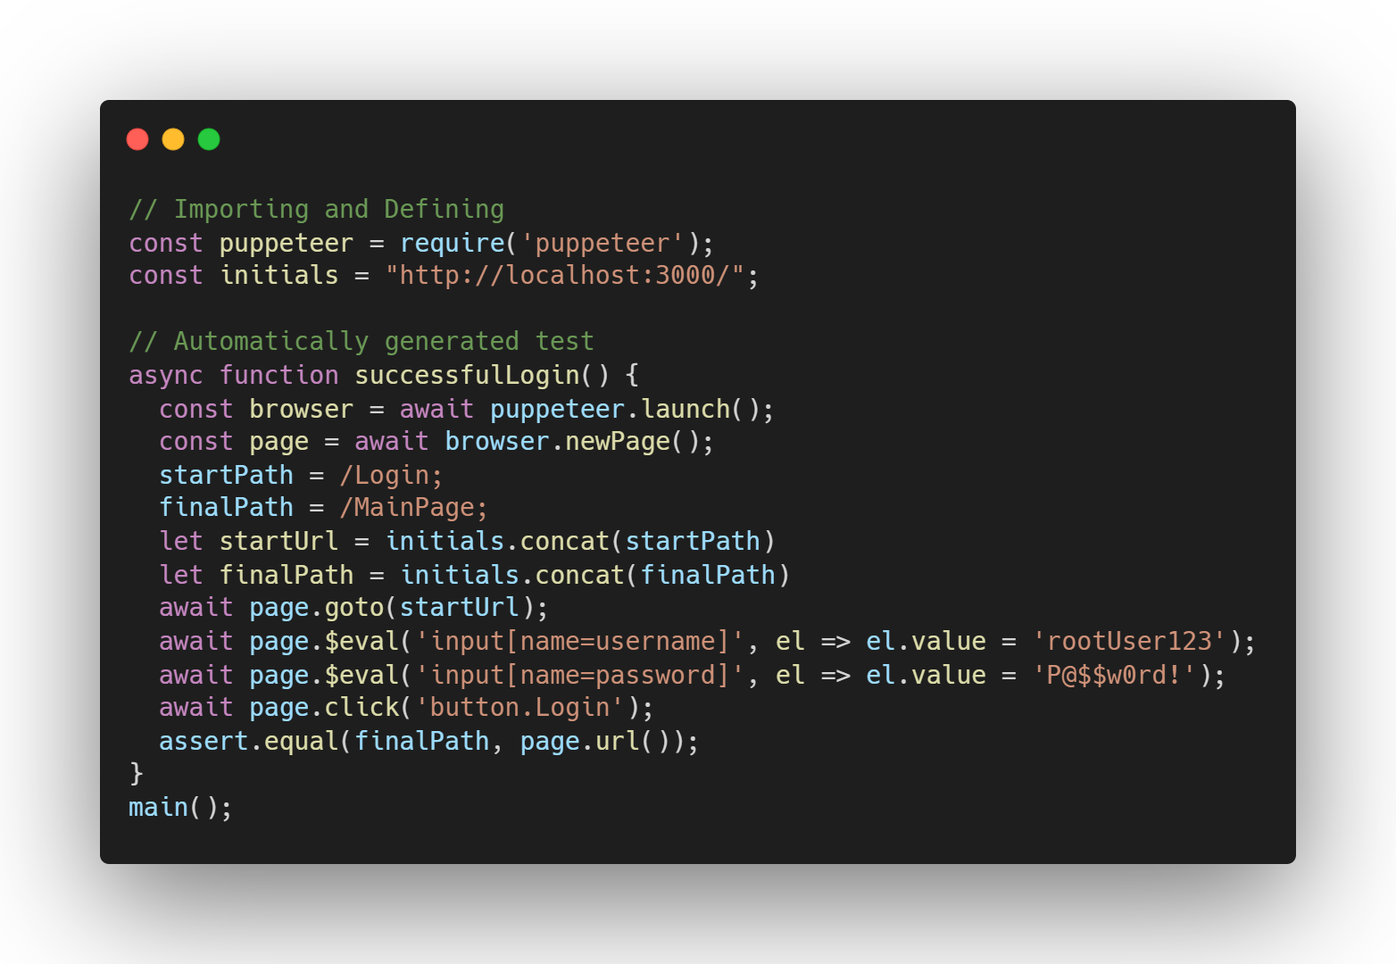
Steps to Achieve This
Translate the paths into Scenario test cases
02

Slide 15
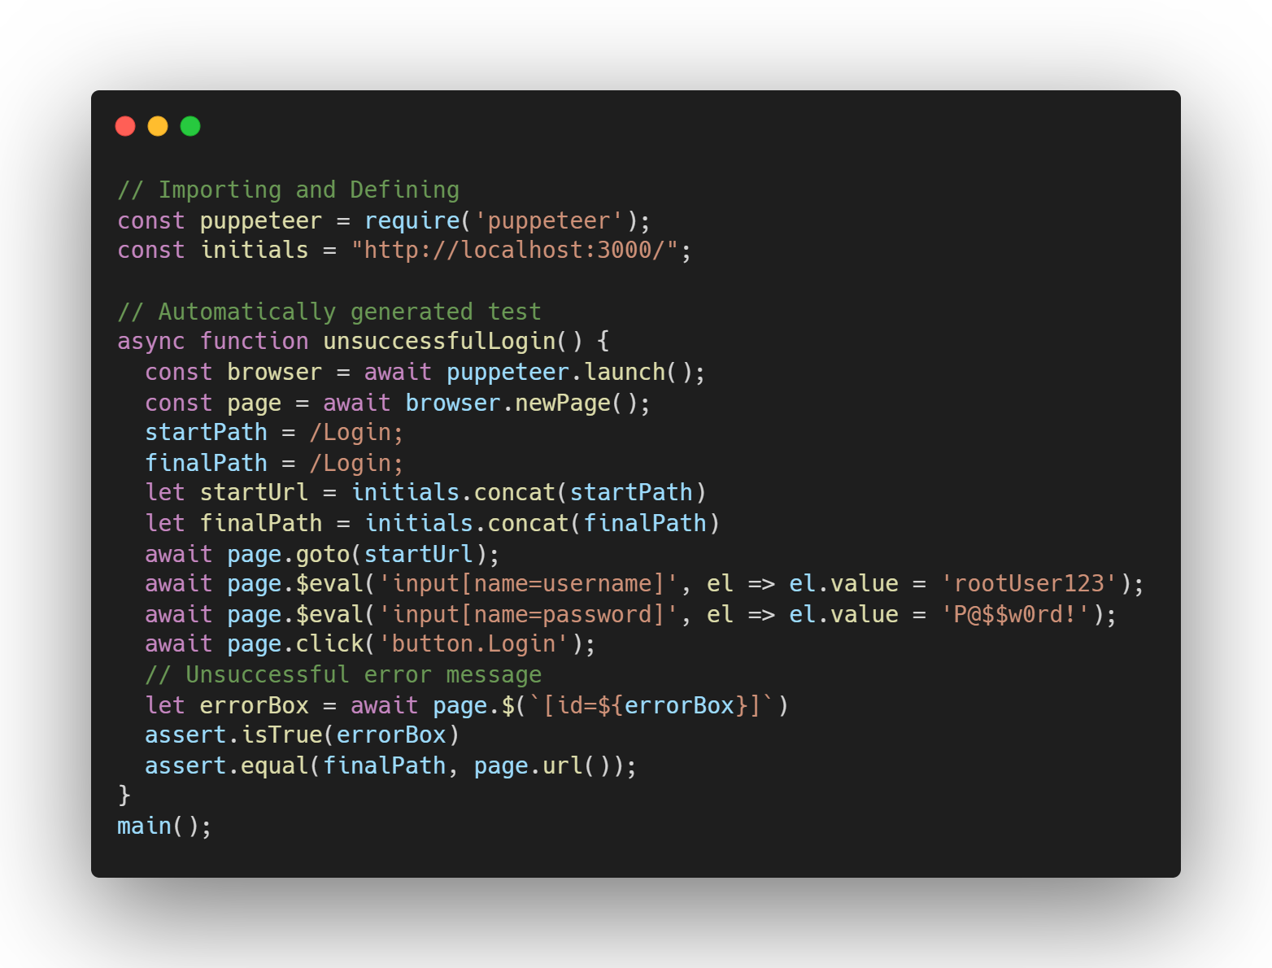
Steps to Achieve This
Translate the paths into Scenario test cases
02

Slide 16
Flow
Figma PlugIn for exporting the flow
Abstract form of page interactions
data processing
Web application code
Extract scenarios
Test case generation
generate code
Scenario generation

Slide 17
Potential Challenges
01
Scraping/defining Figma path URLs if they are not defined
02
Knowing what buttons have what functionality based on button ID if not assigned
03
Generating suitable scenarios

Slide 18
Evaluation methods
01
Path coverage of web application

Slide 19
Q&A

