Slide 1
Applied Math 50: Introduction to Applied Mathematics
Margo Levine
Pierce Hall 207A
mlevine@seas.harvard.edu
Ziwei Qiu(TF)
ziweiqiu@g.harvard.edu

Slide 2
Overview of today
What is applied mathematics and why should you take this course?
Course organization
Topic for the first week: a simple mathematical model for sport competitions

Slide 3
History of AM50
Started in 2009
Most applied math courses focus primarily on techniques and methods (Math 1b, Applied Math 21a, etc.)
This course has been designed to provide a broader overview of what it means to study applied mathematics, by showing through examples about how simple mathematical ideas have had a large impact

Slide 4
Isn’t applied math …
… kind of like engineering?
Both seem interested in solving practical problems.
Both use math and computer simulation.

Slide 5
Isn’t applied math …
… kind of like engineering?
… kind of like physics?
Both are interested in understanding the physical world.
You can take courses in mechanics (e.g. Newton’s laws) in physics and math departments.

Slide 6
Isn’t applied math …
… kind of like engineering?
… kind of like physics?
… a subset of math?
Why make a distinction at all?
Many universities just have math departments.

Slide 7
Quotes
“I describe applied mathematics as the bridge connecting pure mathematics with science and technology.”
W. Prager, 1972
“One should not judge applied mathematicians by their contributions to mathematics any more than one judges historians by their contributions to history. Much creative effort goes into interpretation. To try to use mathematical ideas on problems which at first sight seem too complex or obscurely stated to fit any pattern is, for many people, an exciting challenge and it is this which I feel to be the essence of applied mathematics.”
R. Brockett, 1972
“The miracle of the appropriateness of the language of mathematics for the formulation of the laws of physics is a wonderful gift for which we neither understand nor deserve. We should be grateful for it, and hope that it will remain valid … to wide branches of learning.”
E. Wigner, 1960

Slide 8
Summary
Applied Mathematics is an inherently interdisciplinary subject, which covers a wide spectrum of scientific activities. It is the mathematics dealing with problems arising in the physical, life and social sciences as well as in engineering, and provides a broad qualitative and quantitative background for use in these fields.
The methods of mathematical modeling and analysis provide a unification and mutual enrichment of ideas from many different areas, and a deeper understanding of the fields to which it is applied. Applied Mathematics draws upon concepts and methods of mathematics from the fields of application and in turn, brings ideas, techniques and scientific knowledge back to influence the development of mathematics.
http://www.dam.brown.edu/documents/WhatisAppliedMathematicsPresentation_000.pdf

Slide 9
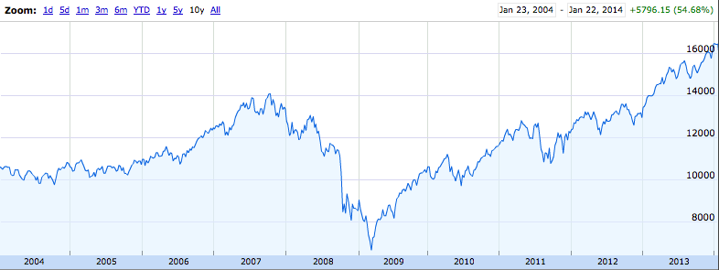
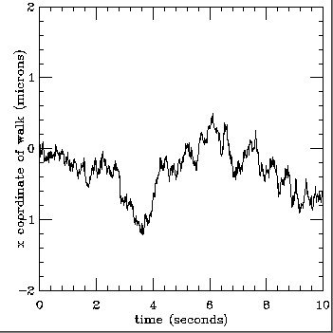
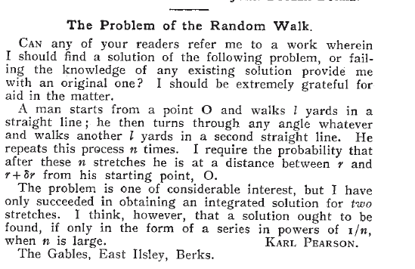
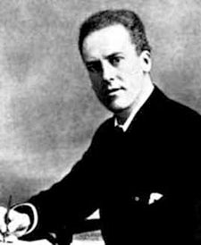
Common patterns, common processes
Ten year plot of Dow Jones Industrial Average
Random motion of a diffusing particle

Slide 10
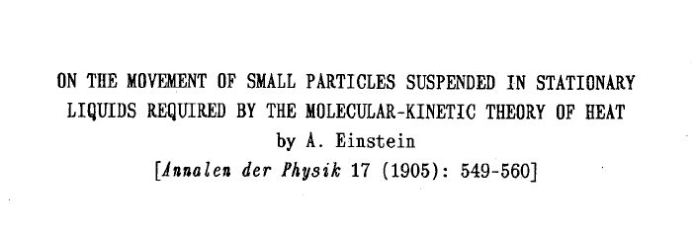
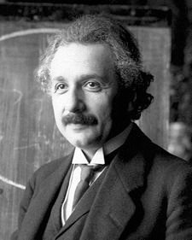
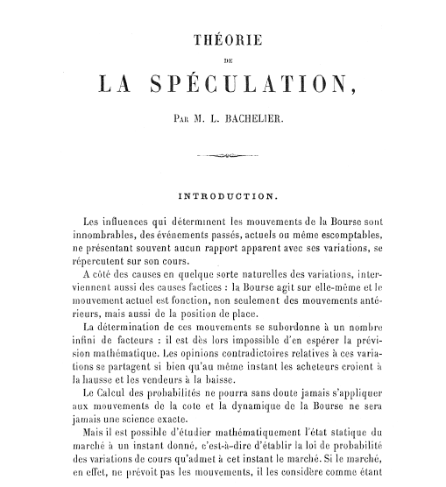
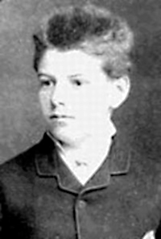
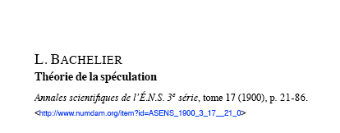
Common patterns, common processes

Slide 11
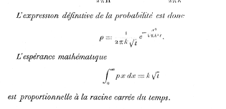
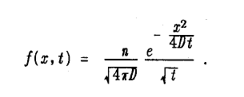

Common patterns, common processes
Bachelier’s solution motivated by stock price variations
Einstein’s solution motivated by random particle motion

Slide 12

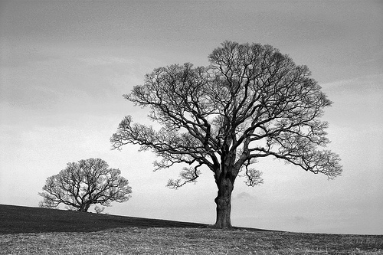
Common patterns, common processes
Drainage network in Baja California salt flat
Tree branches

Slide 13
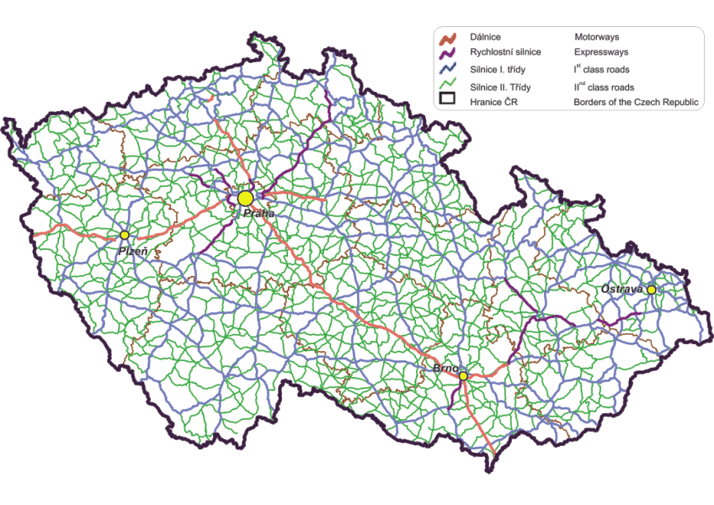
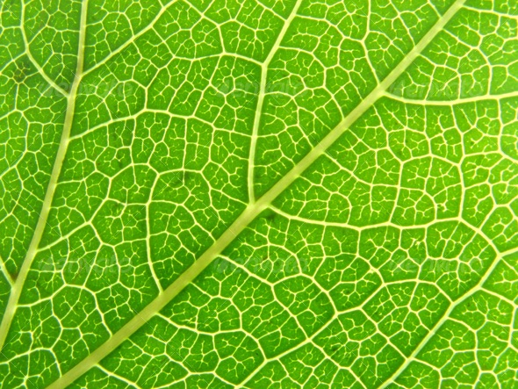
Common patterns, common processes
Highways in Czech Republic
Leaf veins

Slide 14
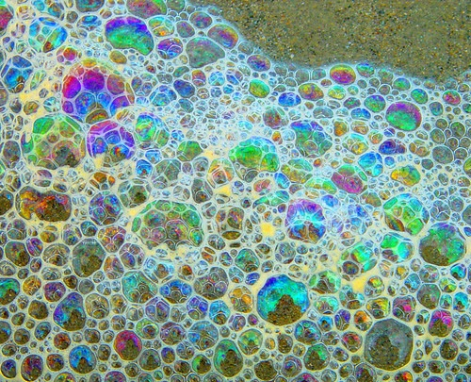
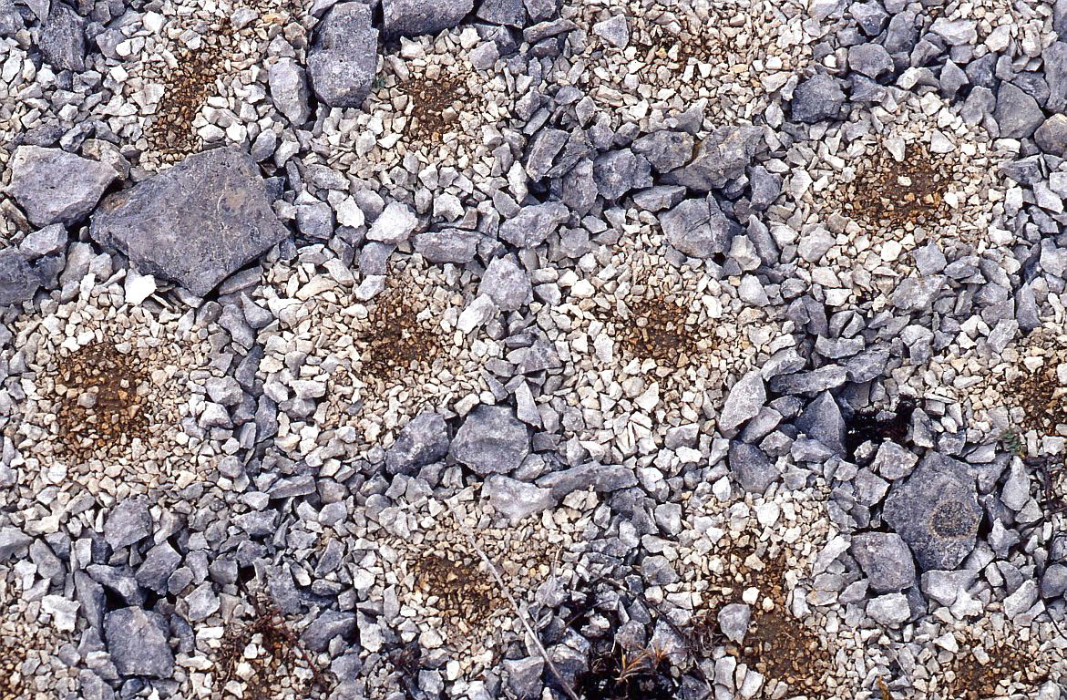
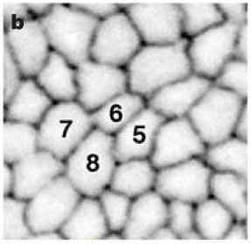
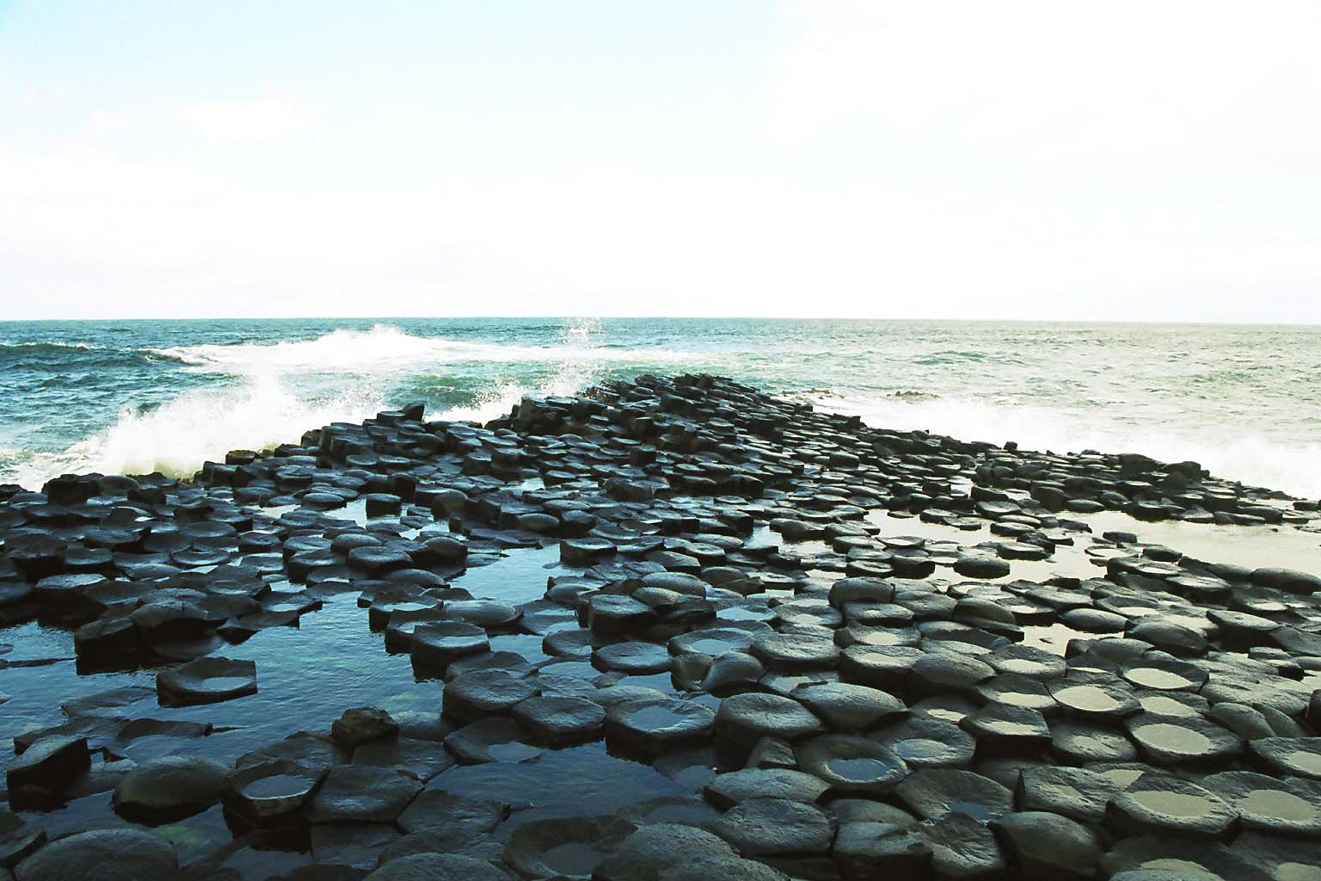
Common patterns, common processes
Soap foam
Stone polygons
common in regions of permafrost
Cell boundaries in fruit fly wing
Polygonal basalt columns
Giants Causeway, Northern Island

Slide 15
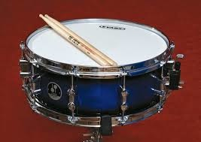
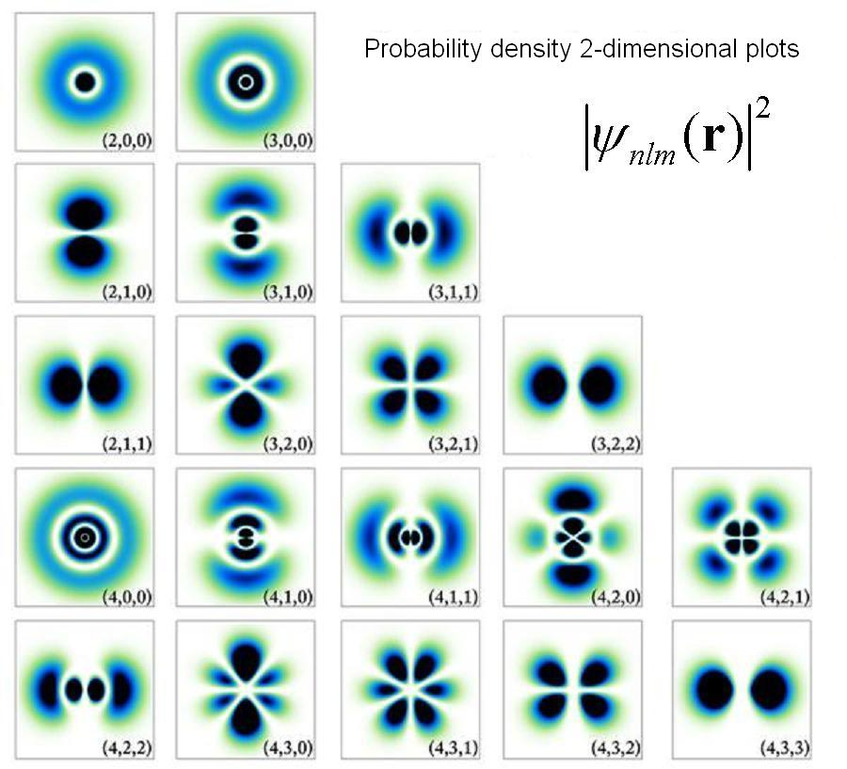
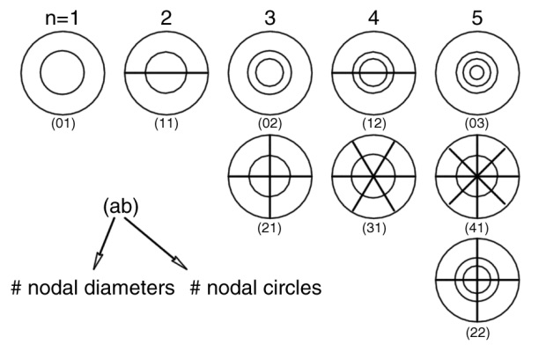
Common patterns, common processes
Oscillation modes of a drum surface
Electron orbitals of a hydrogen atom

Slide 16
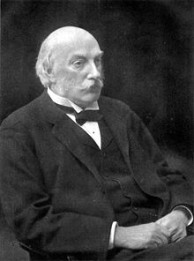
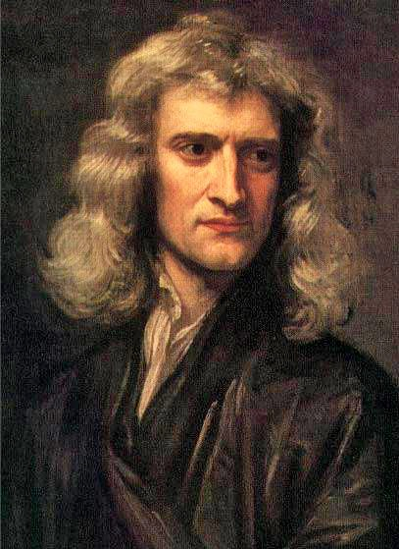
Applied mathematics:
a centuries-old approach
Lord Rayleigh (1842–1919)
Professor of Natural Philosophy at the University of Cambridge (1874–1884). Made major mathematical contributions to fluid dynamics, physics, and acoustics.
Isaac Newton (1642–1727)
Laid the mathematical foundations of classical mechanics through Philosophiæ Naturalis Principia Mathematica published in 1687

Slide 17
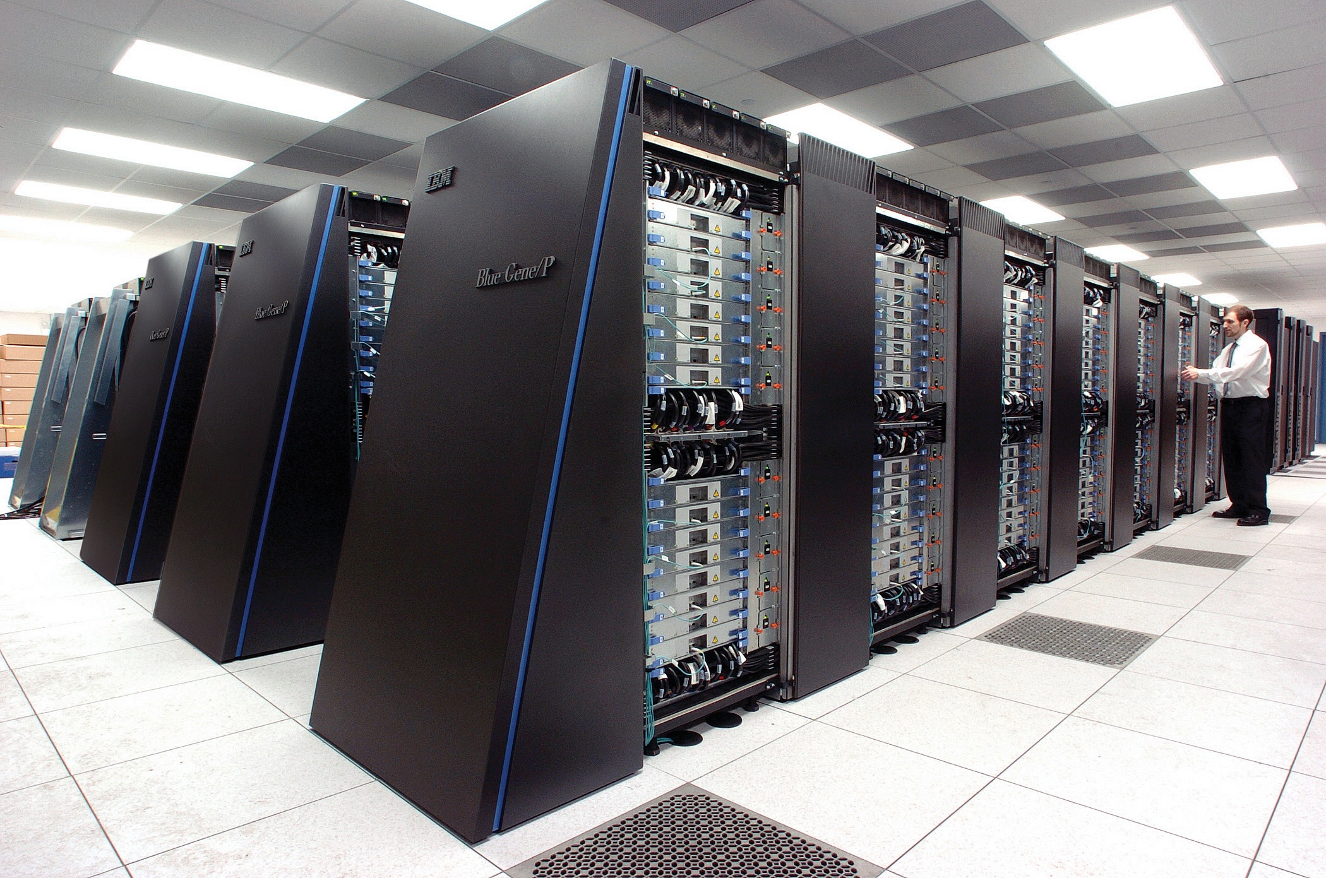
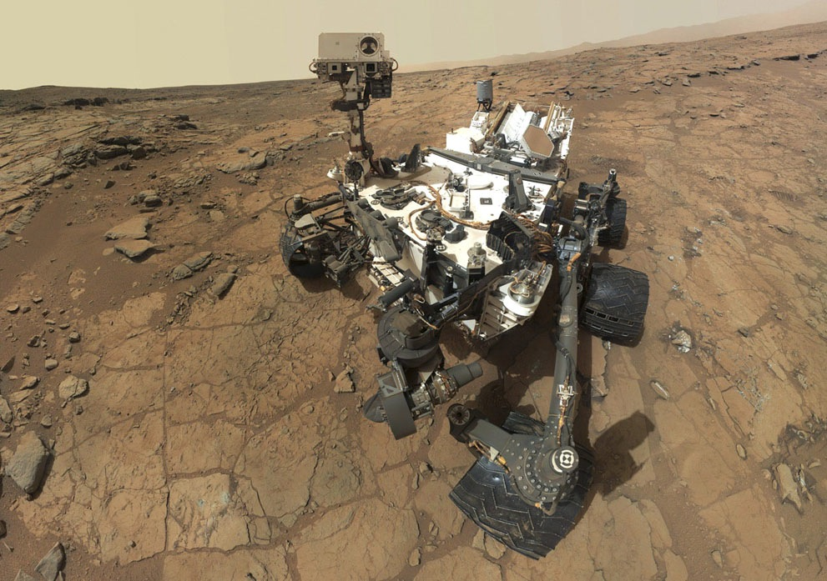
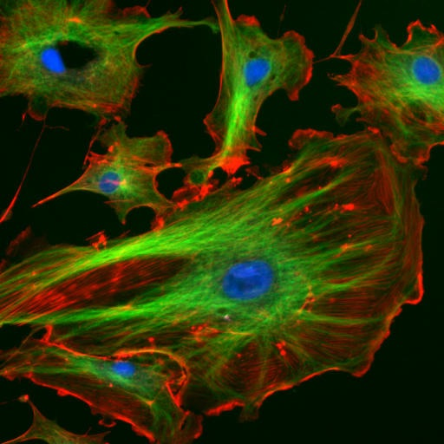
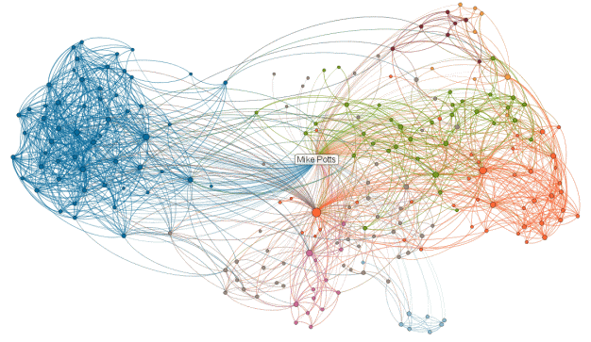
21st century applied math
21st century science and technology: immense and highly specialized
Mathematics underpins almost every field; there is a great need for people who can apply mathematics to important practical issues
Many applied mathematicians have careers spanning multiple disparate fields
An excellent discipline if you’re interested in everything, and want to understand the deep connections between fields

Slide 18
2. Course organization

Slide 19
AM50: Course objectives
Expose you to a wide variety of topics where applied math is used
Through reading great mathematical papers, show how simple mathematical models can large impact on different fields of human inquiry
Learn practical skills:
Reading for main points in math papers
Programming in Matlab
Communicating mathematical ideas through oral and written presentations
Working in a group

Slide 20
Prerequisites
Syllabus lists AM21a (possibly taken concurrently) as a prerequisite
Same prerequisite as previous years
Some ideas from AM21a but not many; in previous years students doing 1b have been fine
Course mainly aimed at freshmen and sophomores
Programming experience is NOT a prerequisite

Slide 21
Course layout
Jan 24
Jan 31
Feb 7
Feb 14
Feb 21
Feb 28
Mar 7
Introduction
Spring Break
Mar 14
Mar 21
Mar 28
Apr 4
Apr 11
Apr 18
Apr 25
Topic 1:
Epidemiology
Topic 4:
Information theory
Topic 2:
Imaging
Topic 5:
Game theory
Topic 3:
Random walks
Topic 6:
Chaos or Projects

Slide 22
Each topic will include:
Class 1: introductory class where a new topic will be presented via a discussion of a math paper.
Class 2: the topic will be explored in more detail. This class will usually include a short modeling activity, which will be done in small groups.
Class 3: a lab where ideas from the paper are simulated in Matlab.
Class 4: student presentations of papers, peer critiques of presentations

Slide 23
General two-week topic schedule
Introduce new topic
Modeling/discussion
office hours
Mon
Tue
Wed
Thu
Fri
Matlab section with Ziwei
Computer lab
Student presentations
Lab assignment due
Homework assignment due
Mon
Tue
Wed
Thu
Fri
office hours
Fri

Slide 24
Introductory week
Today’s intro lecture
Modeling/discussion
HW 0, Lab 0 posted
Mon
Tue
Wed
Thu
Fri
Lab 0 with Ziwei
Mon
Fri
HW 0, Lab 0 due
Matlab bootcamp
https://wiki.harvard.edu/confluence/display/fasmatlab/MATLAB+Boot+Camp+Home

Slide 25
Homeworks/labs: some programming in Matlab
Computer programming is a great way to develop and test mathematical models
We will make use of Matlab in this course
We strongly encourage absolute beginners to take the course, and we will help as much as possible
Why Matlab? Used by many courses at Harvard, used by applied mathematicians and scientists, well-supported at Harvard
Note: for AM concentrators, this course counts toward the modeling requirement, not the computing requirement

Slide 26
Collaboration policy
Collaboration on the homework and labs is encouraged, but each student must write solutions in their own words
If you end up copying verbatim large sections of text, equations, or code from a friend, that’s not okay
Full academic integrity policy on website.

Slide 27
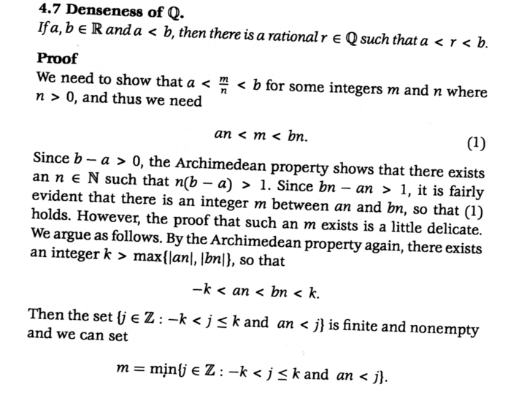
Writing Mathematics
If you look at any good science textbook, you’ll see there’s a standard way of writing mathematical equations
Equations should form part of full sentences, and should go with the flow of text
We strongly encourage you to practice this in AM50
Sample from Introduction to Analysis by K. Ross

Slide 28

Writing Mathematics
LaTeX is a free software package that is widely used for typesetting high-quality scientific documents
It is exceptionally good for typesetting mathematical equations
We encourage you to try it
Links will be posted on the website
\documentclass[12pt]{article}
\begin{document}
The geometric series summation formula is
\begin{equation}
\sum_{n=0}^\infty a^n = \frac{1}{1-a}
\end{equation}
where $a$ is a real number satisfying $|a|<1$.
\end{document}
Input file of LaTeX commands
PDF output file

Slide 29
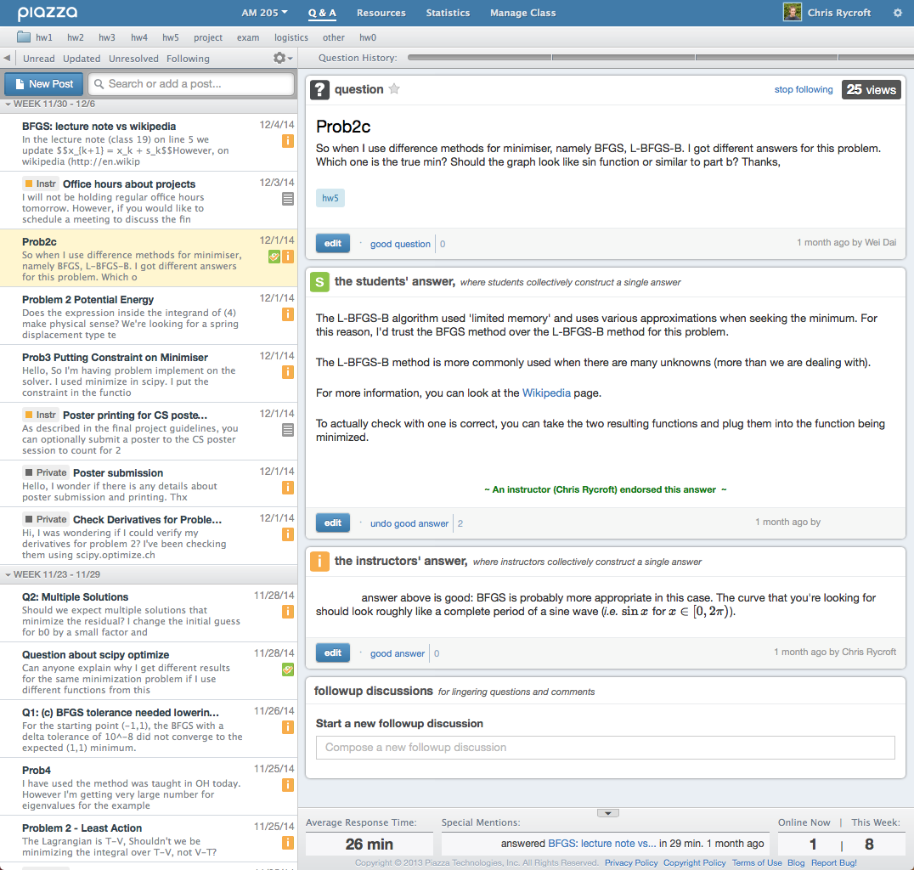
Course discussion on Piazza
We will use Piazza for online discussion
Sign-up link will be posted on website
Enrolled students will receive a sign-up email

Slide 30
Paper presentations
Twice during the semester, each student will give roughly ten-minute presentation about a mathematical paper.
The presentations can be done in pairs
Your classmates will give you verbal/written feedback, which you can reflect on as you work on your second presentation.
We have a database of papers related to each topic that you can choose from, or you can find a paper yourself
We’ll announce exact length/format once we have accurate enrollment numbers

Slide 31
Final project
The final project will involve developing and testing a mathematical model
Students can work in pairs
We’ll start discussing project ideas before Spring Break
Will be due at the end of the semester

Slide 32
Grading
15% : Participation
15% : Paper presentations in class
40% : Homework / computer lab assignments
30% : Final modeling project
Engagement in class activities, student critiques of presentations, contributing to learning community
Can drop one homework OR one lab

Slide 33
3. A simple mathematical model for sport competitions

Slide 34
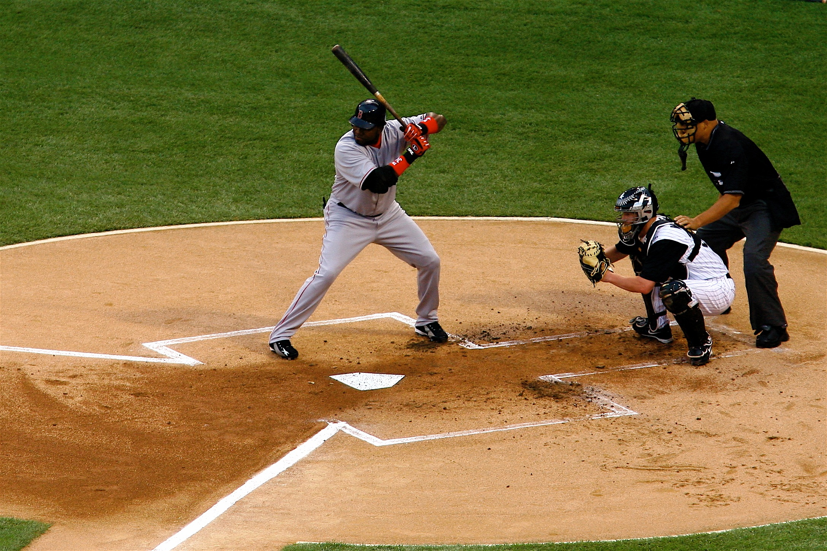
2004 World Series: Go SOX!
Isn’t there a lot of luck in this game?
Did the better team really win?

Slide 35
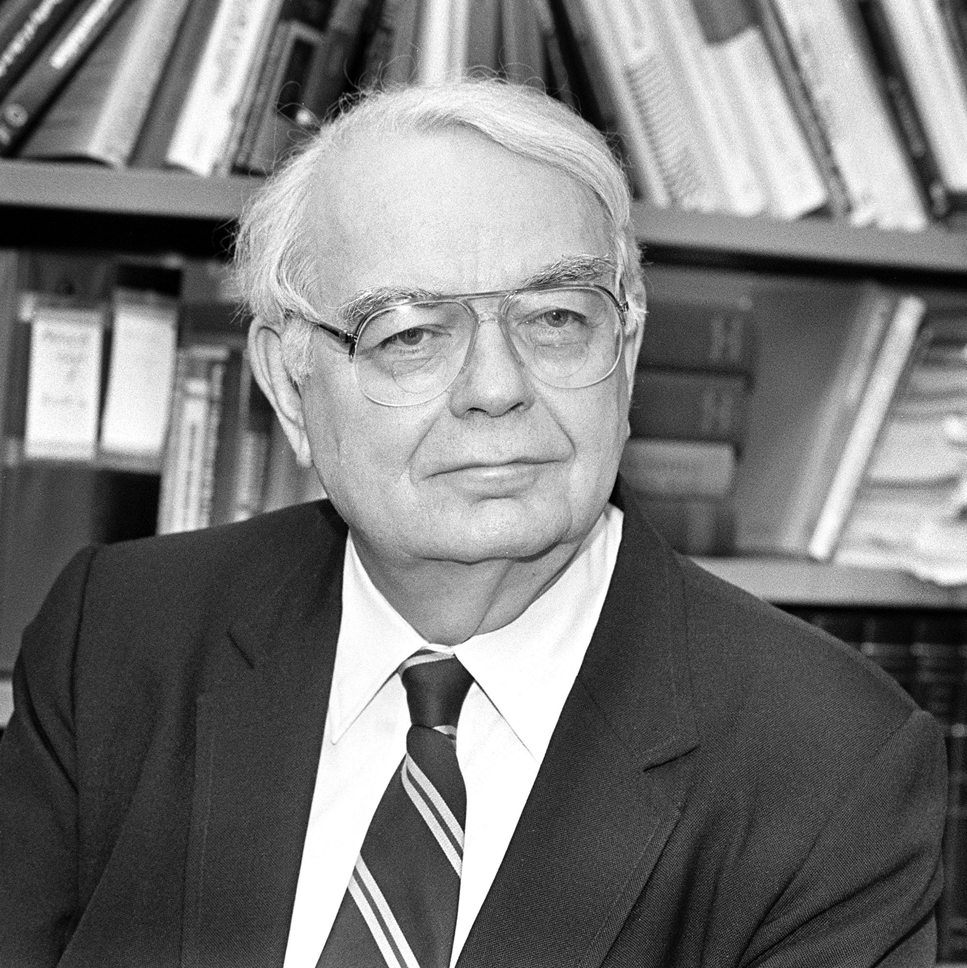
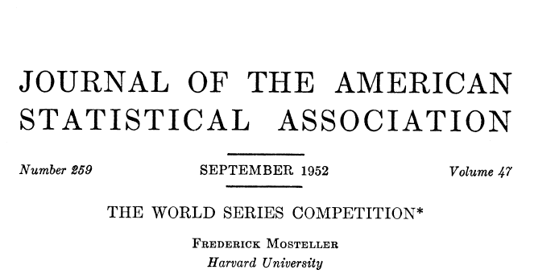
Mosteller’s model
Charles Frederick Mosteller (1916–2006)
Famous 20th century statistician, chair of the Harvard Statistics department (1957–1971), and avid Red Sox fan
Wrote paper in 1952 analyzing the baseball world series (available on course website)

Slide 36
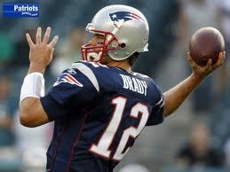
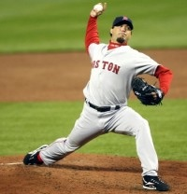
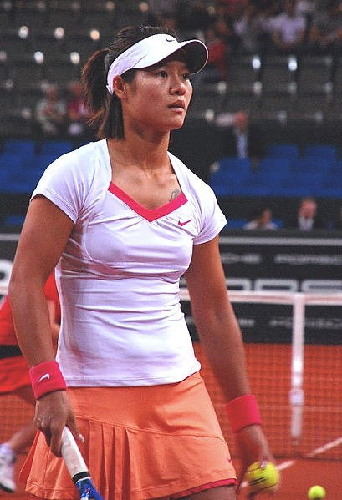
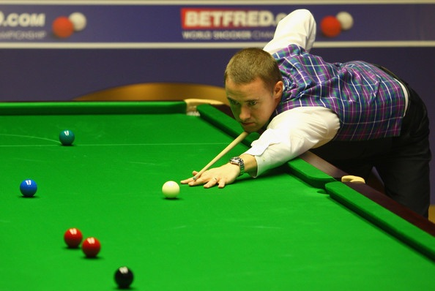
Basic idea
Many sporting events have “play-offs”, designed to find out who is the better team:
Football (Superbowl) — play one game
Baseball (World Series) — best out of 7 games
Tennis — 3 or 5 sets in a match
Snooker (World Championship) — 35 frames in final

Slide 37
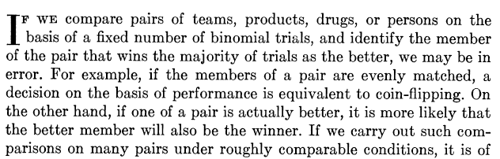
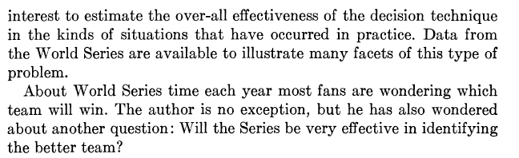
Mosteller’s question

Slide 38
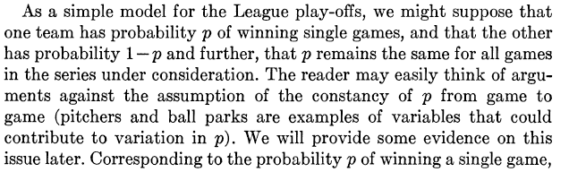
Simple model for the World Series
Assume probability for a given team to win is p
Assume probability is constant throughout the series

Slide 39
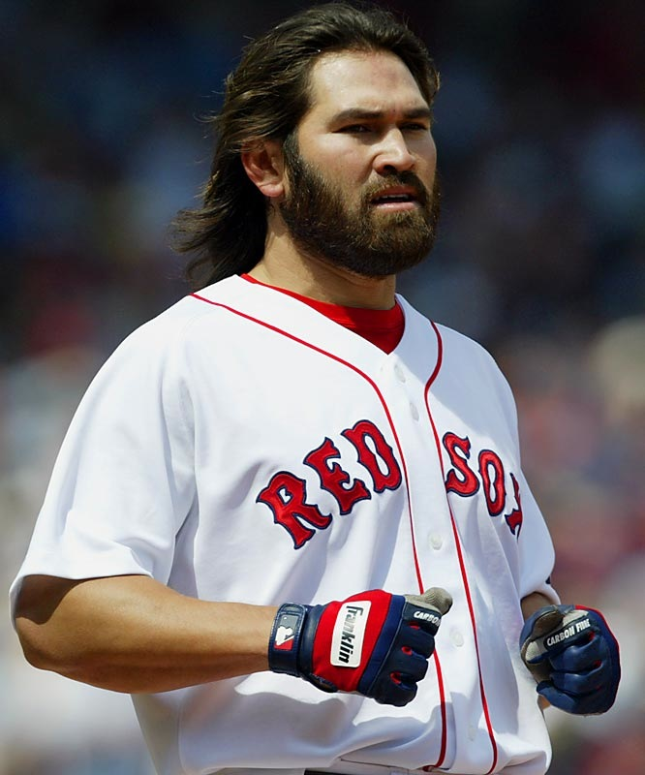


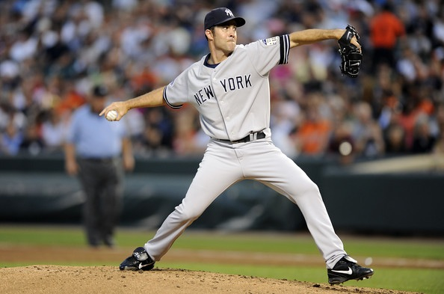
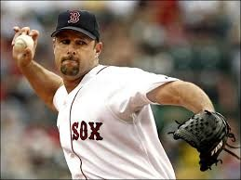
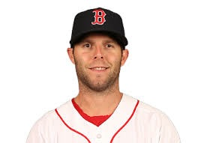
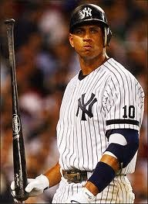
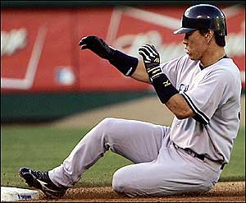
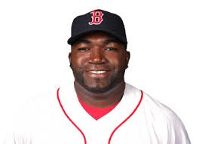

Simple model
Over a series, playing baseball is like flipping an unfair coin:
vs.
Simplify
Win with probability p
Is that reasonable?

Slide 40
Mosteller’s model
Assume outcome of each game is the same as flipping an unfair coin
The better team is the one with the higher probability of winning a single coin flip
The point of playing a “series” is that you would like to amplify the chance the better team wins
Intuitively, it seems clear that the more games you play, the more it will amplify the advantage of the better team
But how good is it? What is the chance a better team will win a 1/3/5/7 game series?

Slide 41
Binomial trials
Suppose you are given a coin, and the probability of getting a head is p. What is the probability of getting m heads out of N trials?

Slide 42
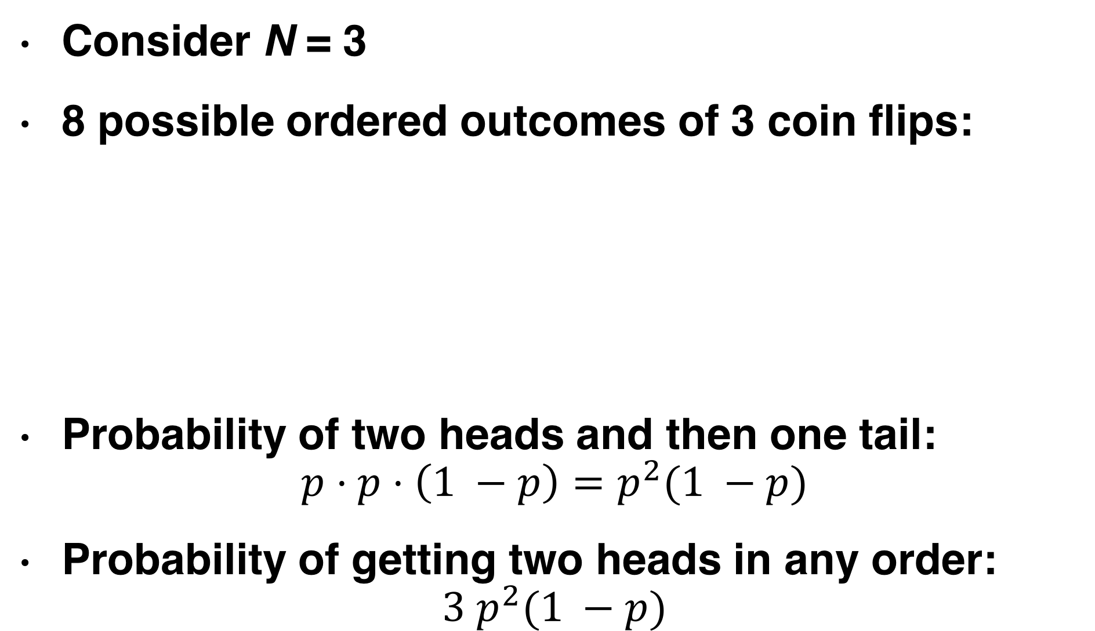
Binomial trials
Consider N = 3
8 possible ordered outcomes of 3 coin flips:
Probability of two heads and then one tail:
$$p⋅p⋅\left(1 −p\right)=p^{2}(1 −p)$$
Probability of getting two heads in any order:
$$3 p^{2}(1 −p)$$
HHH
HHT
HTH
HTT
THH
THT
TTH
TTT
0 heads | 1 head | 2 heads | 3 heads
1 | 3 | 3 | 1

Slide 43
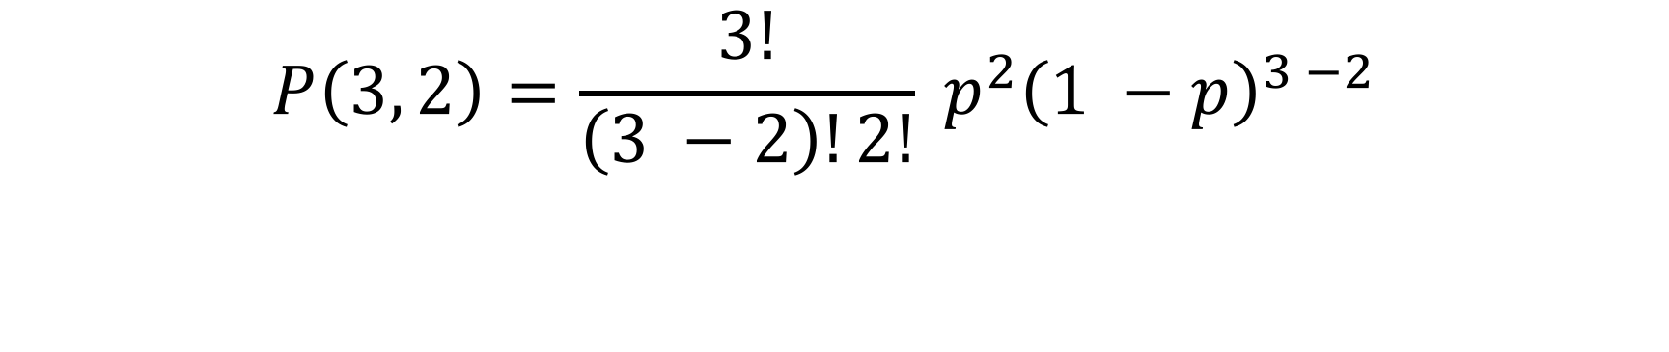

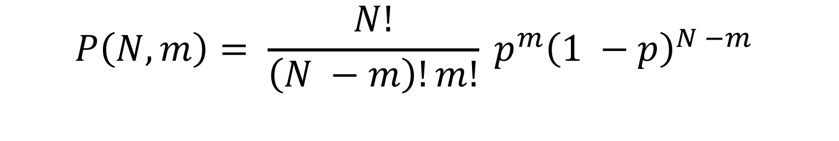
Binomial distribution
$$P\left(N, m\right)= \frac{N!}{\left(N −m\right)!m!} p^{m}{\left(1 −p\right)}^{N −m}$$
For example, for N = 3 and m = 2,
$$P\left(3, 2\right)=\frac{3!}{\left(3 −2\right)!2!} p^{2}{\left(1 −p\right)}^{3 −2}$$
$$=3 p^{2}(1 −p)$$

Slide 44
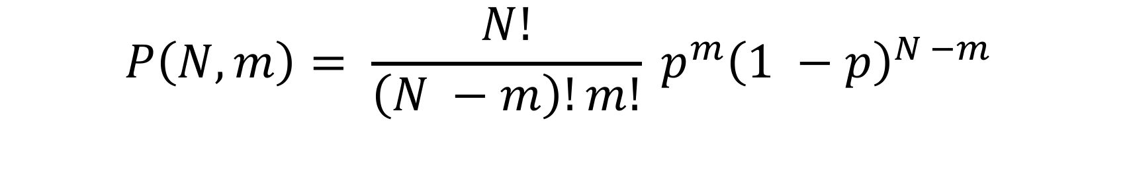

Binomial trials
Suppose you are given a coin, and the probability of getting a head is p. In N trials the probability of getting exactly m heads is
Alternative notation
$$P\left(N, m\right)= \frac{N!}{\left(N −m\right)!m!} p^{m}{\left(1 −p\right)}^{N −m}$$
$$P\left(N, m\right)= \left({N \atop m}\right)p^{m}{\left(1 −p\right)}^{N −m}$$
“N choose m” : the number of ways to choose m items from N things

Slide 45
Success probability
Define S(p, N ) to the be the probability of winning an N game series
Then
$$S\left(p,3\right)=\operatorname{Pr}\left(Win 3\right)+Pr⁡(Win 2)$$
$$=P\left(3,3\right)+P\left(3,2\right)=p^{3}+3p^{2}(1 −p)$$
No series
Winning combinations:
BBB, BBW, BWB, WBB
Mosteller’s notation
B: better team wins
W: worse team wins

