Slide 1
Applied Math 50: Overview
Recap and further discussion of “The World Series Competition” by Frederick Mosteller
Five minute break
Beginning tutorial in Matlab
Lecture notes will be posted on Course site

Slide 2

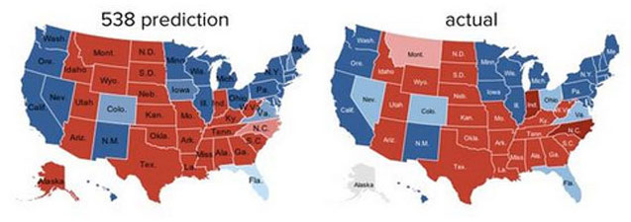
Quick detour
“We love sports, it's a great way to teach people about math and statistics.”
Statistician Nate Silver on
The Colbert Report, Jan 27 2014
Mathematical model of the 2012 US general election: all 50 states predicted correctly
http://www.fivethirtyeight.com/
http://fivethirtyeight.blogs.nytimes.com/

Slide 3
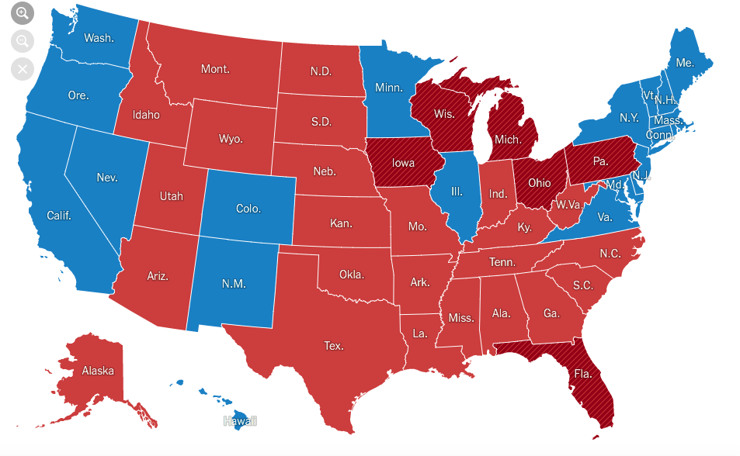
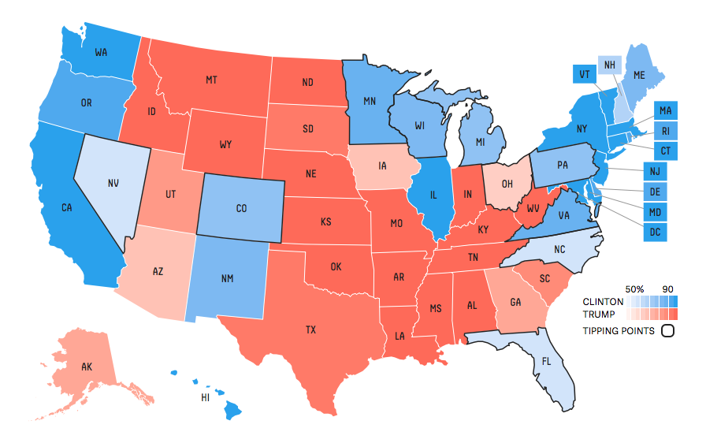
But … 2016?

Slide 4
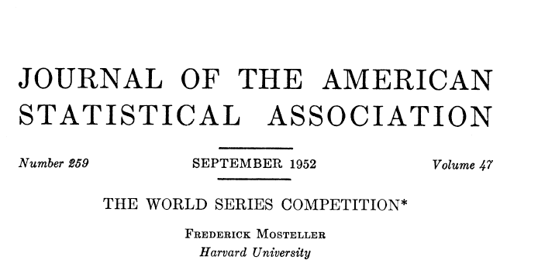
Mosteller’s World Series model
Full paper available on Canvas site

Slide 5
Mosteller’s World Series model
Assume that in the World Series, one team wins with probability p, like a flipping an unfair coin
The better team is the one with the higher probability of winning a single coin flip
The point of playing a “series” is that you would like to amplify the chance the better team wins
Central question: how often does the better team win?

Slide 6
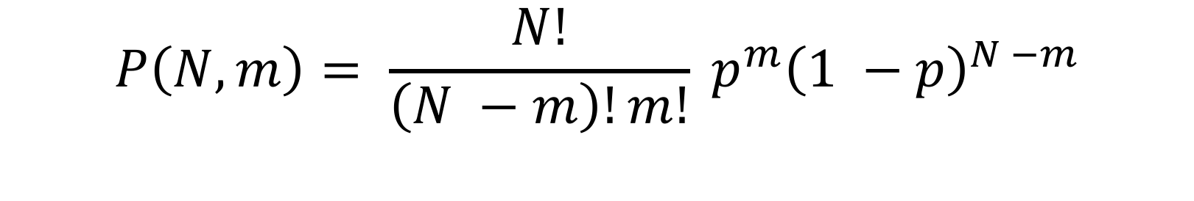
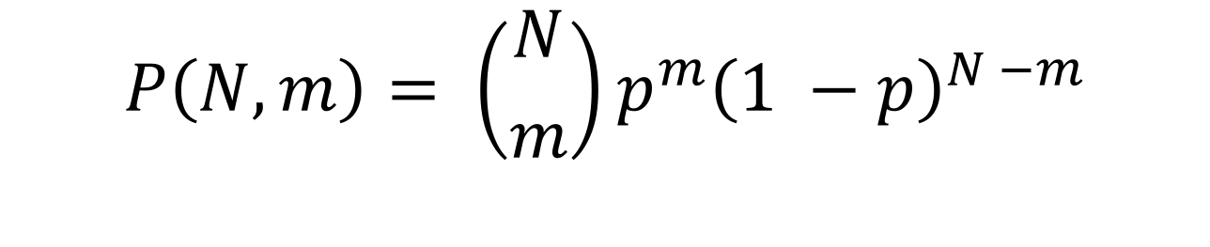
Binomial trials
Suppose you are given a coin, and the probability of getting a head is p. In N trials the probability of getting exactly m heads is
Alternative notation
$$P\left(N, m\right)= \frac{N!}{\left(N −m\right)!m!} p^{m}{\left(1 −p\right)}^{N −m}$$
$$P\left(N, m\right)= \left({N \atop m}\right)p^{m}{\left(1 −p\right)}^{N −m}$$
“N choose m” : the number of ways to choose m items from N things

Slide 7
Success probability
Define S(p, N ) to the be the probability of winning an N game series
Then
$$S\left(p,3\right)=\operatorname{Pr}\left(Win 3\right)+Pr⁡(Win 2)$$
$$=P\left(3,3\right)+P\left(3,2\right)=p^{3}+3p^{2}(1 −p)$$
No series
Winning combinations:
BBB, BBW, BWB, WBB
Mosteller’s notation
B: better team wins
W: worse team wins

Slide 8



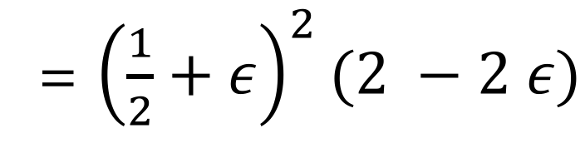
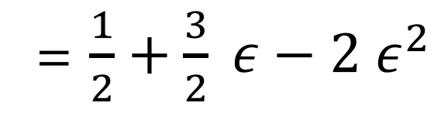

Amplification factor
$$p=\frac{1}{2}+ ε$$
$$ε$$
Let be the “advantage,” so that
Mosteller’s calculation:
Increased chance better team winning:
For p=0.51, so that = 0.01, this is 0.005
$$S\left(p,3\right)=p^{3}+3 p^{2}\left(1 −p\right)=p^{2}(3 −2 p)$$
= ${\left(\frac{1}{2}+ε\right)}^{2}(2 −2 ε)$
= $\frac{1}{2}+\frac{3}{2} ε−2 ε^{2}$
$$ε$$

Slide 9
Amplification grows with series length
Exercise: calculate amplification factor for longer series lengths

Slide 10
What’s an appropriate p?
To answer the central question, Mosteller aims to estimate a value of p based on historical World Series data
Examine period from 1905 to 1951. During this time, there were 44 seven-game series, plus 4 nine-game series
Each World Series has one team from each league
National League (St. Louis Cardinals, S.F. Giants, etc.)
American League (Boston Red Sox, New York Yankees, etc.)

Slide 11

A.L. versus N.L. comparison
First observation: the A.L. team wins more frequently, winning 31 out of 48 series
Won 159 out of 275 games: 57.82%
Has the A.L. team done significantly better than the N.L. team?
Assume null hypothesis of
Probability of winning 31 or more = 0.0297
$$p= \frac{1}{2}$$

Slide 12
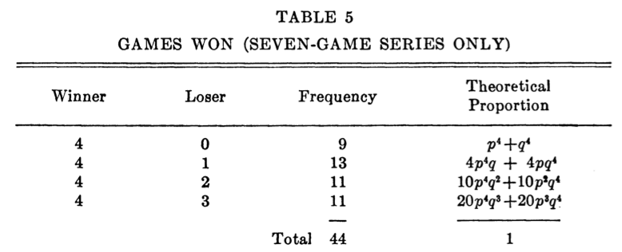
Mosteller’s first estimation
Assume that the better team has the same p each year
Define q = 1 – p
Analyze the 44 seven-game series:
Where does this come from?

Slide 13
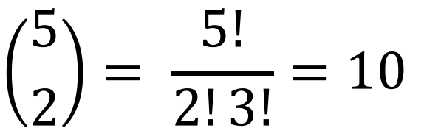
Combinations of games won
Four combinations for better team to win in a 4 – 1 series
WBBBB, BWBBB, BBWBB, BBBWB
How many ways are there for a better team to win a 4 – 2 series?
3 B’s and 2 W’s in any order
*****B
$$\left({5 \atop 2}\right)= \frac{5!}{2!3!}=10$$

Slide 14
Mosteller’s full table
Can try choosing p to fit the observed frequencies
Let’s just examine the 4–0 series, which occur 9/44 = 20.4% of the time

Slide 15
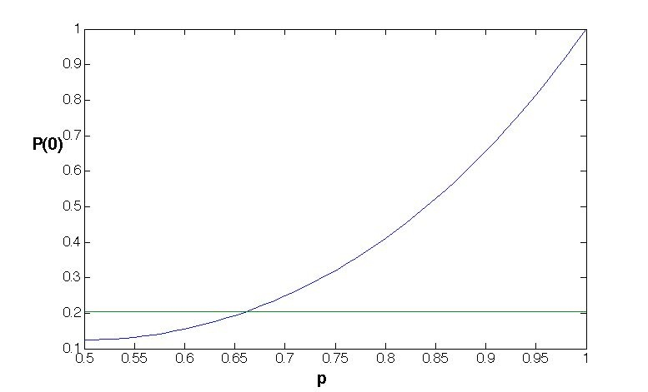
An estimate for p
Looks like p = 0.65 is pretty good

Slide 16
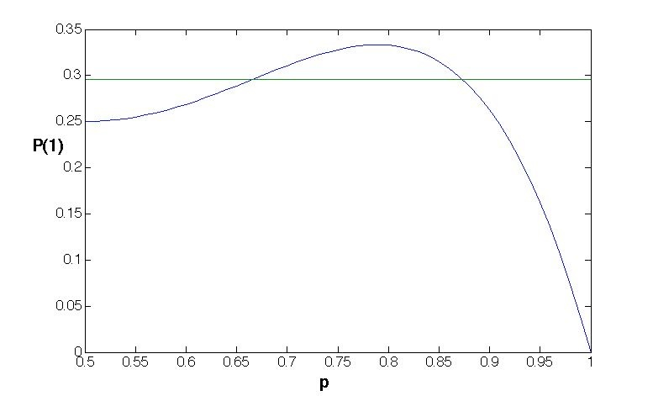
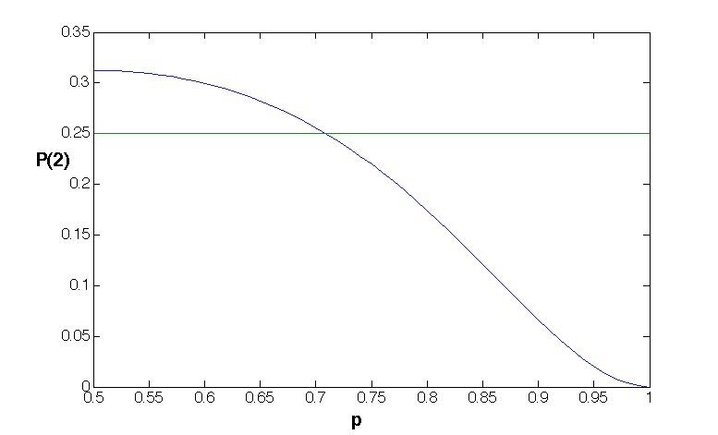
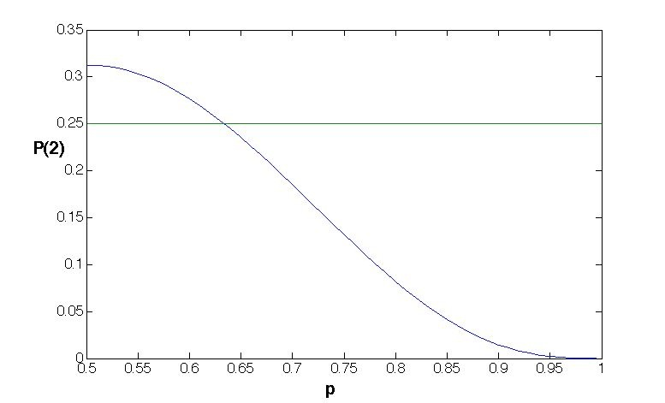
In fact p = 0.65 fits all the data
P(3)

Slide 17

Mosteller’s three estimation methods
Mosteller considers three methods of systematically choosing p:
He makes the average number of games lost by the winning team match
He uses a maximum likelihood argument
He uses a statistic
We’ll examine the first two
$$χ^{2}$$

Slide 18
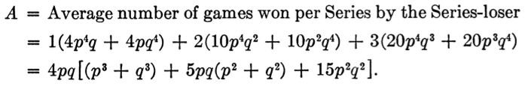

Average number of losing games
After some manipulations,
Problem: find value of p corresponding to the value in the data of A = 1.5455
But the right hand side is a sixth order polynomial in p

Slide 19
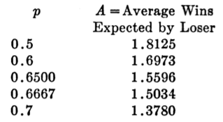
Root finding the old school way
Mosteller calculates the value of A for a number of different values of p:
He then linearly interpolates between the two
Similar to modern computer root-finding strategies (see “bisection search”)*
0.5
0.6
0.65
A = 1.5455
0.6667
0.7
0.65
A = 1.5455
p = 0.6542
*See APMTH 111: Introduction to Scientific Computing
0.6667

Slide 20
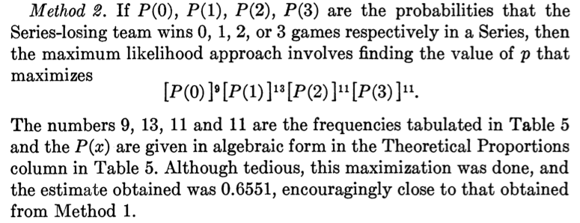
2. Maximum likelihood

Slide 21
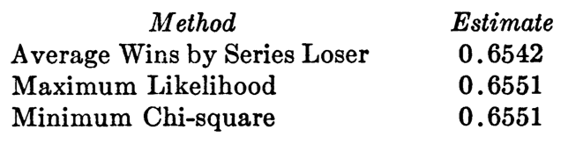

Summary of estimations of p
All three approaches give almost the same answer, which is very close to our initial guess of p = 0.65
Can now answer the original question of how often the better team wins:
This means that 20% of the time, the better team doesn’t win
$$S\left(0.65, 7\right)=0.80$$

Slide 22


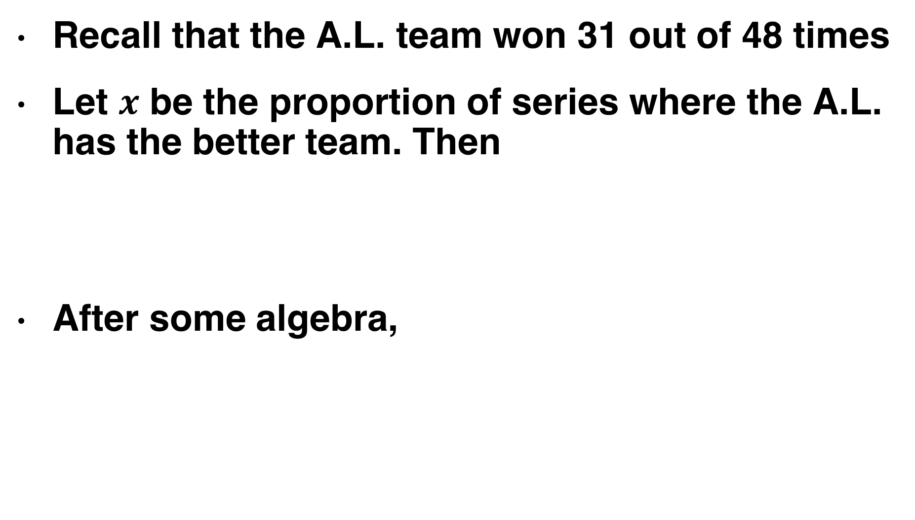
How often does the A.L. have the better team?
Recall that the A.L. team won 31 out of 48 times
Let $x$ be the proportion of series where the A.L. has the better team. Then
After some algebra,

Slide 23
A key assumption in the analysis
Same p for all world series
More realistic to say that the better team will have a varying advantage. Sometimes one team may be much better, sometimes both teams may be almost equally matched
See Mosteller’s paper for a more advanced approach with varying p
Scenario 1
p=0.7 for all games
S(0.7,7)=0.87
Scenario 2
p=0.5 for half, p=0.9 for half
S(0.5,7)=0.5, S(0.9,7)=1.00
Average S = 0.75

Slide 24
Tests of binomial assumptions
Mosteller acknowledges the limitations of assuming binomial trials with a fixed p throughout a series
Addresses issues mentioned in class (home versus away games, “momentum” gained after winning)
In addition, more recent data shows a large increase in 4–3 games!
Why is this? Examine in the first computer lab

Slide 25
Different ways to model the world series
Make a physical simulation of the entire ballpark and every single play, modeling the way the ball moves through the air, and the expected movement of players.
Compile detailed stats on each player and make a probabilistic simulation of every single ball played.
Treat each game as a flip of an unequal coin with varying p, taking into account factors like home/away game, team strength, etc.
Treat each game as a flip of an unequal coin with constant p. (Mosteller)
A world series competition is just a single coin toss.

Slide 26
A variety of modeling choices
Accuracy
Simplicity
Complexity
Easier to calculate
Too many unknown parameters
Not as realistic
Too difficult to solve
Provides more insight
1
2
3
4
5
Mosteller’s choice
Choosing the right level of detail in a mathematical model is a crucial skill, and involves many trade-offs. It depends on what the purpose of the model is. Mosteller’s choice of model complexity is guided by his original question: “how often does the better team win?” The level of detail in his model is just enough to answer this question.

Slide 27
Break

Slide 28
Getting started with Matlab
Tips on learning for beginners:
There’s no substitute for trying it yourself
There’s extensive online documentation,e.g, https://www.mathworks.com/help/matlab/
Come and see us
If stuck on a specific issue, try Googling it

Slide 29
Getting started with Matlab
Download and install: http://downloads.fas.harvard.edu/download
Ziwei’s section on Monday (time TBD)
Matlab Bootcamp, starting Monday evening (https://wiki.harvard.edu/confluence/display/fasmatlab/MATLAB+Boot+Camp+Home)
Matlab on-ramp (http://www.mathworks.com/academia/student_center/tutorials/mltutorial_launchpad.html)

Slide 30
Computer lab 0
On your own or in Ziwei’s section on Monday
Set up Matlab and learn basic commands
Run a small program to simulate Mosteller’s model. We’ll give you the program but you need to explain what it does
Look at the output
Try making some small modifications (e.g. varying p for each game)

Slide 31
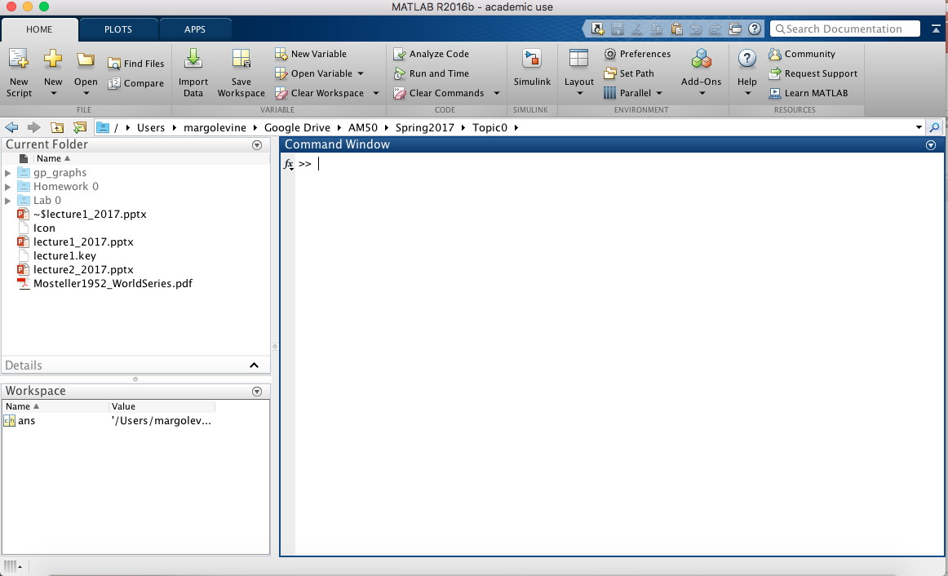
Workspace

Slide 32
Hello World!
Input program
Output
disp('Hello World!')
Hello World!
Example: hello_world.m
http://en.wikipedia.org/wiki/Hello_world

Slide 33
Variables and basic math operations
Input program
Output
%Create two variables
% and do some arithmetic
a = 1;
b = 2*a;
a = a+1;
% Print the contents of the
% variables
a
b
a =
2
b =
2
Notes:
Comments in Matlab start with a “%” symbol
Example: variables.m

Slide 34
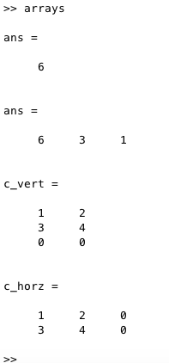
Arrays
Input program
Output
%Create an array, append an item,
% and demonstrate various outputs
a = [6,3,1,4];
b = 10;
a = [a, b];
a(1)
a(1:3)
%Create an matrix, append an array,
% and demonstrate various outputs
c = [1 2; 3 4];
d = [0 0];
c_vert = cat(1, c, d)
c_horz = cat(2, c, d')
Example: arrays.m

Slide 35
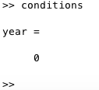
Conditions and “if” statements
Input program
Output
% clears all the previously defined % variables
% closes all previous figures
clear all;
close all;
year = 2;
name = 'Margo';
% Do different things depending on
% the condition
if strcmp(name, 'Eleanor') == 1
year = 2014
elseif strcmp(name, 'Sasha') == 1
year = 2012
else
year = 0
end
Example: conditions.m

Slide 36
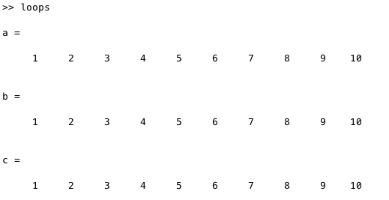
Program flow and loops
Input program
Output
%create an array 1, 2, ..., 10
N = 10;
for i = 1:N
a(i) = i;
end
%do it another way
i = 1;
while i <= 10
b(i) = i;
i = i + 1;
end
%do it without a loop
c = 1:N;
a
b
c
Example: loops.m

Slide 37
Next week: epidemiology
Using search engine queries to detect flu epidemics
Paper will be posted on Canvas site, and will be discussed on Tuesday

