Slide 1
Lecture 3: overview
Admin about student presentations
Continuation of Matlab basics
Introduce flu pandemics
The SIR model of Kermack and McKendrick (1927) – modeling activity!
Google trends

Slide 2
General two-week topic schedule
office hours
+ extra Matlab with Kausalya
Introduce new topic
Modeling/discussion
Mon
Tue
Wed
Thu
Fri
Matlab section with Ziwei
Computer lab
Student presentations
Lab assignment due
Homework assignment due
Mon
Tue
Wed
Thu
Fri
office hours
+ extra Matlab with Kausalya
Fri

Slide 3
Admin: student presentations
Five lecture times (Feb 9, Feb 23, Mar 9, Mar 30, Apr 13)
Sign-up done using a Google Doc. Link posted this evening. 3 - 4 slots per session. Must be done with in a team of three students.
Think about finding a team, which of the five topics you’d like to present, and when works for you.
Practice presentation and review slides with Kausalya, a new TF!
Database of papers going up soon. Papers for next week will be online tonight. You must choose a different paper from other presenters.

Slide 4
Course layout
Jan 24
Jan 31
Feb 7
Feb 14
Feb 21
Feb 28
Mar 7
Introduction
Spring Break
Mar 14
Mar 21
Mar 28
Apr 4
Apr 11
Apr 18
Apr 25
Topic 1:
Epidemiology
Topic 4:
Information theory
Topic 2:
Imaging
Topic 5:
Game theory
Topic 3:
Random walks
Topic 6:
Chaos or Projects

Slide 5
Matlab loops & functions
Example script: summing.m
Example function: sumfunction.m

Slide 6
Topic 1: Epidemiology

Slide 7
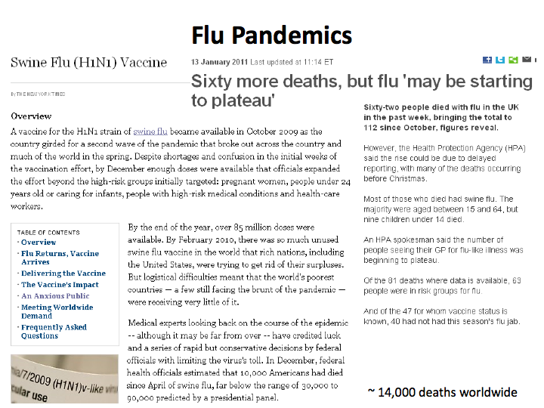
Flu pandemics
Notes:
Flu started in the spring!
An epidemic occurs when a disease affects a greater number people than is usual for the locality or one that spreads to areas not usually associated with the disease.
A pandemic is an epidemic of world-wide proportions.

Slide 8
1918 “Spanish flu” pandemic
One of the worst flu outbreaks in history
500 million infected across entire world
50–100 million killed (3%–5% of world’s population)
Unclear geographical origin, but likely accelerated by massive troop movement at the end of World War 1
Free press in neutral Spain gave impression that Spain was hardest hit

Slide 9
Significantly higher death toll than WW1
Approximate fatalities
Notes:
Flu deaths ~ 4x WW1

Slide 10
Mortality by age group
Large number of deaths in healthy adults, due to over-response of the immune system

Slide 11
Mortality in different cities: similar patterns

Slide 12
Mortality in different cities: similar patterns
Just look at data for London: multiple similar peaks

Slide 13
Questions
Why are some flus pandemics (widespread epidemics) and some not? Why are pandemics so sudden?
Why do flus end? Perhaps all people who can get it either recover or are “removed” from the population?
How can we anticipate a flu pandemic in the early stages?
What are the most effective vaccination strategies?
Suppose someone in this room had bird flu? How worried should you be that you’ll be infected?

Slide 14
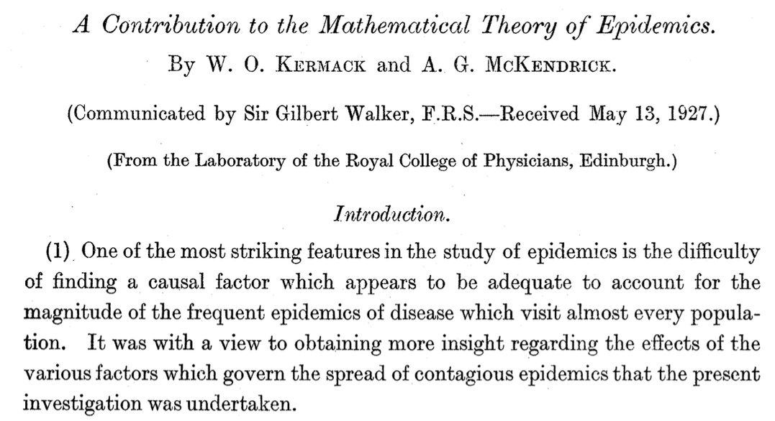

Slide 15






General idea
S
S
S
I
S
S
S
S
S
S
S
Susceptible
Infected
Removed
Three populations:
$$S(t)$$
S
$$I(t)$$
I
$$R(t)$$
R

Slide 16
General idea
S
S
S
I
S
S
I
S
S
S
I
Susceptible
Infected
Removed
Three populations:
$$S(t)$$
S
$$I(t)$$
I
$$R(t)$$
R

Slide 17
General idea
S
S
S
R
S
S
I
S
S
S
I
Susceptible
Infected
Removed
Three populations:
$$S(t)$$
S
$$I(t)$$
I
$$R(t)$$
R

Slide 18


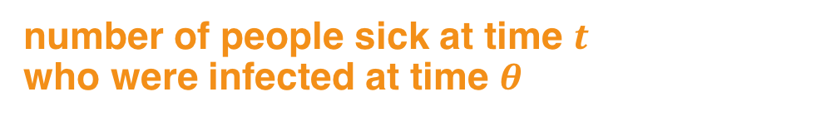





How do we turn this into equations?
$$x_{t}$$
: Number of people not yet infected
: Number of people infected
: Number of people removed (recovered/died)
$$y_{t}$$
$$z_{t}$$
Number of people infected at time $t$is
Total people sick at time $t$is
Total population is
$$v_{t}=x_{t}−x_{t+1}$$
number of people sick at time $t$
who were infected at time $θ$
$$x_{t}+y_{t}+z_{t}=N$$

Slide 19
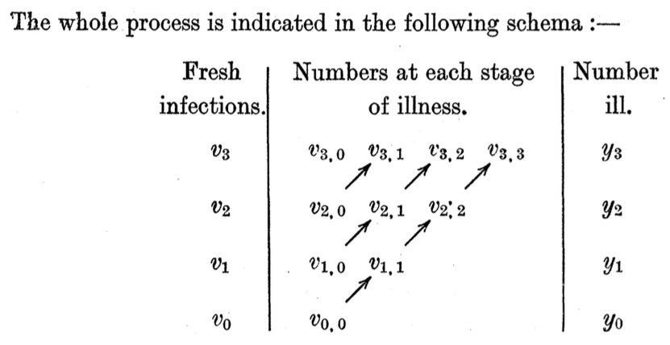
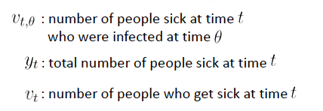
How do we turn this into equations?

Slide 20
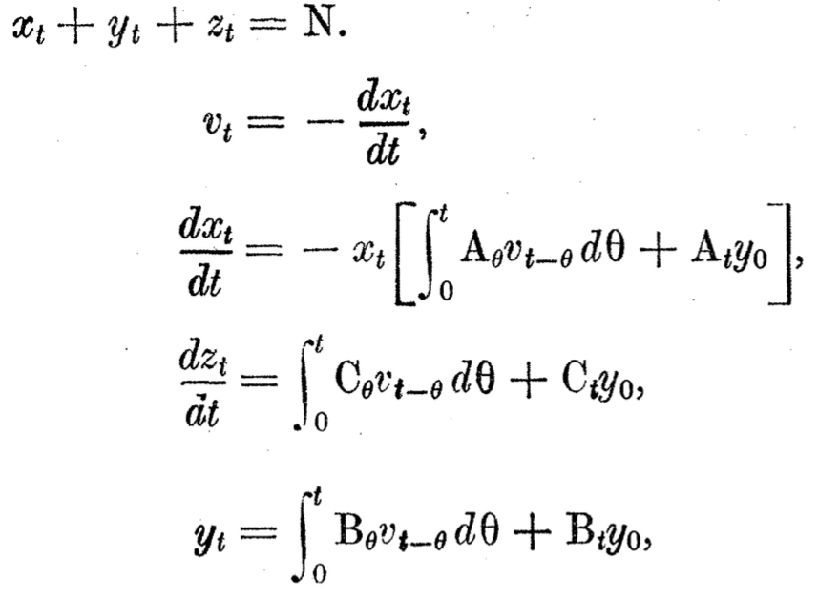



Calculus: assume that intervals become very small
$$A_{t}$$
is related to rates of infection and removal.
and are related to rate of removal.
$$B_{t}$$
$C_{t}$

Slide 21
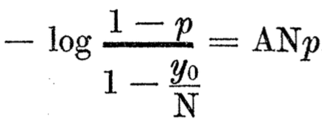
Difficult solution
The authors then attempt to solve these equations
Before digital computers: couldn’t use simulations to gain insight into solutions
They manage to derive a formula for the size of an epidemic
Here, p is the proportion infected during an epidemic
A bit too complicated for clear insight—is there any way to simplify the model?

Slide 22
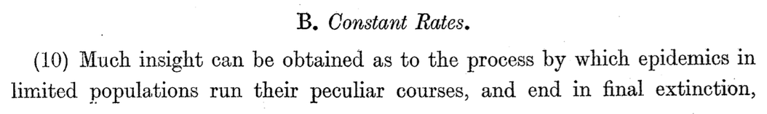
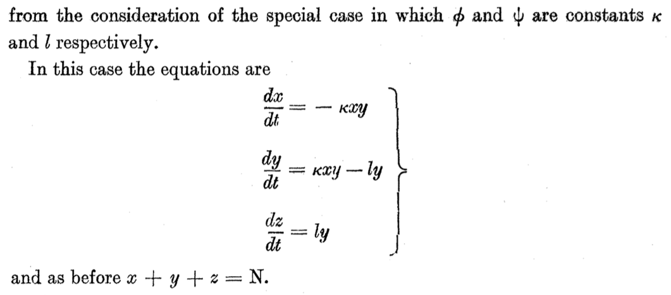
Simpler model: constant rates

Slide 23
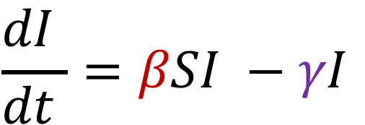
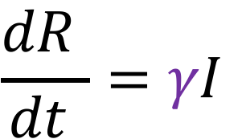



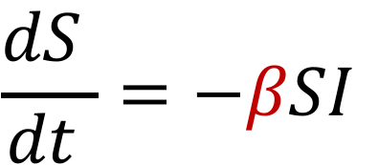
SIR Model (using modern notation)
: Susceptible
: Infected
: Removed/recovered
$$S(t)$$
$$I(t)$$
$$R(t)$$
Infection rate
$$\frac{dS }{dt }=−βSI$$
$$\frac{dI }{dt }=βSI −γI$$
Recovery/death rate
$$\frac{dR }{dt }=γI$$

Slide 24
Let’s develop this model ourselves!

