Slide 1
Lecture 4: overview
The SIR model of Kermack and McKendrick (1927)
Implications of the SIR model on controlling epidemics
Break
Python tutorial in input/output

Slide 2
Admin
Additional TF has been approved
Three labs:
Wednesday 2:30pm–4pm, Northwest B150 (right after lecture)
Thursday evening, time TBA, room TBA
Friday 1pm–2:30pm, room TBA
Will send an announcement with full details
Regular office hours for Chris and TFs will begin next week
Chris will host special office hour on Feb 4, 2pm–3pm for any questions about introductory lab and Python

Slide 3
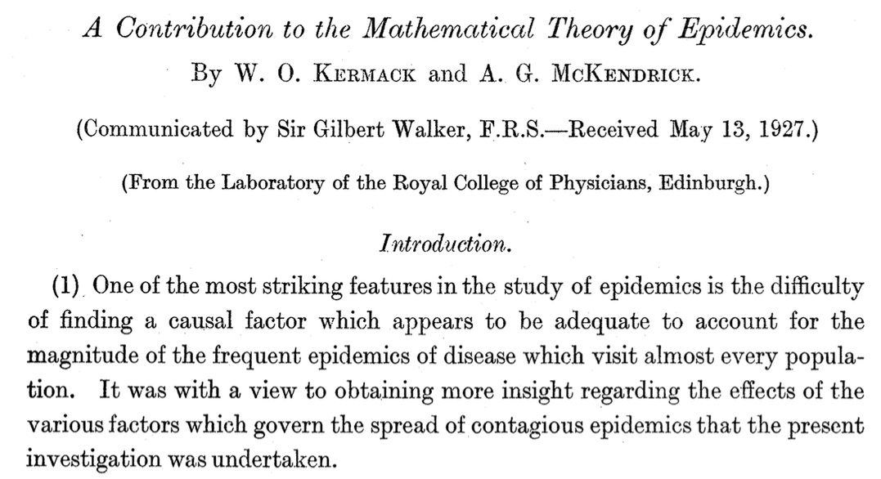

Slide 4



General idea
S
S
S
I
S
S
S
S
S
S
S
Three populations:
Susceptible S(t)
Infected I(t)
Removed R(t)
S
I
R

Slide 5
General idea
S
S
S
I
S
S
I
S
S
S
I
Three populations:
Susceptible S(t)
Infected I(t)
Removed R(t)
S
I
R

Slide 6
General idea
S
S
S
R
S
S
I
S
S
S
I
Three populations:
Susceptible S(t)
Infected I(t)
Removed R(t)
S
I
R

Slide 7

How do we turn this into equations?
xt : Number of people not yet infected
yt : Number of people infected
zt : Number of people removed (recovered/died)
Number of people infected at time t is
Total people sick at time t is
Total population is
Number of people sick at time t who were infected time before

Slide 8
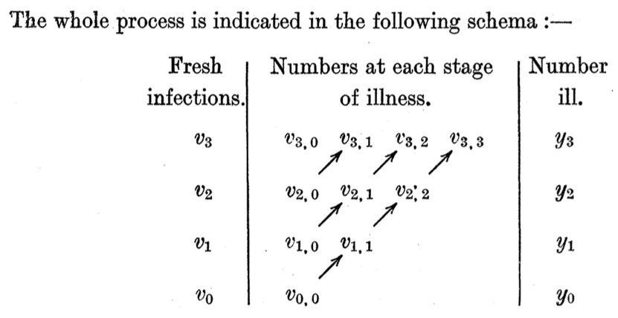
How do we turn this into equations?

Slide 9
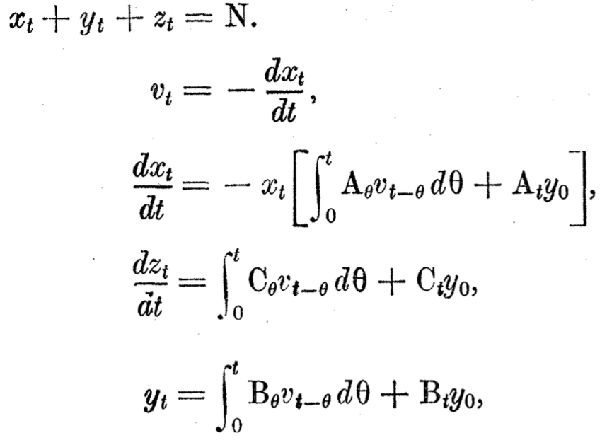
Calculus: assume that intervals become very small
At is related to rates of infection and removal.
Bt and Ct are related to rate of removal.

Slide 10
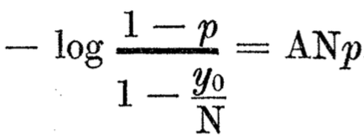
Difficult solution
The authors then attempt to solve these equations
Before digital computers: couldn’t use simulations to gain insight into solutions
They manage to derive a formula for the size of an epidemic
Here, p is the proportion infected during an epidemic
A bit too complicated for clear insight—is there any way to simplify the model?

Slide 11
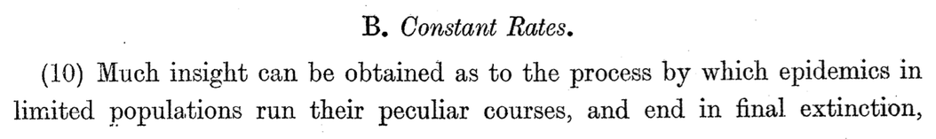
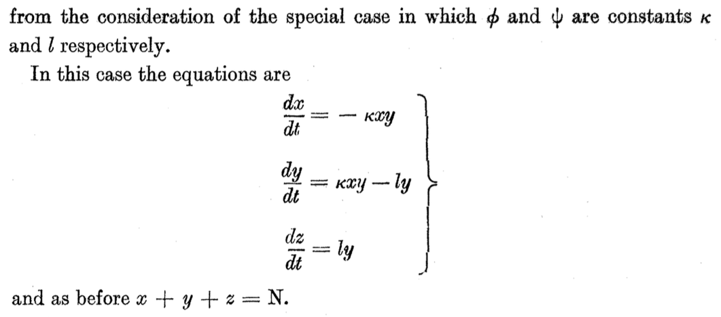
Simpler model: constant rates

Slide 12

SIR Model (using modern notation)
S(t) : Susceptible
I(t) : Infected
R(t) : Removed/recovered
Infection rate
Recovery/death rate

Slide 13

SIR model revisited
S(t) : Susceptible
I(t) : Infected
R(t) : Removed/recovered
Population is constant:
S
I
R

Slide 14
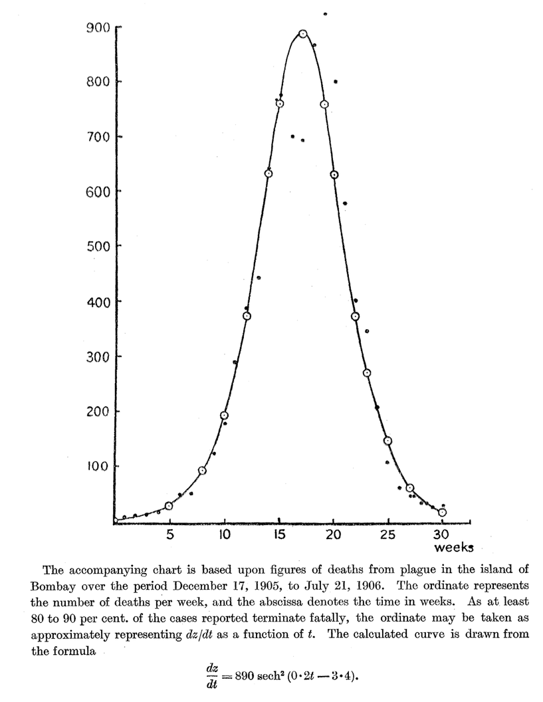
dz/dt

Slide 15
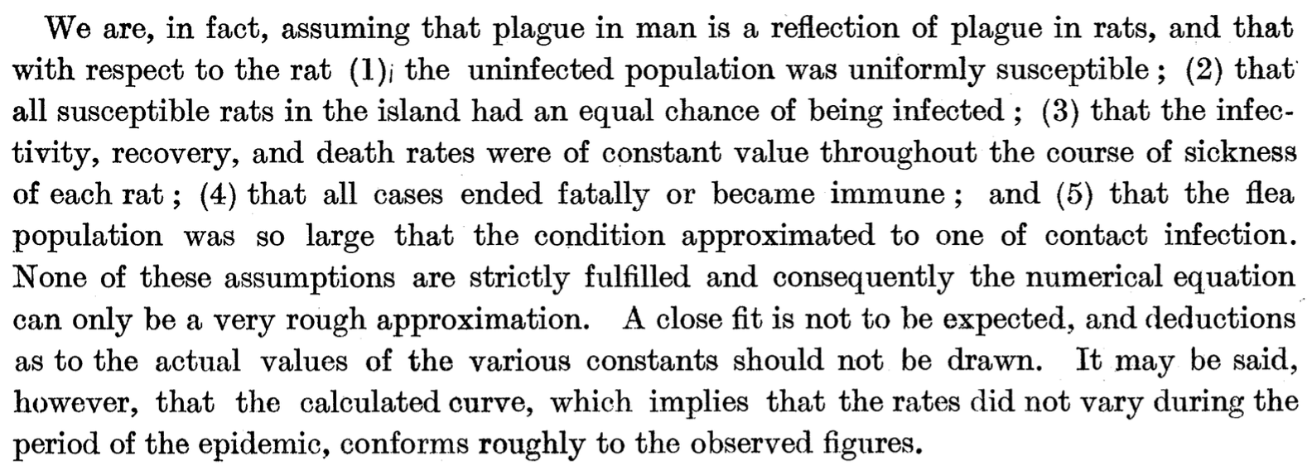

Slide 16


Rate of spreading
Infection spreads if
R0 is called the basic reproduction number
It is a dimensionless quantity
It represents the average number of people a single infected individual will infect
S
S
S
S
S
I
S
S
S
S
S
S

Slide 17
Rate of spreading
Infection spreads if
Techniques to stop the spread of infection:
Reduce
Increase
Reduce S
(quarantining, restricting movement)
(treating infected people)
(vaccination)

Slide 18
Vaccination
S
I
R
Vaccinate
Vaccination equivalent to moving a fraction p of the population from S to R
Aim to reduce susceptibles to critical fraction
Critical vaccination fraction is therefore

Slide 19
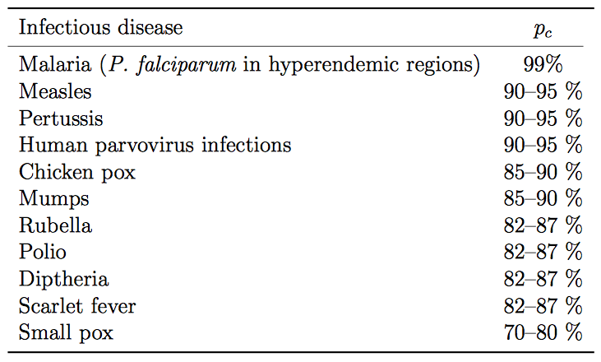
Critical vaccination fractions
Source: Anderson & May, Infectious Diseases of Humans, Oxford University Press

Slide 20
“Herd immunity”
Term used for a population that is sufficiently vaccinated that a disease cannot catastrophically spread
Possible conflict of interest between an individual and the community
Graphic: Center for Disease Control

Slide 21
Herd immunity failure
1998 journal article published in The Lancet links MMR vaccine to autism and digestive disease
Conclusively debunked over the subsequent decade: paper retracted in 2010 and authors tried for professional misconduct
However, public scare causes many parents to opt out, causing vaccination rates to significantly drop
http://en.wikipedia.org/wiki/MMR_vaccine_controversy

Slide 22
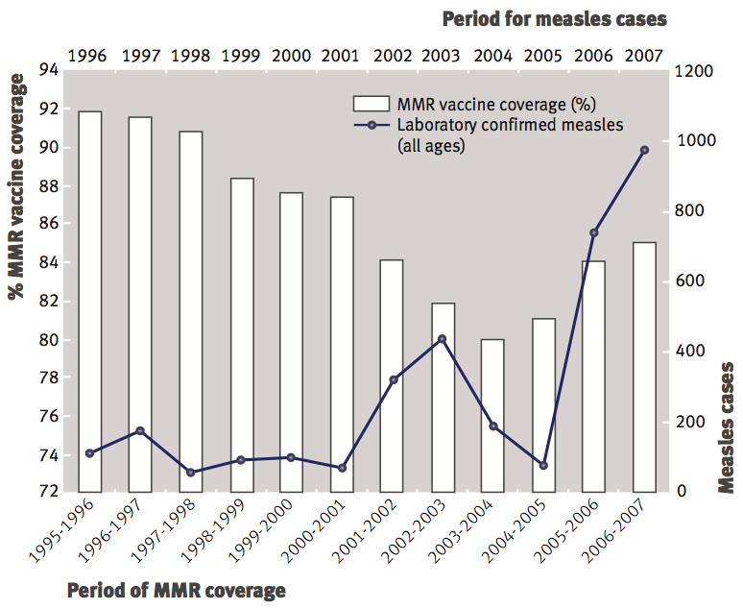
Herd immunity failure
P. McIntyre and J. Leask, Improving uptake of MMR vaccine, BMJ 336, 729–730 (2008).

Slide 23

News article from Feb 4, 2015

Slide 24
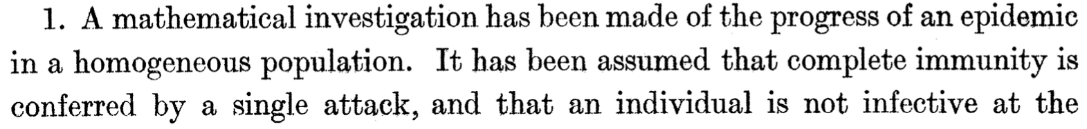
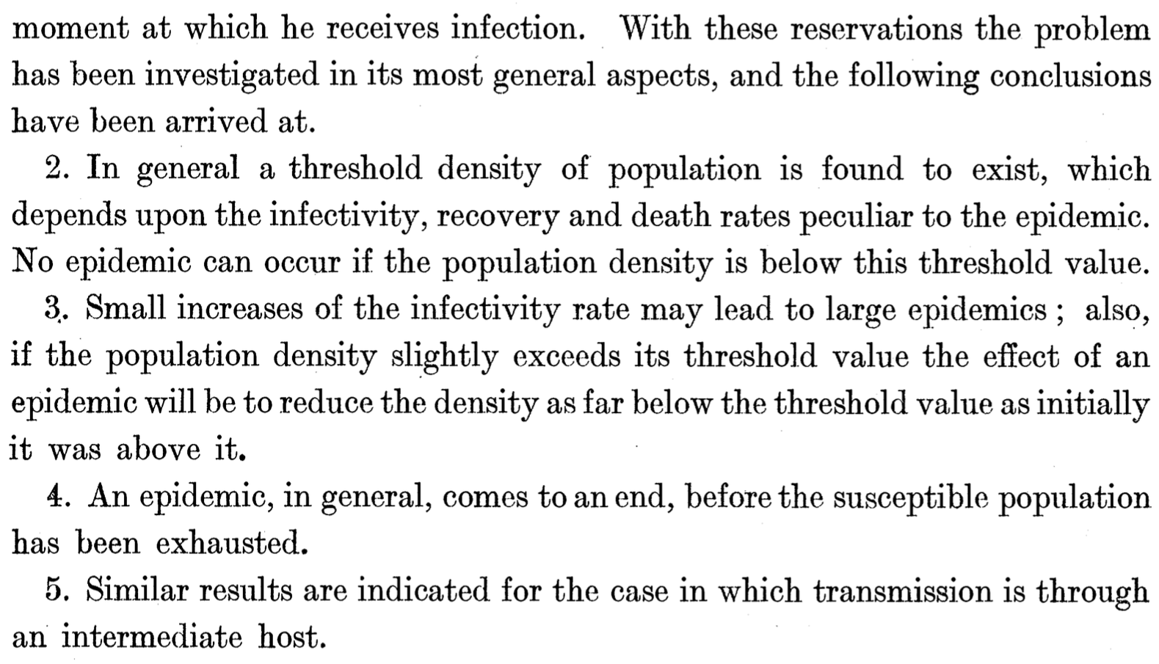
Conclusions of paper

Slide 25
Solution of the SIR model
Equations are coupled and contain a nonlinear term (SI), making them difficult to solve
Common technique to gain some insight: consider a simpler special case
If S = 0 then
Only depends on I

Slide 26
Analytical solution for special case
Separation of variables
Integration of both sides
Exponentiation
Initial condition
The infected population will decay exponentially with rate W

Slide 27
Break

Slide 28
Python tutorial: input and output
A general problem: reading text files of data in arbitrary formats
For example, tropical storm data from National Hurricane Center:
We may wish to extract out the numerical information in this file process it or make a plot of it—how can this be done?
- - - MAXIMUM WIND SPEED (INTENSITY) PROBABILITIES - - -
VALID TIME 06Z FRI 18Z FRI 06Z SAT 18Z SAT 18Z SUN 18Z MON 18Z TUE
FORECAST HOUR 12 24 36 48 72 96 120
- - - - - - - - - - - - - - - - - - - - - - - - - - - - - - - - - -
DISSIPATED 2 4 7 9 12 22 32
TROP DEPRESSION 33 30 25 28 29 41 45
TROPICAL STORM 65 62 59 52 53 35 23
HURRICANE 1 4 9 10 6 2 1
- - - - - - - - - - - - - - - - - - - - - - - - - - - - - - - - - -
HUR CAT 1 1 3 8 9 6 2 1
HUR CAT 2 X X 1 1 1 X X
HUR CAT 3 X X X X X X X
HUR CAT 4 X X X X X X X
HUR CAT 5 X X X X X X X
- - - - - - - - - - - - - - - - - - - - - - - - - - - - - - - - - -
FCST MAX WIND 35KT 40KT 45KT 45KT 45KT 35KT 30KT
Data Wrangler, an alternative solution: http://vis.stanford.edu/wrangler/

Slide 29
Python output
Input program
Contents of “test”
# Open a file called "test" to write it and
# associate it with a file handle called f
f=open("test","w")
# Write some text
f.write("Testing testing\n")
# Write some numbers
for a in range(1,4):
f.write(str(a)+"\n")
# Close file
f.close()
Testing testing
1
2
3
Notes:
A file is opened with the “open” command and it takes two arguments. The first is the filename and the second is the mode, with “w” for writing and “r” for reading. Once the file is opened, it is associated with a “file handle”, in this case called f. Any subsequent reading or writing operations to the file will make use of the file handle (such as f.write to write text).
Example: output.py

Slide 30
Formatted output
Input program
Contents of “test2”
# Import math functions
from math import *
# Open a file called "test2" to write it and
# associate it with a file handle called f
f=open("test2","w")
# Do formatted output
a=4
b=19.0
c="string"
f.write("%d %f %g %s\n\n” % (a,b,b,c))
# Change precision
f.write("pi is %4.3f\n" % pi)
f.write("pi is %4.10f\n\n" % pi)
# Padded output
f.write(" x x^3\n")
for d in range(11):
f.write("%4d %6d\n" % (d,d*d*d))
# Close file
f.close()
4 19.000000 19 string
pi is 3.142
pi is 3.1415926536
x x^3
0 0
1 1
2 8
3 27
4 64
5 125
6 216
7 343
8 512
9 729
10 1000
Example: output2.py

Slide 31
Python input #1
Input program
Contents of “in_test”
# Open "in_test" file for reading
f=open("in_test","r")
# Read entire file
s=f.read()
print s
# Close file
f.close()
# Open file again
f=open("in_test","r")
# Read in line-by-line and print
for d in range(4):
s=f.readline()
s=s.rstrip()
print "Animal",d,":",s
# Close file
f.close()
Cat
Dog
Polar Bear
Hummingbird
Output
Cat
Dog
Polar Bear
Hummingbird
Animal 0 : Cat
Animal 1 : Dog
Animal 2 : Polar Bear
Animal 3 : Hummingbird
Example: input.py

Slide 32
Python input #2
Input program
Contents of “in_test2”
# Open "in_test2" file for reading
f=open("in_test2","r")
# Create empty list
q=[]
# Read entire file
for s in f:
# Remove newline character
s=s.strip()
# Split entries and print
c=s.split(',')
print c
# Also store second column
q.append(c[1])
# Close file
f.close()
# Print list
print
print q
4,5,6
1,2,3
7,8,9
Output
['4', '5', '6']
['1', '2', '3']
['7', '8', '9']
['5', '2', '8']
Notes:
The “split” function can take a line of text, and the split it up into a list, based on some separating character (in this case a comma)
Example: input2.py

Slide 33
Google flu data:
comma-separated values (CSV)
Date,United States,Alabama,Alaska,Arizona,Arkansas,California,Colorado,Connecticut,Delaware,District of Columbia,Florida,Georgia,Hawaii,Idaho,Illinois,Indiana,Iowa,Kansas,Kentucky,Louisiana,Maine,Maryland,Massachusetts,Michigan,Minnesota,Mississippi,Missouri,Montana,Nebraska,Nevada,New Hampshire,New Jersey,New Mexico,New York,North Carolina,North Dakota,Ohio,Oklahoma,Oregon,Pennsylvania,Rhode Island,South Carolina,South Dakota,Tennessee,Texas,Utah,Vermont,Virginia,Washington,West Virginia,Wisconsin,Wyoming
2003-09-28,902,477,,606,,929,233,223,,927,587,514,,,677,544,303,272,420,1017,,1268,344,685,484,,349,,,,,695,,649,565,,616,1040,409,1186,,462,,551,1398,,,1112,588,,466,
2003-10-05,952,501,,663,,849,251,243,,993,582,532,,,732,607,303,270,442,1096,,1374,362,748,514,,359,,,,,716,,725,660,,699,1065,409,1176,,478,,597,1517,,,1198,624,,504,
2003-10-12,1092,492,,700,,1032,283,261,,1033,606,557,,,799,637,312,280,460,1144,,1445,372,791,588,,381,,,,,815,,739,861,,729,1122,428,1340,,521,,670,2010,,,1343,777,,538,
2003-10-19,1209,533,,819,,1084,310,268,,1089,698,608,,,841,680,342,292,485,1308,,1432,367,829,692,,431,,,,,831,,874,852,,759,1199,467,1424,,529,,666,2786,,,1448,866,,595,
2003-10-26,1249,594,,959,,989,344,334,,1177,708,745,,,978,765,368,313,496,1936,,1426,370,803,701,,452,,,,,901,,865,857,,847,1278,510,1514,,556,,717,2917,,,1556,1026,,653,
2003-11-02,1374,715,,1167,,1284,569,394,,1270,746,767,936,,1102,773,399,323,505,2791,,1495,404,898,708,,450,,,,,897,,1005,922,,830,1437,576,1448,,621,,733,3177,,,1640,1053,,688,
2003-11-09,1702,840,,1655,,1741,2053,459,,1377,917,803,993,,1091,831,444,360,563,3975,,1653,474,939,776,,514,,400,,,994,,1059,1135,,880,2082,780,1720,,758,,931,3344,291,,1931,1605,,813,
2003-11-16,2148,1064,,2662,,2110,3669,538,,1538,1095,1236,994,,1374,1143,519,449,673,4796,,2156,782,1061,829,,684,,611,,,1281,,1559,1536,,1040,3888,978,2423,,844,,1152,4287,438,,2575,2881,,1169,
...
Entries are all separated by commas. Can make use of Python “split” command to read in a line, and split up the entries into a list. CSV format is also readable by other programs such as Excel.

Slide 34
Loading in the data
# Open the file in the "read" mode
f=open("googleflu.csv","r")
# Read in header line
h=f.readline().split(",")
# Initialize 53 empty lists
s=[]
for i in range(53):
s.append([])
# Loop over the remaining lines
for l in f:
# Create a list by separating the line at commas
d=l.split(",")
# Store the 53 entries in the line to each relevant list
for i in range(53):
s[i].append(d[i])
# Close the file
f.close()
Each column of the data is now contained in a list: s[1] contains national data, s[6] contains California data, etc.
Example: parse.py

