Slide 1
Lecture 4: overview
Admin
Continuing modeling activity
More discussion of SIR model of Kermack and McKendrick (1927)
Implications of the SIR model on controlling epidemics
Google trends

Slide 2
Admin
Sign up for two presentation slots by Monday, February 6! If you don’t have a team, use Piazza to find one.
Kausalya will schedule practice presentations for the teams presenting “Epidemiology” papers.
What to submit for Lab 0:
Matlab code only as .m files.
In your code, include the comments / answers to lab questions.
Lab next Tuesday in class – bring computer

Slide 3





General idea
S
S
S
I
S
S
S
S
S
S
S
Susceptible
Infected
Removed
Three populations:
$$S(t)$$
S
$$I(t)$$
I
$$R(t)$$
R

Slide 4
General idea
S
S
S
I
S
S
I
S
S
S
I
Susceptible
Infected
Removed
Three populations:
$$S(t)$$
S
$$I(t)$$
I
$$R(t)$$
R

Slide 5
General idea
S
S
S
R
S
S
I
S
S
S
I
Susceptible
Infected
Removed
Three populations:
$$S(t)$$
S
$$I(t)$$
I
$$R(t)$$
R

Slide 6
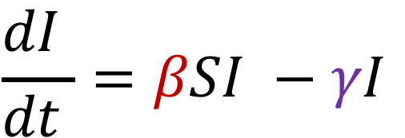
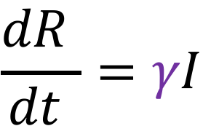



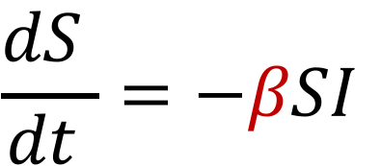
SIR Model: constant rates
: Susceptible
: Infected
: Removed/recovered
$$S(t)$$
$$I(t)$$
$$R(t)$$
Infection rate
$$\frac{dS }{dt }=−βSI$$
$$\frac{dI }{dt }=βSI −γI$$
Recovery/death rate
$$\frac{dR }{dt }=γI$$

Slide 7
Modeling activity
Assume total population is constant.
Justifications
No births?
Other ideas?

Slide 8
Modeling activity
How do we expect these populations to change in time?
Does it depend on:
Initial size of each population?
The infection and recovery rates?
Other ideas?

Slide 9
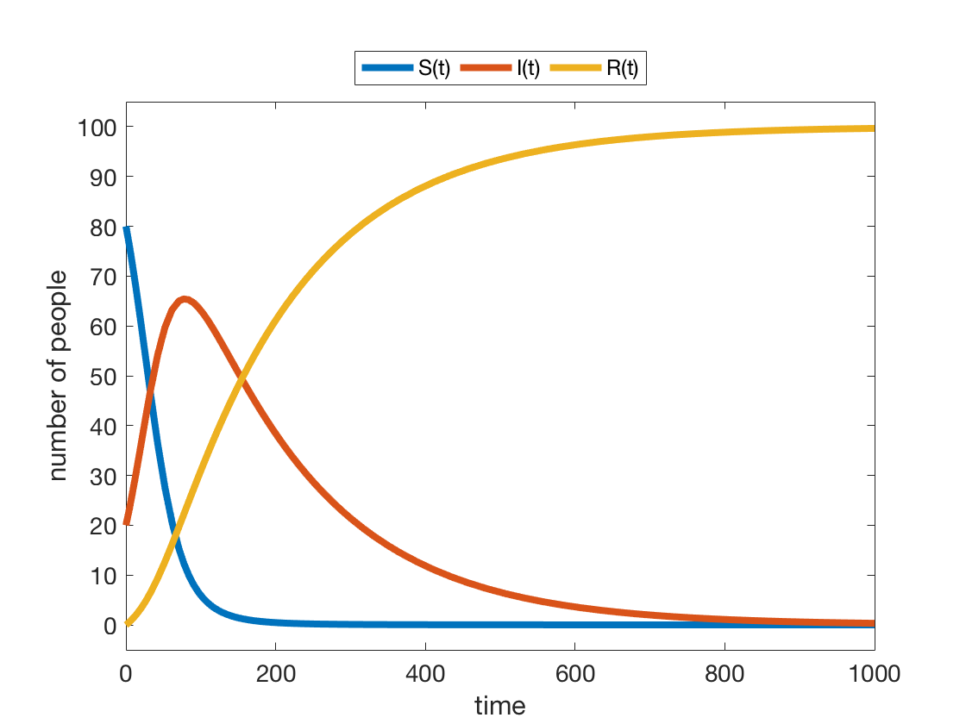
Modeling activity

Slide 10
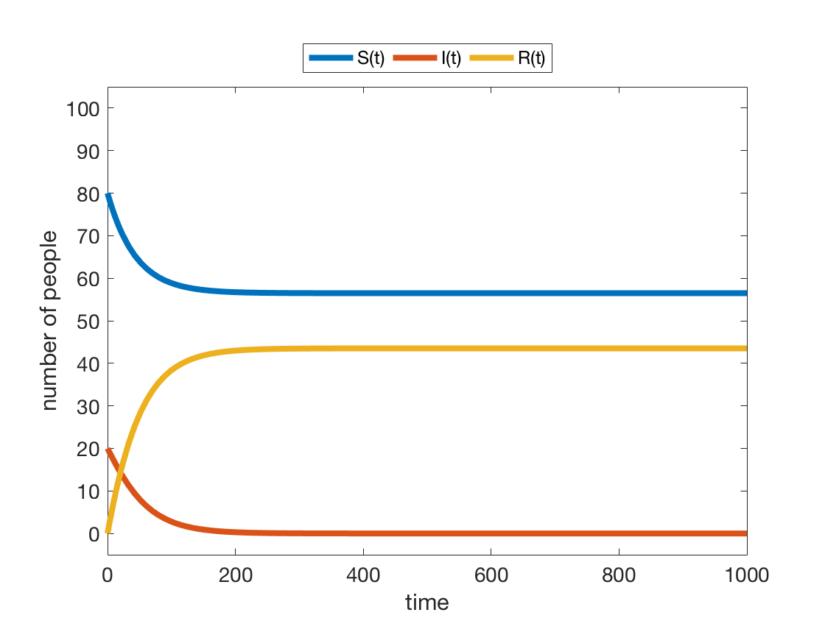
Modeling activity

Slide 11
Continuing the activity

Slide 12
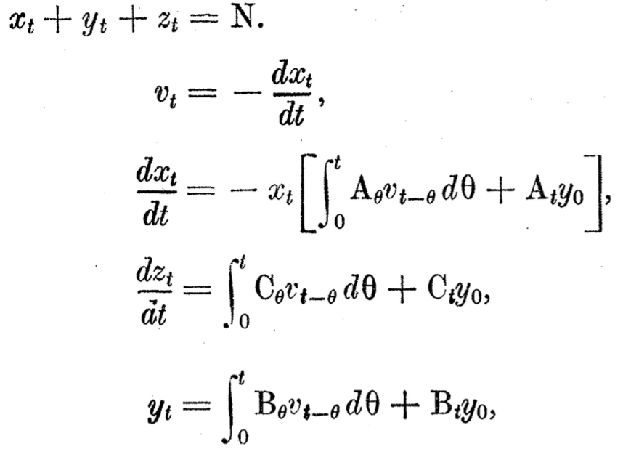
The more complicated model: revisited

Slide 13
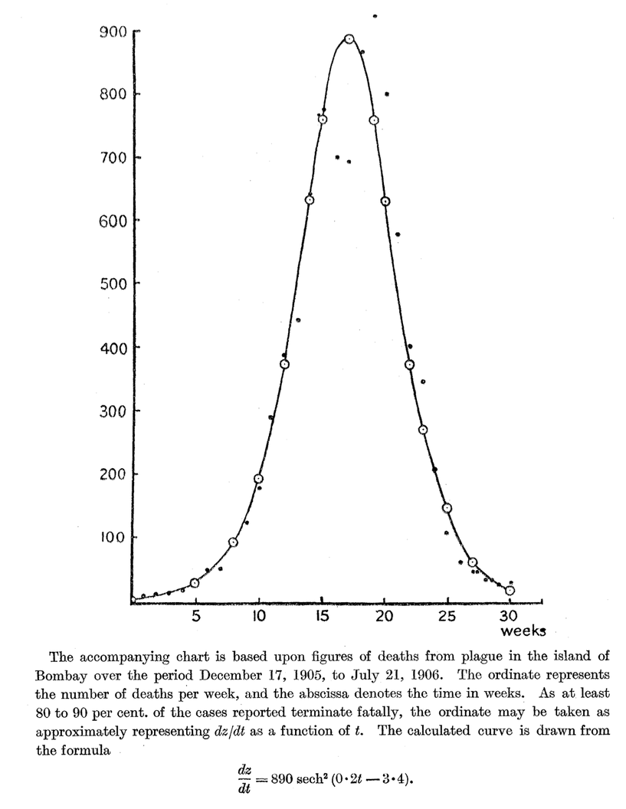
dz/dt
Is this consistent with our activity sketches?

Slide 14
Bad news case

Slide 15
Good news case

Slide 16
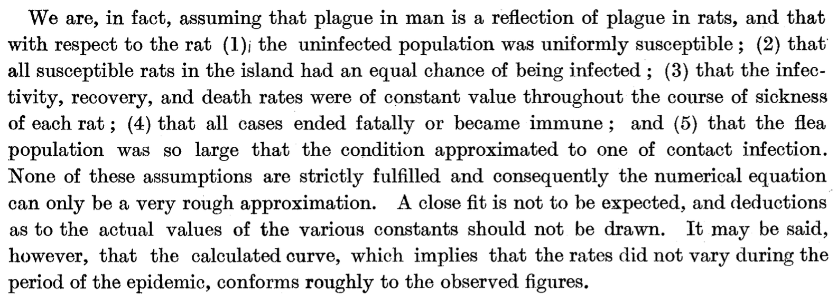

Slide 17
What can we learn?
: Susceptible
: Infected
: Removed/recovered
$$S(t)$$
$$I(t)$$
$$R(t)$$
Infection rate
$$\frac{dS }{dt }=−βSI$$
S
I
R
$$\frac{dI }{dt }=βSI −γI$$
Recovery/death rate
$$\frac{dR }{dt }=γI$$

Slide 18
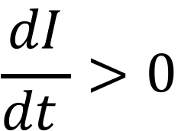
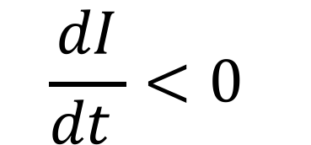
$$\frac{dI}{dt }<0$$
$$\frac{dI}{dt }>0$$

Slide 19



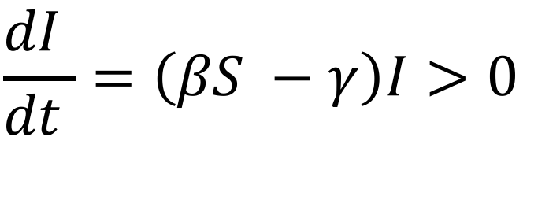
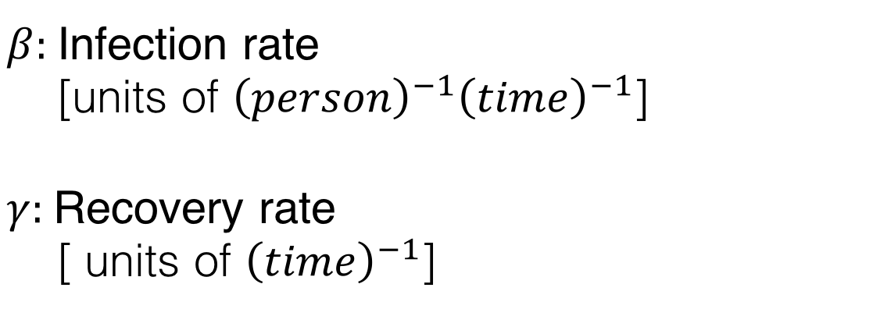
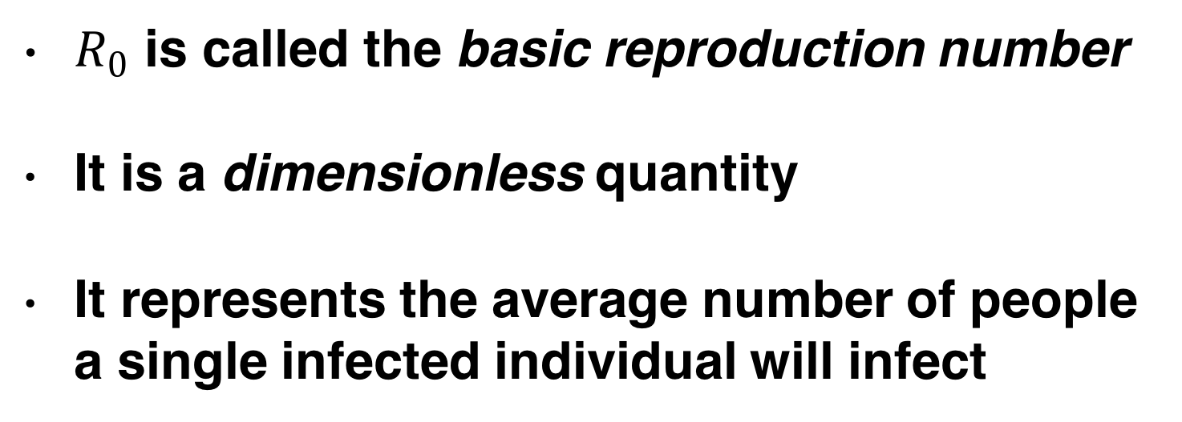
Rate of spreading
$β:$Infection rate
[units of ${\left(person\right)}^{−1}{\left(time\right)}^{−1}$]
$γ:$Recovery rate
[ units of ${\left(time\right)}^{−1}$]
$$\frac{dI }{dt }=\left(βS −γ\right)I>0$$
$$R_{0}= \frac{βS}{γ}>1$$
Infection spreads if
$R_{0}$ is called the basic reproduction number
It is a dimensionless quantity
It represents the average number of people a single infected individual will infect
S
S
S
S
S
I
S
S
S
S
S
S
$$R_{0}=2$$

Slide 20
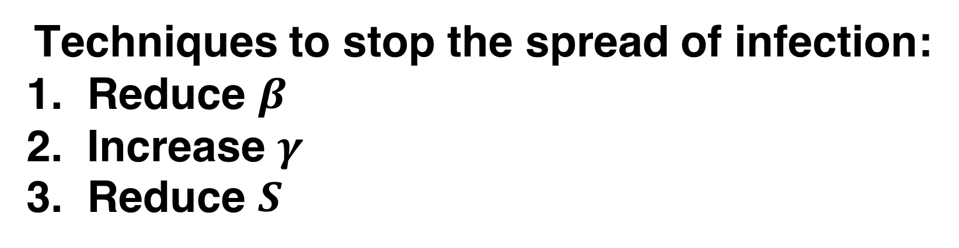
Rate of spreading
$β:$Infection rate
[units of ${\left(person\right)}^{−1}{\left(time\right)}^{−1}$]
$γ:$Recovery rate
[ units of ${\left(time\right)}^{−1}$]
$$\frac{dI }{dt }=\left(βS −γ\right)I>0$$
$$R_{0}= \frac{βS}{γ}>1$$
Infection spreads if
Techniques to stop the spread of infection:
Reduce $β$
Increase $γ$
Reduce $S$
(quarantining, restricting movement)
(treating infected people)
(vaccinating)

Slide 21

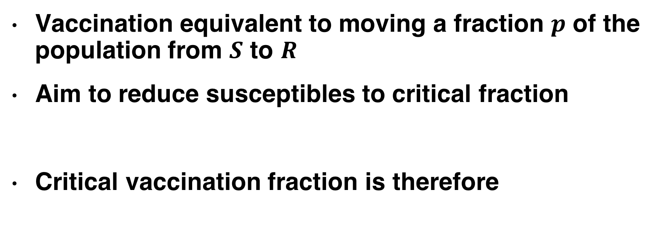
Vaccination
S
I
R
Vaccinate
Vaccination equivalent to moving a fraction $p$ of the population from $S$ to $R$
Aim to reduce susceptibles to critical fraction
Critical vaccination fraction is therefore
$$S_{c}= \frac{γ}{β}$$
$p_{c}= \frac{Total to vaccinate}{Total population}=\frac{S −S_{c}}{S}=1 − \frac{S_{c}}{S} =1 − \frac{1}{R_{0}}$

Slide 22
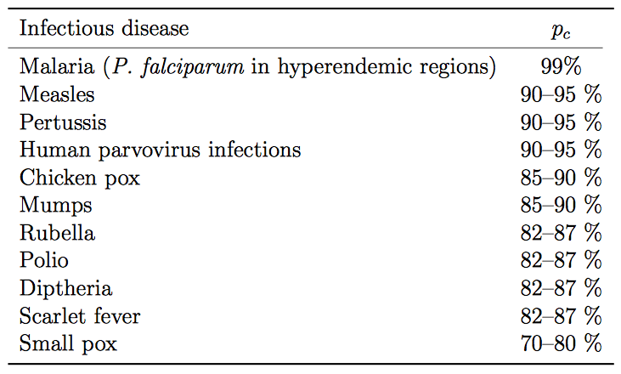
Critical vaccination fractions
Source: Anderson & May, Infectious Diseases of Humans, Oxford University Press

Slide 23
“Herd immunity”
Term used for a population that is sufficiently vaccinated that a disease cannot catastrophically spread
Possible conflict of interest between an individual and the community
Graphic: Center for Disease Control

Slide 24
Herd immunity failure
1998 journal article published in The Lancet links MMR vaccine to autism and digestive disease
Conclusively debunked over the subsequent decade: paper retracted in 2010 and authors tried for professional misconduct
However, public scare causes many parents to opt out, causing vaccination rates to significantly drop
http://en.wikipedia.org/wiki/MMR_vaccine_controversy

Slide 25
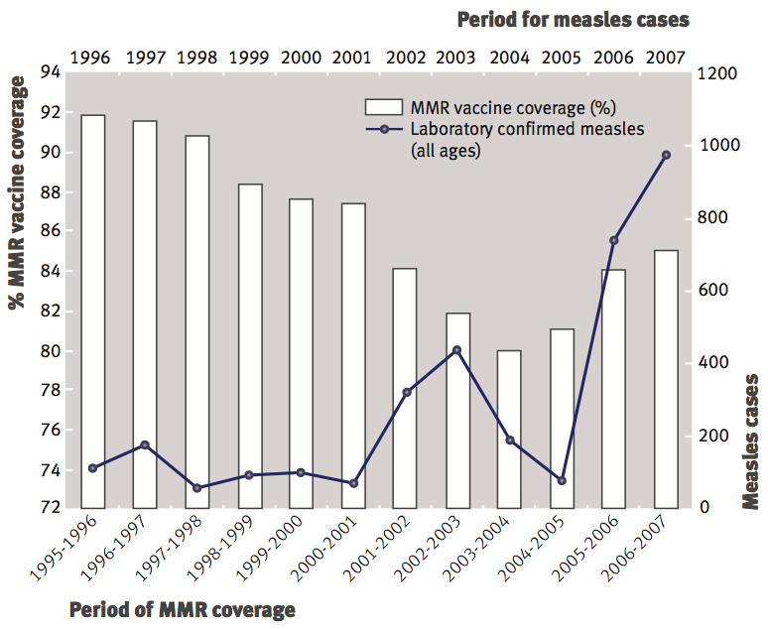
Herd immunity failure
P. McIntyre and J. Leask, Improving uptake of MMR vaccine, BMJ 336, 729–730 (2008).

Slide 26
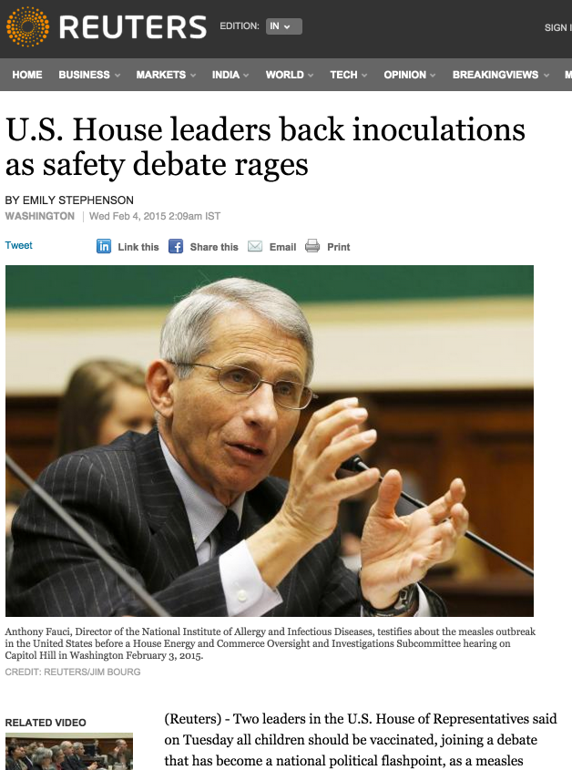
News article from Feb 4, 2015

Slide 27
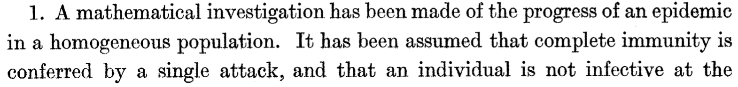
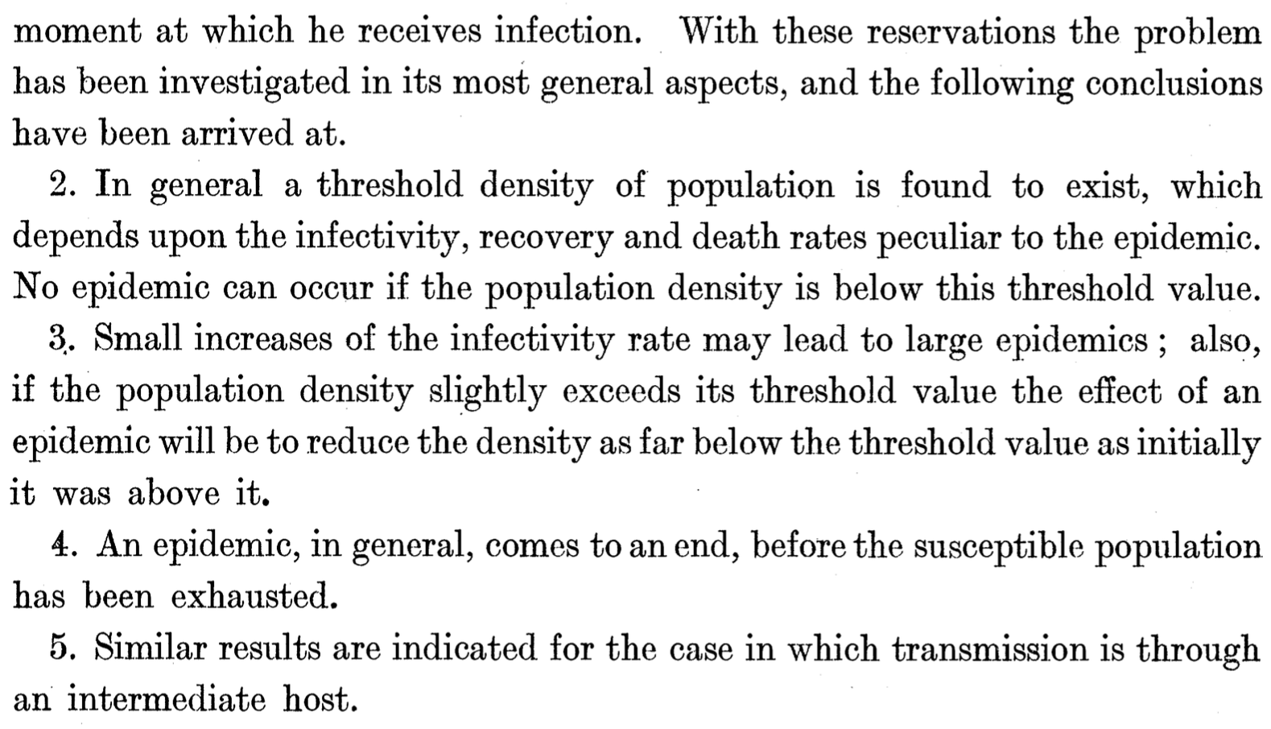
Conclusions of paper

Slide 28
Google trends and flu data

Slide 29
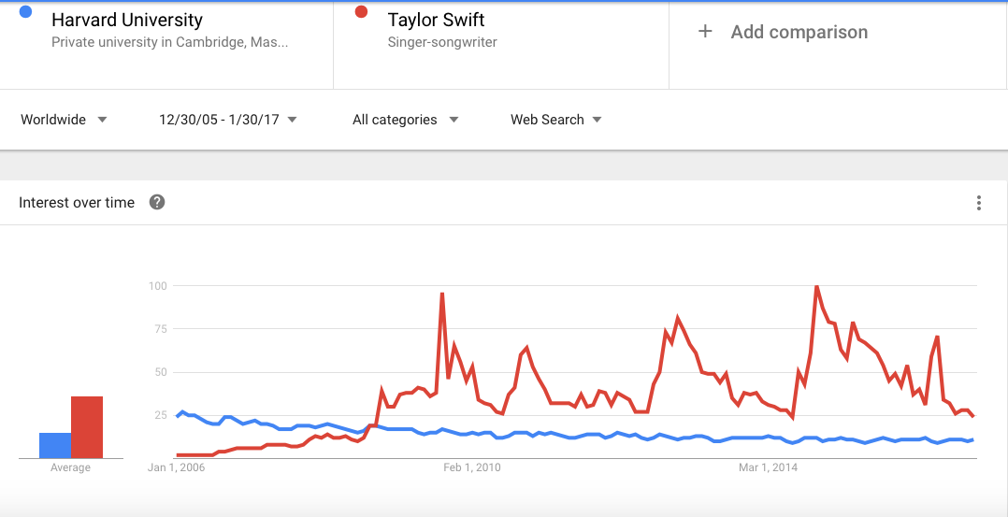
Google trends
https://www.google.com/trends/

Slide 30
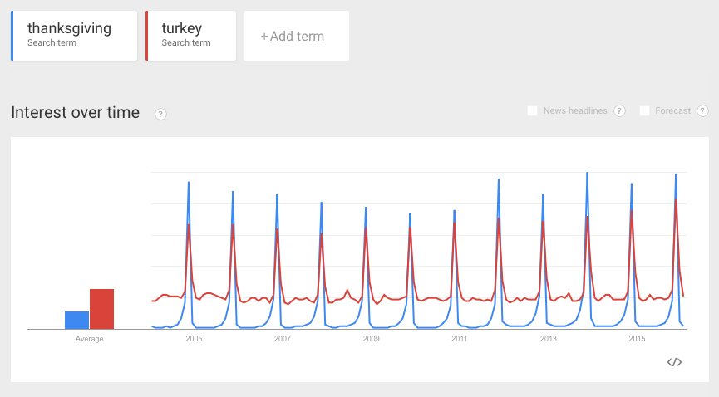
Correlations

Slide 31
Correlations
Find two search terms that are negatively correlated with each other
Find a search term that has two peaks in a year
Find a search term that has three peaks in a year

Slide 32
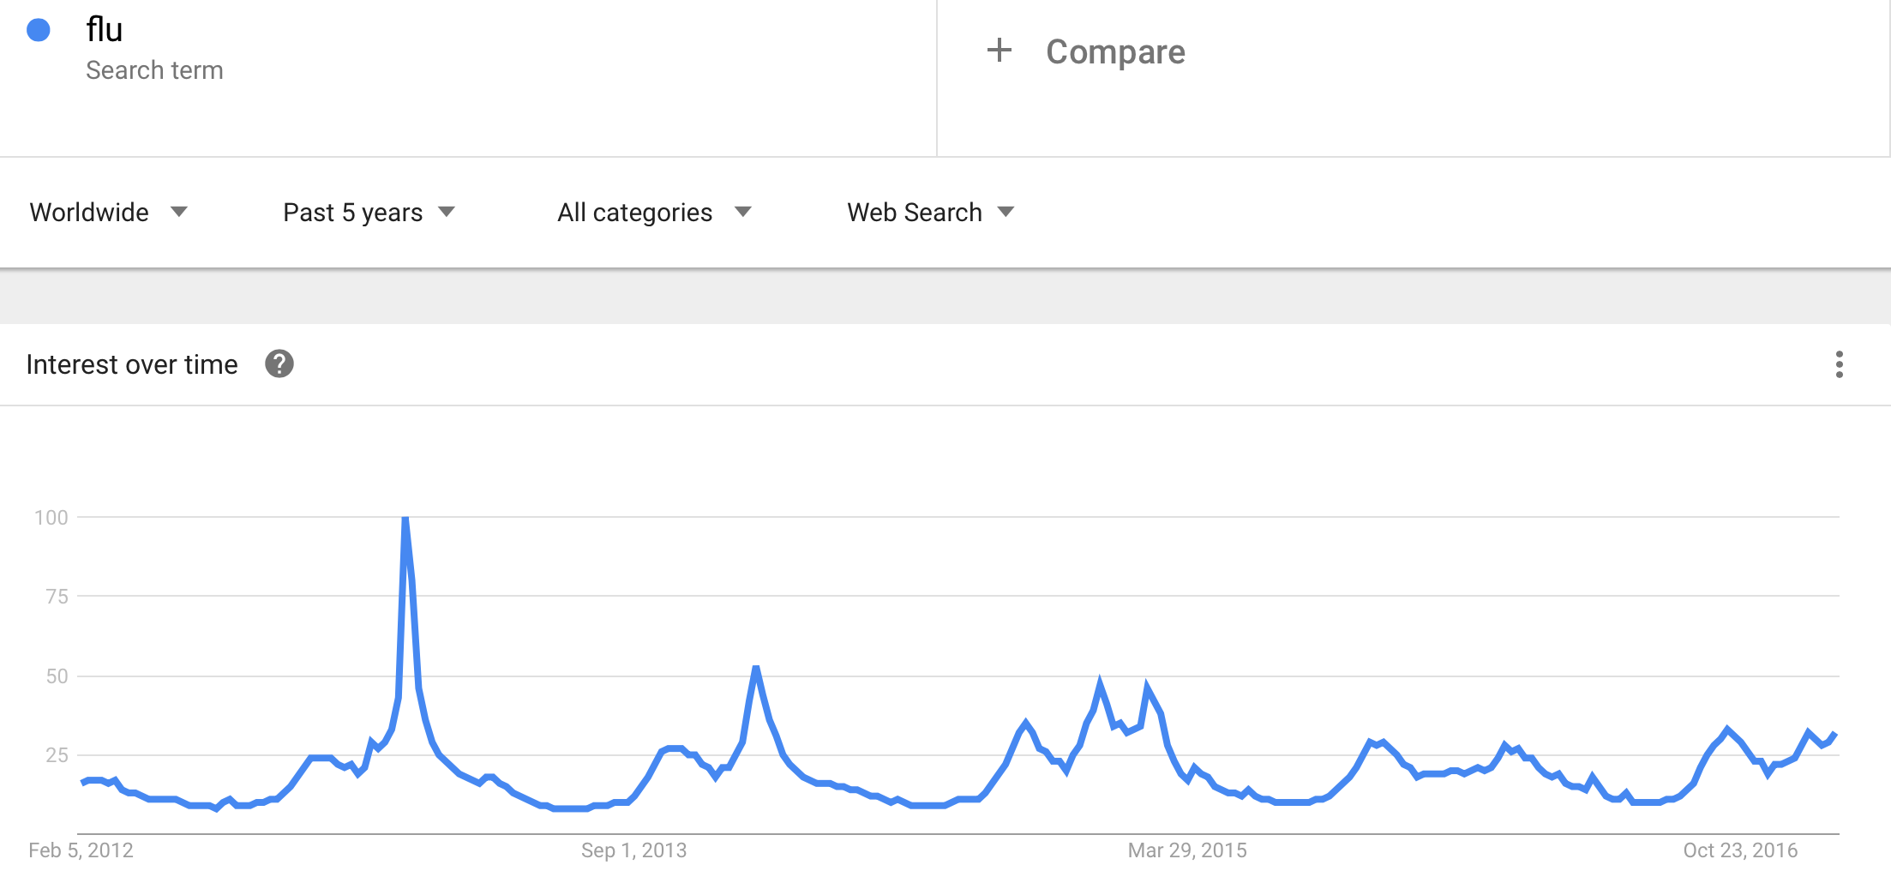
A tool for flu?
Notes:
2009 - Swine Flu

Slide 33
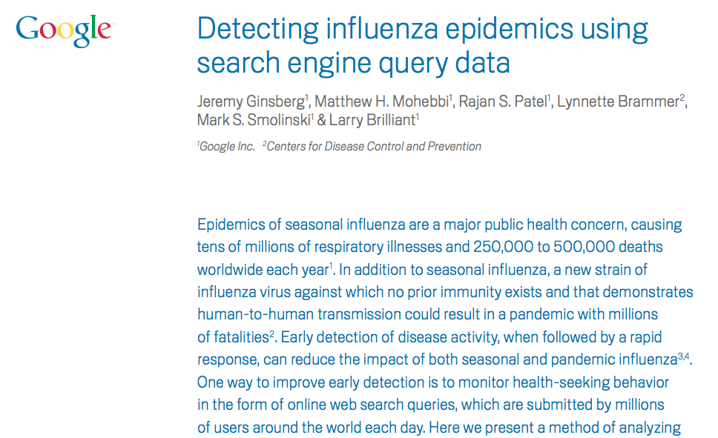
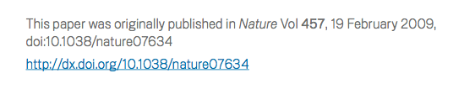
Notes:
Early detection though web search monitoring can enable counter measures

Slide 34
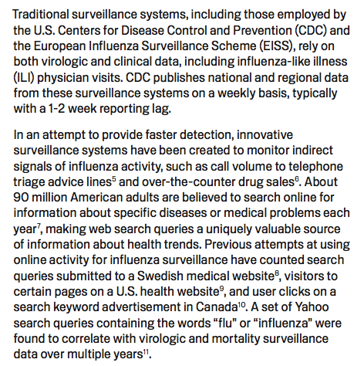
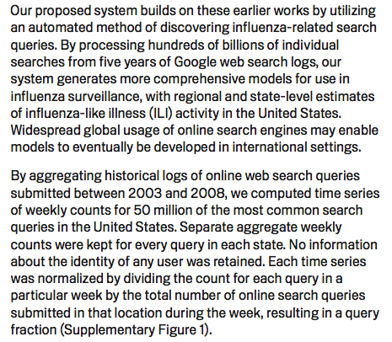
Overview
Their model
Notes:
CDC has good data on flu-related Dr visits but with 1-2 week lag.
Can we make an earlier forecast using online search queries?

Slide 35
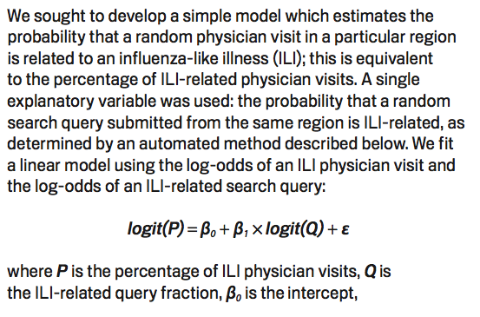

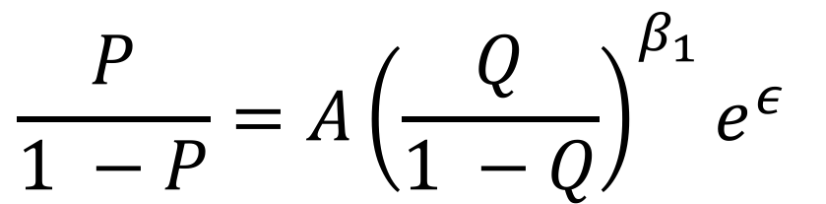
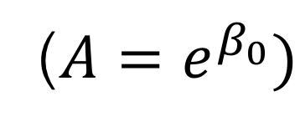
Queries to physician visits
After exponentiation:
$$\frac{P}{1 −P}=A{\left(\frac{Q}{1 −Q}\right)}^{β_{1}}e^{ε}$$
($A=e^{β_{0}})$
A power law:
Notes:
Correlate flu Dr visits to flu searches for later forecasting

Slide 36
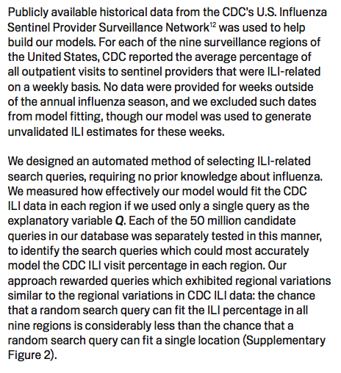
Obtaining search queries
“Taylor Swift”
CDC flu data
“Flu medication”
Time
Notes:
Training the model, i.e. fitting the parameters to data
Which search query trends match CDC?

Slide 37
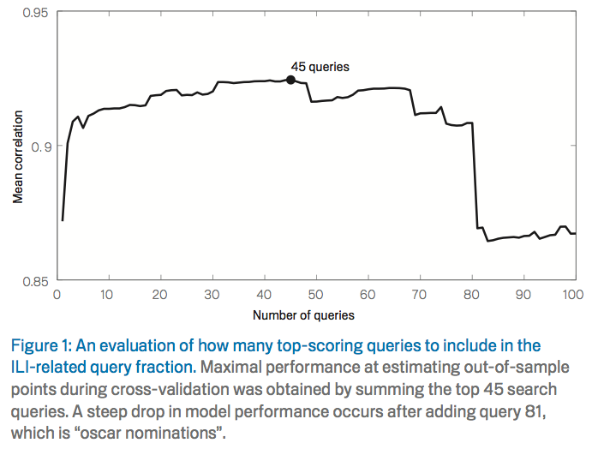
Finding a set of search terms

Slide 38
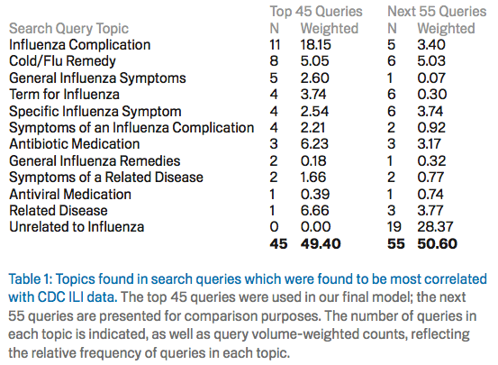
What terms are used

Slide 39
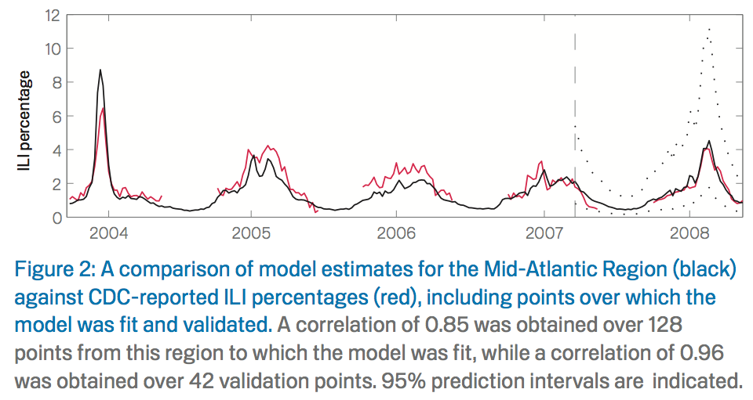
Validating the model

Slide 40
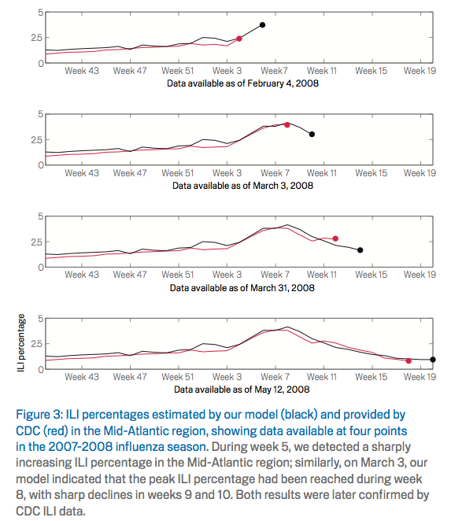
Faster than the CDC

Slide 41
Tuesday lab:
SIR model and Google flu data
Bring laptop to class

