Slide 1
Random walks
History of random walks
Basic theory of random walks
Einstein’s paper: using random walks to calculate the size of a molecule
Stock prices and random walks
Random walk presentation papers posted tonight

Slide 2
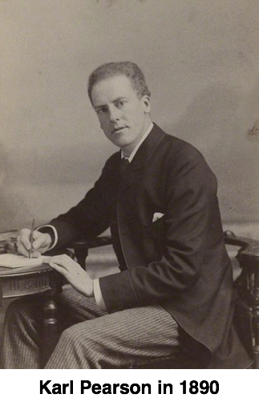
Karl Pearson (1857-1936)
English mathematician
Educated at King’s College, Cambridge
Founded the first university statistics department at University College London in 1911

Slide 3
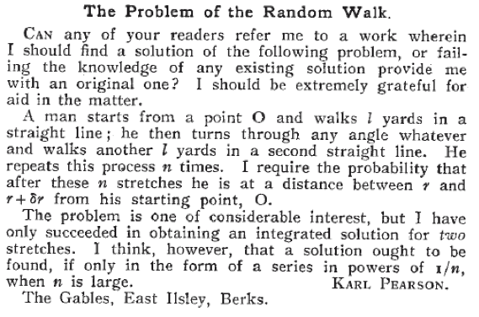
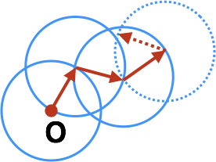
First use of the term “random walk”

Slide 4
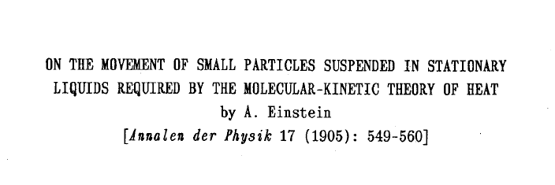
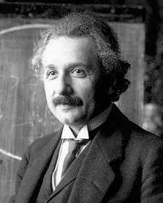
Einstein’s paper
If Pearson had been a careful reader of the literature, he could have found the answer from the (not yet famous) Mr. Einstein!
Notes:
Context: particle motion due to thermal vibrations

Slide 5
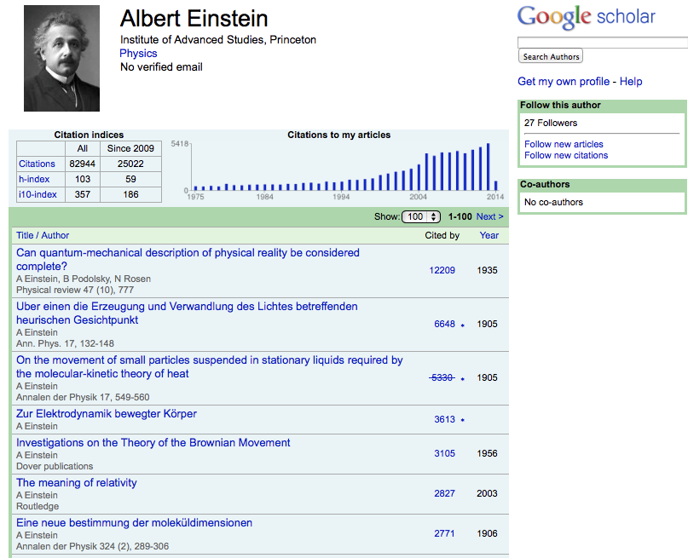
Despite being world-famous for developing special and general relativity, this is one of Einstein’s most highly cited papers.

Slide 6
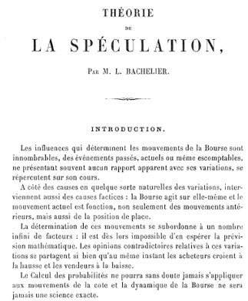
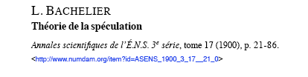
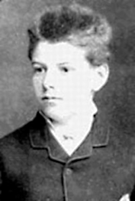
Actually, history is even more interesting
Bachelier beat Einstein to the theory of random walks by 5 years – when working on Stock prices

Slide 7
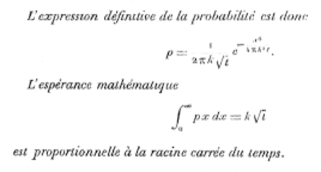
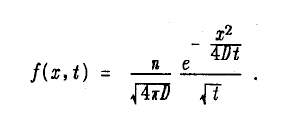

Different problem, same result
Bachelier’s result
Einstein’s result

Slide 8


What is a random walk?
Start at the origin

Slide 9
What is a random walk?
Start at the origin
Flip a fair coin

Slide 10
What is a random walk?
Start at the origin
Flip a fair coin
Walking rule: go right if heads

Slide 11
What is a random walk?
Start at the origin
Flip a fair coin
Walking rule: go right if heads
, left if tails

Slide 12
What is a random walk?
Start at the origin
Flip a fair coin
Walking rule: go right if heads
, left if tails
Prior history has no influence on next move

Slide 13
Question
How far do you travel after time T?

Slide 14
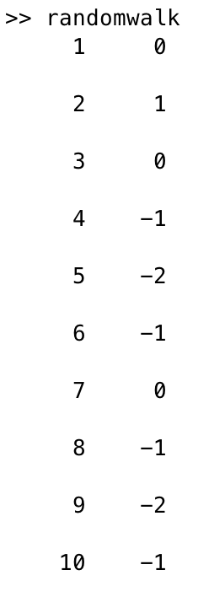
Random walk in Matlab
clear all;
close all;
%starting position
x = 0;
%number of steps
steps = 10;
%carry out steps
for i = 1:steps
%print results
disp([i, x])
if rand(1,1) < .5
x = x+1;
else
x = x-1;
end
end
randomwalk.m

Slide 15
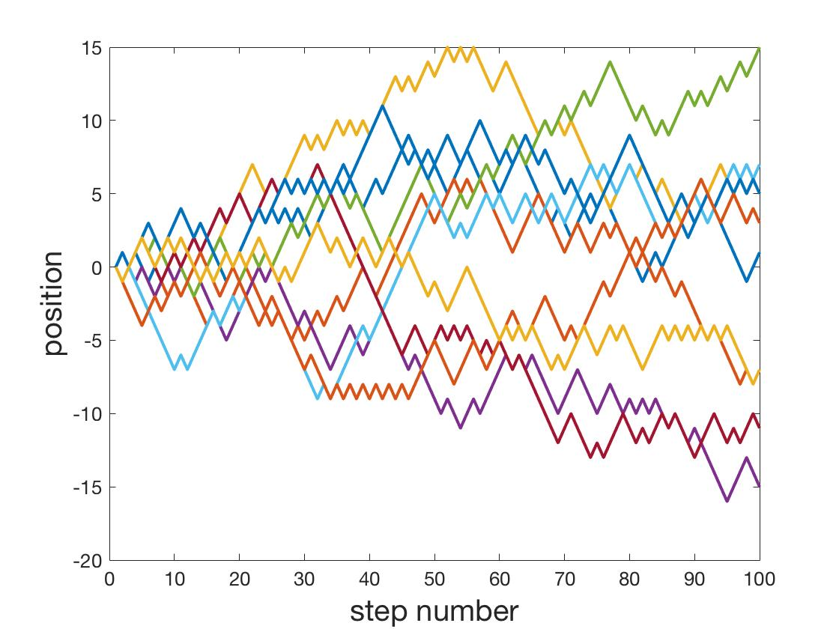
Ten 100-step random walks

Slide 16
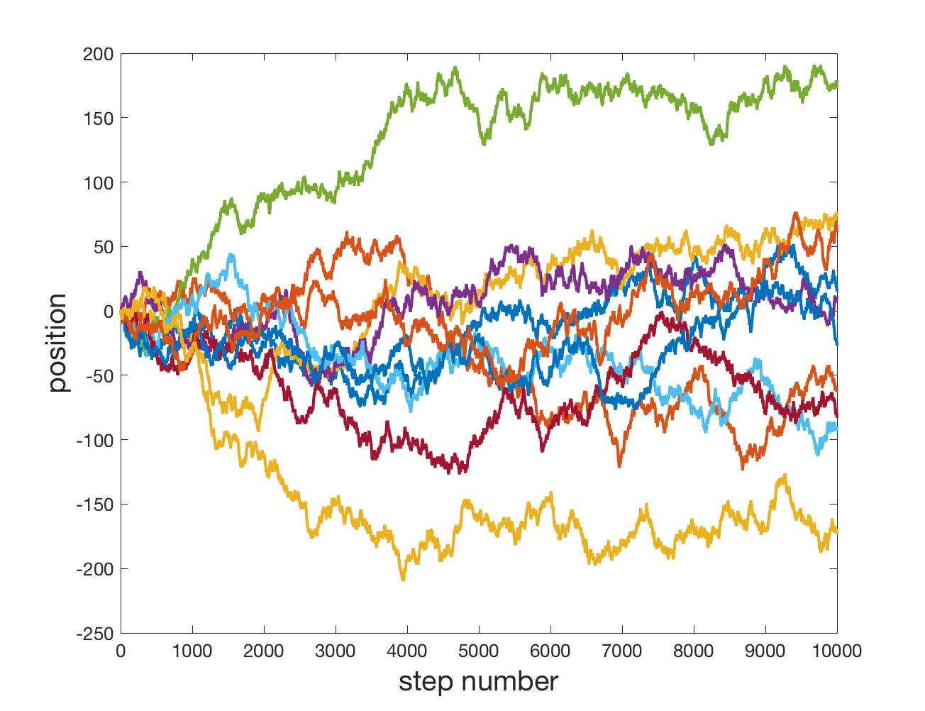
Ten 10000-step random walks

Slide 17
Matlab movie

Slide 18
Snapshots of the distribution

Slide 19
Width of the distribution

Slide 20
Turning walking rule into math
Walking rule: flip a fair coin and move right if heads, left if tails
Let be the probability of being at position $i Δx$ at time $n Δt$

Slide 21
The fundamental equation
MATH!
(AM 105)

Slide 22
Diffusion/heat equation

Slide 23
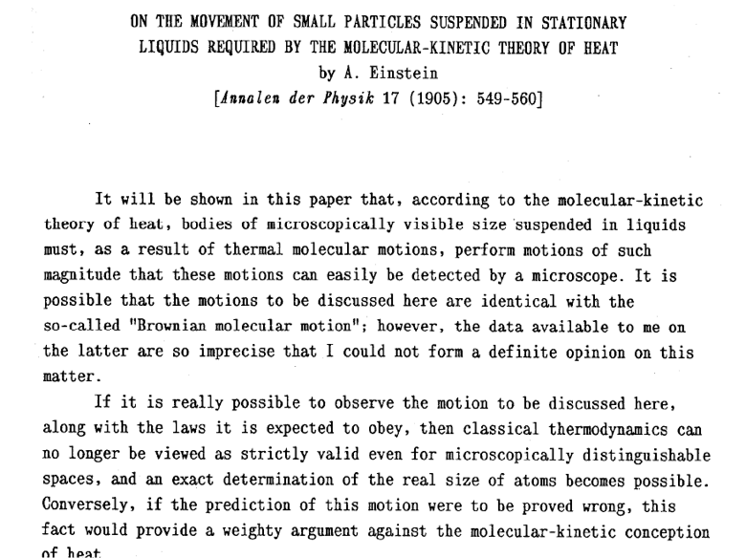
Einstein’s paper

Slide 24
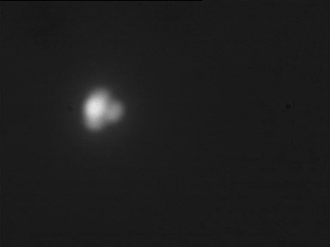
Main points
“Visible” (ie, micron sized) particles will jiggle around in a liquid. i.e. doing a random walk.
This is predicted on theoretical grounds, but had neither been observed nor expected.
Now it is easy to observe!
http://www.sciencemag.org/cgi/content/abstract/327/5965/560

Slide 25

Main points
“Visible” (ie, micron sized) particles will jiggle around in a liquid. i.e. doing a random walk.
2. Calculation of diffusion constant of the particles
This is predicted on theoretical grounds, but had neither been observed nor expected.

Slide 26
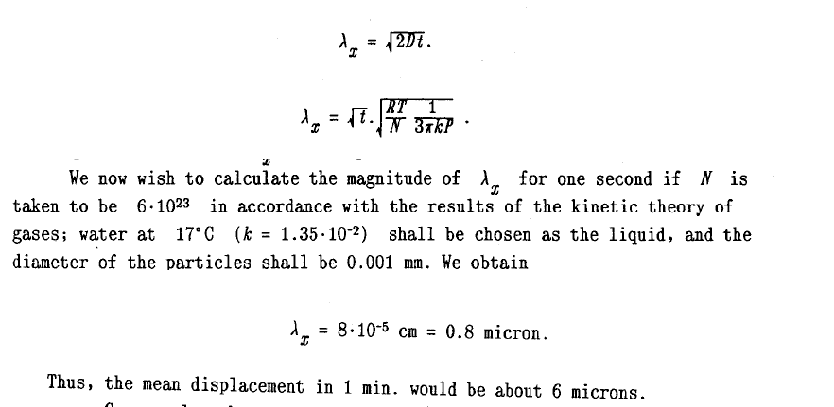

Slide 27
Random Walks and Stock Prices
This is a review article (not posted) ...

