Slide 1
Lecture 9
The continuum limit of a random walk
Einstein’s paper on particle diffusion
The Central Limit Theorem
Anomalous diffusion and Lévy flights

Slide 2
Discrete relation
Let p(x,t) be the probability of finding a walker at position x at time t
Probability of the walker being at x and time

Slide 3
Continuum limit
Subtract additional term from both sides
Additional manipulation
Taking limits while keeping D fixed leads to the partial differential equation
This is the diffusion equation (also known as the heat equation)

Slide 4
Solving the heat equation
Multiple approaches, such as the use of integral transforms
We’ll consider dimensional analysis and finding a similarity solution (see PDF document on website)
For more information, see Scaling by G. I. Barenblatt: a short, classic book on the subject
Available as a paperback and excellent summer reading)
Notes:
Solve heat equation on board

Slide 5
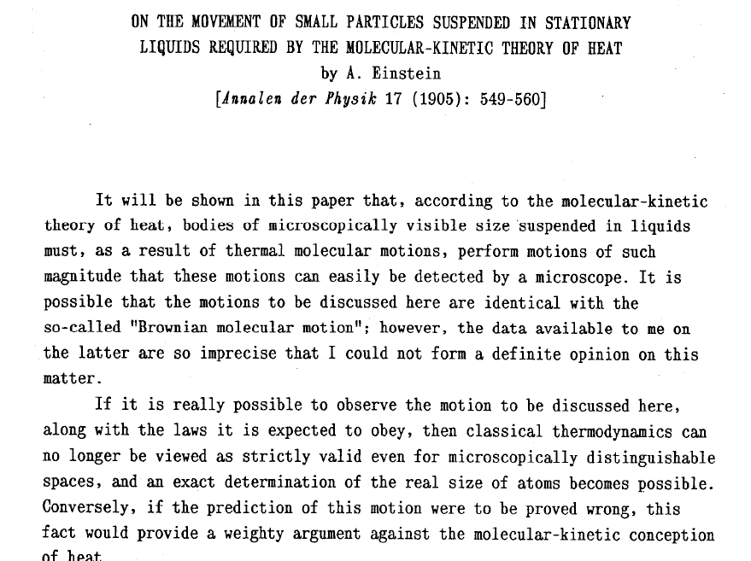
Einstein’s paper

Slide 6
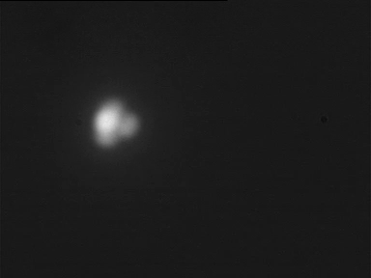
Summary
Visible (i.e. micrometer-sized) particles will jiggle around in a liquid (i.e. doing a random walk)
It was predicted on theoretical grounds, but it hadn’t been observed and it wasn’t expected
Nowadays this is easy to observe
http://www.sciencemag.org/cgi/content/abstract/327/5965/560

Slide 7
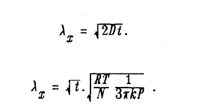
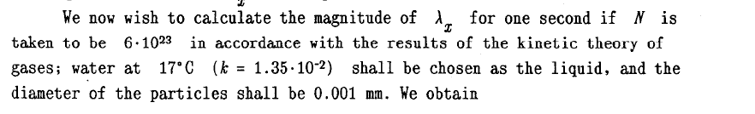
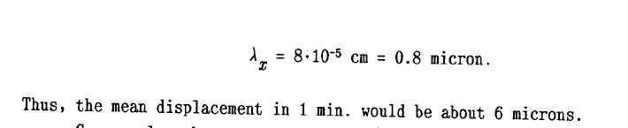

Slide 8
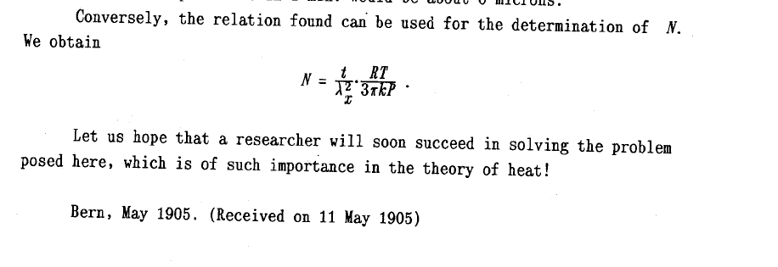

Slide 9
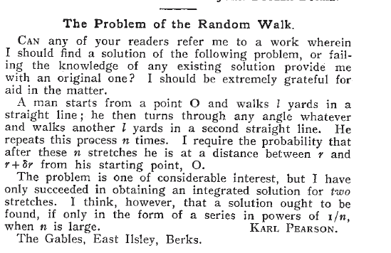
Do details of the walk matter?
In previous analysis, we started from a Bernoulli random walk, but this may not be reasonable for atomic motion
Does this have an effect on the analysis? Would we reach a different conclusion if we used a Pearson walk?
O

Slide 10
Shape of a 1D Pearson walk
Suppose we consider a one-dimensional projection of the Pearson walk
If is uniformly distributed, then
Input program
from random import random
from math import *
# Total trials and random walk length
trials=10000000; n=16
# Bin width and number
bw=0.05; num=1000
b=[[0]*num for i in range(n)]
for i in range(trials):
# Carry out a small random walk
x=0
for j in range(n):
# Pearson walk step
x+=cos(2*pi*random())
# Bin walk position
k=int((x/bw+num*0.5))
if k>=0 and k<num: b[j][k]+=1
# Output the frequency density
ift=1/(bw*float(trials))
for k in range(num):
# Assemble a list of entries on one line
s=[str(bw*(0.5+k-0.5*num))]
for j in range(n):
s.append(str(b[j][k]*ift))
# Print the line
print " ".join(s)
l
Example: many_rwalk2.py

Slide 11
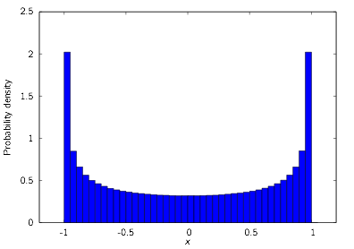
Pearson walk (1 step)

Slide 12
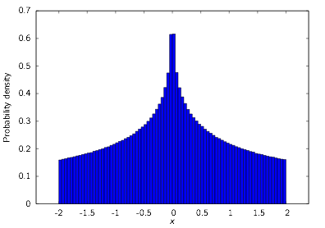
Pearson walk (2 steps)

Slide 13
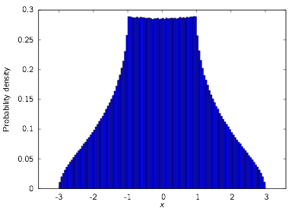
Pearson walk (3 steps)

Slide 14
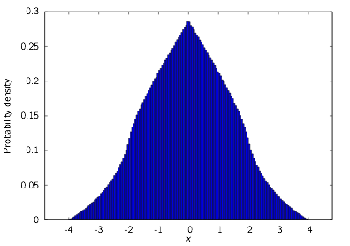
Pearson walk (4 steps)

Slide 15
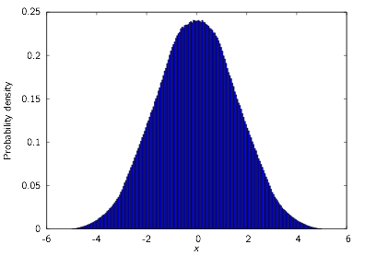
Pearson walk (5 steps)

Slide 16
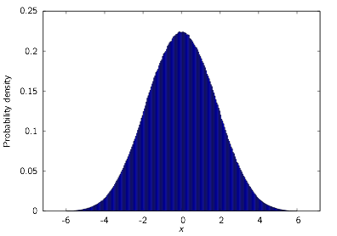
Pearson walk (6 steps)

Slide 17
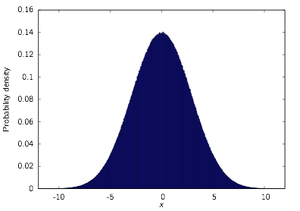
Pearson walk (16 steps)
Notes:
Even though the details of a single step are different, the distribution after 16 steps of the Pearson walk looks like a Gaussian, like Einstein’s continuum solution.

Slide 18
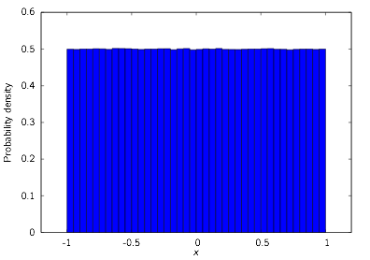
Uniform walk (1 step)
Notes:
x_i =x

Slide 19
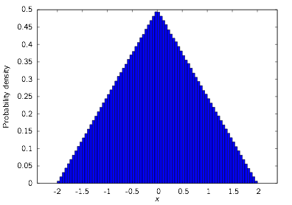
Uniform walk (2 steps)

Slide 20
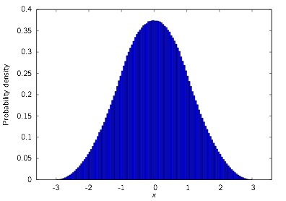
Uniform walk (3 steps)

Slide 21
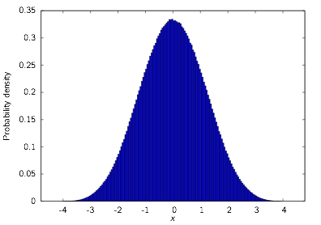
Uniform walk (4 steps)

Slide 22
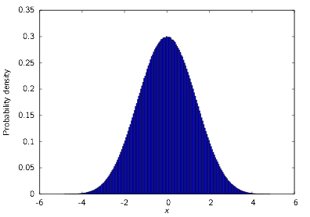
Uniform walk (5 steps)

Slide 23
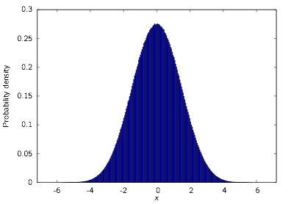
Uniform walk (6 steps)

Slide 24

Uniform walk (16 steps)
Notes:
After sixteen steps of the uniform walk, the probability distribution of the walker also looks like a Gaussian, although with a different width.

Slide 25
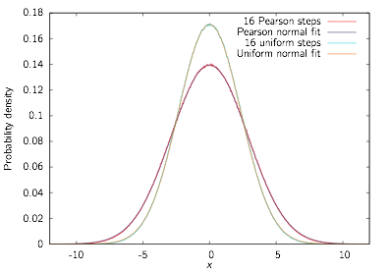


Fit to Gaussian distribution
Notes:
typo in p(x,t): negative exponent

Slide 26


Some facts about random numbers
If S and T are independent random variables then their means and variances are additive:
Suppose a random walk has independent steps Xi each with variance . The position after N steps is
The variance is

Slide 27

Variance calculation for uniform walk
For the uniform walk
Hence the expected width after 16 steps is
Agrees with calculated value of 2.32906 within sampling error
Notes:
var=sigma^2

Slide 28

Variance calculation for Pearson walk
For the Pearson walk
Hence the expected width after 16 steps is
Agrees with calculated value of 2.85589 to within sampling error

Slide 29
Central Limit Theorem
Consider a random walk where the steps Xi have mean and finite variance . Let
Consider the re-scaled random variable
Then the Central Limit Theorem states that Zn tends to a Gaussian distribution with mean 0 and variance 1. Its probability density is

Slide 30

Lévy flights: an example of anomalous diffusion
Not all cases are covered by the Central Limit Theorem
Consider taking steps from a Lévy distribution
Variance calculation
Since variance is unbounded, CLT does not apply

Slide 31
Sampling from a Lévy distribution
Choose uniformly between and and set
Cumulative distribution of X is
Hence PDF of X is
Hence X follows a Lévy distribution

Slide 32
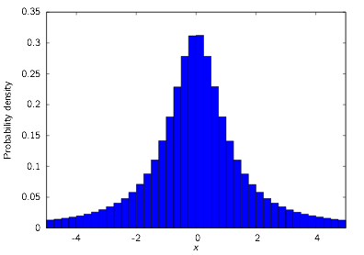
Lévy walk (1 step)
Notes:
The Lévy distribution is often referred to as a “fat-tailed” distribution, since there is much greater probability density in the tails than in a Gaussian. The tails decay like 1/x².

Slide 33
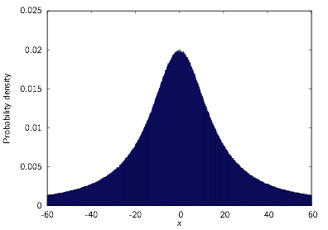
Lévy walk (16 steps)
Notes:
After sixteen Lévy steps, the random walker’s position follows a stretched Lévy distribution instead of a Gaussian.

Slide 34
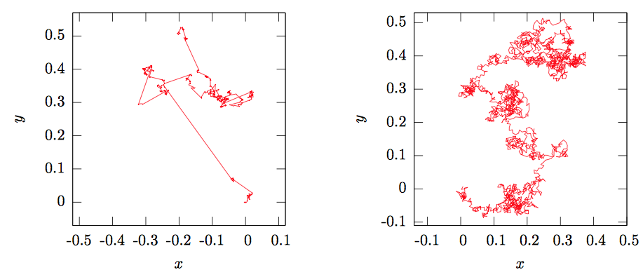
2D Lévy–Pearson comparison
Lévy
Pearson
Notes:
Lévy walks look very different to typical random walks, and highlight the behavior of taking very large steps from time to time.

