Slide 1
Administration
Lab 7
Homework 4
Monday Presentations
Today’s speaker
Aravi Samuel: Bacterial Random Walks

Slide 2

Last Class
What is a Random Walk?
Rule: Every time τ , flip a coin, and either move to the left (tails) or to the right (heads)
Question: How far do you go after time T?

Slide 3
Remark from last class
The essence of a random walk is that what happens in the future does not depend at all on what happened in the past.
At every stage, you just flip a coin.

Slide 4
Haven’t we done this before?
Remember Mostellar and the World Series?
(first week of class)
Suppose we give you a coin, and the probability of getting a heads is p. What is the probability of getting m heads out of N trials?
Playing a series is like flipping a coin N times
Rule: For every game, flip a coin, and either lose (tails) or win (heads)

Slide 5
Comparing the rules
Random walk rule: Every time τ , flip a coin, and either move to the left (tails) or to the right (heads)
Baseball rule: For every game, flip a coin, and either lose (tails) or win (heads)
Question
Are unbiased random walks and series against evenly
matched teams equivalent problems?
Discuss with your neighbor!

Slide 6
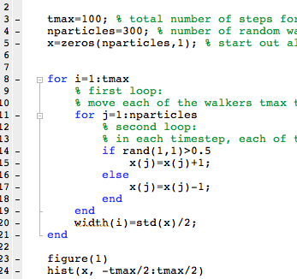
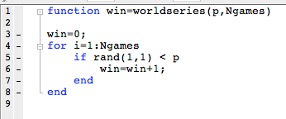
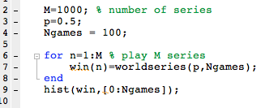
Let’s re-examine our simulations
Lab 7
Lab 1

Slide 7
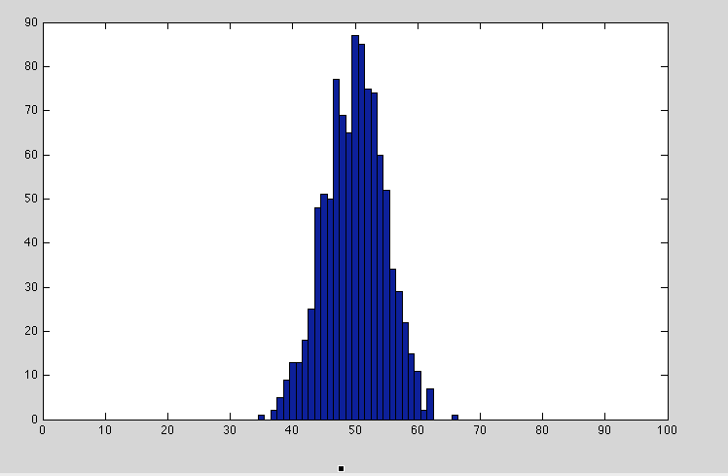

Slide 8
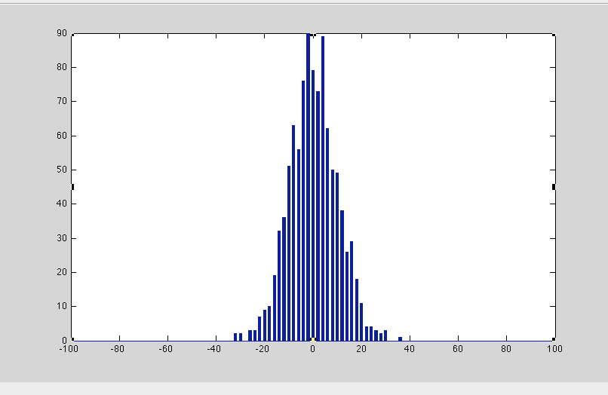

Slide 9
Rename a few variables and the codes look very similar
Plots are qualitatively similar
But the equations look very different
Baseball
Random walks

Slide 10
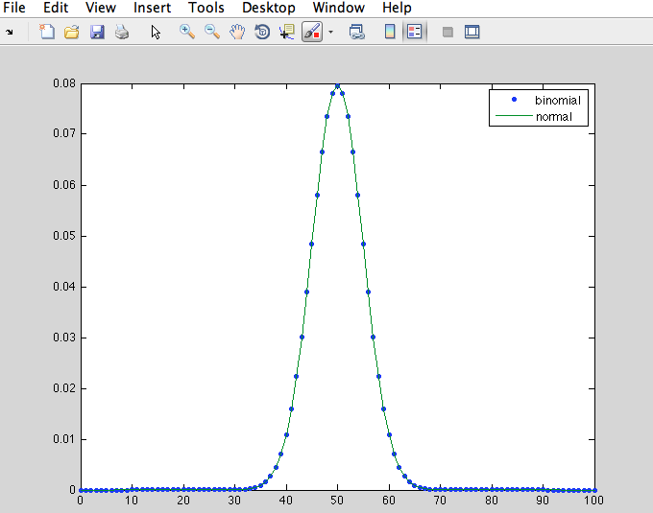

Slide 11
When N is large
Stat 110/111, AM 101
A fun exercise. Use Stirling’s approximation:

