Slide 1
Random Walks
Final project details
Stock Option pricing
Black–Scholes(–Merton) Equation
AM cake today (every Thursday) in Pierce 307B, 2:40pm

Slide 2
Final project
Worth 30% of the course grade
May be done with a partner or individually
Graded out of 80 points
Deadline: 5pm on May 3 (last day of Reading Period)

Slide 3
What are we looking for?
We are looking for you to Apply Mathematics
“Apply” – we want you consider some real-world question and not just something purely abstract. You should think about how you can mathematically model the real world.
“Mathematics” – we want your project to have some scope for doing some significant mathematics.
Another viewpoint: what question are you trying to answer and why would other people care about it?
While many projects involve some programming, purely analytical projects are also allowed.

Slide 4

Length guideline
For text and figures:
7 pages for individual project
12 pages for pair project
This is a highly approximate guideline. The exact length is not important. Depending on the topic, some projects may be longer, and some may be shorter. The key issue is how much did you accomplish.
Text should be clear and concise: see The Elements of Style by Strunk, White, and Kalman

Slide 5
Project proposal
Consider project ideas over the next few weeks. Your project could relate to one of the topics covered in class, or could be about a completely different subject. Please discuss with the teaching staff.
Project proposal due by April 6th at 5 PM, and consists of a half-hour meeting with a Margo.
May optionally submit a half-page overview of project prior to meeting
5 points automatically awarded for doing this.
Meetings arranged by appointment. Good days:
3/8, 3/9, 3/10, 3/27, 3/28, 3/29, 3/30, 3/31, 4/3

Slide 6
Grading breakdown: content
Topic | Points
Project proposal completed by April 6th, 5 PM | 5
Project motivation: what problem are you trying to solve? What has been done before in this area? If appropriate, cite any relevant books and papers. | 10
Project methods and results: what mathematics and/or code did you develop for your problem? Where appropriate, did you consider mathematical analyses of your approach? Is the mathematics/code that you developed correct? | 26
Project conclusions: did you solve what you set out to do? What are possible limitations and problems with your approach? How you could you develop the project further? | 9
Total for content: 50 points

Slide 7
Grading breakdown: style
Topic | Points
Written material: clear, correct grammar and spelling, appropriate citations | 30
Figures (if any): clear, properly labeled
Code listings (if any): clear, well commented
Total for style: 30 points
Grand total (content + style): 80 points

Slide 8
Rough guideline for layout
Abstract: a short, concise summary of your paper
Introduction: background information about your project and your original motivation. References to any relevant papers.
Methods: description of all of the methods (mathematics, coding, etc.) that you used
Results and discussion: Explain your results, including your graphs, why they are important and why we should care. Critically examine the quality of your results and the quality of your models.
Conclusion: a quick round-up of the main points that you learned, plus possible future work
References

Slide 9
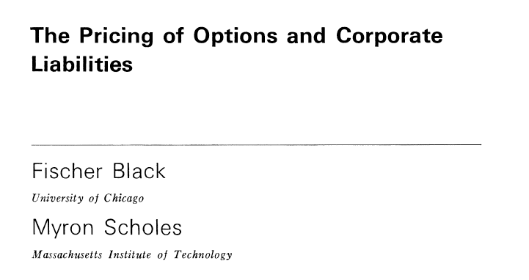
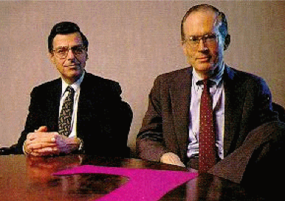
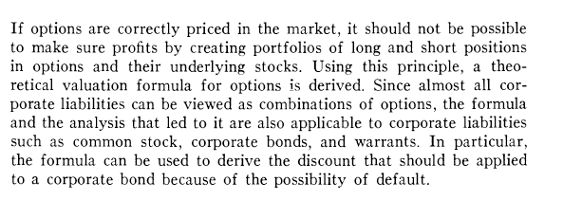
Option Pricing
1973
Notes:
1997 Nobel Prize in Economics
Went to Scholes and Merton (Black died in 1995). Merton MIT
Work laid the foundation for the rapid growth of markets for derivatives

Slide 10
Jargon
Stock – share of a company
Derivative – broad financial term to describe financial instrument whose value is derived from that of other assets, e.g.
stocks
bonds
commodities (oil prices)
other indices (weather, etc.)
Primarily used for managing risk, or hedging

Slide 11
Jargon
Call option – The right, but not the obligation, to buy some asset in the future at a fixed price that is agreed upon today, called the strike or exercise price.
Put option – The right, but not the obligation to sell an asset in the future at a price determined today.
The person buying the option is said to be in a long position: if they keep the option they won’t make money for awhile.
The person selling the option is said to be in a short position.

Slide 12

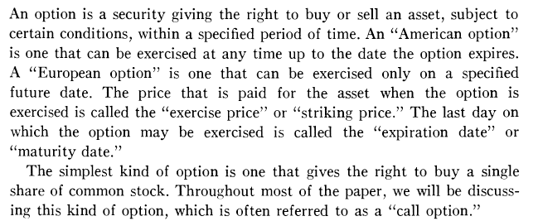

Slide 13
Jargon
5 Minute Break
Explain the jargon to your neighbor

Slide 14
Example – Call Option
You have a June call option for Microsoft with a strike price of $30 for 100 shares. If the price today is $20 and it rises to $40, would you exercise your option?
Yes, you would exercise your call option and buy Microsoft stock for $30, earning $10 in profit
The seller writes the call option contract and the owner (buyer of contract) has the option to buy the said stock at the given value
Note: seller is required to sell, but buyer isn’t required to buy
The seller must give the buyer $10
Hence, the option contract costs money; the price depends on the strike price, the length of time, risk, etc.
Notes:
I will exercise my option if
Stock price > strike price (+ cost of option)
Not quite $10 profit. This doesn’t take into account how much you paid for the option! Option contract costs money!

Slide 15
Option Pricing
Note the option is an insurance contract. The question of valuing options is really thus the question of how much to charge for insurance.
How do we value this?
We do not know what is going to happen to the stock price
Notes:
How much should we charge for the option? What is the value of the option?
Value of option depends on strike price and the future stock price but we don’t know the stock price

Slide 16
Example – Call Option
You have a June call option for Microsoft with a strike price of $30 for 100 shares. Suppose the price today is $20 and, as of today, there is a 1/3 chance each that the stock will go up to $27, to $33, or to $39.
How much should you charge for the option?
5 Minute Break
(Solve this problem with your neighbor)
How much money do you make?
If stock is $27, the option is worthless. PAYOFF = 0
If stock is $33, the option is worth $3. PAYOFF = $3
If stock is $39, the option is worth $9. PAYOFF = $9
Expected payoff = 1/3 * 0 + 1/3 * 3 + 1/3 * 9 = $4
Thus you should charge at least this much for the option
Notes:
How much money do I expect to make?
Payoff = 1/3*max(27 – 30, 0) + 1/3*max(33 – 30, 0) + 1/3*max(39 – 30, 0) = 1/3 sum max(stock price – strike price, 0)
If I expect to make $4 from exercising the option, then I should charge at least $4 for the option. Option price should be >= $4.
Expected value of stock is 1/3*(27 + 33+ 39) ~ $25
E[stock] ~ 25
E[payoff] = 4

Slide 17
Example – Call Option
You have a June call option for Microsoft with a strike price of $30 for 100 shares. Suppose the price today is $20, and as of today, there is a 1/3 chance each that the stock will go up to $30, to $40, or to $50.
Does the value of the option change?
How much money do you make?
If stock is $30, the option is worthless. PAYOFF = 0
If stock is $40, the option is worth $10. PAYOFF = $10
If stock is $50, the option is worth $20. PAYOFF = $20
Expected payoff = 1/3 * 0 + 1/3 * 10 + 1/3 * 20 = $10
The value of the option should change. (The expected value of the stock also changes—it is now $40/share.)
Notes:
Payoff = 1/3*max(30 – 30, 0) + 1/3*max(40 – 30, 0) + 1/3*max(50– 30, 0) = 1/3 sum max(stock price – strike price, 0) = $10.
Expected value of stock is 1/3(30 + 40+ 50) = $40
E[stock] ~ 40
E[payoff] = 10

Slide 18
Example – Call Option
You have a June call option for Microsoft with a strike price of $30 for 100 shares. If the price today is $20, and as of today, there is a 1/3 chance each that the stock will go up to $21, to $40, or to $59.
Does the value of the option change?
How much money do you make?
If stock is $21, the option is worthless. PAYOFF = 0
If stock is $40, the option is worth $10. PAYOFF = $10
If stock is $59, the option is worth $29. PAYOFF = $29
Expected payoff = 1/3 * 0 + 1/3 * 10 + 1/3 * 29= $13
The value seems to depend both on the expected value of the stock and on the volatility
Notes:
E[stock] = 40 as on previous slide. There is more variability in the stock price though.
E[payoff] = 13
Expected value is the same as on previous slide but payoff is more.
Option price seems to depend on E[stock] and stock volatility

Slide 19
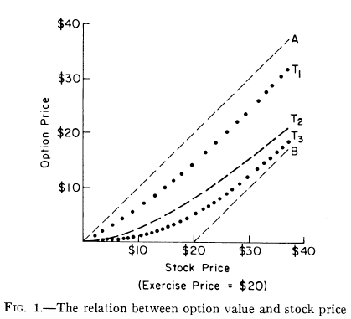
Option Price vs. Stock Price
Line A
Maximum value of option
Line B
Minimum value of option
T1, T2, T3
values at successively shorter maturities.
Note: Exercise Price = Strike Price
Notes:
Current value of option ~= stock price – strike price

Slide 20
Option Price vs. Stock Price
Why does the option value approach line B as the time to maturity shrinks?
Intuitively, what determines where it starts (A) and ends (B)?
5 minute break to discuss with your neighbor
Note: Exercise Price = Strike Price
Notes:
As time to maturity shrinks, the option price should be closer and closer to the strike price because there’s more certainty about the price of the stock?

Slide 21
Which is more volatile?
Suppose I have:
$100 in stock
$100 in options
Which is more likely to change in value?
Note: Exercise Price = Strike Price
Notes:
The option is more volatile. Why?
“the curve representing the value of an option will be concave upward. Since it is also below the 45 degree line, we can see that the option will be more volatile than the stock. A given percentage change in stock price … will result in a larger percentage change in the option value”

Slide 22

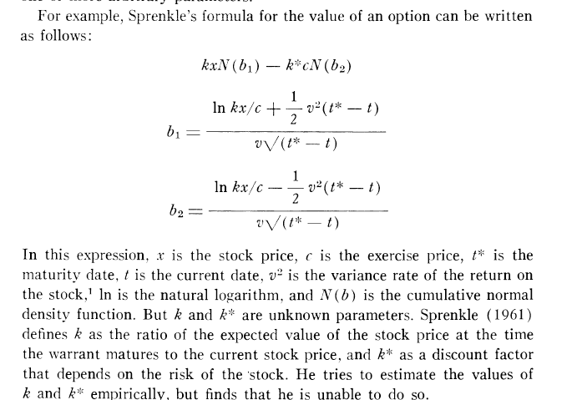
Other formulas, before Black Scholes
Notes:
Difficulty in getting parameters

Slide 23
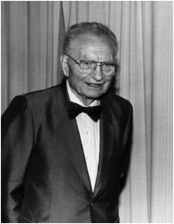
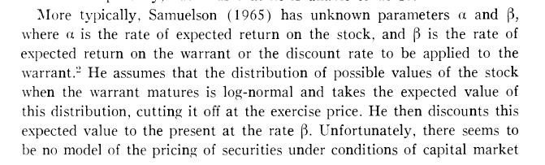
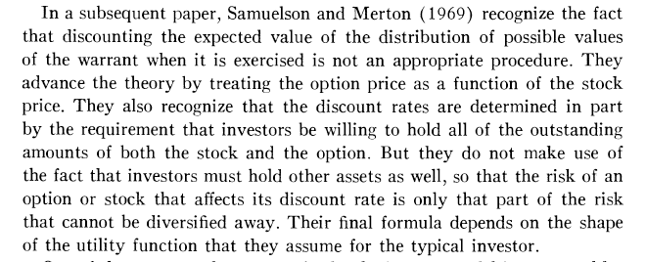
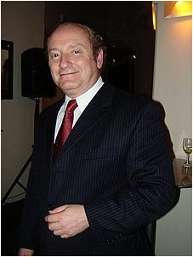
Paul Samuelson
Robert C. Merton
Notes:
warrant is like an option but offered by company and longer term

Slide 24

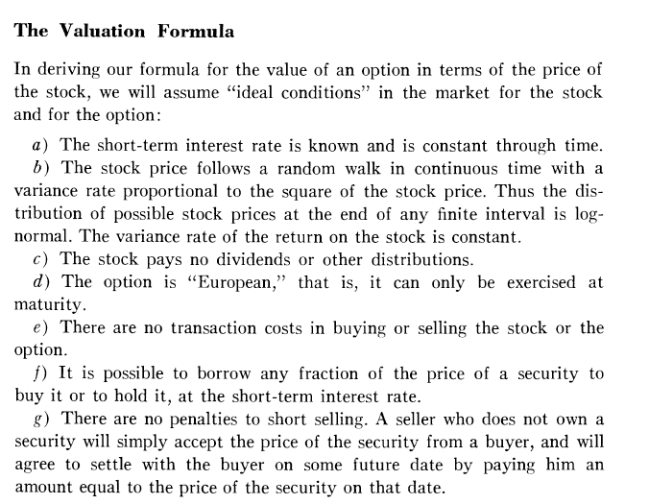
Discuss these assumptions with your neighbor.
Decide which one bothers you the most.
Notes:
Not constant. https://data.oecd.org/interest/short-term-interest-rates.htm. Fairly constant from 2010 – 2015. Big changes from 2008 (~5%) – 2010 ( < 1%).
Lab/HW
If you own a stock you get paid for owning that stock, ie, you get a dividend.
Okay
These costs always exist
What is a security – the stock!?
Prob not true for European option

Slide 25
This assumption will show up in lab and homework

Slide 26

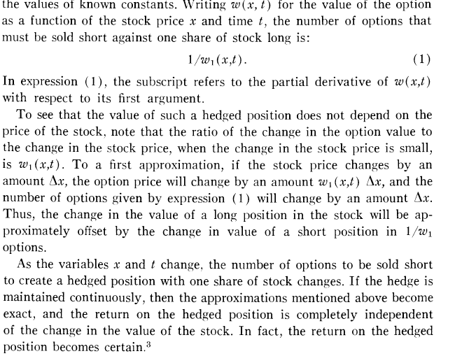
Hedging
Notes:
w1=dw/dx

Slide 27
Main Idea
Consider a portfolio with stocks and options
When stock goes up, you lose money on the options and vice versa
Such a portfolio (if perfectly balanced) has no risk
Thus the portfolio increases at the risk-free interest rate, “r”

Slide 28

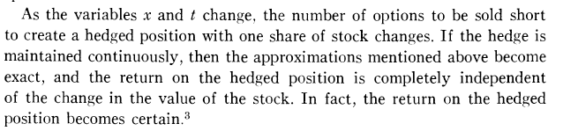

Discuss with your neighbor the main idea.
Convince yourselves that it is both true and nontrivial.

Slide 29

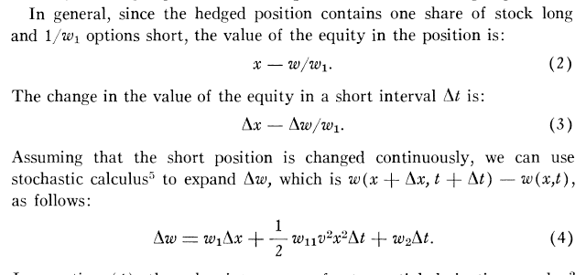
Derivation
Requires Stochastic Calculus
NOTE: This assumes rates of stock change obey a random walk

Slide 30
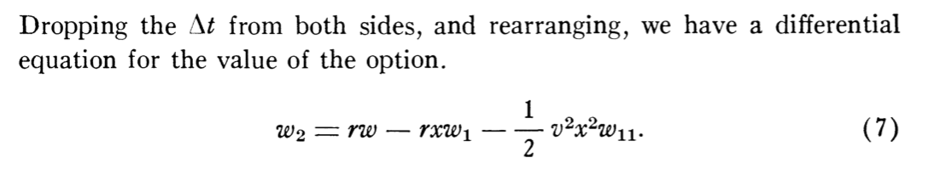



Black-Scholes Equation
where
A sort-of-diffusion equation
Notes:
w = price of option
r = risk-free interest rate
v = volatility of stock
x = stock price

Slide 31

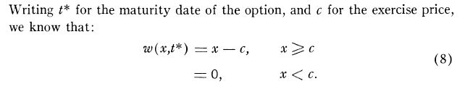

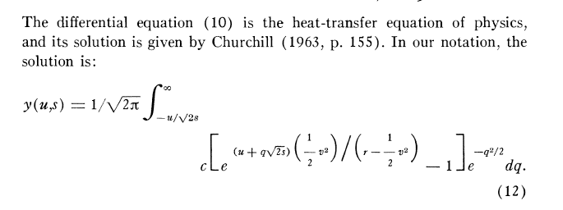
change variables and solve...
Solution to equations like this covered in AM 105
Notes:
w = x – c (option price = stock price – exercise price). Then another complicated substitution w(x,t) = exp(r(t – t*)) y ….
Substitutions give the diffusion equation y_t = y_xx

Slide 32
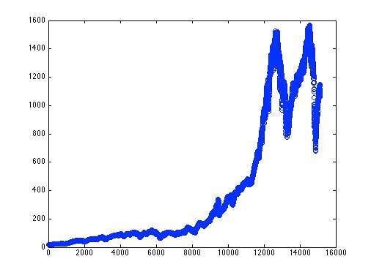
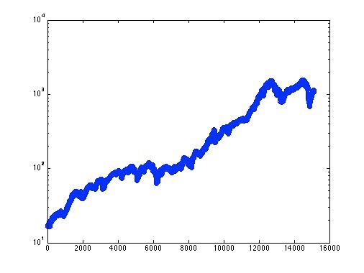
S&P 500 Prices
Central question in lab and homework: do stock prices follow random walks?
price
log(price)
16000 days (1953–present)

