Slide 1
Cancer Prediction with Deep Learning

Slide 2
Truncation

Slide 3
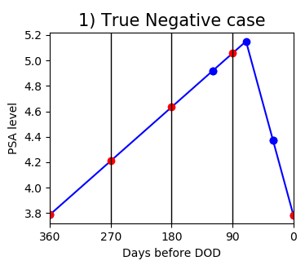
Interpolation
생검 진단일(마지막 PSA 검진일+30일)으로부터 360, 270, 180, 90, 0일
720, 630, 540, 450, 360, 270, 180, 90, 0일
0~12개월

Slide 4
학습 feature 처리
학습 FEATURE: Age, PSA_Average(PSA_ewm), PSA_delta#
**
파란점 간 평균: PSA_Average
생검날짜에 가까운 검사 결과 일수록 가중치 둔 평균: PSA_ewm
PSA_delta3
PSA_delta2
PSA_delta1

Slide 5
Table 1: Distribution of subjects’ age
 | Total | Benign | PCa
Number of subjects | 1,843 | 1,201 | 642
Range | 8-95 | 33-95 | 8-90
Average | 68.83 | 67.90 | 70.57
SD | 9.00 | 9.22 | 8.31
SEM | 0.2096 | 0.2659 | 0.3279
P-value | 1.000 | 0.0061 | <.0001

Slide 6
Table 2: Distribution for number of PSA counts per corresponding biopsies
 | Total | Benign | PCa
Number of subjects | 1,843 | 1,201 | 642
Range | 2-22 | 3-22 | 2-22
Average | 5.72 | 5.83 | 5.51
SD | 3.46 | 3.46 | 3.44
SEM | 0.0806 | 0.1000 | 0.1358
P-value | 1.000 | 0.3772 | 0.1794

Slide 7
Table 3: Distribution for the average PSA levels per corresponding biopsies
 | Total | Benign | PCa
Number of subjects | 1,843 | 1,201 | 642
Range | 0.23-20 | 0.23-20 | 0.29-20
Average | 6.15 | 5.73 | 6.95
SD | 4.19 | 3.77 | 4.77
SEM | 0.0975 | 0.1087 | 0.1884
P-value | 1.000 | 0.0037 | 0.0002

Slide 8
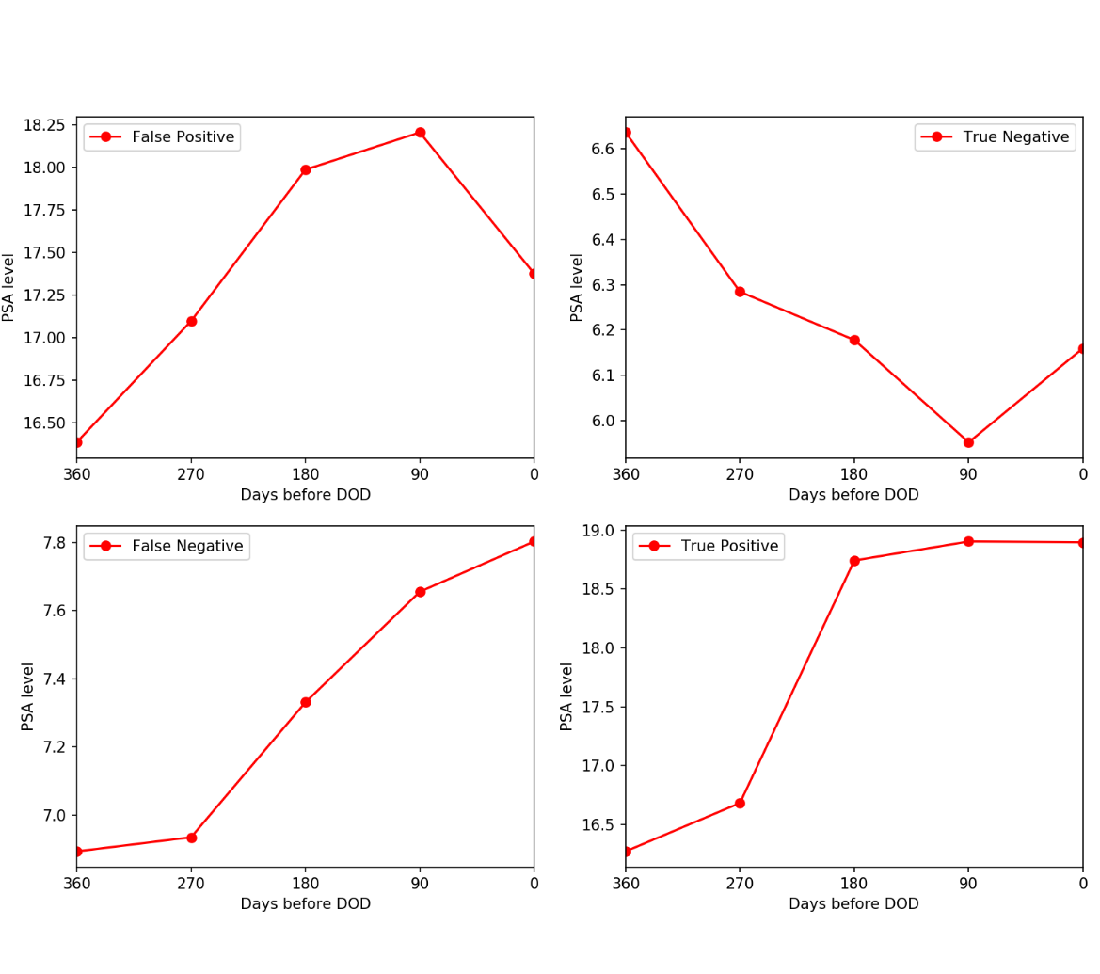
Model 1. Logistic Regression
False Positive
True Negative
accuracy: 65.17% (+/- 1.67%)
precision: 51.66% (+/- 12.02%)
recall: 23.11% (+/- 16.16%)
False Negative
True Positive

Slide 9
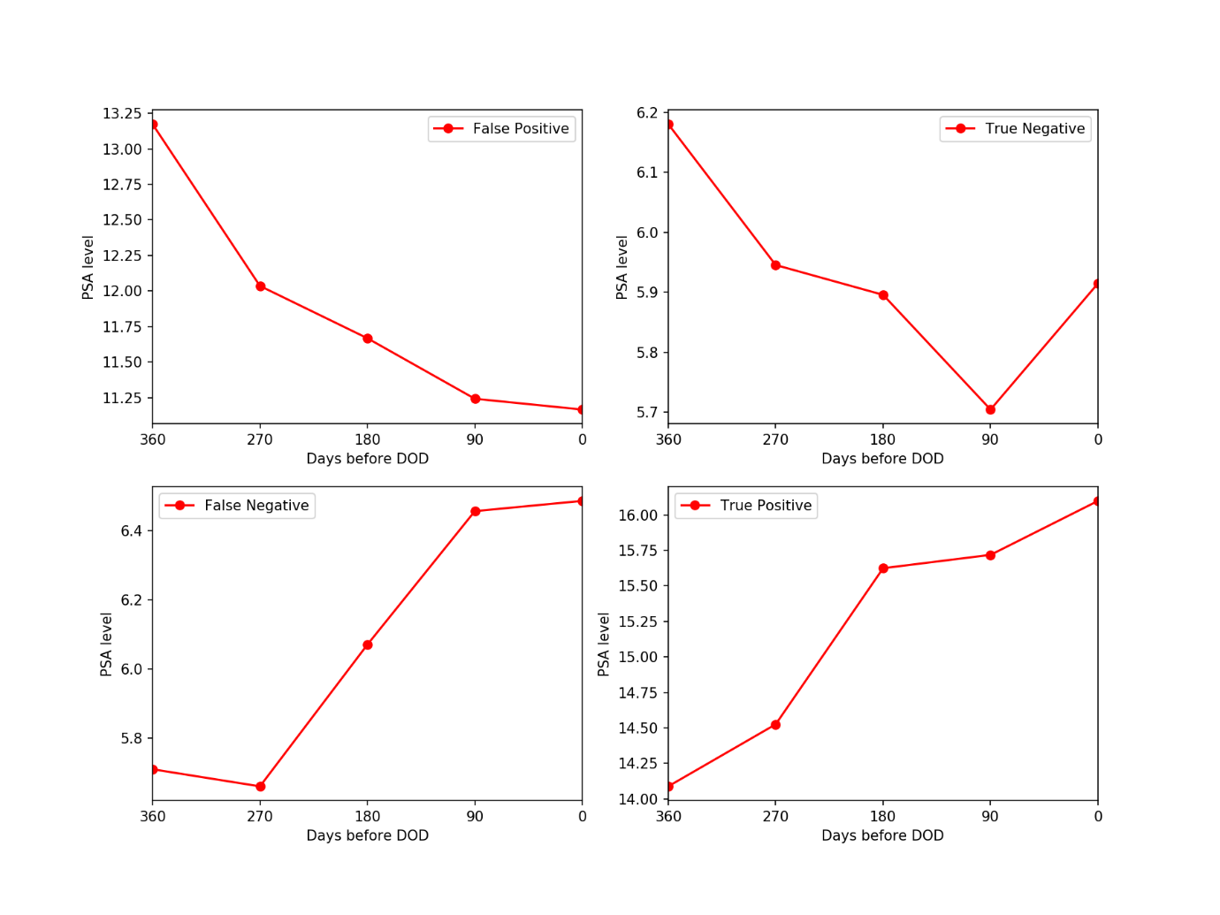
Model 1. Logistic Regression
False Positive
True Negative
accuracy: 65.60% (+/- 2.54%)
precision: 54.47% (+/- 11.88%)
recall: 21.05% (+/- 17.21%)
**학습변수 PSA_average 대신 PSA_ewm
False Negative
True Positive

Slide 10
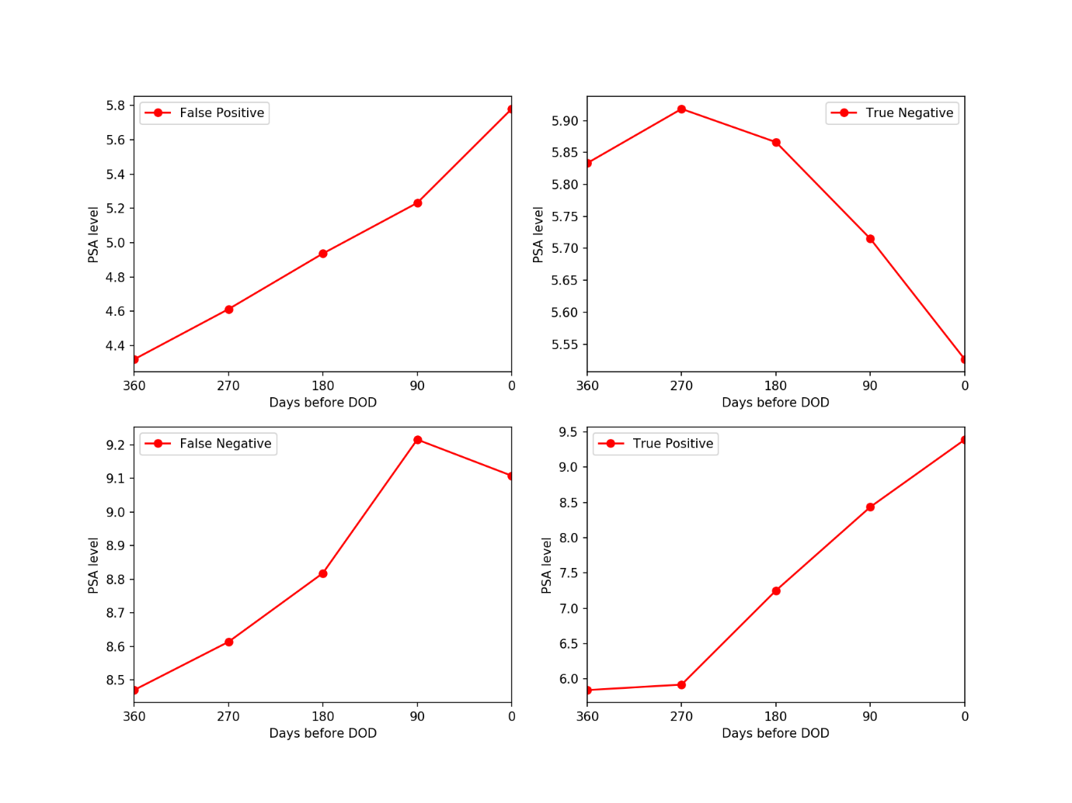
Model 2. Gaussian Naïve Bayes
False Positive
True Negative
Test Accuracy: 0.6973
precision recall f1-score support
benign 0.74 0.85 0.79 126
PCa 0.54 0.37 0.44 59
accuracy 0.70 185
macro avg 0.64 0.61 0.62 185
weighted avg 0.68 0.70 0.68 185
**PSA360, PSA270, PSA180, PSA90, PSA0, Age, PSA_average 학습변수
False Negative
True Positive

Slide 11
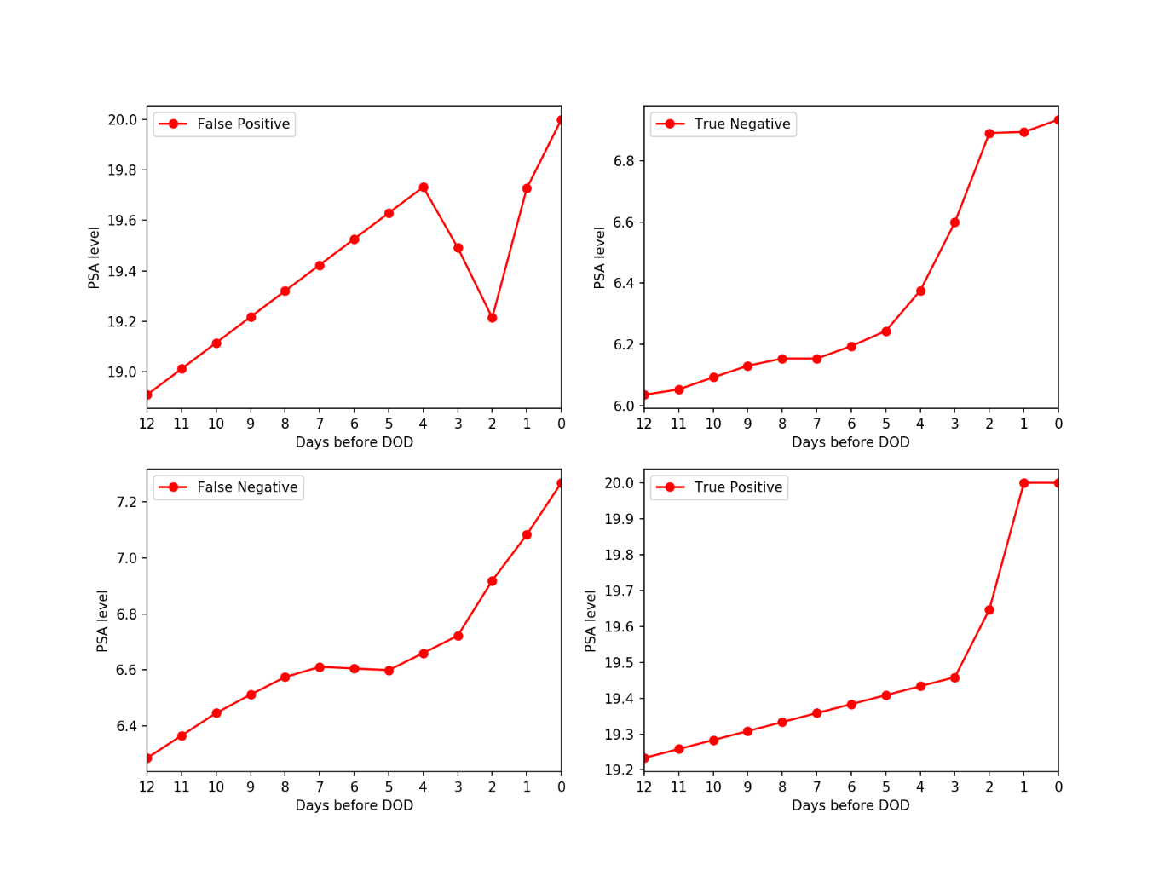
Model 3. Long short-term memory (LSTM)
False Positive
True Negative
Test accuracy: 0.6864865
precision recall f1-score support
benign 0.69 0.97 0.80 123
PCa 0.67 0.13 0.22 62
accuracy 0.69 185
macro avg 0.68 0.55 0.51 185
weighted avg 0.68 0.69 0.61 185
**PSA0m~PSA12m 학습변수
False Negative
True Positive

Slide 12
Truncation >30 | Accuracy | Precision | Recall | F1-score
Logistic Regression | 0.7081 | 0.69 | 0.71 | 0.65
Naïve Bayes | 0.7243 | 0.71 | 0.72 | 0.68
LSTM | 0.6919 | 0.72 | 0.69 | 0.60
Truncation >20 | Accuracy | Precision | Recall | F1-score
Logistic Regression | 0.6560 | 0.5447 | 0.2105 | 0.30
Naïve Bayes | 0.6973 | 0.68 | 0.70 | 0.68
LSTM | 0.6865 | 0.68 | 0.69 | 0.61

Slide 13
Predicted Label
0
1
True Negative
71
False Positive
45
0
True Label
False Positive
22
True Positive
33
1

