Slide 1



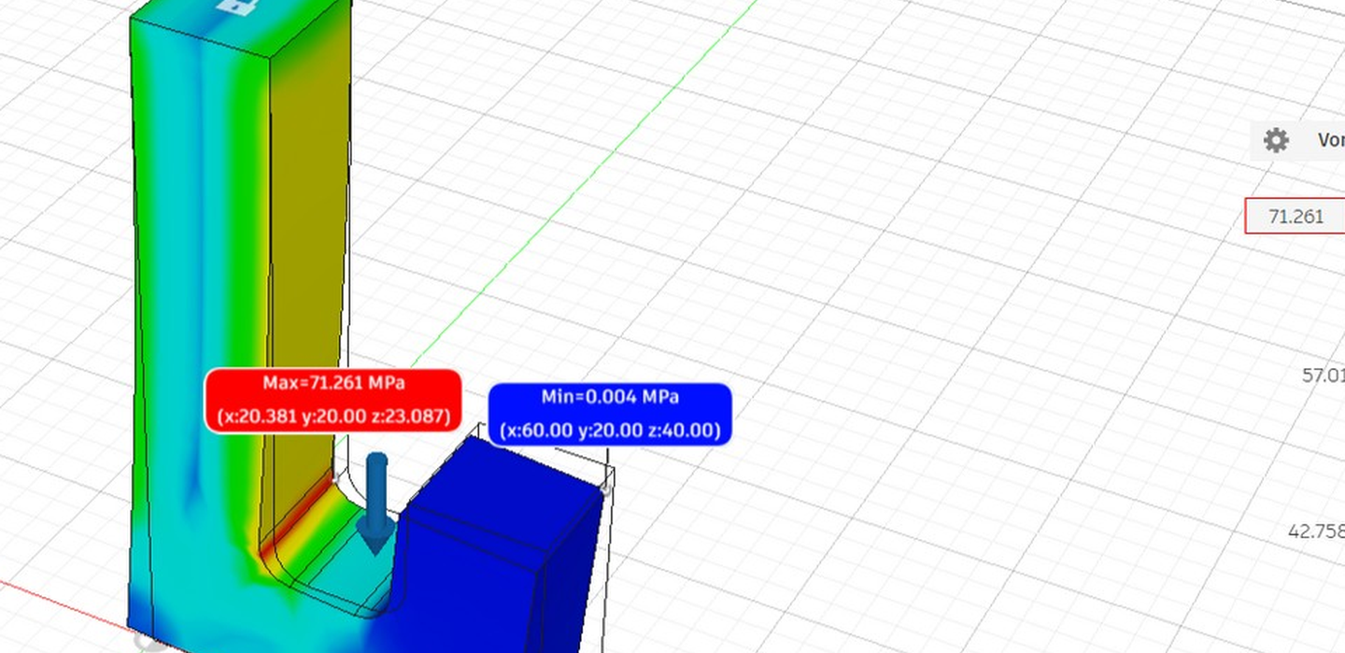
ENGINEERING PORTFOLIO
ENGINEERING PORTFOLIO / 2026–27
/ 2026 – 27
LIFTING HOOK
LIFTING HOOK
STATIC STRESS / FINITE-ELEMENT ANALYSIS
MED_5_SMF • CW1 TASK 1
Initial mild-steel baseline | Autodesk Fusion 360
Static stress analysis
MAX VON MISES
MED_5_SMF • CW1 Task 1
Initial mild-steel design | Autodesk Fusion 360
71.261 MPa
MINIMUM FoS
2.905 | target 2.00
INITIAL MASS
BOKHTEAR UDDIN BADHON
504.085 g
BEng (Hons) Mechanical Engineering • London South Bank University
STATIC STRESS
CASE STUDY
Seeking a 2027 Industrial Placement | London
FEA CASE STUDY
SEEKING A 2027
Autodesk Fusion 360 • Linear static stress
Initial design / coursework baseline
INDUSTRIAL PLACEMENT • LONDON
CAD & SIMULATION • INITIAL BASELINE

Slide 2
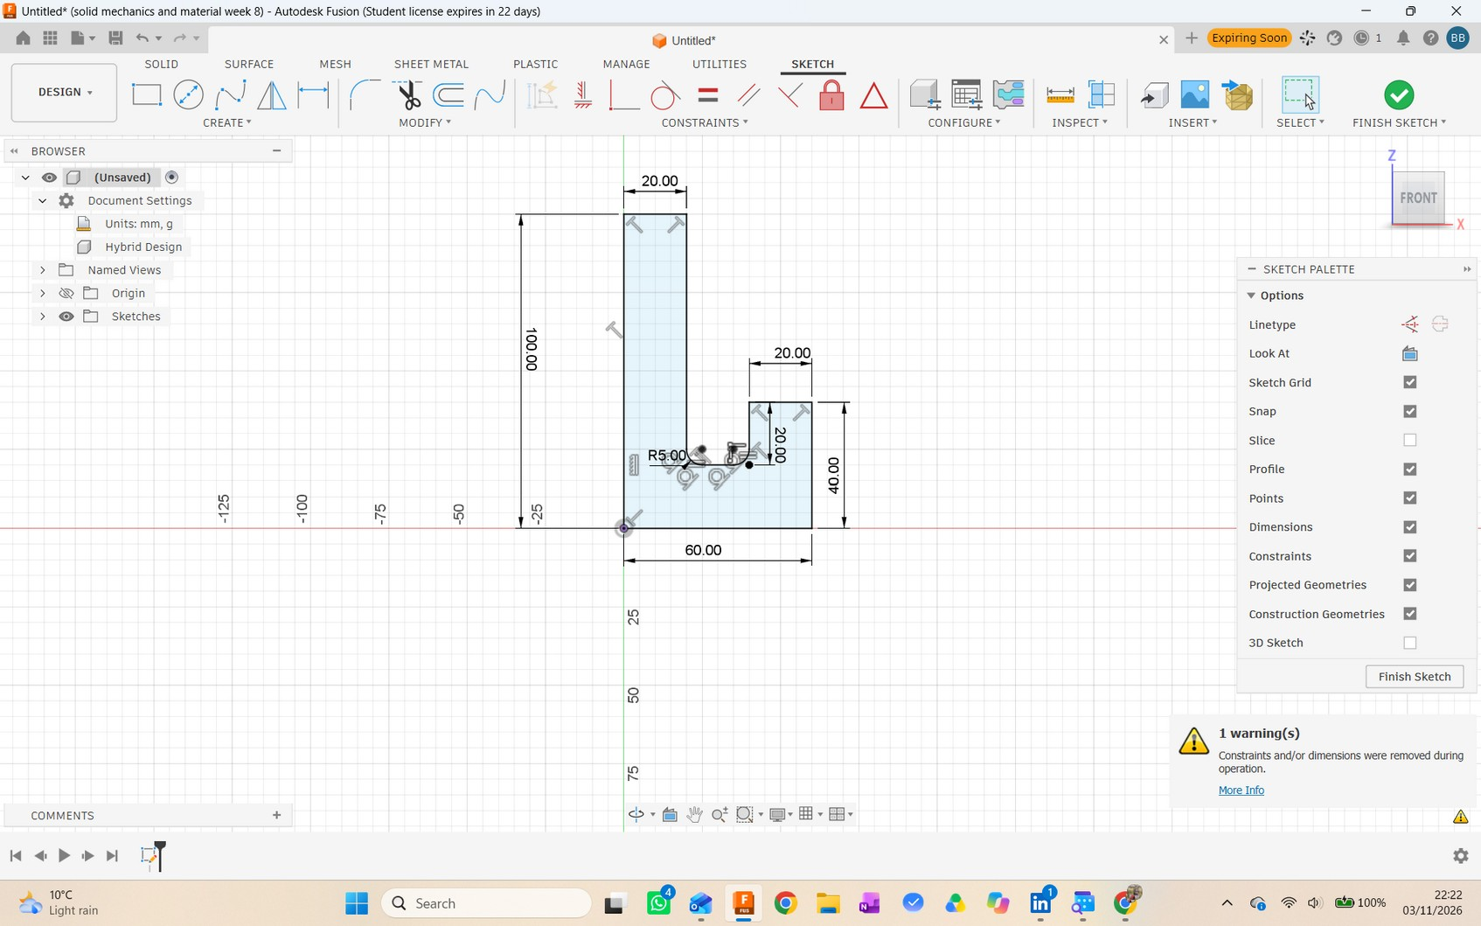
01 / CAD & MATERIAL
The initial hook: geometry and baseline
The submitted Task 1 study evaluates the original mild-steel design.
OVERALL PROFILE
SECTION THICKNESS
100 × 60 mm
20 mm
height × width
extruded depth
INSIDE RADIUS
INITIAL MASS
R5 mm
504.085 g
at the inner transition
volume 64,214.602 mm³
MATERIAL MODEL
Mild Steel • Fusion 360 library
E 220 GPa ν 0.275
Yield strength used 207 MPa
Density 7.850 × 10⁻⁶ kg/mm³
DIMENSIONED PROFILE • FUSION 360
BOKHTEAR UDDIN BADHON • FEA CASE STUDY
02

Slide 3
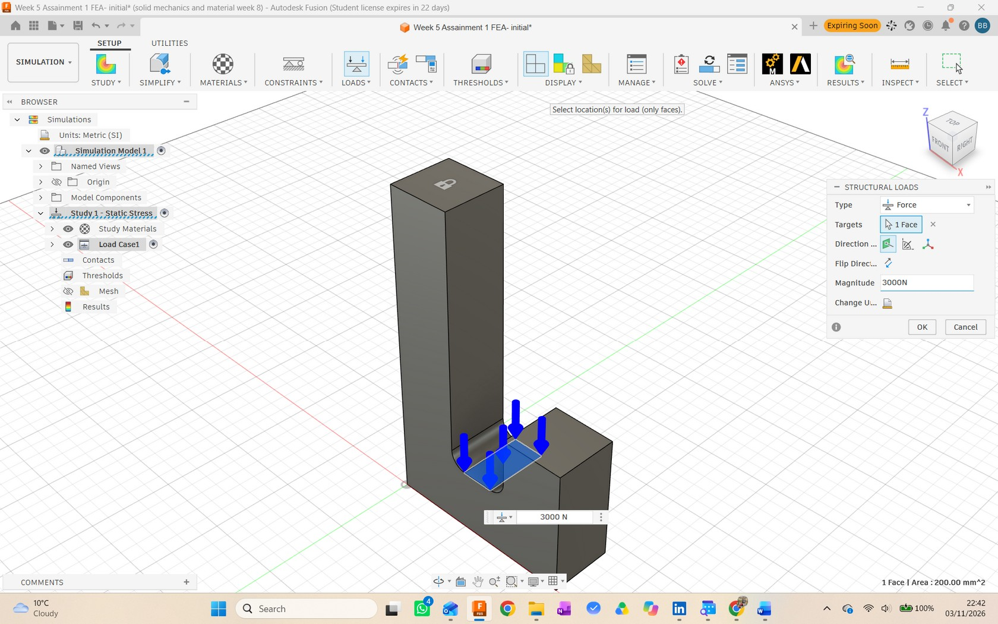
02 / FEA MODEL
How the static-stress study was set up
The same material and boundary conditions define the baseline comparison.
STUDY
Linear Static Stress in Autodesk Fusion 360.
SUPPORT
Top face fixed; translations Ux, Uy and Uz constrained.
APPLIED FORCE
3000 N downward on the face in the hook crook.
MESH
Default automatic mesh; parabolic and curved elements; 228 tetrahedral elements.
The exercise defines 3000 N as a 1000 N expected load multiplied by a load factor of 3.
FIXED TOP SUPPORT • 3000 N DOWNWARD LOAD
BOKHTEAR UDDIN BADHON • FEA CASE STUDY
03

Slide 4
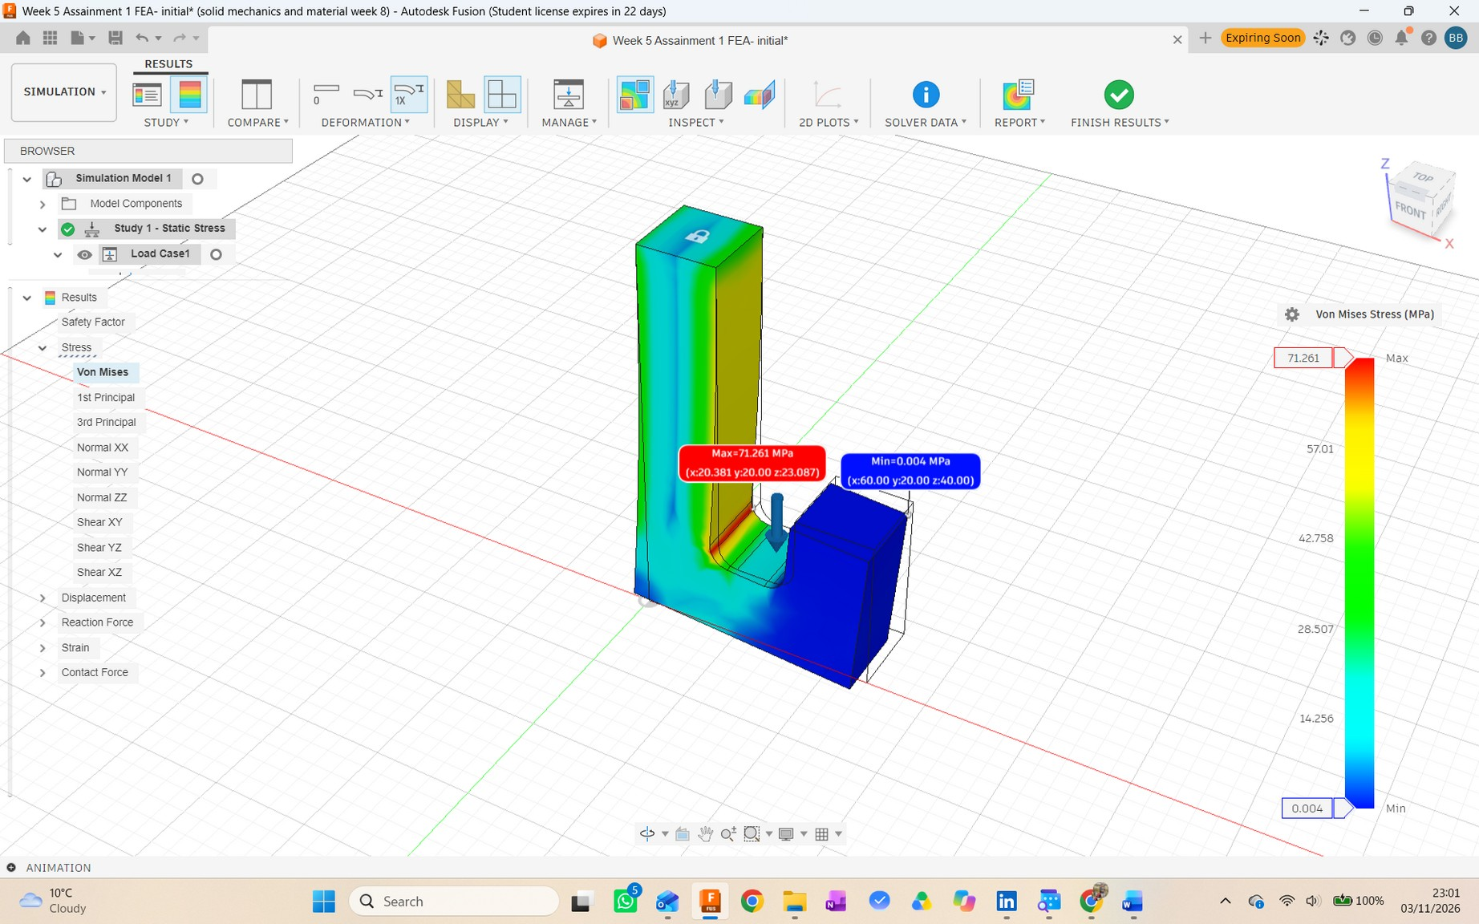
03 / STRESS RESULT
The stress peak sits at the inner transition
Contour values are from the submitted initial-design solution.
MAXIMUM VON MISES STRESS
71.261 MPa
at the inside transition
MINIMUM STRESS
0.004 MPa
reported by Fusion 360
PEAK LOCATION
x = 20.381 mm
y = 20.000 mm
z = 23.087 mm
Fusion 360 model coordinates
BOKHTEAR UDDIN BADHON • FEA CASE STUDY
04

Slide 5
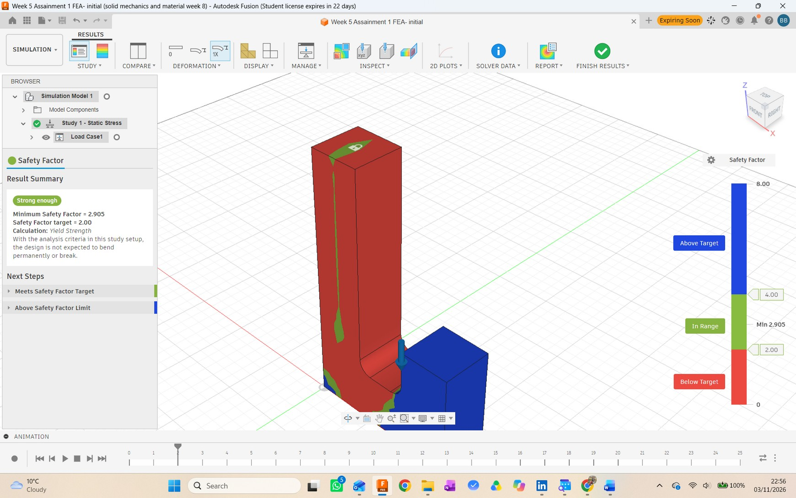
04 / SAFETY-FACTOR CHECK
The baseline exceeds the coursework target
This comparison uses the exercise yield strength and the simulated maximum stress.
CALCULATION
FoS = σᵧ / σᵥₘ,max
207 MPa ÷ 71.261 MPa
= 2.90485 ≈ 2.905
MINIMUM FACTOR OF SAFETY
2.905
Target 2.00
Fusion 360 classified the initial design as “Strong enough” for this study setup.
BOKHTEAR UDDIN BADHON • FEA CASE STUDY
05

Slide 6
05 / MECHANICAL INTERPRETATION
Why the inner corner becomes critical
A load path explanation of the result, based on the applied load and the stress contour.
FIXED TOP FACE
The offset load produces bending through the hook. The fixed top face supplies the reaction; the inside transition carries the strongest local stress in this result.
01
Load enters at the crook
The 3000 N force is applied downward to the inner hook face.
3000 N
02
The body transfers the load
The hook bends as the load travels toward the fixed upright.
PEAK STRESS
03
Geometry raises local stress
At the inside transition, the load path turns and the section changes; the contour shows the peak there.
Interpretation from this finite-element model; it does not replace mesh-convergence or physical testing.
BOKHTEAR UDDIN BADHON • FEA CASE STUDY
06

Slide 7
06 / ENGINEERING JUDGEMENT
What the result supports—and what it does not
The conclusion is limited to the specified static model and its assumptions.
WITHIN THE COURSEWORK MODEL
LIMITS TO KEEP IN VIEW
71.261 MPa < 207 MPa
IDEALIZED SUPPORT
A fully fixed top face is an ideal boundary condition.
The simulated maximum is below the yield strength used in the exercise.
SINGLE STATIC LOAD CASE
This result covers the prescribed 3000 N load only.
2.905 > 2.00
MESH / VALIDATION
The minimum factor of safety exceeds the stated target. The initial design meets the coursework static-strength criterion under this setup.
No mesh-convergence check or physical test was reported for Task 1.
USE IN PRACTICE
This is coursework evidence, not a certified lifting rating.
BOKHTEAR UDDIN BADHON • FEA CASE STUDY
07

Slide 8
07 / WORKFLOW & REFLECTION
I built the baseline, set up the study, and checked the result
Evidence-led account of the submitted Task 1 work.
MY WORKFLOW
GENERATIVE AI DISCLOSURE
01
Modelled the dimensioned hook profile and assigned Mild Steel.
ChatGPT helped clarify the Fusion 360 workflow, organize the report, improve wording, and check the factor-of-safety arithmetic. The CAD model, study setup, simulation, and screenshots are my Fusion 360 work. I am responsible for the submitted work and its technical claims.
02
Recorded the initial mass and volume from Fusion 360 properties.
03
Applied the fixed support and downward force, generated the mesh, and solved the Static Stress study.
Located the stress peak and compared the calculated FoS with the target.
SCOPE
04
This case study covers the submitted CW1 Task 1 initial design only. Later design variants are separate work and are not mixed into these baseline results.
Evidence shown: my Fusion 360 sketch, setup, stress contour, safety-factor result and solver data. Student ID intentionally omitted from this portfolio copy.
BOKHTEAR UDDIN BADHON • FEA CASE STUDY
08

