Slide 1

Do Not Beg:
Moving Beyond Do Not Track
with Privacy By Design
Mike Perry
W3C DNT
Nov 28, 2012

Slide 2
Do Not Track as Privacy By Design
The meat of the initial IETF DNT Draft:
“A server acting in a third-party capacity MUST NOT track a user or user agent...”
“Tracking includes collection, retention, and use of all data related to the request and response.”
Can be met through three areas of technical change:
First Party Identifier Unlinkability
First Party IP Address Unlinkability
First Party Fingerprinting Unlinkability

Slide 3
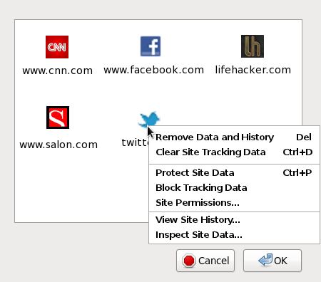
Goal: First Party Top-Level Privacy UI

Slide 4
Identifier Unlinkability in Tor Browser
Jail/silo identifier sources to first party domain
  Cache is siloed similar to Stanford SafeCache
  HTTP Auth is restricted to first party
  Window.name is cleared on origin change
Disable/Limit features we haven't yet siloed
  Third Party Cookies currently disabled
  DOM Storage, AppCache, IndexedDB, SPDY
  SSL Session IDs and Tickets
  HTTP-Keepalive limited to 20 seconds

Slide 5
Identifier Unlinkability: Remaining Work
Silo disabled identifier sources to first party
  “Double-key” (or hold-until-click) 3rd Party Cookies
  DOM Storage, AppCache, IndexedDB
  HTTP-Keepalive and SPDY connection usage
  Disable HSTS for third parties in non-HSTS domains
Prompt before automated cross-domain redirects
  Obtain user consent to avoid covert 3rd party->first party promotion
Utilize Tor path isolation for IP unlinkability
  Set SOCKS username to first party domain
  ISPs could provide such proxies too

Slide 6
Fingerprinting Defenses in Tor Browser
Disable plugins
Limit number of font probes per first party origin
Report a fixed map of “System Colors” to CSS
Report content window size for desktop and outer window resolutions
  Limited set of initial window sizes
Limit WebGL to click-to-play
Prompt on read access of HTML5 Canvas data
Report timezone as GMT
Report OS as Windows

Slide 7
Fingerprinting Defenses: Remaining Work
Improve resolution defenses
  Maximization, toolbars cause problems
  Prompt? Zoom?
Reduce Javascript timing resolution
  Keystroke, CPU fingerprinting
Protocol handler enumeration
Likely possible to infer OS several ways..
  Fonts (provide font pack?), button shape?
New HTML5 features need evaluation
  May need to rely on simulations or intuition

Slide 8
Common Concerns
Link Sharing/Like Buttons?
Web-send.org
  Privacy preserving link sharing + federated login
  Disappeared from Google Chrome?
Safari/Priv3-style hold-until-click cookie policy
Federated Login?
OAuth and OpenID still work per each first party
Persona/BrowserID

Slide 9
Supporting the Long Tail
Behavioral Targeting may support small publishers
“Targeted, Not Tracked” discusses three client-side mechanisms to serve privacy-preserving targeted ads
  Auditable and Universal
More work is needed before Tor would deploy something like this...
  Must be Open Source or will be percieved as spyware
  But privacy doesn't mean the end of the free web

Slide 10
W3C Q&A Highlights
Third Party Analytics Services?
  Dual-Keyed cookies will allow this
Click-Fraud/Abuse?
  Link-click driven conversion is still trackable
  Also, see “Nymble” and related research literature
    Blinded tokens using scarce resource (Computation, SMS)
    Tor currently lacks engineering resources to deploy
How much will websites break?
  Depends on engineering effort invested client-side
  Per-site login for like buttons, but alternatives exist (See Priv3 Firefox extn; or web-send.org)

