Slide 1
architecture
Service-handler-repository

Slide 2
what’s wrong with how we have it now?
Current state
No clear pattern - not always easy to find code
No Single Responsibility Principle - huge classes
Hard to unit test
Lots of if - else if - else if - else if…
Not transactional

Slide 3
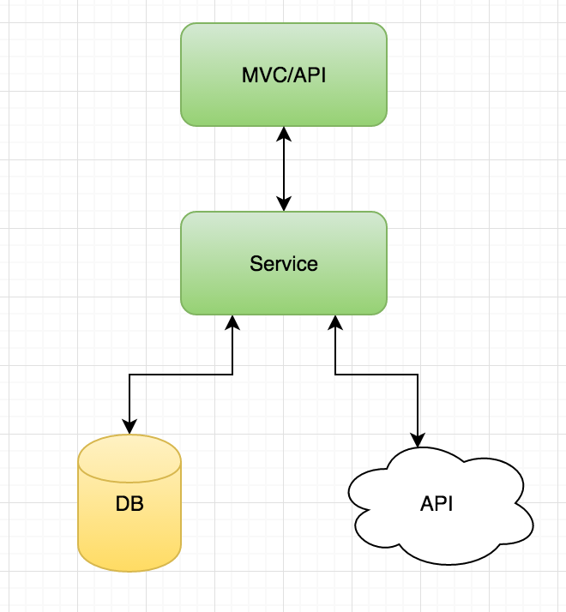
how do we make it better?
MVC/APi controllers have business logic, magic model binder and access to all layers
services are too big and hard to unit test
no Dal (repository just wrapper of context) - linq-SQL everywhere

Slide 4
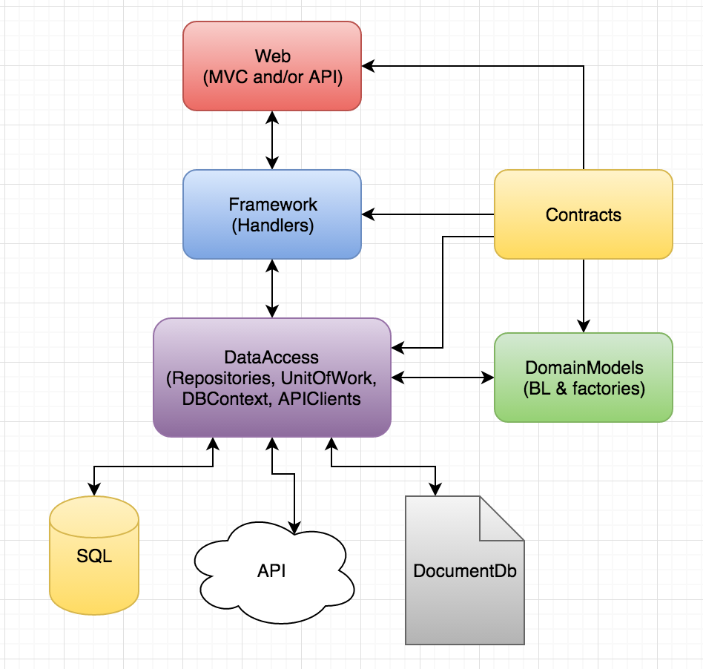

Slide 5
Rules
Keep naming convention strict - verbose, always CRUD, consistency
Single responsibility in Handlers, Repository/Service methods
Controllers never do business logic, only DomainModels
DomainModel properties are immutable outside said DomainModel
DomainModels cannot be instantiated without a Factory
No data access outside of Repositories
Always stick to the pattern!!!

Slide 6
Benefits
Code becomes super easy to navigate, learn pattern once find any logic quickly
Everything becomes unit testable (not a mix of integration testing)
No unnecessary injection (more efficient)
Single responsibility, DRY, bits easily replaced
Small classes are much nicer to work with
DomainModels responsible for business logic and nonsensical values can never be set on objects
More…

