Slide 1





DispoSMS
Disposable SMS Platform
Secure, temporary phone numbers for SMS verification with 100% delivery guarantee and real-time message reception
100% Secure
Real-time
Global Coverage

Slide 2


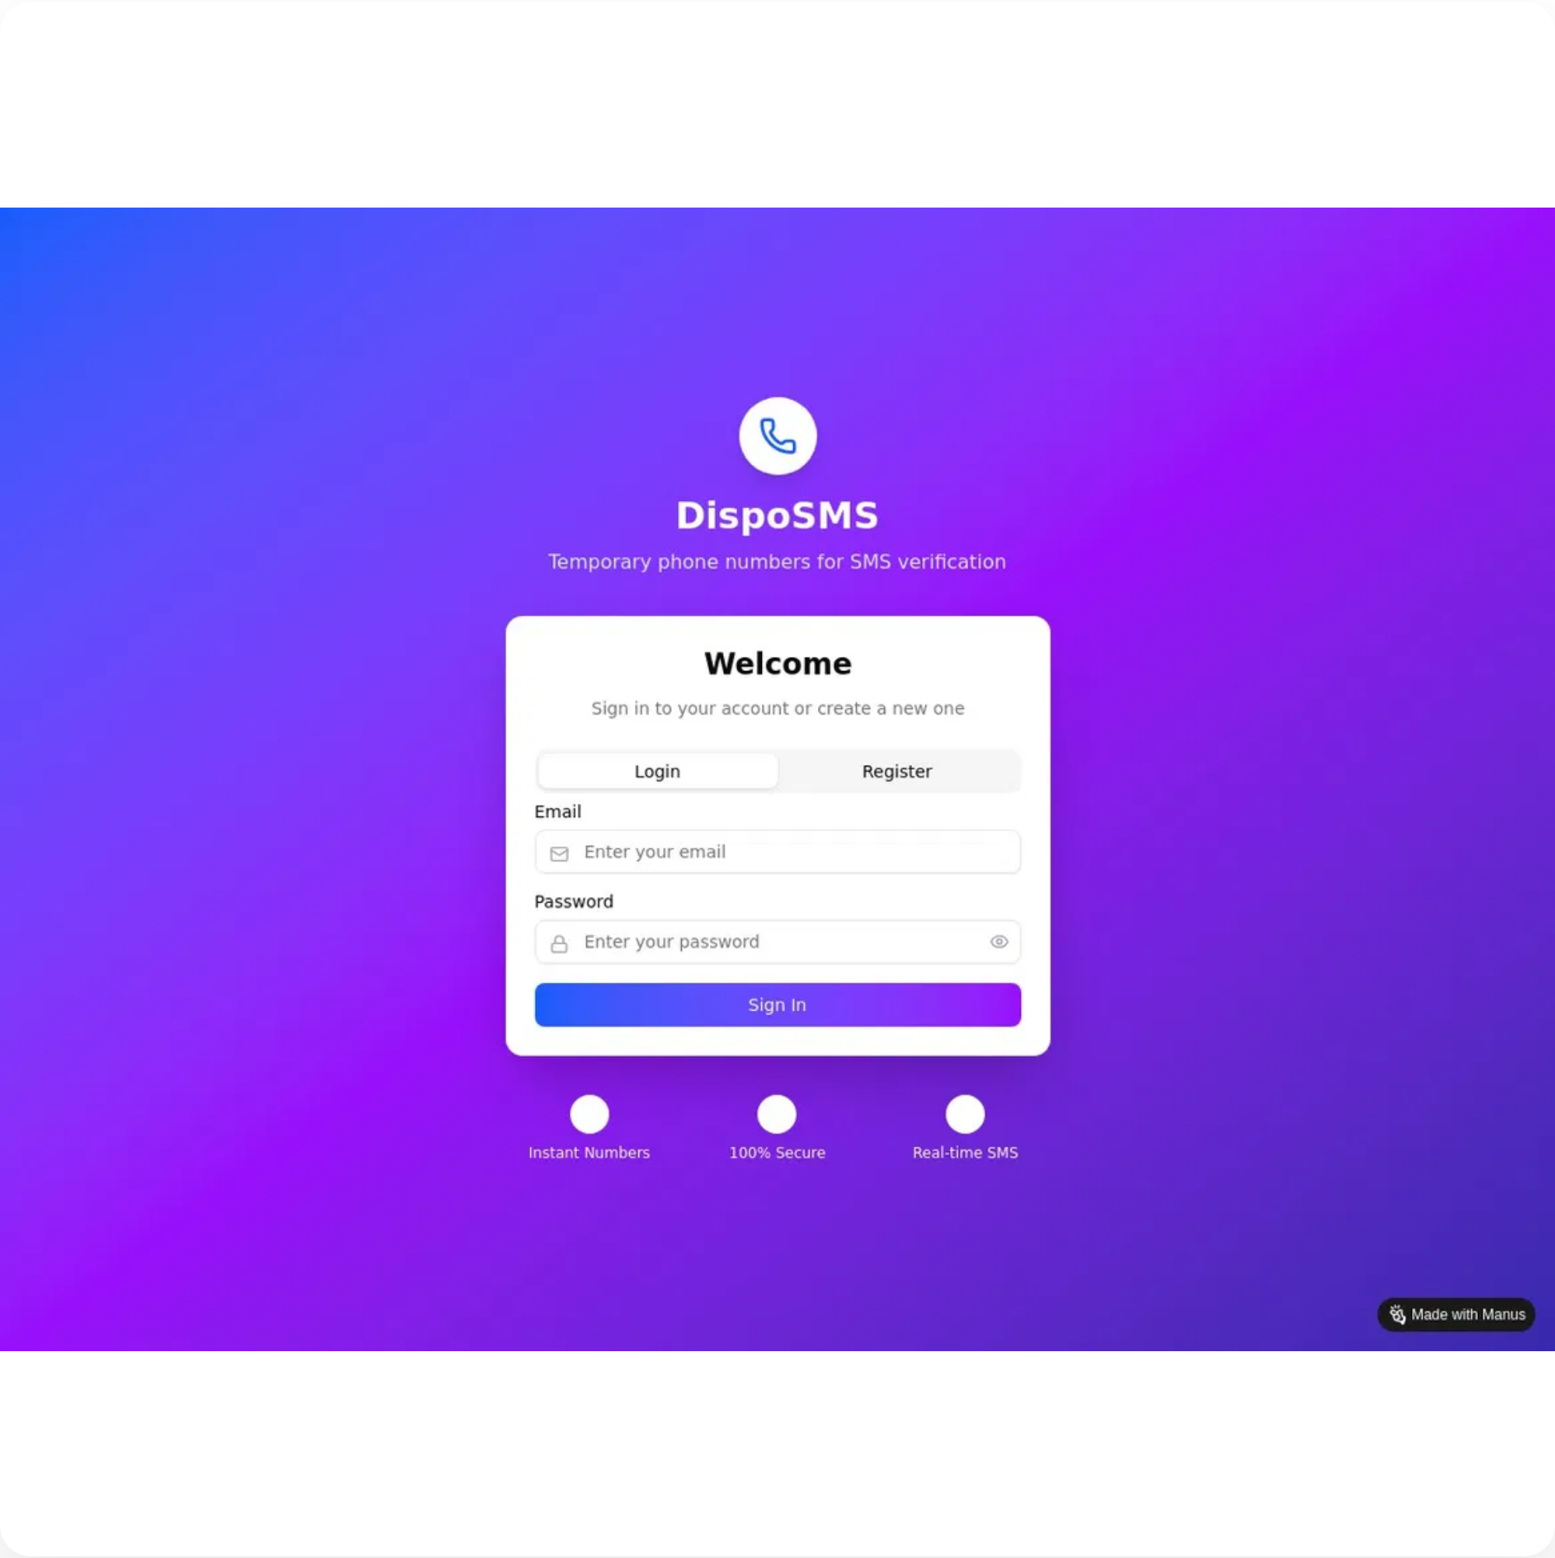




DispoSMS: Disposable SMS Platform
The Problem We Solve
Privacy Concerns
Using personal phone numbers for online verification exposes users to potential privacy breaches, unwanted marketing messages, and data harvesting by third parties.
Spam Messages
After verification, users often receive unwanted promotional messages and spam, cluttering their personal messaging inbox and causing notification fatigue.
Geographic Limitations
Many services restrict verification to specific countries, making it difficult for international users to access these platforms without a local phone number.
Developer Testing Challenges
Developers need multiple phone numbers to test SMS functionality in applications, which is costly and logistically challenging without a dedicated solution.

Slide 3

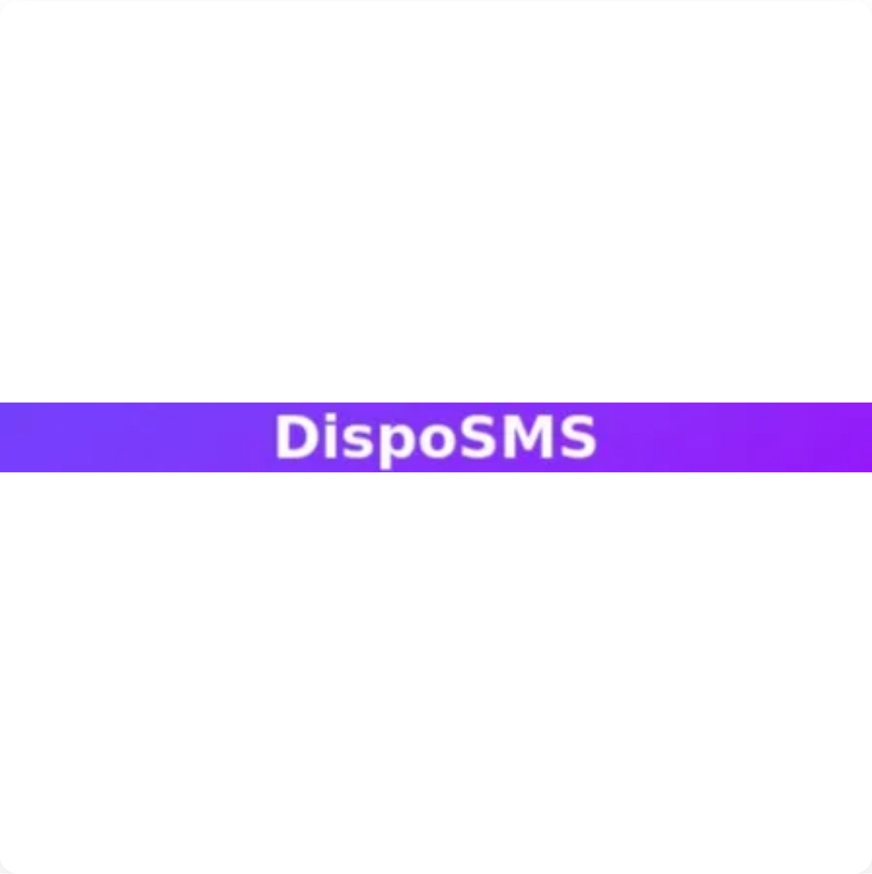




DispoSMS: Disposable SMS Platform
Our Solution
DispoSMS provides temporary phone numbers that act as a secure intermediary between users and services requiring SMS verification, protecting privacy while ensuring message delivery.
Privacy Protection
Users can keep their personal phone numbers private by using our temporary numbers for verification, preventing data harvesting and unwanted marketing.
Real-time SMS Reception
All messages are delivered instantly through our WebSocket technology, with automatic OTP detection and highlighting for quick verification.
Global Number Access
Access phone numbers from 50+ countries, bypassing geographic restrictions and enabling global service access for international users.
100% Delivery Guarantee
Our multi-provider failover system ensures all messages are received, with redundant connections to major SMS gateways for maximum reliability.

Slide 4





DispoSMS: Disposable SMS Platform
System Architecture
DispoSMS uses a modern, scalable architecture with a clear separation of concerns, real-time communication capabilities, and multi-provider SMS integration.
Frontend Layer
React.js application with Tailwind CSS for responsive UI, Socket.IO client for real-time updates, and JWT authentication for secure access.
Backend API
Flask application with RESTful API endpoints, WebSocket support via Socket.IO, and JWT-based authentication system for secure access control.
Database Layer
PostgreSQL database with SQLAlchemy ORM for data persistence, storing user accounts, phone number assignments, and message history.
SMS Gateway Integration
Multi-provider integration with Twilio, Nexmo, and other SMS gateways with automatic failover for 100% message delivery guarantee.
Security Layer
Comprehensive security with bcrypt password hashing, JWT token validation, CORS protection, and rate limiting to prevent abuse.

Slide 5

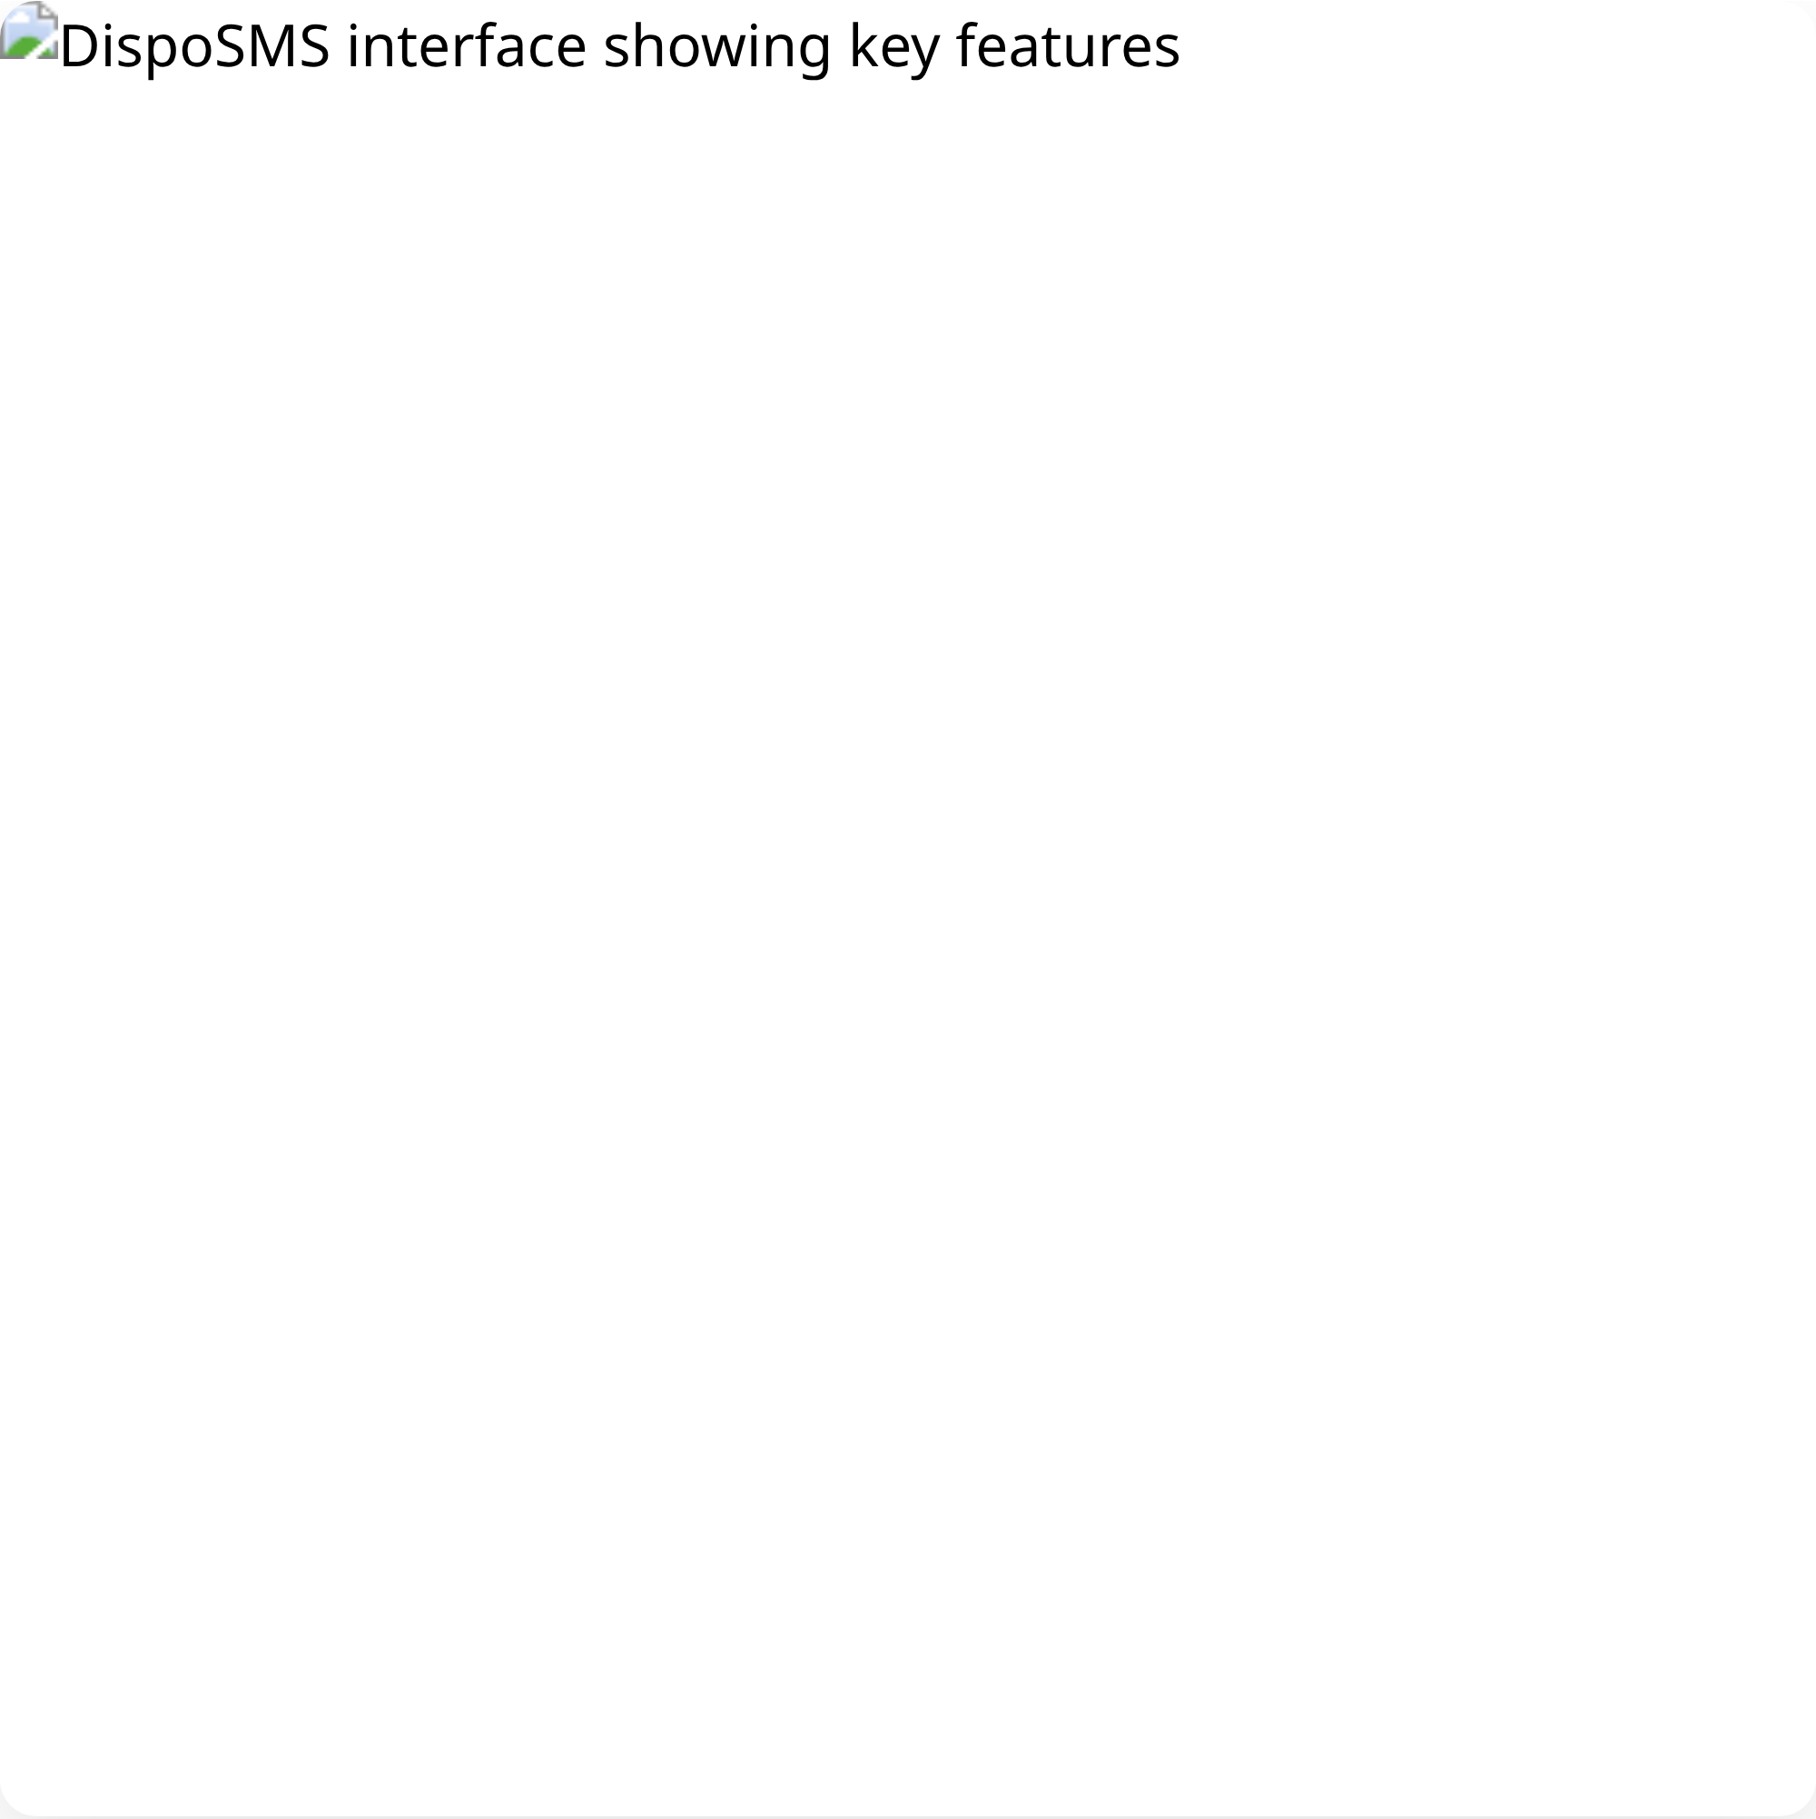






DispoSMS: Disposable SMS Platform
Key Features
DispoSMS offers a comprehensive set of features designed to provide secure, reliable, and user-friendly temporary phone number services for SMS verification.
Number Management
Real-time Updates
Assign unlimited phone numbers from 50+ countries with flexible duration options (1-24 hours) and easy extension capabilities.
Receive instant notifications when new messages arrive through WebSocket technology, with no need to refresh the page.
OTP Detection
100% Delivery Guarantee
Automatic detection and highlighting of verification codes in messages, with one-click copy functionality for quick use.
Multi-provider failover system ensures all messages are received, with redundant connections to major SMS gateways.
Message Filtering
API Integration
Advanced filtering options by sender, content, date, and message type, with full-text search capabilities.
Comprehensive REST API and WebSocket support for developers, with SDKs for popular programming languages.

Slide 6

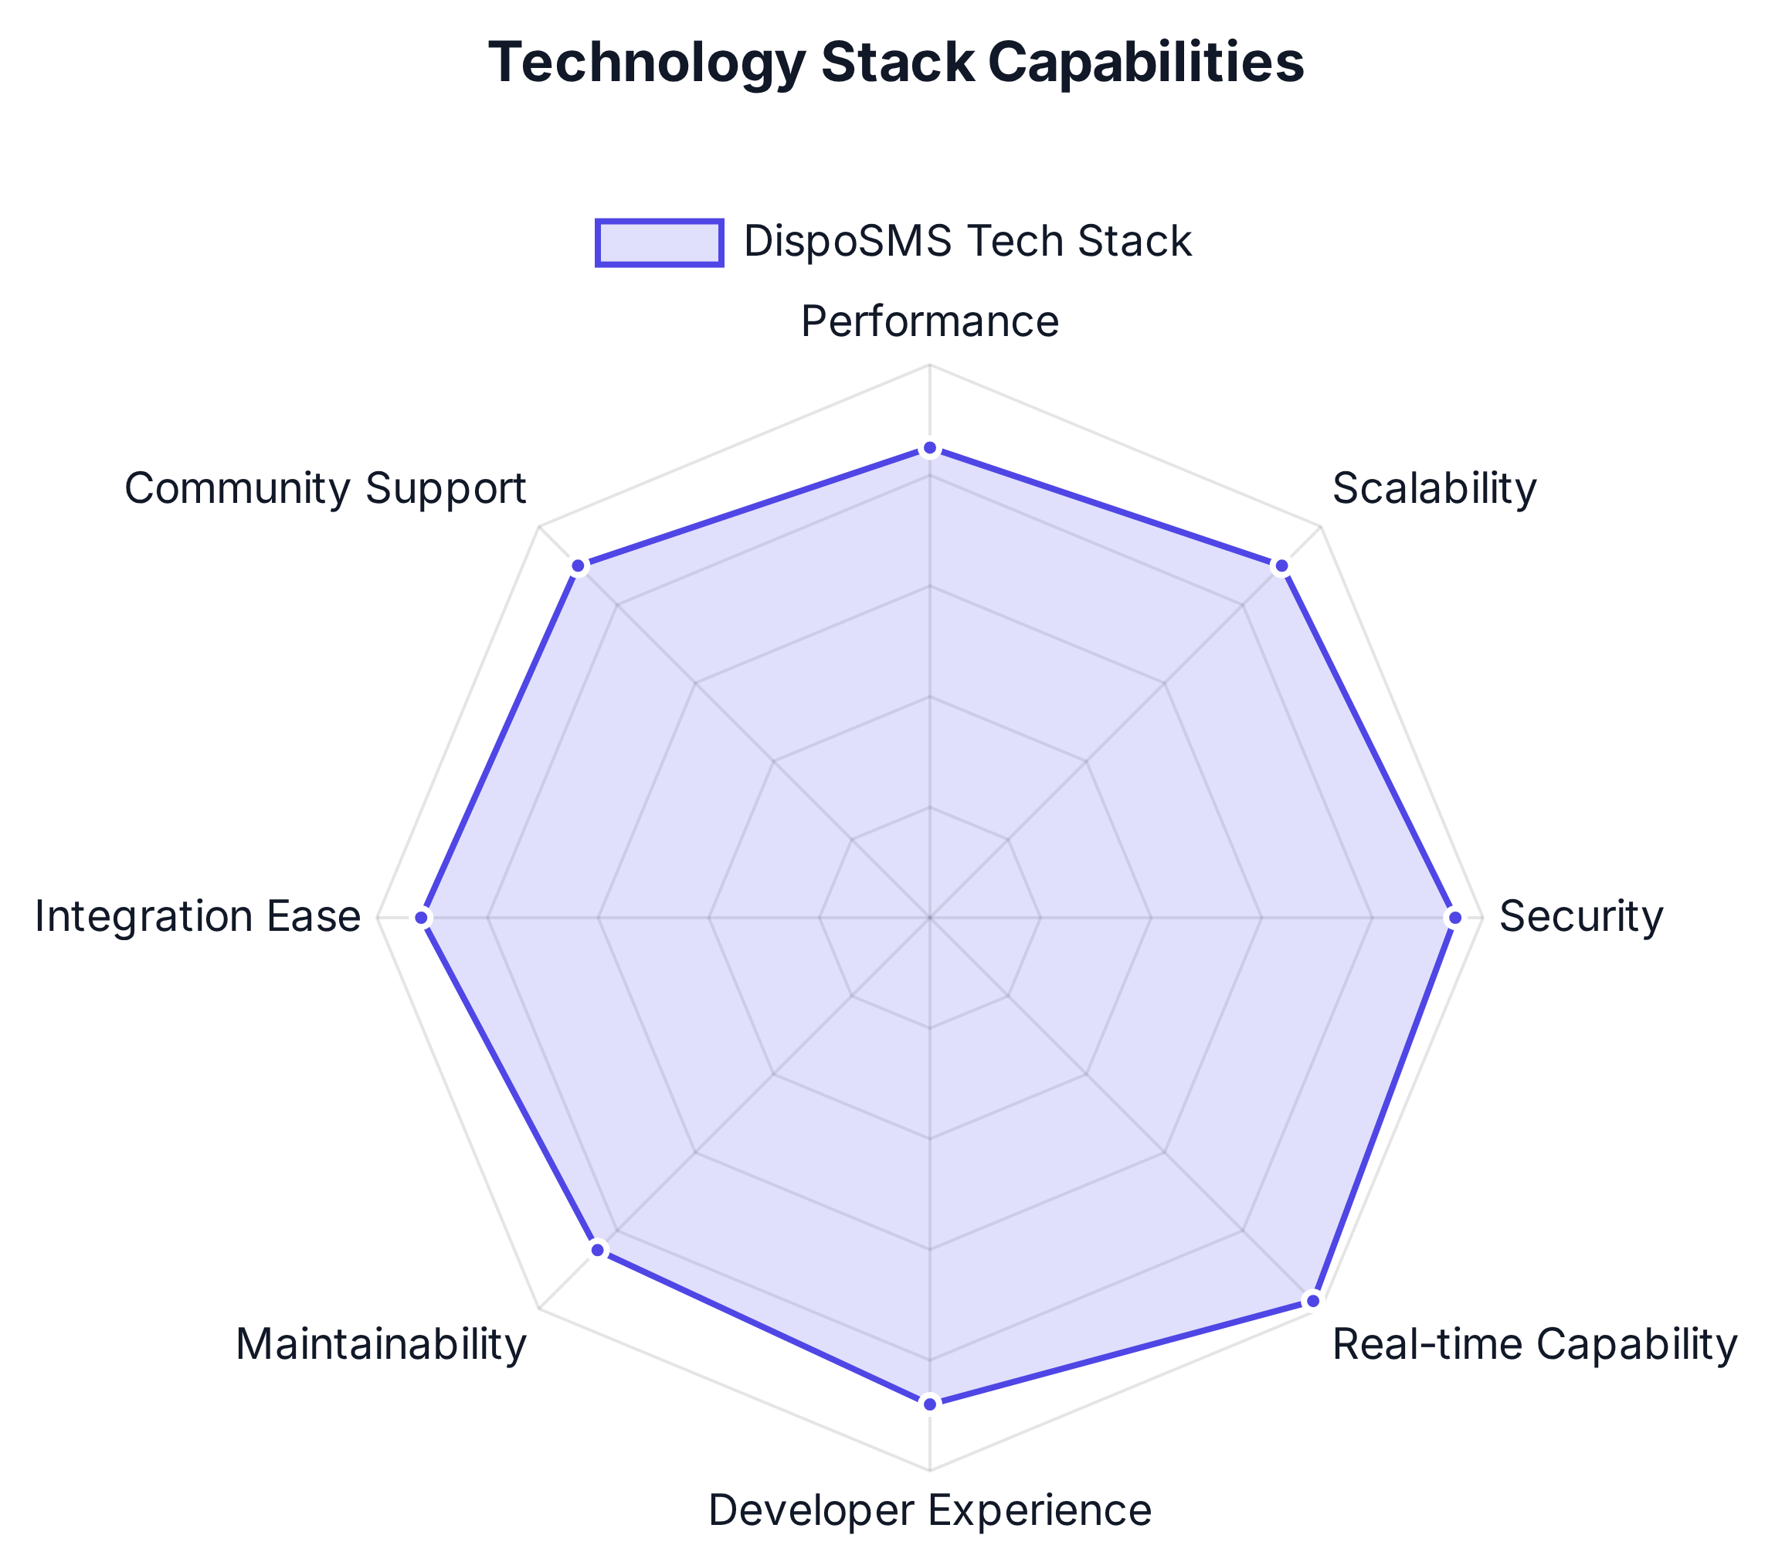

















DispoSMS: Disposable SMS Platform
Technology Stack
DispoSMS is built with modern, scalable technologies that enable real-time communication, secure authentication, and reliable SMS handling.
Frontend Technologies
React.js
Tailwind CSS
Socket.IO Client
JWT Auth
Backend Technologies
Flask
Socket.IO
Flask-JWT-Extended
RESTful API
Data Storage
PostgreSQL
SQLAlchemy ORM
Redis (Caching)
External Services
Twilio
Nexmo/Vonage
Other SMS Providers

Slide 7







DispoSMS: Disposable SMS Platform
Conclusion
DispoSMS provides a comprehensive solution for temporary phone number needs, ensuring privacy, security, and reliability for all your SMS verification requirements.
Complete privacy protection with disposable phone numbers
Real-time message delivery with 100% guarantee
Automatic OTP detection and one-click copy
Access to phone numbers from 50+ countries
Developer-friendly API for seamless integration
Secure, scalable, and reliable platform
Scan to Access
Try DispoSMS Now
View Source Code
https://77h9ikcww70j.manus.space

