Slide 1
Crop Recommendation Using Machine Learning
Project Logic
A high-level view of how the model supports crop planning
1. Soil & Climate Data
Data + local knowledge = smarter and more sustainable farming decisions
N, P, K, temperature, humidity, pH, rainfall
Model interpretability + balanced dataset
2. Machine Learning Model
2,200
records
22
crop classes
7
predictors
Compare classifiers and select the best-performing model
3. Crop Recommendation
Prepared by Bokun Ge Machine Learning Project • June 2026
Support better agricultural planning and food security
Detailed model results and interpretation appear later in the presentation.
Bokun Ge • Crop Recommendation ML Project
01

Slide 2
OVERVIEW
Executive Summary
The project translates soil and climate data into practical crop recommendations.
PROBLEM
APPROACH
RESULT
Farmers need crop choices that match local soil and weather conditions.
Train and compare supervised learning models using soil nutrients and climate features.
Random Forest achieved the best overall performance and gives useful feature importance.
Main takeaway: machine learning can support better agricultural planning when combined with local farming knowledge.
Bokun Ge • Crop Recommendation ML Project
02

Slide 3
CONTEXT
Problem Framing: Why Crop Choice Matters
Crop selection is a high-impact decision because it affects yield, resource use, and food supply.
Real-world challenge
The same crop does not perform equally well in every soil and climate.
Poor crop matching can waste water, fertilizer, labor, and time.
Climate variability makes agricultural planning more difficult.
Data-driven tools can provide an additional decision-support layer.
Decision-support logic
Soil nutrients
Climate conditions
Model prediction
Crop recommendation
Bokun Ge • Crop Recommendation ML Project
03

Slide 4
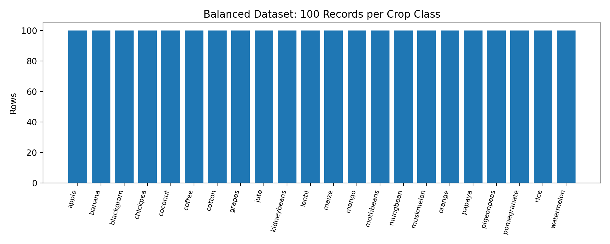
DATA
Dataset and Research Design
The dataset is balanced and suitable for a supervised multi-class classification task.
2,200
records
100 per crop class
22
crop labels
balanced target
7
predictors
soil + climate
80/20
split
train/test
Predictors used
Soil nutrients: nitrogen, phosphorus, potassium.
Weather and environment: temperature, humidity, rainfall.
Soil condition: pH level.
Target: recommended crop label.
Balanced class distribution
A balanced target helps avoid misleading accuracy caused by dominant classes.
Bokun Ge • Crop Recommendation ML Project
04

Slide 5
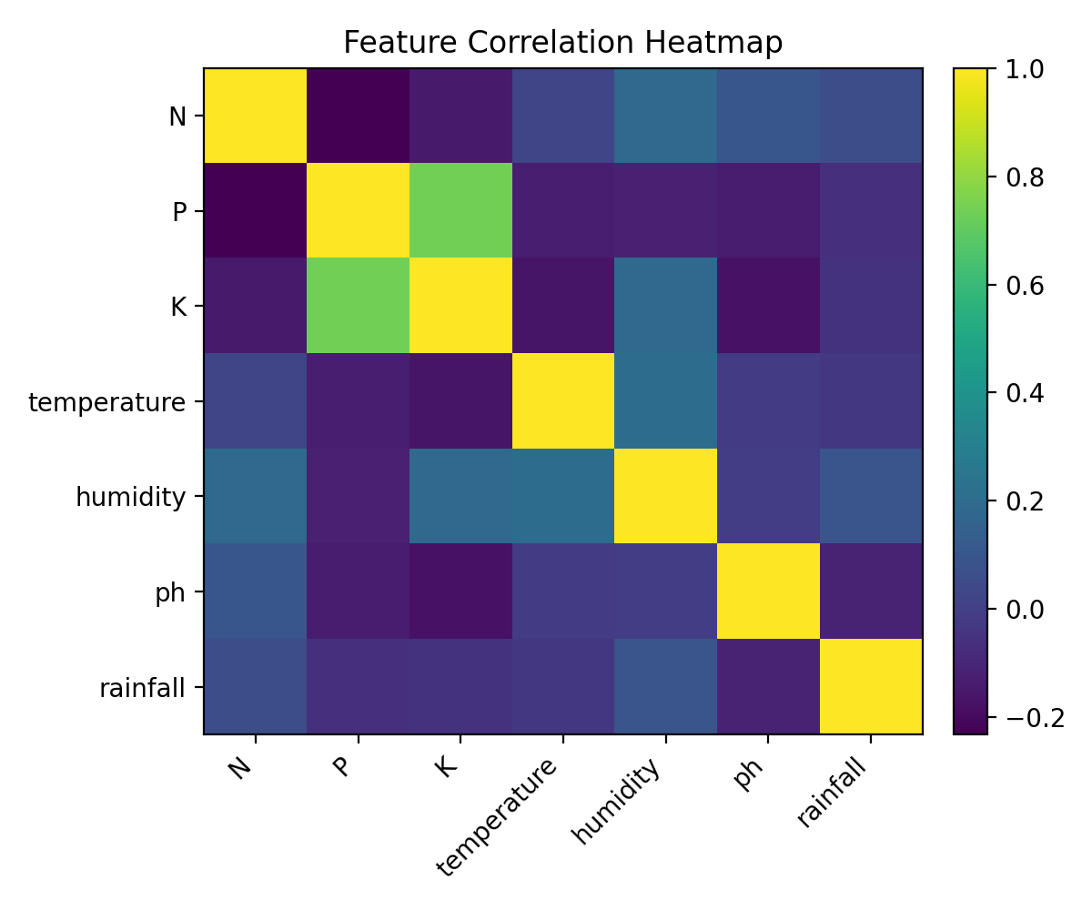
EDA
Exploratory Analysis: What the Data Shows
Before modeling, the project checked feature relationships and dataset suitability.
Interpretation
Features describe complementary aspects of crop growth.
There is no single predictor that fully explains crop choice.
This supports using models that can capture interaction effects.
The dataset is clean enough for a standard machine learning pipeline.
Correlation heatmap
EDA takeaway: the problem is appropriate for multi-class classification.
Bokun Ge • Crop Recommendation ML Project
05

Slide 6
METHOD
Machine Learning Pipeline
A structured process makes model comparison fair and easy to explain.
1
Explore
2
Clean
3
Split
4
Train
5
Evaluate
class balance summary statistics
missing values duplicates
stratified train/test
DT, RF, KNN, SVM
accuracy, F1, confusion matrix
Technical note
KNN and SVM used scaling because distance-based models are sensitive to feature units.
Evaluation note
All models were compared on the same test set using classification metrics.
Bokun Ge • Crop Recommendation ML Project
06

Slide 7
MODELS
Model Candidates
The project compared simple, ensemble, distance-based, and margin-based classifiers.
Decision Tree
Random Forest
Interpretable baseline Can overfit without control
Ensemble of many trees Strong accuracy + importance
KNN
SVM
Distance-based voting Needs feature scaling
Margin-based classifier Strong with scaled features
Bokun Ge • Crop Recommendation ML Project
07

Slide 8
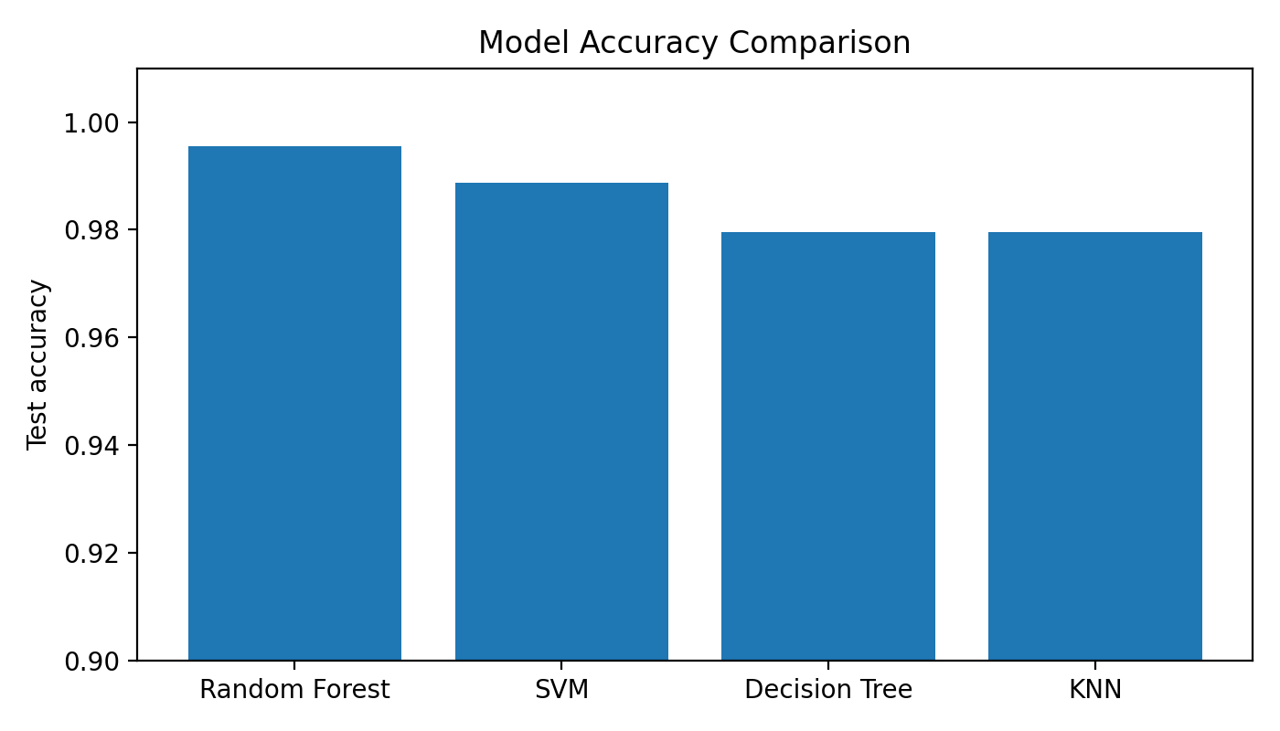
RESULTS
Performance Leaderboard
Random Forest produced the strongest test performance.
0.9955
Best accuracy
Random Forest
0.9955
Best F1-score
Random Forest
Accuracy
F1
Random Forest
0.9955
0.9955
SVM
0.9886
0.9887
Decision Tree
0.9795
0.9794
Accuracy comparison
KNN
0.9795
0.9793
Selected final model: Random Forest
Bokun Ge • Crop Recommendation ML Project
08

Slide 9
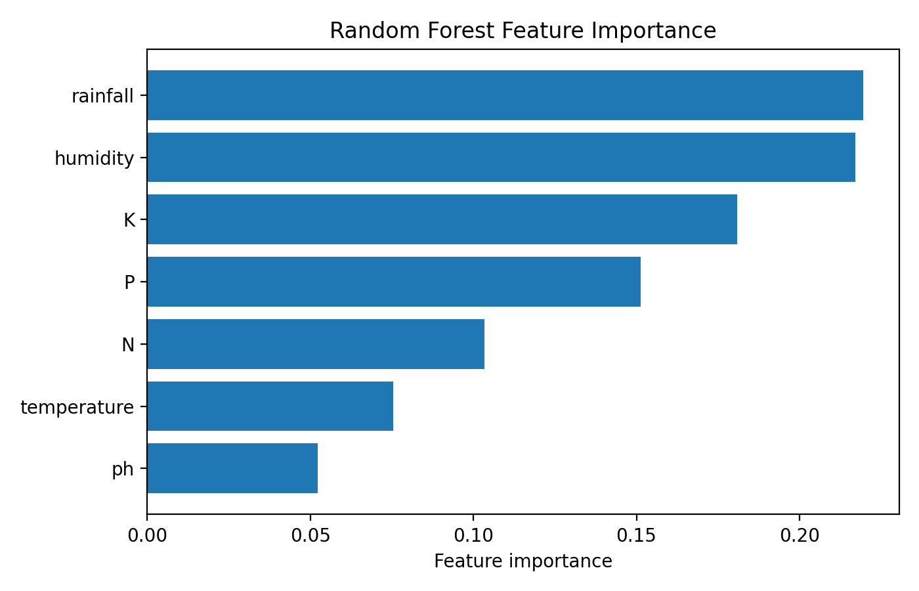
DECISION
Why Random Forest Is the Final Model
The final model balances high accuracy with interpretability.
Selection rationale
Best overall model performance.
Captures non-linear relationships between soil, climate, and crop type.
Less likely to overfit than a single decision tree.
Feature importance helps explain model behavior to non-technical audiences.
Feature importance
For a class presentation, Random Forest is strong because it is both accurate and explainable.
Bokun Ge • Crop Recommendation ML Project
09

Slide 10
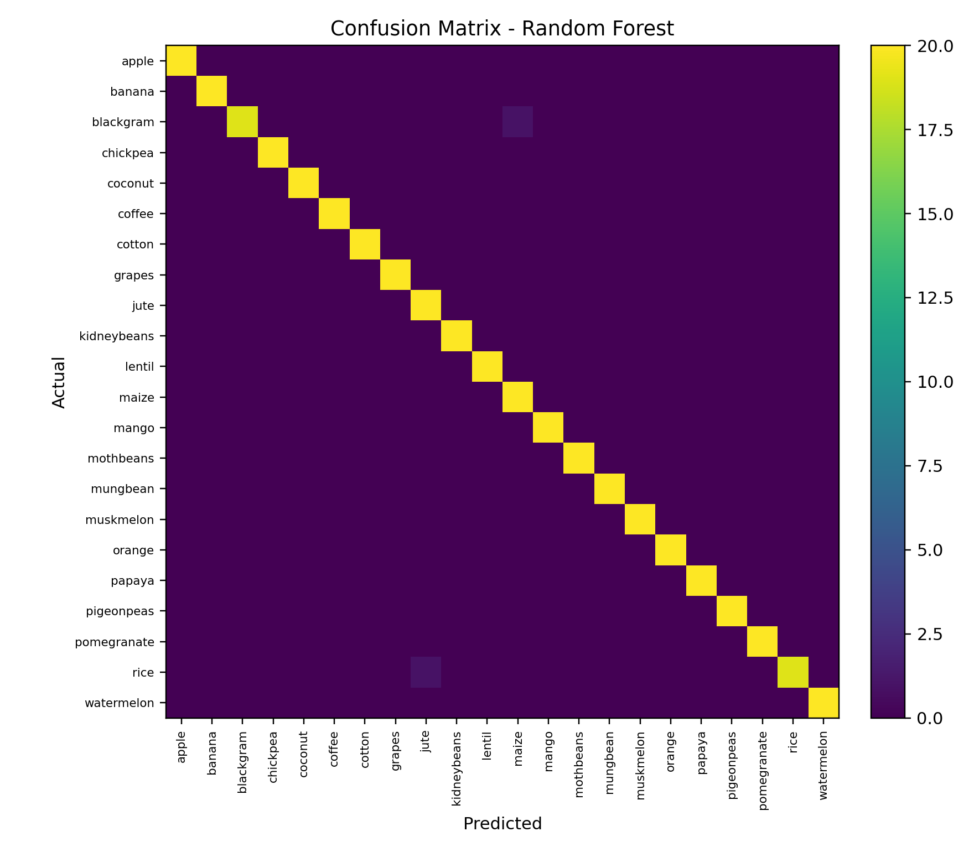
VALIDATION
Validation: Where the Model Performs Well
The confusion matrix confirms that most predictions are on the correct diagonal.
0.9955
Accuracy
0.9957
Precision
0.9955
Recall
0.9955
F1-score
What this means
Most crop classes are predicted correctly.
Few visible errors appear outside the main diagonal.
Real-world testing is still needed before farm deployment.
Final model confusion matrix
Bokun Ge • Crop Recommendation ML Project
10

Slide 11
APPLICATION
Example Use Case
The model converts field conditions into a crop recommendation.
INPUT DATA
OUTPUT
• N = 90
Recommended Crop
• P = 42
Tuned Random Forest
• K = 43
RICE
• Temperature = 20.87°C
• Humidity = 82.00%
• pH = 6.50
This output is easy to understand and can support field-level planning.
• Rainfall = 202.93 mm
Bokun Ge • Crop Recommendation ML Project
11

Slide 12
FUTURE
Limitations and Next Steps
A strong classroom model should still be connected to real-world validation.
Limitations
Kaggle data may not fully represent local farm conditions.
The model does not include price, crop demand, labor cost, or irrigation cost.
Environmental conditions can change over time and across seasons.
Agricultural expert review is still needed.
Next steps
Validate with local field data.
Add market and economic variables.
Collect more seasonal observations.
Build a simple user interface for farmers or advisors.
Combine model output with local expert knowledge.
Prototype → Local validation → Expanded variables → Farmer-facing decision support tool
Bokun Ge • Crop Recommendation ML Project
12

Slide 13
Final Takeaway
Machine learning can help transform soil and climate data into practical crop recommendations, supporting better agricultural planning and the broader goal of food security.
Data + local knowledge = smarter and more sustainable farming decisions
Thank you — Questions & Discussion
Bokun Ge • Crop Recommendation ML Project
13

