Slide 1
Title
SUBTITLE

Slide 2
title
Chiller power, temp, evaporator flow, condenser flow
Weather temperature, humidity
Cooling tower fan speed

Slide 3
Chiller power
ch1watt, ch2watt, ch3watt
totalpositivewatthour

Slide 4
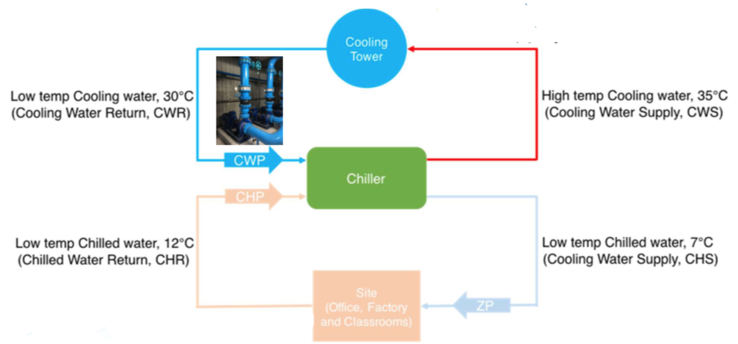
Chiller temp
value1 : chilled water supply
value2 chilled water return
value 3 : cooling water supply
value 4 : cooling water return

Slide 5
condenser flow / evaporator flow
flowrate
flowspeed
totalFlowrate

