Slide 1
HLS Final Hand-written numbers classifier
GROUP1
R09921132 劉彥甫 R10943008 柯宗賢 R09921129 黃意堯

Slide 2
Agenda
Original goal is… facenet!
What we encounter?
Early stage physical estimation
Hand written numbers classifier on pynq
Hand written letters classifier on pynq

Slide 3

Original goal
Train a quantize model on vggfacenet2 dataset.
Input size : 140x140x3 (WHC)
Output size : 512

Slide 4
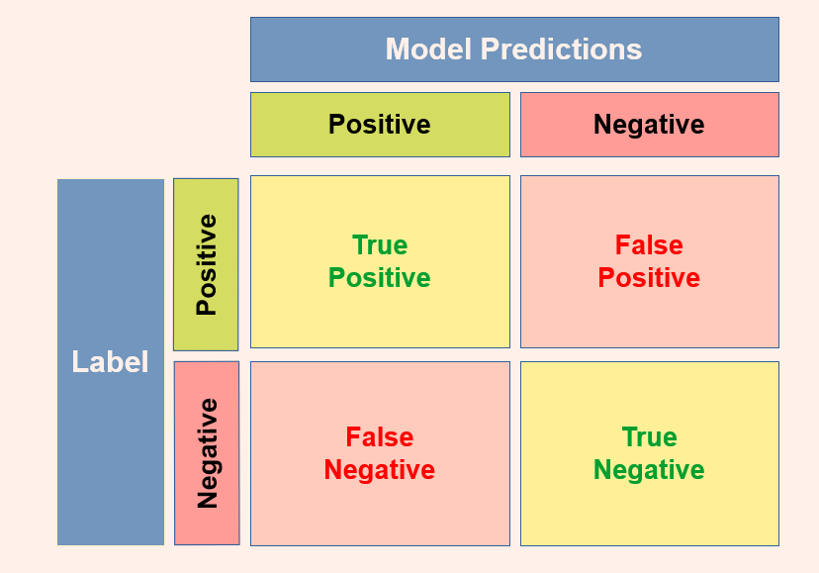
Metrics on Facenet
First, we compute confusion matrix
We can compute accuracy, precision, recall, tar@far=0.001.

Slide 5
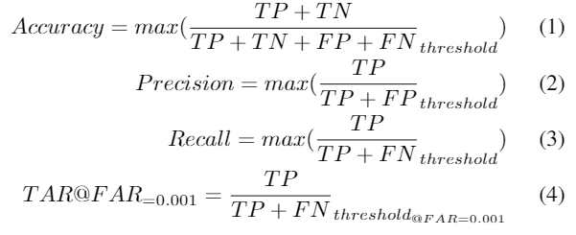
What is tar@far=0.001?
Calculate TAR, TP/(TP+FN), with the same Euclidean distance threshold when FAR, FP/(TN+FP), is 0.001
“What is the true acceptance rate of the model when only one false image in 1000 images is allowed”.

Slide 6
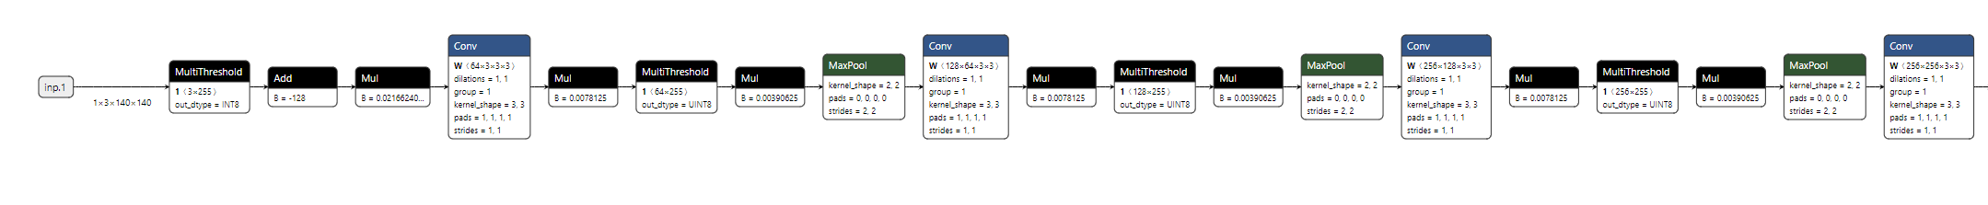
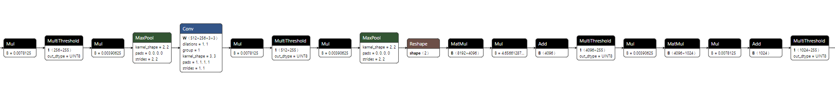
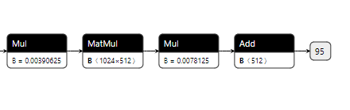
Reference model
A VGG9 model (40,418,497= 40M learnable parameter)
Weight: 8-bit, Activation: Int8
ROC curve: 0.98 and TAR@FAR=0.001: 0.8

Slide 7
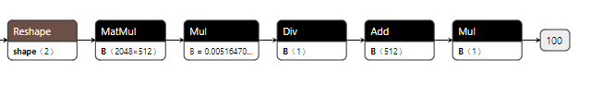
Target model
Reference model is crazy! Onnx file is around 300MB.
Tiny_VGG (1,437,025= 1.4M learnable parameter)
Weight: 4-bit, Activation: Int8
ROC curve: 0.97 and TAR@FAR=0.001: 0.4

Slide 8
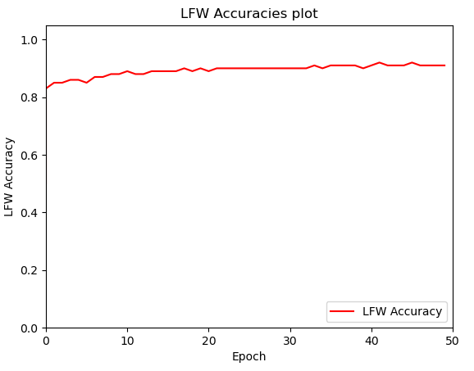
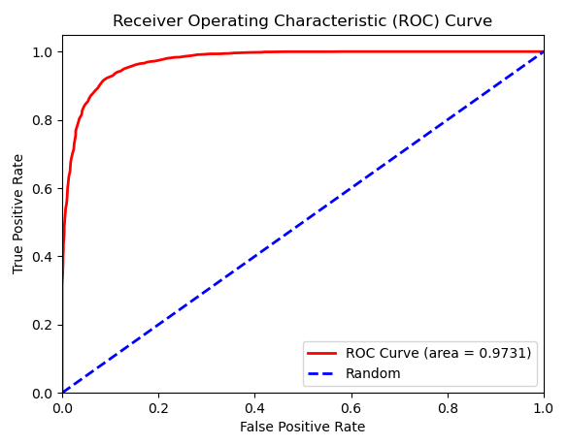
Target model

Slide 9
New Design Flow
1. Use build dataflow config instead lots of transformations in Lab D.
2. Using this flow, we only need a config and some parameter in python to generate HLS IP.

Slide 10
Old Flow
New Flow
PreProcessing
PreProcessing
Esimatation
Lowering and Streamlining
RTLsim
Partitioning, Conversion to HLS Layers and FoldingLowering and Streamlining
FIFO RTLsim
Hardware Generation
Bitfile and Driver

Slide 11
Idea of early estimation Tool
In old flow, we cannot estimate the total LUT usage for the targeted model and we failed the deployed in the last step. It wastes us lots of time.
We develop a early estimation API which will return the total LUT usage of the targeted model. This tool can help use to know whether the model LUT usage is under the 50 thousand LUTs or not. (PYNQ has 50 thousand LUTs in total)

Slide 12
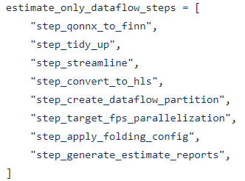
Early stage physical estimation
We can estimate our model at early stage flow with physical resource usage.
* No actual logic synthesis. First order estimation only.
We use the flow in :
finn.builder.build_dataflow_config.estimate_only_dataflow_steps
Export ESTIMATE_REPORTS

Slide 13
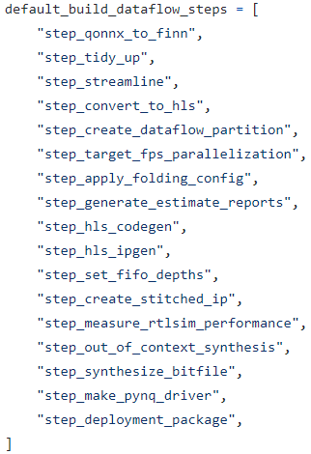
Early stage physical RTL sim
We can estimate our model at early stage flow with RTL sim performance.
*Memory behavior is ideal.
Export STITCHED_IP, RTLSIM_PERFORMANCE

Slide 14
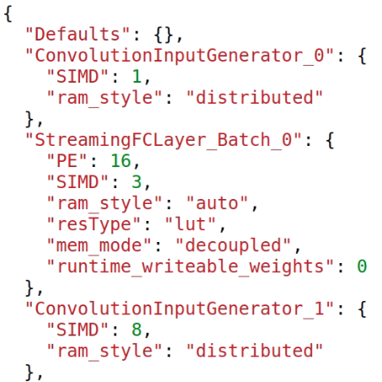
Early stage physical FIFO RTL SIM
We can estimate our model at early stage flow with different fifo, PE, SIMD settings with RTL sim performance.
*Memory behavior is ideal.
We can generate an auto folding file with low target fps at first.
Then we can change PE, SIMD depend on the hardware resource we use in physical RTL sim.
.json we gen in physical RTL sim

Slide 15
The problem we encounter
1. Maxpool does not support in_dim %2 != 0.
2. Depthwise convolution is not well supported.
3. Resnet structure is also not well supported.
4. U50 bit file generation will fail somehow.

Slide 16
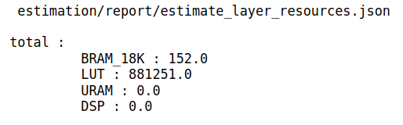
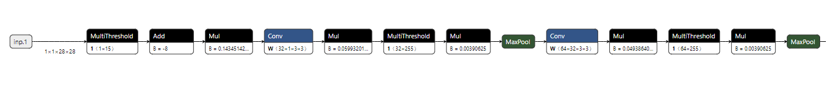
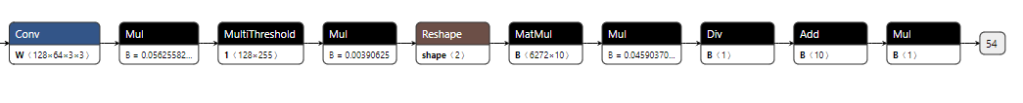
Hand written numbers classifier
VGG (155,179 learnable parameters)
Weight: 4-bit Activation: 8-bit
Accuracy on brevitas: 99.11%

Slide 17
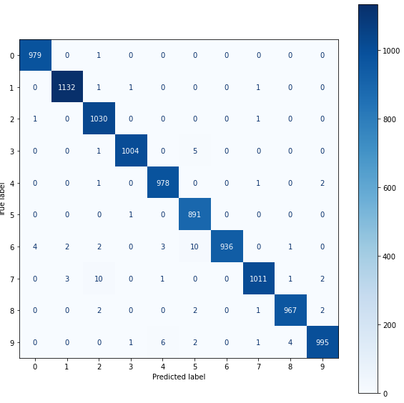
Hand written numbers classifier

Slide 18
Early stage physical estimation

Slide 19
Hand written numbers classifier
TinyLenet (45,273 learnable parameters)
Weight: 3-bit Activation: 8-bit
Accuracy on brevitas: 98.59%
Accuracy on PYNQ-Z2 : 99.09%

Slide 20
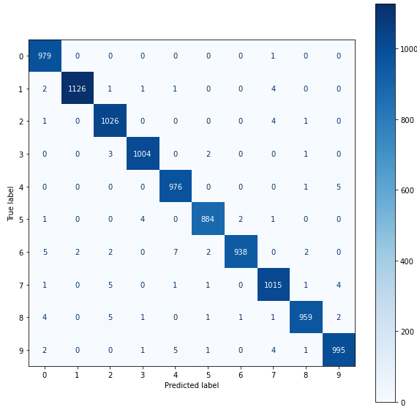
Hand written numbers classifier

Slide 21
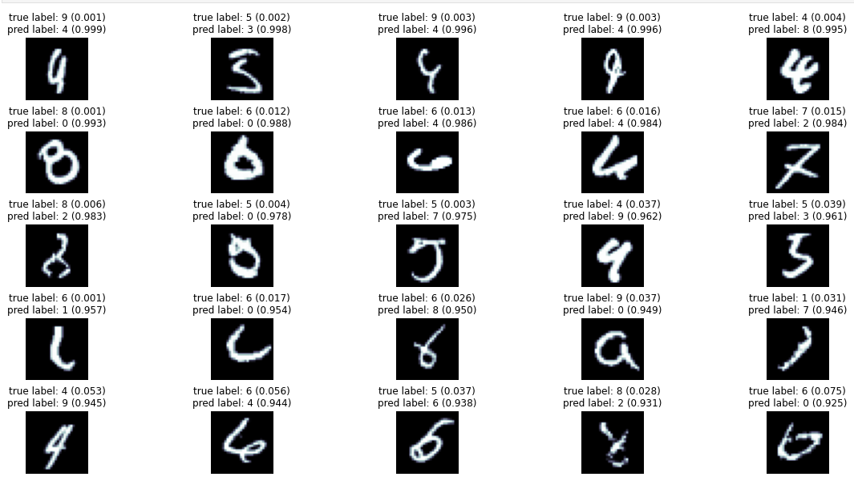
Hand written numbers classifier
Error:

Slide 22
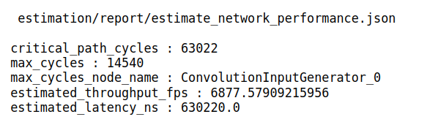
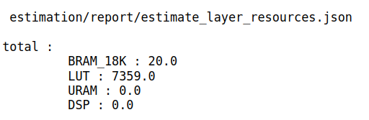
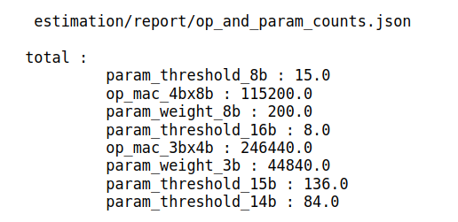
Early stage physical estimation

Slide 23
Actually Resource[Postsim]
Post_sim:
TOTAL LUT = 13069
LOGIC LUT = 11866
LUT RAM = 736
SRL = 467
FF = 18352
RAM 36B = 10
RAM 18B = 3

Slide 24
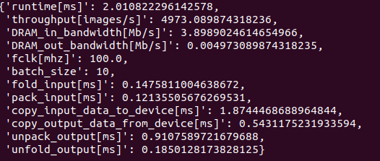
Actually performance [PYNQ-Z2]

Slide 25
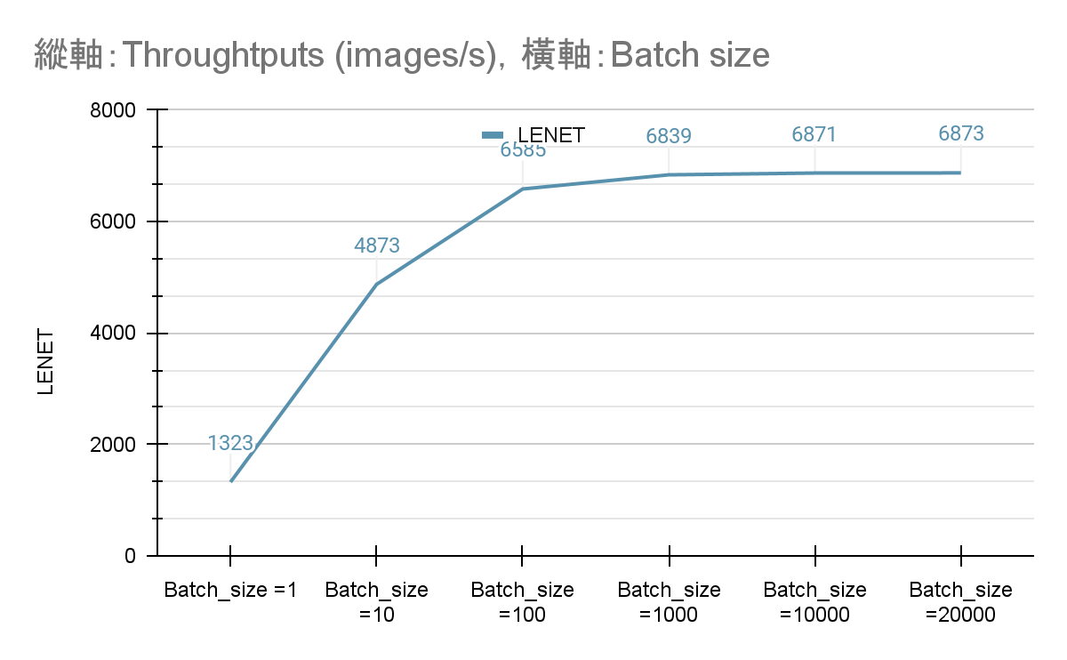
Batch size vs Throughputs

Slide 26
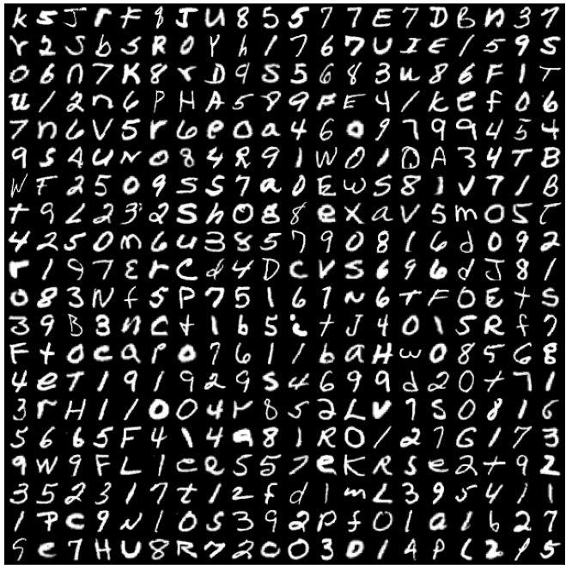
Hand written letters classifier
Dataset: EMNIST
Class: 0-9, a-z, A-Z total (10+26+26=62) classes

Slide 27
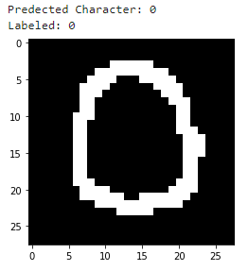
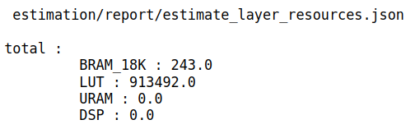
Hand written letters classifier
VGG (481,375 learnable parameters)
Weight: 4-bit Activation: 8-bit
Accuracy on brevitas: 86.88%

Slide 28
Hand written letters classifier
TinyLenet (49,641 learnable parameters)
Weight: 3-bit Activation: 8-bit
Accuracy on brevitas: 86.18%
Accuracy on PYNQ-Z2: 83.06% (0-9 dataset)

Slide 29
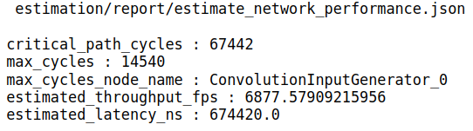
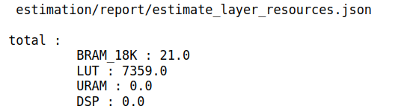
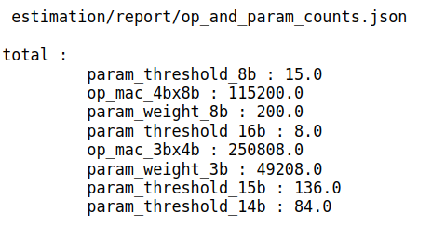
Early stage physical estimation

Slide 30
Actually Resource[Postsim]
Post_sim:
TOTAL LUT = 13153
LOGIC LUT = 11946
LUT RAM = 736
SRL = 471
FF = 18518
RAM 36B = 11
RAM 18B = 5

Slide 31
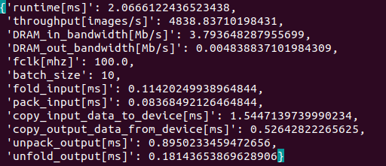
Actually performance [PYNQ-Z2]

Slide 32
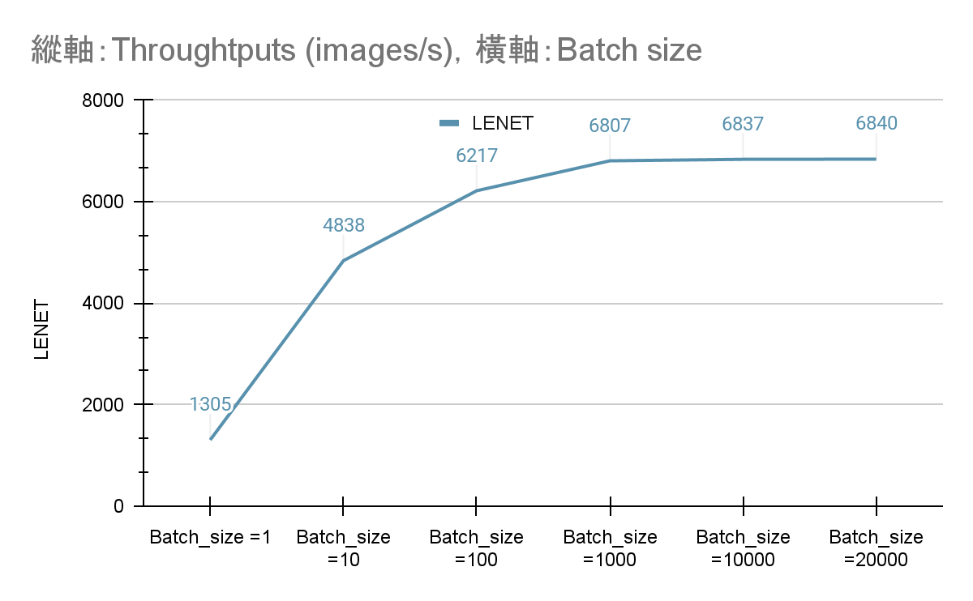
Batch size vs Throughputs

Slide 33
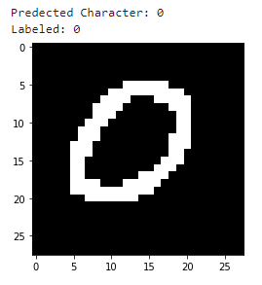

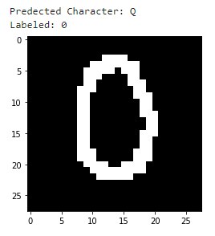
Fun things to know
0 -> O? -> Q? Very hard for machine!

Slide 34
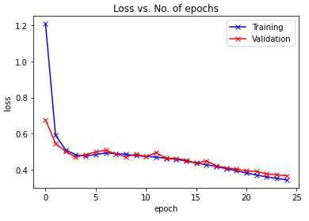
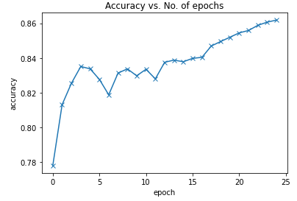
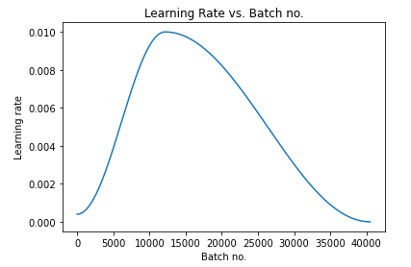

Slide 35
Github link
https://github.com/samke0301/HLS_final

Slide 36


