Slide 1
Real Time Image AI System
R09943108 王皓仁
R09943100 黃友杉
D09943021 張鶴騰
Github link: https://github.com/superpi15/hls_nn_final

Slide 2
Introduction
Implemented a real time image AI system.
The targeted scenario is an intelligent detection system.
Can be used in factory to detect defects.
Can easily customize the system for different applications by changing different NN models.
Inputs and outputs are streams of image frames.
All kernels communicate with each other through streams.

Slide 3
Overview
Video Capture
Stream of images
Pre-process
ML Model
Post-Process
Stream of images
Video
Output
Green parts are the kernel functions.
Pre-process: Resize images to the proper size.
ML Model: Binarized VGG for image classification.
Post-process: Alpha mix the predicted label onto the input image.

Slide 4
Preprocess - Resize
The preprocess kernel resizes the captured images to the size of the training data.
Use the “resize” function in the Vitis Vision Library.

Slide 5
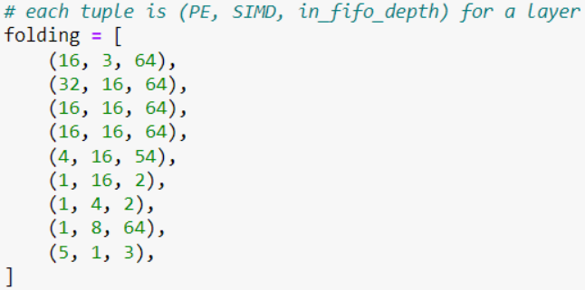
NN Model - CIFAR10 Classification
Train the model using Brevitas.
VGG-like CNN model
Binarized weights and activations
Synthesize the model with FINN.
Follow cnv_end2end_example.ipynb
FINN folding setting:

Slide 6

Postprocess - Alpha Mix
Load in an image of alphabets and numbers.
According to the predicted label of the classification output, generate the image of the corresponding label.
Mix the label image onto the input image.

Slide 7
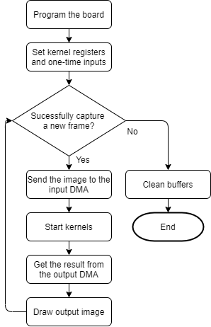
Host Program
Program th board and set kernel registers whose values only have to be set once.
Capture frames from a video to mimic a video input.
With “cv2.VideoCapture”.
Send the image to the input DMA and run the kernels.
Get the labeled image from the output DMA and show it.
The host program will also monitor the runtime for different operation stages for each frame.

Slide 8
Demo
Notes:
acc: 81%
First show original video.
Run jupyter notebook.

Slide 9
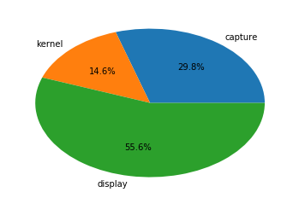
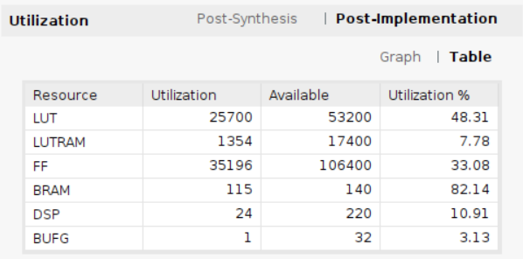
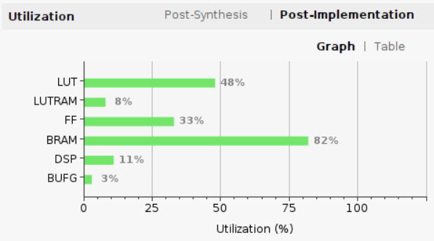
Results
The average kernel time is 0.024s per frame (42FPS).
The average total time is 0.164s per frame (6FPS).
The accuracy for the 100 self-collented images is 81%.
Notes:
acc: 81%
First show original video.
Run jupyter notebook.

Slide 10
Integration flow
Local prototyping, shorter turnaround time:
Use ultra96v2: larger board, more threads, and resource
Feature test:
Streaming & AXI
Official IP
Off-shelf IP (NN core generated by FINN)
Several partial modification and integration before final integration
Remote deployment on Z2:
Try 2 times on Physical synthesis due to resource issue
Deployment success in one shot

Slide 11
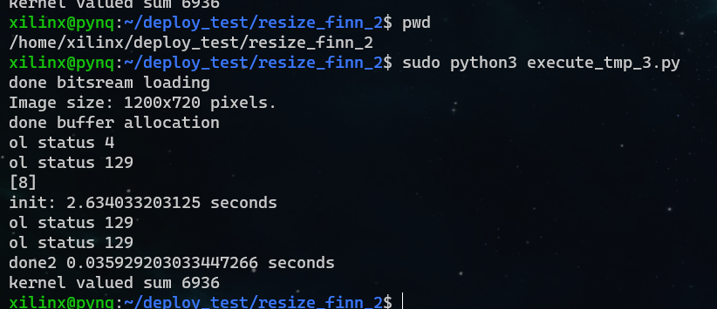
Building steps
Run FINN end-to-end example
All you need are in the building directory
For each of *.cpp in src folder, create IP using Vitis HLS
Create top level vivado project, include IPs created by FINN
StreamingFIFO_*, ConvolutionInputGenerator_*, … etc
Connect IPs according to the datapath diagram (in later slides)
Usual routines: auto-connect, synthesis, gen bitstream … etc.
Send *.bit, *.hwh to target

Slide 12
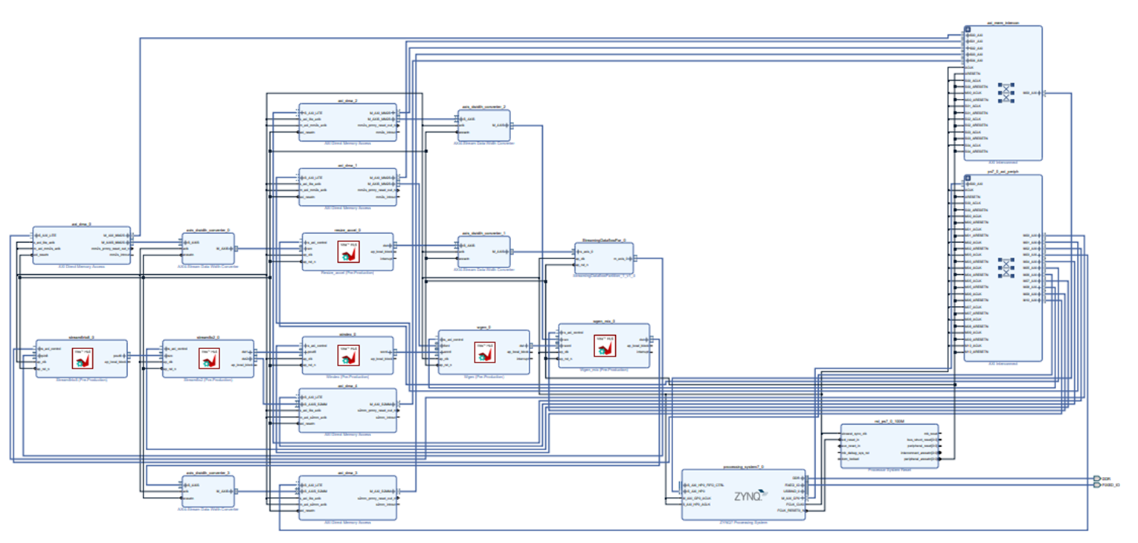
Block diagram: too detailed. skip to next slide

Slide 13
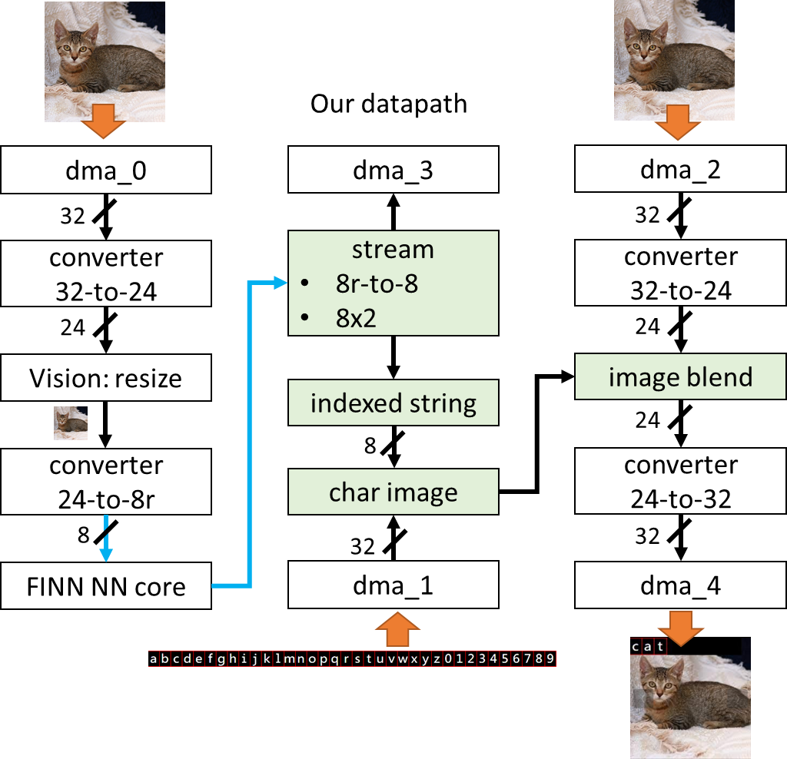
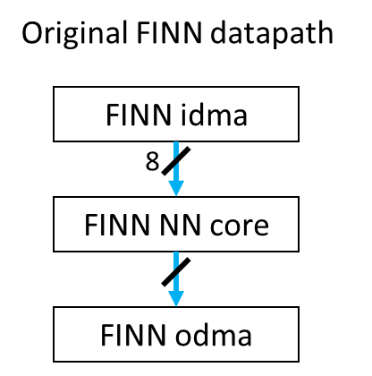
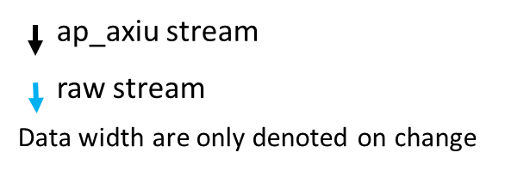
Datapath overview

Slide 14
The journey of learning AXI stream
Scenario: Deal with AXI stream (DMA) and raw stream (FINN core)
Problem:
PL kernel halt due to unknown reason
DMA receive nothing
Solution: on-site debugging
Add side channels to access status of suspicious IPs
Add local counter recording received and sent packages
Result:
Being aware of the overlooked flags: keep & strb
Confirmed by ARM AXI4-Stream datasheet

Slide 15
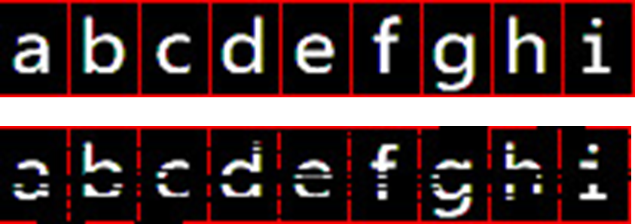
Data missing during burst transfer
Input
Output
Workaround:
don’t use AXI master
use stream as much as possible
be aware of data cached on PL-side
Let us know if you got any clue or guess about this!

Slide 16
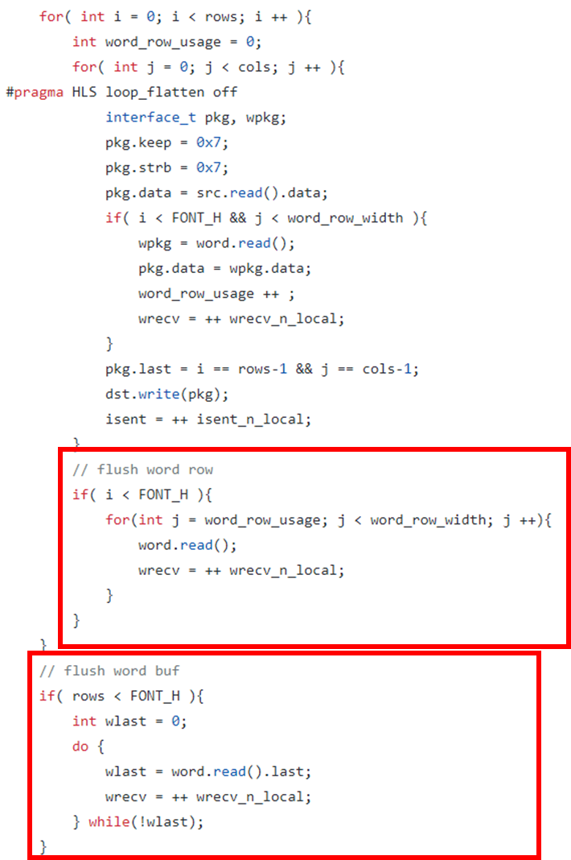
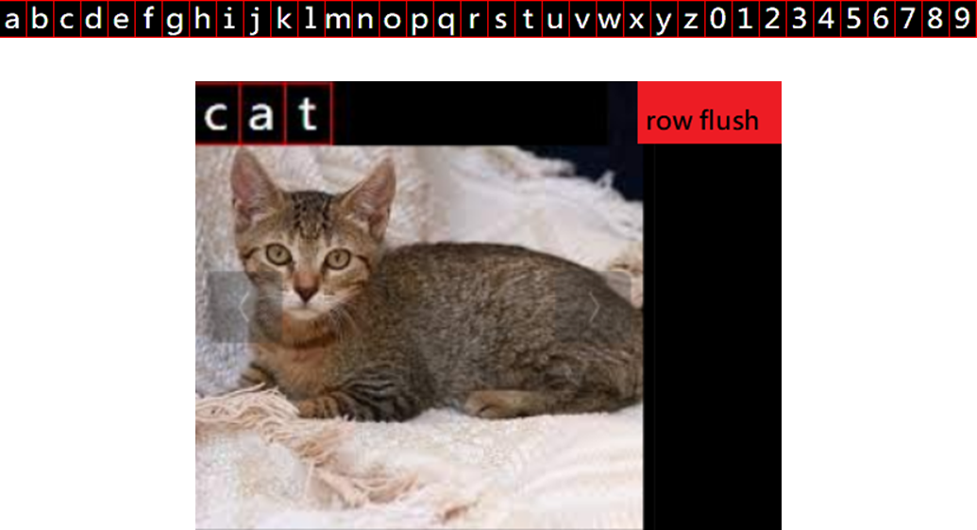
Index-based String, blending & flush
''cat'' = {'c'-'a', 'a'-'a', 't'-'a'}
={ 2, 0, 19 }

Slide 17
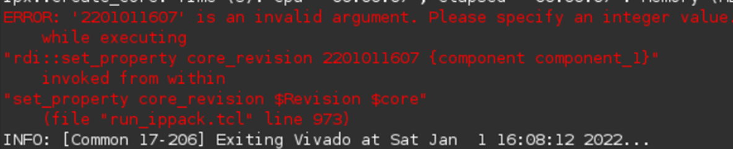
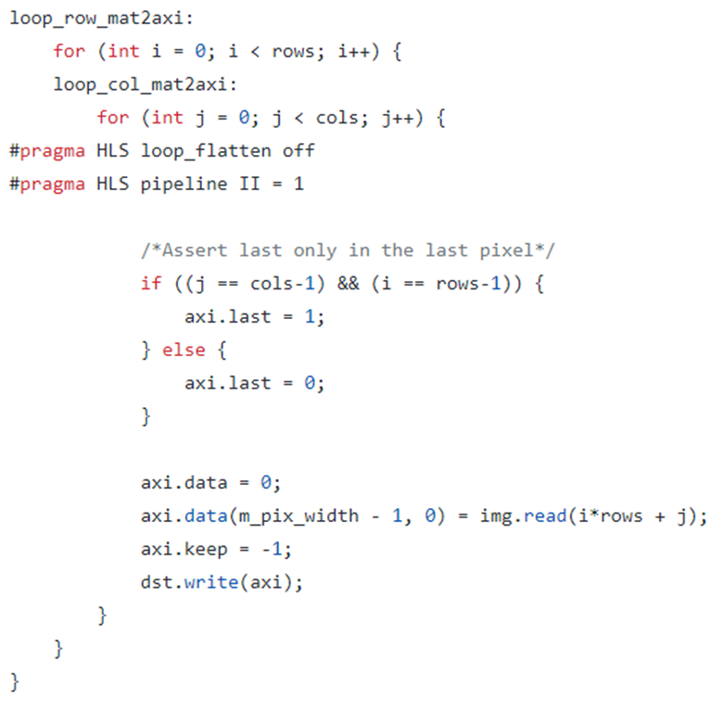
Supplement
Identify the new year bug:
Xilinx issue the Y2K22 patch for the bug
Hidden bug in PYNQ example:
The fault were luckily eliminated by pragma
Abuse of terminologies:
“assert” or “deassert” occurs several times in datasheet
Authentic assertion in propositional logic or program:
assert( 1+1 == 2 );
assert( ! is_last(package) || package.last );
assert( is_last(package) == package.last );

Slide 18
Future Work
Intergrate hardware video IO bolcks like camera or HDMI.
Composable Pipeline
Create NN HLS engine in Darknet framework

Slide 19
Reference
https://github.com/Xilinx/PYNQ-HelloWorld
https://xilinx.github.io/Vitis_Libraries/vision/
https://github.com/Xilinx/finn
https://developer.arm.com/documentation/ihi0051/a/
https://github.com/Xilinx/finn/blob/main/notebooks/end2end_example/bnn-pynq/cnv_end2end_example.ipynb

